Slide 1
Agency Report ECMWF
Vincent-Henri Peuch, ECMWF
Agenda Item #2.2

Slide 2

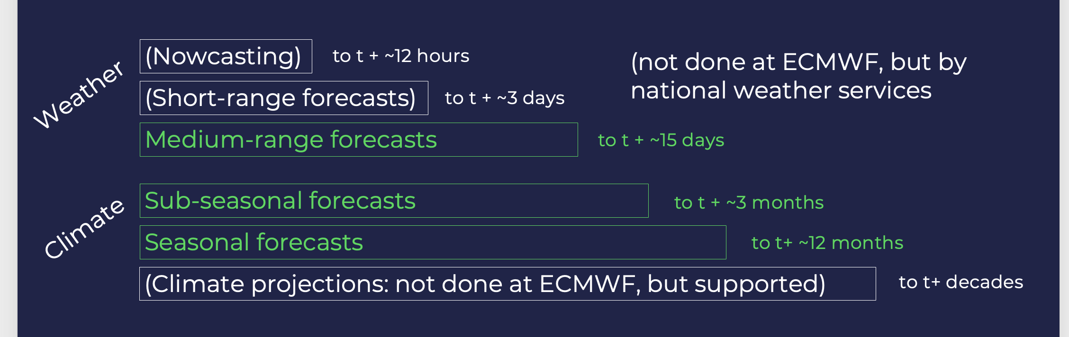
European Centre for Medium-Range Weather Forecasts

Slide 3
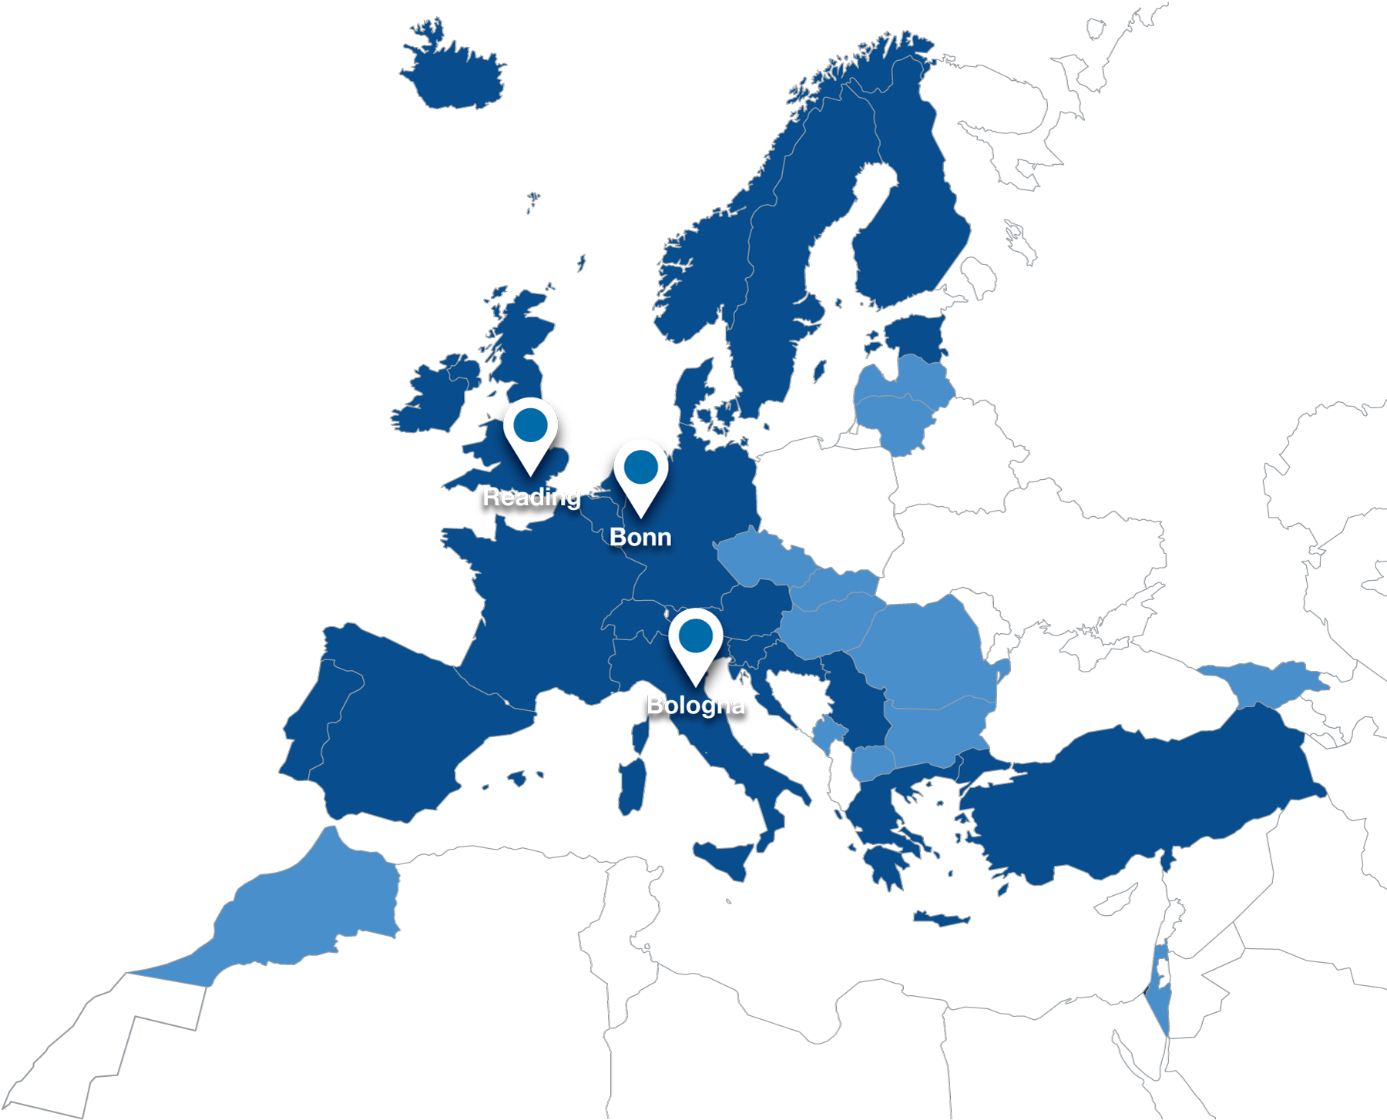
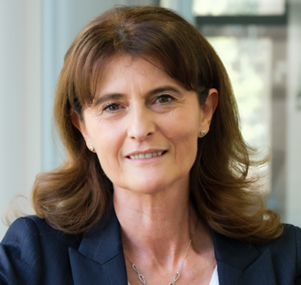
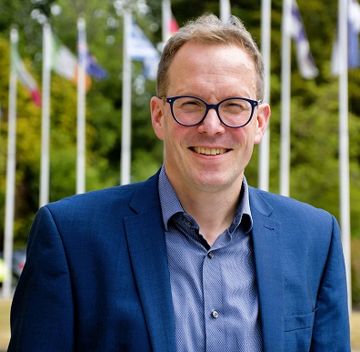
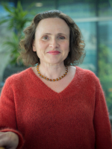
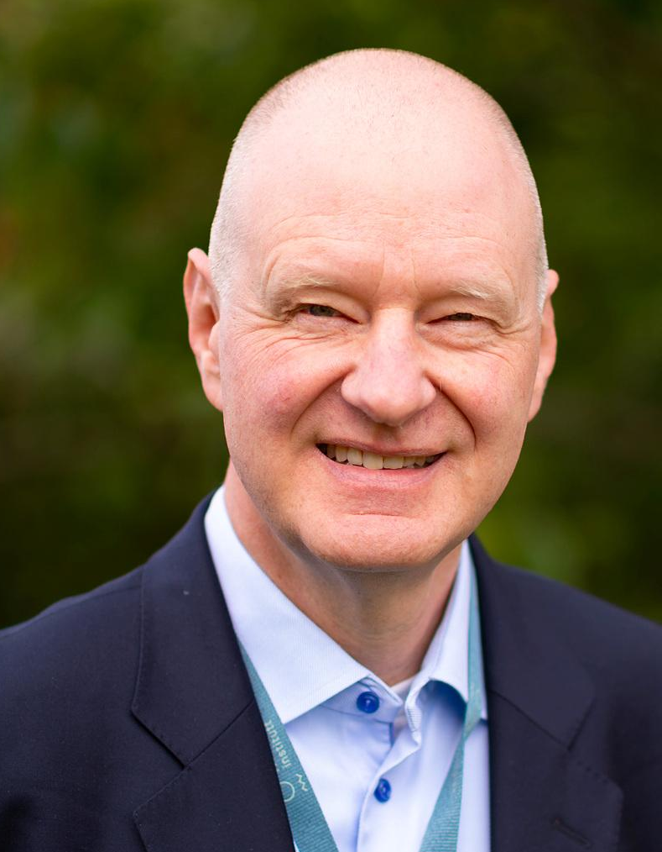
ECMWF
Director-General
23 Member States
12 Cooperating States
~600 staff
Florence Rabier
Florian Pappenberger
President
Penny Endersby (UK)
Roar Skålin (NO)

Slide 4

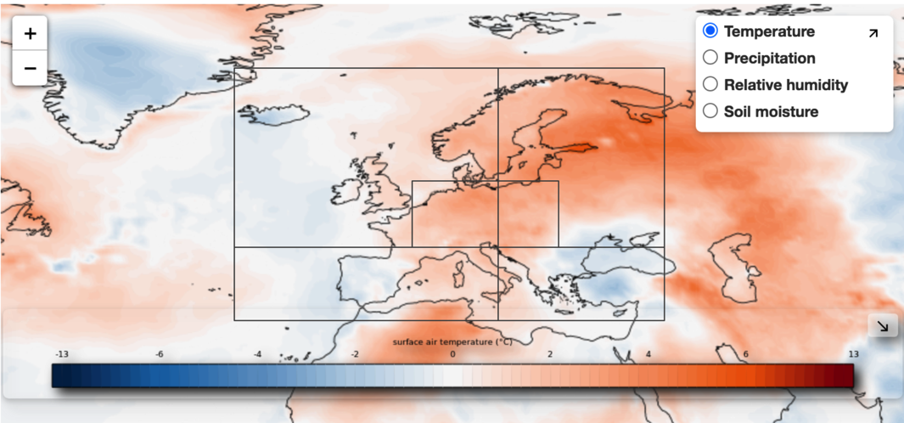
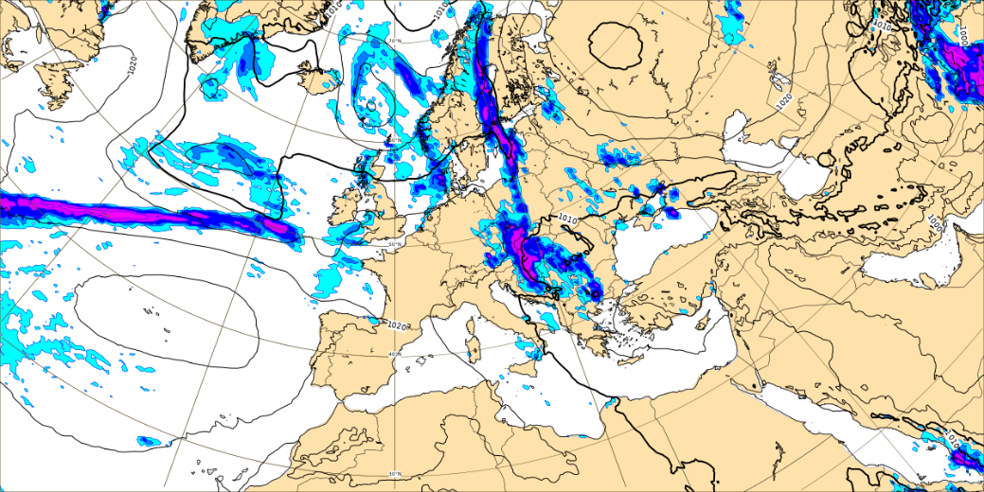

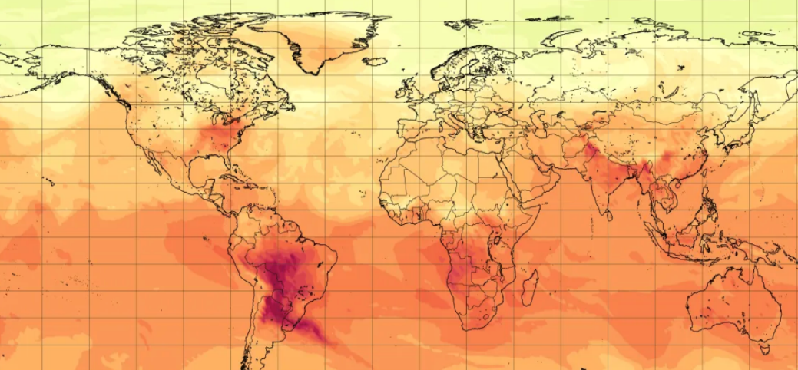
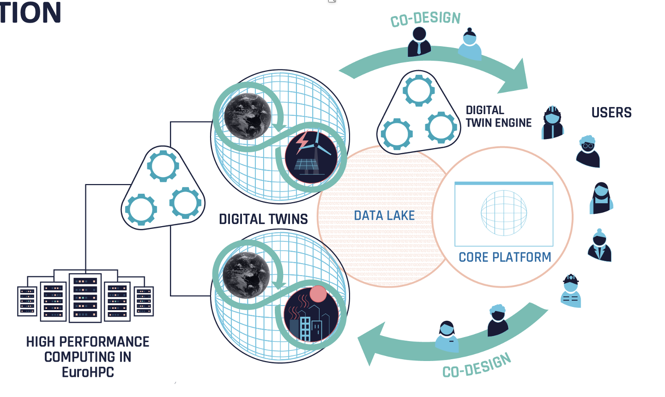
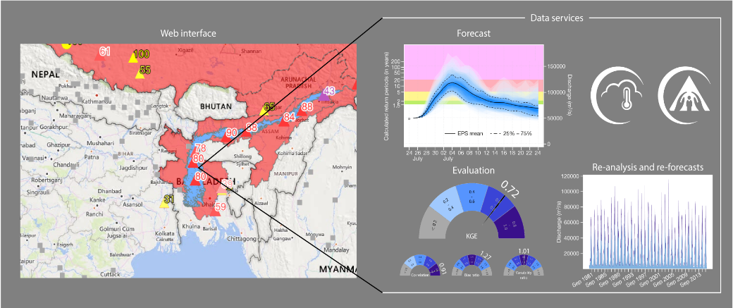
What we do
Weather
Copernicus Climate Change Service
Copernicus Atmosphere Monitoring
Service
Destination Earth
Contribution to
Copernicus Emergency Management
Service

Slide 5
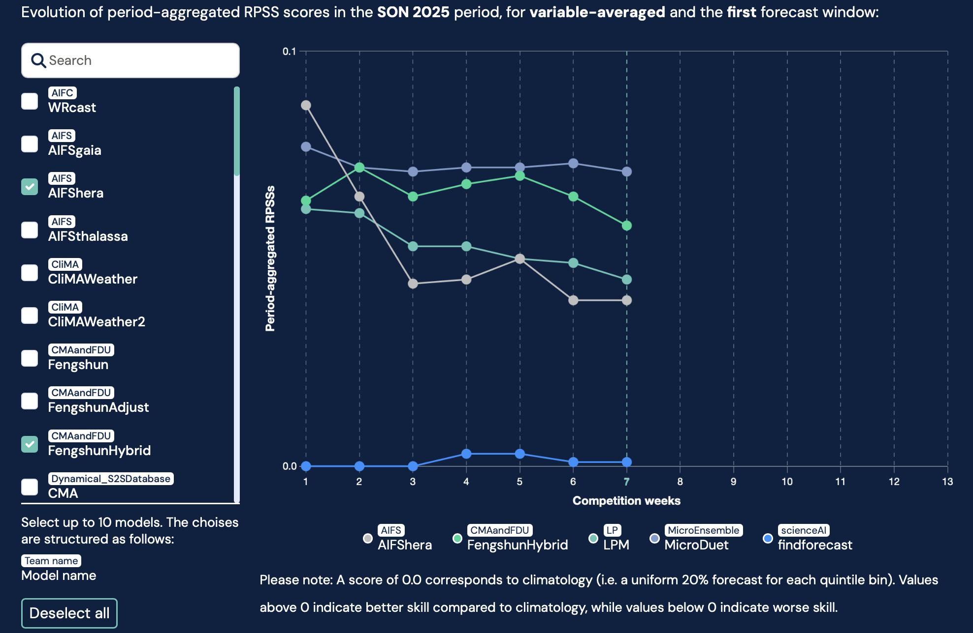
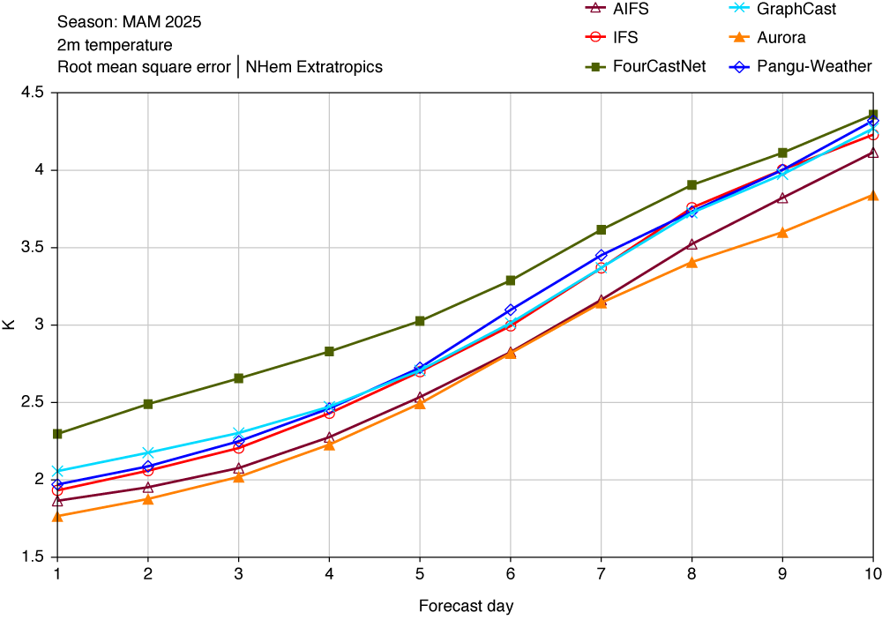
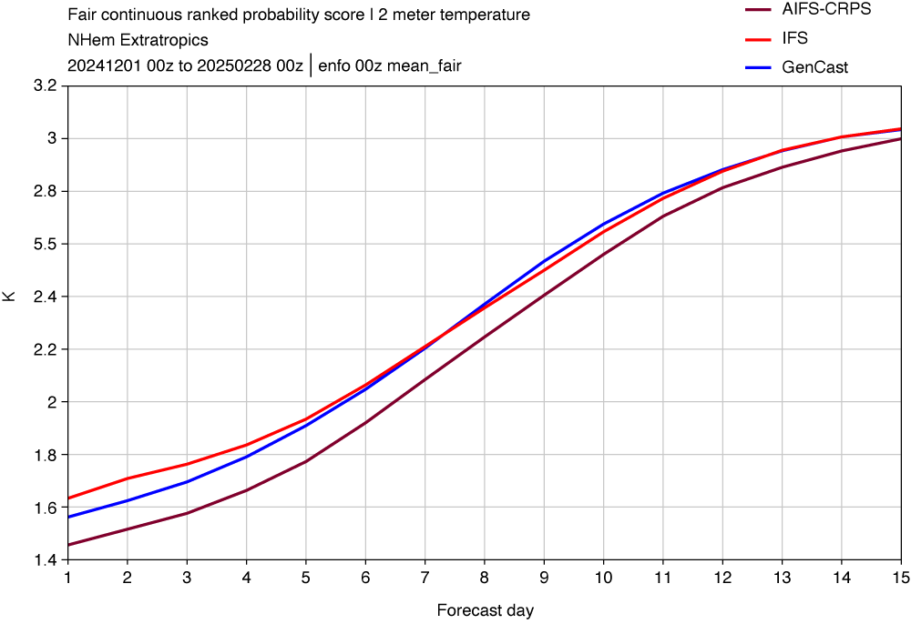
Numerical Weather Prediction (NWP)
AI-based systems are now operational at ECMWF (AIFS single 25/02/2025; AIFS ensemble 01/07/2025)
IFS, AIFS single and other leading AI systems
IFS, AIFS ensemble and Google GenCast
Online open challenge: forecasting week 4 and week 5

Slide 6
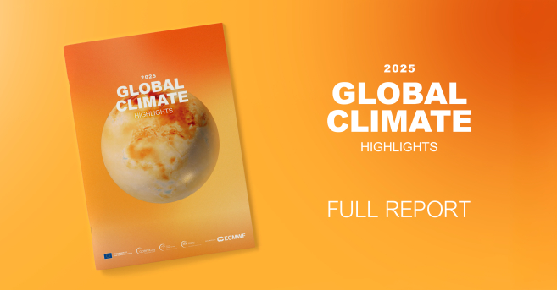
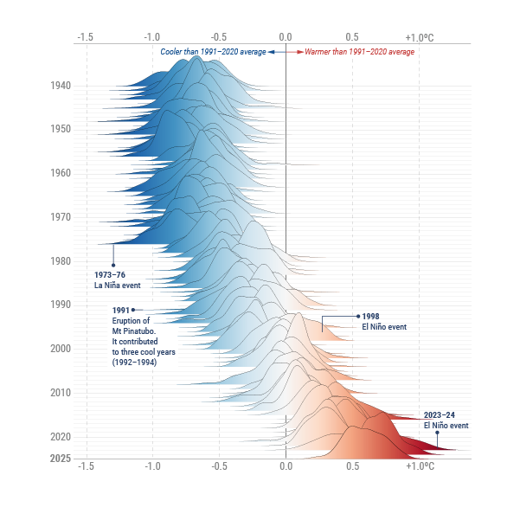
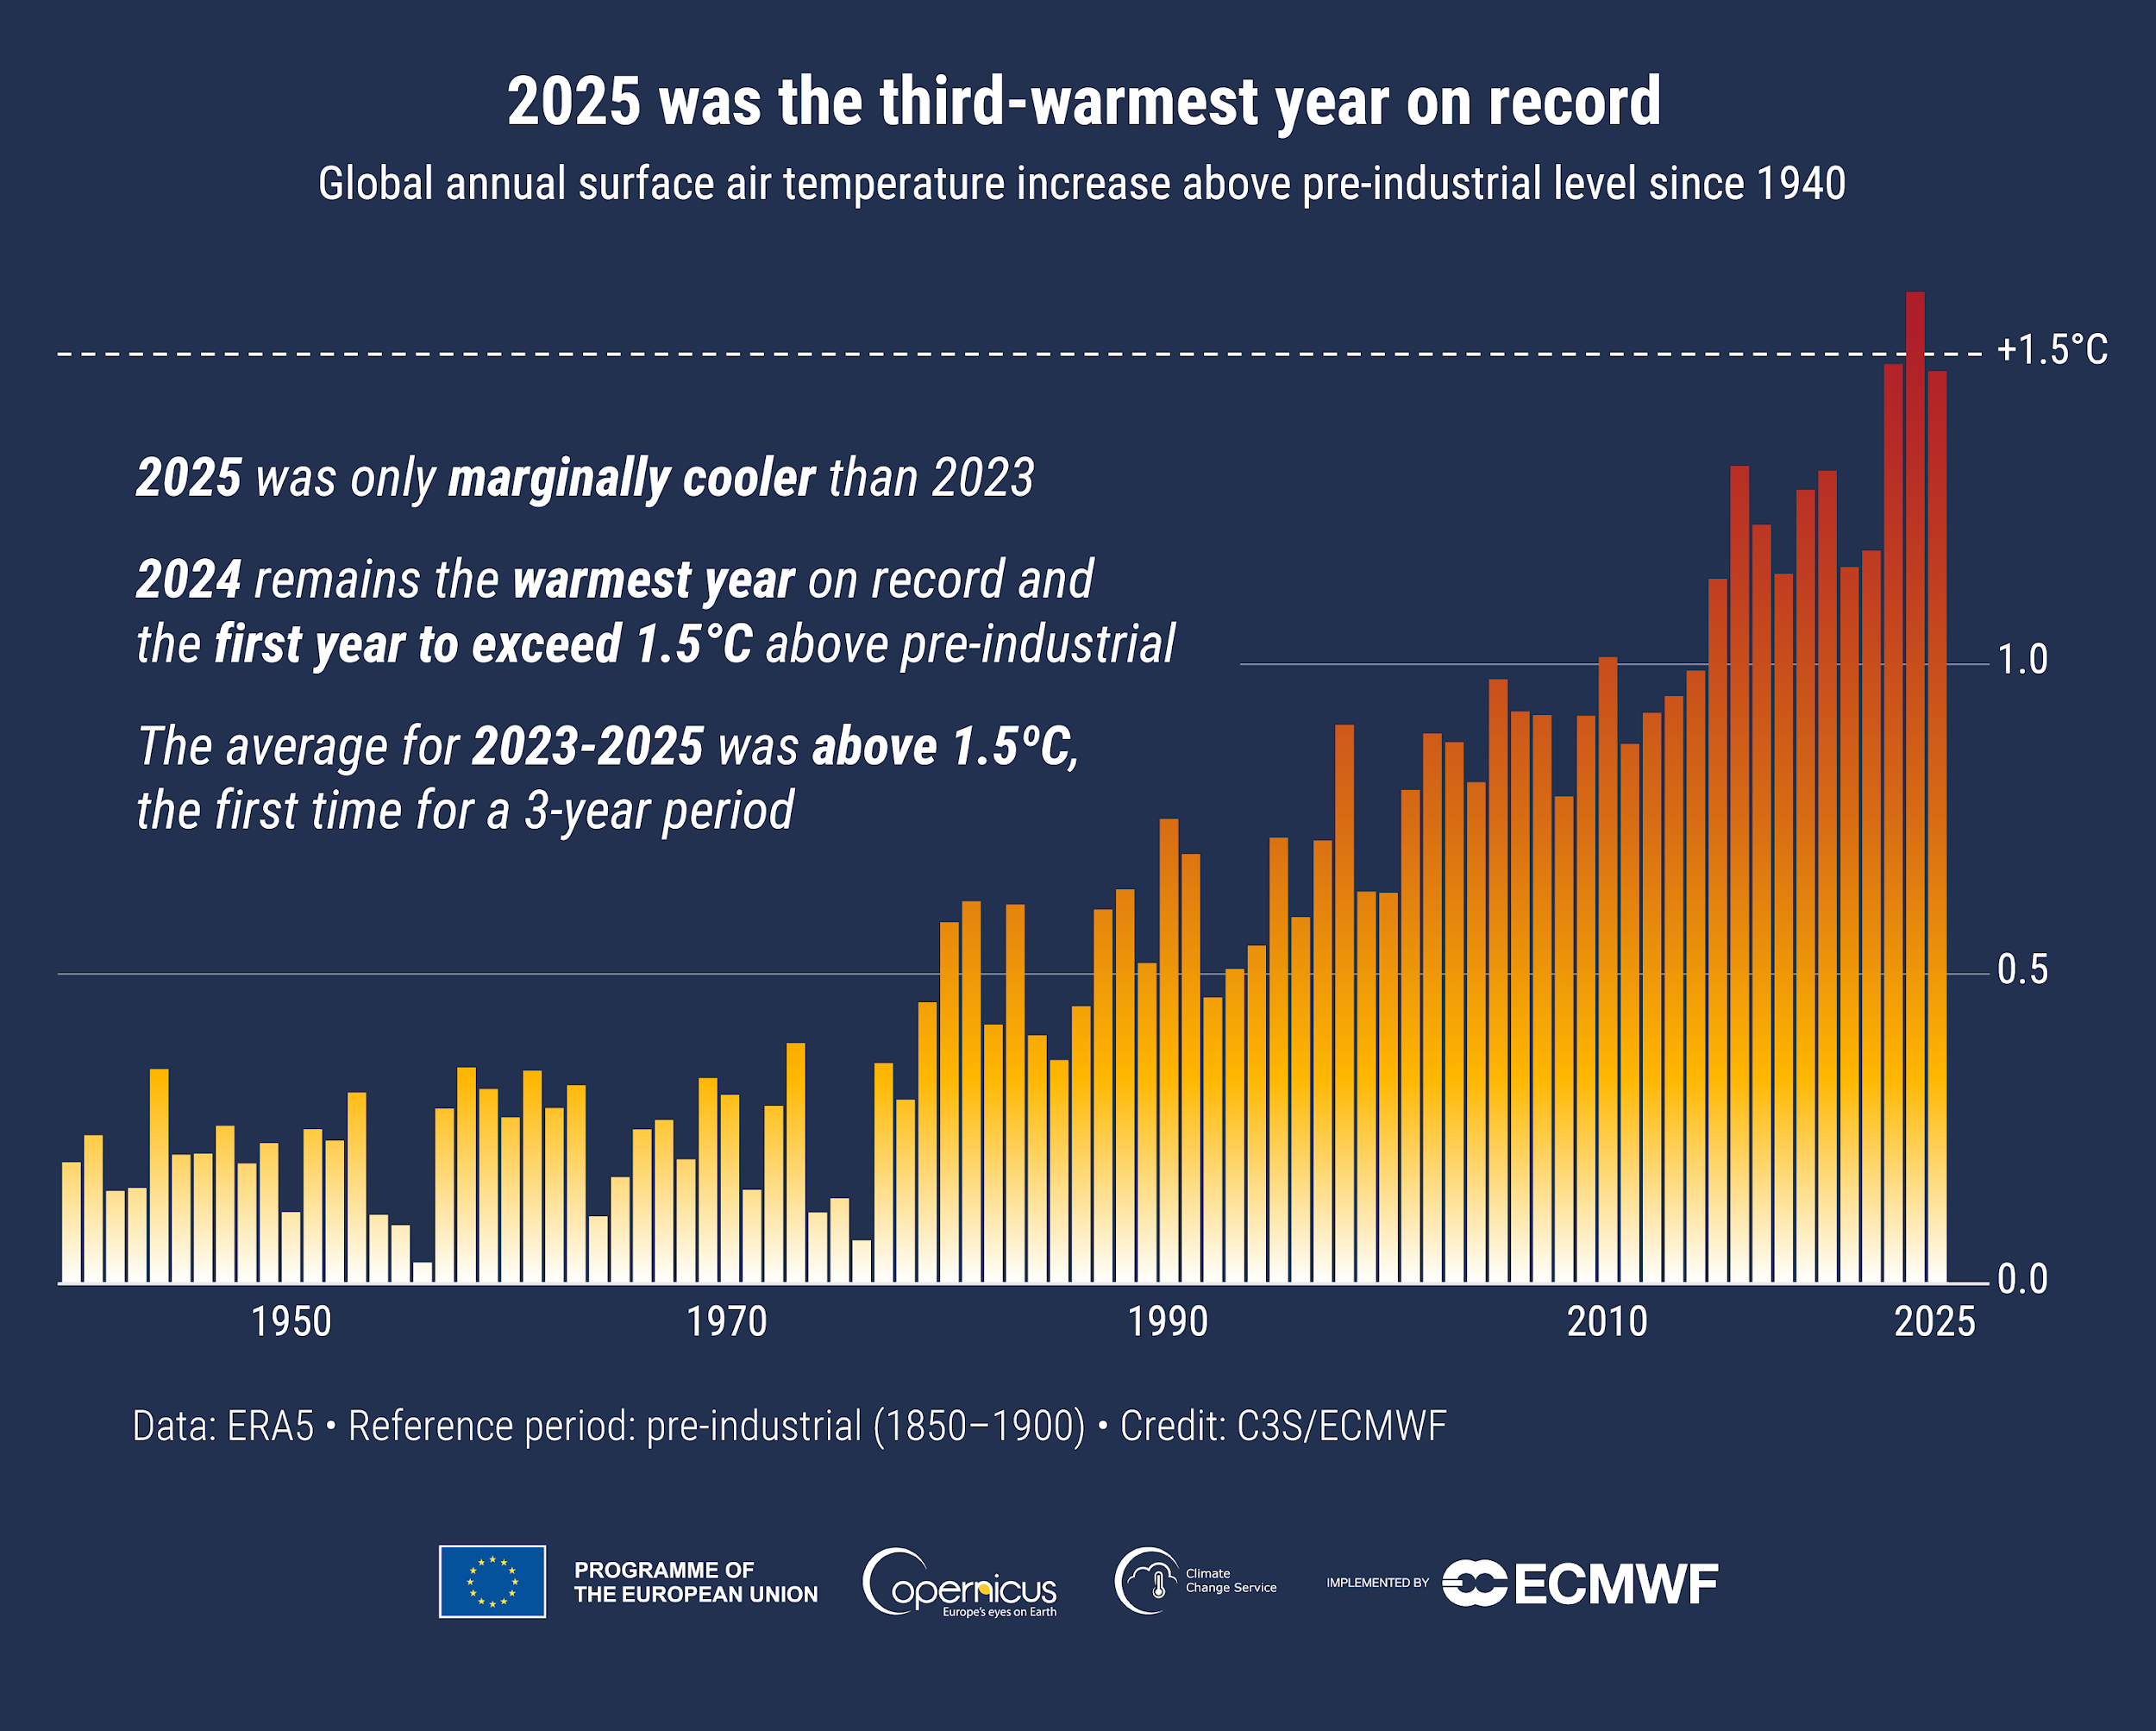
Copernicus Climate Change Service (C3S)
ERA6 production – imminent
Impact of Global Climate Highlights (Jan) and preparation of the European State of the Climate 2025 (April) in partnership with WMO
Release 14 January in coordination with other agencies workdwide
Operational production of ECV datasets
Preparation of Copernicus 3 (2028-2034)

Slide 7
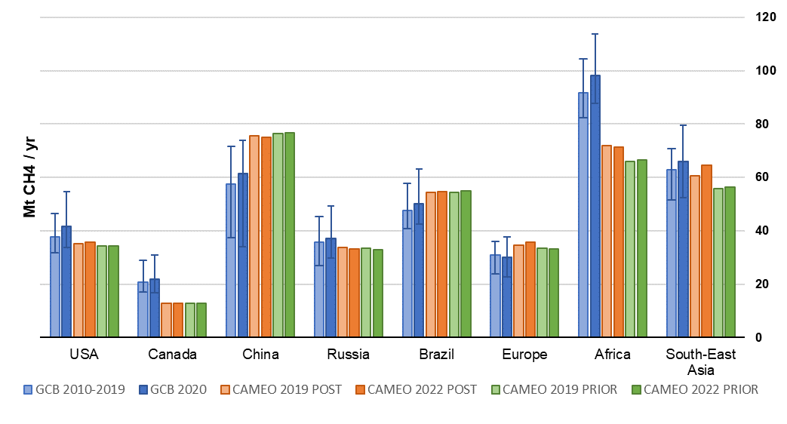
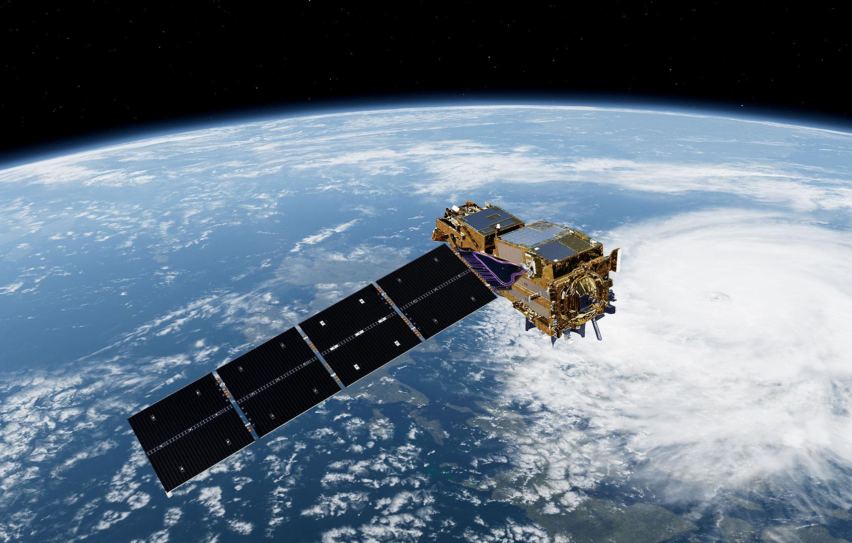
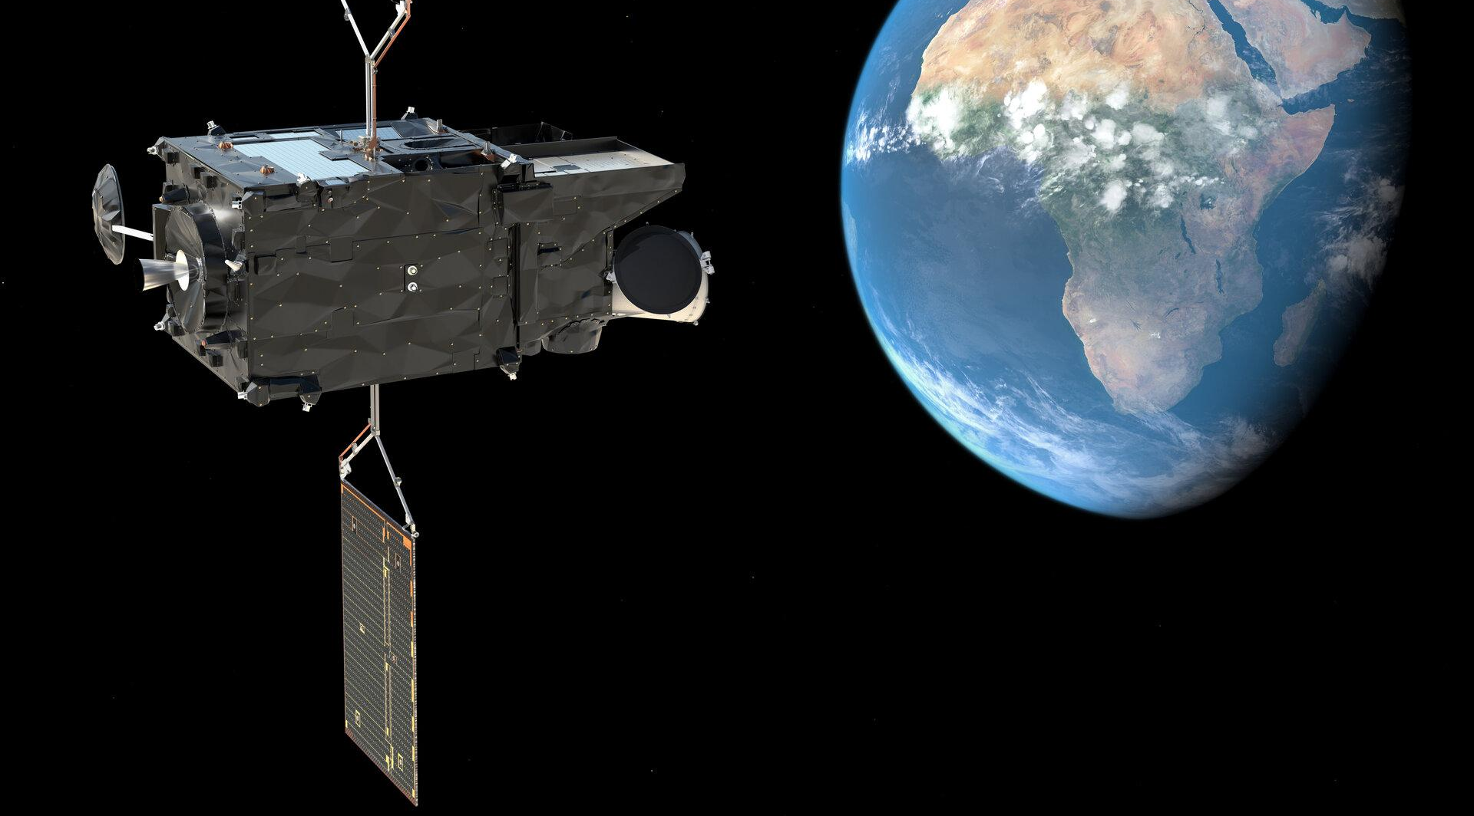
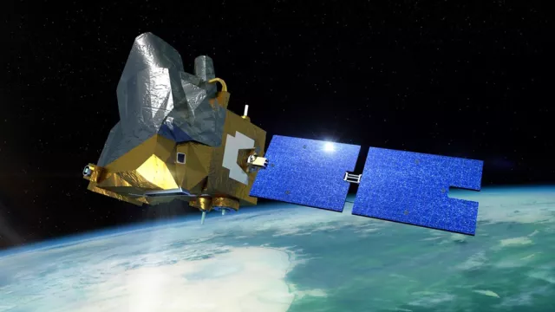
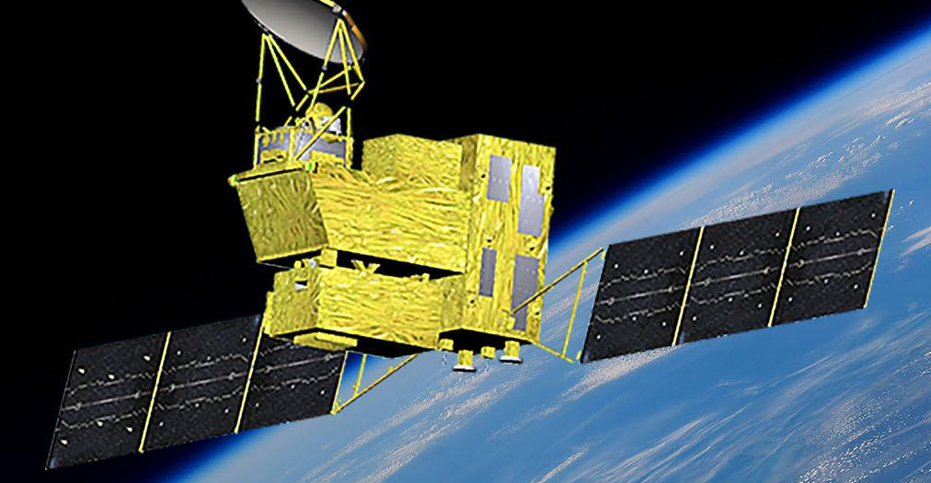
Copernicus Atmosphere Monitoring Service (CAMS)
EAC5 production – imminent
Ramping up of GHG emissions monitoring
Uptake of new satellite data
Preparation of Copernicus 3 (2028-2034)
Methane inversion in CAMS evolution project CAMEO
Data from Sentinel-5P, IASI, GOSAT
better agreement with GCB
small posterior update (neutral)
MetOp-SG-A1
MICROCARB
GOSAT-GW
MTG-S1

Slide 8
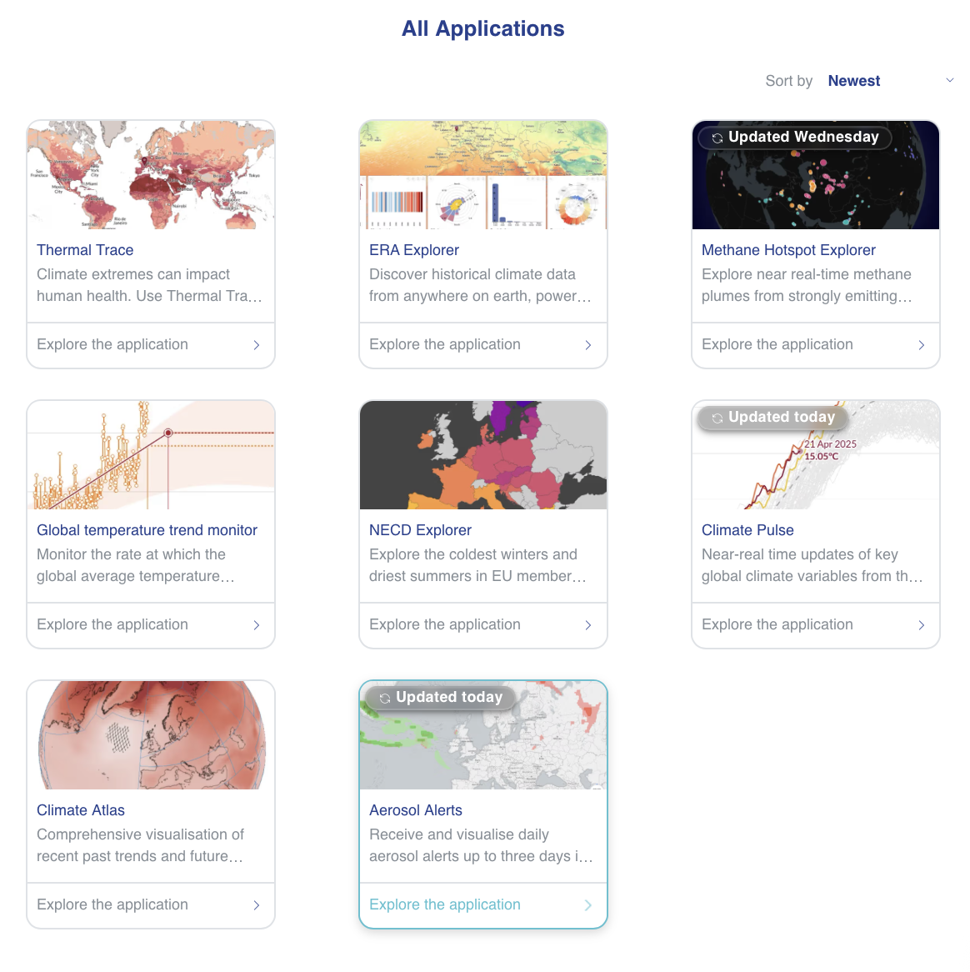
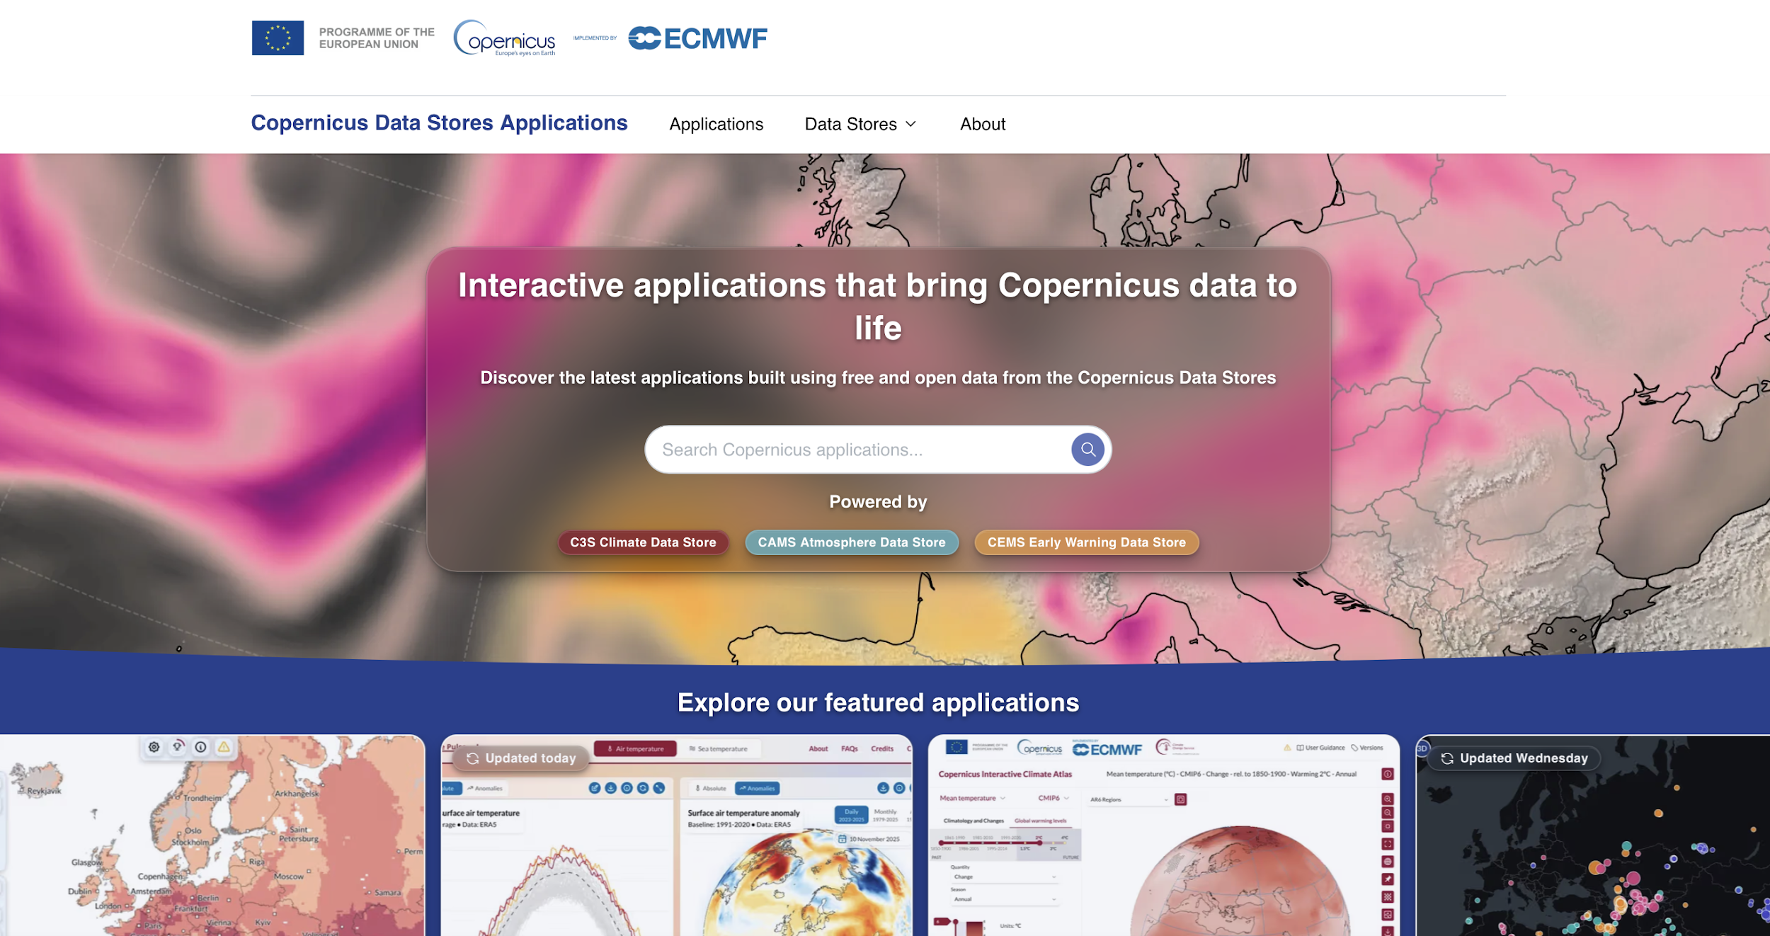
ECMWF Copernicus apps
https://apps.atmosphere.copernicus.eu

Slide 9
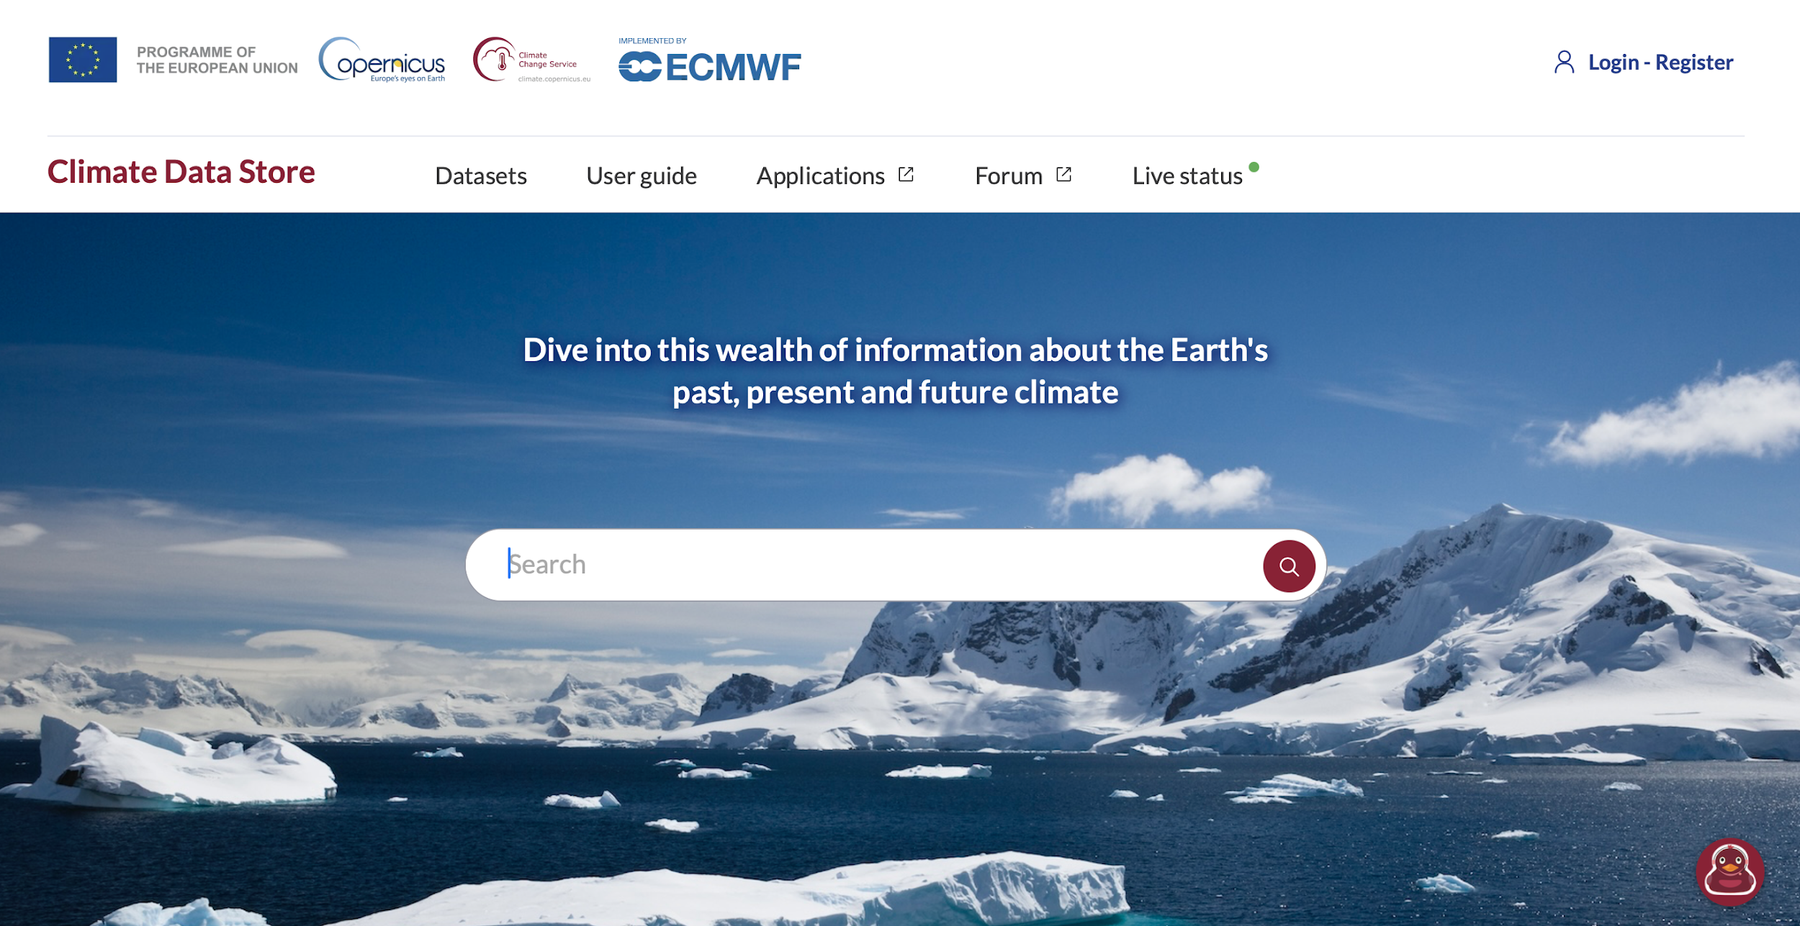
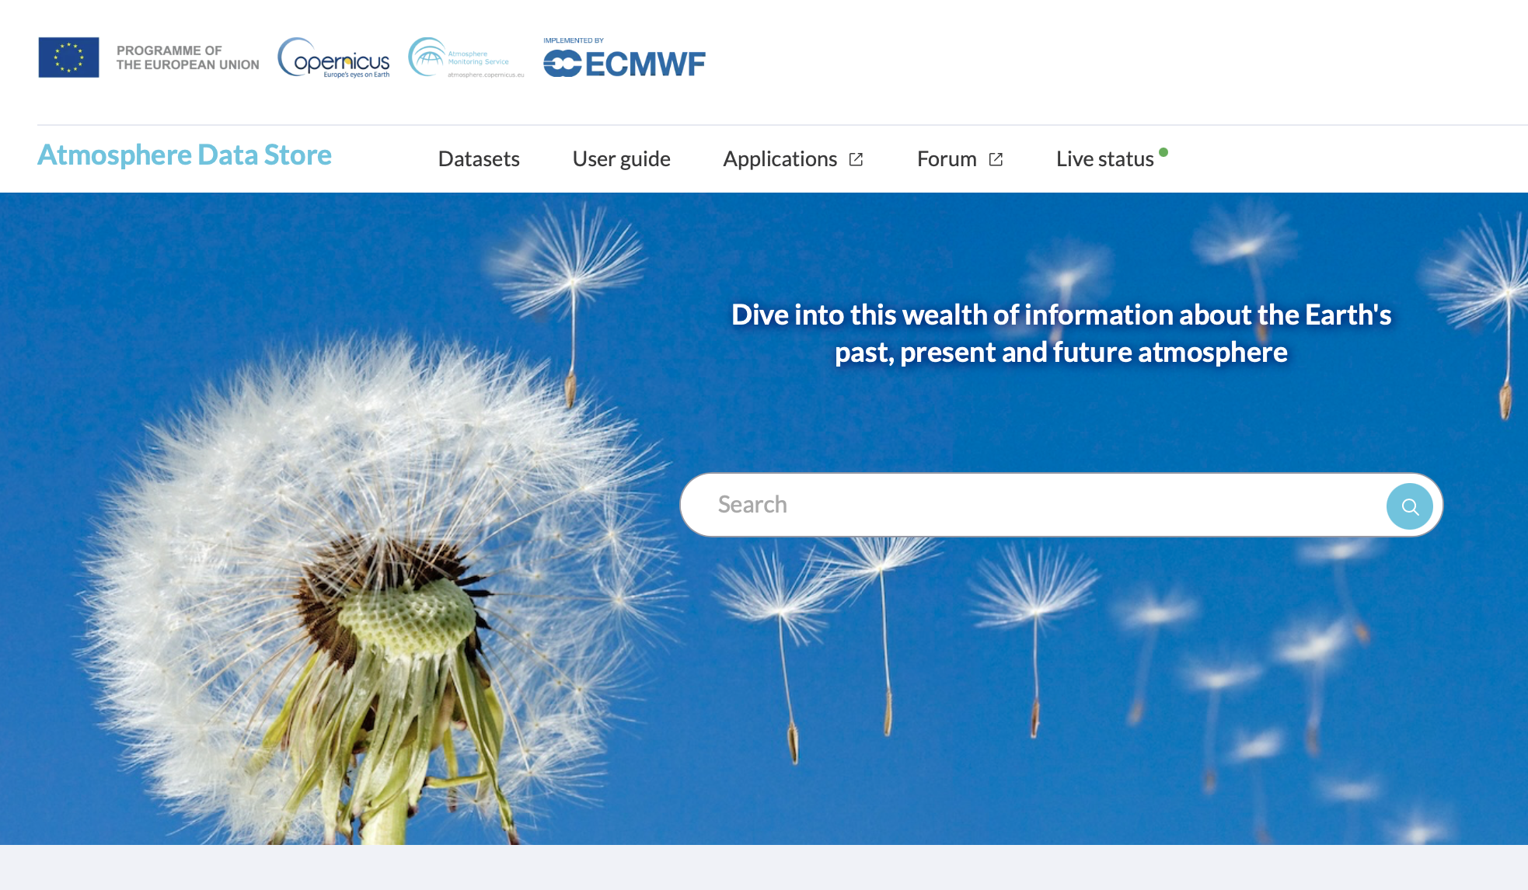

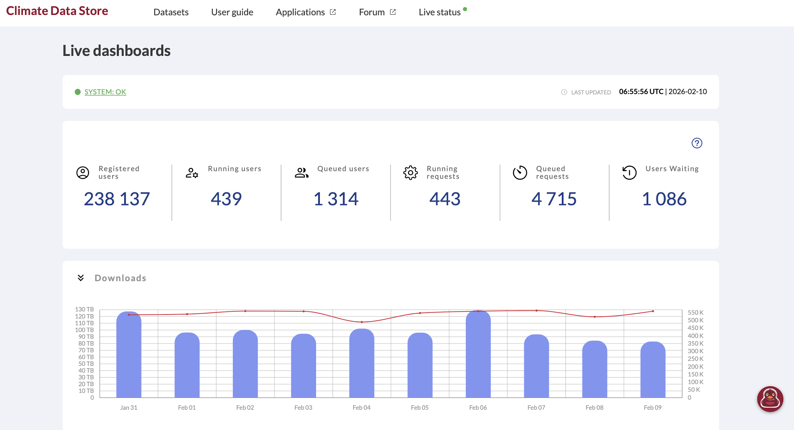
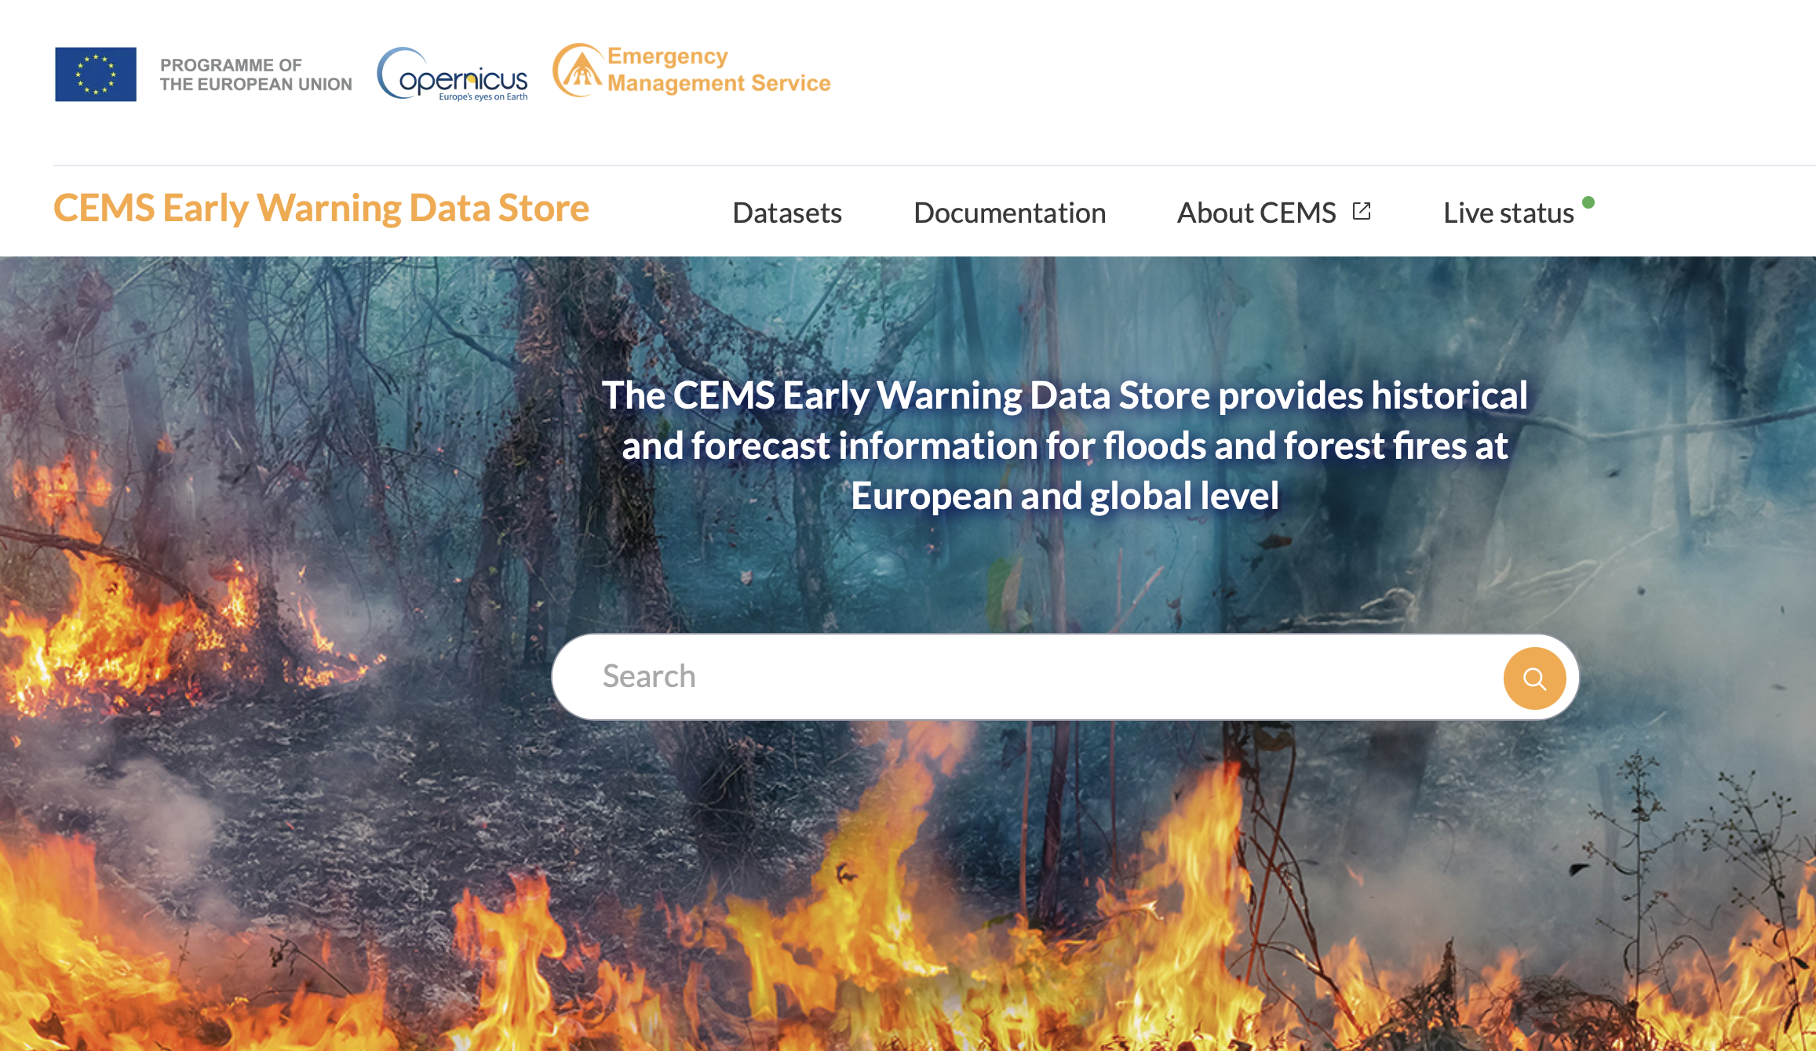
ECMWF Copernicus Data Stores
https://cds.climate.copernicus.eu/
https://ads.atmosphere.copernicus.eu
https://apps.atmosphere.copernicus.eu
https://ewds.climate.copernicus.eu

Slide 10
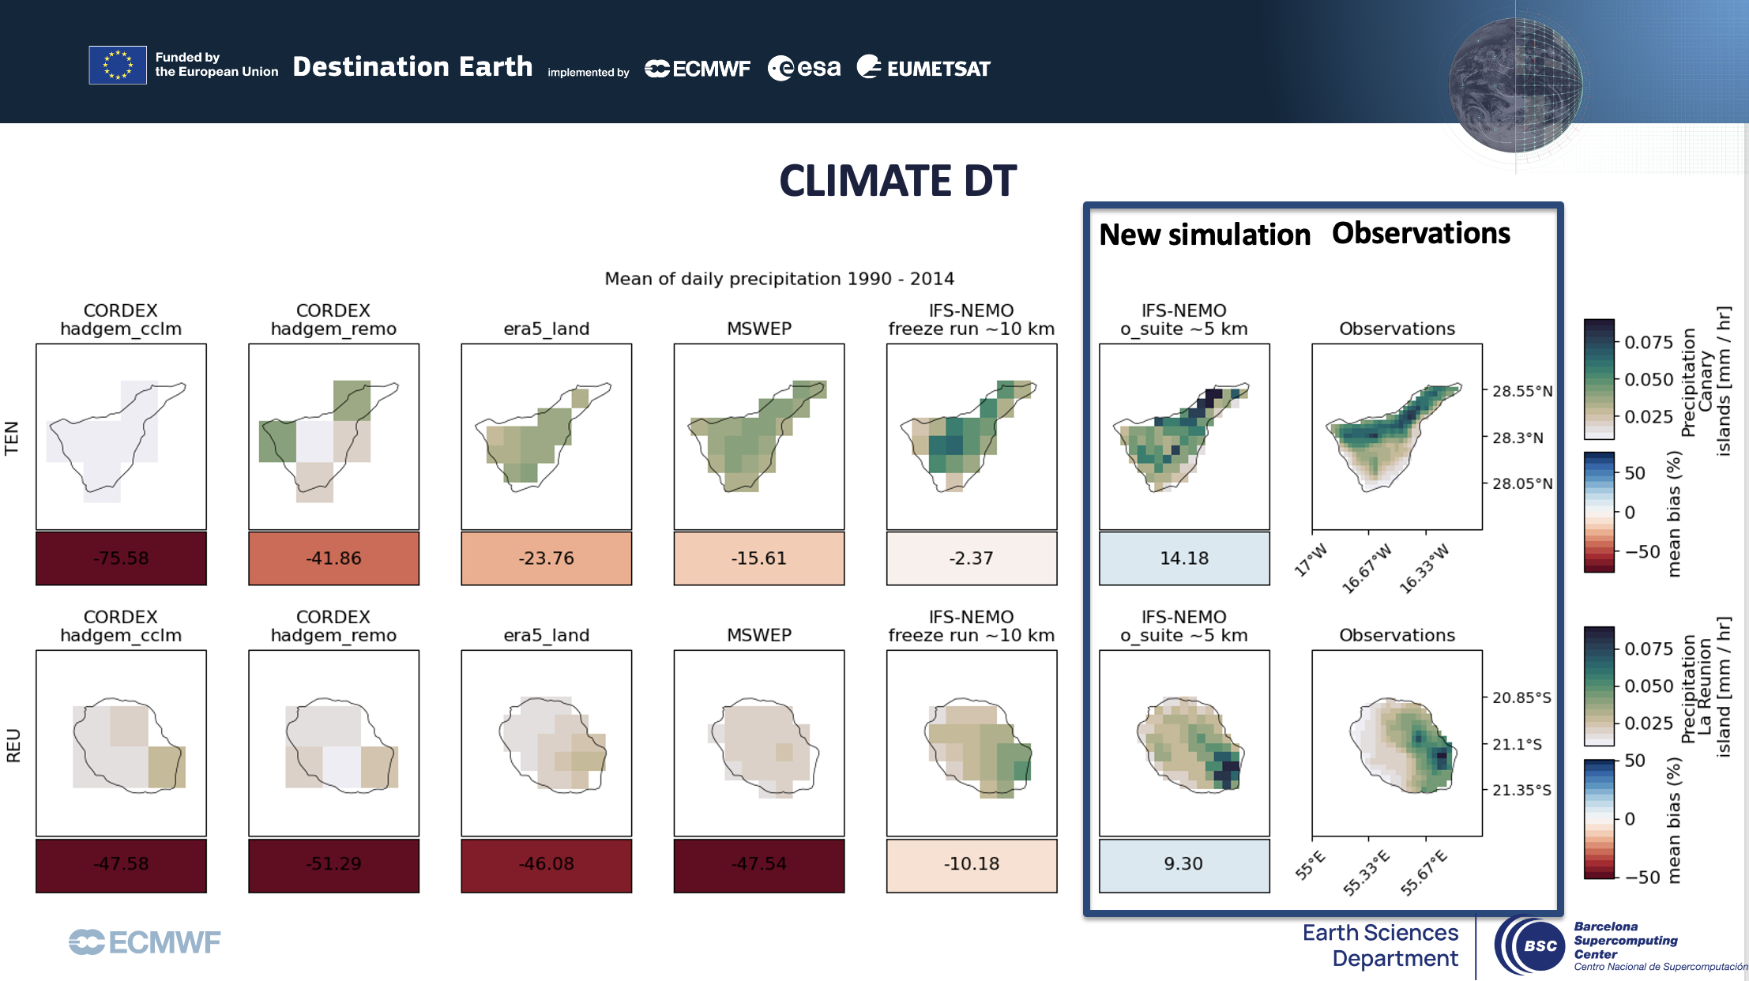
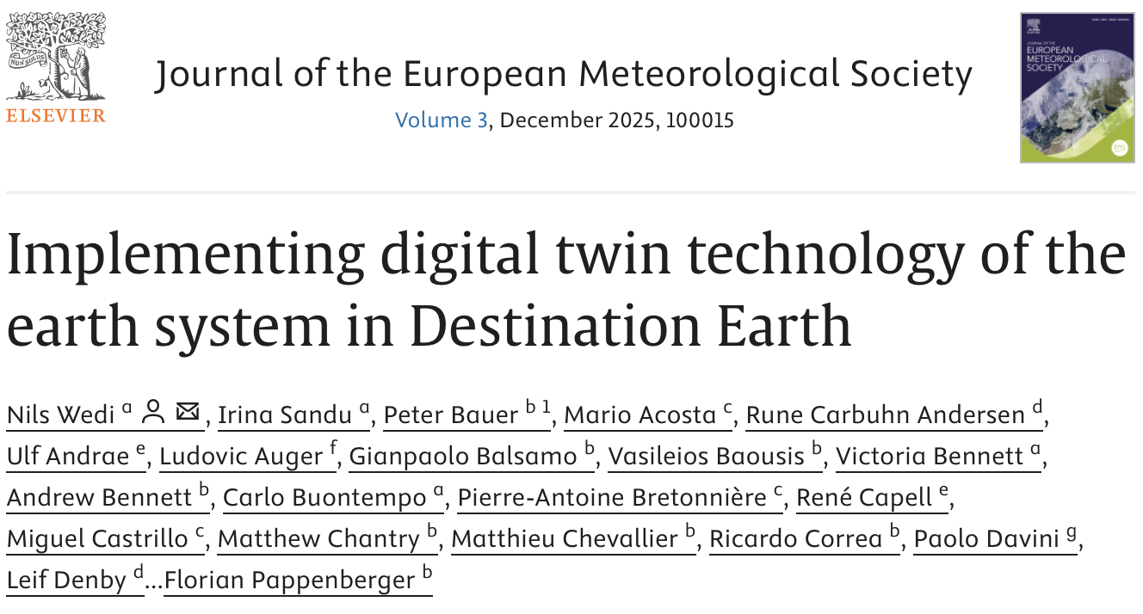
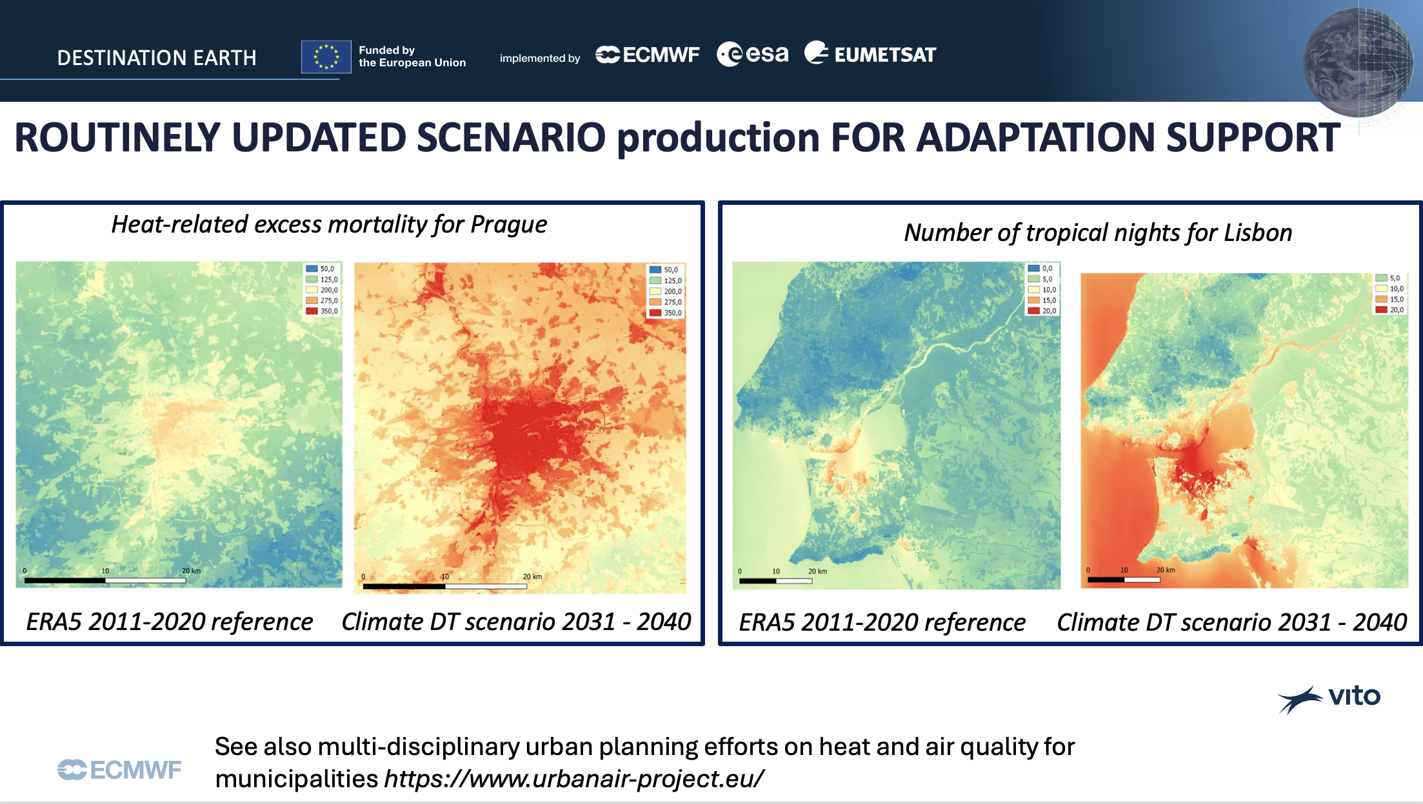
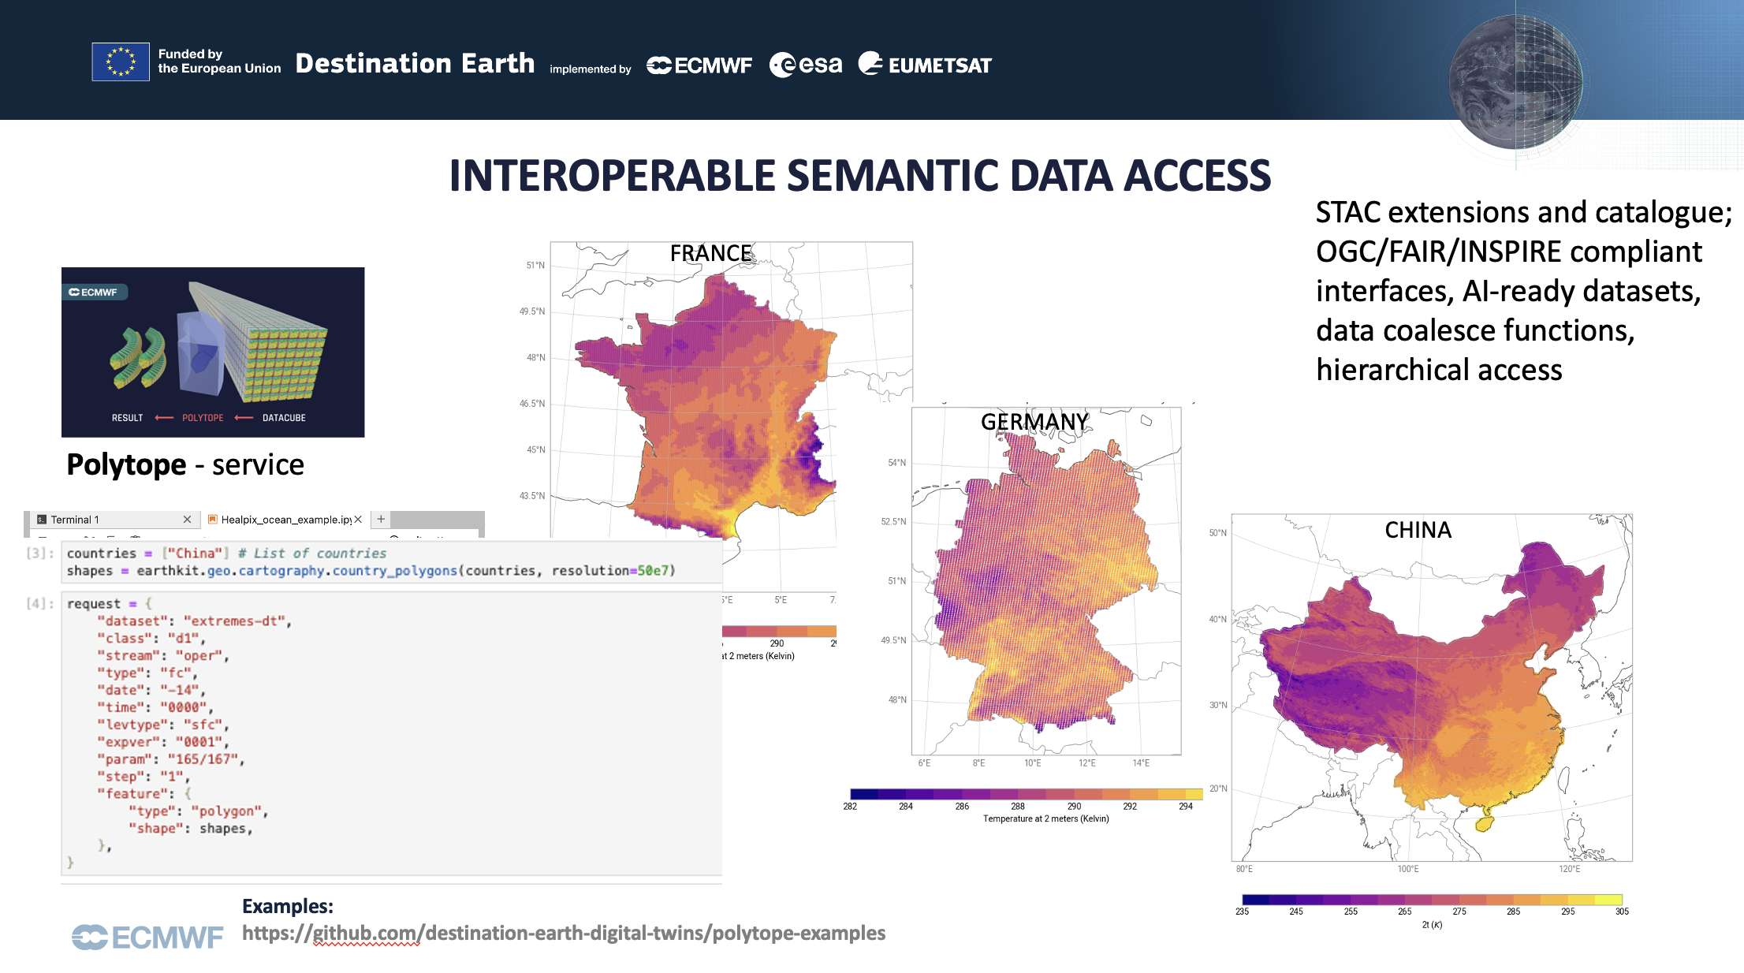
Destination Earth (DestinE)
Implementation together with ESA and EUMETSAT
Moving to phase III in summer 2026
Discussions in progress within EC for bringing mature elements closer to Copernicus
https://www.sciencedirect.com/science/article/pii/S2950630125000092?via%3Dihub

