Slide 1
Stability Requirements for CEOS-ARD
Supporting long-term analysis
Mark Dowell, EC-JRC
Agenda Item 3.1

Slide 2

CEOS Analysis Ready Data
CEOS Analysis Ready Data (CEOS-ARD) are satellite data that have been processed to a minimum set of requirements and organized into a form that allows immediate analysis with a minimum of additional user effort and interoperability both through time and with other datasets.
Established by CEOS in 2016
Aim: Ease the use of satellite EO data to reach new, non-expert users by:
  Requiring a suitable degree of pre-processing
  Exact methods are up to the data provider
  Providing analysis-ready geophysical measurements (primarily L2)
  Ensuring robust metadata and documentation
  Providing an open and transparent first step for data interoperability

Slide 3

CEOS-ARD 2025 Consultation Paper & Concept Note
In 2025, CEOS-ARD Team engaged with the community to understand gather community feedback on the current state of CEOS-ARD, and understand priorities for future development
Future CEOS-ARD Consultation Paper & Concept Note endorsed by 2025 CEOS Plenary
Item 4.5 from the Concept Note:
Increased Support to Scientific Applications and Environmental Adaptation and Resilience Issues
Include requirements for dataset stability

Slide 4
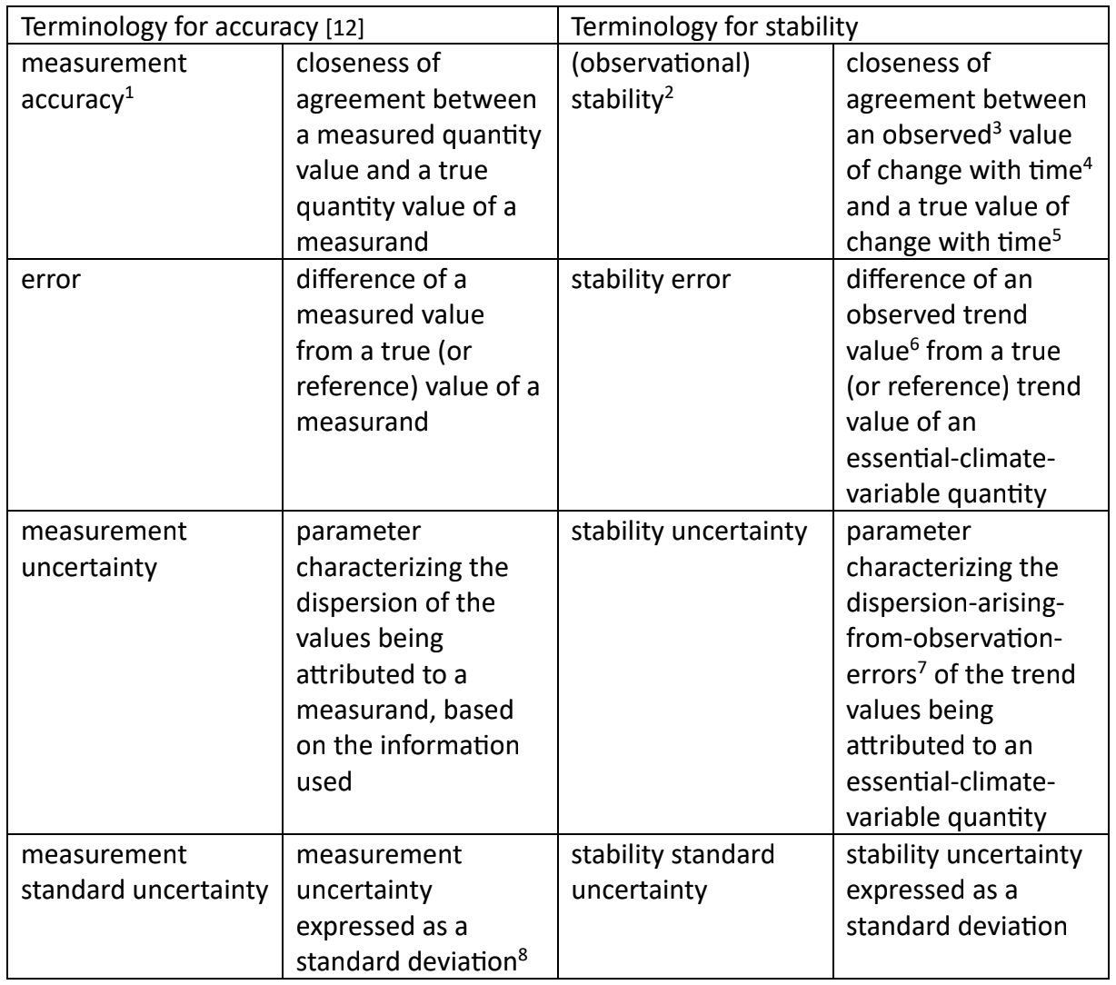
Stability: What does it mean?
Chris Merchant & Emma Woolliams draft paper:
We want providers to provide the ‘stability uncertainty’

Slide 5
Draft Requirement
# | Item | Threshold | Goal
1.17 | Stability | Not required. | Provide indicative metrics on stability, via stability uncertainty expressed as a stability standard uncertainty (with a 66% confidence level) or stability expanded uncertainty (with a 95% confidence level). Include considerations of: (a) temporal drift of individual sensors, (b) inter-sensor biases as instruments are replaced, and (c) changes in the spatial and/or temporal sampling regime, and the impacts on aliasing with, e.g., diurnal and seasonal cycles and spatial patterns.
Goal level requirement only
Provided for the dataset as whole (general metadata)

Slide 6
Next Steps
Once draft requirement is agreed, develop 2-3 test CDR datasets which meet the requirement
Present the proposed requirement to CEOS-ARD Oversight Group to be included in all PFS
Encourage CDR providers to include this metric via the CDR Inventory

Slide 7
Questions for Discussion
Is the draft requirement agreeable?
Suggestions/volunteers for CDRs to be used as test datasets?

