Slide 1
CDR Inventory
WGClimate
Jörg Schulz, EUMETSAT
Agenda Item: Joint meeting 2.3

Slide 2
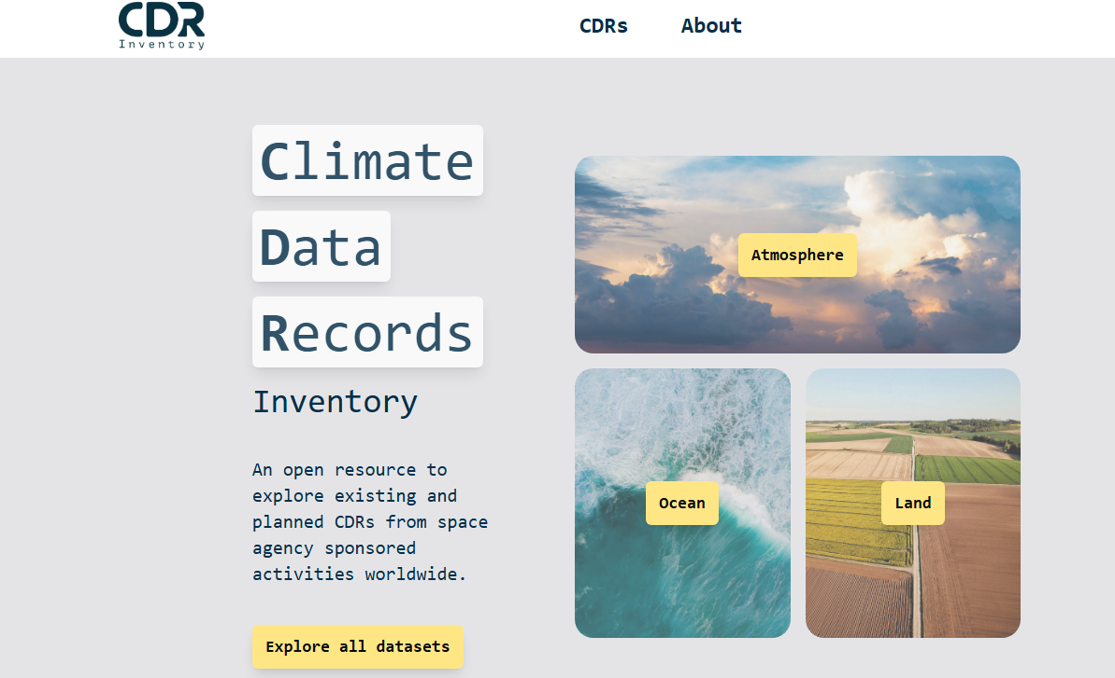
CDR Inventory
Since Nov 2025
Enhanced user experience: filter, search, export, comment, label*
Automated reporting capabilities* (available to all users)
Continuous update and publication (individual “last updated on” time tag)
New improved UI
Flexible database structure, formatted [core] data
Adaptation to emerging priorities*
* in progress
https://climatemonitoring.info/cdr-inventory/ 🡪 feedback welcome!
Notes:
New improved UI
More appealing graphics; UI more interactive and clearer.
Flexible database structure, formatted [core] data
Will easily accommodate changes of upcoming GCOS framework and additional information topics as needed; formatted data record characteristics (variables, time and space coverages, resolutions, data formats, …) allow for effective filtering and automated analysis.
Enhanced user experience: filter, search, export, comment, label*
Comment: users are be able to provide comments to specific datasets or database fields – comments visible to admin only (e.g. “Please note that this URL is broken.” ☹);
Labels*: users will be able to create their own labels (e.g. results of filtering and search – “my selection 1” -- available for them within the session) or use admin-defined labels (available to all users) – this functionality is already developed (see example of Earth Cycles demo) but not yet made available for non-admin users;
Search: general free-text search currently limited to a reduced set of DB fields, expandable as needed.
Filter: formatted information is a game-changer – some additional harmonisation / fine-tuning needed for optimisation.
Export: export of user-selected datasets possible (excel file)
Automated reporting capabilities* (available to all users)
Work in progress: plan is to provide temporal coverage maps per ECV / ECV Product / Physical Quantity, gaps in time (and space, if needed, for non-global datasets), connection to space segment (using WMO OSCAR classification of instrument type?), and any other request by agencies, GCOS, WGC, … similar to what used to be done for Gap Analysis exercises and any intermediate reports 🡪 Wishlist accepted for gradual implementation (GCOS?)
New workflow for input and verification
Continuous update and publication (individual “last updated on” time tag)
The database can be updated on a daily basis, potentially: every time there is new information available (corrections, new datasets, …)
Adaptation to emerging priorities*
This may entail the results of the “expansion of usability”, new ECVs, non-GCOS variables (omitted in this slide to avoid heated discussions with GCOS at this point).
General note: no login required for public usage, only for admins / power users.

Slide 3
Status: (ECV +) CDR Inventory
ECV Inventory (closed)
      v6.0 *last version* published in mid-November on the climatemonitoring.info website as a downloadable excel file only
      Webpage and file accessible via link from the new CDR Inventory page
      CDR Inventory (current status)
      New database and UI made public in mid-November 🡪 official joint announcement still to come (after WGC#24)
      Webpage (https://climatemonitoring.info/cdr-inventory/) replaced that of the ECV Inv
      Migration of ECV Inv contents still in progress (currently all “verified” content from 2020 onwards)
      Continuous update with new contents, records with “last updated on” time tags
      API…
      Beta implementation of Earth Cycles applications (ECV-based only, not visible to general public yet)
Notes:
WGClimate presentation
The information on this slide is repeated somewhere else.

Slide 4
Plans: CDR Inventory
      Plans for next 12-15 months (end of 3rd contractual year):
      Joint CEOS-CGMS Announcement [coming weeks!]
      Main focus on DB contents: new (C3S and ESA-CCI projects have been proactive) and updates [open-ended]
              Refinement of user tools and experience ([continuous] depending on feedback and resources)
              Development of gap analysis tools (gap analysis and user analysis – most tools available to all users) [basics available in Summer] <- maybe replaced by AI-Agents or usage via API
              Accommodation of “expansion of utility” inputs (beta implemented Earth Cycles tested as labels / tags, can be implemented as entry-points, like for domains), reqs.-based selection for applications will need assessment of sufficiency of information content (vis-à-vis the new workflow) [upcoming, depending on progress and resources]
              Expansion to non-GCOS ECVs widely used for climate applications (eg NDVI) – WGClimate needs to take decisions which variables
Notes:
WGClimate presentation
From Mike, wrt (Gap) Analysis tools: “I'm also rather interested in following up the AI angle, or even usage via API. We could outsource the analysis to external tools then. May be better even! E.g. a jupyter notebook for analysis.”

Slide 5
Plans: F(C)DR Inventory +
      F(C)DR Inventory – Important as basis to create CDRs – Provides guidance!
      Separate database, same technology [mostly ready, minor adjustments needed]
      Linked to CDR Inventory (FCDR 🡨 🡪 CDR) [CDR Inv ready 🡪 links, related datasets]
      Prototype by mid-May (end of current WP)
      Development and implementation for year 3 of current contract [🡨 May 2027] – starting with “low-hanging fruit” (sourced from CDR Inv and EUM internal information) [beta release with reduced content and basic tools by the end of 2026])
      (Lower priority than full development of the CDR Inventory, but in the pipeline!)
  Other:
  Improve discoverability (see Mike’s slide)
  Do we want to monitor usage of CDR Inventory?
  Databases synergy: WMO OSCAR/Space current *main* source for sats./instrs., CEOS MIM a complementary resource? – Could suggest (again) to WMO and CEOS to align nomenclature and to move to a single data base containing everything without errors.
  CEOS WGISS, ARD, etc?

Slide 6
Catering for AI search & analysis
Maximising usage of the CDR Inventory nowadays means more than just human usage
  Searching for info may be evolving from Google search to asking an AI assistant
  Potential for AI agents to perform some analysis work for doing gap analysis
  Reduction in the need for custom tooling on the CDR Inv & learning how to use it
CDR Inventory already provides a documented API for info retrieval:
  Useful for „human-driven“ automation ; also usable by well-directed AI agents
Looking at adding a Model Context Protocol (MCP) server:
  First steps: simpler interfacing with AI agents, info retrieval
  Later: more advanced query functions to support analysis by agents

Slide 7
Gap Analysis
Witnessed some disruptive changes in mission planning, that are faster than GCOS IP cycles and thus not fully contained in the IP actions, e.g.:
  CGMS had been contacted by GEWEX on ERB measurements. Issues on missing overlap of SNPP (likely deorbited in 2026) with Libera (only launched late 2027). Long term future after Libera unclear, needs conceptual analyse how a continuous observing system could be done (were all relying on USA, but need something international and beyond research)
  issues around Sentinel-6 and the reference altimetry record
Need to see if GCOS sees these issues in their Status Report and could start joint analysis to develop a way forward that could be used in future mission planning such as the EUMETSAT foresight mechanism

