Slide 1
Review of GHG Constellation
Yasjka Meijer, ESA
Agenda Item 4.1

Slide 2
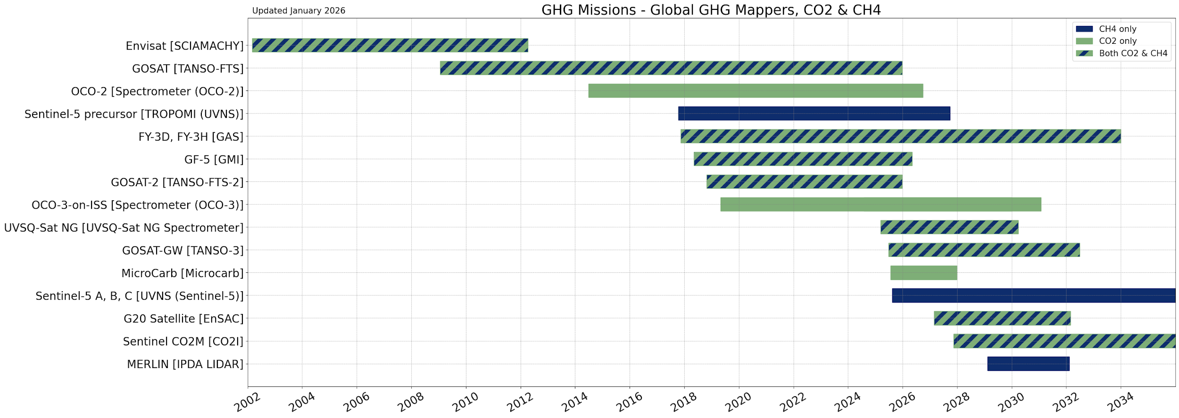
GHG Constellation – Global GHG Mappers
operational
2025
launch
planned

Slide 3
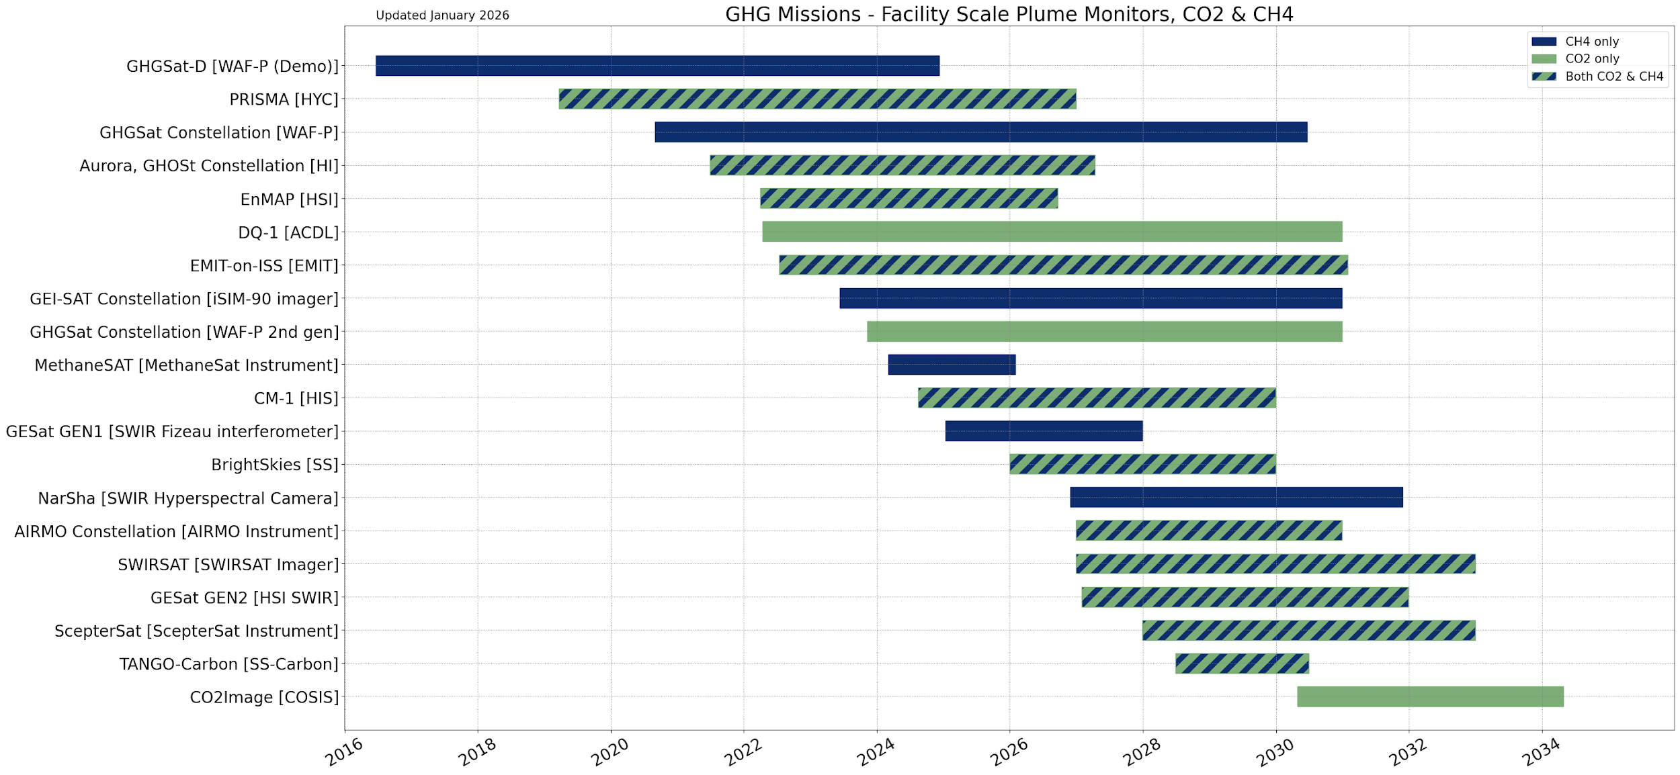
GHG Constellation – Plume Monitors
operational
2025
launch
planned

Slide 4
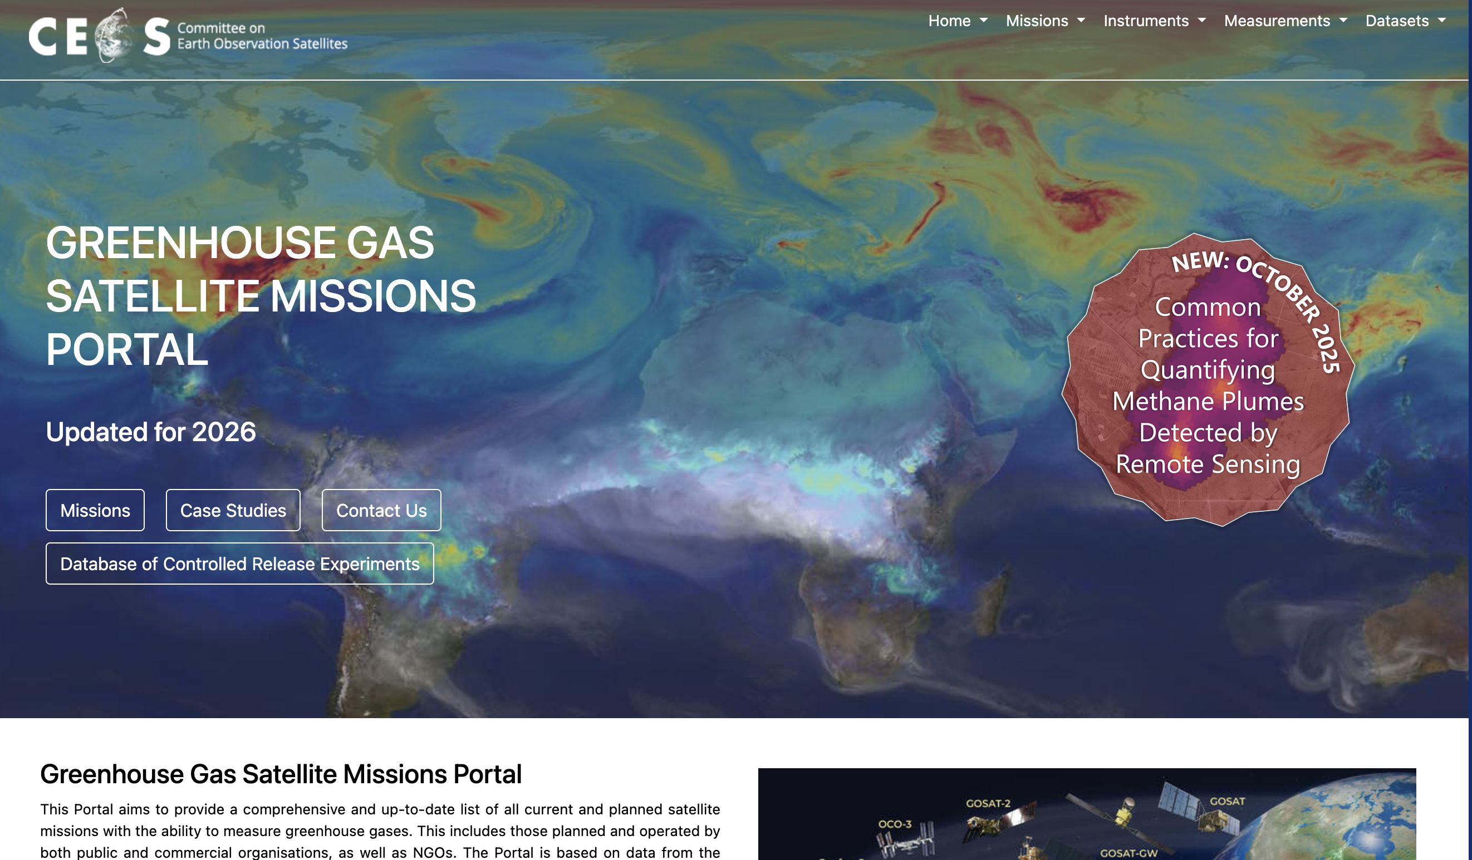

Slide 5
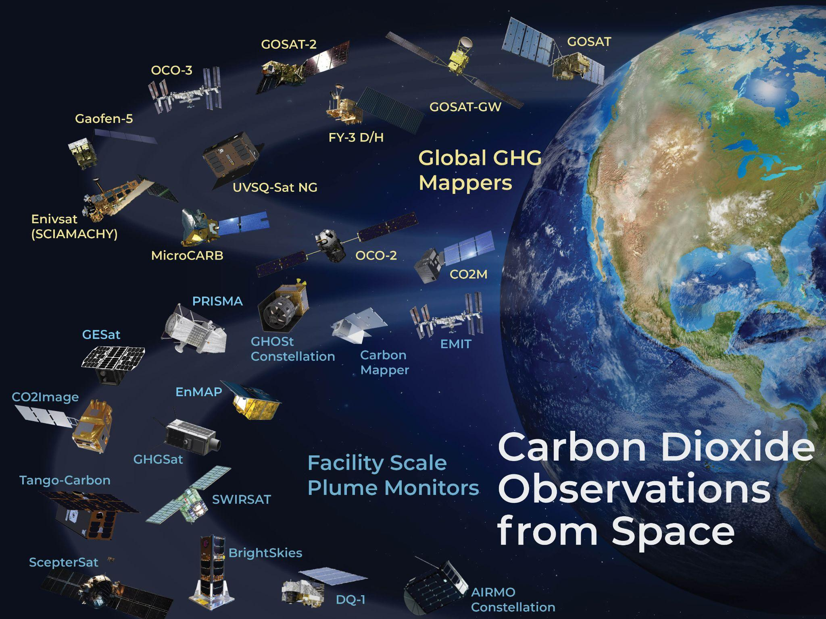

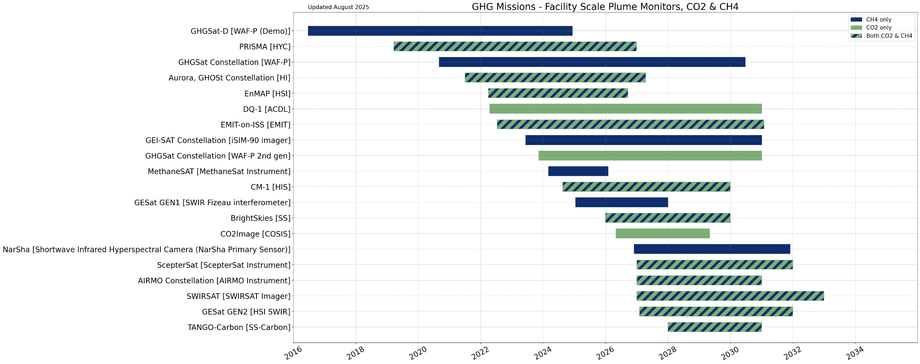
GHG Mission Portal
Updated portal, see ceos.org/ghg
(public and non-public)
Allows exploring GHG missions, explore building constellations, detailed mission info, timelines, and case studies

Slide 6
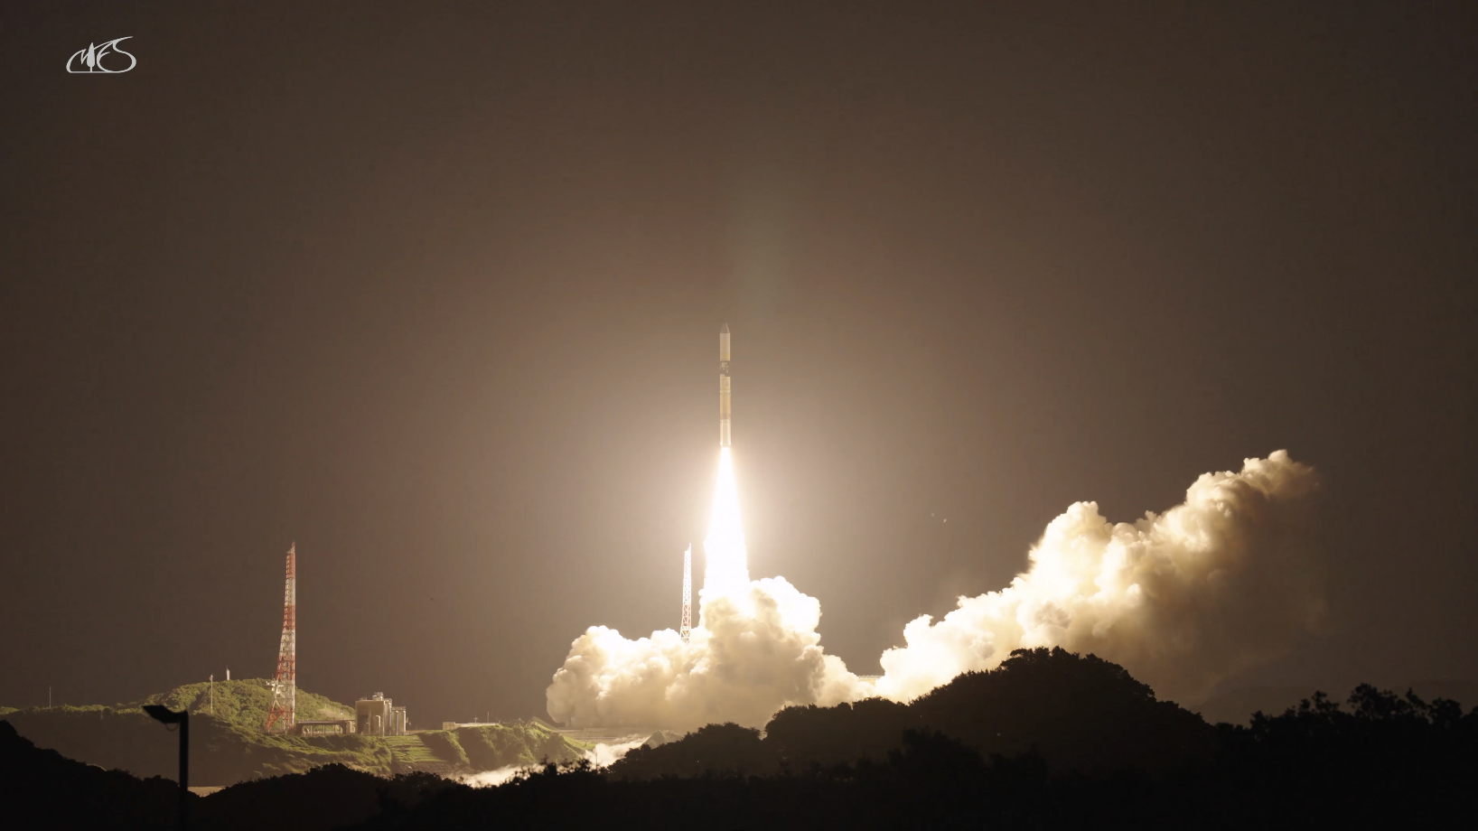
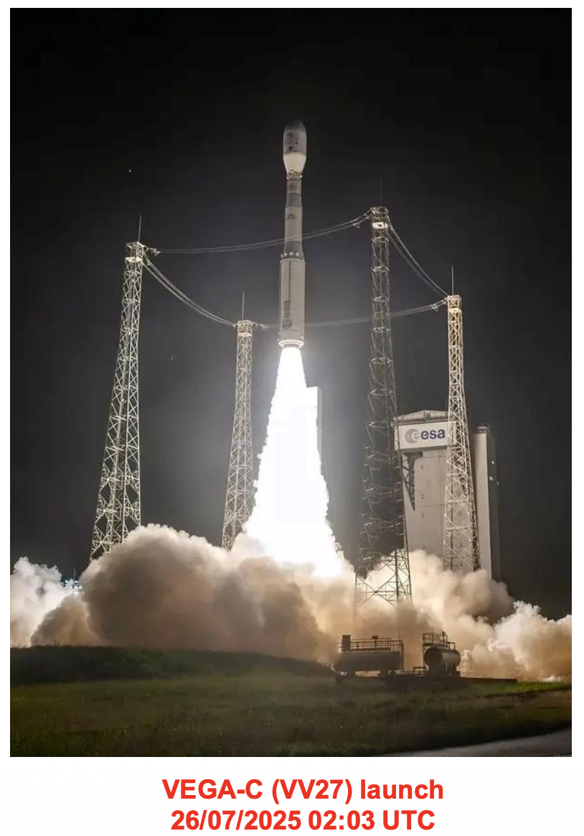
Significant Updates from 2025 - 1
Successful Launch of GOSAT-GW, MicroCarb and Sentinel-5 Missions
The GOSAT-GW satellite was launched at 1:33:03 am Japan time on 29th June at Tanegashima Space Center with the 50th H-IIA rocket, the last vehicle of the H-IIA series. (Credit: H. Tanimoto)
(Credit: D. Jouglet)

Slide 7
Significant Updates from 2025 - 2
NASA’s OCO-2 and OCO-3 missions – NASA is exploring potential for private-philanthropic-commercial partnerships to continue the OCO-2 and OCO-3 missions. Final decisions are expected around April 2026. Meanwhile both missions continue to operate nominally.
JAXA’s GOSAT has been successfully recovered from an anomaly and restarted taking observations → continuing its long-term XCO₂ data record.
NASA did not select the Carbon-I mission (Caltech/JPL) for the Earth System Explorer opportunity.

Slide 8
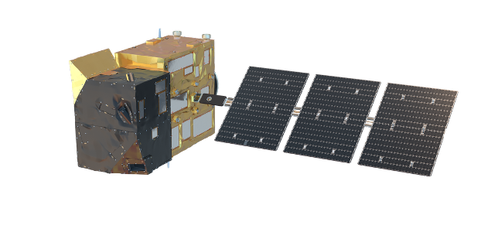
Significant Updates from 2025 - 3
ISRO’s G20 satellite will carry the Environmental Sensor for Atmospheric Composition (EnSAC) measuring CO₂, CH₄ and N₂O. Working towards identifying relevant ISRO representative for the GHG-TT group.
Copernicus CO2M mission will be a constellation of 3 satellites.
Each satellite >270 km swath with instruments providing at relatively high resolution 2x2 km² measurements of CO₂, CH₄ and NO₂.
* First satellite Acceptance Review 08-2027
* Second satellite Acceptance Review 02-2028
* Third satellite is scheduled in 2029

Slide 9
Relevant events in 2026
CEOS AC-VC annual meeting, 1–5 June 2026, Leiden (NL)
IWGGMS, 29 June to 2 July, Bonn (DE)

