Slide 1
WGClimate-24 & GHG-TT-6
Best Practices
Paul Green, NPL / UKSA
with Data Foundation,
UCLA-JIFRESSE & LLBL
& wider GHG TT
Agenda Item 4.2

Slide 2
Motivation
The Global Methane Pledge (now signed by 155 countries) seeks to reduce methane emissions by 30% between 2020 and 2030
Fugitive emissions / high emitters (emissions t> 100 kg/hr) represent a substantial fraction of fossil and waste emissions. Estimated between 30% and 75% of O&G emissions in some US production basins.
Public and New Space observations of CO₂ and CH₄ are increasingly being used to identify high emitters to improve production efficiency of drilling, support regulation, and are likely needed for a functioning reporting obligations and carbon market. Despite the current geopolitics, the need for data is increasing, not reducing.
Currently there are 3 missions dedicated to facility scale emissions monitoring, with another 10 expected in few years – in addition to the products generated from public data.
We need a set of “common” practices for reporting VVUQ and QA for facility scale emissions so that producers of these data know what is expected by the community and (new) users know how the data should be generated and reported so that it can be trusted

Slide 3
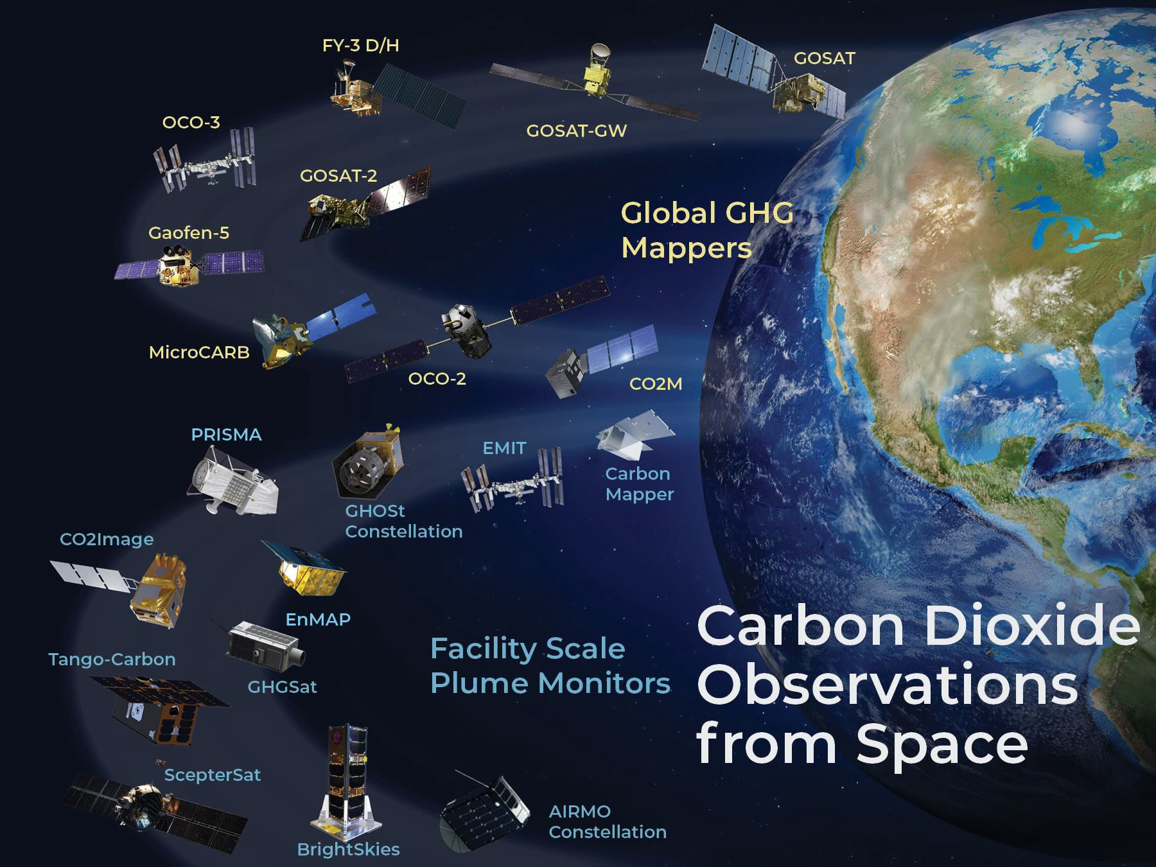
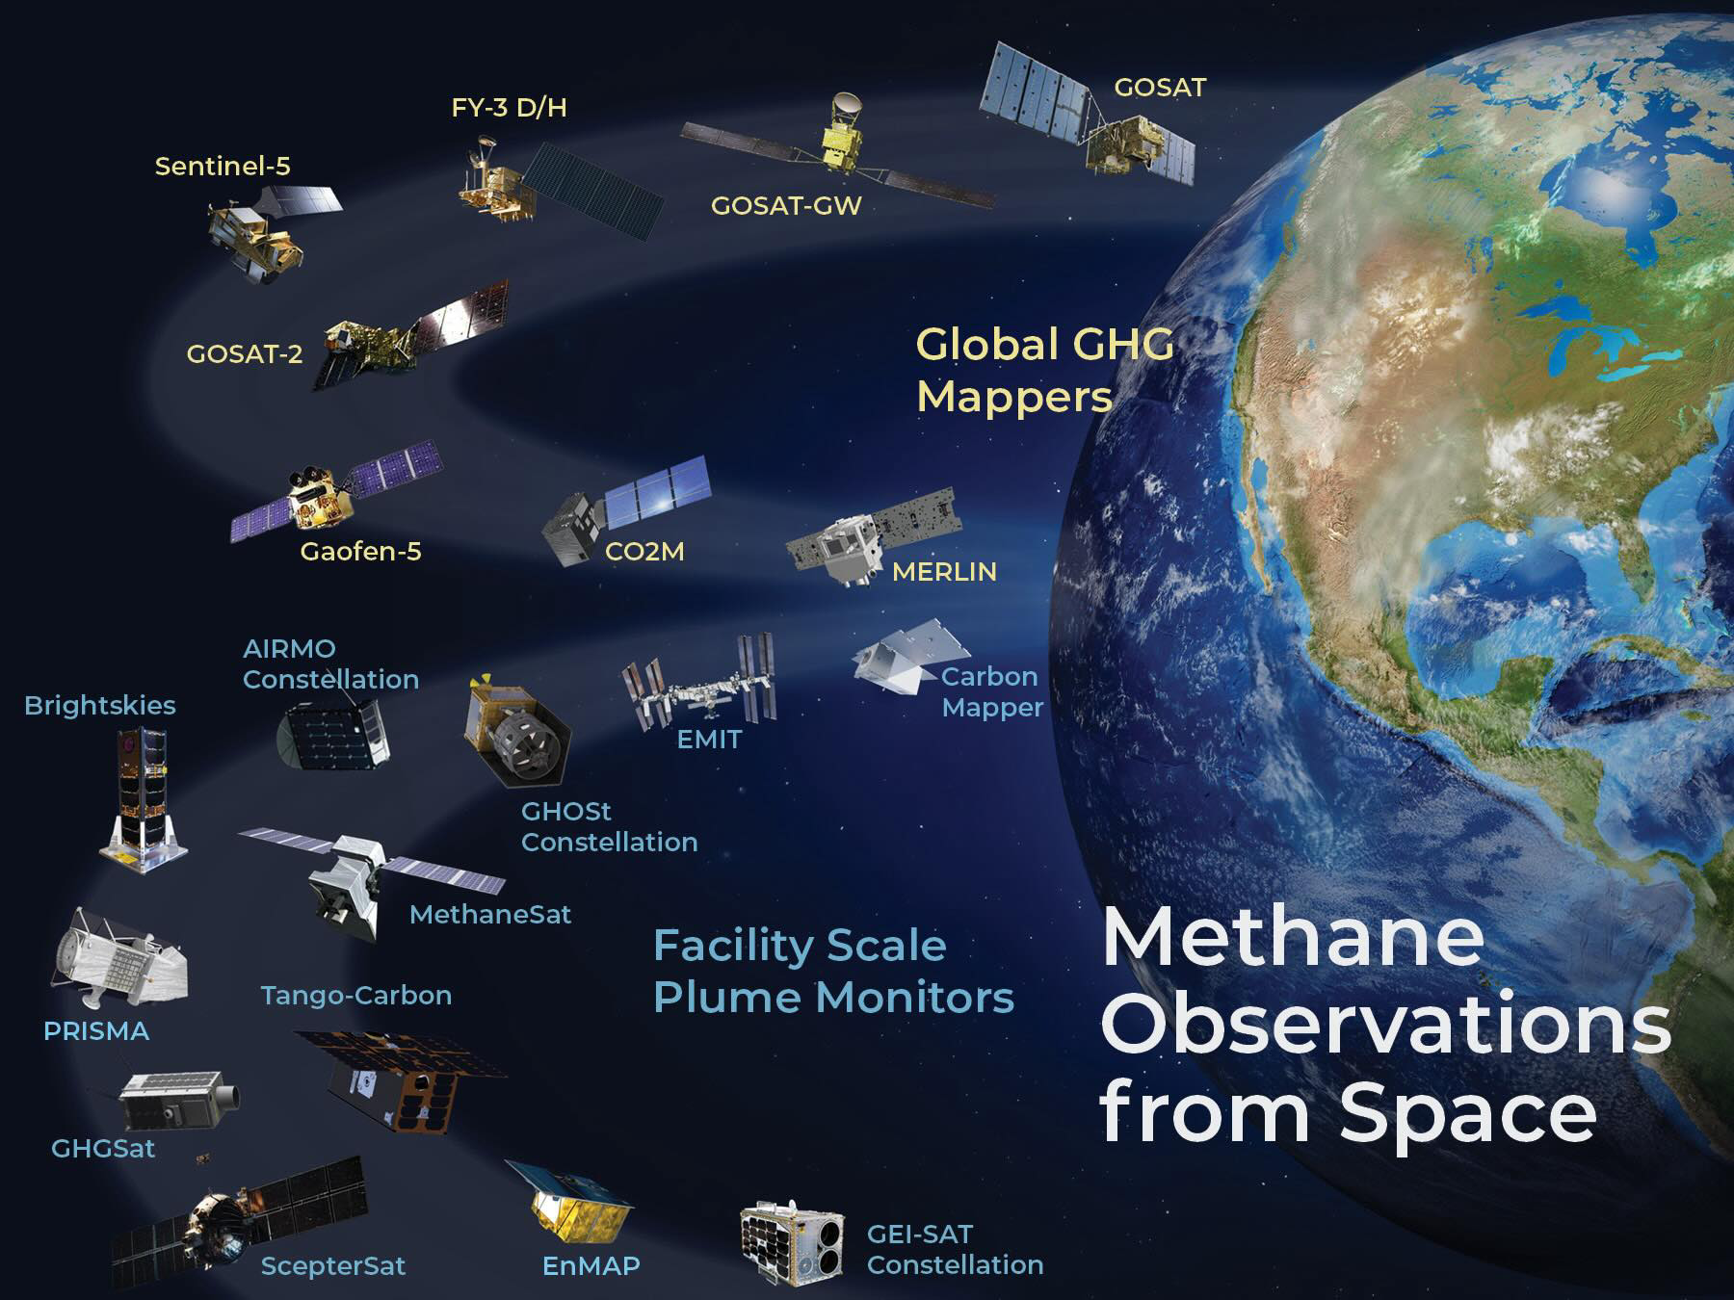
Growing constellation of GHG concentrations observations from the global to the facility scale
These are now being used to derive carbon dioxide and methane emission (flux) estimates on a range of spatial and temporal scales

Slide 4
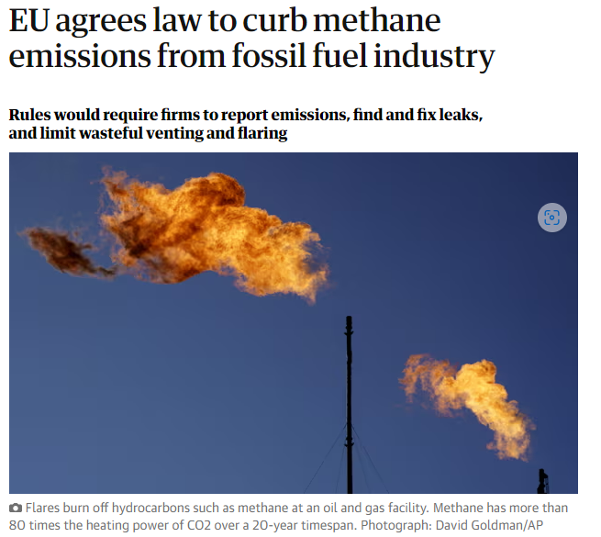
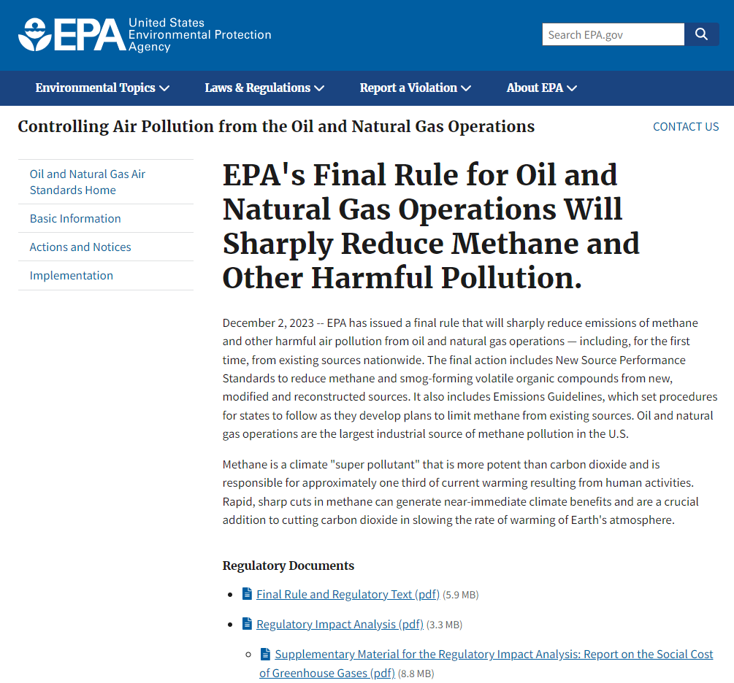
New rules on Energy sector
https://www.epa.gov/controlling-air-pollution-oil-and-natural-gas-operations/epas-final-rule-oil-and-natural-gas
https://oeil.secure.europarl.europa.eu/oeil/popups/ficheprocedure.do?reference=2021/0423(COD)&l=en

Slide 5

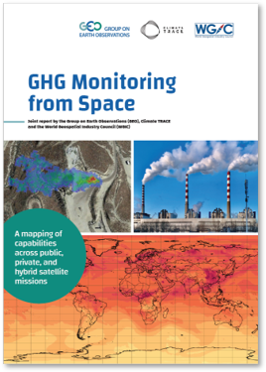
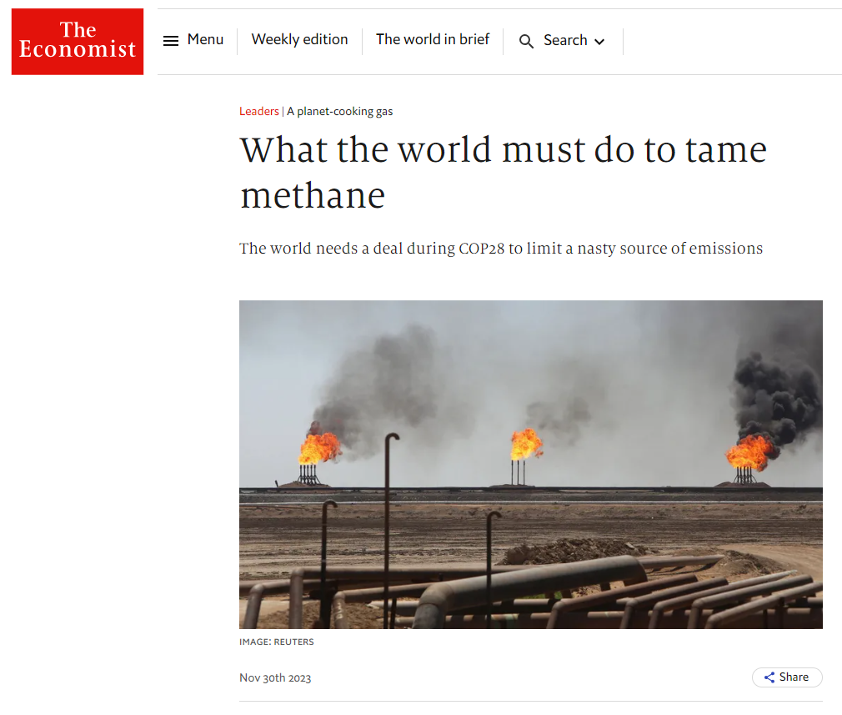
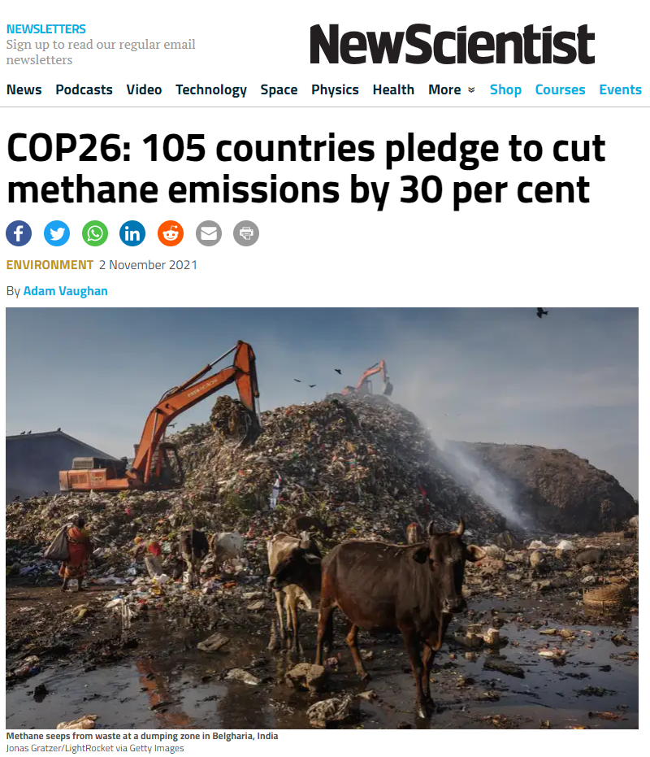
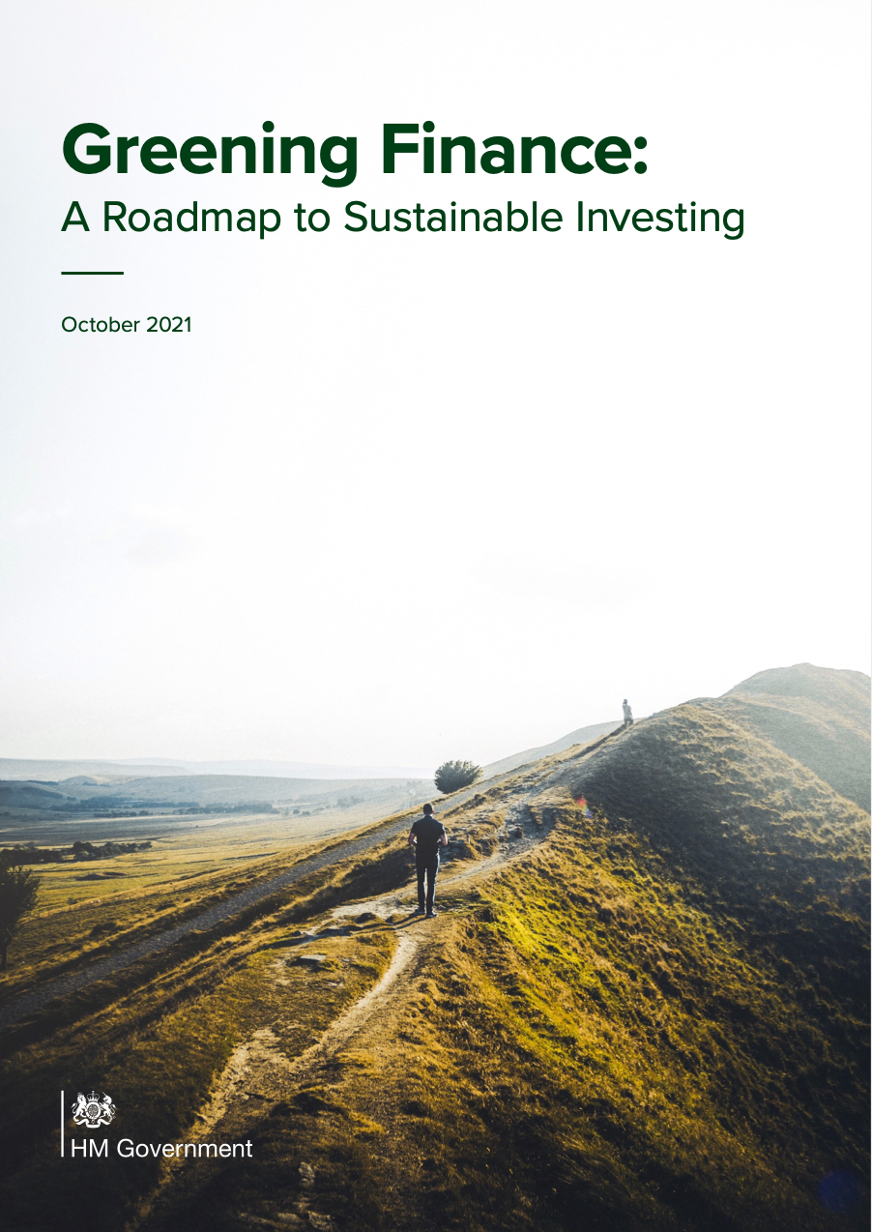
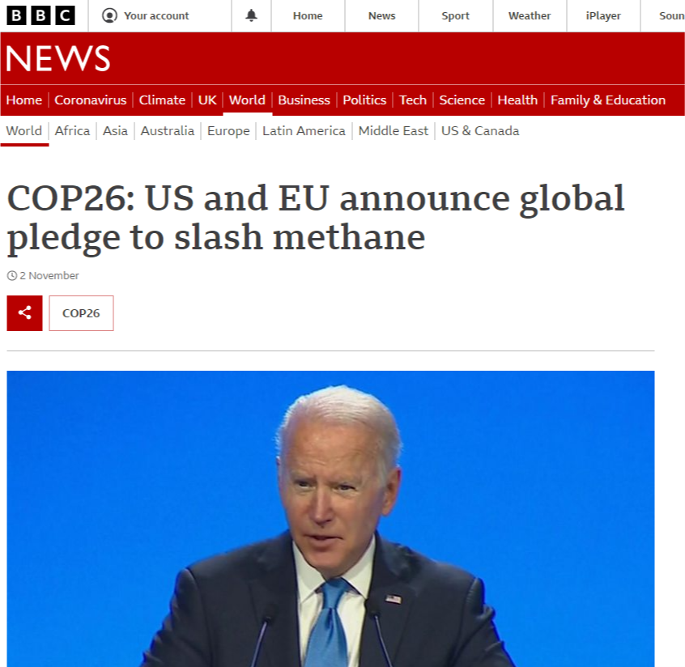
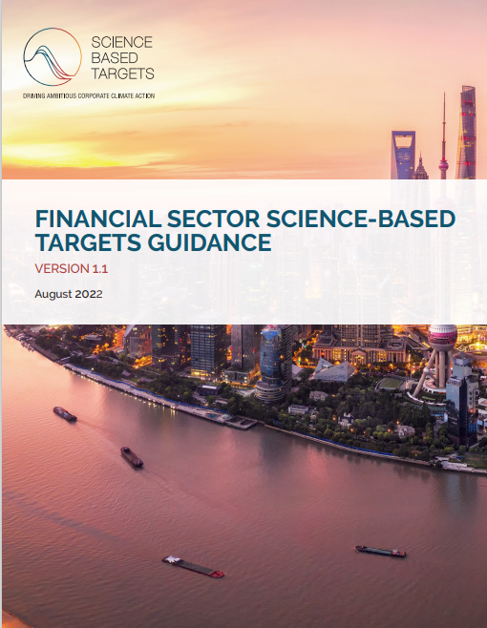
Corporate emissions and climate risk reporting
TCFD
Compulsory emissions & climate risk reporting for listed companies in US and UK, together with voluntary schemes to maintain market competitiveness aligned with customer climate expectations

Slide 6
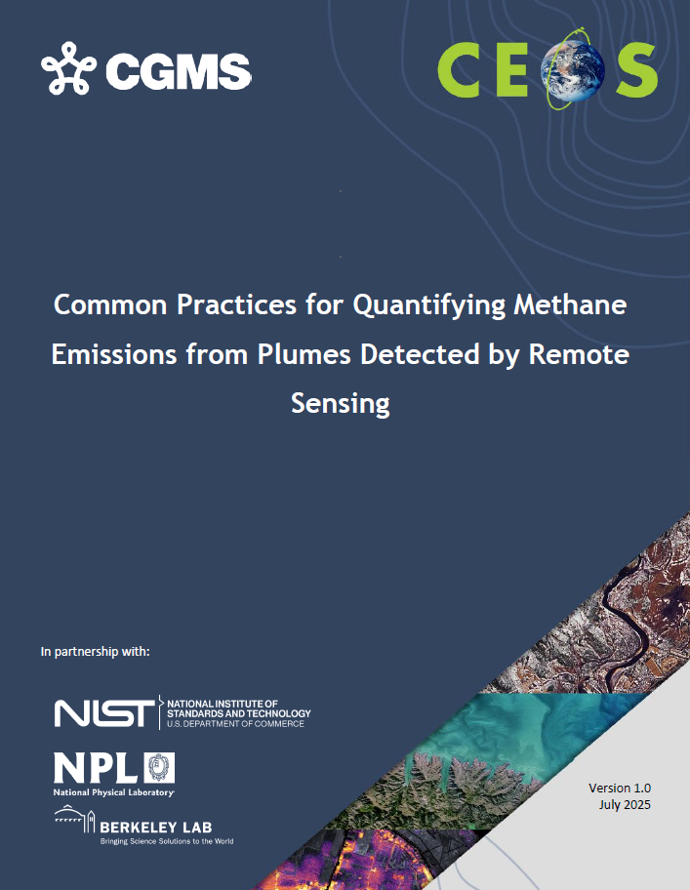
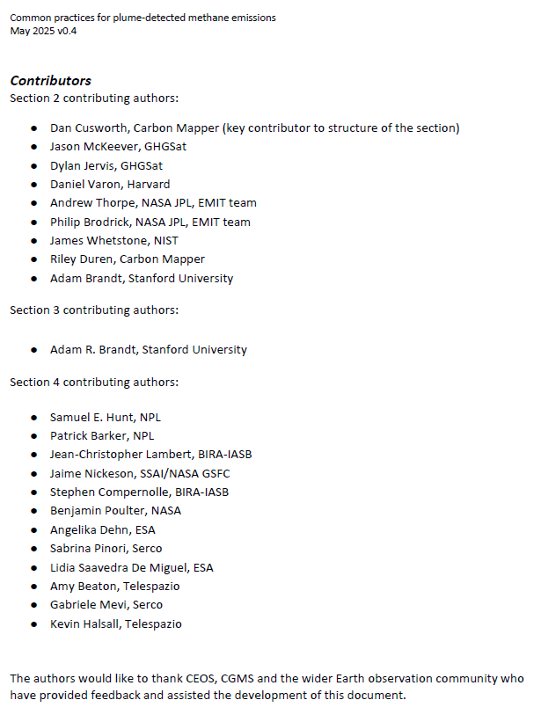
Common practise structure & contributors
Common practices intended users are
producers of these data (to know what is expected by the community)
users of these data (to understand how it should be generated and know how to use)
Overall structure
Motivation, remit and timeliness
Common practise for L0 to L4
Validation current art
Quality assessment framework
Integrates efforts across multiple agencies

Slide 7
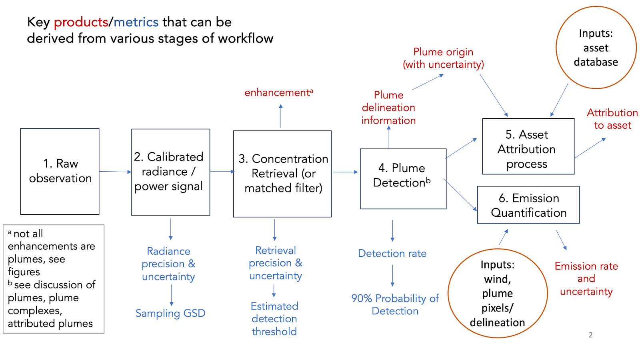
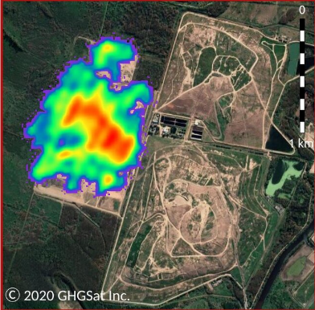
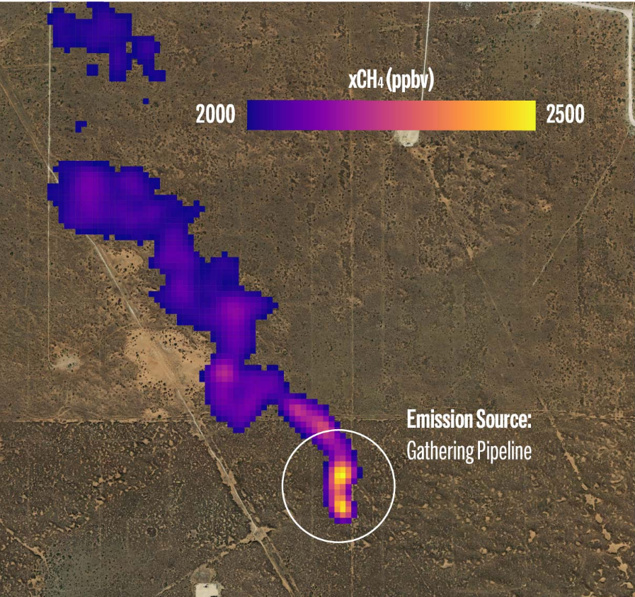
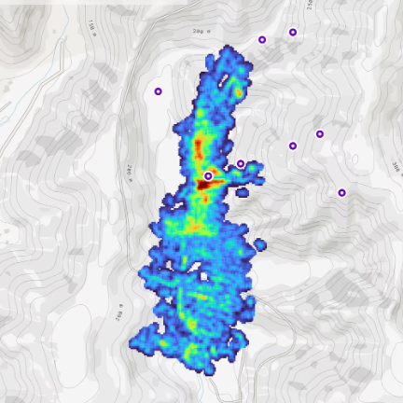
Workflow Common Practice
At a high level, all practitioners use the same sequence of steps in their workflows
The details of implementation vary, increasingly later in the process (from concentration/enhancement to emissions estimates)
Later plume detection, delineation and emission quantification steps require a human in the loop
Credit (L-R):
GHGSat
MethaneSat
CarbonMapper

Slide 8
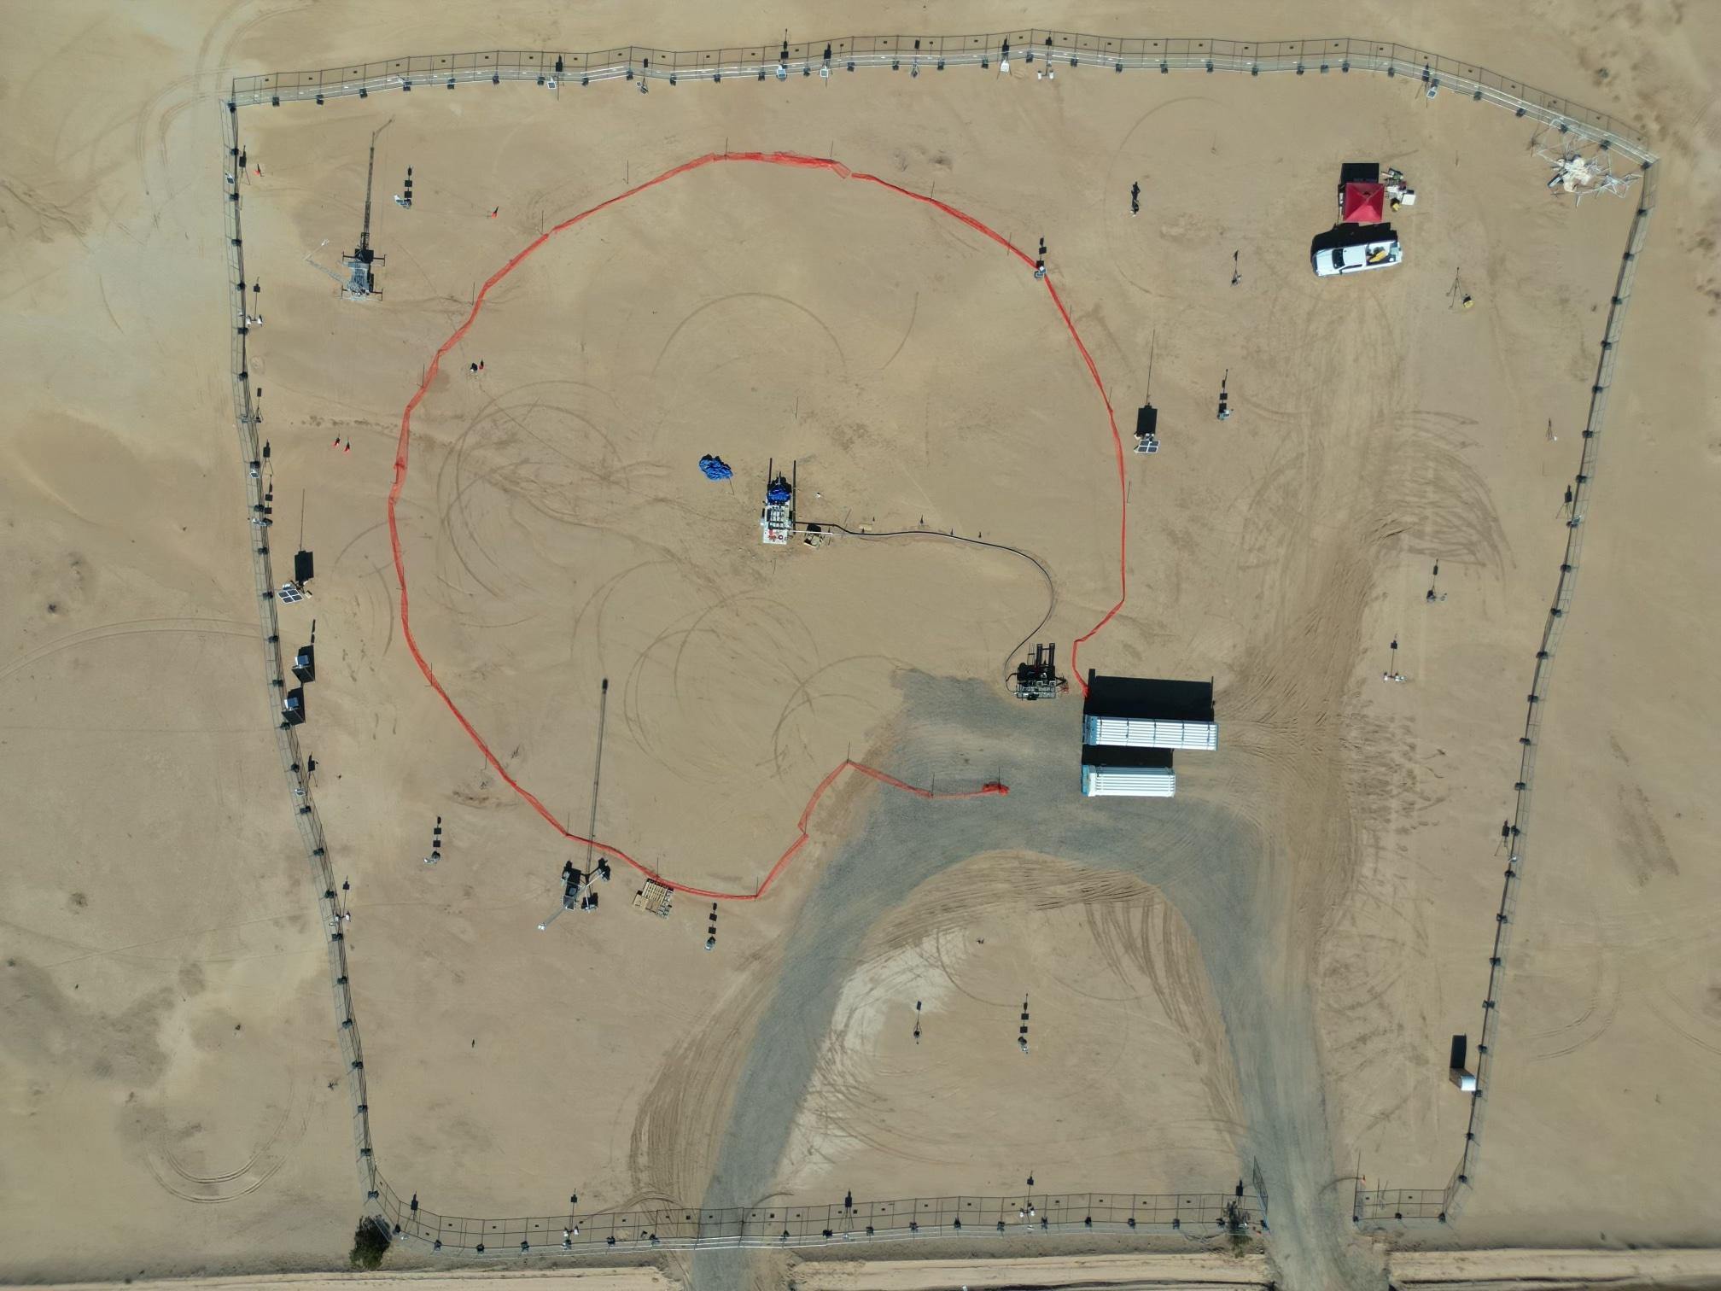
State of Practice for Validation –
controlled release
Independent testing of space-based methane detection needed, including several new satellite programs launched last year
Cooperative and single-blind controlled release tests, building on 5+ years of satellite, airplane and ground sensor tests
Expanded participation to 12+ methane satellite platforms and 15 analysis teams
2024-2025
150 release (10-1500 kg/h) cooperative stage
First single-blind stage “Phase 1” in Q1 2025, data unblinding Q2 2025
2026+
Controlled flaring expt. Q2 2026
Expanded extent and sophistication of CR
10 m ultrasonic winds
and meteorological station
Work station
?
Metering and
release point
Gas trailers and
pressure reg
Credit: A Brandt Stanford tinyurl.com/stanford-methane
*Participants know location but not [on/off] or volume flow rate. Coriolis flow metering for leaks between 3 kg/h and 1500 kg/h

Slide 9
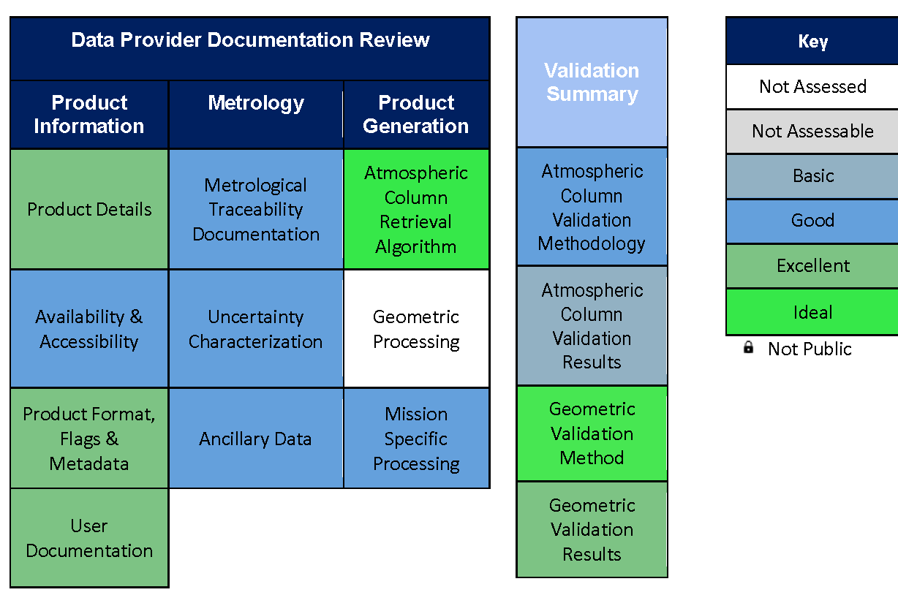
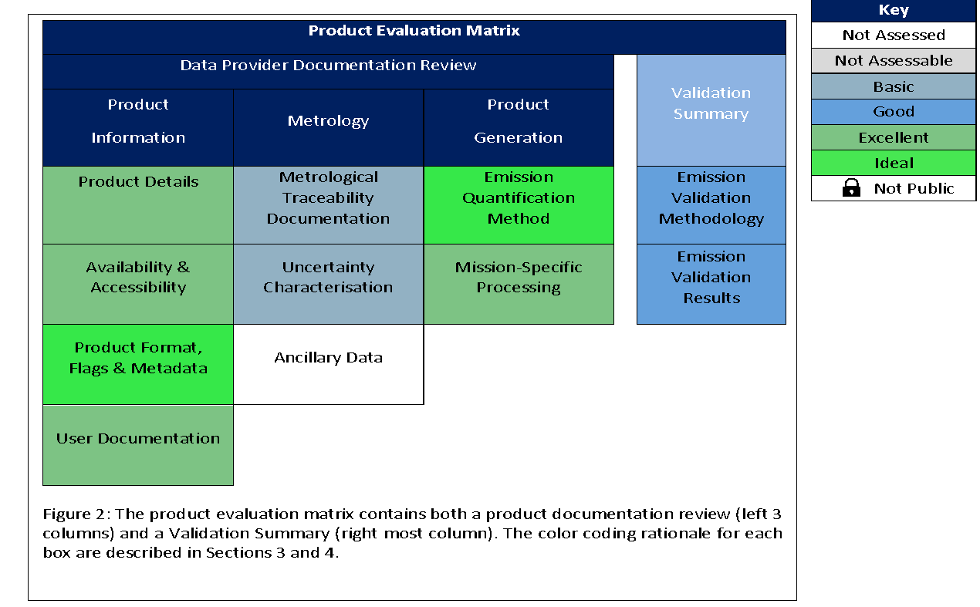
Quality Assessment framework
Quality Assessment framework aligned with that developed within EDAP / CSDA for consistency across GHGs and other ECVs
Column Enhancement
Emissions

Slide 10
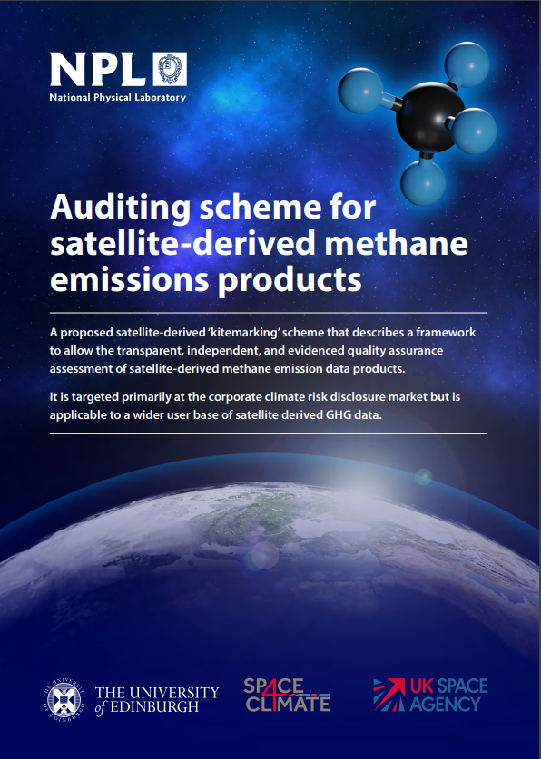
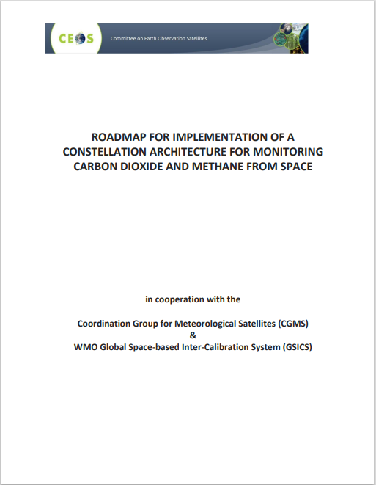

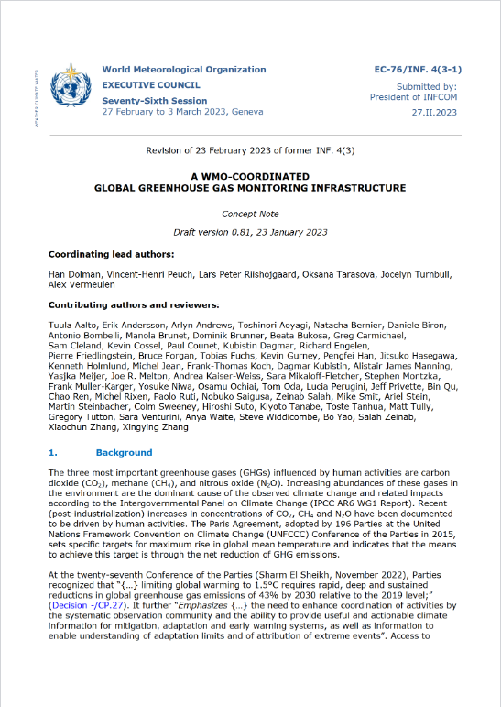
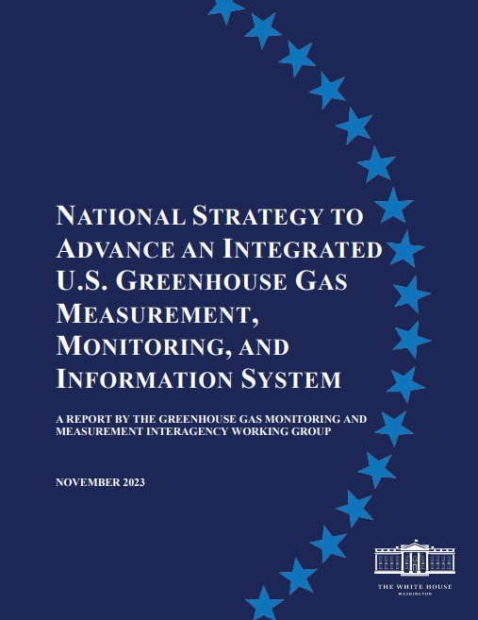
Best practice as an enabler
Build on previous CEOS work on best practises in the public and new space domains and want to partner with key parallel programmes and stakeholders to add value as an underpinning framework to enable reporting in the public and commercial sectors
UNFCCC
CEOS roadmap
UNEP IMEO
WMO G3W
US GHG Centre

Slide 11
COP30 & related engagement
Highlighted in the UK Methane Action Plan (published 29 October), a report outlining UK government’s strategy to reduce methane emissions domestically and globally.
At COP30 in Belem, Brazil
referenced in the first UN Global Methane Status Report 2025 released at COP30
singled out as a highlight at the 2025 Global Methane Pledge Ministerial held on the 17 November 2025, with UK Minister for Climate
Principles echoed in the Third Methane and Other Non-CO₂ Greenhouse Gases Summit co-hosted by Brazil, China, and the United Kingdom (DESNZ Secretary of State)
referenced in the COP30 Earth Information Day (10 November) CEOS statement (63rd SBSTA)

Slide 12
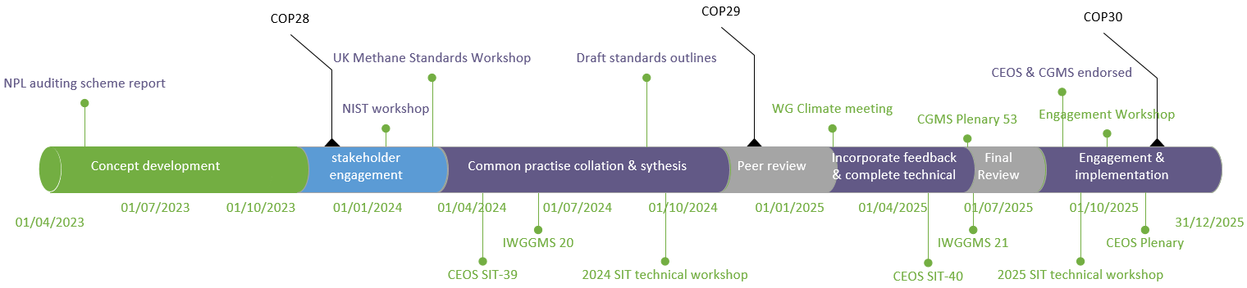
v1.0 Progress and timeline
2024 – outline development & peer review
2025 – detailed completion, peer review & v1 finalization for Summer 2025
v1.0 endorsed by CEOS & CGMS in August 2025
Available at https://ceos.org/publications-key-documents/ and directly at https://zenodo.org/records/17047789

Slide 13
Implementation & engagement
Facility scale / Plume Detected emissions
Implementation plan to develop first adopters –two commercial producers engaged (GHGSat and CarbonMapper) with assessment against common practices underway (followed by others)
Continued engagement with UNEP IMEO in their adoption within the MARS program and beyond
"With CEOS's common practices for satellite-derived plume emission estimates, we now have a shared language for satellite data—a foundation that enables efficient, meaningful exchange of plume-level information. IMEO will adopt these standards for all data providers contributing to our system, so we can continue to provide insights that help the world reduce methane emissions.“ Giulia Ferrini Head of UNEP IMEO
UN Climate & Clean Air Coalition (short-lived climate pollutants initiative) Global Methane Pledge – with representation at the CCAC ‘Methane Action for People & Planet’ conference in Mar/Apr 2025
Representation at the IG3IS ‘IG3IS Stakeholder Consultations and User Summit 2026’ and ‘Guidelines on facility-scale emissions of methane’
Presentation at EGU 2026
Represented at COP-30 via SBSTA statement, UNEP IMEO, ESA and GMP Ministerial engagement
Highlighted in UK Govt Carbon Budget and Growth Delivery Plan Methane Action Plan
Discussion: Future work on implementation, promotion, and encouraging uptake.

Slide 14
Plume-derived emissions (proposed) timeline
2026
2027
v1.0 Implementation to emission products
CarbonMapper & GHGSat
Future… MethaneSat? GEISat? …
Quality Assessment criteria development
Uncertainty quantification studies
ESA MEDUSA / METRICS
Future studies
US / Commercial / Producer studies
L2/L4 intercomparisons
US-led EMIT / EnMAP
Future intercomparisons
ESA MEDUSA / METRICS
CR intercomparisons
Controlled release expt
Stanford controlled flaring
Leak case studies
CEOS database
Best practices
v2.0
Coordination
Synthesis
Review
Publish v2.0
Methane 250
Community workshop
Community workshop
Community workshop
Stakeholder engagement
EGU
SIT-TW
AGU
SIT-TW
WG
climate
IG3IS
2026
IWGGMS
CEOS/IMEO workshop
COP 31
IWGGMS
COP 32
UNEP IMEO

Slide 15
Next steps (in GHG TT roadmap)
Facility scale / Plume Detected emissions
Co-ordination of controlled release validation alongside academic partners
Studies to follow up v1.0 recommendations (and identified gaps)
L2 & L4 intercomparison exercises recommendations
Towards v2.0 (in a few years) to maintain relevance in evolving ecosystem and incorporate on-going studies to more from ‘common practice’ to ‘good practice’- activity progressed by AC-VC and GHG task team.
Area flux mappers
Motivated to provide more useful and accessible routes to use in GST2 (2027), the focus is on a unified offering on country-scale emission estimates.
Draws on existing initiatives OCO-MIP, RECCAP2 etc.
Aim is to quantify, consolidate and (where possible) reduce uncertainties in estimates
Existing finance sector interest alongside academic.
CO2/CH4 may require different approaches – as at different levels of agreement and maturity.

