Slide 1
GHG L2 Validation: Provision of ground-based reference data
Validation of area fluxes
David Crisp (Crisp Spectra)
and David Baker (CSU)
Agenda Item # 4.3b

Slide 2
Objectives
A key objective of space-based XCO₂ and XCH₄ estimates is to quantify CO₂ and CH₄ fluxes (sources & sinks) on regional or national scales
This is done by assimilating XCO₂ or XCH₄ into atmospheric inverse models, along with winds, to estimate the surface fluxes needed to yield the observed GHG anomalies in the presence of the wind field
Validating area fluxes is challenging because they cannot be directly measured over extended areas with ground-based or airborne sensors
  Stack monitors and controlled release experiments constrain GHG fluxes from individual facilities, but not extended areas
  Eddy covariance methods have spatial footprints much smaller than satellites

Slide 3
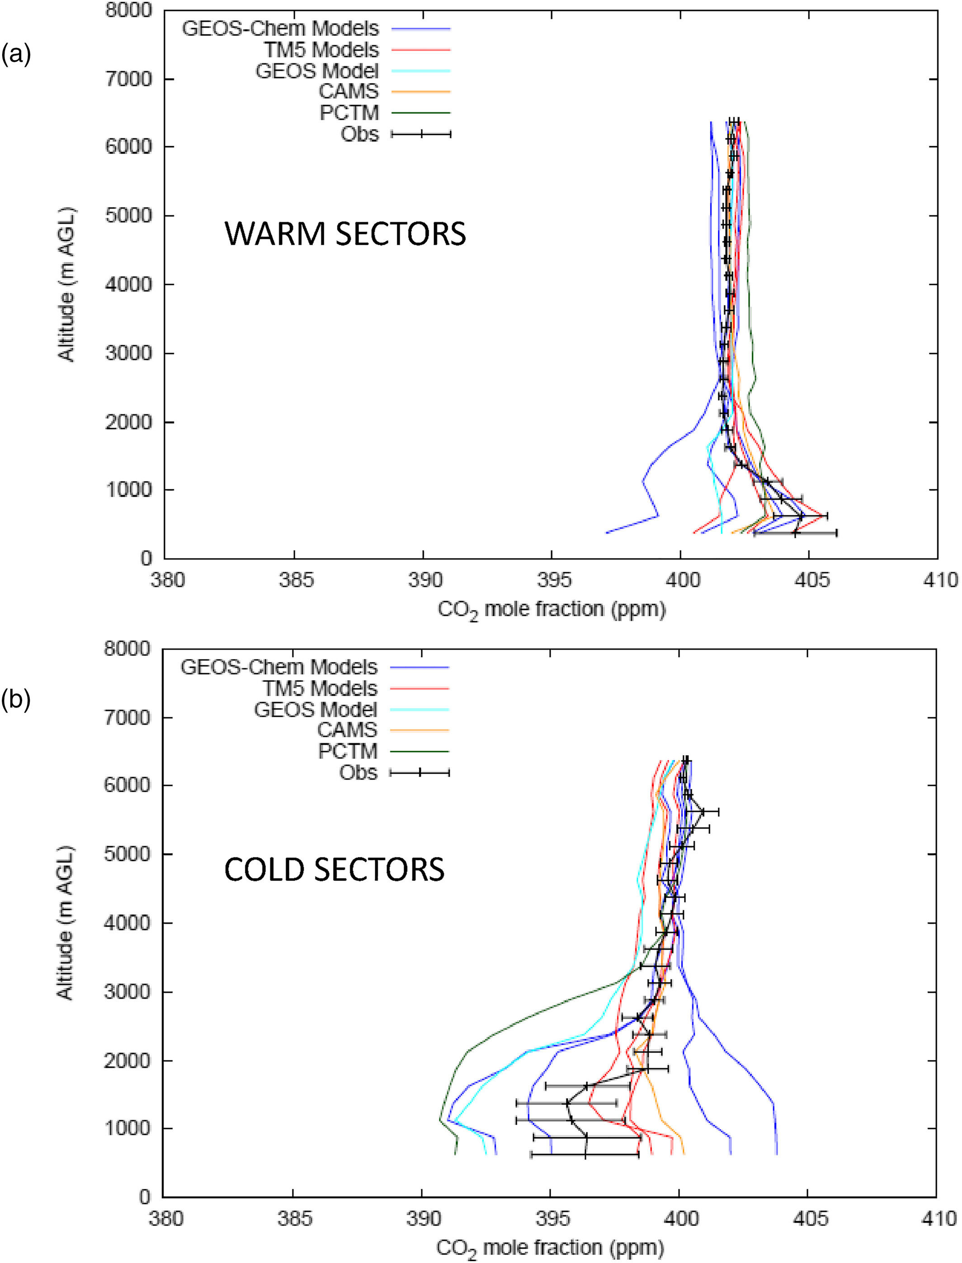
Validating Area Fluxes against Data
Validation of a posteriori CO₂ or CH₄ fields against available surface data and airborne profile measurements
  Strong surface sources generally produce enhanced concentrations near the surface
  Persistent sinks generally produce decreased concentrations near the surface
Principal challenge
  Inverse models with loose prior co-variances can overfit the available (sparse) data
Need – More aircraft profiles over a wider range of source/sink regions
Net source
Net sink
Aircraft CO₂ profiles from the ACT-America campaign (black) are compared to results from several inverse models in source (left) and sink (right) regions. Adapted from Gaudet et al., 2021. doi:10.1029/2020JD033623

Slide 4
Model-to-Model Comparisons
The spread between inverse model results in multi-model intercomparisons (MIPs) provides an indication of uncertainties introduced by model assumptions (e.g., overly tight constraints on ocean fluxes, overly long or short correlation length scales, pre-determined flux patterns within large (Transcom3) regions)
Comparisons of models with different transport schemes (e.g., GEOS Chem vs TM5) reveal the impact of transport on fluxes (e.g., Schuh et al., 2019 doi:10.1029/2018GB006086)
Tracers with well-understood sources (e.g., SF₆) are being used to validate the transport schemes used in atmospheric inverse models
Median Fluxes
Model-to-model standard deviation
Byrne et al., 2023
doi:10.5194/essd-15-963-2023

Slide 5
Prospects and Opportunities
Several CEOS organizations (e.g., NOAA, Copernicus) are exploring ways to increase number, frequency and distribution of aircraft CO₂ and CH₄ profiles
Other approaches (e.g., mesoscale networks of eddy covariance sensors) are needed
Multi-model intercomparisons, like those conducted by the OCO science team are providing new insights into model-to-model comparison methods

