Slide 1
UNFCCC engagement
Session Introduction
Vincent-Henri Peuch, ECMWF
Agenda Item #5.1

Slide 2

Mandate and team
(Open) membership, status 11/2025
Clément Albergel (ESA)
Maggie Arnold (CEOS chair, GA)
Albrecht von Bargen (DLR)
Antonio Bombelli (WMO/GCOS)
David Crisp (via JAXA)
Adrien Deschamps (CNES)
Mark Dowell (EC)
Patrick Gibson (UKSA)
Beth Greenaway (UKSA)
Mariko Harada (JAXA)
Alex Held (CEOS chair, CSIRO)
Susanne Mecklenburg (ESA)
Yasjka Meijer (ESA)
Osamu Ochiai (JAXA)
Steven Ramage (CEOS exec)
John Remedios (NCEO)
Frank Martin Seifert (ESA)
Joerg Schultz (EUMETSAT)
Vincent-Henri Peuch (ECMWF)
Matthew Steventon (CEOS exec, Symbios)
Libby Rose(Symbios)
Harvey Jones (Symbios)
WGClimate 22-24 (Feb. 2025): create Tiger Team for Engagement with UNFCCC with specific tasks to
Ensure consistent preparation for Earth Information Day
Enhancing coordination at key UNFCCC events throughout the year
Contribute to GST strategy process led by SIT chair
Define key objectives for each COP and EID, ensuring that CEOS and CGMS efforts are strategic and aligned with broader climate goals.
Survey agencies to understand their level of participation at each COP (individuals and/or pavilions)

Slide 3
Overview of activities
Principle of twin telcos to allow participation at a „reasonable“ time of the day for all members across the globe. 6 meetings: 6 TT sessions (17 March, 15 April, 27 May, 17 July, 9 October, 5 Feb) and an online workshop with UNFCCC (30 April).
Main discussions/activities:
Refine ToR/mandate (clarify it is time limited, ~18 months) & interaction with GST strategy update process
Organise workshop to stimulate wider collaboration with UNFCCC & follow-up actions
Limited effort on SB-62 (June 2025) in view of stronger coordinated participation to SB-64; in-person meeting of some members in the margins of the sessions
Prepartion contributions to Earth Info Day at COP30

Slide 4
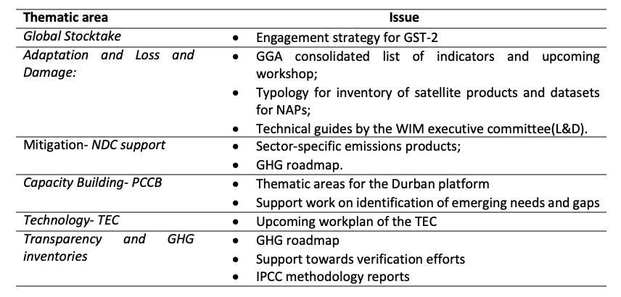
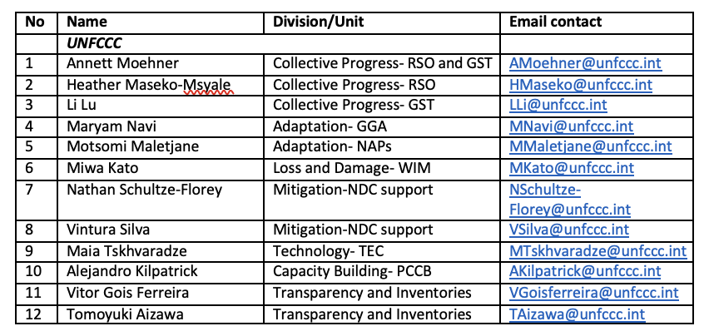
30/04 workshop - Streams of engagement
WGClimate PoCs
Global Stocktake: S. Mecklenburg and O. Ochiai
Adaptation and Loss and Damage: M. Dowell and S. Connors
Mitigation (NDC support): Y. Meijer and V.-H. Peuch
Capacity Building (PCCB): A. von Bargen and S. Ramage
Technology (TEC): J. Remedios and V.-H. Peuch
Transparency and GHG Inventories: O. Ochiai (or someone from JAXA), S. Mecklenburg and Y. Meijer
(Climate finance): ESA interested to connect with UNFCCC on this
Notes:
Yasjka: to ensure a streamlined message across CEOS towards UNFCCC/COP.

Slide 5
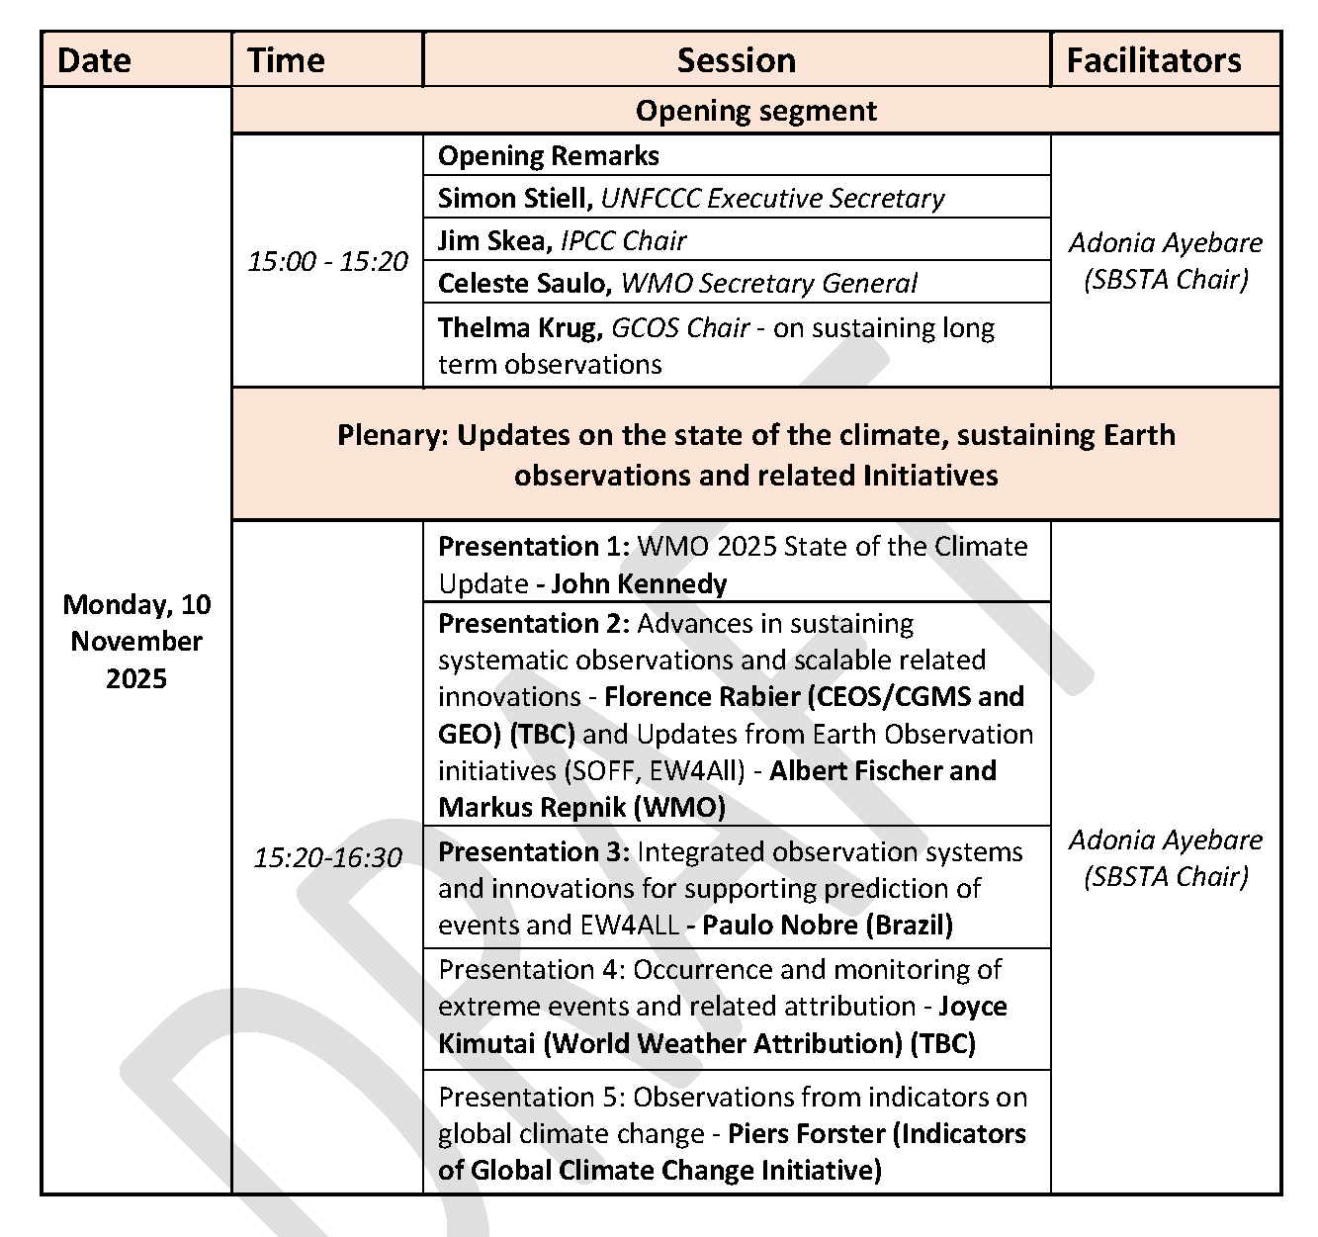
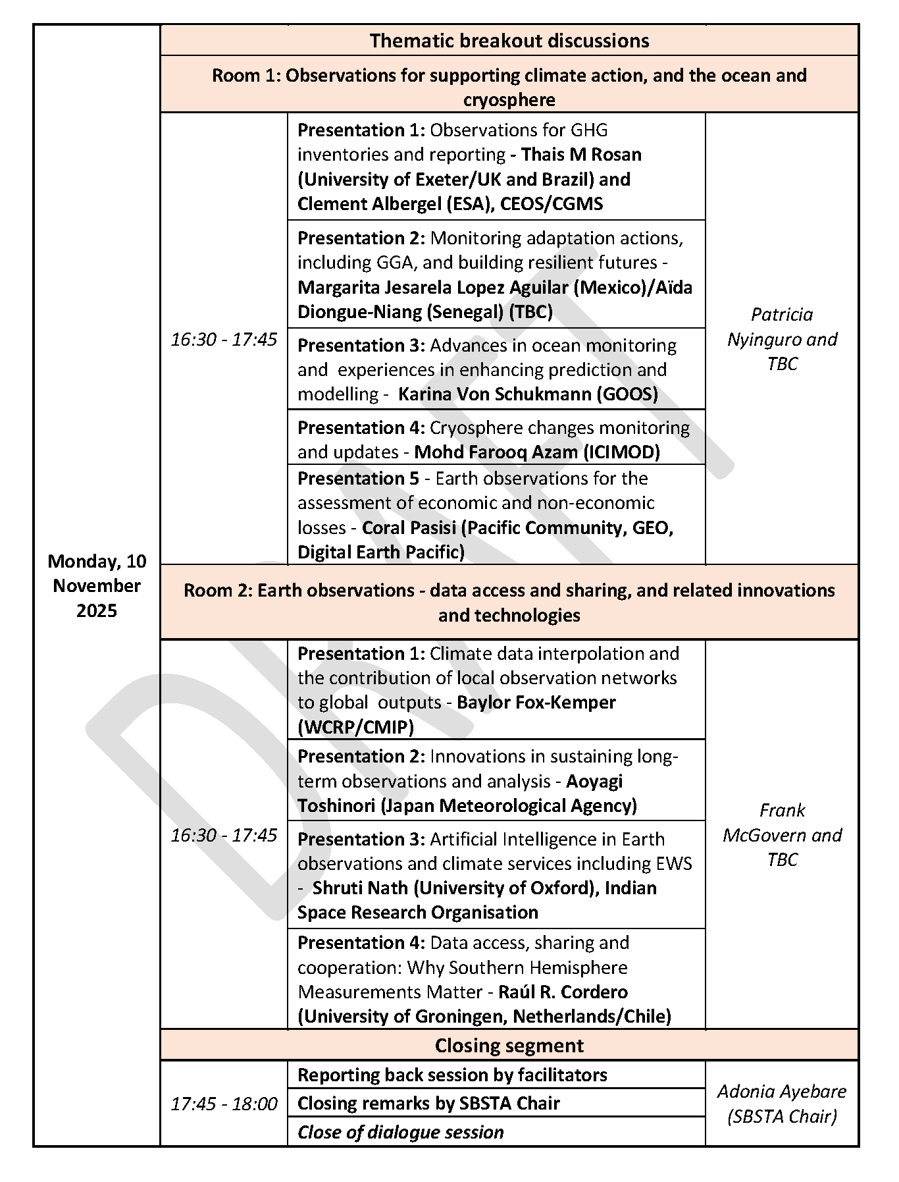
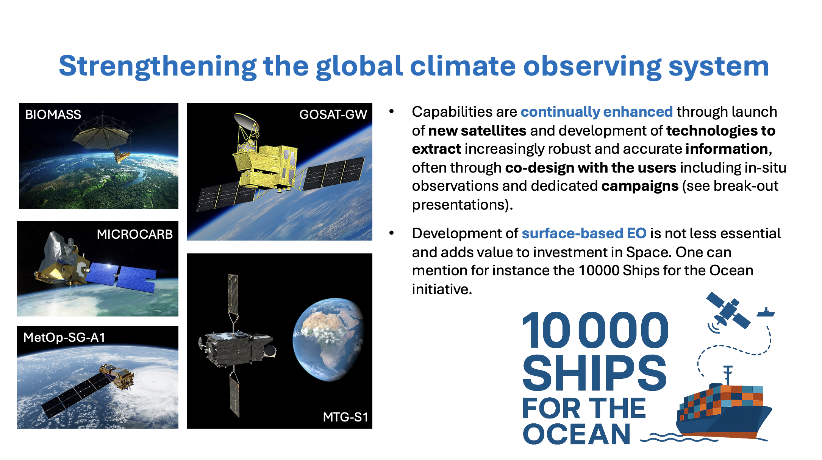
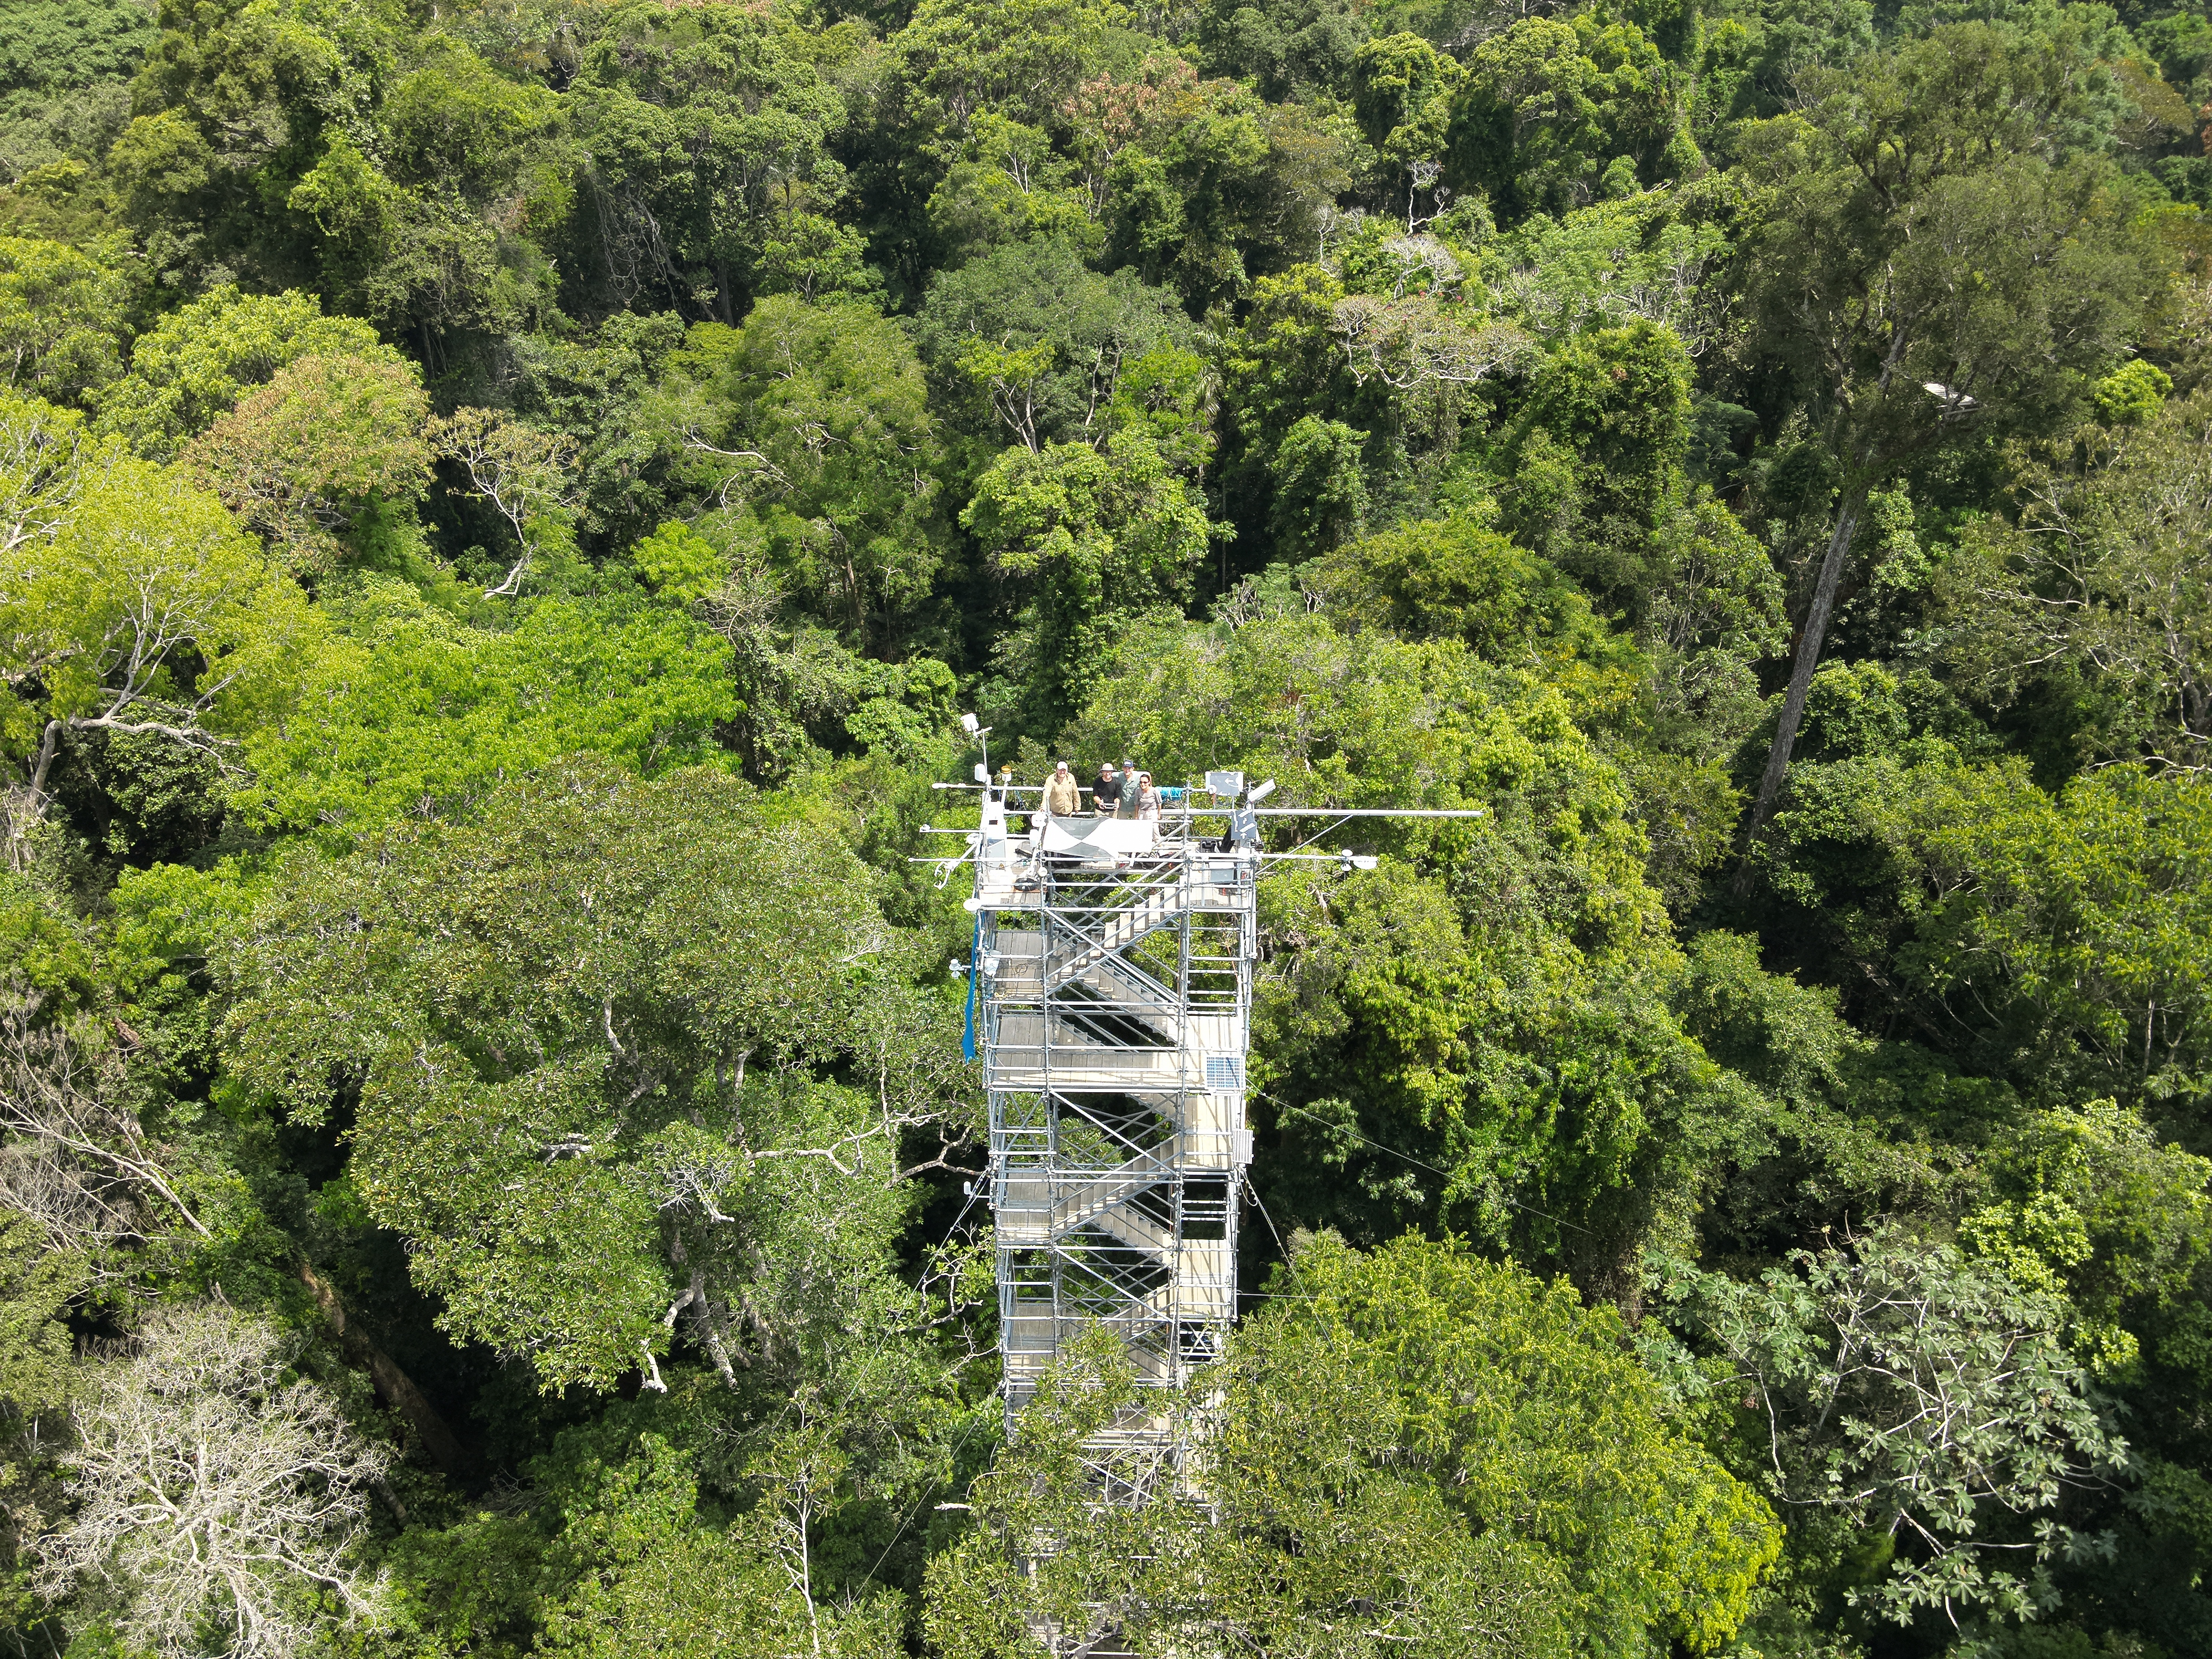
EID COP30 agenda
Plenary presentation joint with GEO and WMO/SOFF around closing data gaps

