Slide 1
COP 30 Outcomes (Systematic Observation)
2026 outlook
CEOS/CGMS Working Group on Climate, 11 February 2026

Slide 2



Research and Systematic observation (RSO) in the UNFCCC processes
Research and Systematic Observation (RSO)
Periodic assessments of collective progress, ambition and action
Cooperation with research and science actors incl the WMO, IPCC, Assessment panels etc
Informs work under the substantive workstreams such as on Adaptation, Loss and Damage, Mitigation, Means of Implementation, Transparency and Cooperation.
Subsidiary Body for Scientific and Technological Advice

Slide 3
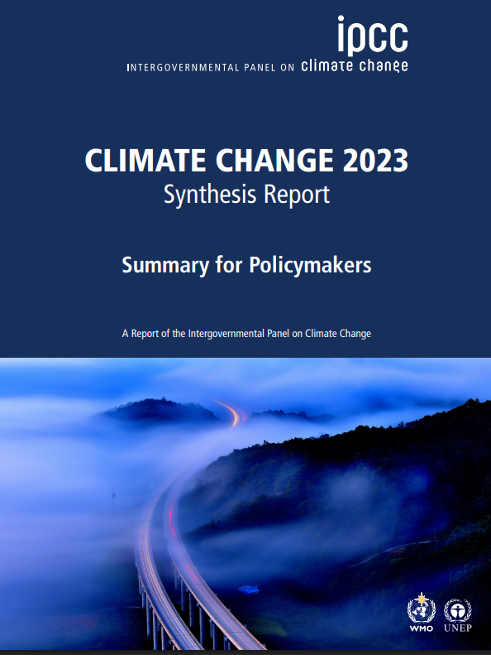
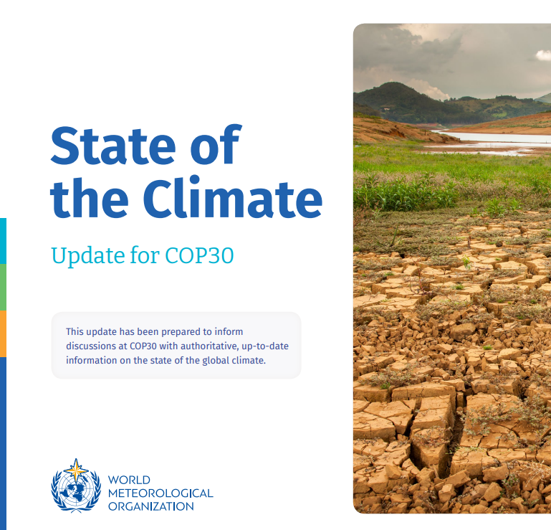
Research and Systematic Observation (RSO)
Directly informs the Paris Agreement and the Convention; providing Best Available Science- Outcomes of assessments and status updates
Provides a platform and supports dialogue between experts including scientific community, Parties and stakeholders on latest scientific research findings and needs
Aims to fill in gaps and strengthen knowledge in our understanding of the climate, system and Earth observations key
Systematic observation of the climate system (ECVs) and early warning systems, in a manner that informs policy, reporting, and action incl climate services,

Slide 4




Pre- COP 30- EID 2025
Submissions- From Parties and Non-Party stakeholders, proposing topics and organization (18 submissions- incl CEOS/CGMS)
Information note – Highlights status and updates from SO community, UN and workstreams under the Paris Agreement and the Convention. Under SBSTA Chair
Coordination call- to harmonize presentations, and align content in response to needs of Parties
Invitation for resources and reference information- To serve as background information to EID and negotiations (Tested at COP30)

Slide 5
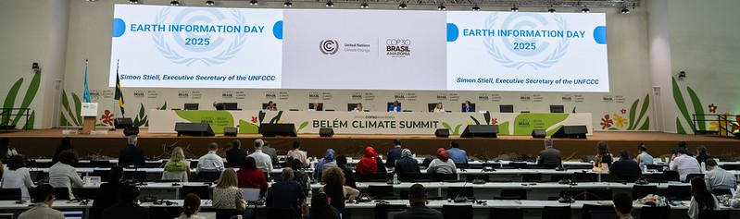
COP 30- EID 2025
Thematic areas are based on submissions from Parties and non-Party stakeholders:
  State of the global climate system and sustaining long-term observations: Concerns on status of GCOS and recurring calls to sustain long-term observations and strengthen data sharing.
  Updates from WMO, GCOS, World Weather Attribution (WWA) and Indicators for Global Climate Chnage (IGCC), CEOS/CGMS and GEO
  Observations for supporting climate action (mitigation, adaptation, and averting, minimizing, and addressing loss and damage), and the ocean and cryosphere; Reflections on opportunities with GGA, inventories and reporting, Ocean monitoring and loss and damage
  Enhancing Earth observations data sharing and access, and related innovation and technologies: Experiences from JMA on long-term observations, CMIP efforts and AI for climate services,

Slide 6
COP 30 Negotiations and Outcomes- SBSTA Conclusions
Importance and value of EO:
  Including sustaining observations and long-term data records, for supporting mitigation, adaptation, loss and damage and EWS, and
  Planning and monitoring, including reporting of GHG emissions and removals (in context of existing inventory guidelines)
  Understanding climate impacts, in planning and monitoring of climate adaptation actions- including GGA
  Assessment , averting, minimizing and addressing of Loss and Damage, and EWS
Status of the global climate system:
Decline in support for observation networks (in-situ and towards GCOS)
  and uncertainty over future satellite missions, and
  Recognized the State of the Global Climate update 2025 and concern over the state of the global climate system (Unique messaging for 2025 report- call to acknowledge inter-annual variability and long-term records vs annual extremes)
  Advances and gaps in attribution science- occurrence, frequency and intensity of extreme events (expanding interest on types and forms of extremes)
Notes:
Highlight the impacts of the threats towards sustaining GCOS to work under the UNFCCC- Including the provision and monitoring of key common- transparent- metrics for monitoring the Earth system and climatic changes. GCOS ECVs also essential during the assessment of progress towards the goals of the Convention and the Paris Agreement. The relevance of climate data, data sharing and related information for EWS.

Slide 7
COP 30 Negotiations and Outcomes cont’d
Observational gaps and support- fianance:
  Address observational gaps in the monitoring of underobserved systems or regions (such as hydrosphere and cryosphere)
  Extending financial support for observations to more developing countries, through SOFF
Cross-cutting areas
  The need for open science and integrity of climate information
  Encourage broad geographic representation of experts.
  Main Mutirao decision references science, keeping warming to 1.5°C and role of BAS

Slide 8
Emerging/recurring and key issues
Status of the observation systems- Particulalry in-situ observation and due to geopolitical shifts and decline in support and expansion for GBON compliance
1.5 °C and overshoot: In the context of the Paris Agreement, information and evidence and during the IPCC inter-cycle period
Understanding attribution: Continued interest in attribution of extreme and slow onset events
ECV rationalization: Implications for the UNFCCC process and for SO community
Role of emerging technologies- particularly AI, machine learning/cloud computing vs integrity of data and services
Geographic coverage and balance- on outputs with high resolution and processes (esp under observed regions) as well as expert engagement
Fit for purpose data/datasets/products/services, and transparency in generation and use- including access and sharing. How to enable dialogue?
Upcoming processes: Systematic support and coordination for contributions towards GGA, GST and Transparency workstreams- increased coordination, dissemination and outreach

Slide 9




2026 outlook
Research related: 18th Research Dialogue, and SBSTA 64 (June 2026)
Earth Information Day 2026 at COP 31 (Submission deadline- August 2026)
What worked? What can be done?
Systematic engagement, including with thematic workstreams (requiring follow-up)
Collaboration on messaging for SBSTA and COP incl foresight and with Parties
Expert contributions (through submissions-topics, infor note and as presenters
UN-wide coordination, e.g. on data governance
SBSTA 65 with a focus on systematic observations- Priority areas to be defined in advance
GST to commence at COP 31/CMA 8, Note timelines for submissions to be ably considered during technical dialogue (3months prior to commencement)

Slide 10
Hmaseko@unfccc.int

