Slide 1
CEOS/CGMS Engagement with UNFCCC

Slide 2
Monitoring Collective Progress
High-resolution, global, space-based measurements provide transparent, accessible information that could be used for assessing collective progress toward the goals of the Paris Agreement
Global observations of climate change, including changes in land and sea surface temperature, ice cover, sea level rise, ocean transport, precipitation, soil moisture, groundwater, and severe weather
Time-resolved measurements of greenhouse gas emissions by sources & removals by sinks on spatial scales varying from individual large facilities to nations
Land use maps, monitoring changes associated human activities (urbanization, deforestation/afforestation, agriculture) and climate change (drought, floods, fire)
Data for assessing the evolving needs for climate resilience, hazard mitigation and progress toward sustainable development

Slide 3
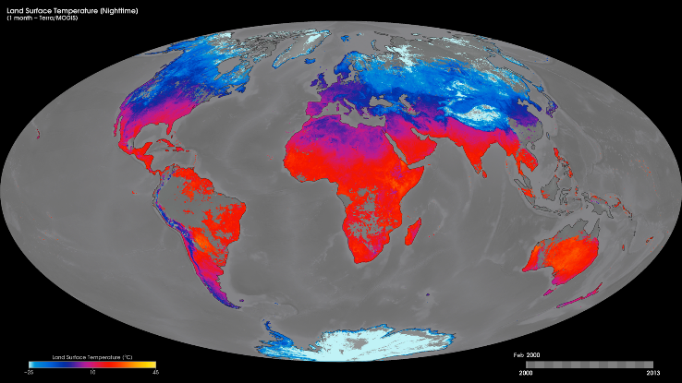
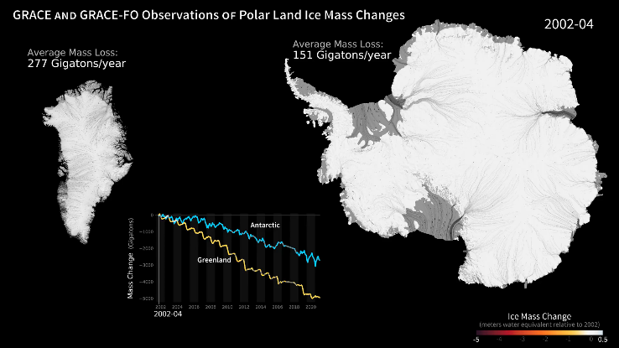
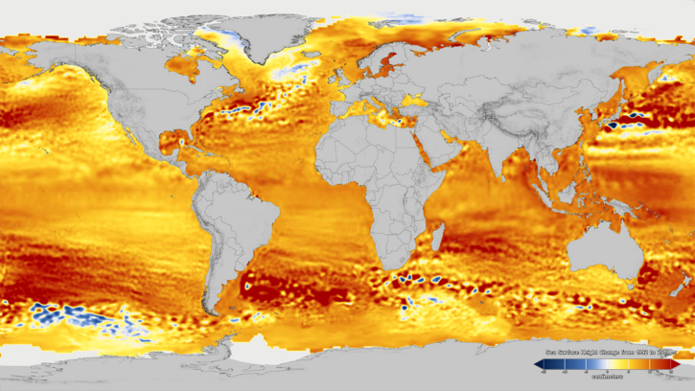
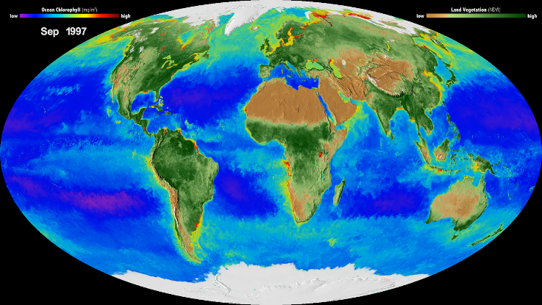
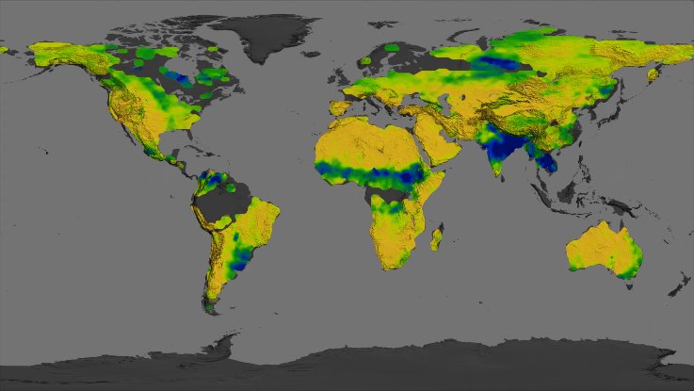
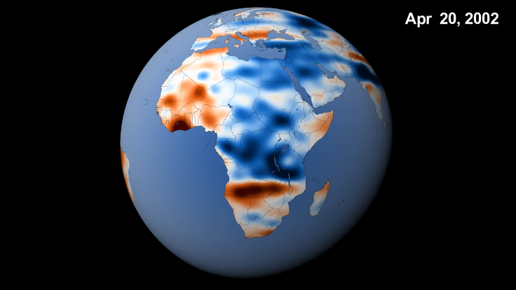
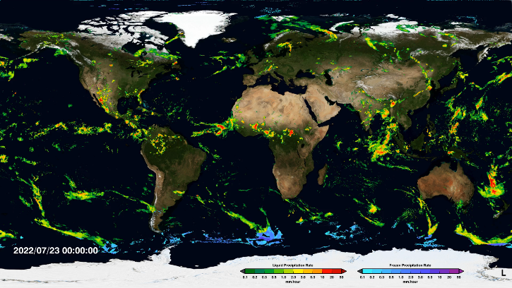
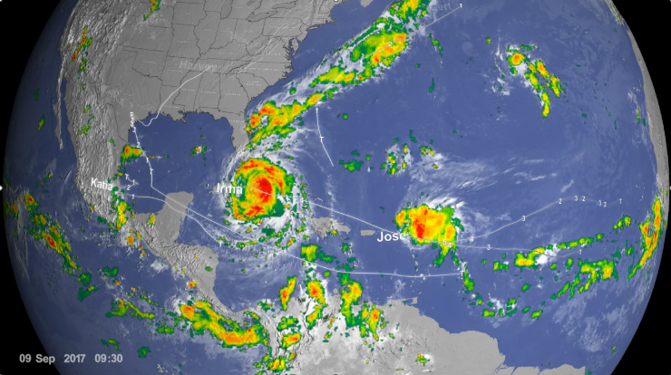
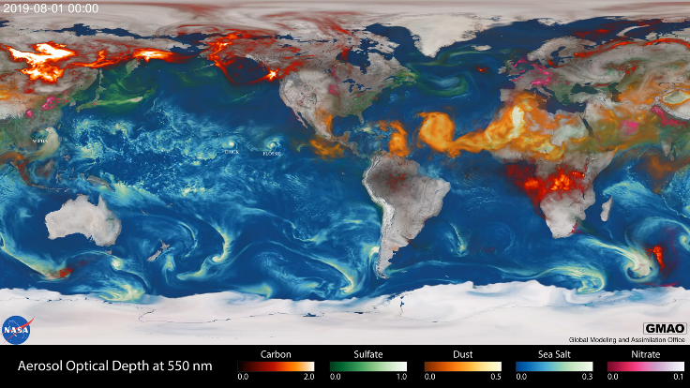
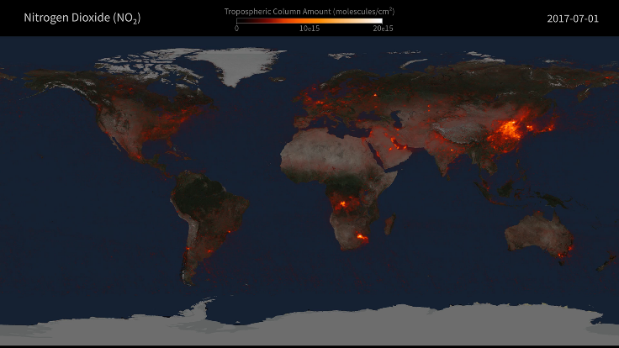
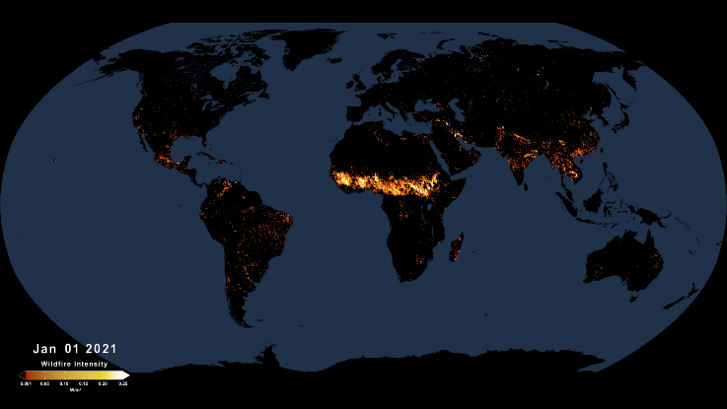
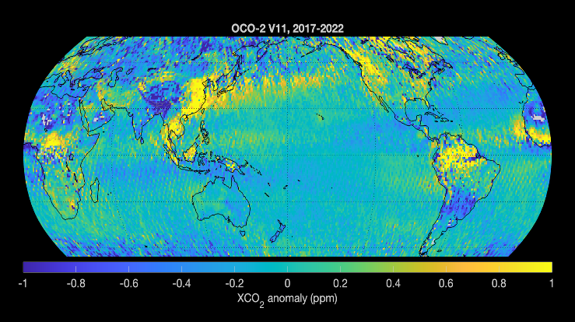
Space-based Measurements
Land Temperature
Land Cover/Productivity
Ice Cover
Sea Level
Severe Weather
Soil Moisture
Precipitation
Surface Water Storage
Aerosols/PM2.5
NO₂ - Pollution
Fire
Carbon Dioxide

Slide 4
Supporting Mitigation and Transparency
Space-based measurements provide increasingly precise, accurate and transparent information on the principal drivers of climate change
High-resolution land surface imaging provides information about land use & land use change, providing activity data needed for developing bottom-up inventories
Measurements of above-ground biomass monitor changes in land carbon stocks, providing additional activity data as well as insights into emission factors on regional scales, supporting the development and assessment of bottom-up emissions inventories of land carbon emissions & removals
Spatially-resolved, global measurements of carbon dioxide (CO₂) and methane (CH₄) provide time-resolved budgets of the net emissions and removals of the two greenhouse gases that responsible for more than 90% of the observed temperature change

Slide 5
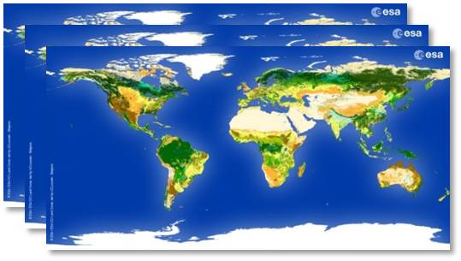
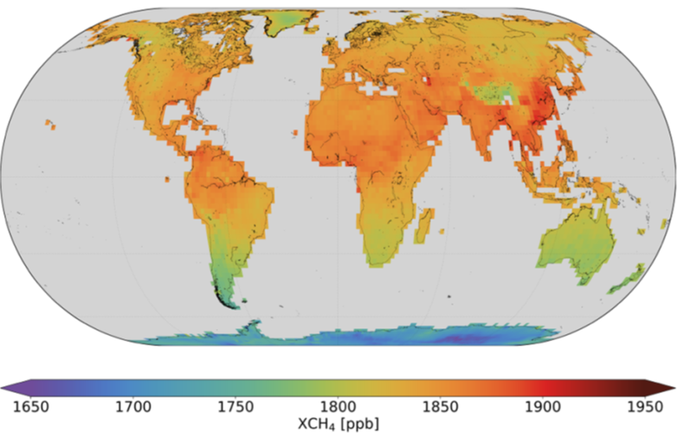
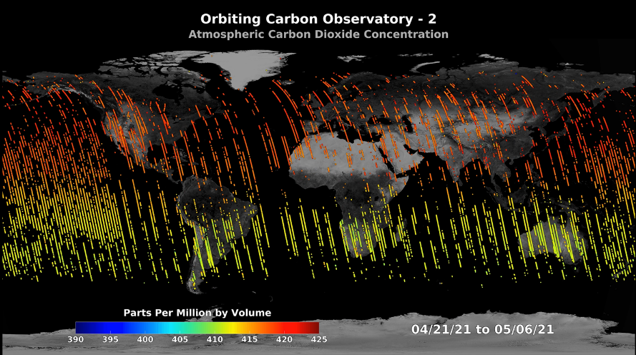
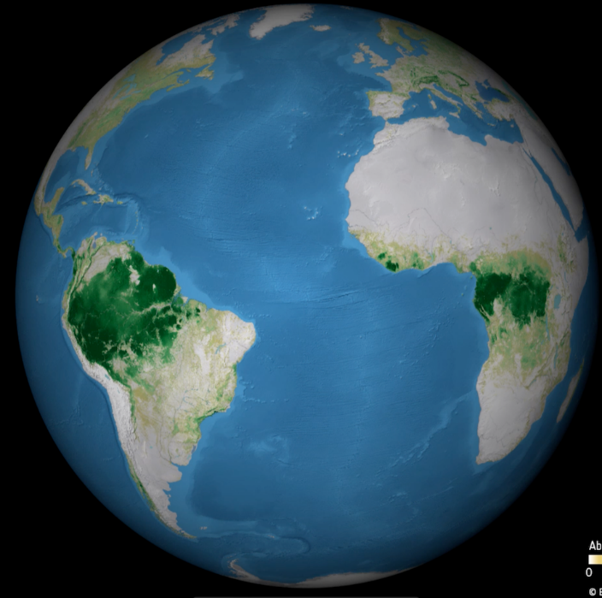
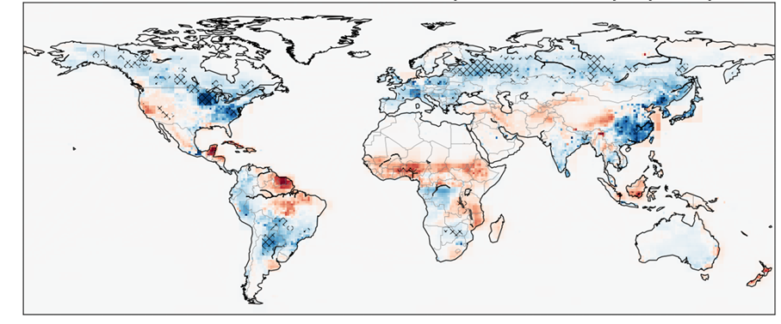
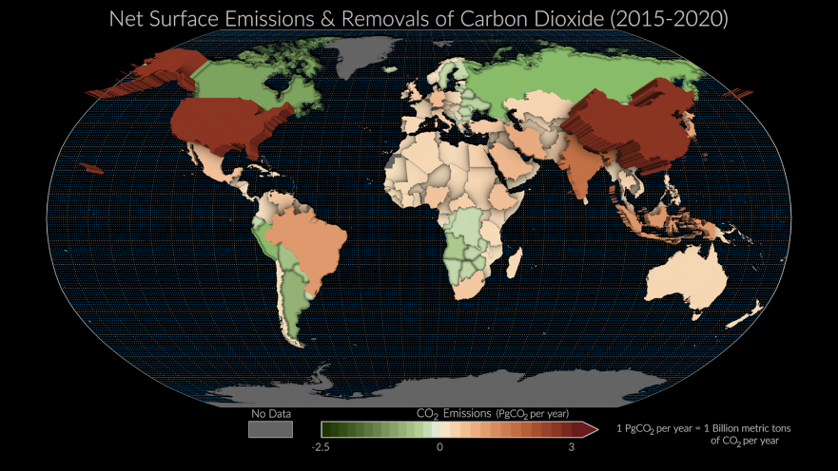

Space-based Support for Inventories
CO₂ Observations (OCO)
CH₄ Observations (S5p)
Land Cover maps (ESA CCI)
Above-Ground Biomass
Land Net Carbon Fluxes
Net Sources + Sinks

