Slide 1
Future workshop with
Asian Inventory compliers
NIES GIO’s efforts in Asia
Hiroshi Tanimoto, NIES
Agenda Item 5.7

Slide 2

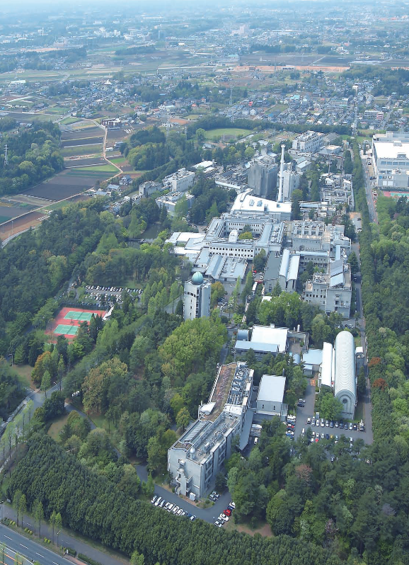





NIES Earth System Division
Earth System Division
Biogeochemical Cycle Section
Global Atmospheric Chemistry Section
Atmospheric Remote Sensing Section
Satellite Remote Sensing Section
Climate Modeling and Analysis Section
Earth System Risk Analysis Section
since 1974
since 2016
since 1990
SOC
(Satellite Observation Center)
CGER
(Center for Global Environmental Research)
Office for Atmospheric & Oceanic Monitoring
Office for Terrestrial Monitoring
Office for Global Environmental Database
Global Carbon Project Tsukuba Int’l Office
Greenhouse Gas Inventory Office of Japan
Japan GHG Center (provisional) Office
https://esd.nies.go.jp/en/

Slide 3
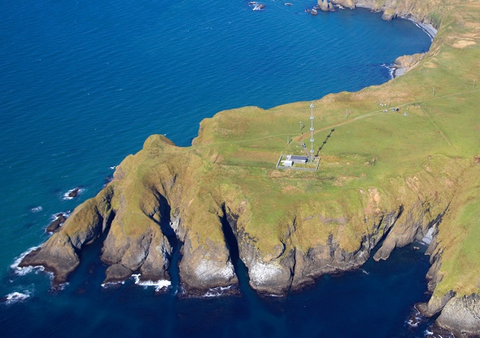
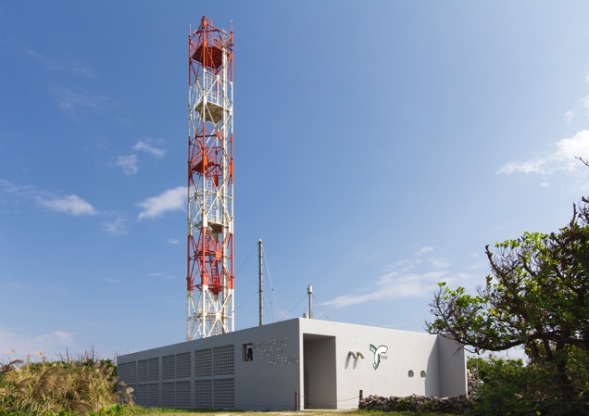
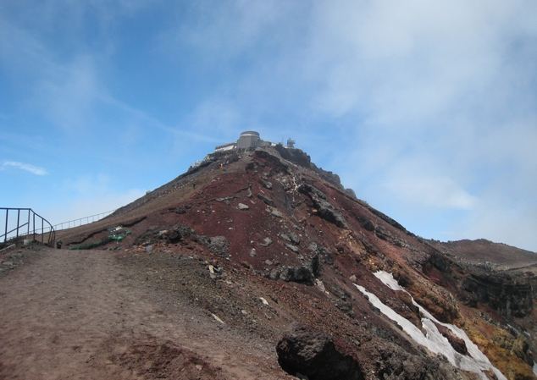
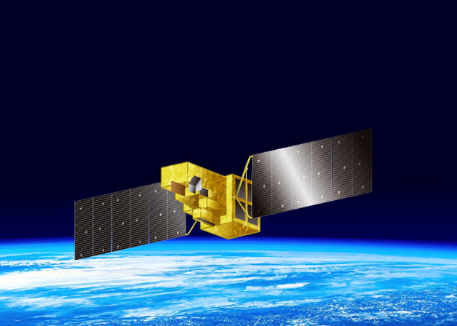
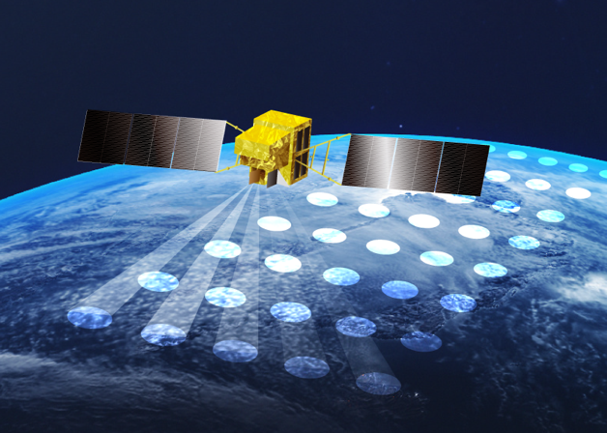
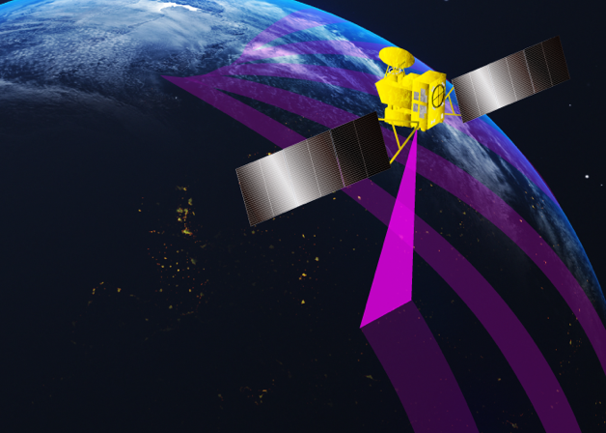
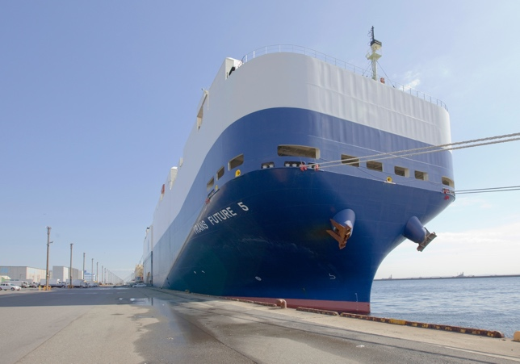
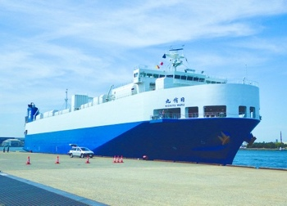

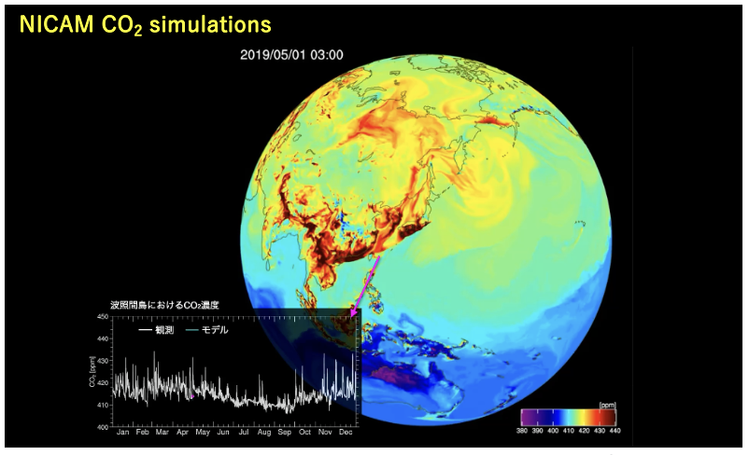
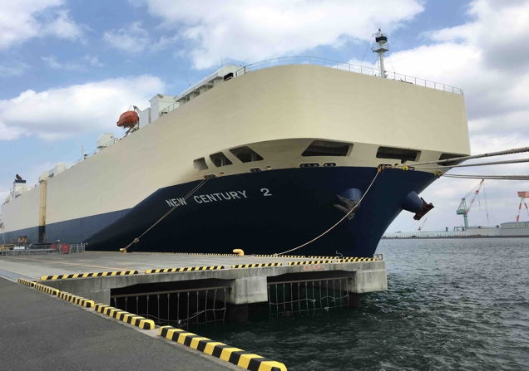
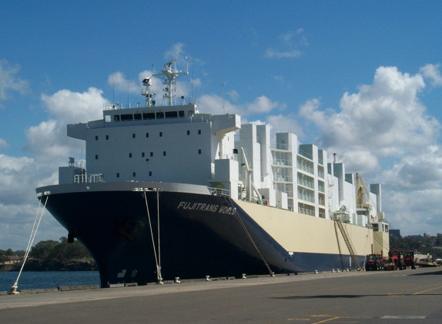
NIES Earth System Division
ground
satellite
©nies
©nies
©nies
©nies
©nies
©nies
Cape Ochi-ishi
Hateruma Island
Mt. Fuji Weather Station (NPO)
GOSAT
GOSAT-2
GOSAT-GW
ship
©日本航空
aircraft
航空機
©nies
©nies
TRANS FUTURE 5
NICHIYU MARU
©nies
NEW CENTRY 2
Niwa et al., Prog. Earth Planet. Sci., 2022
FUJITRANS WORLD
©nies

Slide 4


NIES Earth System Division
Earth System Division
Biogeochemical Cycle Section
Global Atmospheric Chemistry Section
Atmospheric Remote Sensing Section
Satellite Remote Sensing Section
Climate Modeling and Analysis Section
Earth System Risk Analysis Section
since 1974
since 2016
since 1990
SOC
(Satellite Observation Center)
CGER
(Center for Global Environmental Research)
Office for Atmospheric & Oceanic Monitoring
Office for Terrestrial Monitoring
Office for Global Environmental Database
Global Carbon Project Tsukuba Int’l Office
Greenhouse Gas Inventory Office of Japan
Japan GHG Center (provisional) Office
since 2002
https://esd.nies.go.jp/en/

Slide 5
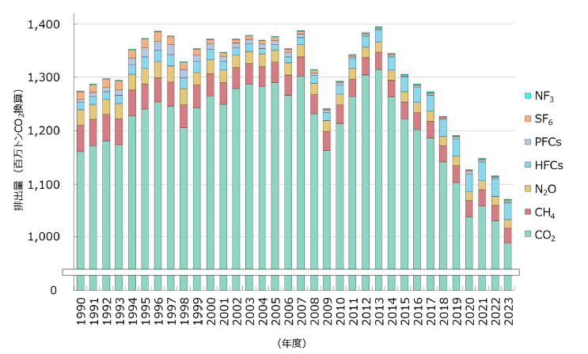
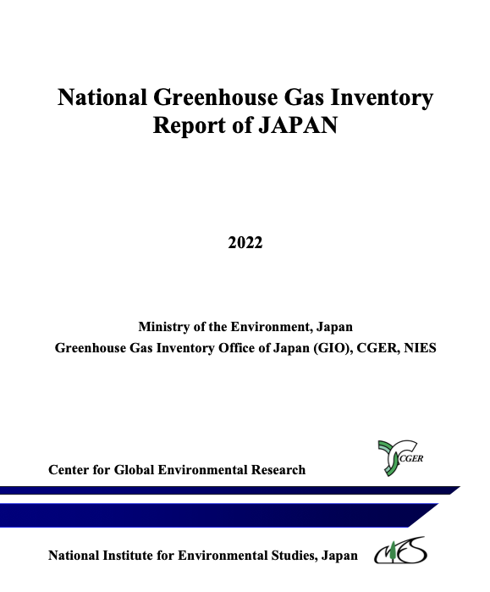
Greenhouse Gas Inventory Office
Released, 25 April 2025
Emissions (million CO2 eq)
1017 million ton CO2 eq. (incl. CO2, CH4, N2O, HFCs, PFCs, SF6, NF3)
4% decrease from 2022 to 2023; 27% decrease from 2013 to 2023
https://www.nis.go.jp/whatsnew/20240425/20240425-e.html

Slide 6
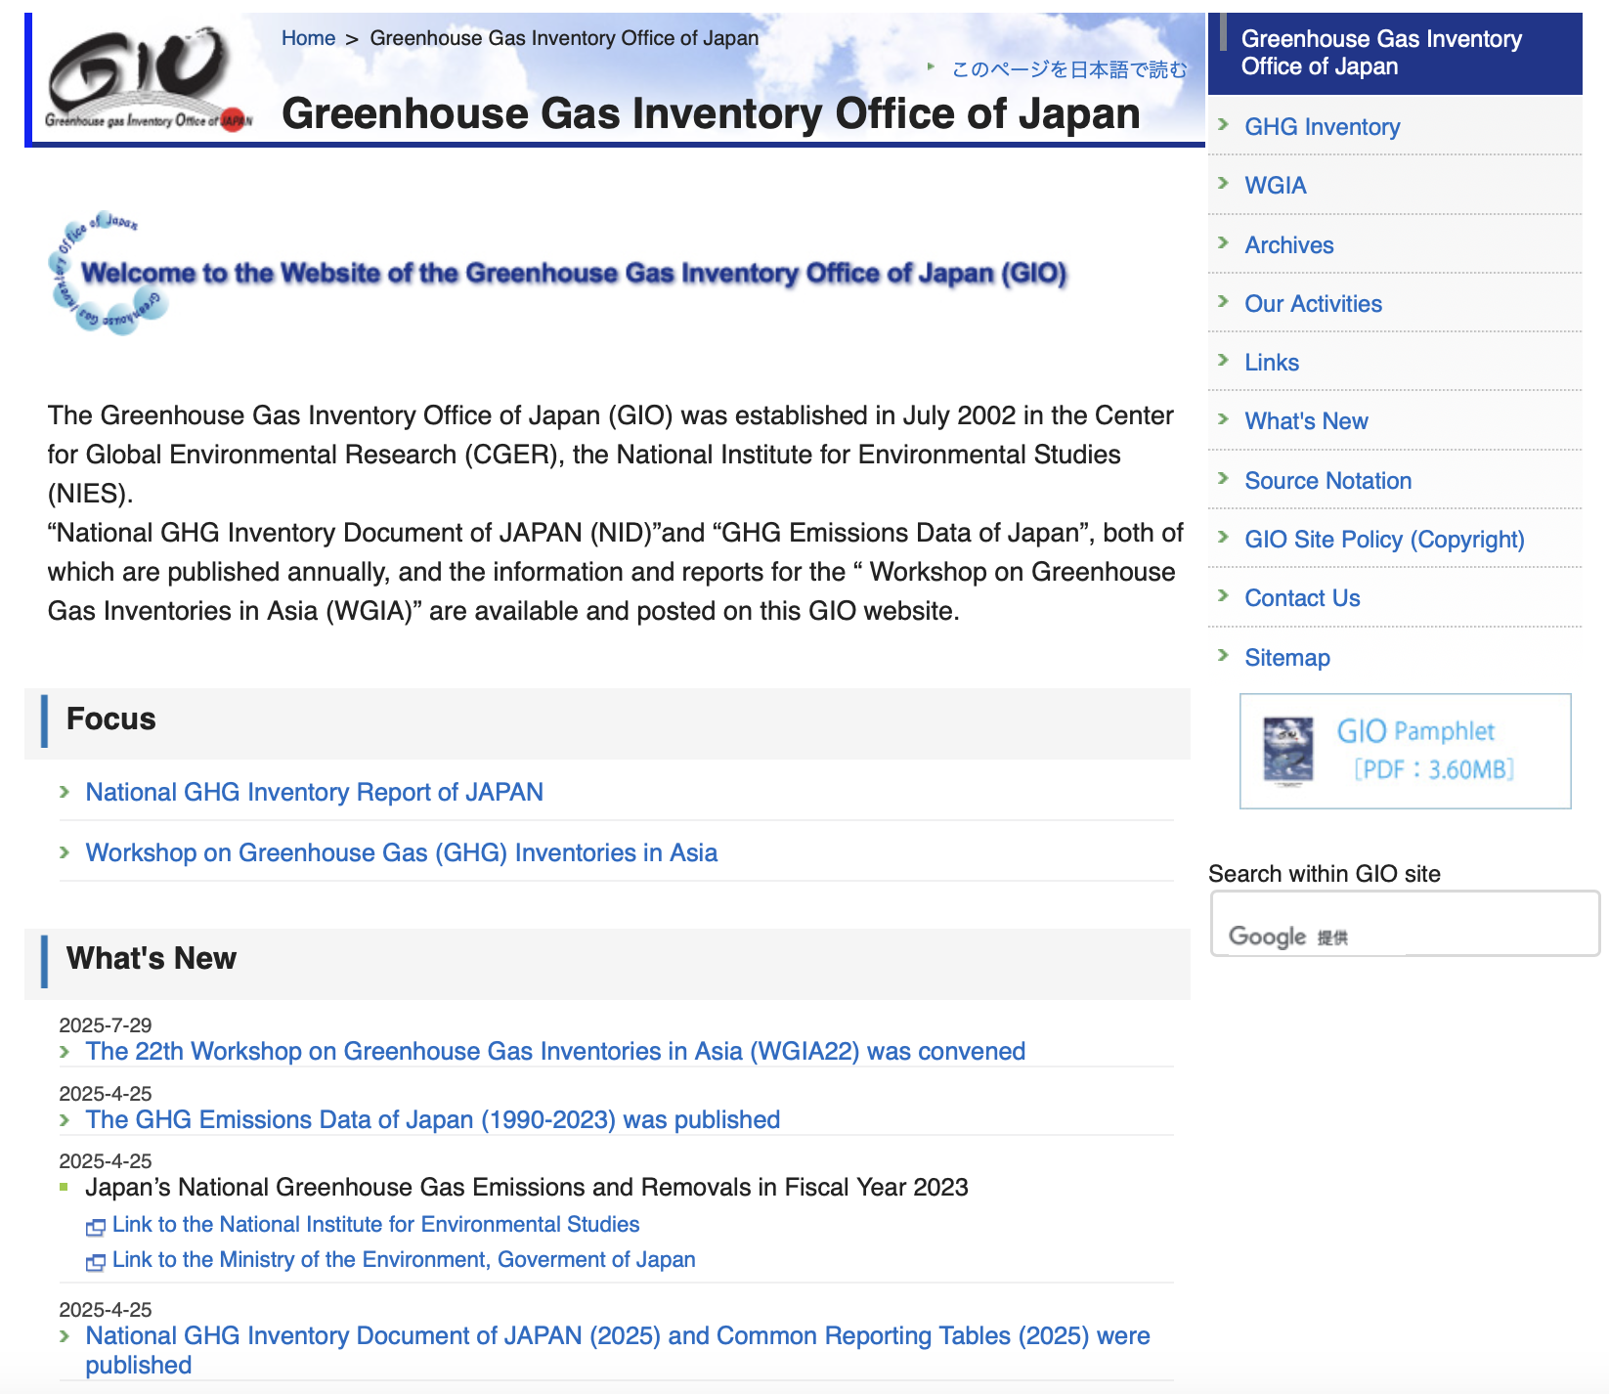
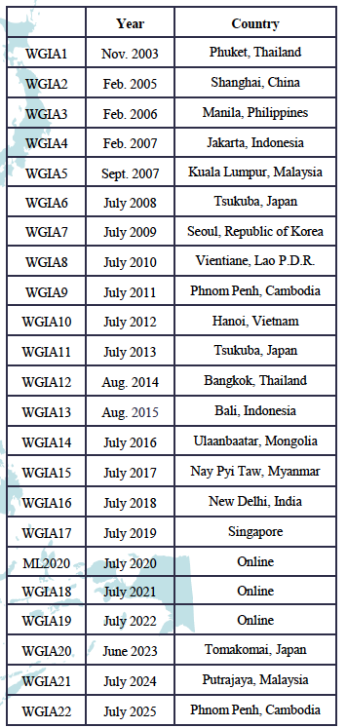
Workshop on Greenhouse Gas Inventories in Asia
https://www.nies.go.jp/gio/en/

Slide 7
WGIA Overview
Annually hosted by NIES and MOEJ (Ministry of the Env., Japan) since 2003
With the aims at assisting countries in Asia to improve the quality of their GHG inventories and build capacity for the inventory preparation by promoting the exchange of information and experiences obtained in the region
Member countries: Bhutan, Brunei, Cambodia, China, India, Indonesia, Japan, the Republic of Korea, Lao PDR, Malaysia, Mongolia, Myanmar, Philippines, Singapore, Thailand, and Vietnam
Visions
  Continually contributing to capacity building in GHG inventory preparation
  Making a strengthened network for improving GHG inventories of countries in Asia
  Enhancing collaboration with other projects related to climate change

Slide 8
Outcomes since 2003
Established a network platform to exchange information on climate change, mitigation measures and GHG inventories
Identified common issues and exploring possible solutions
Shared information on each country’s activities and experiences
Shared updated information on member countries’ status of inventory development and improvement
Improved inventories through exchanging information on methodologies and institutional arrangements, such as applying advanced estimation methods and conducting key category analysis, uncertainty assessment and quality assurance/quality control (QA/QC)
Improved inventories by learning from another country’s inventory through mutual learning

Slide 9
Workshop Format
Plenary Sessions: Exchanging information on inventory-related issues, reporting member countries' progress made in the latest BTR including national GHG inventory, and holding discussions on the TER of BTRs, etc
Breakout Groups: Discussing sector-specific issues etc. and possible ways to solve them
Mutual Learning: Improving inventories by learning from other countries’ inventories, including data, through exchanging questions and comments
Hands-on-training: Performing calculation using the IPCC Inventory Software for some categories, etc.

Slide 10
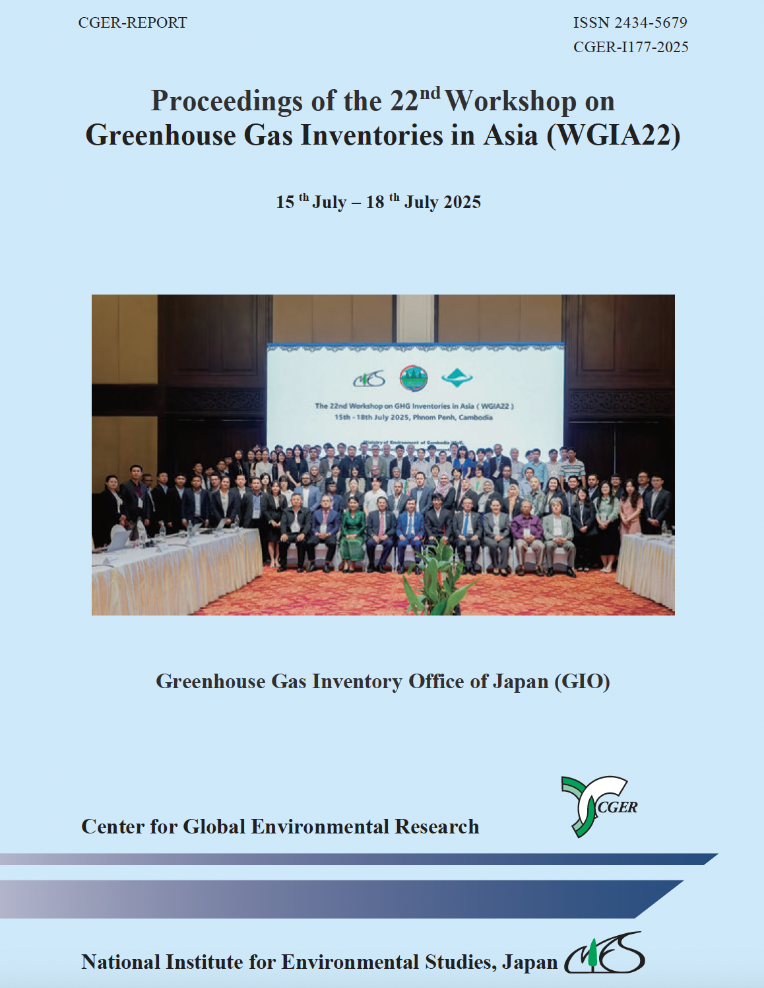
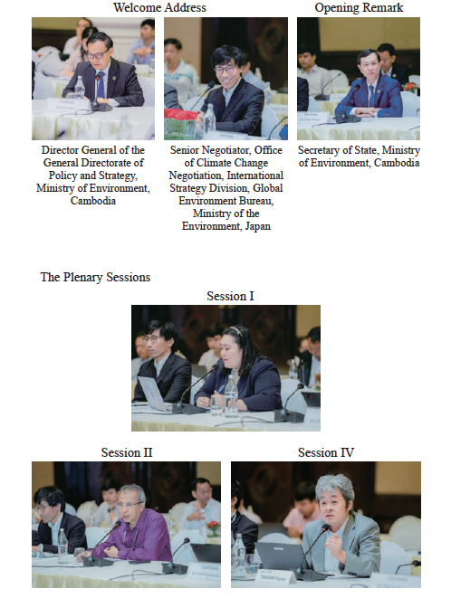
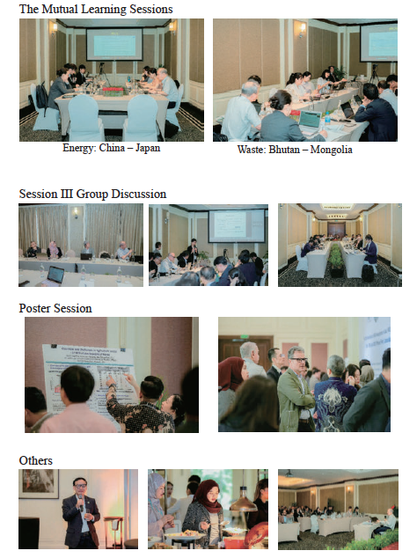
WGIA22 in 2025
Mutual Learning
Breakout Groups
Plenary Sessions
Posters

Slide 11
WGIA22 in 2025
144 participants from 15 countries
MOEJ, NIES
Representatives from IPCC TFI, UNFCCC Secretariat, FAO Secretariat
MAFF, Japan, NARO, Japan
Plenary discussions
  Updates on the GHG Inventory of BTRs
  Estimation Methodology and Data for Agriculture
  Discussion on the ETF GHG Inventory Reporting Tool
  Technical Expert Review and Support Available
BTR: Biennial Transparency Report
ETF: Enhanced Transparency Framework

Slide 12
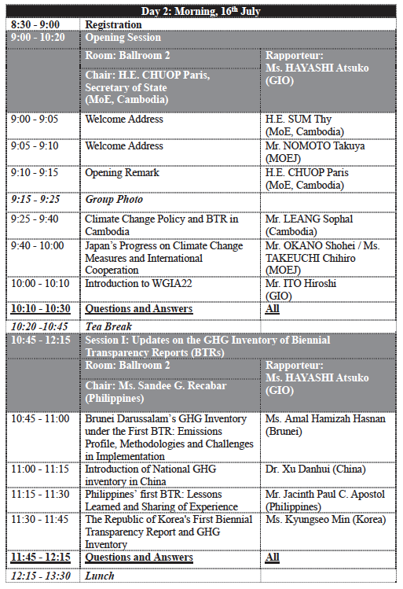
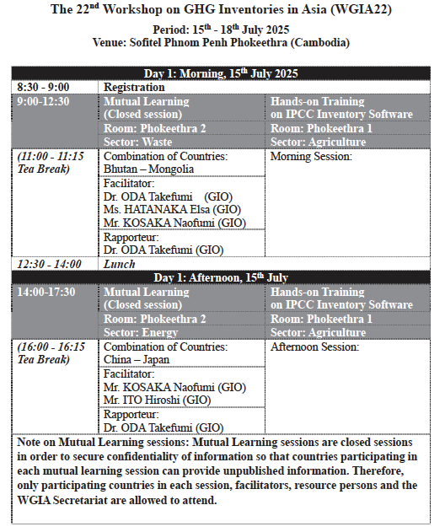
WGIA22 in 2025
Day 2 am
Plenary Sessions
Day 1
Mutual Learning
Hands-on-training

Slide 13
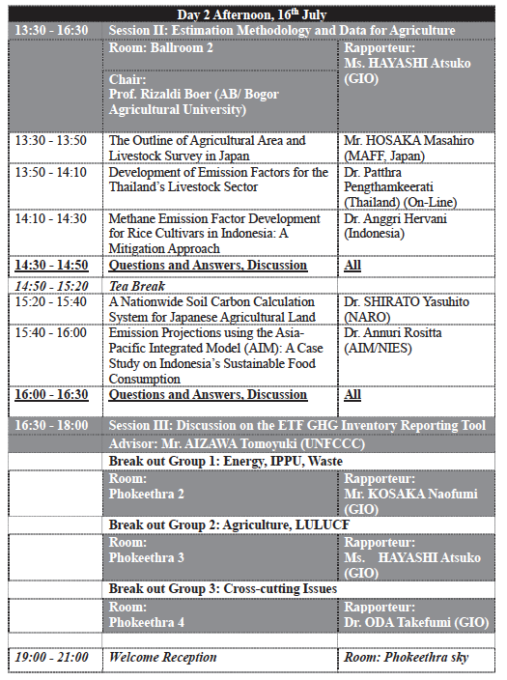
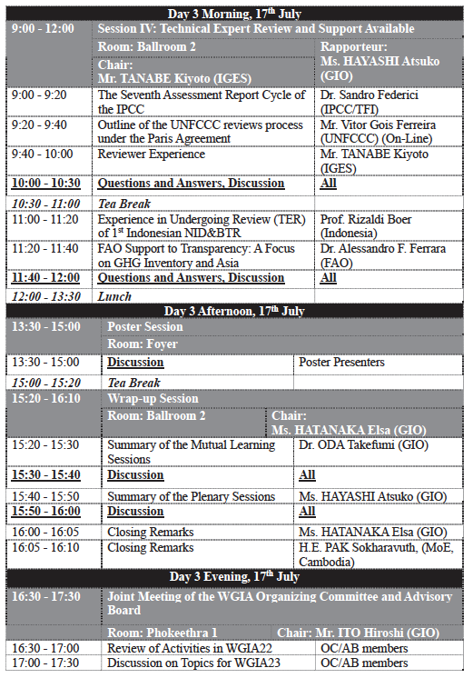
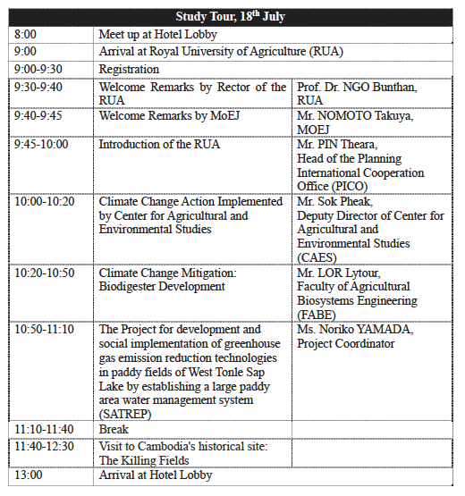
WGIA22 in 2025
Day 2 pm
Day 3
Day 4
Plenary Sessions
Plenary Sessions
Study Tour
Posters
Breakout Groups
Wrap-up
Reflection/Next

Slide 14
WGIA23 planned in 2026
Draft proposal
  Early August, 2026?
  Bandar Seri Begawan, Brunei?
Decision pending upon the FY2026 budget approval
More info in April 2026
NIES hosts one of GCP International Offices (social science), generally in close contact with Pep Canadell
Will be co-led by Yosuke Niwa/Shin Nakaoka beginning in 2026
Should we also discuss with GCP for coordination?

