Slide 1
2026 CEOS Chair Activity
Positioning CEOS for Success in a Rapidly Changing Context
Credit: USGS/NASA Landsat 8

Slide 2
CEOS Chair 2026
Team Australia - “three for the price of one”
  CSIRO - Chair Team Lead, CEOS Chair: Dr Alex Held
  With Geoscience Australia and the Bureau of Meteorology
Headline Theme:
Positioning CEOS for Success in a Rapidly Changing Context
Two focus activities:
  Information Products on Satellite EO and CEOS Support to Adaptation and Resilience
  Updated CEOS ARD Strategy - Ensuring CEOS ARD is Fit for the Future

Slide 3
CEOS Support to Environmental Adaptation and Resilience
Prepare information products that support Principals at the 2026 Plenary to strategically consider the role CEOS is playing, and can play, in supporting societal adaptation and resilience in the face of environmental change
  Multiple drivers of such change
  Applications rely on access to, and ability to integrate, multiple datasets at different spatial scales
    In particular at local scales.
  A lens through which to explore CEOS’s role in the EO ecosystem and value chain, including threads around commercial sector engagement and scalability of demonstrators/pilots
  Relevant across many parts of CEOS, as evidenced by efforts to date

Slide 4
Inward Focus: Challenges & Opportunities
Collation and analysis of challenges and opportunities that support Principals to consider strategic topics such as:
  Where can CEOS get the greatest ‘bang for buck’ and add the greatest unique value?
  Do we have the right partnerships? Are we leveraging existing partnerships effectively?
  Are existing CEOS activities/efforts connected and aligned to support greatest impact?
Key sources:
  CEOS’s efforts and experiences, e.g. WGDisasters, COAST-VC, GST Strategy, Biodiversity Study Team, Agriculture, etc
  Synthesis of issues and themes arising from the case study capture and analysis process

Slide 5
Outward Focus: EO Handbook
Supporting ESA in developing the 2026 EO Handbook
  See item 6.4

Slide 6
CEOS Chair Highlight Topics
Antarctica Plenary Experience
  Opportunity to deepen the CEOS community’s connections with polar issues through in-person engagement with leading experts with lived experience
  Leverage Plenary in Hobart, Australia’s gateway to Antarctica
Water Quality Workshop
  Joint Chair and SIT Chair demonstration of EO based methodologies for water quality, with a focus on how these methodologies could fill the gaps identified in the Adaptation and Resilience chair theme.
  How to transform EO archives into actionable water quality insights to support adaptation strategies.
CEOS in Schools Sessions
  Continue legacy of the 2025 UKSA CEOS Chair

Slide 7

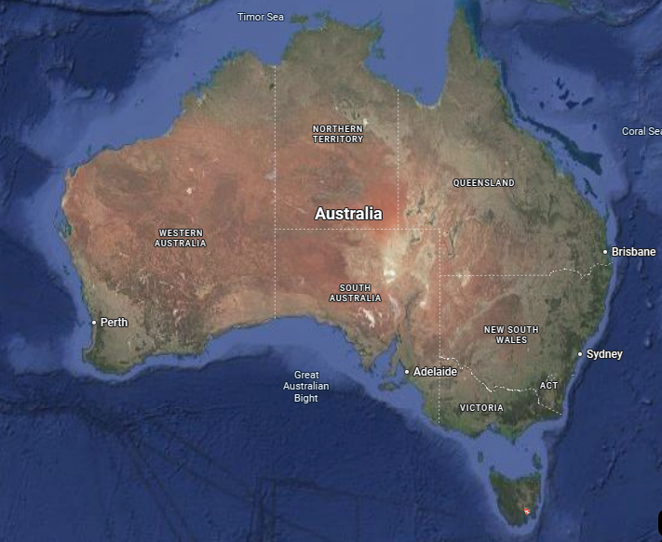
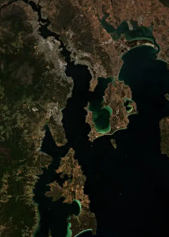

40th CEOS Plenary
3-6 November 2026
Hobart, Australia
Antarctica
Venue: Hotel Grand Chancellor
Credit: European Union Sentinel-2

