Slide 1
GGA Indicators measurable via space-based observations
Mark Dowell
European Commission, JRC
Agenda Item # 2.4

Slide 2
WGClimate efforts on Adaptation
WGClimate:
GST1 Startegy didn’t really address
New GST2 Startegy has some specific recommendation
Other part of CEOS have relevant activities e.g. ARD
Use Cases Typology Indicators & Target

Slide 3
GST2 Startegy: Requirements & Emerging Actions for Adaptation and Resilience
CEOS should showcase adaptation use cases that employ EO data. Establish a repository of successful examples where EO has been applied to support adaptation actions across various sectors (e.g., agriculture, urban planning, disaster risk reduction, ecosystem management). These case studies, potentially drawn from agency-led projects, would demonstrate the value and feasibility of using EO for adaptation and encourage wider adoption
CEOS should enhance discoverability of adaptation-relevant Climate Data Records (CDRs). This involves improving access to information about existing data records, focusing on thematic indicators relevant to climate impacts and resilience. It also includes an adaptation-focused analysis of gaps in the ECV inventory. These efforts should promote the use of ARD principles to enhance utility of EO products for national reporting systems​
CEOS should map ECVs and other amenable EO products to GGA indicators, documenting potential EO products and services and their links to the indicators being developed and adopted for tracking progress under the Global Goal on Adaptation. This should also promote the use of ARD principles to enhance usability for national reporting systems

Slide 4

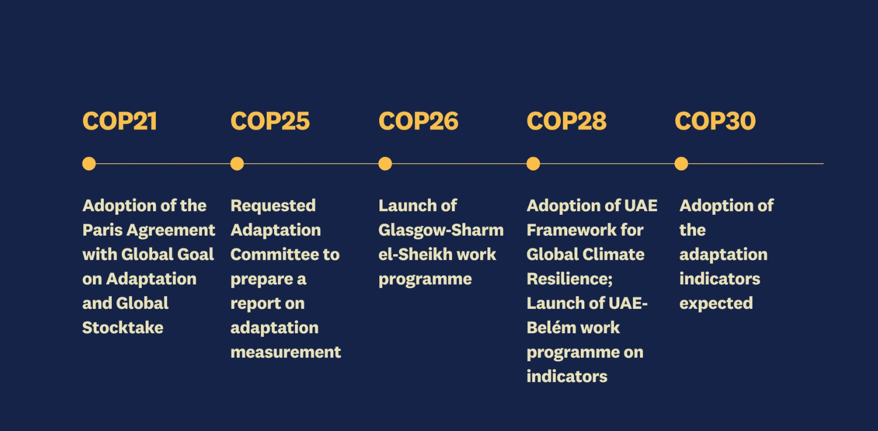
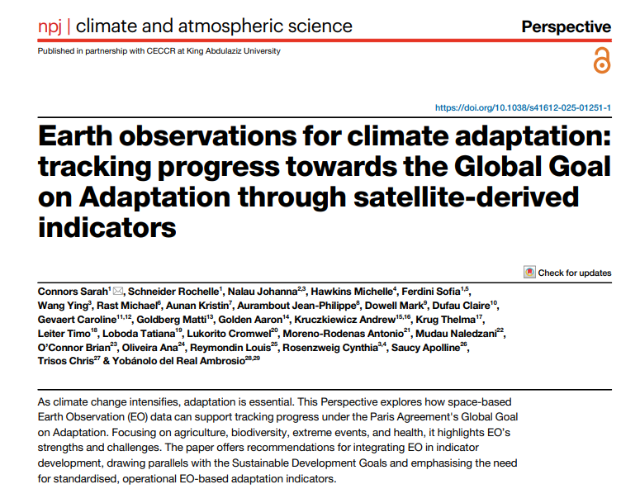
Global Goal on Adaptation Indicators
Examples: 9e01 Informal settlements exposed to hazards 9d05 Extent of adaptation-relevant ecosystems 9g01 Percentage of at-risk cultural and natural heritage sites with adaptation measures implemented 9a01 Change in water stress levels over time
https://www.nature.com/articles/s41612-025-01251-1
Supporting Metric
% urban area covered by green space
% population within 300m of green/blue space

Slide 5
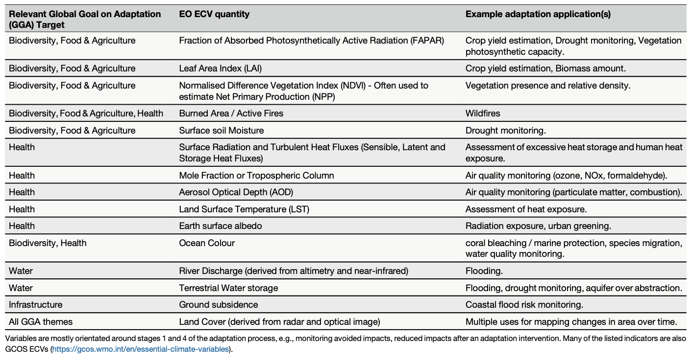
Examples of EO-derived indicators relevant for GGA (Conners et. al. 2025)

Slide 6
Global Goal on Adaptation – Indicators (pre COP30 ~490)
Indicator clusters
Water Security & Resilience
GGA Target Cluster | Examples of Indicators | EO Contribution
9a – Water Security | Water stress, water quality, flood risk | Sentinel-1/2/3, CLMS lake & hydrology layers, C3S climate reanalysis
9b – Food & Agriculture | Yield loss, resilient practices, food security | Vegetation indices (NDVI), evapotranspiration, drought indices, agricultural mapping
9c – Health & Wellbeing | Heat stress, vector-borne disease risk | Land surface temperature, humidity fields, stagnant water detection
9d – Ecosystems & NbS | Restoration, ecosystem extent, habitat resilience | Land cover trends, biomass change, mangrove/wetland mapping
9e – Settlements & Infrastructure | Informal settlements, adaptation readiness | Urban extent, impervious surface, exposure to hazards
Cross-Cutting | Exposure, vulnerability, multi-hazard early warning | Hazard footprint mapping and intersection with population/assets
Indicator ID | Indicator Name | EO Support | EO Contribution Type | Key EO Data
9a01 | Water stress levels | INDIRECT | EO informs hydrological balance (ET, precipitation, storage) | ERA5, GRACE, WaPOR
9a02 | Water use efficiency | INDIRECT | EO supports crop water productivity | Sentinel-2, WaPOR
9a05 | Drinking water services at climate risk | INDIRECT | EO maps flood / drought exposure of infrastructure | Sentinel-1 SAR, CEMS GFM
9a06 | Sanitation services at climate risk | INDIRECT | EO maps flood / land subsidence risk affecting sanitation systems | Sentinel-1 InSAR
9a08 | Water quality in lakes/reservoirs | DIRECT | EO retrieves turbidity, chlorophyll, color | Sentinel-2, CLMS LWQ
9a09 | Population assisted due to water hazards | INDIRECT | EO provides hazard footprint, not people count | Sentinel-1 SAR, CEMS Rapid

Slide 7
Value Chain: Targets & Indicators
Fitness for Purpose
Decide
Apply
Data Production
Sense
Needs identified for Policy and Decision Making
Resulting requirements for applications, indicators, models and Services
Resulting requirements for Data Products
Resulting requirements for observations
Data/Information
Service
Evolution
Ground Segment
Evolution
Space Segment
Evolution
Evolution

Slide 8
Value Chain: Targets & Indicators
Fitness for Purpose
Decide
Apply
Data Production
Sense
Needs identified for Policy and Decision Making
Resulting requirements for applications, indicators, models and Services
Resulting requirements for Data Products
Resulting requirements for observations
Targets
Indicators
ECV/CDR
Data/Information
Service
Evolution
Ground Segment
Evolution
Space Segment
Evolution
Evolution

Slide 9
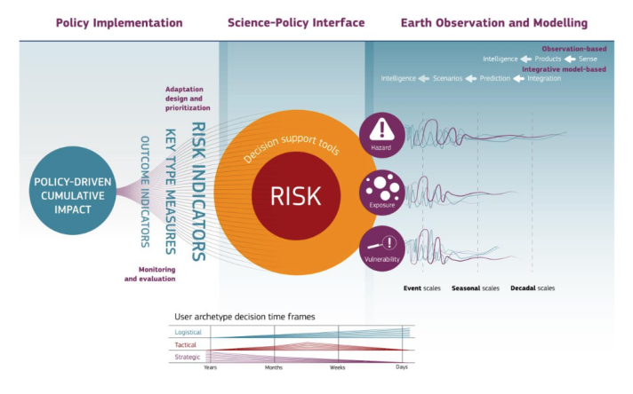

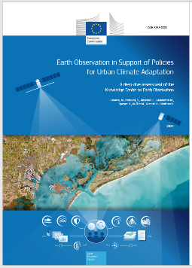
Extending the Value Chains

Slide 10

Adopted 59 Indicators
🌊 Water
9(a)-a – Level of water stress
9(a)-b – Level of water use efficiency
9(a)-h – Proportion of bodies of water with good ambient water quality
➡ EO uniquely provides precipitation, ET, storage, and water-quality proxies.
🌾 Food & Agriculture
EO here is fully operational and mature.
9(b)-d – Level of food and agricultural yield
9(b)-c – Level of degraded agricultural areas under management
➡ EO provides yield, productivity, and degradation trends at scale.

Slide 11
Adopted 59 Indicators
🌱 Ecosystems
9(d)-c – Ecosystem resilience
What it measures: Resistance and recovery after climate shocks
GCOS ECVs:
Vegetation Productivity · Soil Moisture · Land Surface Temperature · Fire
9(d)-d – Ecosystem threat status
What it measures: Pressure and degradation trends
GCOS ECVs:
Land Cover · Fire · Vegetation Productivity
🏘️ Settlements
9(e)-b – Relocation of vulnerable settlements
What it measures: Spatial relocation relative to hazard zones
GCOS ECVs:
Land Cover · Surface Water · Land Surface Temperature

Slide 12
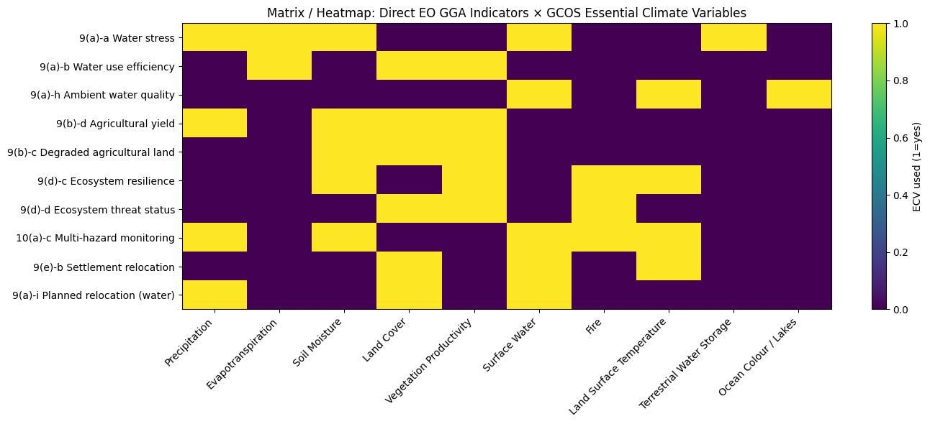
Adopted 59 Indicators and “ECVs”
🌱 Ecosystems
EO is the only scalable option.
9(d)-c – Level of ecosystem resilience
9(d)-d – Level of threat status of ecosystems
➡ Time-series EO is intrinsic to resilience and pressure detection.
🏘️ Settlements
Emerging but strategically important.
9(e)-b – Proportion of vulnerable settlements relocated to safer locations
➡ EO directly detects spatial relocation relative to hazard zones.

Slide 13
Possible steps (KCEO Perspective)
First level analysis of opportunities for EO data (across 59 indicators)
Workflow tracibility for indicator production
Dependency on non-EO data (e.g. socioeconomic) in indicator production
First estimate of targeted requirements for EO data (spatial, temporal,latency, uncertainty, stability)
Fitness-for-purpose (“Lite”) with respects existing EO products
Feedback from indicator reporters
Test productions of champion indicators
Pathways to sustained/operational production or toolbox

Slide 14
Build a Narrative
Feasibility of systematic indicator production
Supporting Transparency (traceable workflows, metadata, documentation)
Global products – support to LDCs
Alleviate Reporting Burden
EO AND socio-economic data

Slide 15

Climate Adaptation (Indicator) Workshop
ESA and EC-JRC
Focus on GGA Indicators. Amenability of EO for deriving indicators systematically
June 23-25 2026
European and Global
Earth observation for climate adaptation Workshop - June 2026

Slide 16
Loss & Damage

Slide 17
Points from UNFCCC-WGClimate 2025 workshop
Warsaw International Mechanism for Loss and Damage : technical working groups provide support in the areas of non-economic losses and slow onset events, displacement and comprehensive risk management.
Enhancing stakeholders’ capacities through technical guidelines on application of climate information for comprehensive risk management, sea-level rise, non-economic losses; integration of human mobility consideration into national processes
Areas potential engagement include upcoming technical guidelines on glacial retreat and data sources; knowledge of cultural heritage and Loss and Damage reporting.
Committee’s agenda on how latest science can inform L&D policy making intends to use L&D information (such as observed impacts, or state and predicted losses) for actions and solutions (such as approaches in NBS or policy options).

Slide 18
GST2 Startegy:
CEOS should work with WMO, CGMS and other partners to refine space-based observations, derived products and delivery systems to reduce vulnerability to emerging threats. Increased support for UN initiatives, such as the UN’s Early Warning for All (EW4All), should be explored.

Slide 19
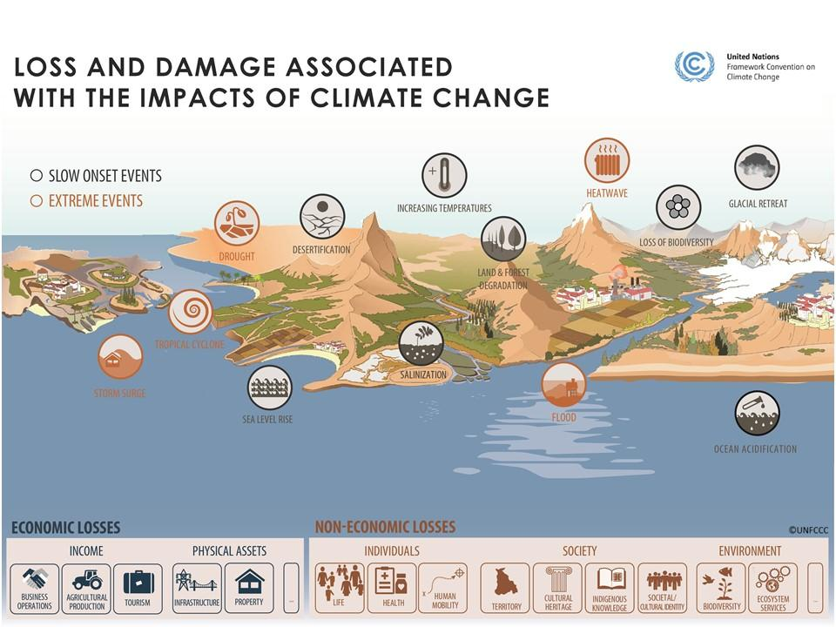
Loss and Damage: Impacts of Climate Change

