Slide 1
2026 CEOS
EO Handbook
S Ward
ESA EO Handbook Team

Slide 2

Context
CEOS Earth Observation Handbook has been produced for major
events related to CEOS priorities since 1992 (Rio Conference)
Promotes the role and importance of satellite EO for the thematic areas, to
policy makers, politicians and key users
Powered by the CEOS MIM database
A contribution from ESA to CEOS as permanent CEOS SEC member

Slide 3

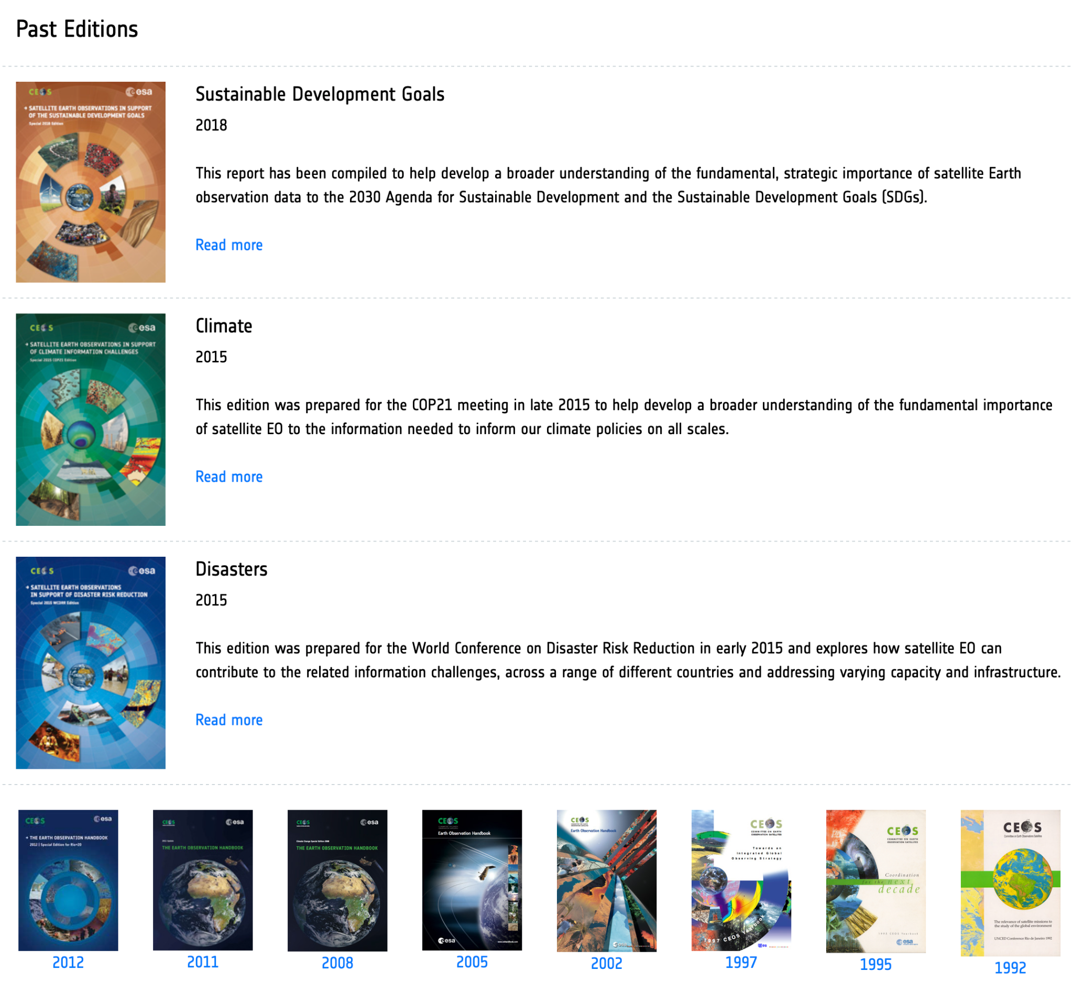
Past editions

Slide 4
2026 Edition
Focus on satellite EO role for Adaptation and Resilience
Printed book and dynamic website
Consistent with CEOS Chair and SIT Chair teams priorities in these areas

Slide 5
Planned contents
Part I explains the various ways in which EO data are of value for the
different elements of adaptation and resilience
Part II features a global case study atlas, under the following headings:
Water supply and sanitation
Food and agriculture
Health and well-being / health services
Ecosystems and biodiversity
Infrastructure and human settlements (incl. coastal settlements)
Poverty eradication and livelihoods
Cultural heritage and traditional knowledge

Slide 6
Case studies
We are looking for the most powerful stories about programmes and projects that have demonstrated real benefits and solved real problems for identifiable user communities, at all scales. We wish to clearly highlight the role of satellite EO data, but recognise that may be as a small part of a multitude of tools that support the outcomes. CEOS Agencies are naturally invited to share their stories through the Handbook, but we also welcome examples from users, intermediaries, academics, non-governmental organisations (NGOs), and government departments of all kinds - if you feel you have a story to tell that may inspire others.

Slide 7


Contributions
Visit https://eohandbook.com/2026casestudies/
To propose a case study, provide some basic information using the form provided
CEOS Handbook team will confirm whether the proposal is suitable and provide further guidance on a full submission in a provided template.
Contributors encouraged to get in touch early and no later than 20th March
Complete case study drafts no later than 24th April
You are also welcome to propose more than one case study - submit multiple forms

Slide 8
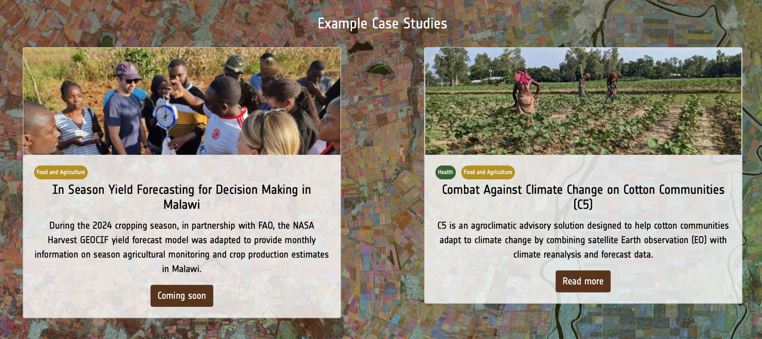
Exemplars for guidance
Heat stress bulletins for Bangladesh cotton farmers
FAO & NASA Harvest agricultural products for Malawi

Slide 9
Schedule
Part 1 drafted in Feb - Apr window
Case studies invited, compiled and edited by Jun
Printed and online ahead of CEOS Plenary

Slide 10

Thanks in advance… lets have your stories!
https://eohandbook.com/2026casestudies/

