Slide 1
WGClimate-24 & GHG-TT-6
Update from WCRP WGORC (& ESMO)
Claire Macintosh, ESA/ESMO
Agenda Item 7.1

Slide 2
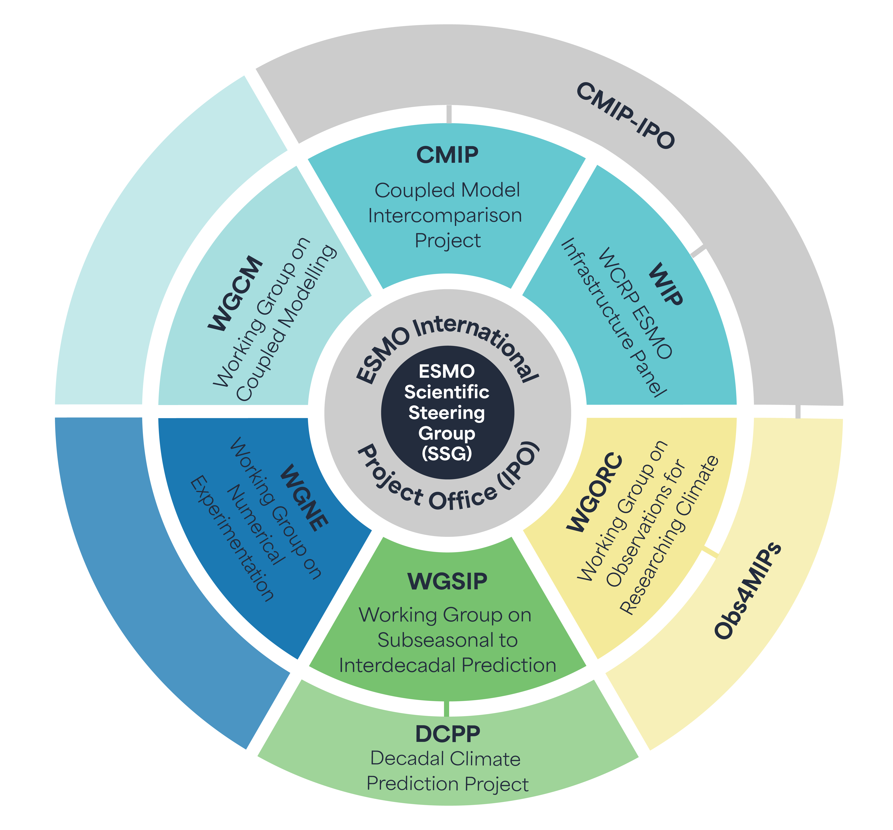

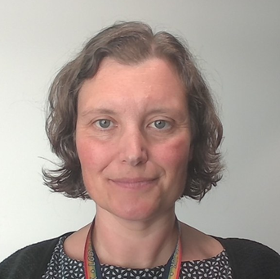
WGORC structure
Co-chairs
Yuhan Douglas Rao,
North Carolina Institute for Climate Studies
Amy Doherty,
Met Office Hadley Centre
ESMO SSG Liaisons : Claire Macintosh (ESA) and Ali Cobb (ECMWF)
Mission:
  This working group aims to identify and address research gaps in climate observation data and act as a facilitator for collaboration across diverse research and industry sectors.

Slide 3
WGORC TOR
To identify gaps in the climate observations and observing systems, including novel and indirect observations, and make recommendations to address these gaps;
To facilitate collaboration between observational communities across WCRP projects and activities and support coordination with external observational bodies;
To collect and promote recommended practices for the generation, stewardship, quality assurance, and infrastructure of climate observations for Earth system modelling (ESM) and other applications;
To identify scientific priority areas for climate observations across scales, beneficial for reanalyses, prediction, forcings, boundary conditions, model evaluations and process diagnostics, as well as other ESM-related needs;
To promote scientific practices for adopting emerging technologies, such as high-resolution modelling, machine learning and AI, future observing systems that can enhance the development and application of observations for climate research.

Slide 4
WGORC TOR
To identify gaps in the climate observations and observing systems, including novel and indirect observations, and make recommendations to address these gaps;
To facilitate collaboration between observational communities across WCRP projects and activities and support coordination with external observational bodies;
To collect and promote recommended practices for the generation, stewardship, quality assurance, and infrastructure of climate observations for Earth system modelling (ESM) and other applications;
To identify scientific priority areas for climate observations across scales, beneficial for reanalyses, prediction, forcings, boundary conditions, model evaluations and process diagnostics, as well as other ESM-related needs;
To promote scientific practices for adopting emerging technologies, such as high-resolution modelling, machine learning and AI, future observing systems that can enhance the development and application of observations for climate research.
Will act as focal point for data provider community in ESMO and fill many of the functions previously (before 2020) held by WDAC including stakeholder engagement and e.g. data standards etc,
Clear remit to work across earth system modelling scales, e.g. see example on supporting scope-broadening of CMIP initiatives
December 2025 ESMO/WGORC meeting included representatives of GCOS and CEOS, and discussions on how we can effectively engage between ourselves
As of December 2025, draft work plan (internal) including some extant work and some scoping studies

Slide 5
Activities outline
WGORC - Uncertainty Metadata Conventions
ESMO - Scope broadening of CMIP REF
ESMO/CMIP updates from the IPO at the obs-model interface
  Benchmarking paper
  New CMIP nomenclature system
  Model Forcings
  August 2025 Uncertainty workshop report back

Slide 6
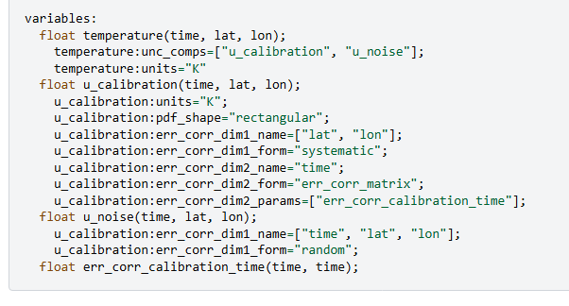
1. Uncertainty Metadata Conventions.
Uncertainty Metadata meeting, August 2025, UK, bringing together science practitioners, convened by UoR, NPL, CMIP IPO – several groups working on similar problems!
Develop a set of metadata conventions to facilitate standards & dialogue within the observation community and thereby user uptake – we need to all speak the same language!
Conventions will be Based on UNC proposal developed as part of CoMet toolkit, incorporating other communities working on similar problems. Led by NPL (Emma Woolliams and Sam Hunt)
Supported by WCRP WGORC to facilitate community uptake and then obs uptake in the modelling community.
Integrating uncertainty information of any complexity into a CF-compliant metadata structure. End goal is adoption into CF conventions
Enables development of more specific, application-driven uncertainty frameworks.
To hear the latest news/sign up to be a Beta tester go to https://bit.ly/UNC-EoI-Form
https://comet-toolkit.github.io/unc_website/specification/draft-v0.1/unc_specification.html

Slide 7
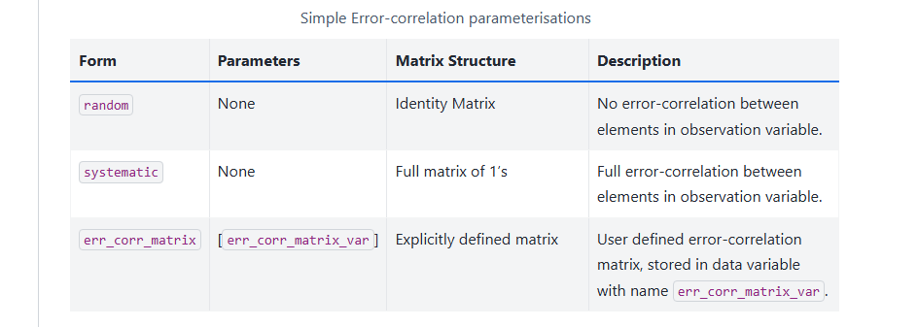
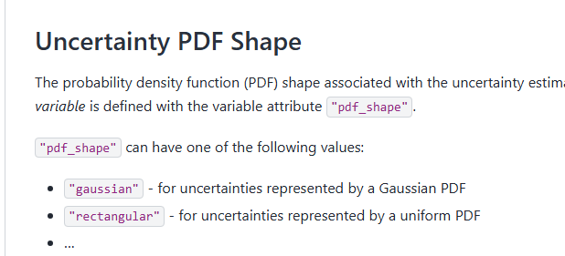
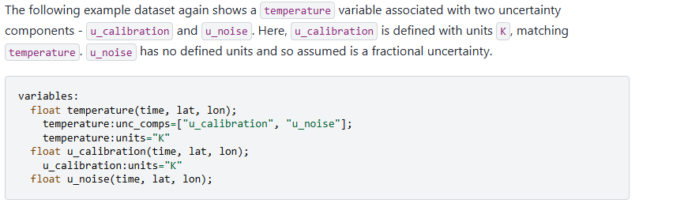
1. Some (non-exhaustive) considerations
Additional Considerations from data providers at August meeting
Active sensors
In situ observations
L4+
Decision tree/ classification algorithms
AI/ML aleatoric vs epistemic uncertainty
Notes:
Developed mostly rom a passive nadir L1-L2 kind of tradition
Need to ensure that e.g L3/L4 data, in situ, very vertically resolved, active sensor, classification algorithms etc can also reasonably be served
Alppha testing – comes fiduceo
Types of OBS
ALSO meachine learning and fwks for uncertainty there.
Links – work on uncertainty for ML ECVS

Slide 8
1. Current status & next steps
Alpha testing phase (core participants) : Aug 2025 - Q1 2026
Beta testing community input phase from ~March 2026 (EOI &Key stakeholders, EOI form)
  Please circulate widely to your communities!
  ‘newsletter’ or ‘beta tester’ sign up is possible
Community public input phase ca Q3 2026
Development of proposal to CF ca Q4 2026

Slide 9
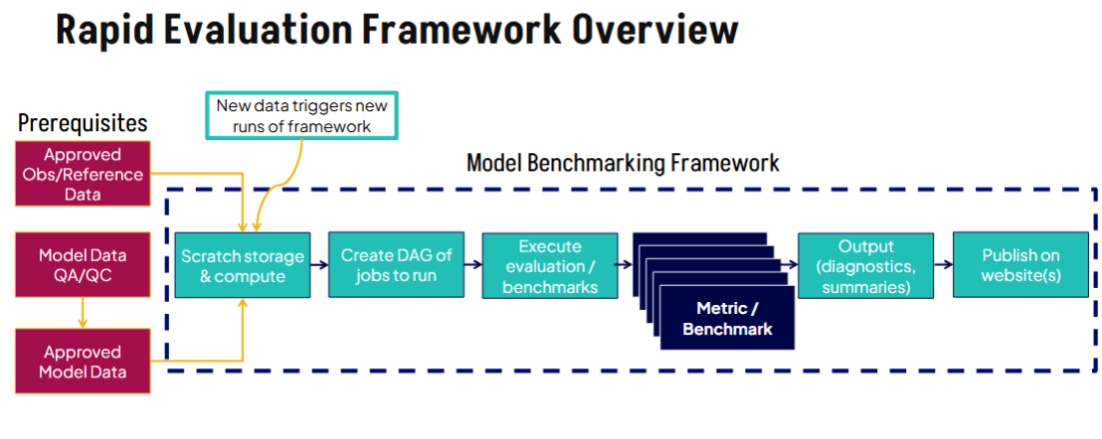
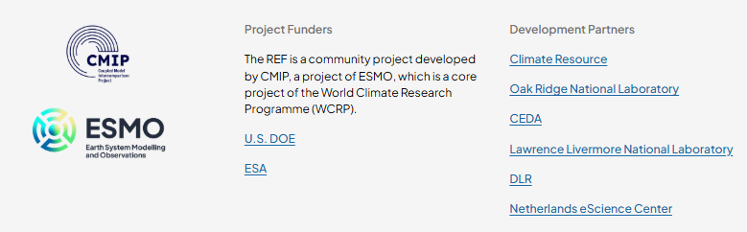

2. Rapid Evaluation Framework - CMIP/ESMO
Resources available:
All available via: http://www.climate-ref.org
26 Obs- based metrics against which to benchmark your model
Based on CMIP6 data. Phase 2 launches March 26.
Dashboard & Dashboard tutorial (online)
Guidance on responsible use
Pre-print in GMD Special Issue
Uncertainty checklist for reference dataset providers
Scope broadening –& future governance now with ESMO
Feedback via Github:
github.com/Climate-REF/climate-ref/issues​
The Assessment Fast Track diagnostics for the REF are available at: https://zenodo.org/records/14284375
For more information about obs4MIPs see: https://www.wcrp-esmo.org/projects-and-panels/obs4mips
For further information about the REF see: https://climate-ref.org
Notes:
The Rapid Evaluation Framework (REF) is a community-owned evaluation framework, built upon, and compatible with, existing community evaluation packages.
The CMIP7 Assessment Fast Track-ready REF (CMIP7 AFT REF) is due for launch on 9 March 2026. It will provide a systematic and rapid performance assessment of the expected models participating in the CMIP7 Assessment Fast Track supporting the AR7 cycle.
It is designed to be open source and modular, enabling the community to build and expand its capabilities beyond the AR7 Fast Track and potentially serve other WCRP communities (e.g. supporting model selection for downscaling and impacts).
•Is not starting from scratch…building from, and leveraging, many existing tools and packages such asESMValTooland utilising the obs4MIPsdatasets.
•Development is being funded by ESAand US Department of Energyand the expertise of the following software packages and organisations: , ESMValTool, iLAMB, PMP, CMEC
There are opportunties here for the modellers to share approved diagnostics –those for the AR7 and those for community expansion, to identify observation gaps for those and use this cldear reuqirement as a basis for earlier stage discussion
Going up to ESMO now fro gobernance

Slide 10
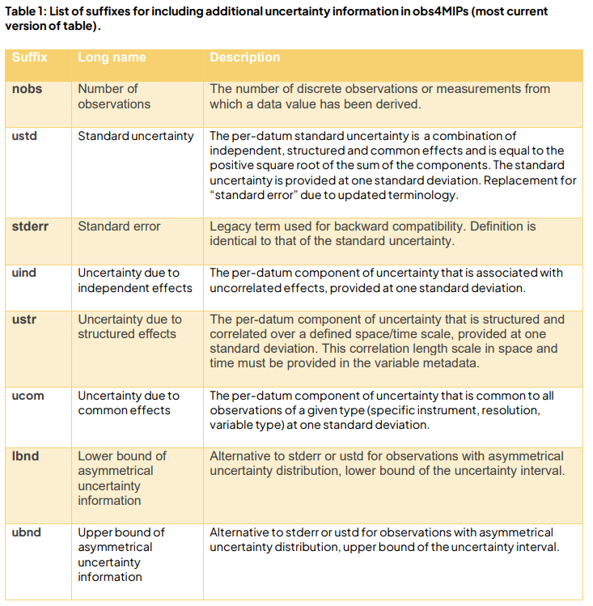

2. REF data providers Uncertainty checklist
Current status and next steps
Q3 & Q4 2025
  Uncertainty checklist has been peer reviewed and published
  Simplest possible structure to capture initial uncertainty information
  Adopted into Obs4MIPs ODS 2.6 standards
Q1 2026:
  Information gathering phase – data provider uncertainty information review
  QA of phase 1 dataset listings (documentation, obsolete versions etc.)
  Analysis of uncertainty information responses – stocktake.
Q2-3 2026
  Test case of ‘uncertainty aware’ model evaluation – code development
Dóra, H., Swaminathan, R., & Woolliams, E. (2025). Climate - Rapid Evaluation Framework Uncertainty Checklist (1.0). Zenodo.
https://doi.org/10.5281/zenodo.17312883
Notes:
Obs4mips adopted these into ODS 2.6

Slide 11
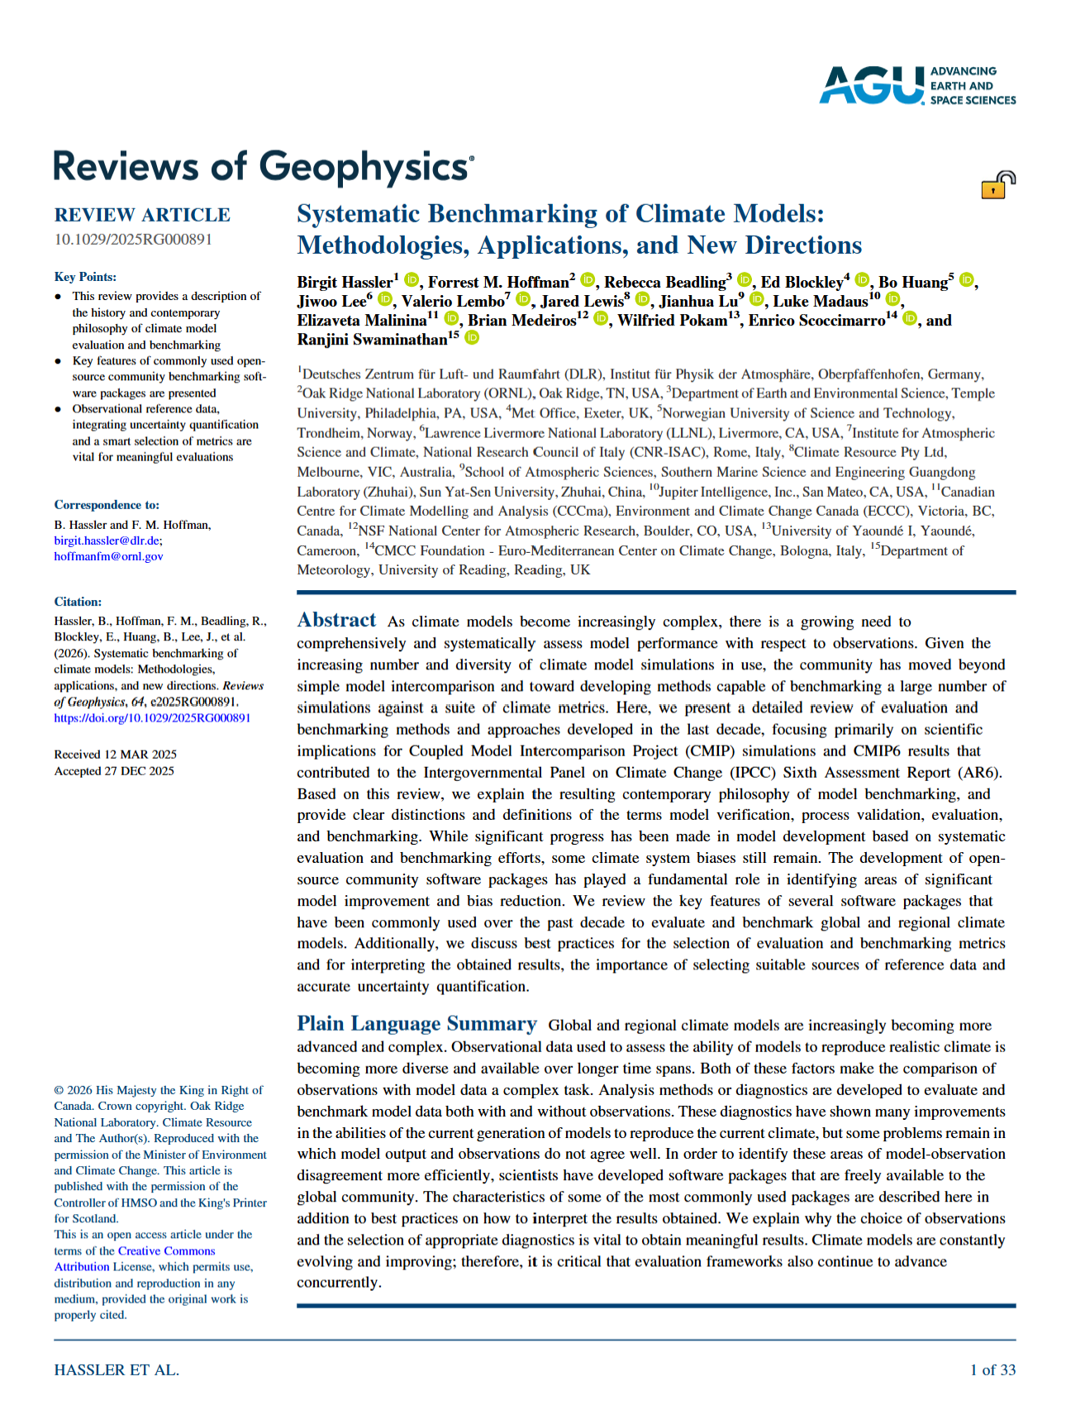
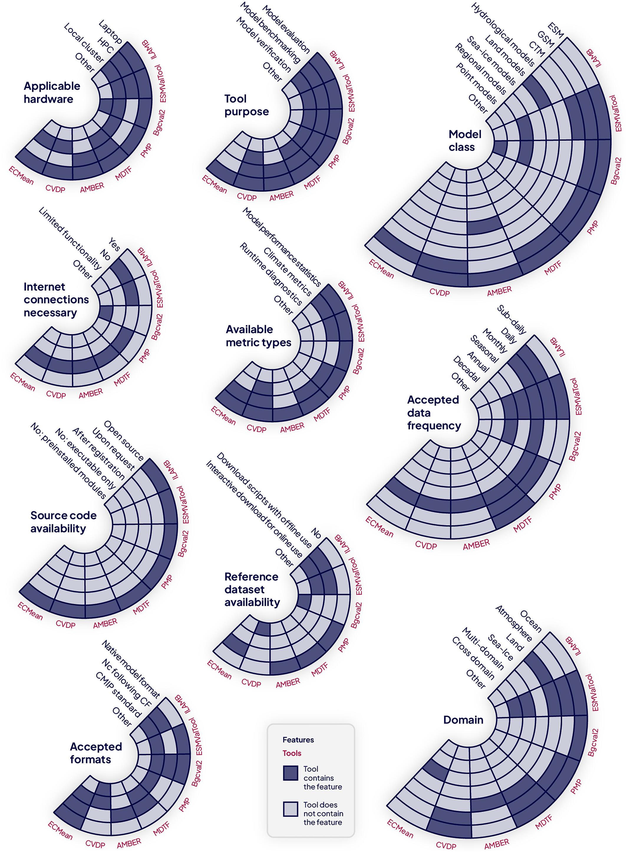
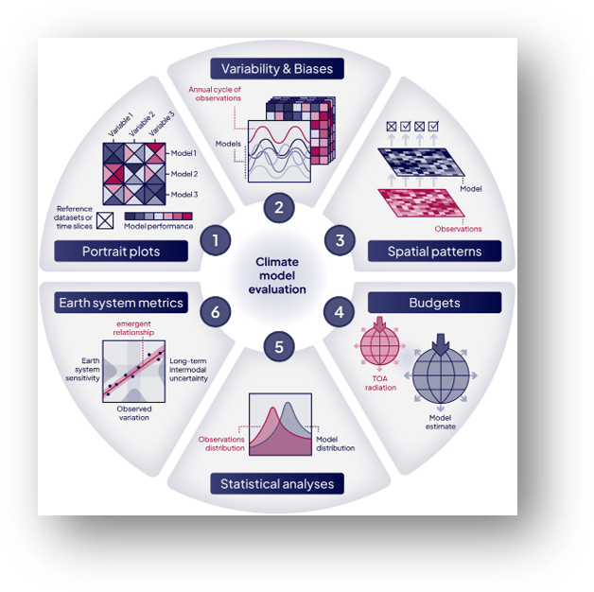
3. CMIP - Model evaluation
New paper published by the CMIP Model Benchmarking task team
review of evaluation and benchmarking methods and approaches developed in the last decade
definitions of the key terms model verification, process validation, evaluation, and benchmarking.
review of the key features of several software packages that have been commonly used over the past decade to evaluate and benchmark global and regional climate models
Hassler, B. et al. (2026). Systematic benchmarking of climate models: Methodologies, applications, and new directions. Reviews of Geophysics, 64, e2025RG000891. https://doi.org/10.1029/2025RG000891

Slide 12
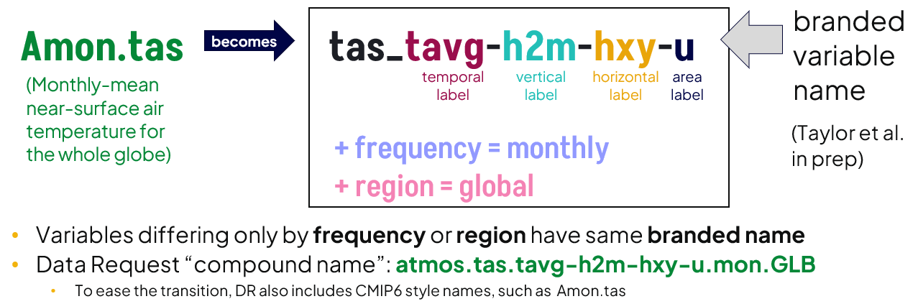
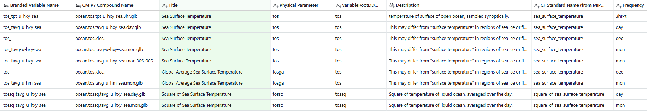
3. CMIP - Variable name changes
There are a number of infrastructure changes for CMIP7. Relevant to reference dataset use in the REF is the following:
A new naming system termed “branded variables” has been created to address some of the issues with the earlier naming system and provide unique variable names
It will be a step change for many within the climate data supply chain
The root name, which is very similar to the physical parameter will be in netCDF files as the variable_id.
You can view the CMIP7 variables, these names alongside CMIP6 in the Data Request
Let us know how we can work with you to make the Earth observation community aware of this.
Notes:
A new way of uniquely identifying variables has been adopted by the WIP for CMIP7 onwards. This is known as ‘branded variable names’. A branded variable identifies a physical quantity and how it is sampled, and the data request additionally specifies the frequency, region, and grid type for which it is requested. The “branded variable” name is constructed from two components
•: a root name associated with the standard name and defining the property, and
•a branding suffix, which indicates how the property should be sampled spatially and temporally. The branding suffix is composed from four components, referencing the variable’s temporal sampling, vertical sampling, horizontal sampling and area type.
The branding variable algorithm development has been led by Karl Taylor (PCMDI/LLNL) and was adopted by the WIP in a formal decision on 14th January 2025. Branded variable names have been generated with version 0.12.0 of the branded variable mapper. A new CMIP7-era compound name has been derived to determine a unique name for each variable in the Data Request. It combines the branded name, the frequency, the realm, and the region requested.
We appreciate this is a big change from CMIP6, and one that may be confusing at first. We have therefore left the CMIP6 tables, and CMIP6 Compound Names in the CMIP7 Data Request to aid the transition.

Slide 13
3. CMIP - Forcings
Data production phase coming to an end – historical all available, scenarios expected to be fully available end of March
Focus will shift towards evolution – see e.g. Naik et al. (2025),
  Sustained mode (annual extensions)
  Sustainable underlying coordination, development and research
  Widening applicability to other climate and modelling activities (e.g. ERA6/SEAS6, CORDEX, Climate indicators)
Notes:
Datasets spanning EO and pre-EO era are vitally important to large sections of the ESM community – including reanalysis, climate modelling, regional modelling and others.
MUCH less sustainably funded / coordinated than EO only

Slide 14
3.ESMO/CMIP outcomes from Uncertainty metadata meeting
Uncertainty Metadata meeting, August 2025, UK, bringing together science practitioners, convened by UoR, NPL, CMIP IPO in support of the REF
Uncertainty workshop report back to the community, 21 Aug 2025
  CEOS, GCOS and WCRP/ESMO/CMIP/WGORC invited to workshop report back
  Recommendations to the community presented
  Meeting note, slide dec and recording were circulated, and are available at Uncertainty Metadata drop-in: UK Workshop Report Back - Coupled Model Intercomparison Project
Recommendations on
  Developing uncertainty metadata guidelines
  Developing specific guidelines for CMIP REF and model evaluation community
  Recommendations on broader requirements at the obs-model interface
Many groups working on a subset of this problem, and substantial community interest from the modelling community.

Slide 15
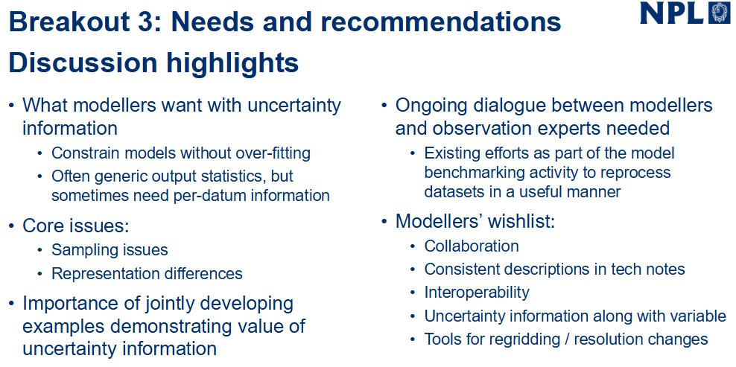
3. Uncertainty meeting report back and Wider recommendations

Slide 16
3. Uncertainty meeting report back and Wider recommendations
Report back on: UK Uncertainty Metadata Meeting
Notes:
Key message was strengthening dialoge
Modellers inverested n this information but that it is very difficult to use.

Slide 17
Upcoming events
1st in person meeting – ECMWF, Reading, Dec 2025
  Thanks to CEOS and GCOS representatives (Wenying, Vincent-Henri, Antonio, Peter, Sabrina) for their participation!
Summary of the ESMO SSG + WGORC Kick-off meeting - Plenary Sessions
Find us at:
Feb: CEOS/WGClimate/GCOS Harwell
March: CMIP community workshop, Kyoto
May: EGU, Vienna
June: GLOC, Kigali
Dec: AGU
Notes:
AF Global Space Conference on Climate Change

