Slide 1

WGClimate-24 & GHG-TT-6
The World Climate Research Programme
Mike Sparrow and colleagues, WCRP
Agenda Item 7.2

Slide 2



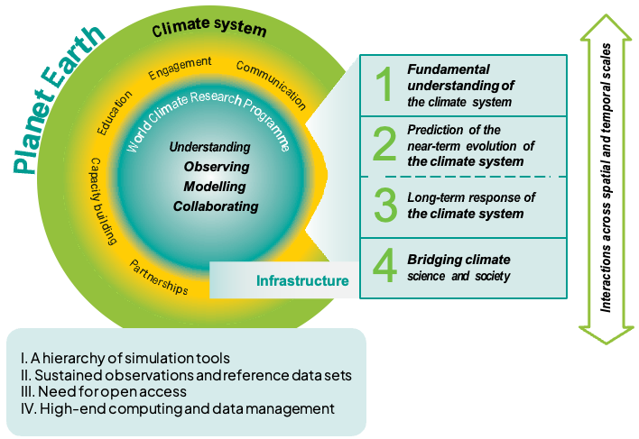


WCRP Strategic Plan for this decade (2019-2028)
VISION:
A world that uses sound, relevant, and timely climate science to ensure a more resilient present and sustainable future for humankind.
MISSION:
To coordinate and facilitate international climate research to develop, share, and apply the climate knowledge that contributes to societal well-being.

Slide 3
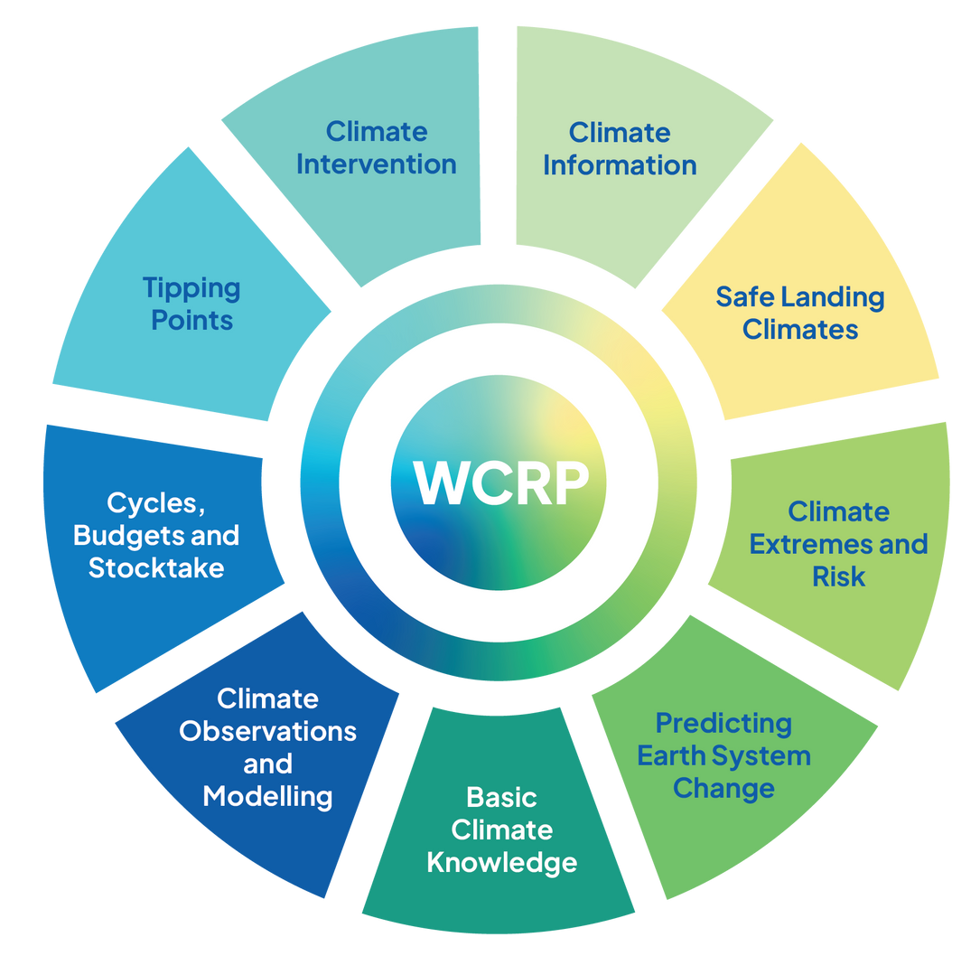
WCRP major ongoing Science Foci
WCRP’s objectives for these focus areas are achieved through its six Core Projects, six Lighthouse Activities, and the WCRP Academy.
Science foci will change to reflect the highest priority research questions in WCRP's strategy.
The WCRP Secretariat, hosted mainly at the World Meteorological Organization (WMO) headquarters in Geneva, coordinates the work of its activities.

Slide 4
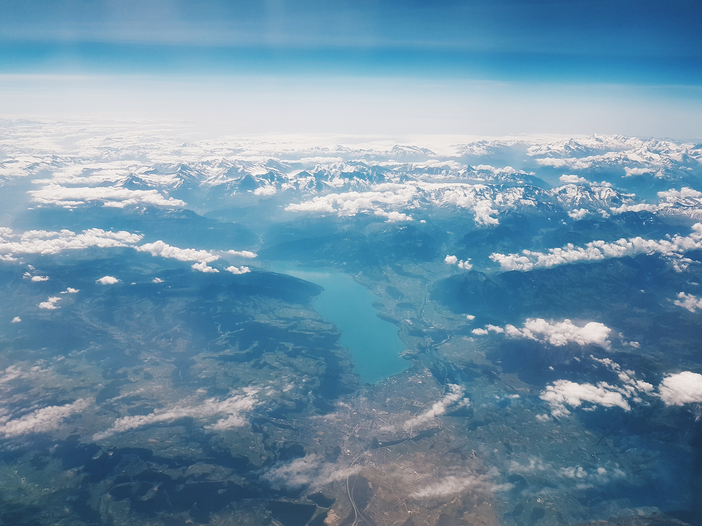








Core Projects
Atmospheric Processes and their Role in Climate
APARC
Climate and Ocean Variability, Predictability and Change
CLIVAR
  Long-term activities that are dedicated to specific aspects of climate science within WCRP​
  Are the home to various scientific communities – across oceans, cryosphere, land, and atmospheric science domains; process studies, modelling, and observations; and regional climate information​
  Supported by International Project Offices with oversight by the WCRP Secretariat
Climate and Cryosphere
CliC
Earth System Modelling and Observations
ESMO
Global Energy and Water Exchanges
GEWEX
Regional Information for Society
RIfS

Slide 5
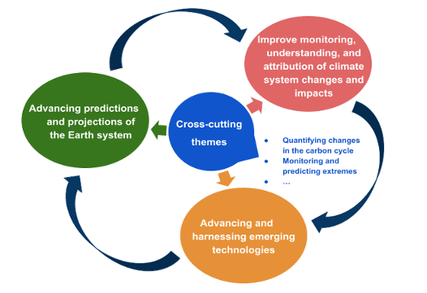

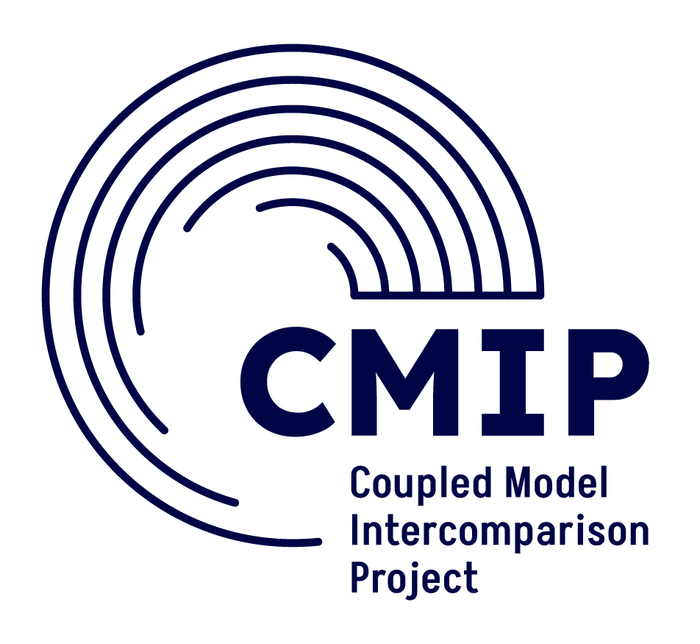


ESMO objectives and initial cross-cutting themes
Working Group on Observations for Researching Climate (WGORC)

Slide 6
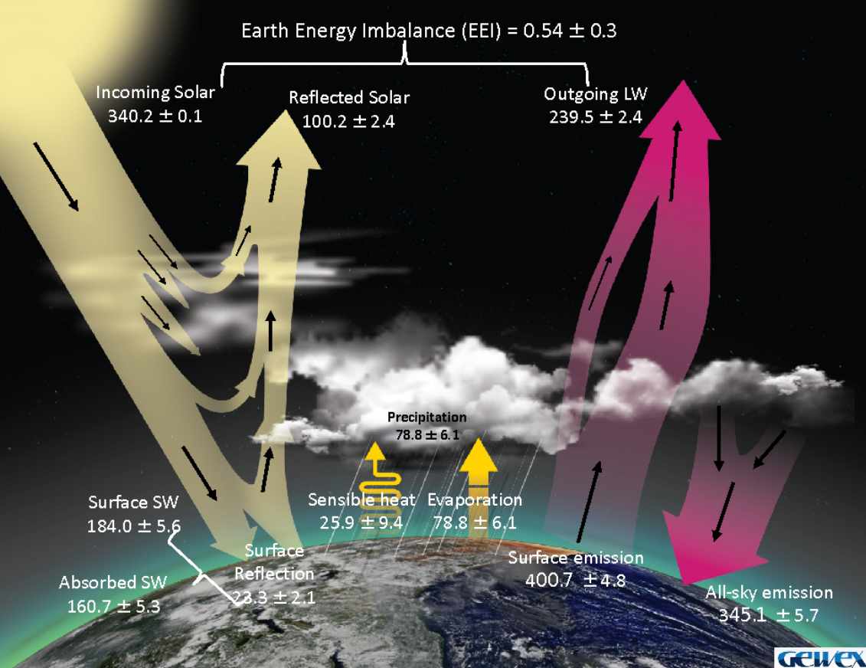
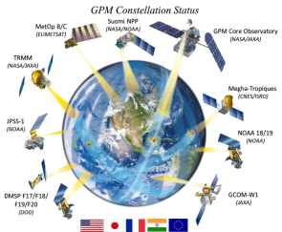
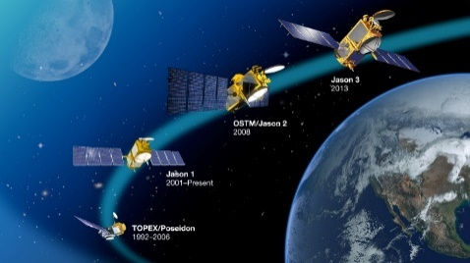
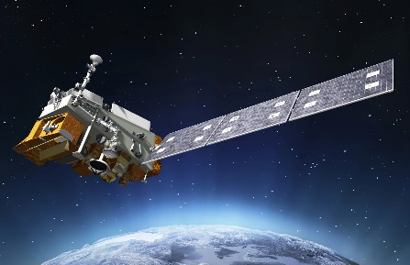
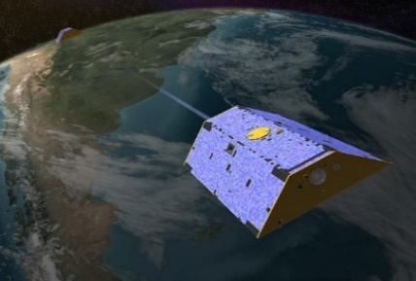
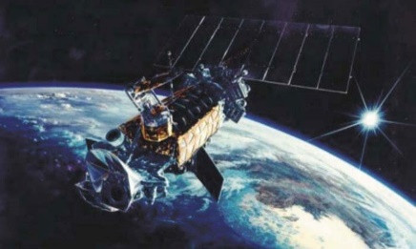
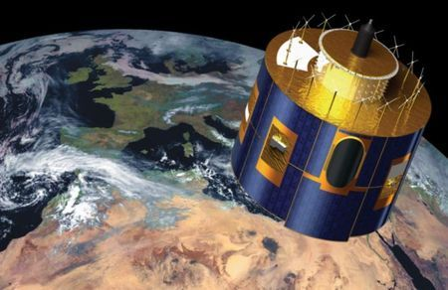
Example: The GEWEX Data Analysis Panel (GDAP)
Precipitation
Sea level
Radiation
Gravimetry
Stephens et al, 2023, BAMS
Surface Fluxes
Clouds
Notes:
EEI activity (CERES + altimetry satellites),
ISCCP-NG (geostationary meteorological satellites),
and precip assessment (GPM, AMSR, SSMI, geostationary IR, etc.).
There are also the legacy products SRB, GPCP, SeaFlux, LandFlux, etc. and numerous other global E&WC assessments that were all born out of GDAP activities

Slide 7

Example: APARC and satellite needs
There are many activities within APARC that are dependent on satellites include:
Species relevant to stratospheric ozone chemistry
Radiatively active species (such as middle atmosphere water vapor and ozone)
Tracer measurements that can be used to infer middle atmosphere motion, and global changes
Aerosol measurements in the middle atmosphere, used to monitor impacts of large volcanic eruptions such as the recent Hunga eruption.
In particular, APARC activities made heavy use of measurements from the AURA MLS instrument, which is near end of lifetime. Activities also make use of the Atmospheric Chemistry Experiment (ACE).
Future satellite missions that will be very important to APARC science are STRIVE (recently selected by NASA), Altius
Gaps in measurements, in particular stratospheric water vapor are a concern, and appear likely to happen given MLS being shut off before future missions are launched. There should be increased ground-based measurements to help cover the gaps and tie together past satellite mission measurements with future missions.

Slide 8

Lighthouse Activities
Explaining and Predicting Earth System Change
EPESC
Global Precipitation Experiment
GPEX
Digital Earths
DE
  Designed to be ambitious and interdisciplinary, and work across core projects.
  Goal is to rapidly advance the major and new scientific approaches, technologies, and institutional frameworks required to meet society’s need for robust and actionable climate information.
My Climate Risk
MCR
Research on Climate Intervention
RCI
Safe Landing Climates
SLC

Slide 9
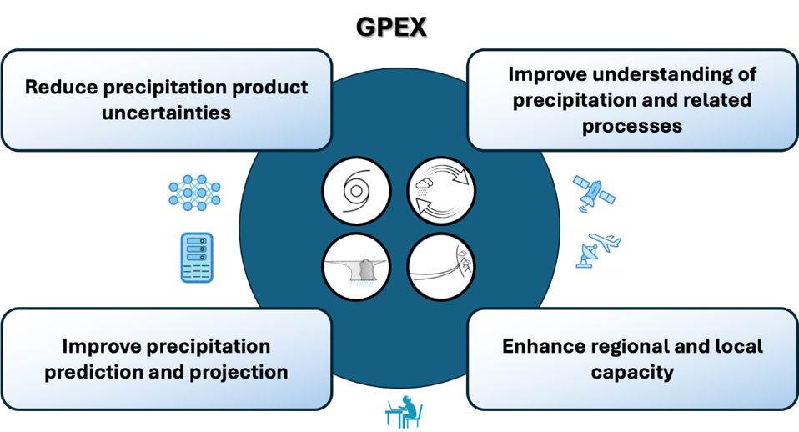

Example: Global Precipitation Experiment (GPEX)

Slide 10

GPEX And Satellite Precipitation Data
GPEX relies on satellite precipitation observations to study precipitation variability, extremes, and key drivers (ARs, monsoons, MCSs, TCs) across regions and timescales, especially where in situ data are sparse.
Satellite datasets support model evaluation, data assimilation, and hybrid (physics- AI) approaches (GPEX WG3).
Integration with in-situ observations for uncertainty characterization (WG2).
Integral to improving precipitation predictability and supporting WCRP science priorities.
Agencies such as Japan Aerospace Exploration Agency (JAXA) contribute missions, retrievals, and open data supporting GPEX science.

Slide 11

WCRP Flagship Teams
Coordinated Regional Climate Downscaling Experiment
CORDEX
The Coupled Model Intercomparison Project
CMIP
Academy

Slide 12
Some highlights…
First WCRP Status Brief, focussed on sea level rise
High-level assessments on (a) Earth system high impact events, tipping points and their consequences (almost done) and (b) the atmospheric impacts of the January 2022 eruption of the Hunga Tonga Hunga Haʻapai volcano (completed)
Global South Inclusion Task Team to ensure meaningful participation of researchers from the Global South in WCRP
Many papers, hackathons, webinar series, white papers

Slide 13
Looking ahead…
Loss of funding from the US and from its co-sponsors means an ~60% cut in income from 2025/26
WCRP is working to prioritise its activities – spinning up new activities when needed, but will need to refocus/cut others
  Science Strategy - Direction and & Future Priorities Task Team
  Sea level Rise – Projections, Impacts & Adaptation Task Team
  Machine Learning/Artificial Intelligence – Innovations & Applications in Climate Science
Fund raising, particularly with the private (finance) sector a major focus

Slide 14



Thank you
msparrow@wmo.int
www.wcrp-climate.org

