Slide 1

WGClimate-24 & GHG-TT-6
Stakeholder Engagement:
Presenter, Organization
Agenda Item 7.4
Notes:
Presenters should name their file using the following convention:
AgendaItemNumber_LastName_Subject_Version (e.g., 1.1_Su_Welcome_v1)
Documents and presentations should be uploaded to the shared folder to allow for streamlined self service
Shared Presentation Folder (default view only, ask for upload/edit permission as required)
For support contact Libby/Wenying: libby@symbioscomms.com / wenying.su-1@nasa.gov
Meeting website: https://ceos.org/meetings/wgclimate-24/

Slide 2

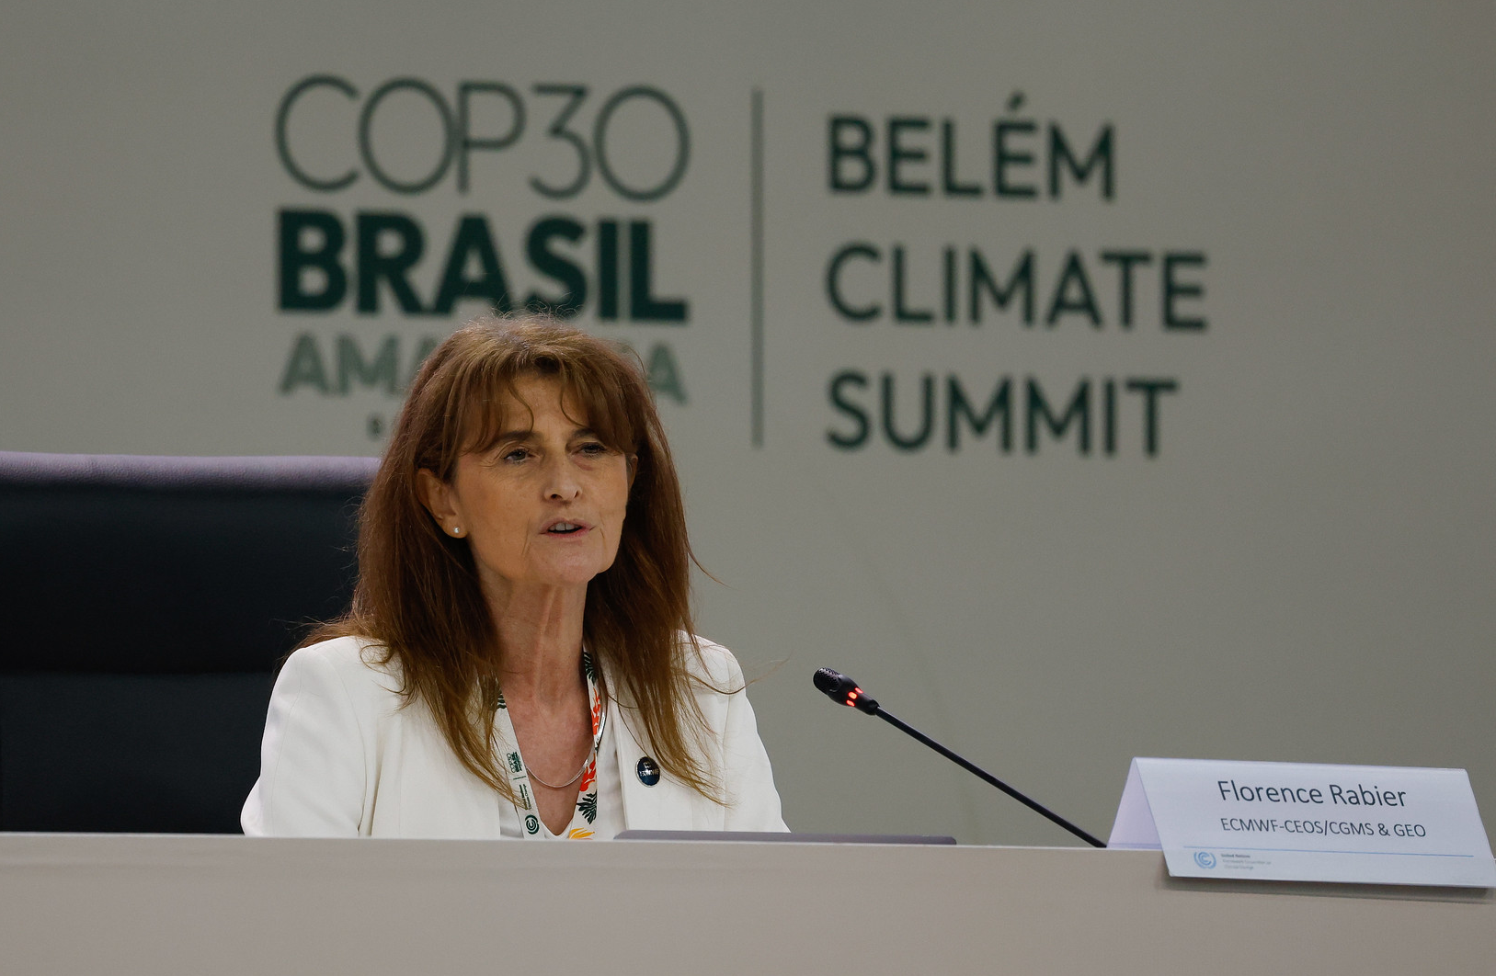
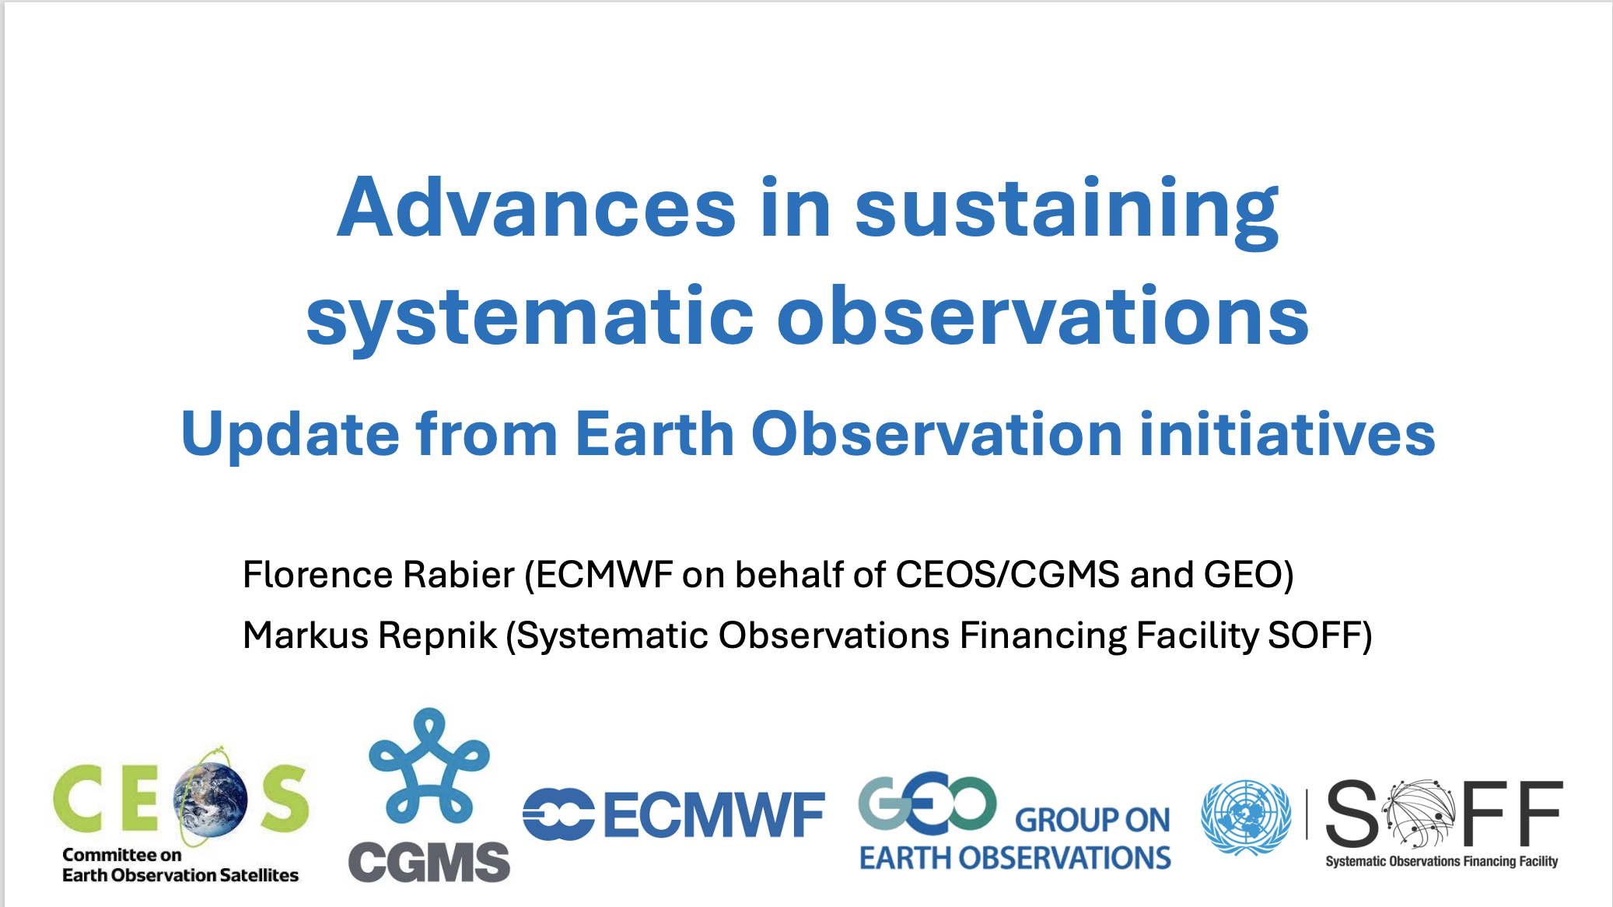
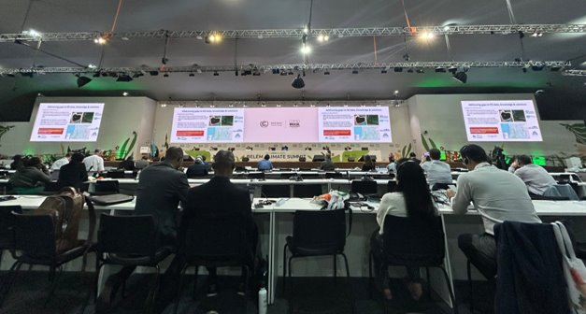
COP30
Appreciation to CEOS for close coordination/collaboration at EID 2025 --- joint presentation & coordinated messaging
Notes:
Huge thanks to CEOS for close coordination/collaboration at EID 2025 --- joint presentation & coordinated messaging with CEOS and WMO/SOFF.
The GEO update, delivered by the Committee on Earth Observation Satellites (CEOS) through Florence Rabier (GEO Principal of the European Centre for Medium-Range Weather Forecasts), highlighted GEO's efforts in driving climate action.
Many thanks to Vincent Henri for all the heavy lifting
RSO conclusion acknowledged the role of technological innovation (e.g. AI/ML) in supporting EWS etc and noted challenges using such tech in developing countries. --> Value of our work is increasingly important -- in high demand

Slide 3

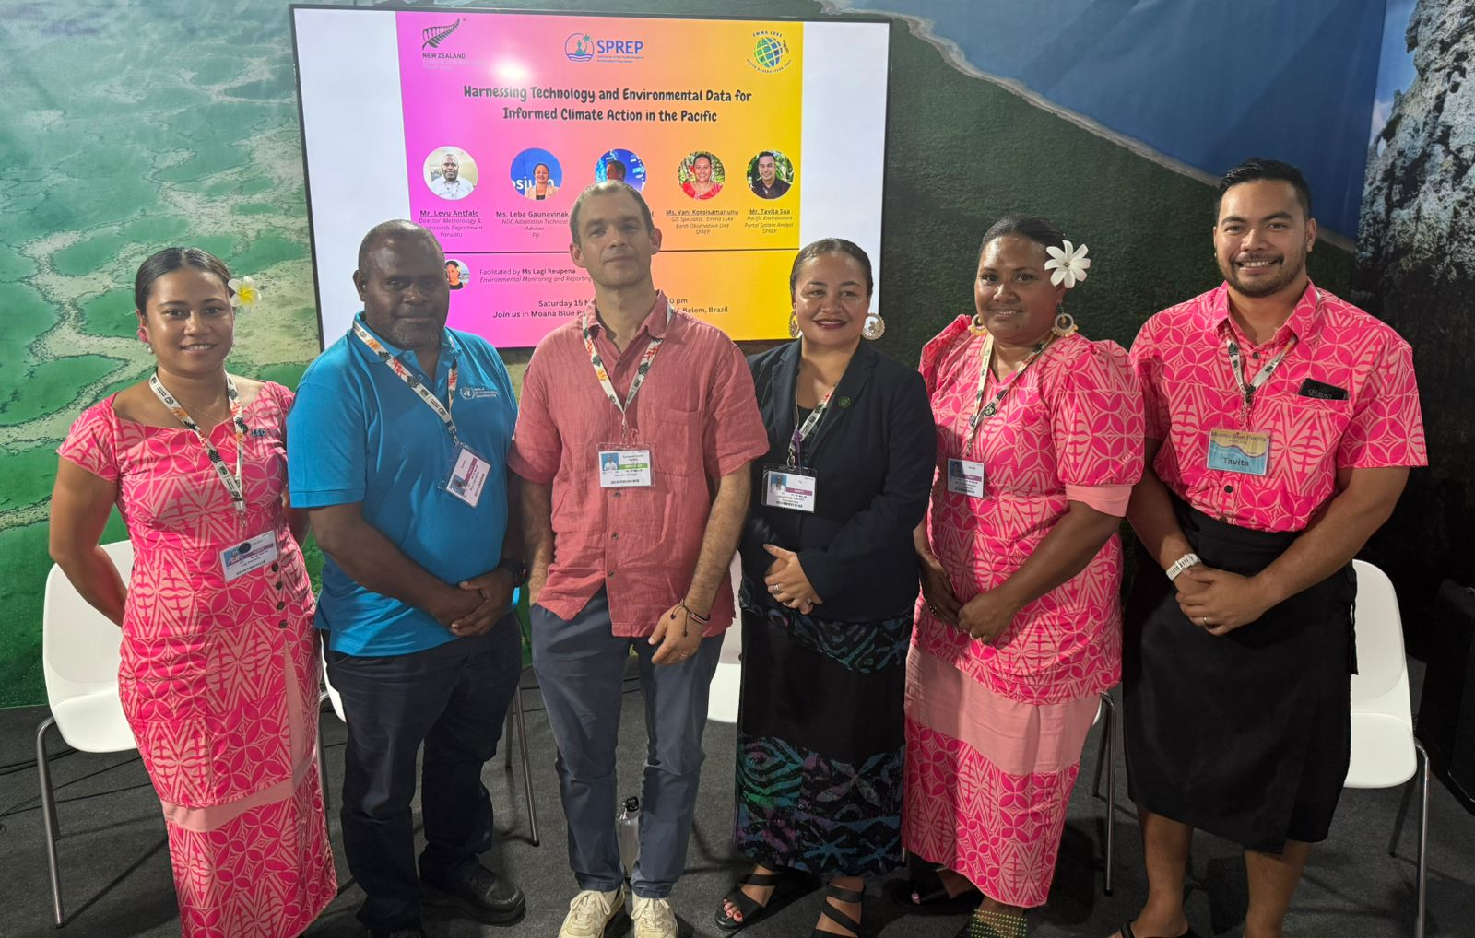
COP30
NAP Technical Guidelines Supplements by GEO initiative partners featuring knowledge/tools to embed EO in adaptation planning.
Appreciation to ESA participation in SPREP event at Moana Pavilion.
Notes:
In 2025, GEO initiative partners launched two new supplements to the NAP Technical Guidelines—on coastal and ocean adaptation and land degradation neutrality—providing governments with tools to embed Earth observation in adaptation planning and implementation.
One of them was on land degradation by GEO-LDN' partners, UNU-EHS and UNCCD--- LDN is participated by CEOS
Hope to continue supporting NAP processes through GEO's series of NAP tech guideline
Also appreciate ESA and Clement Albergel to respond positively to GEO's request to help our PO---and spoke to SPREP event at Moana Pavilion where new Emma Luke EO centre was highlighted.
Hope to further enhance coordination/collaboration with CEOS for COP31 and beyond.

Slide 4


CEOS EO Handbook on Adaptation and Resilience
Joint call for expression of interest launched on 12 Dec 2025.
Receiving around 30 submissions.
Drafting GEOGLAM as a sample.
Notes:
One ground work (seeds) of COP31 collaboration is GEO's participation to CEOS EO handbook
Joint call for EoI launched on 12 Dec
Received quite a lot of interests --- around half of whom (30) have formally submitted EoI.
Working with GEOGLAM (where CEOS has been a key partner) to develop a sample use case

Slide 5

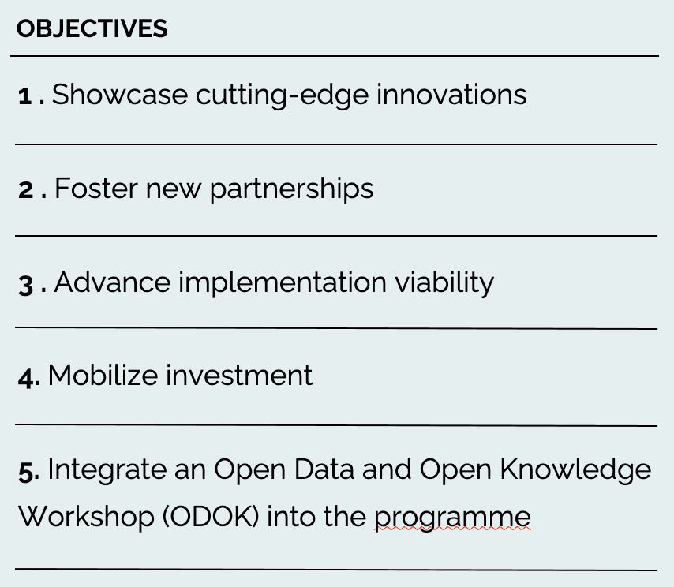

2026 GEO Symposium
GEO-21 Plenary
Proposals by 28 Feb.
Registration by 31 March.
Sponsorship opportunity by 31 March.
Notes:
Conclude with info on 2 upcoming events
First is GEO's annual event – GEO Symposium and the 21st plenary –
Deadline of 28 Feb is for proposals on community events, showcase, posters and news releases
Registration of in person participation of the symposium as well as sponsorship opporunity are open until 31 March

Slide 6





GEO Open House Webinar Series
Indigenous Alliance
Theme on DRR-Climate-Biodiversity nexus.
Featuring 3 (out of 5) activities that CEOS participates.
Highlighting innovative approaches (e.g. new EO satellites, AI/ML).
Notes:
GEO also launched a open house webinar series last Dec. to highlight 5 GWP activities in 2 hour timeslot.
Following the 1st one on WHDR themed webinar, the 2nd webinar is on DRR-Climate-biodiversity nexus.
3 out of 5 activieis (GEOLDN, GEO Trees and DEA) are participated by CEOS
In the webinar, innovative approaches, including the use of new EO satellites, are highlighted.

Slide 7

Thank you!
Group on Earth Observations
Secretariat@geosec.org
7 bis, avenue de la Paix,
Case postale 2300
CH-1211 Geneva, Switzerland​
Notes:
Looking fwd to further collaboration with CEOS

