Slide 1
Capacity Development for Climate
Christoph Aubrecht
Martyna Stelmaszczuk-Górska
WGCapD and EOTEC DevNet
Agenda Item 7.3

Slide 2
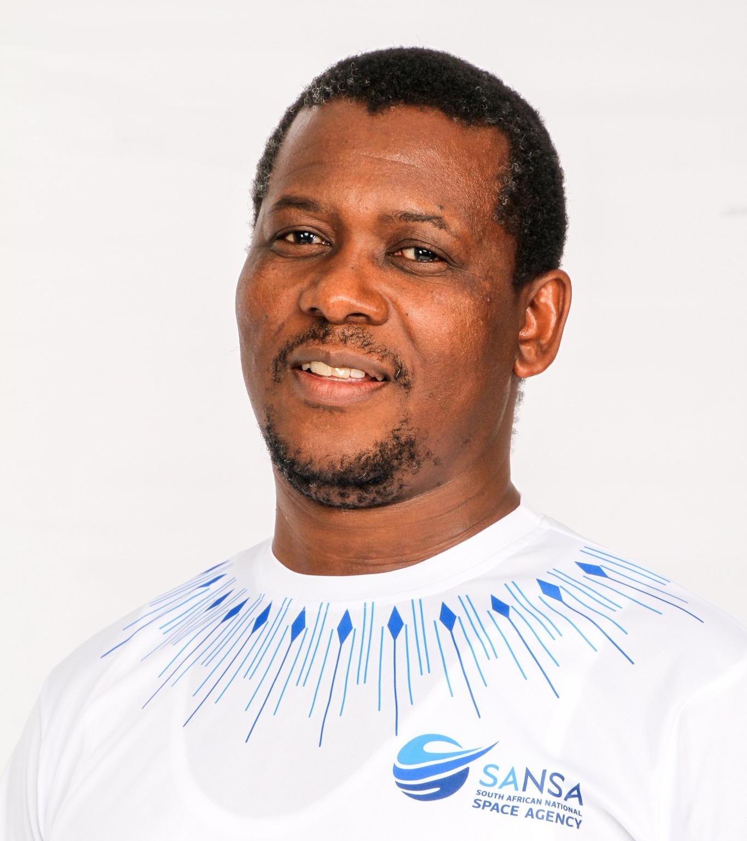
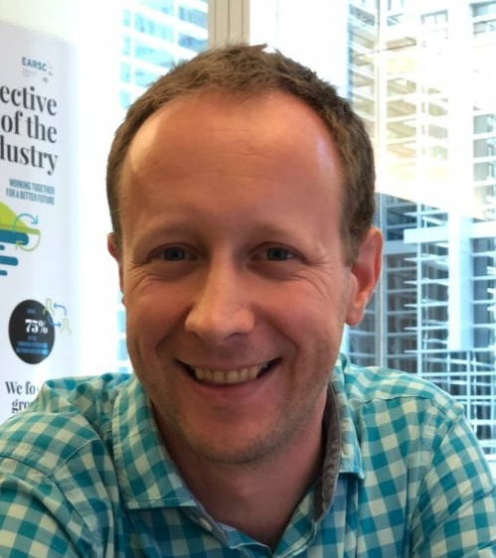

WGCapD Leadership
Dan Matsapola (SANSA)
WGCapD Chair 2024/25 + 2026
staying on for an additional year to support transition
Christoph Aubrecht (ESA)
WGCapD Vice Chair 2026
to serve as Chair 2027/28
A WGCapD Vice Chair for 2027/28 needs to be identified,
for nomination and approval at the Plenary in Nov’26

Slide 3
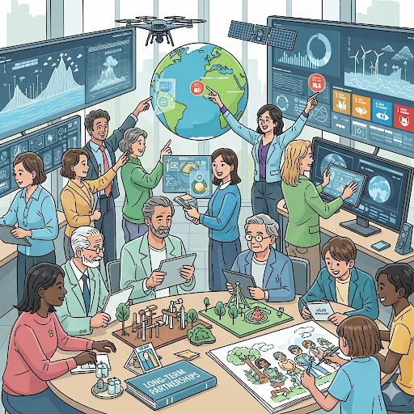
WGCapD Priorities
Shift from one-time joint trainings or webinars to sustained long-term collaborations
Focus on capacity building of underrepresented communities, i.e. Indigenous Mapping Workshops and Engaging Youth to use EO for Economic Empowerment
Promoting cross-cutting deliverables that involve more than just two agencies, i.e. SDG MOOC
Strengthen collaborations with Working Groups on Disasters, Climate, SDGs, and others
Engaging more CEOS members who are not yet involved in WGCapD
Prioritize capacity development of decision- and policy-makers for greater impact
Incorporate new AI tools and best practices to support capacity building efforts

Slide 4
WGCapD Actions
WGCapD member agencies are currently working to execute 29(!) deliverables
Continue to leverage activities that expand beyond direct CEOS scope (e.g. EOTEC DevNet)
Start consolidated effort to structure WG activities within a classification framework
- will provide comprehensive status overview
- highlighting WG member engagement patterns/trends → stimulate less-involved/new members to engage
- highlighting ‘bottom-up’ priorities (following the ad-hoc deliverables initiation process)
- identification of gaps as compared to WG overarching objectives
  Conceptual analysis on approaches to capacity development beyond ‘training’
  Consideration of establishment of Task Team/s to address selected focal areas, e.g.
  - Indigenous communities
  - Youth
  - Commercial sector
  - Climate, Disasters, …

Slide 5
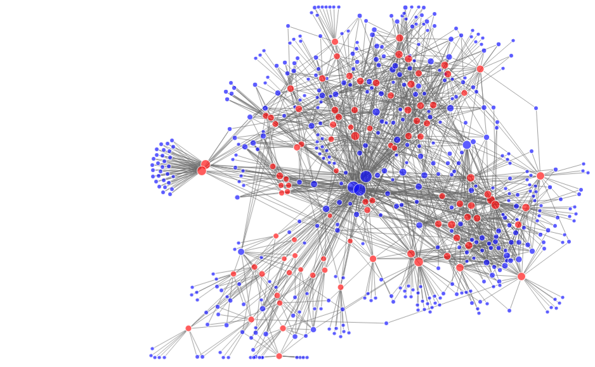
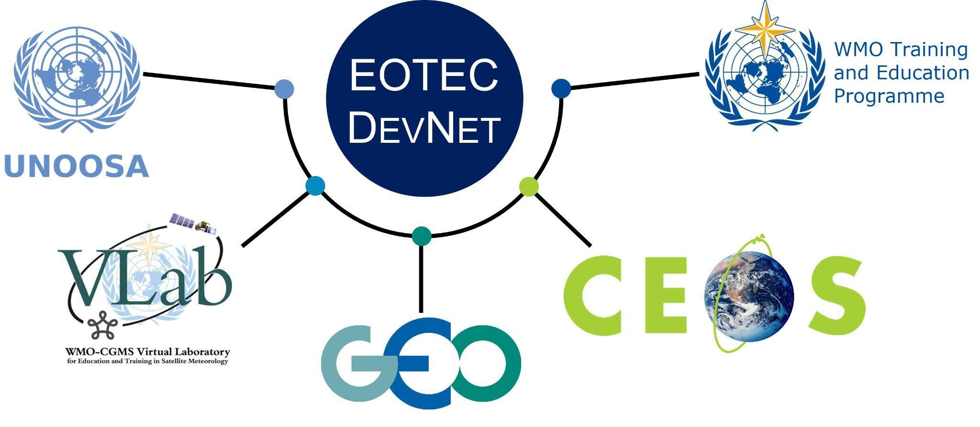
EOTEC DevNet Extends WGCapD Impact
Earth Observation, Training, Education, and Capacity Development Network (EOTEC DevNet) grew out of WGCapD deliverable in 2021 with a mission of extending the reach of Earth observation capacity building globally.
2022-2025 milestones:
  2,000+ people engaged in EOTEC DevNet activities between 2022 and 2025
  Vibrant regional and thematic CoPs hosted meetings for 940+ participants with 50–70% repeat attendance
  130+ spotlight sessions on government, private sector, international agency, and NGO EO capacity building and research
  500+ attendees of five webinars conducted with partners
Individual participation (blue dots) in EOTEC regional and thematic meetings (red dots). (Source: Network analysis conducted by Altay Özaygen, Metis Analytica)
Notes:
EOTEC DevNet grew out of WGCapD members realizing the need to coordinate efforts with EO Training providers beyond CEOS members
It has since grown significantly and serves as an important connective tissue across partner networks
The chart on the right which came out of EOTEC network analysis and represents the state of EOTEC DevNet in 2024 with each blue dot representing an individual participant and red dots marking specific collaboration/learning opportunities.

Slide 6
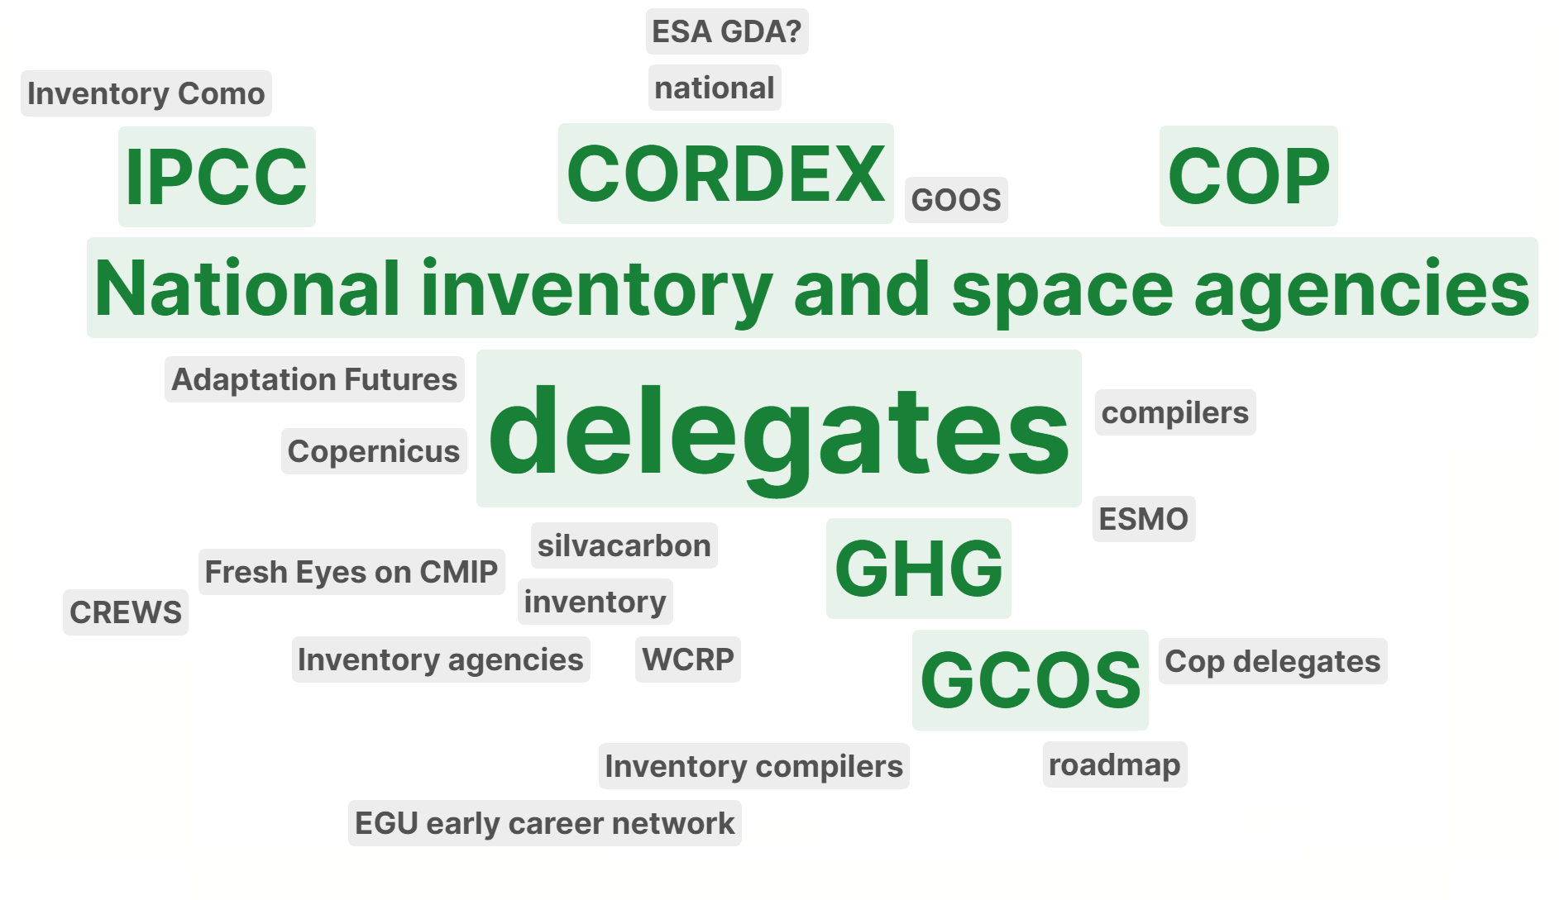
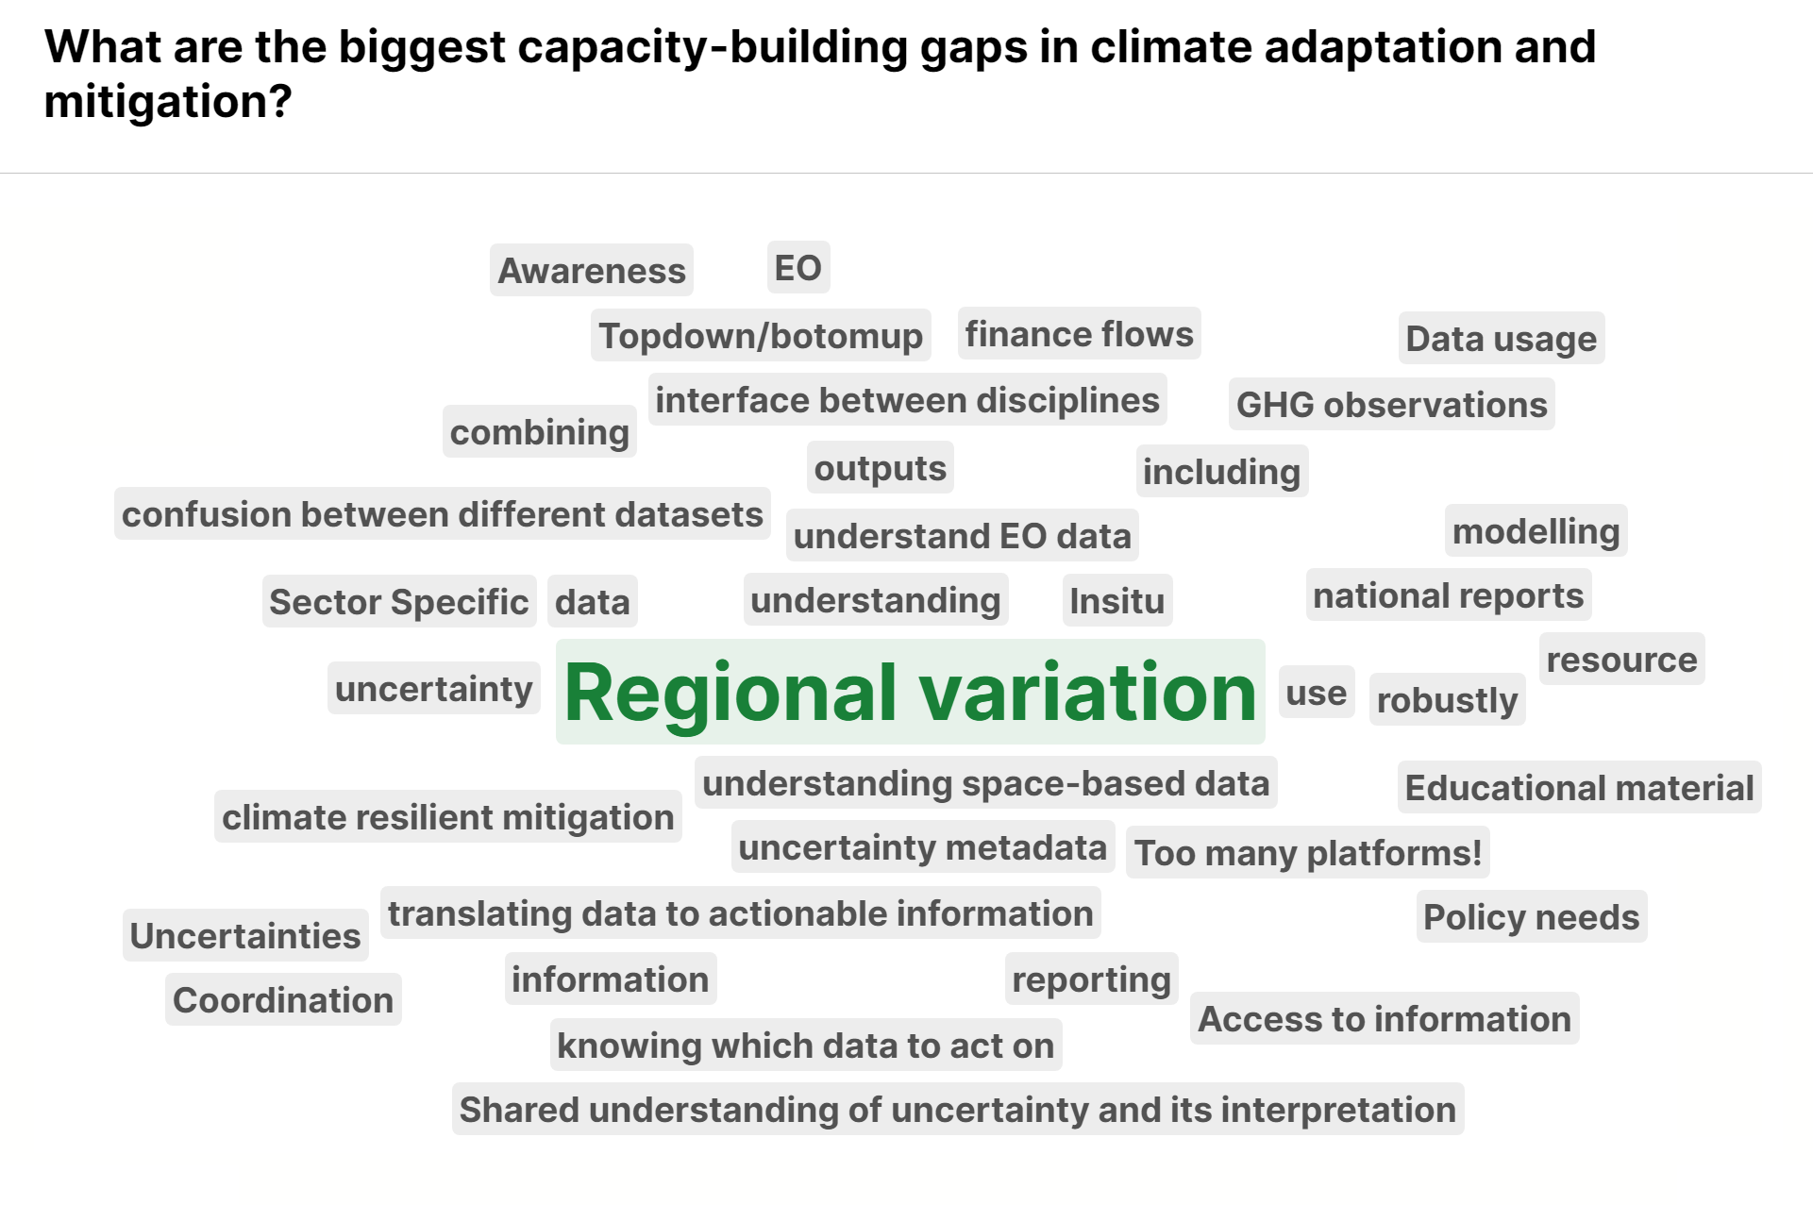
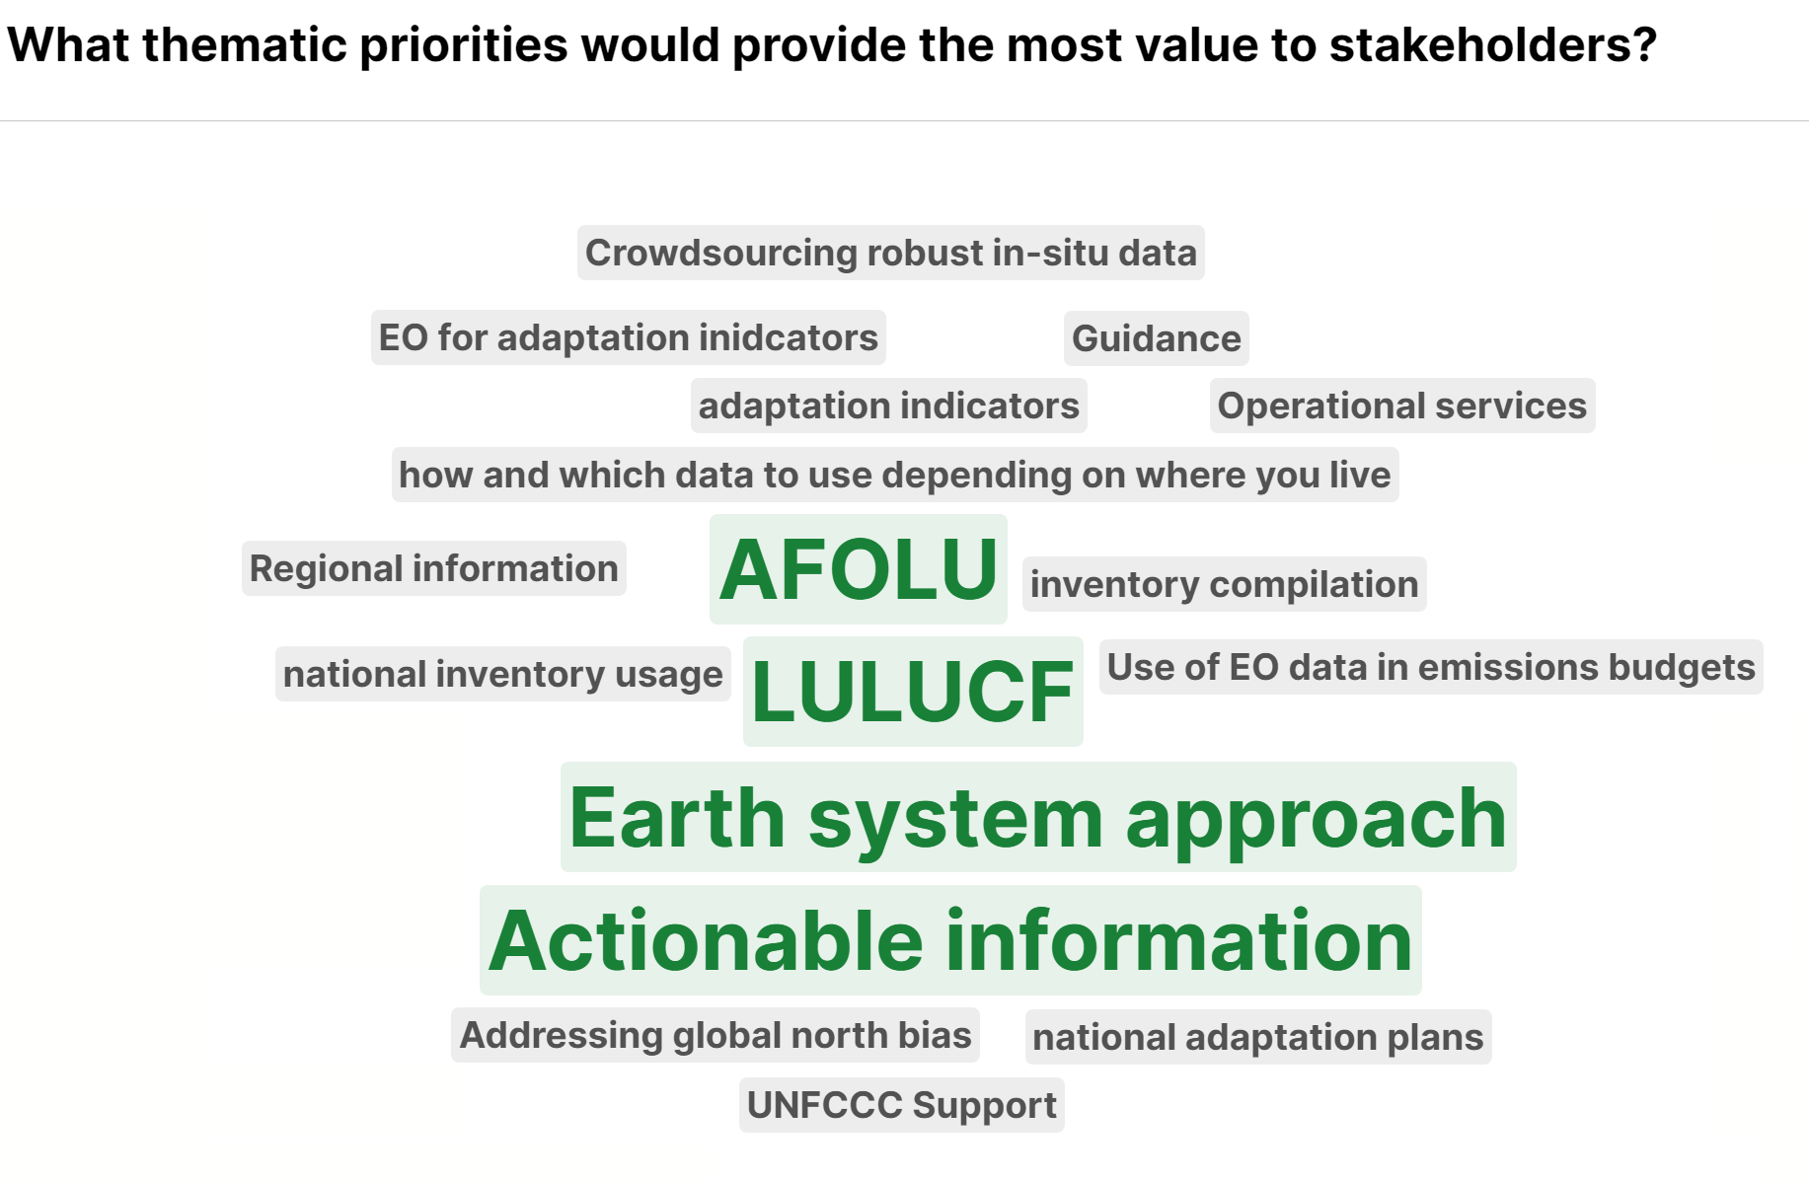
Responding to WGClimate & GHG-TT Discussions: EOTEC DevNet’s Perspective
Context
  WGClimate (2025): EO uptake gaps persist, despite increasing availability of data and tools
  GHG-TT (2026): A broad range of capacity-building materials already exist, with limited visibility and user guidance
Shared challenge
  The primary challenge is not the availability of training content
  Rather, it’s the discoverability, structuring, and practical application of existing materials
Who are the critical partners & projects we should engage with?

Slide 7
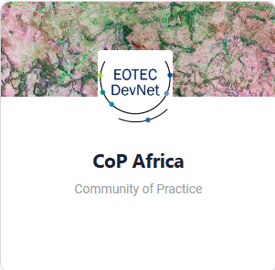
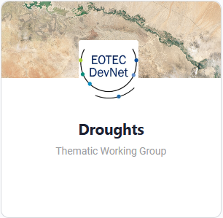
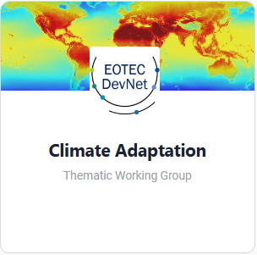
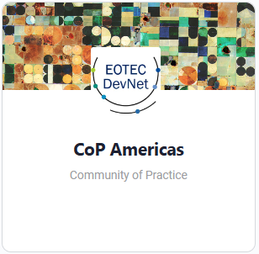
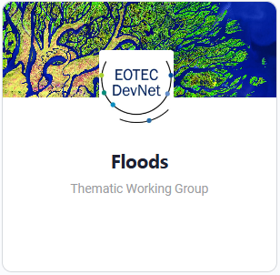
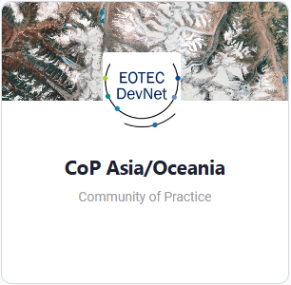
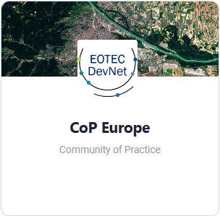
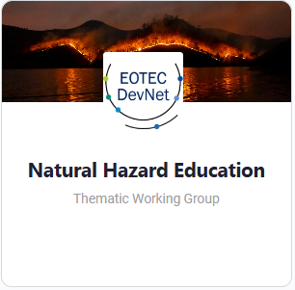
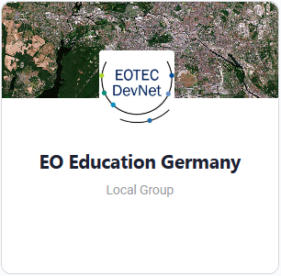
How EOTEC DevNet Can Support
EOTEC DevNet’s Added Value
  Coordination and communications platform, linking CEOS activities with the wider EO capacity-building community
  Facilitation of community engagement, as demonstrated by regional/thematic Communities of Practice
  Structured exchange of practices and lessons learned across regions and thematic areas
Practical Support
  Foster access to tools and data (e.g., Floods and Drought Tools Trackers, Needs Assessment Guidance, use cases)
  Facilitate community contributions and feedback
  Channel to a diverse community of ~400 members across national agencies, space institutions, academia, UN bodies, regional climate centres, and private sector organisations with expressed interest in climate topics
  The infrastructure for a climate-focused community is in place; its scope is being defined, and we welcome input to align future activities for impact

Slide 8
Plenary Recommendations
Activities/Actions | Responsible entities | Resources needed​ | Duration​ (years) | Draft GST Roadmap Recommendations Addressed​
Develop specific use cases to provide transparent explanations of the information content and uncertainties associated with these products and collaborate with EOTEC DevNet to provide trainings on using EO to support adaptation and resilience. (Consider further refinement by WGCapD and 2026 Chair before adding to workplan) | WGCapD (primary) ACVC LSIVC 2026 CEOS Chair WGClimate | ​Significant resources for demonstrators and long-term commitment for trainings | Annually | 6. WGCapD should work with subject matter experts on the AFOLU, GHG TT and AC-VC GHG teams and with the NGHGI community to develop capacity building materials that provide a transparent explanation of the information content and uncertainties of these products 14. CEOS should reinforce its partnership with EOTEC DevNet and engage in the Climate Adaptation Working Groups (CAWG), to develop and deliver capacity building activities to support the adaptation goals of the Global Stocktake.
Engage with end users and stakeholders to showcase the use cases that provide transparent explanation of the satellite-derived GHG and AFOLU products | WGClimate LSI-VC | ​​Short-term engagement after other actions complete | ​2-3 | 6. WGCapD should work with subject matter experts on the AFOLU, GHG TT and AC-VC GHG teams and with the NGHGI community to develop capacity building materials that provide a transparent explanation of the information content and uncertainties of these products

Slide 9
Plenary Recommendations
Activities/Actions | Responsible entities | Resources needed​ | Duration​ (years) | Draft GST Roadmap Recommendations Addressed​
Develop specific use cases to provide transparent explanations of the information content and uncertainties associated with these products and collaborate with EOTEC DevNet to provide trainings on using EO to support adaptation and resilience. (Consider further refinement by WGCapD and 2026 Chair before adding to workplan) | WGCapD (primary) ACVC LSIVC 2026 CEOS Chair WGClimate | ​Significant resources for demonstrators and long-term commitment for trainings | Annually | 6. WGCapD should work with subject matter experts on the AFOLU, GHG TT and AC-VC GHG teams and with the NGHGI community to develop capacity building materials that provide a transparent explanation of the information content and uncertainties of these products 14. CEOS should reinforce its partnership with EOTEC DevNet and engage in the Climate Adaptation Working Groups (CAWG), to develop and deliver capacity building activities to support the adaptation goals of the Global Stocktake.
Engage with end users and stakeholders to showcase the use cases that provide transparent explanation of the satellite-derived GHG and AFOLU products | WGClimate LSI-VC | ​​Short-term engagement after other actions complete | ​2-3 | 6. WGCapD should work with subject matter experts on the AFOLU, GHG TT and AC-VC GHG teams and with the NGHGI community to develop capacity building materials that provide a transparent explanation of the information content and uncertainties of these products
WGCapD will connect to WGClimate, the GHG TT, AFOLU experts, to discuss potential linkages and identify priority use cases for capacity development.
To develop and deliver EO training and capacity development for adaptation and resilience, WGCapD will [a] continue to liaise with EOTEC DevNet and [b] explore additional pathways with CEOS members.

Slide 10
Joint Actions
Establish WGClimate-WGCapD coordination team to address capacity building (needs assessment, development, delivery) in the climate (adaptation & resilience) domain
- may lead to establishment of a WGCapD Task Team
- leverage EOTEC DevNet community insights (reaching beyond CEOS entities) to identify gaps and foster engagement (incl.
through regional & thematic CoPs)
Start consolidated effort to collect existing capacity building material related to the climate domain (both centrally, and leveraging WG members)
- will provide comprehensive status overview
- will enable the identification of gaps as compared to identified ‘community priorities’
- explore whether additional structuring or tracking mechanisms for GHG-related resources could support improved access
and coordination
Stimulate WGCapD member agencies to submit deliverables related to the climate domain,
in liaison with WGClimate

