Slide 1

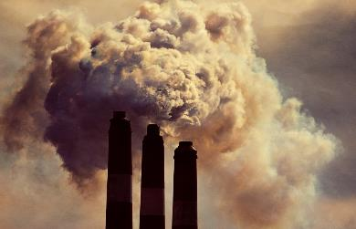
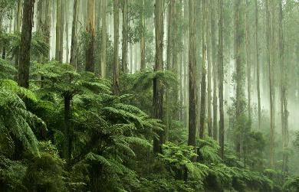

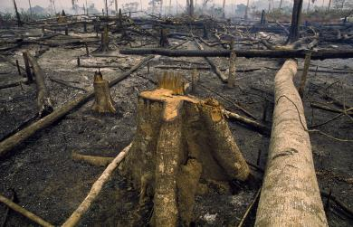



GCP / RECCAP2 & 3 Activities
relevant to CEOS WG Climate

Slide 2
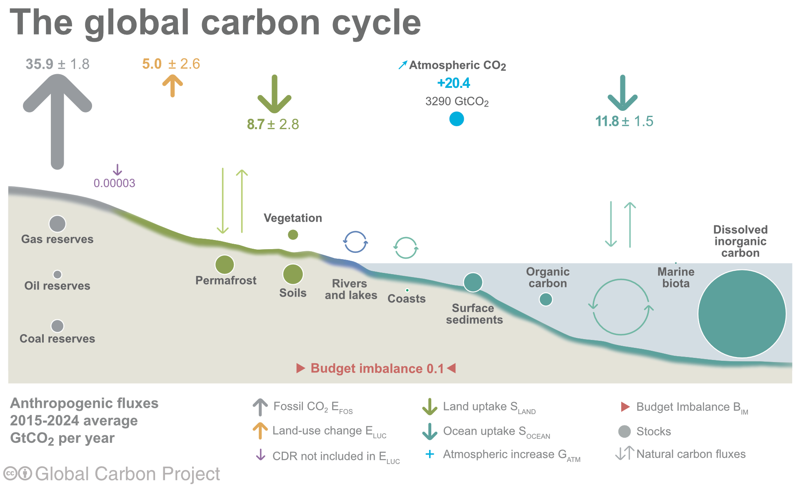
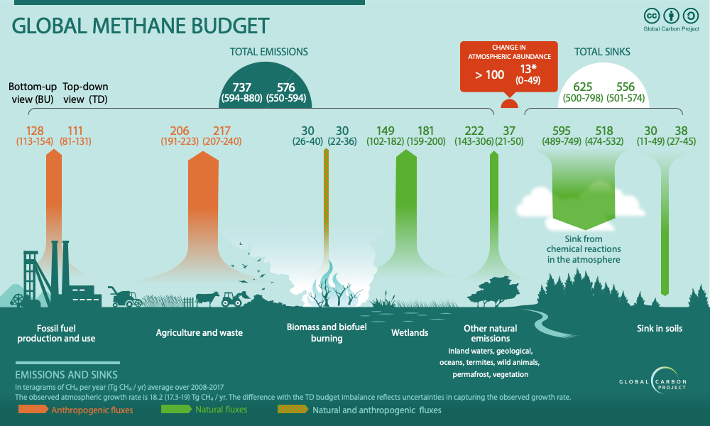
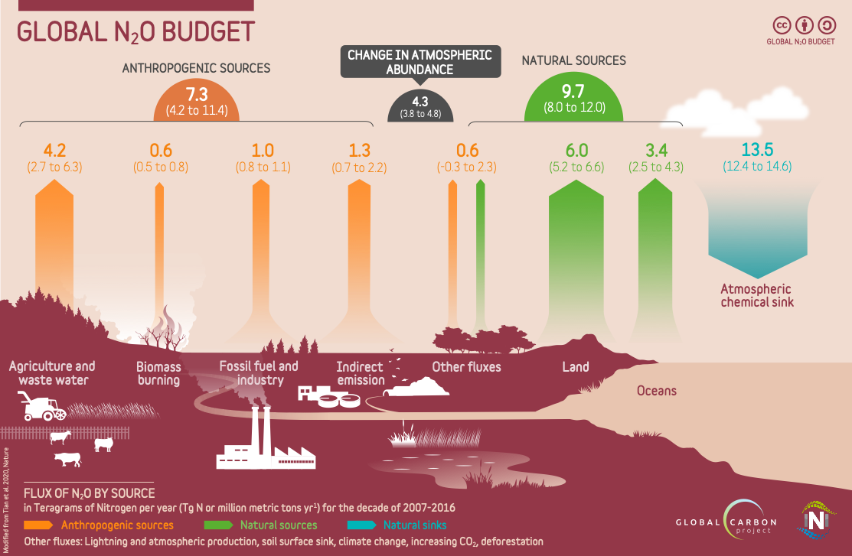
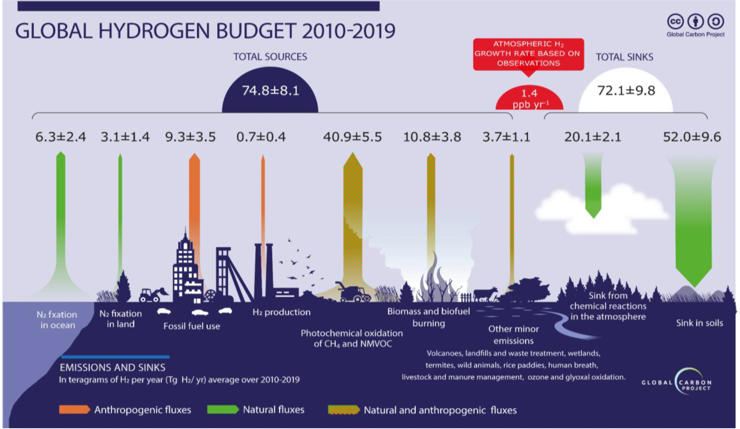
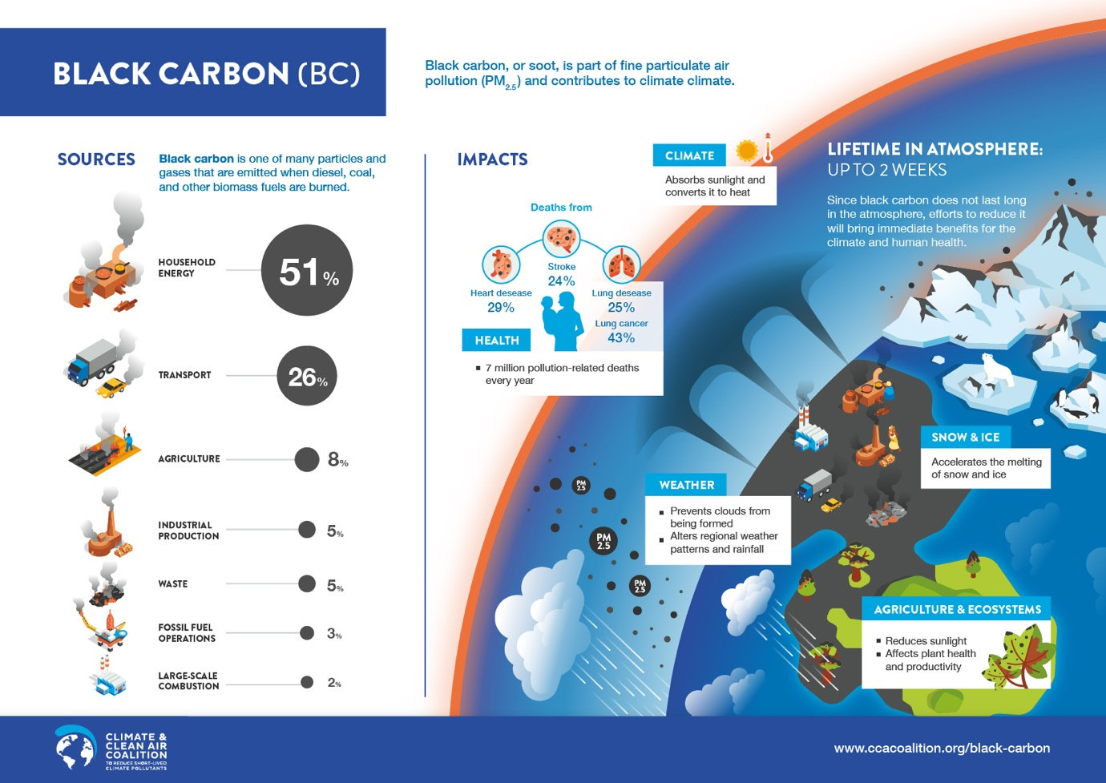
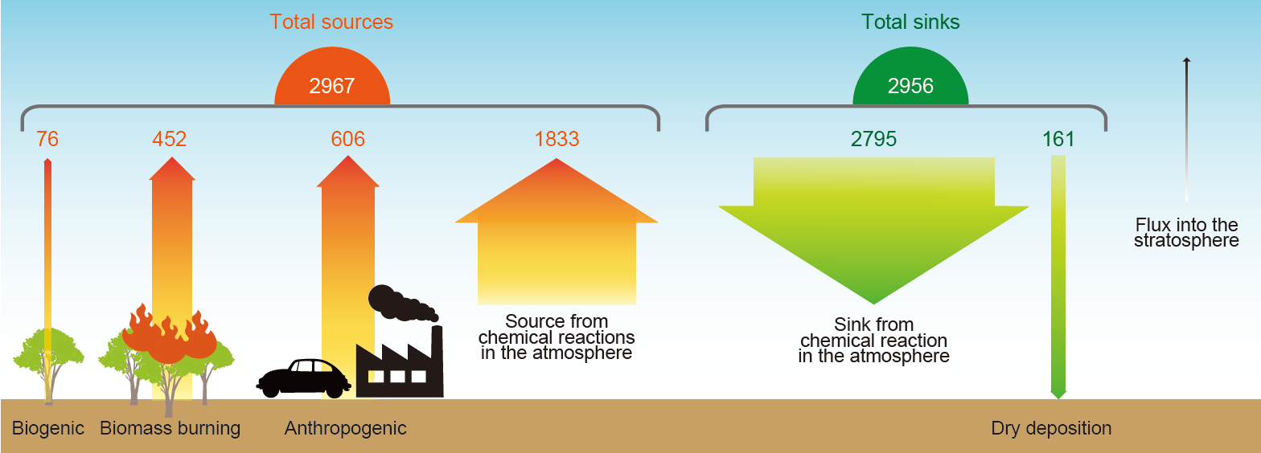
Current Global GHG Budget Activities
Increasing interest in the use of Remote Sensing products
CO₂
CH₄
N₂O
H₂
Black Carbon
Carbon Monoxide

Slide 3
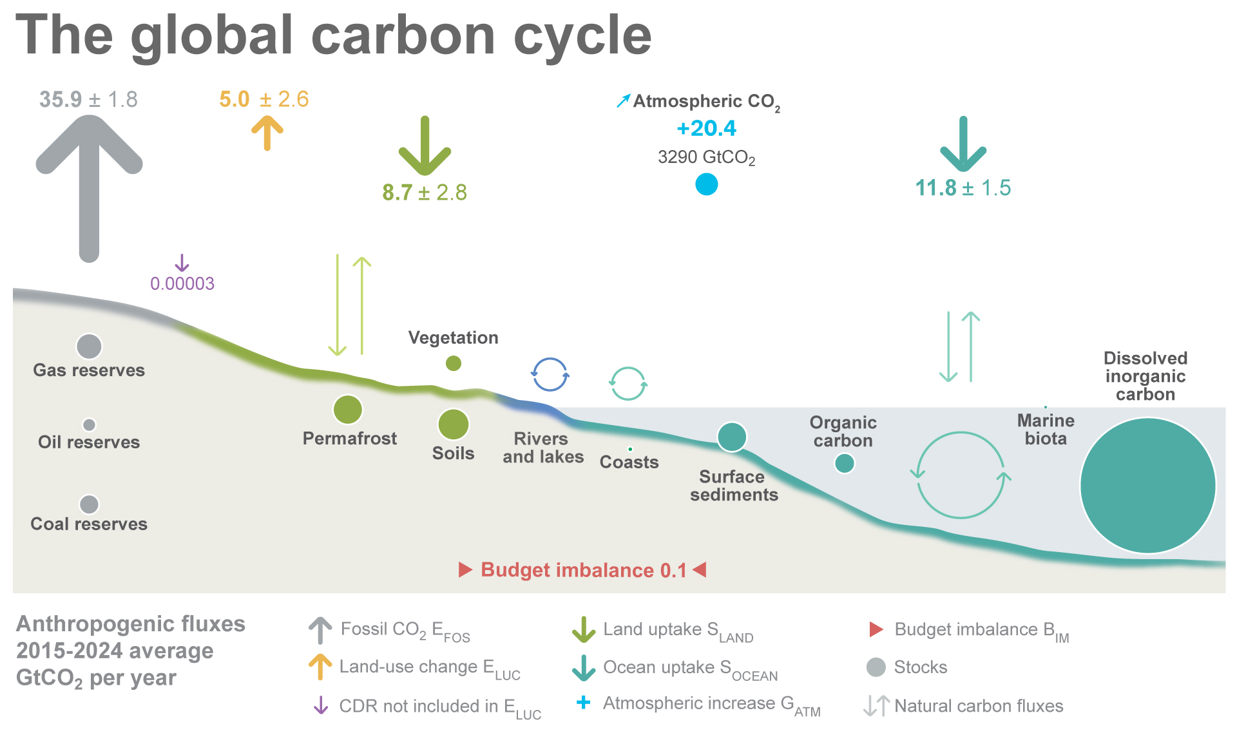
Anthropogenic perturbation of the global carbon cycle
Perturbation of the global carbon cycle caused by anthropogenic activities, global annual average for the decade 2015–2024 (GtCO₂/yr)
CDR here refers to Carbon Dioxide Removal besides those associated with land-use that are accounted for in the land-use change estimate. The budget imbalance is the difference between the estimated emissions and sinks. Source: NOAA-GML; Friedlingstein et al 2025; Canadell et al 2021 (IPCC AR6 WG1 Chapter 5); Global Carbon Project 2025

Slide 4
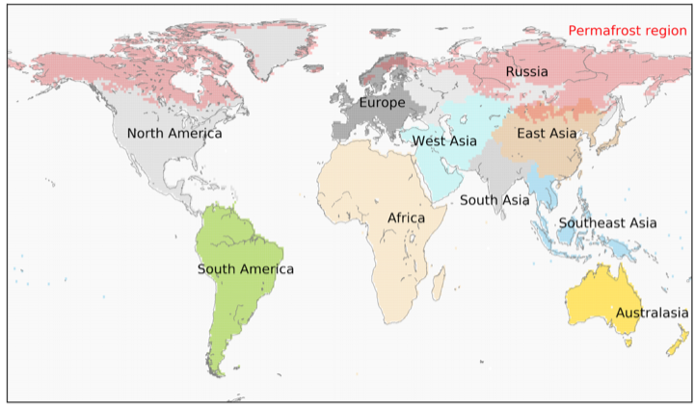
Terrestrial Regional GHG Budgets-RECCAP2
Land Regions/Teams:
L1 Africa
L2 Australasia
L3 Europe
L4 Russia
L5 North America
L6 South America
L7 East Asia
L8 Southeast Asia
L9 South Asia
L10 Central Asia
Special Interest Regions:
L11 Permafrost Region
L12 Polar Regions (Greenland & Antarctica)
Ocean basins and coastal zones are also part of RECCAP2, not shown.
Budgets, Trends, Variability, Processes, Future projections
RECCAP2 ending in mid-2026 with final synthesis
Polar regions
AGU RECCAP2-Special Collection
https://agupubs.onlinelibrary.wiley.com/doi/toc/10.1002/(ISSN)2169-8961.RECCAP2
Polar regions

Slide 5

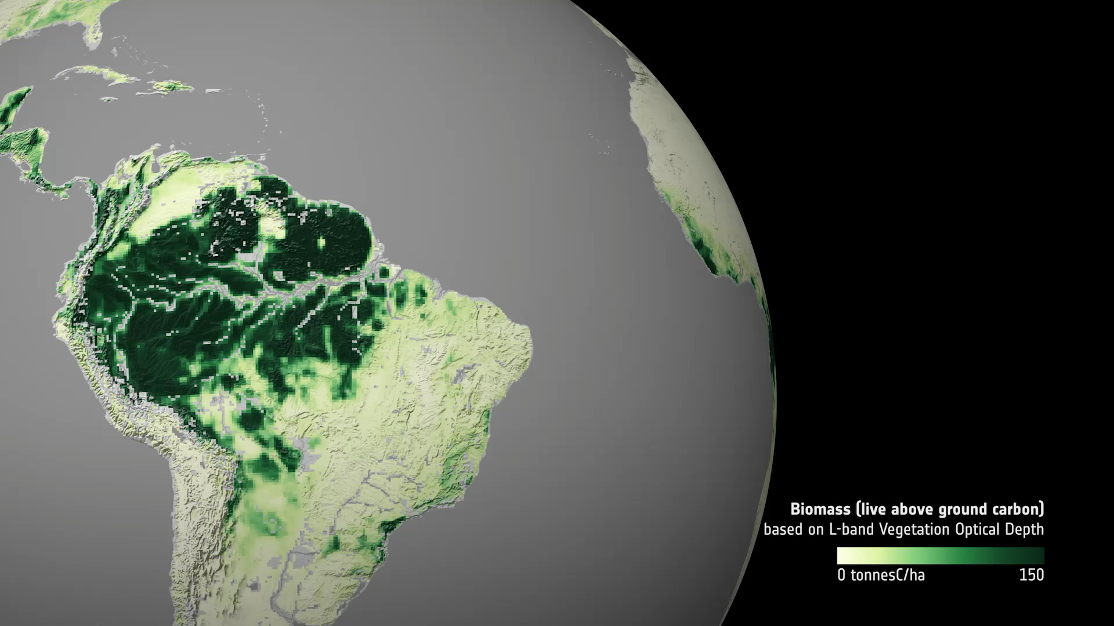
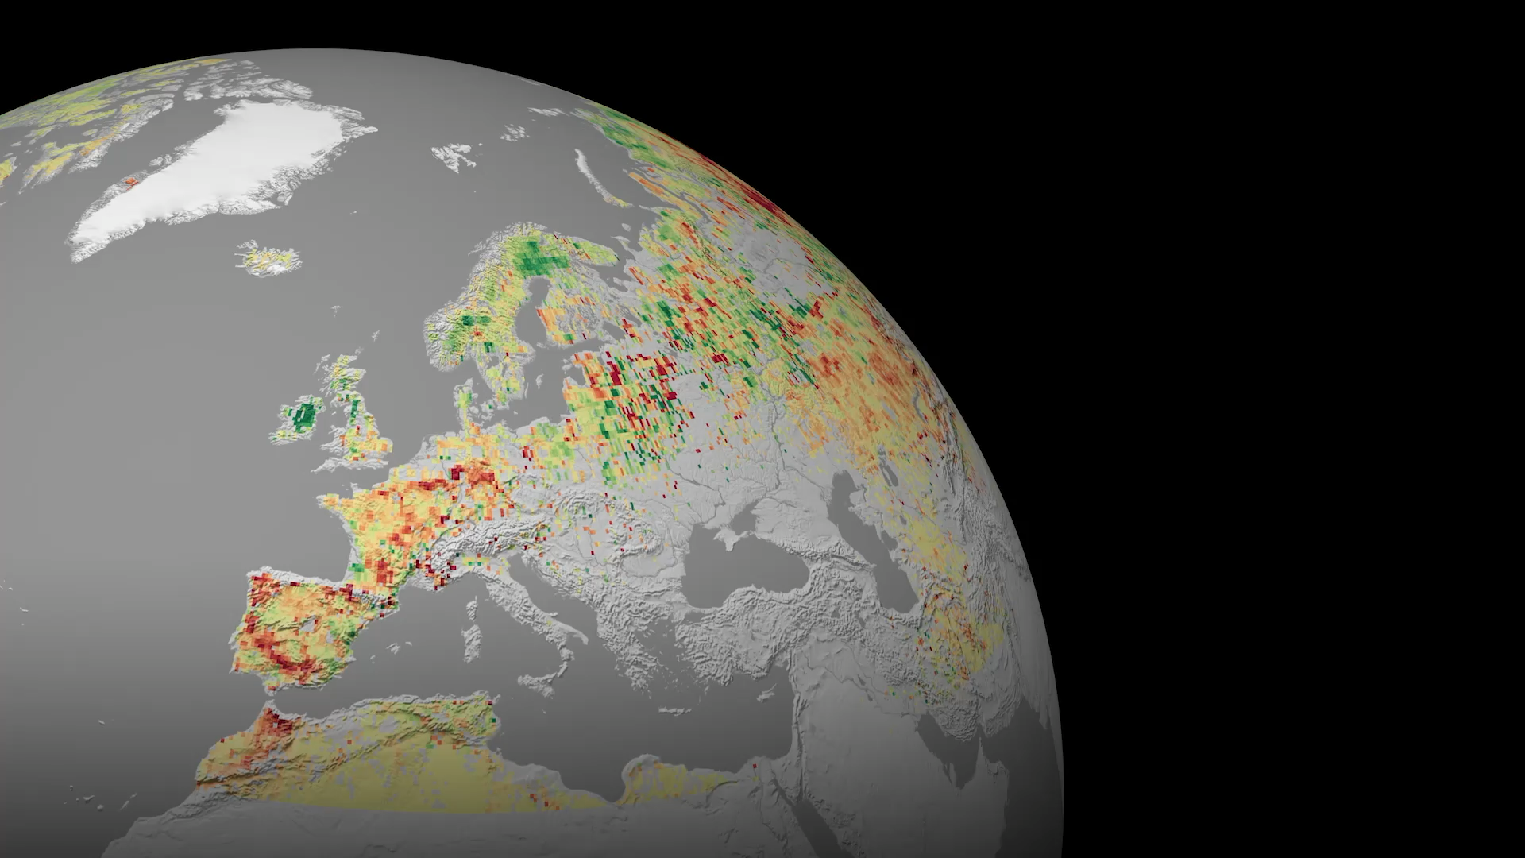
Observations for GHG inventories and reporting
Amazon
Europe
The Amazon region lost 370 million tonnes of carbon 2010-2020 decade. The south-eastern area is now a net source.
European forests’ ability to absorb carbon has weakened over the past decade, posing a risk to achieving future European climate goals.
Article in full / Video in full ➔ ESA - ESA satellites track progress on Paris Agreement goals
Notes:
LEFT
We have also combined satellite observations together with ground data and computer models to map global land carbon stocks.
In the amazon the region lost 370 million tonnes of carbon over the 2010-2020 decade and the south eastern part is now a net carbon source meaning that carbon absorption by growing forest has been outweighed by deforestation degradation and agricultural use
RIGHT
A similar pattern appeared across Europe, forest absorbed about 10% of the EU’s greenhouse gas emissions between 1990 and 2022.
But in the last ten years this emissions offset has declined by nearly 30% due to forest harvesting and ageing, more frequent droughts, heatwaves and wildfires, plus insect outbreaks and plant disease.
This decline poses a risk to achieving future European climate goals.

Slide 6
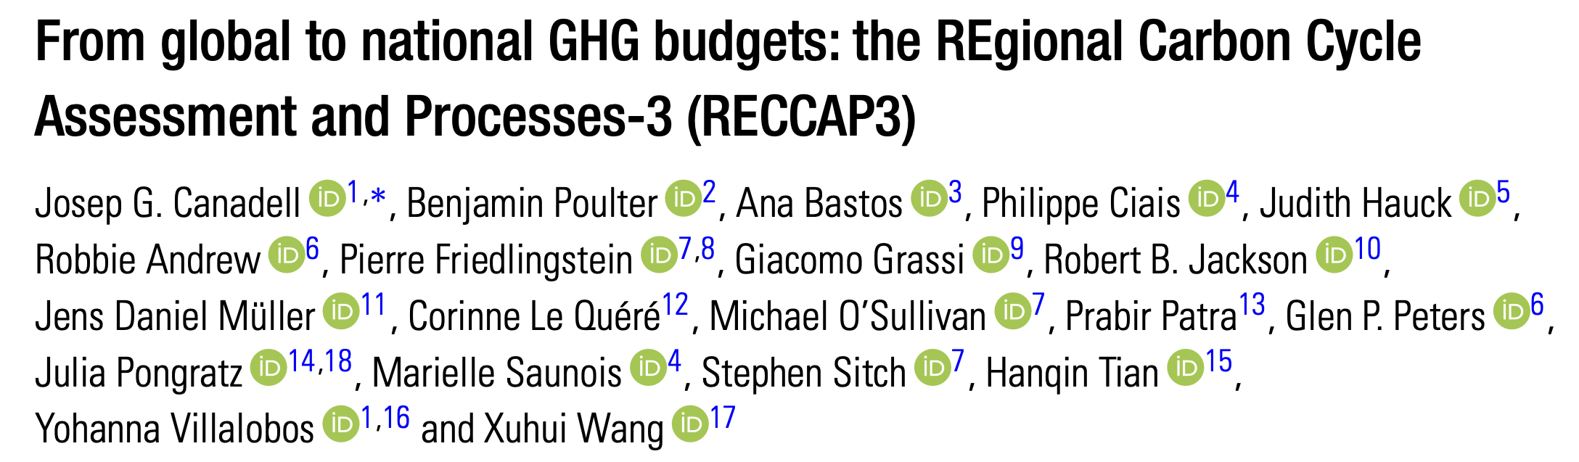
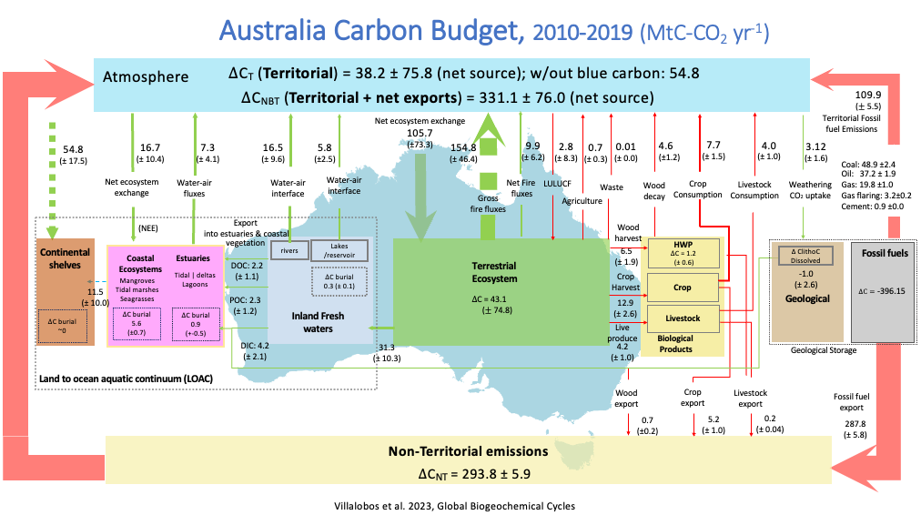
From Global & Regional GHG Budgets to National Budgets
REgional Carbon Cycle Assessment and Processes-3 (RECCAP3)
To be launched in 2026, w/Conference end 2026/early 2027
Example of the type of comprehensive assessment, with anthropogenic & natural sources & sinks, and integration of NGHGI
National Science Review, Volume 12, Issue 4, April 2025, nwaf037 https://doi.org/10.1093/nsr/nwaf037
Also in RECCAP3: Regions (and processes) of Special Interest: Permafrost region, Amazon, Tropical Africa, Tropical Wetlands, Southern Ocean, Ocean biological carbon pump,…
Remote Sensing Products: column GHGs, Biomass, Burned Area, wetlands, saturated soils area, …
Initial Interest in national budgets for RECCAP3:
China (PKU-led), India (Schmidt Foundation), North America (GHG Coalition), SEAsia consortium, Mongolia (ChibaU-led), other countries have expressed interest.
Notes:
…
access to cloud computing and running of Jupyter notebooks.

Slide 7
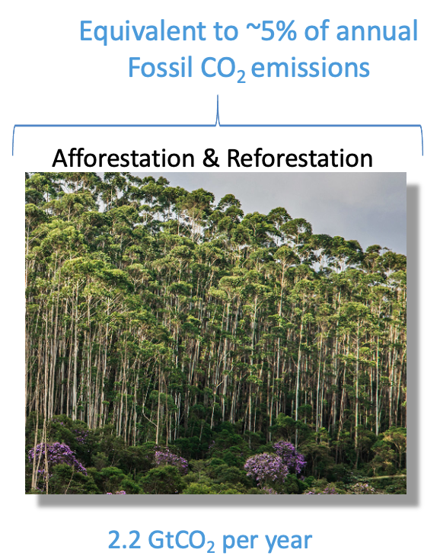
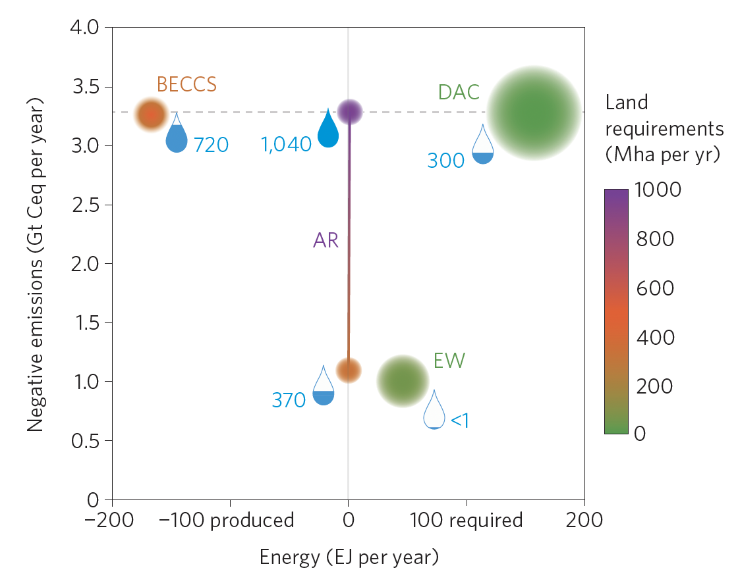
Global and National Potentials for Carbon Dioxide Removal
Location, size, and drivers of current anthropogenic C sinks
Biophysical and economic limits to negative CO₂ emissions
(an update of Smith et al. 2016, NatCC)
Remote Sensing needs: Biomass, Land cover change, land use, Greenness, …
(mean 2014-2023)

