Slide 1
Updates on the Integrated Global Greenhouse Gas Information System
Tarasova Oksana, WMO
Agenda Item 8.5

Slide 2

Reminder of the IG³IS scope
… a common framework for provision of systematic services to user community supporting their greenhouse gas emission reduction ambitions
Support the use of atmospheric data to improve emission
and/or removals estimates
Consensus on a coherent set of good-practice methods and guidelines
Quality control (benchmarking)
The solutions is:
Scalable
Applicable to different gases
Transparent
Based on the most recent science
Range of scales
Industry
Cities
Countries
Global Stock taking

Slide 3
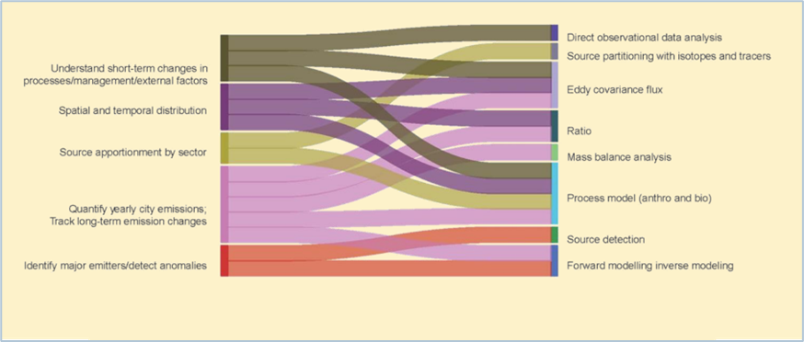
IG³IS achievements 2025
Revision of the Urban Emission Observation and Monitoring Good Research Practice Guidelines
31 techniques are included in the document that aim to enhance the quantification of gaseous emission estimates by integrating atmospheric observations with activity data.
The guidelines address stakeholders' key questions about city emissions and outline tools for effectively gathering the necessary data.
The document was reviewed at the Urban Greenhouse Gas Conference and Stakeholder Summit (7-9 April 2025)

Slide 4
IG³IS achievements 2025
Development of the Integrated Global Greenhouse Gas Information System Good Practice Guidance for Estimating National-scale Greenhouse Gas Emissions using Atmospheric Observations
First addition is produced and launched in December 2025
It builds on mature (Lagrangian modelling) techniques
Includes 8 National cases in the Annex to the general methodological description
Supplements 2019 refinement to the 2006 IPCC guidelines for national greenhouse gas inventories
The supporting workshop “IG3IS National-scale Applications of the Science-based Quantification of Emissions and Removals” took place on 30 June–01 July 2025
Comments were received from IPCC TFI and UNFCCC Transparency Division
Next version is planned to be produced in collaboration with the EU projects EYE-Clima, PARIS and EVENGERS and will include more diverse set of techniques
Connects to G3W via boundary conditions

Slide 5
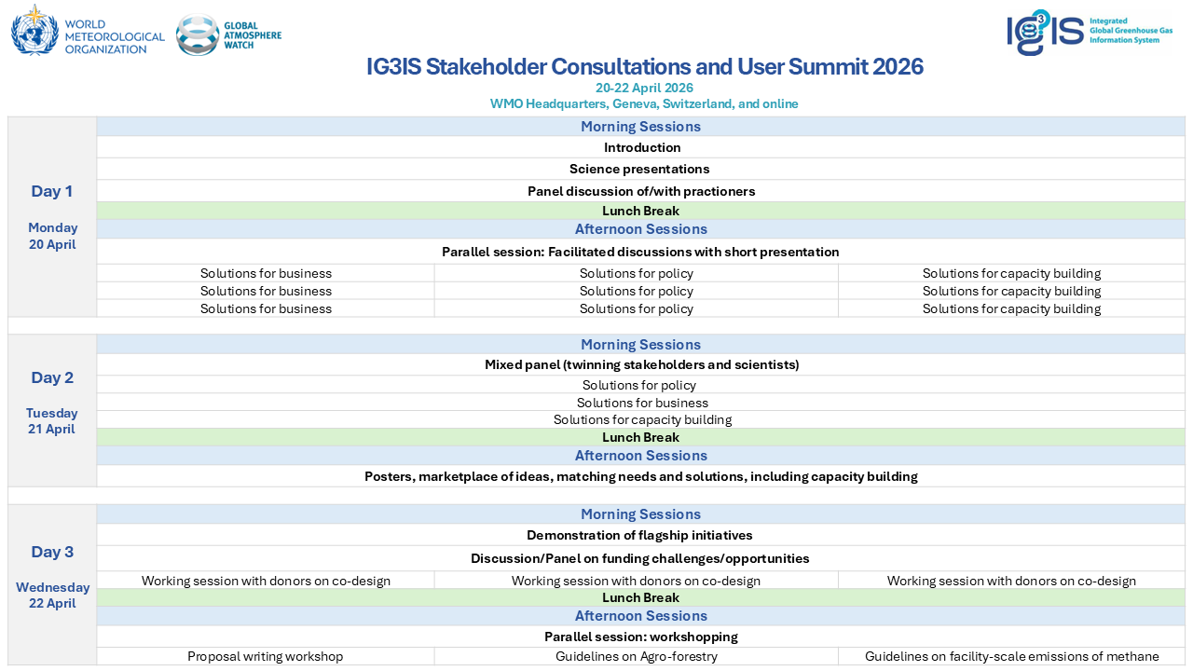
IG³IS plans for 2026
IG³IS Stakeholder Consultations and User Summit 2026 (20 - 22 April, Geneva, Switzerland) – hybrid – substantial engagement from the NDC Partnership
Development of the good practice documents for:
          facility scale CH₄ (coordinated by Felix Vogel)
          landscape scale CO₂ emissions and removals with the focus on forestry (coordinated by Jocelyn Turnbull)
Continuous webinars

Slide 6
Key issues of relevance to WGClimate
Register and participate in the IG³IS Stakeholder consultations.
Contribute to good practices.
Inform WMO about the institutions/focal points to engage in the good practices work.

