Slide 1
Updates on the Global Greenhouse Gas Watch
Tarasova Oksana, WMO
Agenda Item 8.6

Slide 2
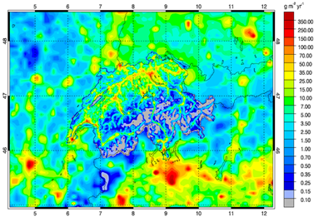
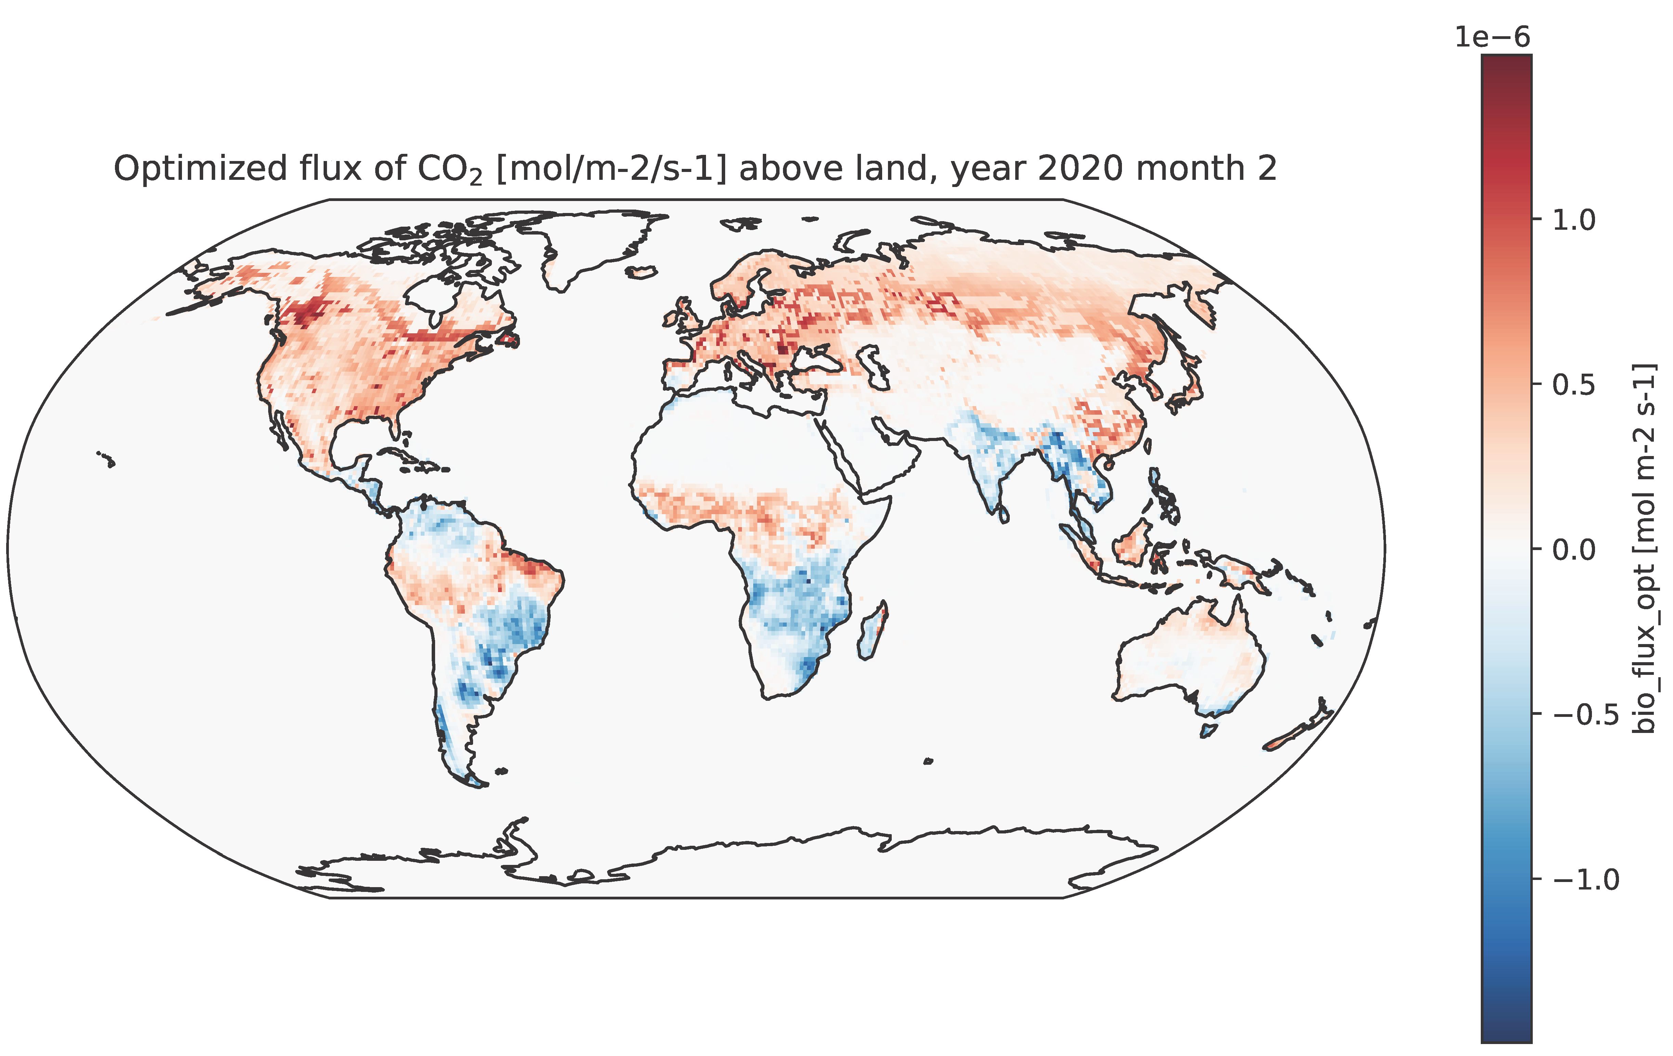
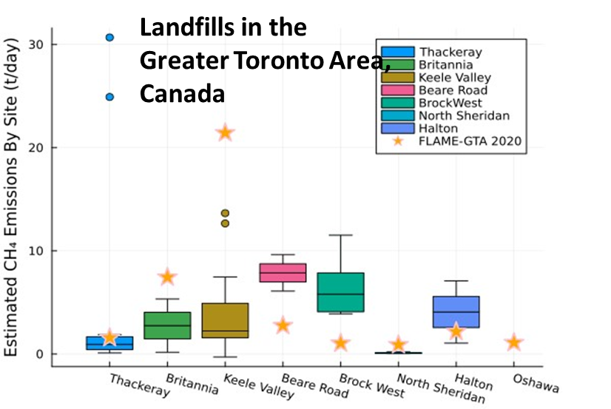

Reminder on G3W objectives
G3W global products could provide boundary conditions to the decision-making scales
National
Boundary conditions
Urban
Facility
G3W: modelled global GHG concentration fields at 1x1° resolution, and modelled monthly net surface fluxes at 1x1° resolution
External to G3W programme
Space for research, private and national public initiatives

Slide 3
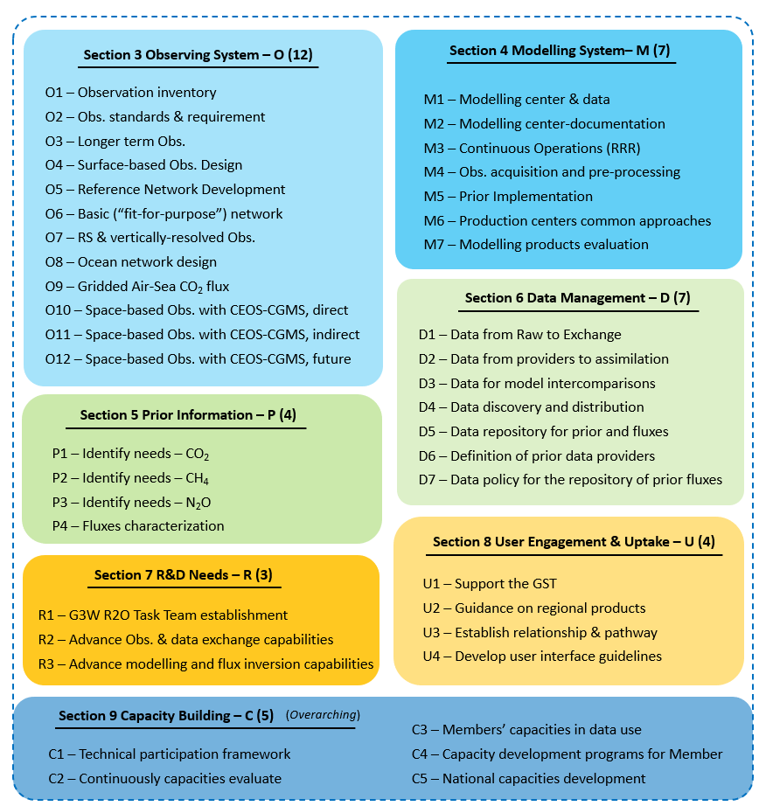



G3W Implementation plan
Create inventory of observations
Carry out observational network design
Definition of the output products and system requirements
Evaluate applicability of WIS2.0 for G3W required data exchange
Connect existing observations to WIS
Create inventory of prior data products
Identify requirement for the products
Provide recommendations on the use of G3W outputs
Develop the supporting
R&D strategy
Identify the highest priority research needs for the operational systems

Slide 4
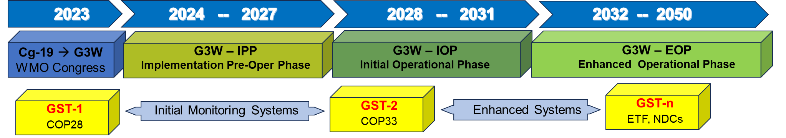
Status of G3W Implementation
G3W Implementation of pre-operational phase officially started.
G3W Advisory Group and Task Teams (Modelling, Networks, Data) are formed.
Technical workshop for data providers was organized on 5-7 March 2025 in Geneva, Switzerland
Technical workshop on G3W network design took place on 7-9 October 2025 in Geneva, Switzerland
Extraordinary Session of the World Meteorological Congress (20-23 October 2025) “Decides to advance the goals of G3W by integrating key components into existing programmes, including the expanded World Weather Watch and the Global Atmosphere Watch Programmes, as appropriate, without adversely impacting the workplans of those programmes”

Slide 5
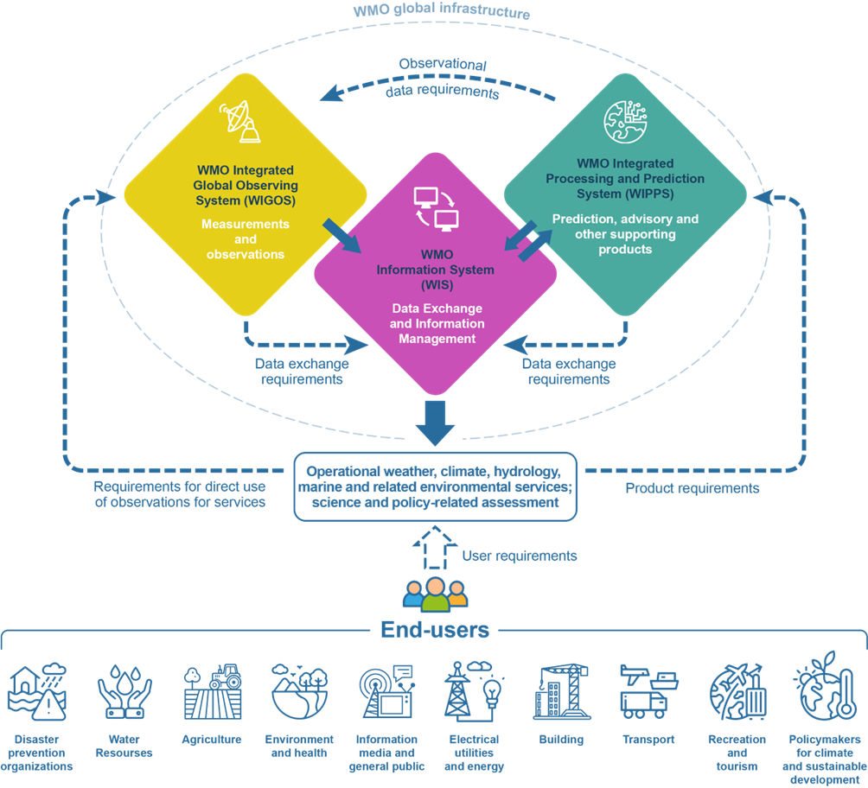
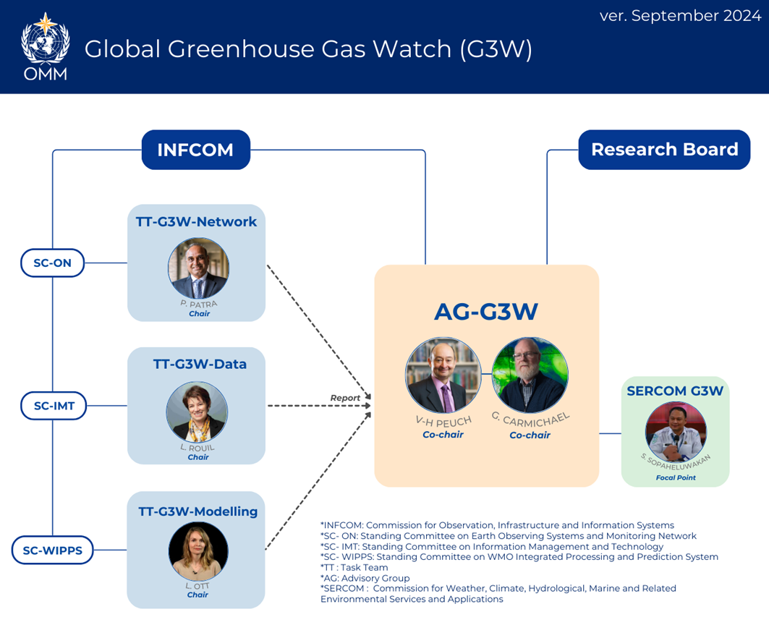
Expanded WWW programme components
Expanded WWW programme components
G3W observations across Earth System domains
G3W outputs by designated centers
G3W data exchange via WIS
G3W does not have a specific assigned budget

Slide 6
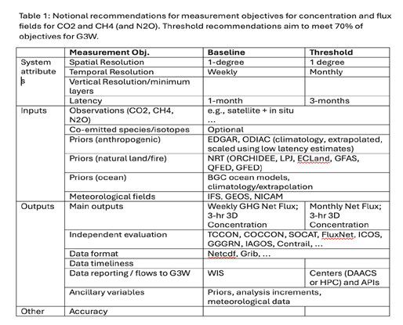
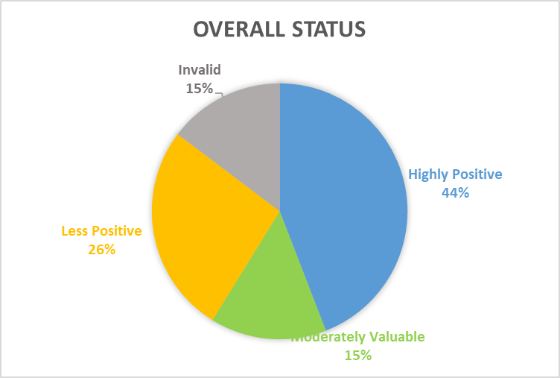
Status of G3W Implementation
Task Team on G3W modelling
Review of the draft WIPPS Manual section
Regular comparisons of the output products conducted by modelling centres
Task Team on G3W data
Survey of data management practices (deadline is on 15 February)
Planning of detailed interviews
Responses include observations, modelling outputs and inventory
Highly Positive：Share data and are willing to be interviewed to discuss their practices
Moderately Valuable: Share data, but not willing to be interviewed
Less Positive: Don’t have GHG data(CO₂, CH₄,N₂O)
Invalid: No valuable information or confused with meteorological observation
Highly Positive | 15
Moderately Valuable | 5
Less Positive | 9
Invalid | 5
 | 34
Open questions: model performance, uncertainty characterisation
Technical workshop in June 2026

Slide 7
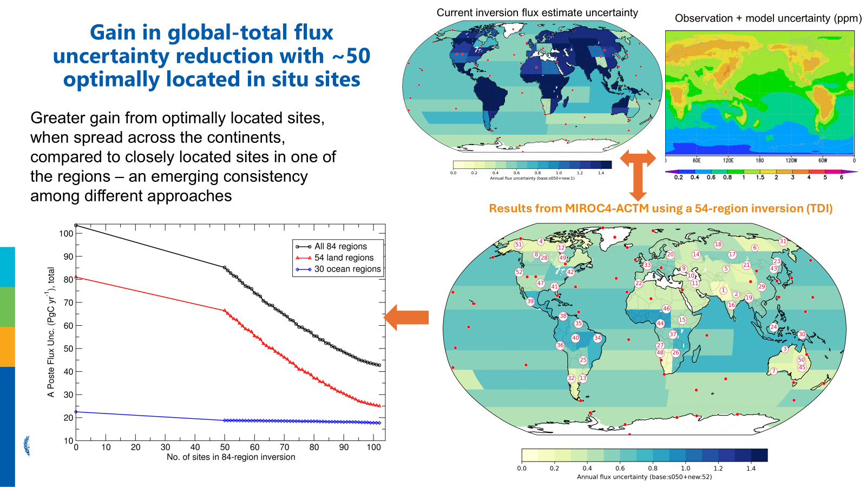
Network design
G3W Network Design Workshop — 7–9 October 2025, Geneva
Important message: Even a limited number of strategically placed stations can dramatically reduce inversion uncertainties

Slide 8
Network design: priority activities
 | Description | Lead | Team members | Timeline | Needed partners
S2 | Define application area for G3W products as an application under Rolling Review of Requirements | Prabir Patra |  | March | JET-OSDE
S2 | Develop specific observation requirements for G3W operational products (monthly 1°x1° gridded CO₂ and CH₄ fluxes) – requirements are independent of technology | Prabir Patra | Sourish | Mid May | TT-modeling
S4 | Define tieres of observations (tiered network framework) | Sanam Vardag | Thorsten, John, Dagmar | Mid May | TT-Data
S5 | Conduct controlled intercomparison exercises that separately assess ingested data, transport model uncertainty, and prior flux uncertainty | Sourish Basu |  | End June | TT-modelling
S4 | Conduct dedicated studies on the quantitative added value of vertical profiles (aircraft data) versus surface observations | Sourish Basu | John | End June
S5 | Implement iterative uncertainty reduction approach starting with achievable targets (e.g., 20% uncertainty for larger regions) through OSSE | Prabir Patra |  | End June | TT-modelling
 | Conduct community research activity on footprint analysis of existing infrastructure (CTBTO, ITU) | Beata Bukosa | Ravi, Matt | End June | CTBTO, ITU
S5 | Support OSSE activity using SOCOM platform | Adrienne Sutton |  | End June
 | Develop final report with recommendations on the global GHG network deployment for G3W | Prabir Patra | All TT-networks | July-August | TT-modelling, TT-data

Slide 9
G3W plans
Deliverables for 2024-2025 and priorities for 2026-2027
Expected deliverables by INFCOM-4 (November 2026)
Priority activity 2026-27
OSSE experiments design, initial network design proposal, definition of tiered network
Inventory of existing greenhouse gas observations
Initial mapping of data streams and their characterisation
Updates for WIPPS Manual on G3W products and centers
Working on demonstration/pilots of the network implementation
Start developing network sustainability strategy
Advance data architecture
Implement some demonstrations of data workflows
Establish operational model comparison protocols and performance metrics

