Slide 1
GHG Capacity Development Materials
Libby Rose
GHG-TT Secretariat
Agenda Item 8.7

Slide 2
GHG Capacity Development Materials
Many agencies and institutions already provide workshops and other materials to support capacity building for the use of space-based GHG datasets
GHG-TT will compile these resources and share for awareness and use by partners

Slide 3
Summer School for Inverse Modeling of Greenhouse Gases (SSIM-GHG)
Supported by US GHG Center
Run in 2024 & 2025
2024 Materials: https://www.cira.colostate.edu/teams/carbon/ssim-ghg-2024/
Target audience: graduate students and early-career post-docs

Slide 4
EMIT Data Resources
Repository containing guides, short how-tos, and tutorials to help users access and work with data from the Earth Surface Mineral Dust Source Investigation (EMIT) mission
Jupyter Notebooks on:
Visualizing Methane Plume Time Series
Generating Methane Spectral Fingerprint
Target audience: introduction to working with space-based methane data

Slide 5
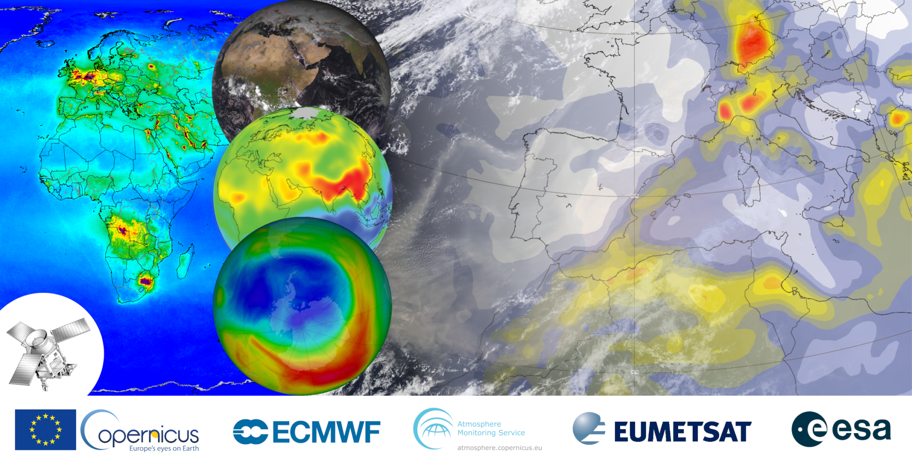
Joint ECMWF/ESA/EUMETSAT Training on Atmospheric Composition
Workshops run annually since 2019
https://atmostraining.info/
Some recordings and presentations available online
Mention of GHGs in 2022 and 2024 editions
Target audience: graduates and early career researchers

Slide 6
ARSET: Atmospheric CO2 and CH4 Budgets to Support the Global Stocktake
Three-part webinar series run in 2022
Video and presentation materials available online
Trainer: Dr. David Crisp ☺
Target audience: stakeholders at local, regional, and national levels who are interested in managing greenhouse gas emissions

Slide 7
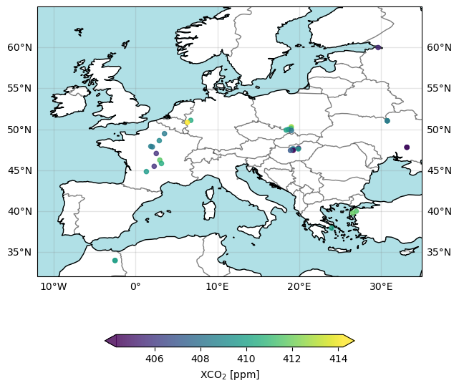
C3S: How to access and use a satellite-derived GHG Level 2 data product using XCO2_EMMA as an example
Jupyter notebook - introduction to using space-based GHG products
Published by Copernicus / ECMWF
https://ecmwf-projects.github.io/copernicus-training-c3s/ecv-notebooks/greenhouse-gases-level2-products.html
Target audience: those wishing to explore how to access and analyse space-based GHG data

Slide 8
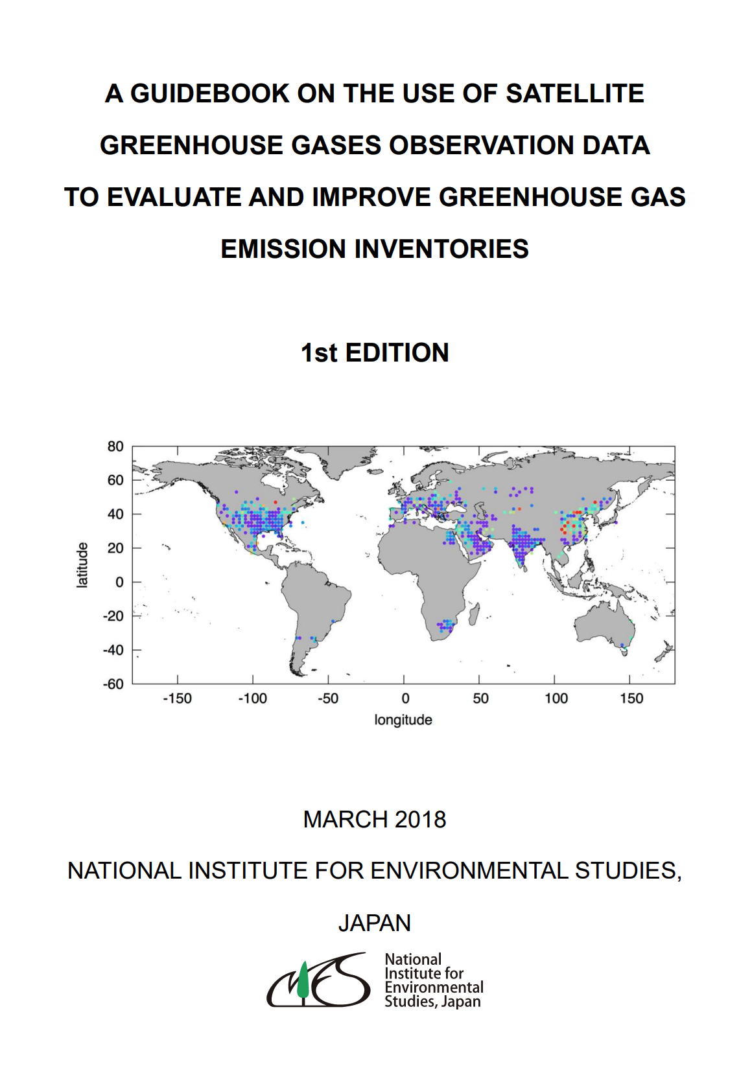
A Guidebook On The Use Of Satellite GHG Observation Data To Evaluate And Improve GHG Emission Inventories
Published by NIES in 2018, last updated 2020
https://www.nies.go.jp/soc/en/documents/guidebook/
144 page detailed document
Some familiar names in the contributors list!
Target audience: national inventory compilers and researchers in the related fields

Slide 9
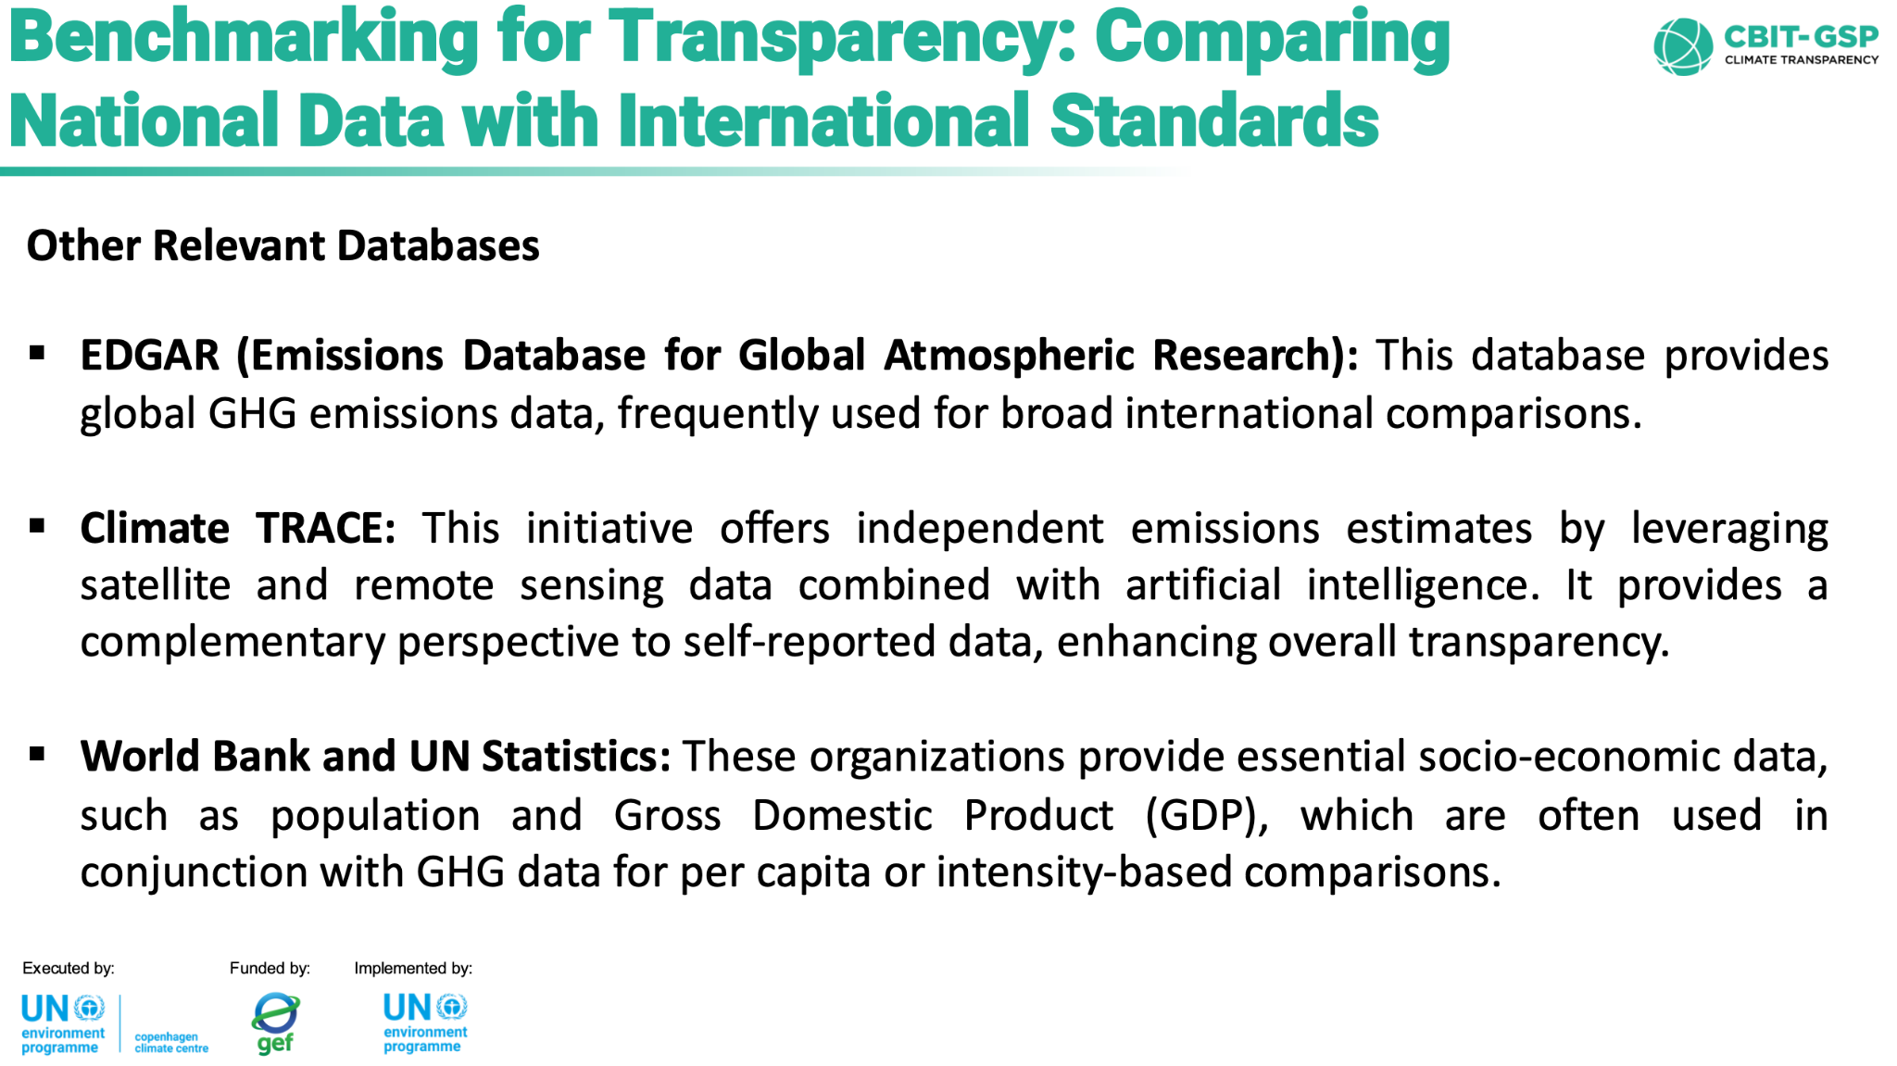
Greenhouse Gas Inventory System Training
Workshop
Run by the UN Office of Sustainable Development
7th edition occurred in 2025
Variety of videos and presentations online
Little to no discussion about the use of space-based data
Can we engage with UN OSD?

Slide 10
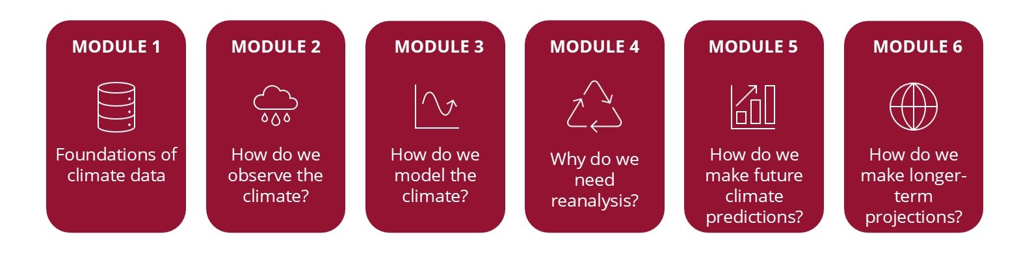
C3S: Understanding Climate Data
Foundations of climate data: what it is, how it is collected, processed, and made available by C3S.
Overview of the C3S Climate Data Store (CDS)
Online course, ~8hrs
https://climate.copernicus.eu/online-course-understanding-climate-data

Slide 11
Next Steps
What other resources should we look into?
DG-Clima workshop?
KCEO?
How to make these resources available?
What target audiences are we aiming to reach?
What types of materials are we interested in?

