Slide 1
Flux Inversion Modeling and Validation
Notes:
Flux Inversion Modelling and Validation
➢
➢
Impact of new sensors (GOSAT-GW & MicroCarb)
OCO-2 model intercomparison project (MIP)

Slide 2
The path between observation to action: inverse modeling
Modern GHG inversion systems estimate the conditional distribution function.
control/
state
forward model
data
prior
model-data error covariance
prior error covariance
Posterior estimate
Posterior covariance
Information content
The return on investment of CEOS investments is contingent on choices and approximations made for each component.
Choose wisely.

Slide 3
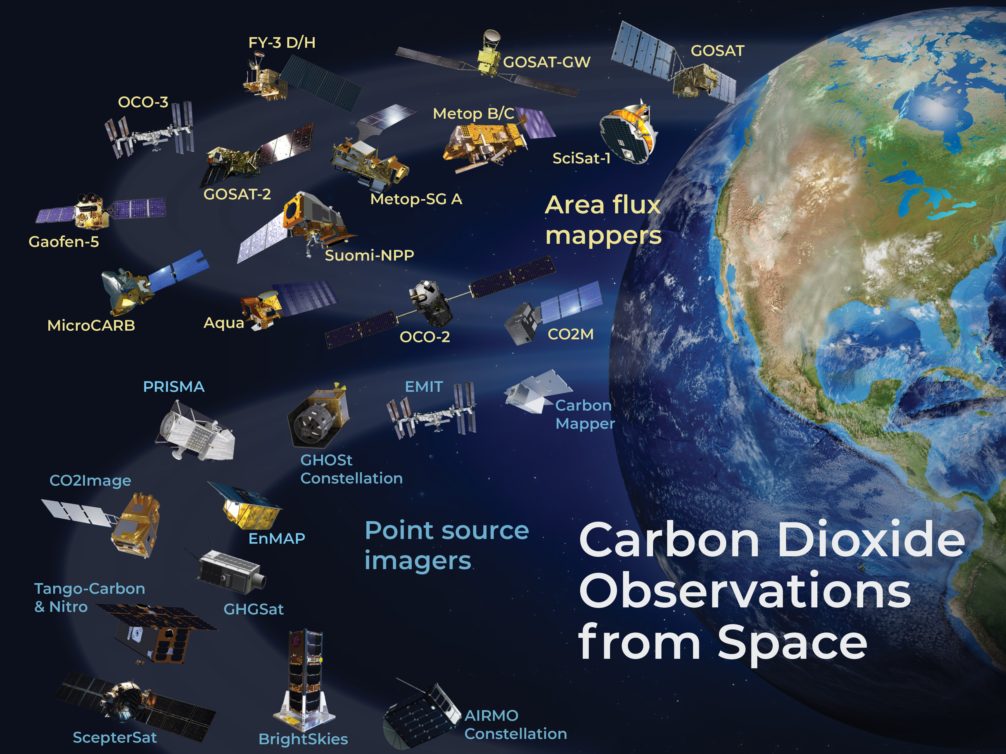
Observatory
Substantial increase in satellite-based GHG observations.
  The spatio-temporal sampling and coverage varies orders of magnitude
  The information content of GHG measurements is multi-scale
Efforts to combine satellite observations are still nascent.
The CEOS carbon observatory is incomplete with a concomitant independent validation network.
https://database.eohandbook.com/ghg/

Slide 4
The GHG mandate
2019 IPCC refinement: “An ideal condition for verification is the
use of fully independent data as a basis for comparison. Measurements of
atmospheric concentrations provide such datasets, and recent scientific ad­vances allow using such data as a basis for emission modeling.”

Slide 5
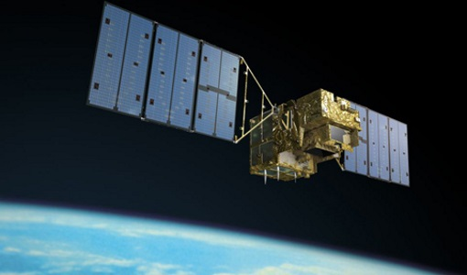
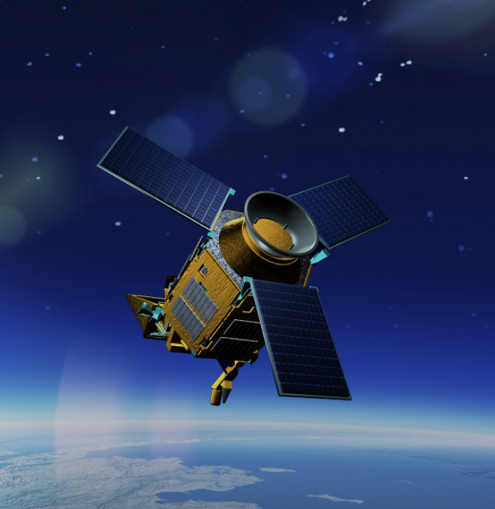
The Workhorses
OCO-2
GOSAT
S5P
OCO-2, GOSAT, TROPOMI have been the ”workhorses” to quantify global GHG fluxes that could be used to support assessment of national and subnational commitments.

Slide 6
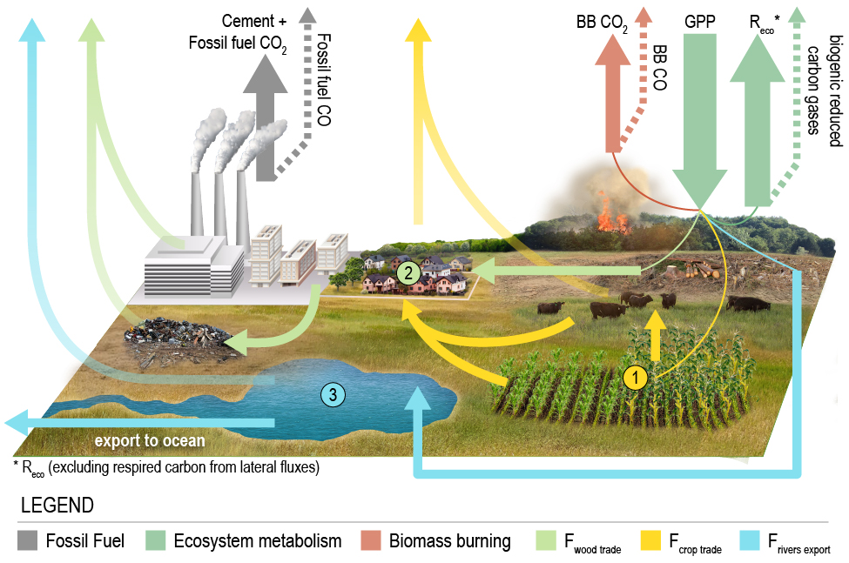

Attribution Net Carbon Exchange to GHGI sectors
Atmospheric CO₂ is a fundamental constraint
Net Carbon Exchange (NCE)
NGHGIs track changes in carbon stocks (ΔC_{loss}) due to Agriculture, Forestry and other Land Use (AFOLU).
We need to isolate this component for comparison:
$$ΔC_{\text{loss}}=NCE−FF−C_{\text{lateral}}$$
OCO-MIP
Bottom-up estimates
Byrne et al, ESSD, 2023
Uncertainties are propagated assuming independence

Slide 7
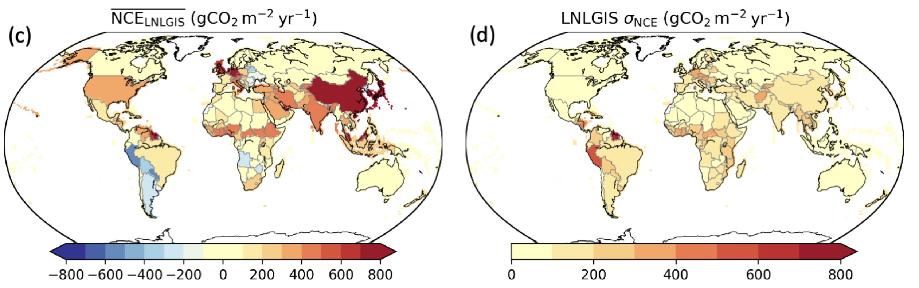
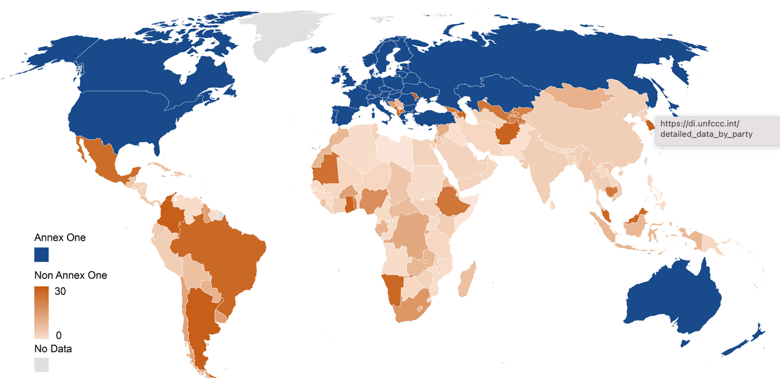
Contrasts with national GHG inventories (NGHGI)
OCO2 has enabled country-scale flux estimates.
These are independent estimates using a consistent methodology.
They can fill in gaps, both in Annex I and non-Annex I countries, consistent with the 2019 refinement recommendations.
Byrne et al, ESSD, 2023
Substantial differences in reporting in the global south.
Not all Annex I countries will report their emissions.
Deng et al, Earth Sci. Data, 2022
Number of reporting years by NGHGI reports

Slide 8
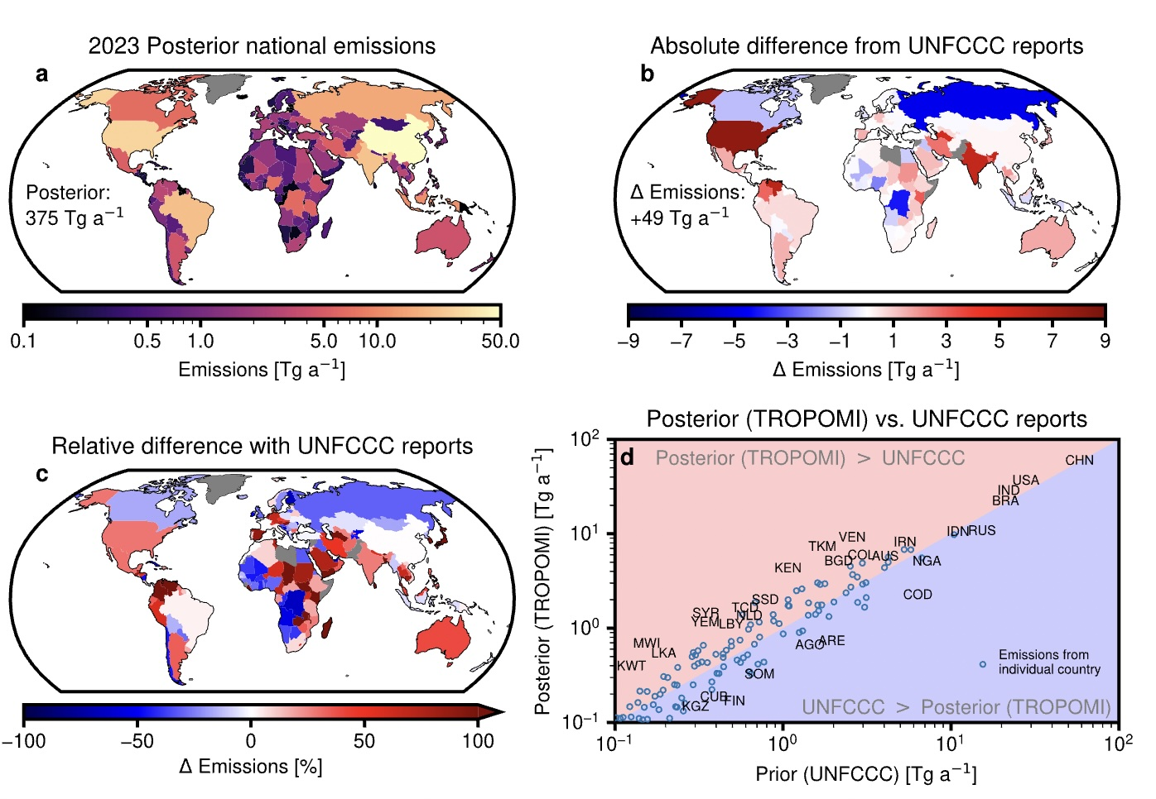
Independent methane estimates
TROPOMI-based top-down CH4 estimates show substantial differences with UNFCC reports, even in Annex I countries.
East et al, Nat. Comm. 2025

Slide 9
OCO2-MIP V11
The OCO-2 Model Intercomparison Project (MIP) substantially improves the value of OCO-2:
Protocol for flux estimates with understood inputs and consistent outputs
Systematic evaluation of posterior concentration outputs against independent data: in-situ, TCCON, AirCore, and aircraft data
Evaluation against other satellite data, e.g., OCO-3
Quantifies the sensitivity of the flux estimates to inverse model choices
Group name | Runs done by | Transport model | Meteorology | Met. Resolution (lat x long) [deg] | Inverse method
Ames | Johnson & Philip | GEOS-Chem | MERRA-2 | 4 x 5 | 4D-Var
CAMS | F. Chevallier | LMDz-Dispersion | ERA5 via LMDz | ~90 km | Variational
CMS-Flux | J. Liu | GEOS-Chem | MERRA-2 | 4 x 5 | 4D-Var
CMS-MFlux | K. Bowman | GEOS-Chem | MERRA-2 | 4 x 5 | Bayesian Analytical
CarbonTrackr | A. Jacobson | TM5-zoom | ERA5 | 2 x 3 / 1x1 NAm zoom | EnKF
CT-MP | A. Jacobson | TM5-MP | ERA5 | 1 x 1 | EnKF
GCAS | F. Jiang | GEOS-Chem | MERRA-2 | 2 x 2 | NLS-4Dvar
GONGGA | Z. Jin | MOZART | GEOS5 | 4 x 5 | EnKF
JHU | Morgan + Miller | GEOS-Chem | MERRA-2 | 4 x 5 | 4Dvar+Geostatistical
NISMON-CO2 | Maity + Niwa | NICAM-TM | JRA-3Q | ~223 km (solved 1 x 1) | 4D-Var
NTFVAR | S. Maksyutov + R. Janardanan | NIES-TM / Flexpart | ERA-5/JRA-55 | 3.75 x 3.75 / 0.1x 0.1 | Variational
PCTM | D. Baker | PCTM | MERRA-2 | 4 x 5 / 1 x 1.25 prior | 4D-Var
TM5-4Dvar | S. Basu | TM5 | ERA5 | 2 x 3 | 4D-Var
WOMBAT-GC | M. Bertolacci | GEOS-Chem | MERRA-2 | 2 x 2.5 | Hierarch. Bayesian
CMS-Flux
Contributions from US, Japan, China, France, Australia
The relationship between model-data mismatch in concentration space to validation of fluxes remains a research topic
Briggsdale, Colorado, United States
https://gml.noaa.gov/ccgg/OCO2_v11mip/index.php
WGClimate-24 & GHG-TT-6 | 9 - 12 February, 2026

Slide 10
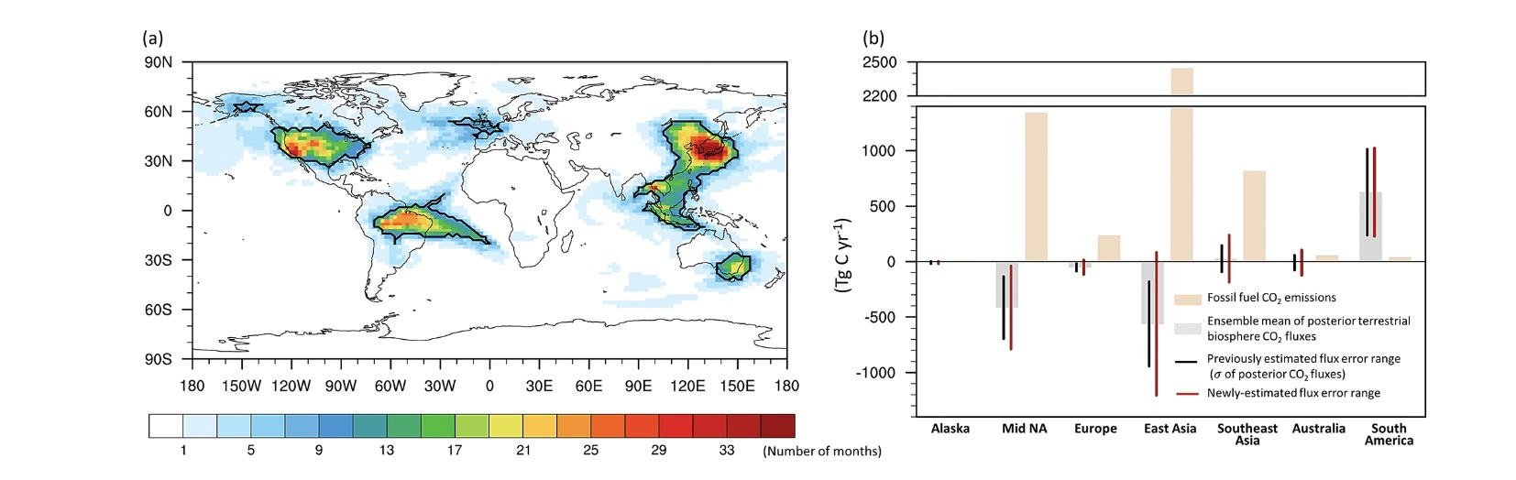
Validation
NWP solves an initial condition whereas GHG Inversions solves a boundary condition
The latter can not be directly verified for large regions.
Independent concentration measurements can be evaluated against prior and posterior concentrations.
Adjoint techniques can attribute differences to fluxes.
Ensemble and analytic techniques can project flux uncertainty to concentrations.
Must be used in conjunction with independent measurements.
Following Liu and Bowman, GRL, 2016
Yun et al, 2025 used a combination of adjoint analysis and independent data to provide updated fluxes uncertainties for selected regions.

Slide 11
Challenges and advancements for CEOS modeling efforts

Slide 12
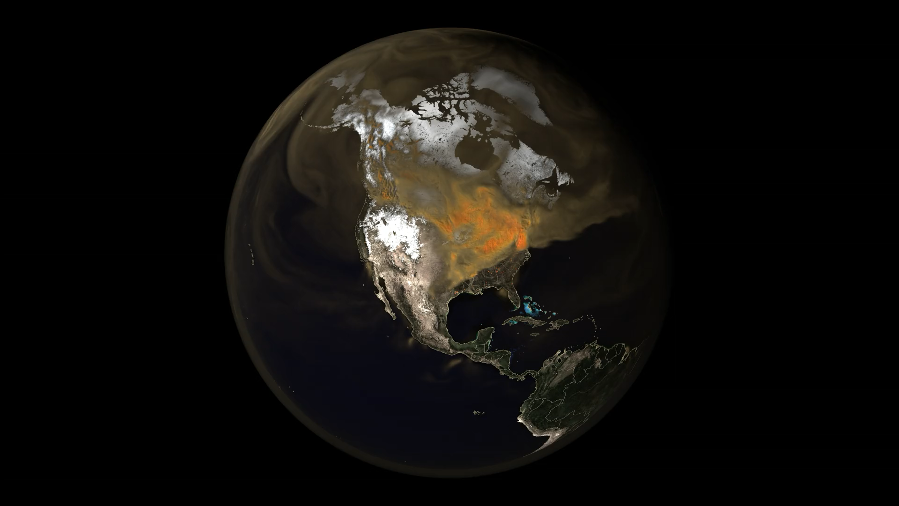
Forward model need to increase in resolution and accuracy
GHG transport models are able to routinely run at resolutions that exceed 1 degree.
CEOS research activities are pushing to simulation better than 10 km, which are approaching the footprint of individual satellite observations.
Inverse modeling, however, typically remains at coarse resolution (>1x1)
https://svs.gsfc.nasa.gov/5196/
GEOS CO2 running at 3km

Slide 13
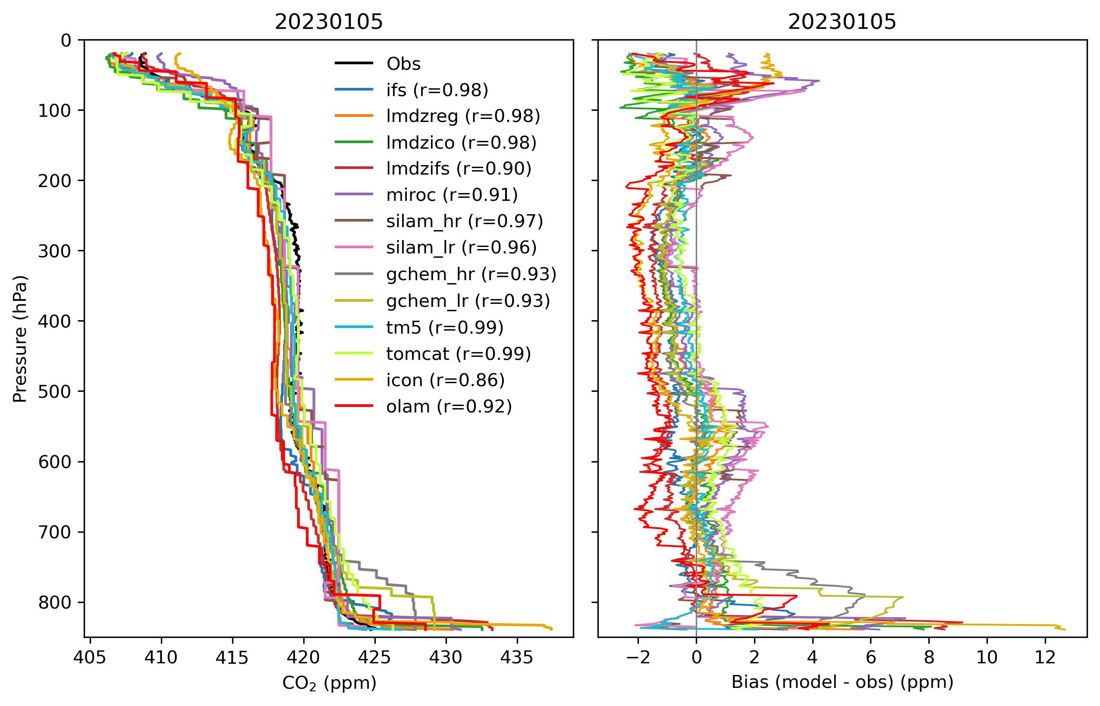
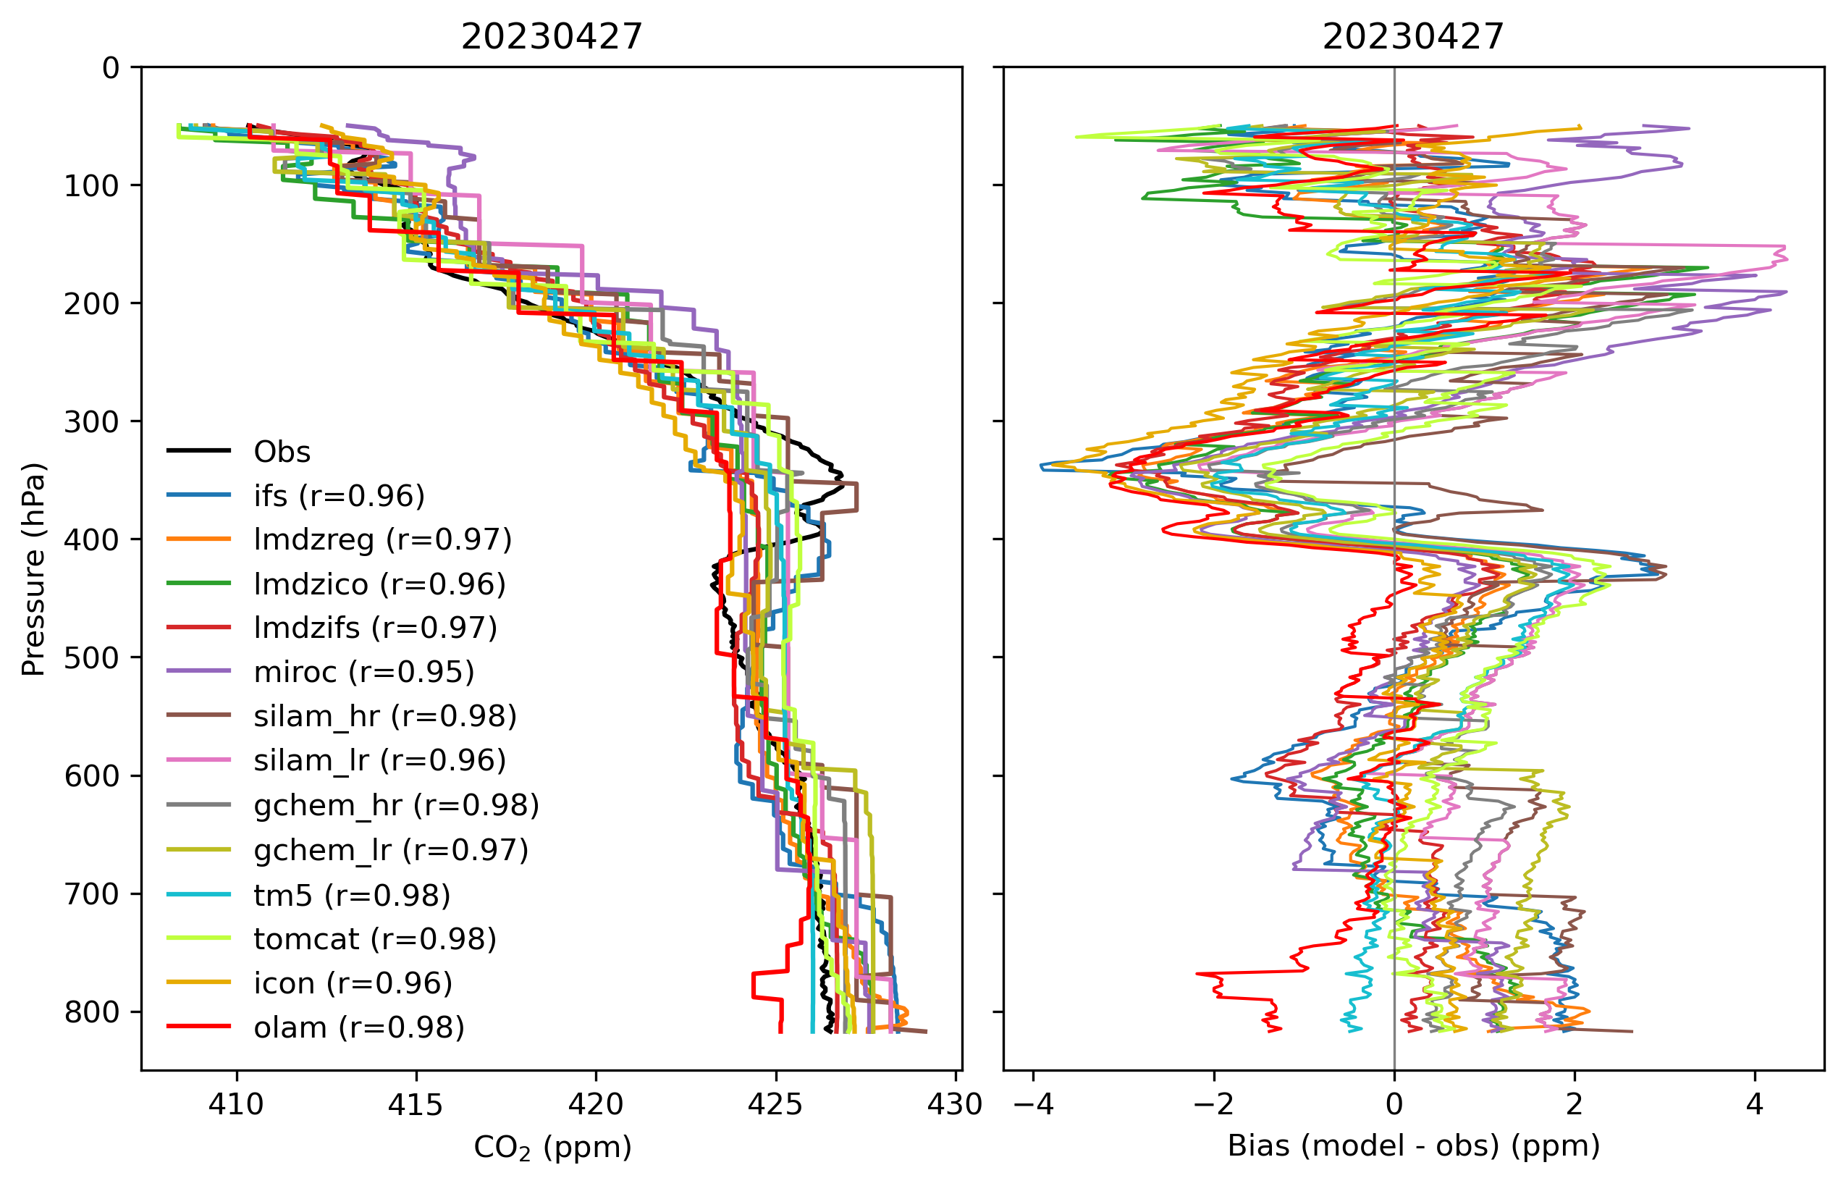

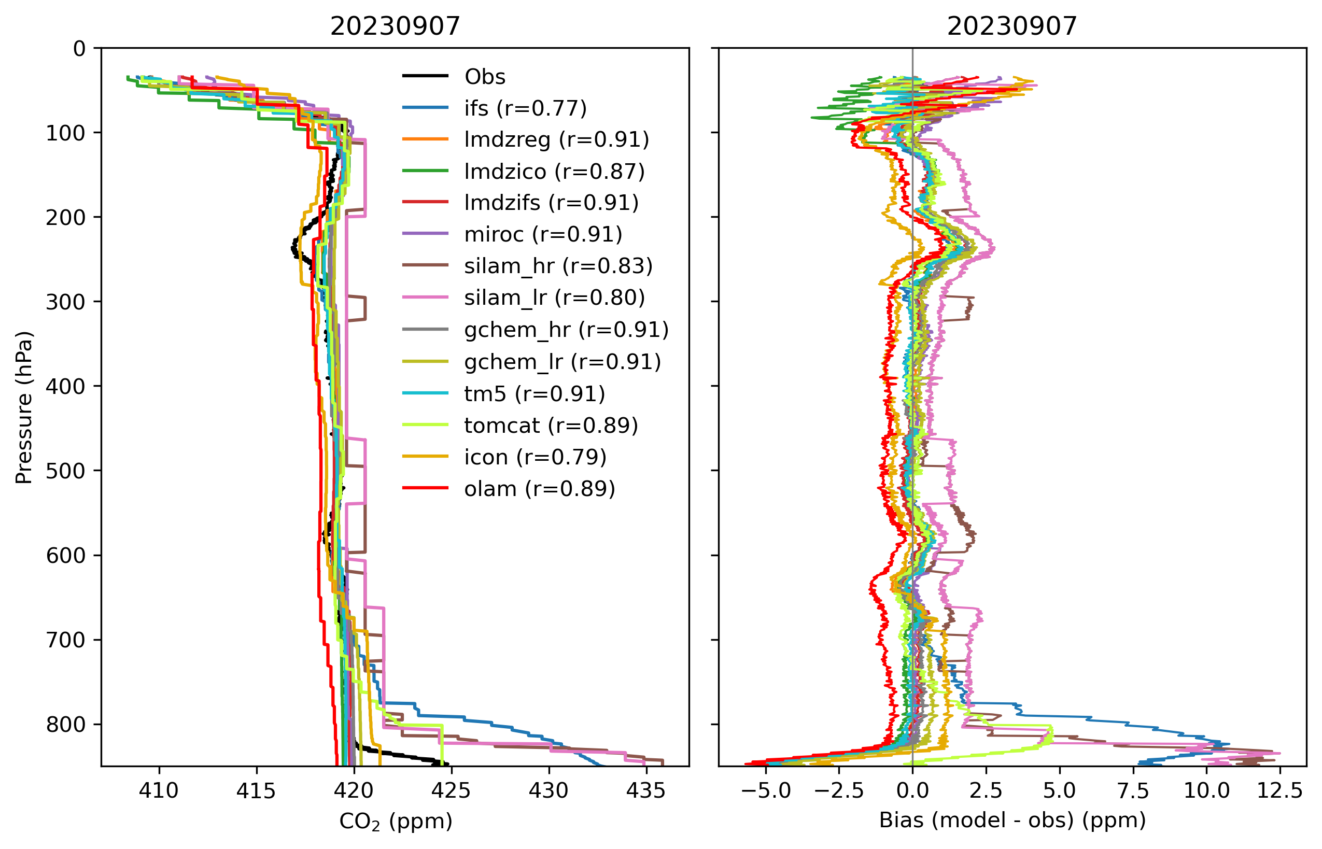
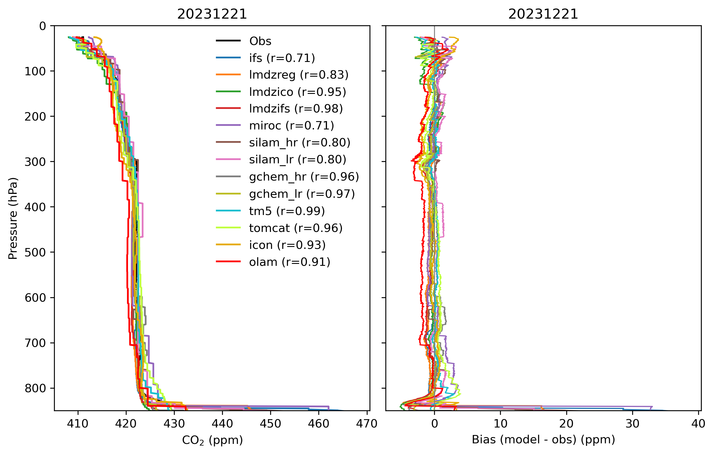
Transport model evaluation
January, 2023
April, 2023
New European effort to quantify transport uncertainty using both CO2 and SF6
September, 2023
December, 2023
ObsPack GV+ 10.1

Slide 14
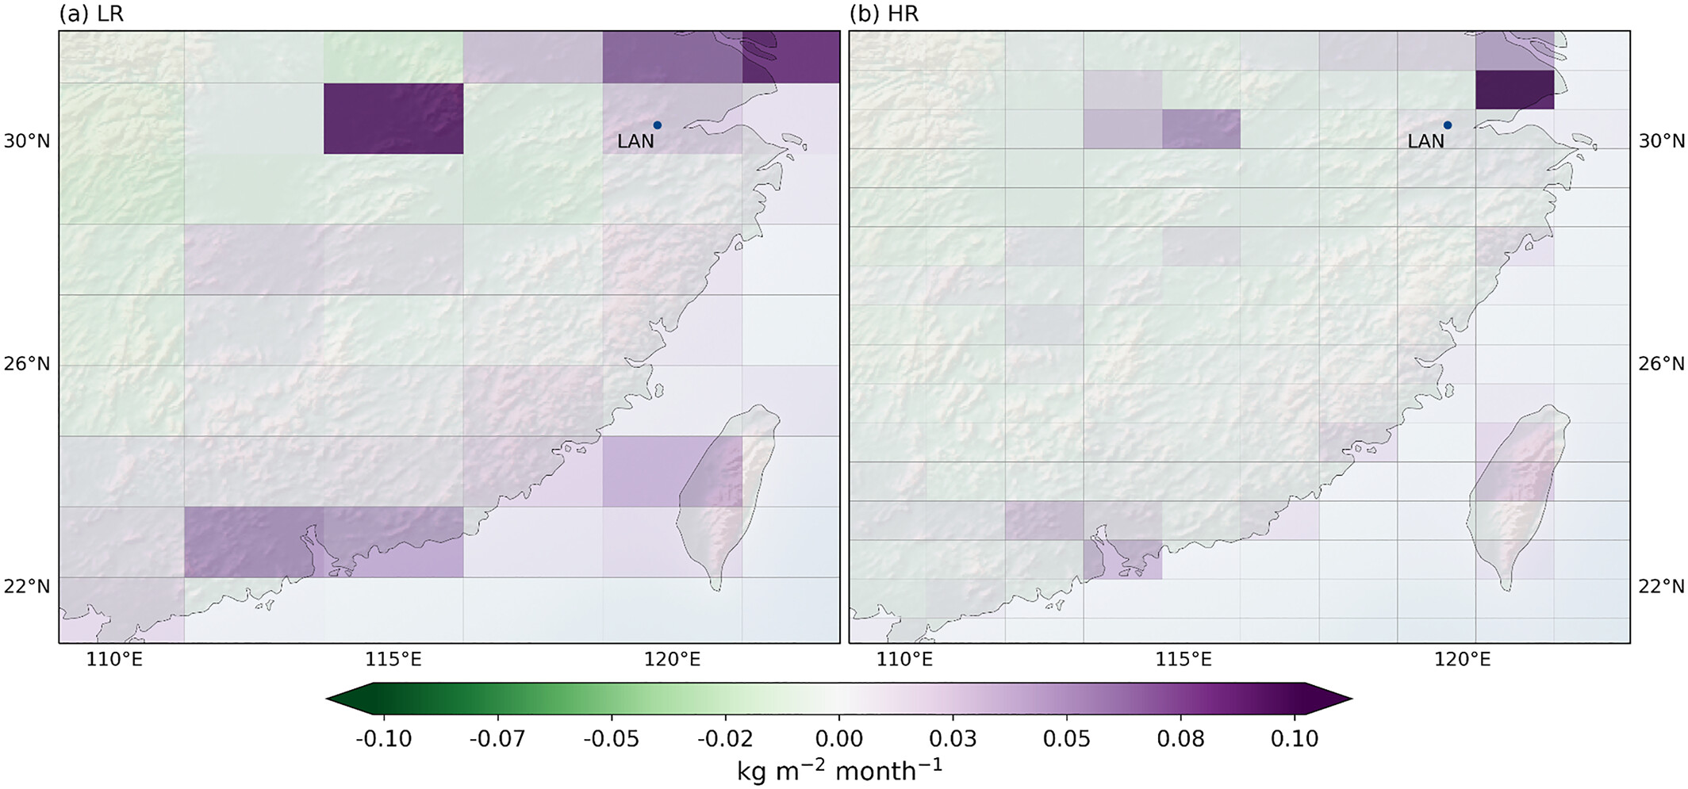
CO2 inverse modeling at 1 deg
Lloret et al, 2024 demonstrated the CAMS/LSCE CO₂ inversion system at 0.7° latitude by 1.4° longitude, tripling the number of global grid cells.
Using OCO-2 satellite data, the high-resolution (HR) model improves CO₂ transport representation, particularly at the synoptic timescale, with a mean correlation increase from 0.36 to 0.38 at surface stations.
The improved model shows higher CO₂ land sinks (e.g., North America’s sink increased by ~0.34 GtC in 2016) while slightly reducing ocean sinks.

Slide 15
But
Grid resolution is not equal to the resolution of the inversion
The degrees of freedom for signals (dofs) of TROPOMI-constrained CH4 emissions is substantially less than the grid resolution
Nesser et al, 2024

Slide 16
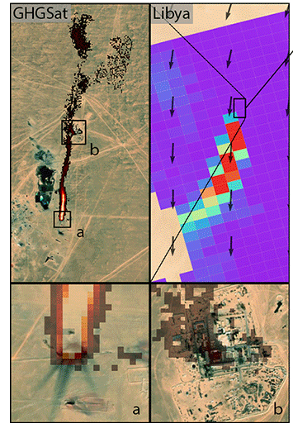
Towards multi-scale integration
 | Plume mappers | Global concentration mappers | Inventories
Examples | GHGSat, Carbon Mapper | TROPOMI | EPA GHGI
Spatial coverage | Limited | Dense | Dense
Spatial resolution | High | Low | Very high (process-level)
Temporal coverage | Irregular revisits | Regular (e.g., daily) revisits | Annual estimates
Inventory evaluation potential | Need to reconcile temporal scales | Need to reconcile spatial scales | N/A
Adapted from Schuit et al. (2023)

Slide 17
Mid-Atlantic Gas Emissions Quantification (MAGEQ)
MAGEQ campaign held between June and August 2025 involved 60+ researchers.
Coordinated 6 research aircraft-–including AVIRIS—to quantify anthropogenic and natural emissions needed by public, commercial, and philanthropic stakeholders.

Slide 18
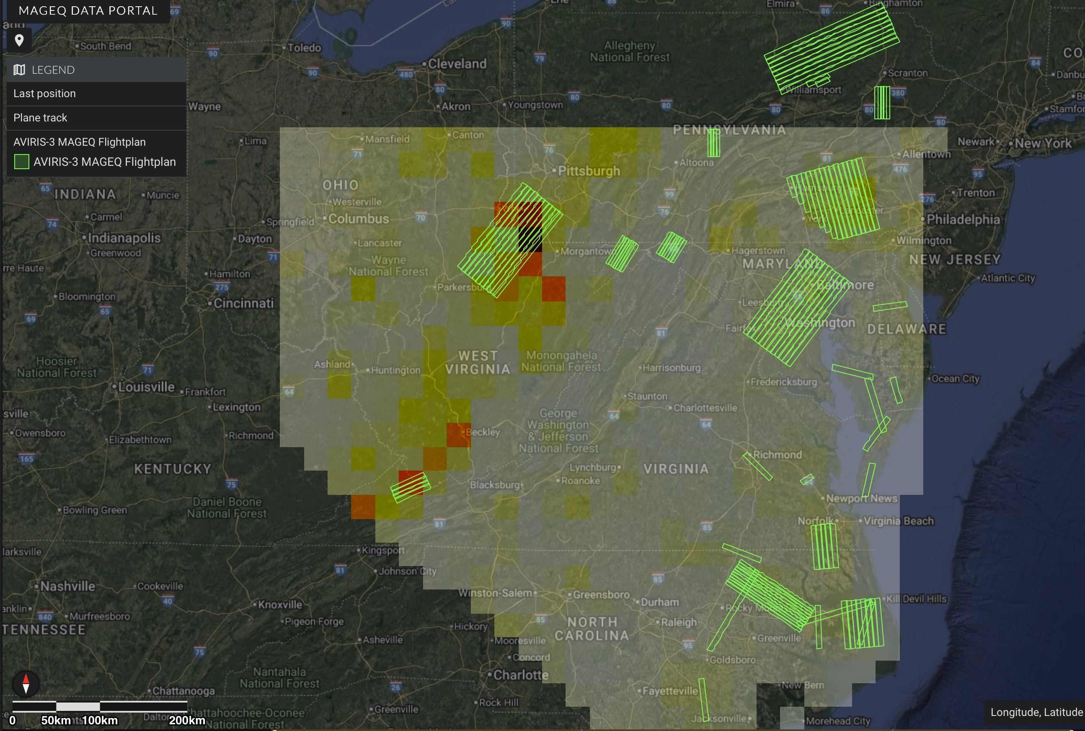

Multiscale integration testbed: CH4
Top-down CH4 emissions constrained by TROPOMI observations through the Integrated Methane Inversion (IMI) provide a priori insight into spatial gradients.
AVIRIS flights paths capture many but not all of these gradients.
Integration of satellite and aircraft measurements in MAGEQ will allow us to better quantify point sources in a regional emissions context.
https://popo.jpl.nasa.gov/mmgis-aviris/?mission=MAGEQ

Slide 19
Conclusions/next steps
CEOS observations from facility to global scale offer new opportunities to improve understanding of the distribution and magnitude of emissions.
  Methodological advancements are needed to integrate these scales together.
  MAGEQ campaign is a good testbed for that integration
Global inverse modeling OCO-2, GOSAT, and TROPOMI has advanced substantially over the past 15 years.
  Robust validation network
  Coordinated inverse modeling
  Continued advances in inverse modeling methodologies, transport modeling, and validation
This experience should inform resource allocation of other CEOS assets including MicroCarb, GOSAT-GW, and CO2M.

Slide 20
Presenter Guidelines 1
Presenters should name their file using the following convention:
  AgendaItemNumber_LastName_Subject_Version (e.g., 1.1_Su_Welcome_v1)
Documents and presentations should be uploaded to the shared folder to allow for streamlined self service
  Shared Presentation Folder (default view only, ask for upload/edit permission as required)
  For support contact Libby/Wenying: libby@symbioscomms.com / wenying.su-1@nasa.gov
Meeting website: https://ceos.org/meetings/wgclimate-24/

