Slide 1
CEOS/CGMS status on GHG monitoring
David Crisp (NASA JPL)
Ben Veihelmann (ESA ESTEC)

Slide 2
An Architecture for Monitoring CO₂ and CH₄ from Space
The CEOS Chair commissioned the Atmospheric Composition Virtual Constellation (AC-VC) to write a white paper that defines the key characteristics of a global architecture for monitoring atmospheric CO₂ and CH₄ concentrations and their natural and anthropogenic fluxes from instruments on space-based platforms to:
  reduce uncertainty of national emission inventory reporting;
  identify additional emission reduction opportunities and provide nations with timely and quantified guidance on progress towards their emission reduction strategies and pledges (Nationally Determined Contributions, NDCs); and,
  to track changes in the natural carbon cycle caused by human activities (deforestation, degradation of ecosystems, fire) and climate change

Slide 3
The CEOS AC-VC GHG White Paper
166-page document
88 authors representing 47 organizations
Executive Summary (2 pages)
  Overview of objectives and approach
  Intended for policy makers, CEOS/CGMS Agency leads
Body of report (75 pages)
  Science background and requirements
  Current and near-term mission heritage
  System implementation approach
  Intended for program scientists and project managers
Technical Appendices (42 pages)
  “Textbook” summarizing state-of-the-art in observation capabilities and analysis methods to justify system-level requirements
  Intended for scientists, engineers, and inventory community

Slide 4
A System-Level Approach for Integrating Atmospheric Data
Observations
Prior Information
Outputs
Satellite Measurements of CO₂ and CH₄
Fluxes, model parameters, emission reports, economic statistics.
CO₂ and CH₄ emissions & removal Hot-spots with uncertainties
Ground and Airborne Measurements of CO₂ and CH₄
Integration & Attribution
Estimation system
Data assimilation and uncertainty estimation
Country/region CO₂ and CH₄ emissions & removals with uncertainties
Meteorology
Satellite & in-situ
Auxiliary Data
Satellite observations of CO, NO₂, clouds, aerosols …
Models
Transport, land & ocean carbon cycle, fossil fuel emissions.
Other Carbon Cycle Products

Slide 5
Actions Proposed in the AC-VC GHG White Paper
Proposes a series Actions to the CEOS Plenary for disposition:
  Link atmospheric GHG measurement and modelling communities with stakeholders in national inventory and policy communities to refine requirements;
  Exploit capabilities of the CEOS and CGMS member agencies and the WMO Integrated Global Greenhouse Gas Information System (IG³IS) to:
    integrate surface and airborne measurements of CO₂ and CH₄ with those from available and planned space-based sensors
    develop a prototype, global atmospheric CO₂ and CH₄ flux product in time to support inventory builders in their development of GHG emission inventories for the 2023 Global Stocktake; and,
  Use lessons learned from this prototype product to facilitate the implementation of a complete, operational, space-based constellation architecture that can:
    quantify atmospheric CO₂ and CH₄ concentrations and
    serve as a complementary system for estimating NDCs in time to support the 2028 Global Stocktake.

Slide 6
GHG Mission Timeline

Slide 7
Endorsement of the AC-VC GHG White Paper
The 2018 CEOS Plenary endorsed the AC-VC GHG White Paper
  The Plenary confirmed CEOS interest in continuing collaboration with CGMS through a specific task in WGClimate on GHG monitoring, with dedicated resources and activities based on the mapping table of the actions identified in the Way Forward chapter of the report
    The 3-point plan and activities are interpreted as recommendations to the CEOS Agencies
  Plenary also endorsed the revision of the Terms of Reference of the WGClimate to accommodate these changes
  AC-VC will continue to support GHG constellation development and synergistic GHG and atmospheric composition observations and modelling efforts
  The CEOS SIT Chair encouraged the publication of the white paper to facilitate citations and efforts to build on its content
    WMO and Copernicus have agreed to jointly publish the white paper
    Publication date ~June 2019

Slide 8
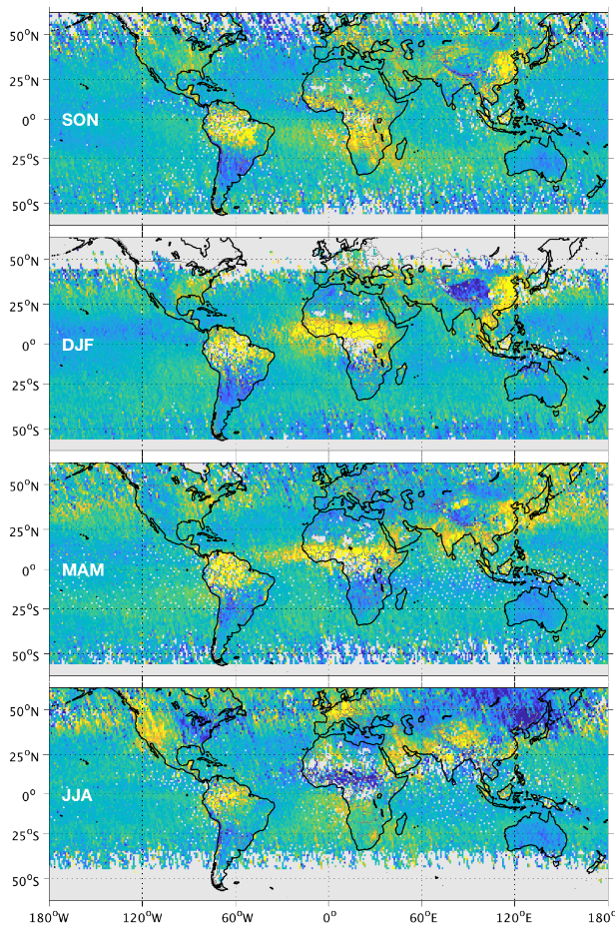
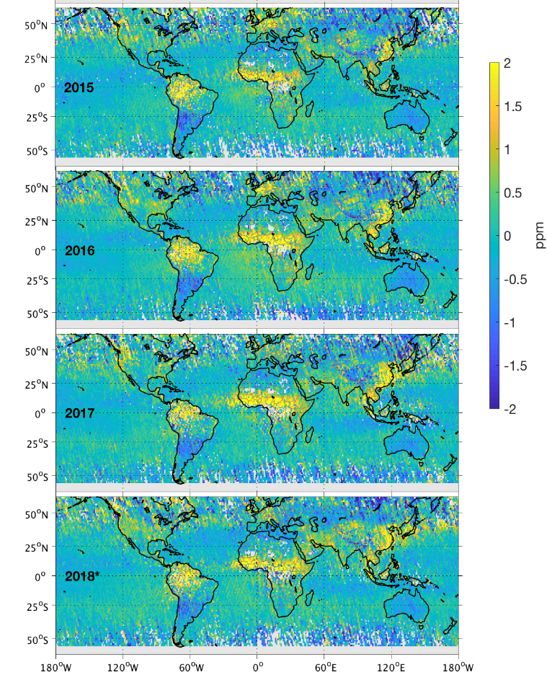
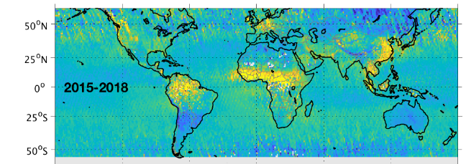
State of the Art – CO₂ Anomalies
Seasonal Averages
Annual Averages
Goal: Identifying persistent XCO₂ anomalies in OCO-2 data
Seasonal (left) and annual (right) average anomalies derived for 2015-2018.
  Positive XCO₂ anomalies dominate the tropics, except equatorial Africa during JJA – are the tropics now a net source of CO₂?
  High latitudes land dominated by negative XCO₂ anomalies (strongest during JJA)
  Biospheric CO₂ uptake reverses the positive XCO₂ anomalies over northeast U.S. and east Asia during JJA
4-year
Average
Hakkarainen, J., et al., Global XCO₂ anomalies as seen by Orbiting Carbon Observatory-2, Remote Sensing, in review, 2019.

Slide 9
2015-2016 Fluxes as seen by OCO-2 and the Global in situ Network
The OCO-2 team has been running a global multi-model intercomparison to improve our ability to retrieve CO₂ sources and sinks on regional scales from in situ and OCO-2 observations
Results
  OCO-2 v7 data and in situ data indicate a global annual carbon sink of 3.7±0.5 PgC
    Land contribution is 1.5±0.6 PgC
  Agreement is best in northern hemisphere extratropics, which are well sampled by the surface networks
  The largest difference occur over tropical Africa where there are few in situ measurements
Crowell et al. Atmos. Chem. Phys. Discuss 2019

Slide 10
Implementation Approach
Ben Veihelmann
ESA ESTEC, AC-VC Co-Chair

Slide 11
Approach for Implementing GHG Actions
The CEOS Chair proposed that WGClimate coordinate the joint effort between CEOS and CGMS to monitor GHGs
  Create a well-identified task within WGClimate addressing GHG monitoring (action WGClimate to decide how this would be implemented, by SIT-34).
  WGClimate to detail a roadmap based on activities from the AC-VC white paper and the outputs from the JRC GHG workshop (draft by SIT-34).
  WGClimate to establish appropriate links and cross-representation with AC-VC and the WGCV Atmospheric Composition subgroup.
  Relevant CEOS Agencies to dedicate appropriate resources.
  Task would also include the existing coordination layer for the CEOS Carbon Strategy.
  Update the WGClimate terms of reference (to also be confirmed by CGMS).
AC-VC will work with CEOS and CGMS to implement a (new) CO₂/CH₄ focus within WGClimate, using their existing interfaces with GCOS, WMO, IPCC, and UNFCCC. Mark Dowell has agreed to lead this activity.

Slide 12
CEOS GHG Monitoring Actions
CEOS-32-05 | WGClimate to report on internal implementation for the way forward on CEOS-CGMS coordination on GHG monitoring, including a roadmap based on the mapping of the GHG report recommendations and the JRC workshop conclusions. | SIT-34
A document mapping the recommendations from AC-VC white paper to different CEOS/CGMS working groups (WGClimate, WGCV) and virtual constellations (AC-VC) was distributed for discussion
The process and governance on the GHG monitoring within WGClimate will be discussed at the joint GCOS/WGClimate meeting in Marrakech during the week of March 18th 2019
A proposal will be presented to CEOS SIT-34

Slide 13
Objective
The following slides
propose AC-VC activities and interactions with WGClimate and WGCV (dedicated sub-groups) to support the implementation of GHG monitoring system (Rec#1,2,3)
are meant to serve as input for discussion with WGClimate and WGCV
are meant to serve as input to the roadmap for the development of the GHG constellation (Rec#3)
WGClimate Task Team on GHG monitoring
WGCV
ACSG
Atmospheric Composition - VC

Slide 14
AC-VC GHG Activities and Interaction with WGClimate
WGClimate input for AC-VC (Rec#4, 7):
Policy users’ needs for GHG flux products from space
ECVs and FCDRs needs for GHG L2 products from space
Evaluation of satellite GHG products wrt related requirements
Support of AC-VC to WGClimate (Rec#7):
Consolidation and refinement of satellite GHG product requirements, at various temporal and spatial scales (global, regional, national, local)
AC-VC input for WGClimate (Rec#1) Description of
GHG Constellation and gaps
GHG L1&2 data set, its consistency, and traceable data quality
GHG flux data set and its consistency

Slide 15
AC-VC GHG Activities and Interaction with WGCV
Work with WGCV and GSICS to define cal/val needs (Rec#9)
Identify available standards and techniques that can be used to cross-calibrate space based sensors prior to launch and on orbit (lunar, solar, vicarious)
  Level-1: cross-calibration, common radiometric standards, vicarious calibration, ...
Identify available standards and techniques that can be used to cross-validate space based estimates (TCCON, AirCore …) (Rec#11)
  Level-2: cross-calibration, (fiducial) reference measurements, ...
Discuss possible role of an active mission as flying standard in a GHG constellation (Rec#14)
Surface flux products: validation approaches and reference estimates

Slide 16
AC-VC Coordination of Spaceborne GHG Sensor Development
Implement a prototype system that incorporates products from a virtual constellation of sensors by 2021 (Rec#1)
Define an operational system or dedicated constellations of sensors as long-term goal to as backbone for the Climate Monitoring Architecture (Rec#2)
Define best practices and facilitate exchange and harmonization of approaches for instrument cross-calibration (Rec#10)
Facilitate exchange of expertise and support in defining mission requirements (Rec#7)
Coordinate discussion on auxiliary observations enhancing data quality (e.g., aerosol properties for light path correction) (Rec#15)
Track implementation and operations of space-based GHG sensors (Rec#14)
Identify and propose solutions for observational gaps (Rec#14)

Slide 17
AC-VC Coordination of GHG Product (L1&2) Development
Document the performance of existing and near term L1 and L2 products and their ability to meet WGClimate needs for ECV and FCDRs
Establish product accuracy, precision, resolution, and coverage requirements needed to meet the flux requirements on various scales
Coordinate between CCI and ACOS to identify best practices and develop a prototype product
Pursue consistency in product content, format, units, variable names, …
Pursue traceability of data quality
Coordinate algorithm inter-comparisons to improve accuracy and speed of retrieval algorithms
Facilitate exchange and harmonization of approaches to calibration and retrieval challenges
Follow and provide recommendations on development of laboratory spectroscopy
Define types of data (calibration, L1, L2) that must be exchanged to enable the integration of space based systems into a constellation

Slide 18
AC-VC Coordination of GHG Flux Estimation Development
Coordinate research on flux estimation (local to national scale; Level-4 products) (Rec#3)
Coordinate between CAMS/C3S and NASA OCO-2/CMS/GMAO (Rec#12)
Coordinate OSSE studies dedicated to flux estimation (Rec#8)
Identify synergies between observation strategies for GHGs and air quality gases and aerosols
Consolidate mission requirements for auxiliary observations (e.g. plume tracers like NO₂) (Rec#14)
Aim at accuracy and precision sufficient for policy applications
Pursue consistency in the product content (Rec#12)
Pursue traceability of data quality (Rec#12, 13)
Define types of data that must be exchanged to derive and validate fluxes from a constellation of space-based sensors to facilitate open data access (Rec#11)

Slide 19
Near-term AC-VC Output
Deliverables needed by 2021 to demonstrate that satellites can support the 2023 stocktake (WP-Rec#1)
Description of the virtual constellation consisting of the GHG satellite sensors that fly in 2021
Prototype CO₂ and CH₄ product (spanning 2009-2021) from this virtual constellation, with traceable consistency and data quality
Description of the quality of flux estimates derived from the prototype product on various spatial and temporal scales
Deliverables needed by ~2021 to prepare a future purpose-built, operational constellation to support future stocktakes (WP-Rec#2)
Observational requirements for a future GHG constellation
R&D plan for GHG retrieval and flux estimation schemes
Action plan for validation and cross-calibration of GHG products aiming at traceable consistency and data quality

Slide 20
Progress with Interfaces in the GHG Communities
The White Paper proposes to link atmospheric GHG measurement and modelling communities with stakeholders in national inventory and policy communities to refine requirements
Existing scientific conferences and workshops are being exploited to encourage interactions among these groups
  17-20 Sept 2018: IG³IS/TRANSCOM - Ground and space-based measurement, flux modeling, and gridded inventory communities
  26-29 Nov 2018: ESA ATMOS – Current/future Space based measurements
  10-14 Dec 2018: AGU - Ground and space-based measurement, flux modeling, and gridded inventory communities
  4-8 March: GSICS – Calibration and operational satellite communities
  12-14 March: CHE/VERIFY - Ground and space-based measurement, flux modeling, gridded inventory and national (bottom-up) inventory communities
Principal Challenge – Interface with national inventory community

Slide 21
Future Meetings
The 15th International Workshop on Greenhouse Gas Measurements from Space (IWGGMS-15) will be held at Hokkaido University, Sapporo campus on 3-5 June.
  The meeting announcement, registration, and abstract submission page here: https://www.nies.go.jp/soc/en/events/iwggms15/
  Registration closes on March 28 and Abstracts are due on April 1,
The CEOS AC-VC meeting webpage is posted here: http://ceos.org/meetings/ac-vc-15/
  Venue: Nakano Sunplaza in Tokyo, Japan on 10-12 June.
    The registration closes on May 3
  We are still compiling the agenda, but the current plan is to focus on greenhouse gases on Monday, 10 June and air quality on 11-12.

Slide 22
Backup

Slide 23
A Candidate Operational CO₂/CH₄ Constellation Architecture
The coverage, resolution, and precision requirements could be achieved with a constellation that incorporates
A constellation of 3 (or more) satellites in LEO with
  A broad (> 200) km swath with a mean footprint size < 4 km²
  A single sounding random error near 0.5 ppm, and vanishing small regional scale bias (< 0.1 ppm) over > 80% of the sunlit hemisphere
  One (or more) satellites carrying ancillary sensors to identify plumes (CO, NO₂) or to detect and mitigate biases (CO₂ and/or CH₄ Lidar)
A constellation with 3 (or more) GEO satellites
  Monitor diurnally varying processes (e.g. rush hours, diurnal variations in the biosphere)
  Stationed over Europe/Africa, North/South America, and East Asia
This constellation could be augmented with one or more HEO satellites to monitor carbon cycle changes in the high arctic

Slide 24
Other Needs: Calibration Advances
Space based sensors for CO₂ and CH₄ must be
  calibrated to unprecedented levels of accuracy to detect and quantify the small XCO₂ and XCH₄ changes associated with surface fluxes
  cross-calibrated against internationally-accepted standards prior to launch and in orbit so that their measurements can be integrated into a harmonized data product that meets the accuracy, precision, resolution, and coverage requirements for CO₂ and CH₄
Efforts by the ACOS and GHG-CCI teams have demonstrated the feasibility of this approach for SCIAMACHY, GOSAT, and OCO-2
  Rigorous pre-launch and in-orbit calibration methods demonstrated
Substantial improvements will be needed to meet the much more demanding requirements of anthropogenic emissions monitoring
  Cross-calibrating a more diverse range of spacecraft sensors
  Reducing calibration-related biases across multiple spacecraft

Slide 25
Other Needs: Validation Advances
XCO₂ and XCH₄ estimates across the constellation must be cross validated against internationally-recognized standards to yield a harmonized integrated product that meets the demanding precision, accuracy, resolution, and coverage requirements
The Total Carbon Column Observing Network (TCCON) currently serves a critical transfer standard between the space based measurements and the in situ standard maintained by WMO GAW
TCCON must be maintained and expanded meet the much greater demands of anthropogenic emissions monitoring on national scales
  Biases must be reduced by a factor of 5-10 from 0.25% on regional scales to < 0.025 to 0.05% to improve inventories
Additional validation methods must be developed to support validation emissions estimates on scales ranging from that of individual large power plants to that of a large urban area.

Slide 26
Other Needs: Science advances needed to support GHG monitoring
Two types of analysis tools are needed to estimate CO₂ and CH₄ fluxes (sources and sinks) from space-based observations:
  Remote sensing retrieval algorithms used to estimate the XCO₂ and XCH₄ from space based observations
  Flux inversion models are used to estimate the surface fluxes needed to maintain the observe XCO₂ and XCH₄ distributions in the presence of the prevailing wind field
These methods are now being successfully used to study emission hot spots and regional-scale natural CO₂ sources and sinks
A substantial amount of additional development is needed to support applications as demanding and diverse as
  supporting urban- to national-scale GHG emission inventories
  monitoring the natural carbon cycle response to climate change
CEOS should work with its partners to meet these needs

