Slide 1
Organisation for GHG monitoring in WGClimate following Discussion at Plenaries CGMS-46 and CEOS-32
Jörg Schulz, EUMETSAT
Chair Joint CEOS/CGMS Working Group on Climate
Notes:
CEOS (the Committee on Earth Observation Satellites): September, 1984 is made up of 55 Agencies from all around the world committed to coordinating their satellite Earth observation programs and sharing data for a more sustainable and prosperous future. These satellite observations are critical for environmental monitoring, meteorology, disaster response, agriculture and many other applications (take a look at these case studies) that can improve life on Earth and save lives.
CEOS organizations currently operate 112 satellites. These satellites and their related systems operate simultaneously and serve both interdisciplinary and international activities; therefore, international discussion and cooperation are critical to their success.
CGMS: 19 September 1972, 16 members + 6 observers, coordinates the meteorological observing system. The main goals of the coordination activities of the Coordination Group for Meteorological Satellites are to support operational weather monitoring and forecasting as well as climate monitoring, in response to requirements formulated by WMO, its programmes and other programmes jointly supported by WMO and other international agencies.

Slide 2
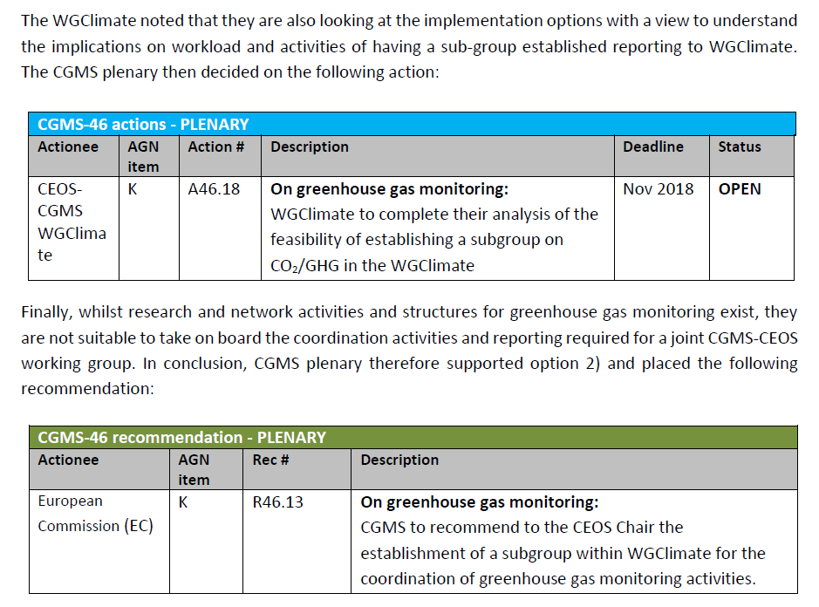
CGMS-46
GHG Monitoring

Slide 3
CEOS-32 Plenary
On GHG Monitoring it was proposed:
Create a well-identified task within WGClimate addressing GHG monitoring (action WGClimate to decide how this would be implemented, by SIT-34).
WGClimate to detail a roadmap based on activities from the AC-VC white paper and the outputs from the JRC GHG workshop (draft by SIT-34).
WGClimate to establish appropriate links and cross-representation with AC-VC and the WGCV Atmospheric Composition subgroup.
Relevant CEOS Agencies to dedicate appropriate resources.
The task would also include the existing coordination layer for the CEOS Carbon Strategy.
Update the WGClimate terms of reference (to also be confirmed by CGMS).

Slide 4
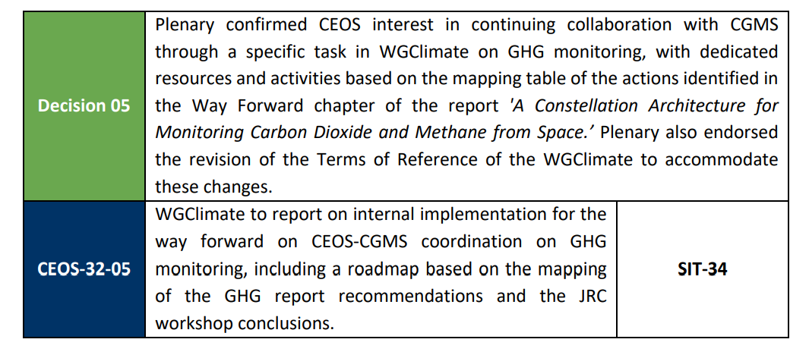
CEOS-32 Plenary
GHG Monitoring

Slide 5
TOR of WGClimate
Terms of Reference as agreed at 32nd CEOS Plenary:
Coordinate activities of CEOS and CGMS defining and implementing an integrated global carbon observing system including a targeted observing system for monitoring the column concentrations of CO₂, CH₄ and other greenhouse gases from space as well as ensuring that these activities are integrated into a broader approach on greenhouse gas monitoring, i.e. WMO IG³IS, GCOS, and GEO-C;
Oversee the implementation of the CEOS Carbon strategy.

Slide 6
Rationale for Organisation
CEOS has a coordination structure (WGClimate, WGCV, AC VC, …) that has successfully been used to write the GHG Monitoring Constellation White paper;
CGMS has well established coordination structures to define products (WG II) and to develop interoperability (GSICS);
WGClimate needs to:
Develop and maintain the roadmap, i.e., the overall distributed workplan;
Coordinate CEOS and CGMS bodies in executing the distributed workplan;
Provide links to UNFCCC, GCOS, WCRP, GEO, IG3IS and perform communication of results;
Oversee the implementation of the CEOS carbon strategy (remaining actions).
Organisation in WGClimate shall not duplicate activities of contributing coordination structures;
Involved bodies will have some extra efforts ensuring the coordination;
Need a structure that is able to execute the coordination work and ensures balanced representation of involved bodies and needed skills.

Slide 7
Implementation I
Formally establish a task team as requested by CEOS Plenary;
The Task Team consists of a leader and a deputy with nominal terms of 2 years;
The task team leader is proposed by the WGClimate Chair to the WGClimate after consultation with contributing bodies. The deputy should be the ViceChair of the WGClimate;
Representation of bodies is achieved by identifying PoCs for tasks in the contributing CEOS and CGMS bodies;
Need a “white smoke” initial meeting involving the contributors to develop the spreadsheet (including temporal dimension) and then to put tasks into VC/WG work plans;
WGClimate reviews progress at every WGClimate meeting. At those meetings we shall reserve a day for GHG so that status review of tasks is ensured including the PoCs’ reporting (so not only through coordinators);
This shall allow other agencies to share via WGClimate meetings the activities (transparency) in terms of reporting.

Slide 8
Implementation II
Links to bodies outside of CEOS and CGMS:
UNFCCC – WGClimate Chair
GCOS – WGClimate Chair
WCRP – WGClimate Chair via WDAC (if still existing after WCRP reorganisation)
GEO – The GEO-C activity is inactive at the moment, but if revived task team
IPCC (Inventory and guidelines) – Task team
IG3IS – Task team

Slide 9
Implementation I
Formally establish a task team as requested by CEOS Plenary;
The Task Team shall have a leader and a deputy with terms of maximum 2 years each;
The task team leader is identified by the WGClimate Chair in collaboration with chairs of contributing bodies in CEOS and CGMS. The deputy shall be the ViceChair of the WGClimate;
Explicit representation of bodies in task team is useful to ensure additional resources from agencies;
Representation of bodies can be ensured by 1 AC-VC, 1 WGCV, 1 GSICS, 1 CEOS and 1 CGMS agency representatives;
No agency shall have more than 1 person regardless of role;
WGClimate shall review (output, size, and membership) every two years with the appointment of a new leader.

