Slide 1


Activities of CEOS WGCV Atmospheric Composition Subgroup and the CGMS GSICS and Towards an operational GHG monitoring system
Committee on Earth Observation Satellites
B. Bojkov (WGCV/ACSG), R. Munro (CGMS/GSICS), A. Kuze (WGCV)
CEOS WGClimate 10
Marrakech, Morocco
20 March 2019

Slide 2

Outline
CEOS/WGCV/ACSG Activities
CGMS/GSICS Activities pertinent to GHG monitoring
Towards an operational GHG monitoring system

Slide 3
WGCV/ACSG Mission
To ensure accurate and traceable calibration of remotely-sensed atmospheric composition radiance data and validation of higher level products, for application to atmospheric composition, land, ocean, and climate research.
Reminder: the framework/cooperation/best practises in AC validation exists for 30+ years (onset of O₃ trend reports in the 1980s, WMO/GAW, NDACC, … )

Slide 4
ACSG activities 2017-2019
WGCV/ACSG sub-group works as a “task team” - numerous thematic meetings with members throughout the year in related fora, including the AC-VC, GSCIS-UVSG, NDACC SG, AEROSAT, Cal/Val anf FRM meetings, etc.
WGCV/ACSG participated/organised: cloud masking for medium-resolution sensors ws, AQ FRM coordination (@AGU 2017 & 2018), CEOS/CGMS MW imager gap task group (AGU, CGMS Plenary), ground-based AQ FRM gap analysis (Feb. ‘18), German Cal/Val Symposium (June ‘18), etc.

Slide 5
WGCV/ACSG Considerations
Participation/interest in ACSG has always been challenging… focus by agencies in the last 10-15 years has been shifting from research missions to operational missions addressing air quality, green house gases, and down-stream services
CGMS/GSICS-UVSG addresses many activities for the operational AC missions… with the benefit of the inter-calibration activities
GHG mission interoperability is critical especially in the next years as operational missions will be launched…

Slide 6
CGMS/GSICS Mission (i)
Global Space-based Inter-Calibration System (GSICS) is an international collaborative effort initiated in 2005 by the World Meteorological Organization (WMO) and the Coordination Group for Meteorological Satellites (CGMS) to 1-monitor, 2-improve and 3-harmonize the quality of observations from operational weather and environmental satellites of the Global Observing System (GOS).
GSICS aims at ensuring consistent accuracy among space-based observations worldwide for climate monitoring, weather forecasting, and environmental applications.

Slide 7
CGMS/GSICS Mission (ii)
This is achieved through a comprehensive calibration strategy which involves:
              monitoring instrument performances,
      operational inter-calibration of satellite instruments,
      tying the measurements to absolute references and standards, and
      recalibration of archived data.
GSICS delivers calibration corrections needed for accurately integrating data from multiple observing systems into products, applications and services.
GSICS contributes to the integration of satellite data within the WMO Integrated Global Observing Systems (WIGOS) and within the Global Earth Observation System of Systems (GEOSS) of the Group on Earth Observations (GEO).

Slide 8
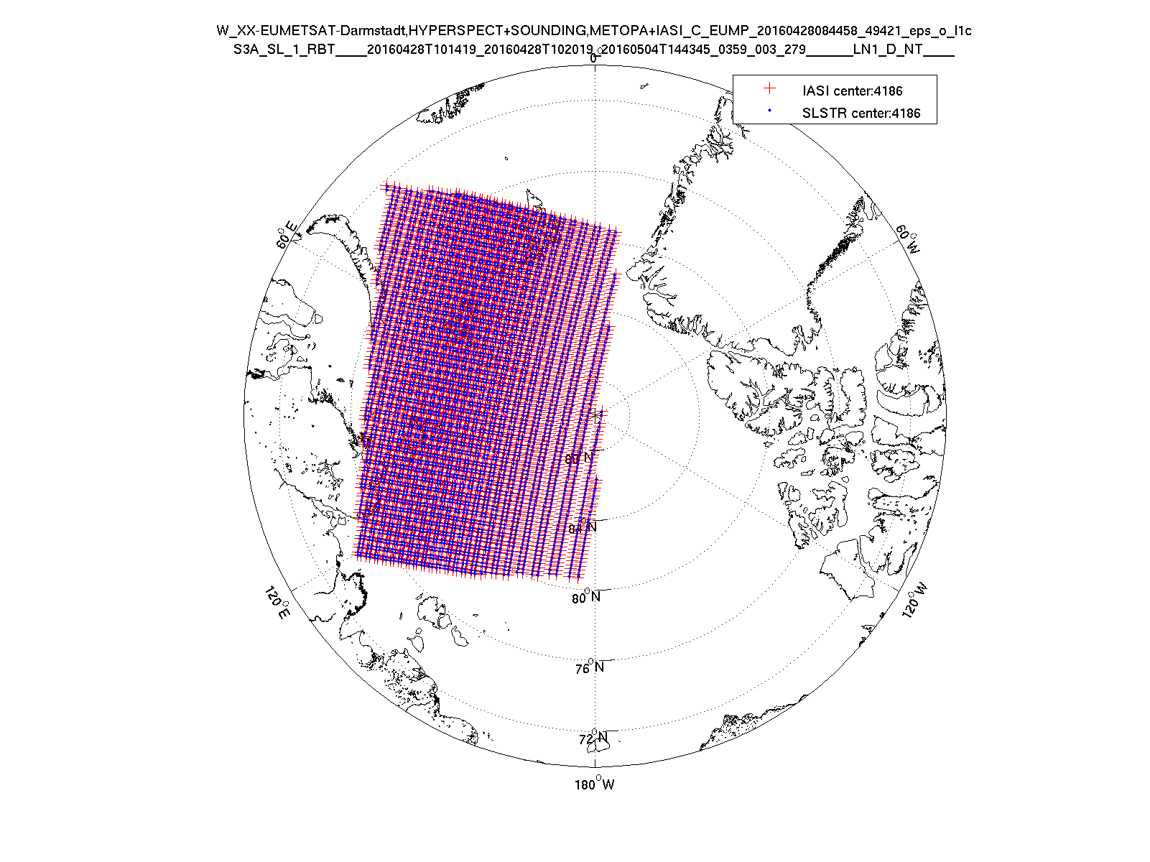
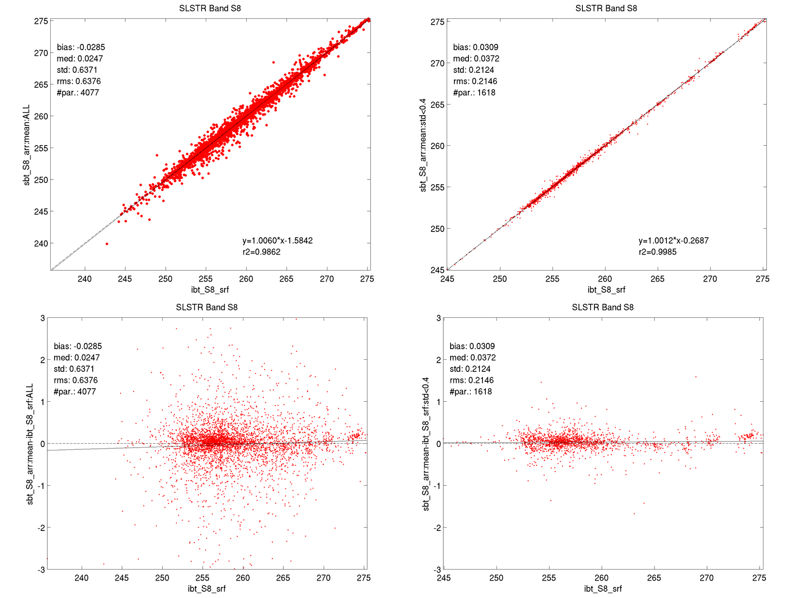
Sentinel-a3/SLSTR: first calibration check
Apply GSICS Simultaneous Nadir Observations (SNO) methodology to intercompare the Sentinel-3/SLSTR with Metop-IASI instruments as a first check:
  10 min. satellite co-location, pixel aggregation without stray-light correction
Extremely challenging process because
of the data volumes involved and the complexity of the matching of the instrument fields of view
This pragmatic approach to monitor
the performance of the Sentinel-3/SLSTR using accepted international best practices (SNO) should be implemented into operational chains – especially in light of the launch of future sensors
I.Tomazic, EUMETSAT

Slide 9
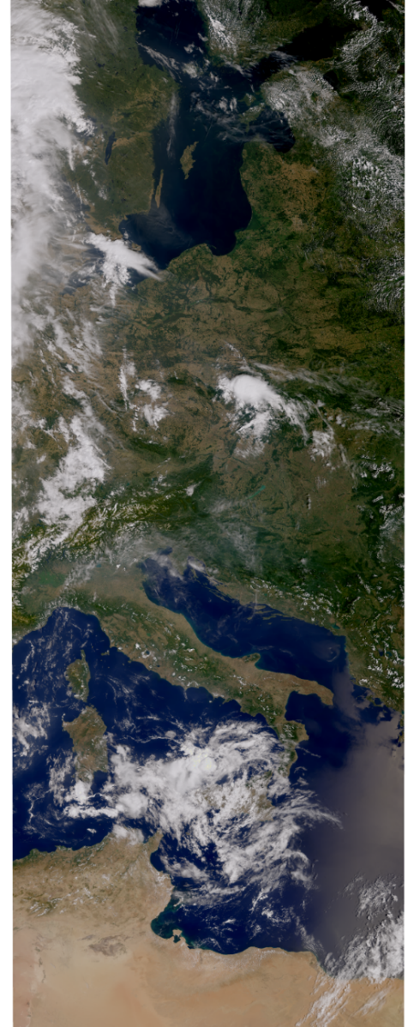
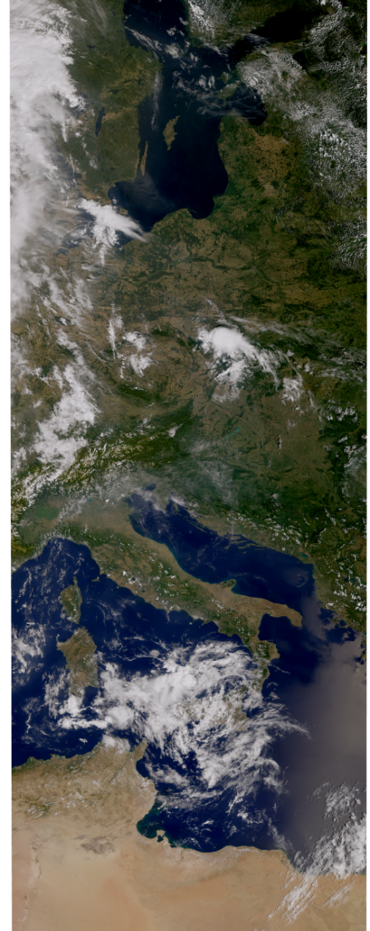
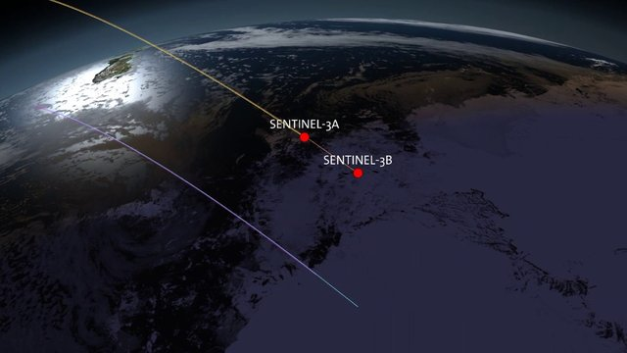
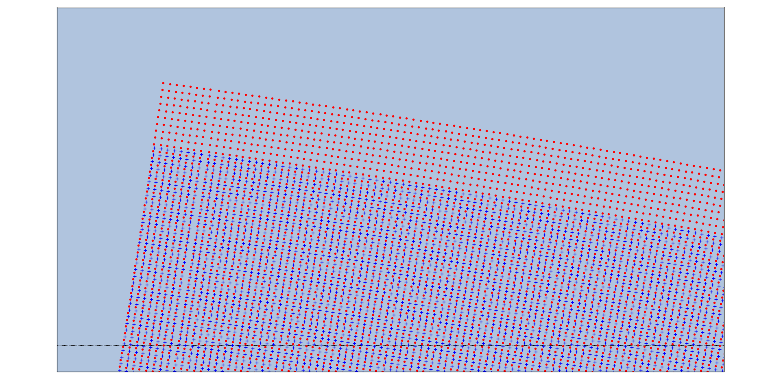

Sentinel-3 Tandem Scenario
Sentinel-3a and Sentinel-3b have been operated in “tandem” configuration from June to September 2018. The two platforms are flying with ~30s separation on the same orbit.
The main purpose of this configuration is to allow inter-calibration activities
Objective:
To identify the mutual behavior of OLCI-B vs OLCI-A and SLSTR-B vs SLSTR-A
Constraints:
To run a systematic intercomparison over large dataset
To minimize the manipulation of radiances
OLCI-A
OLCI-B
08.08.2018
Courtesy of ESA
Scenario Details

Slide 10
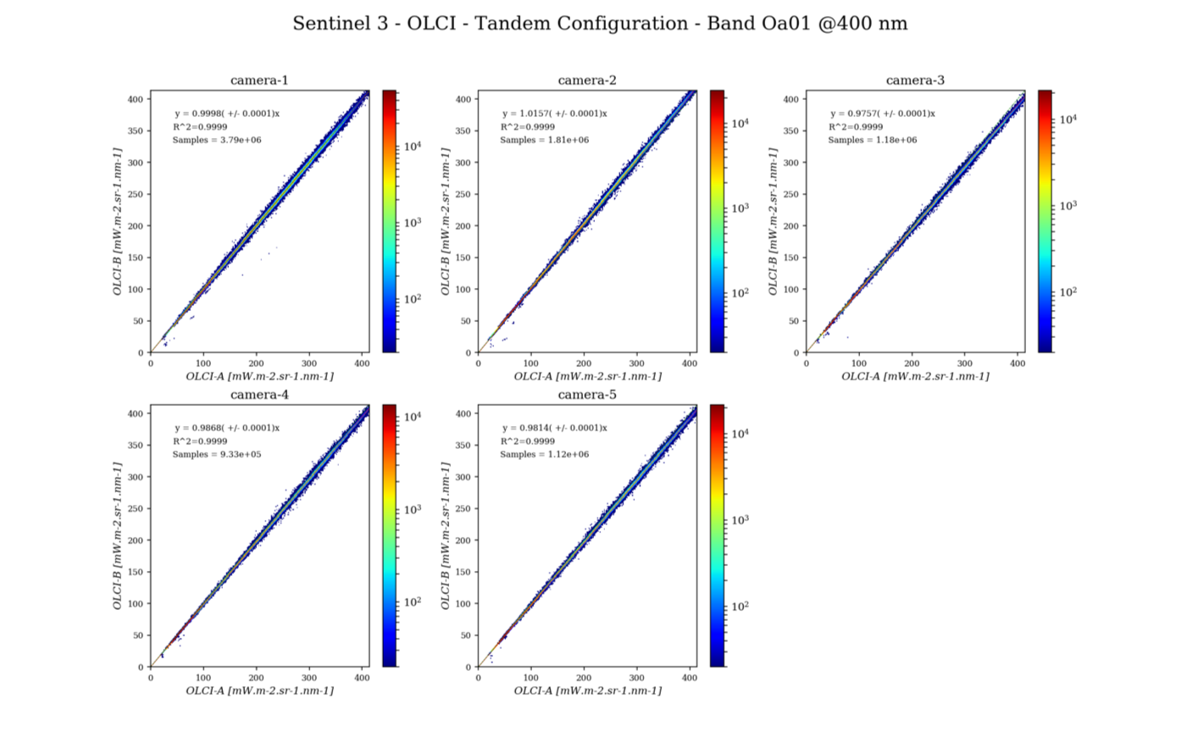
OLCI: Oa01@400nm
A. Burrini, EUMETSAT

Slide 11
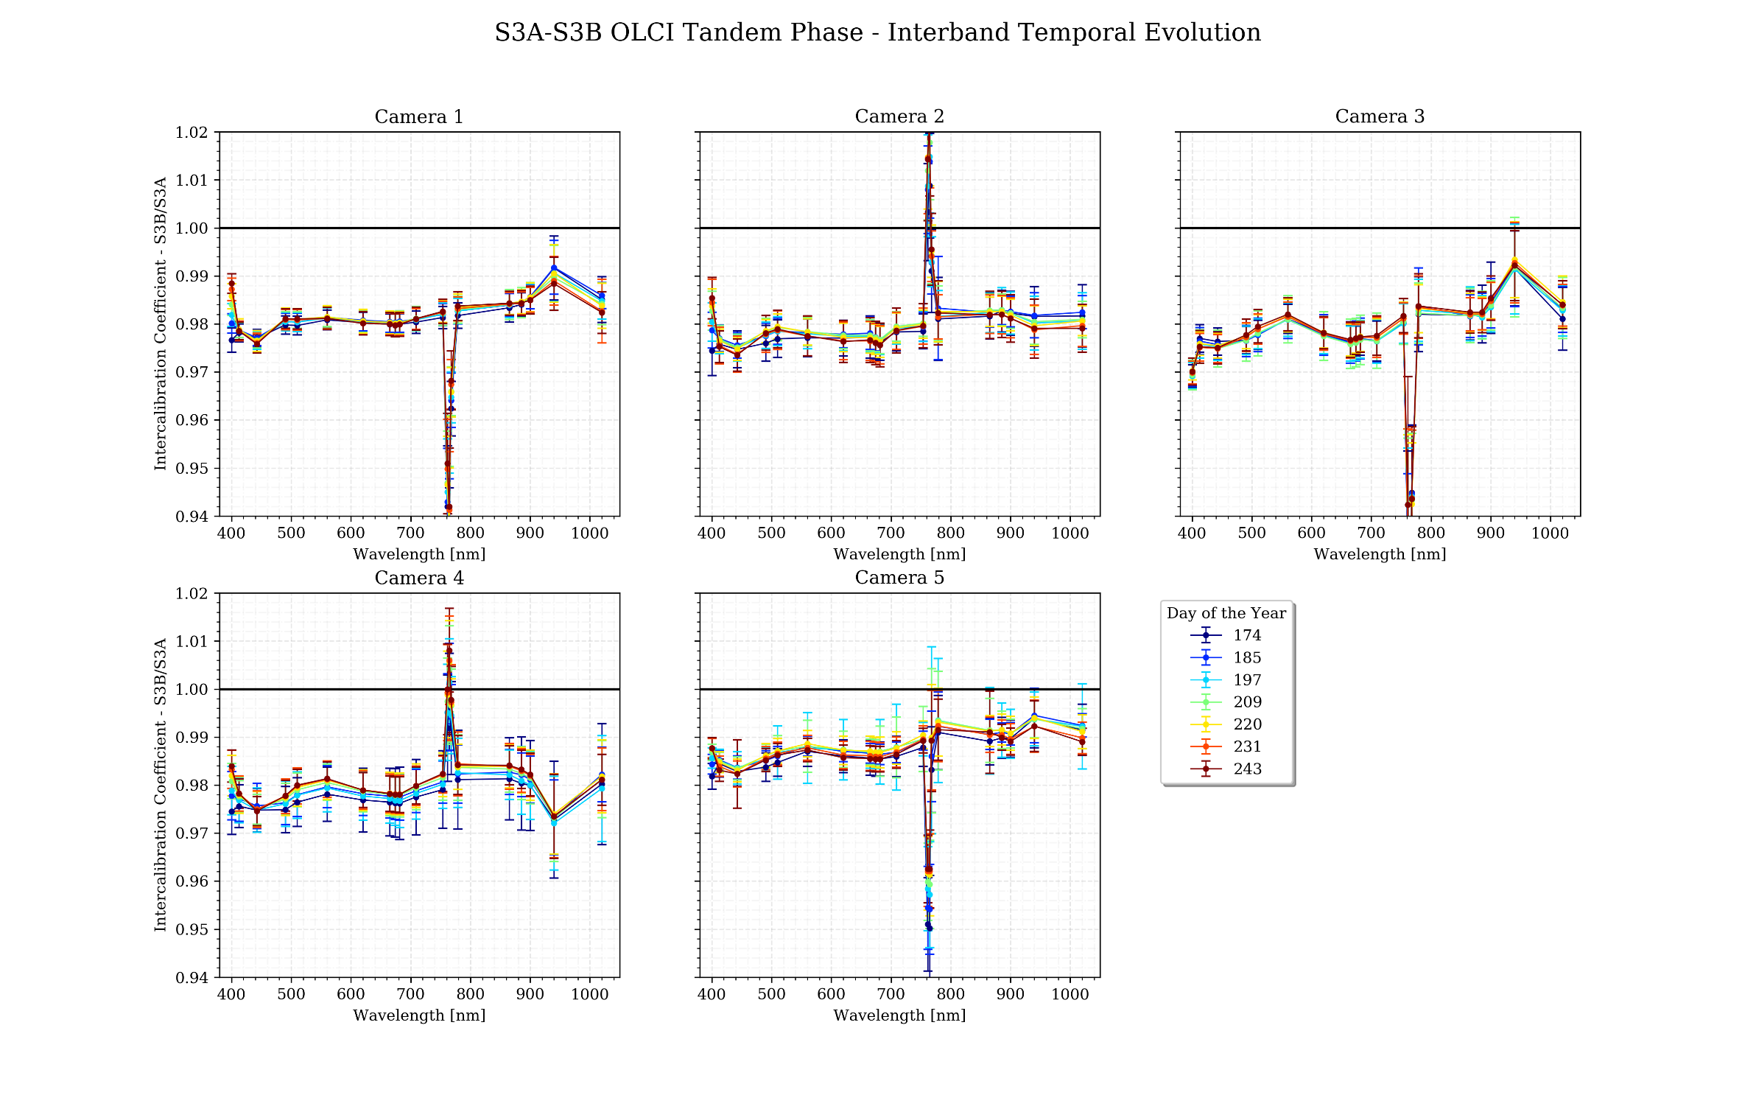
OLCI: Inter-band Evolution per Camera (reflectance)
A. Burrini, EUMETSAT

Slide 12
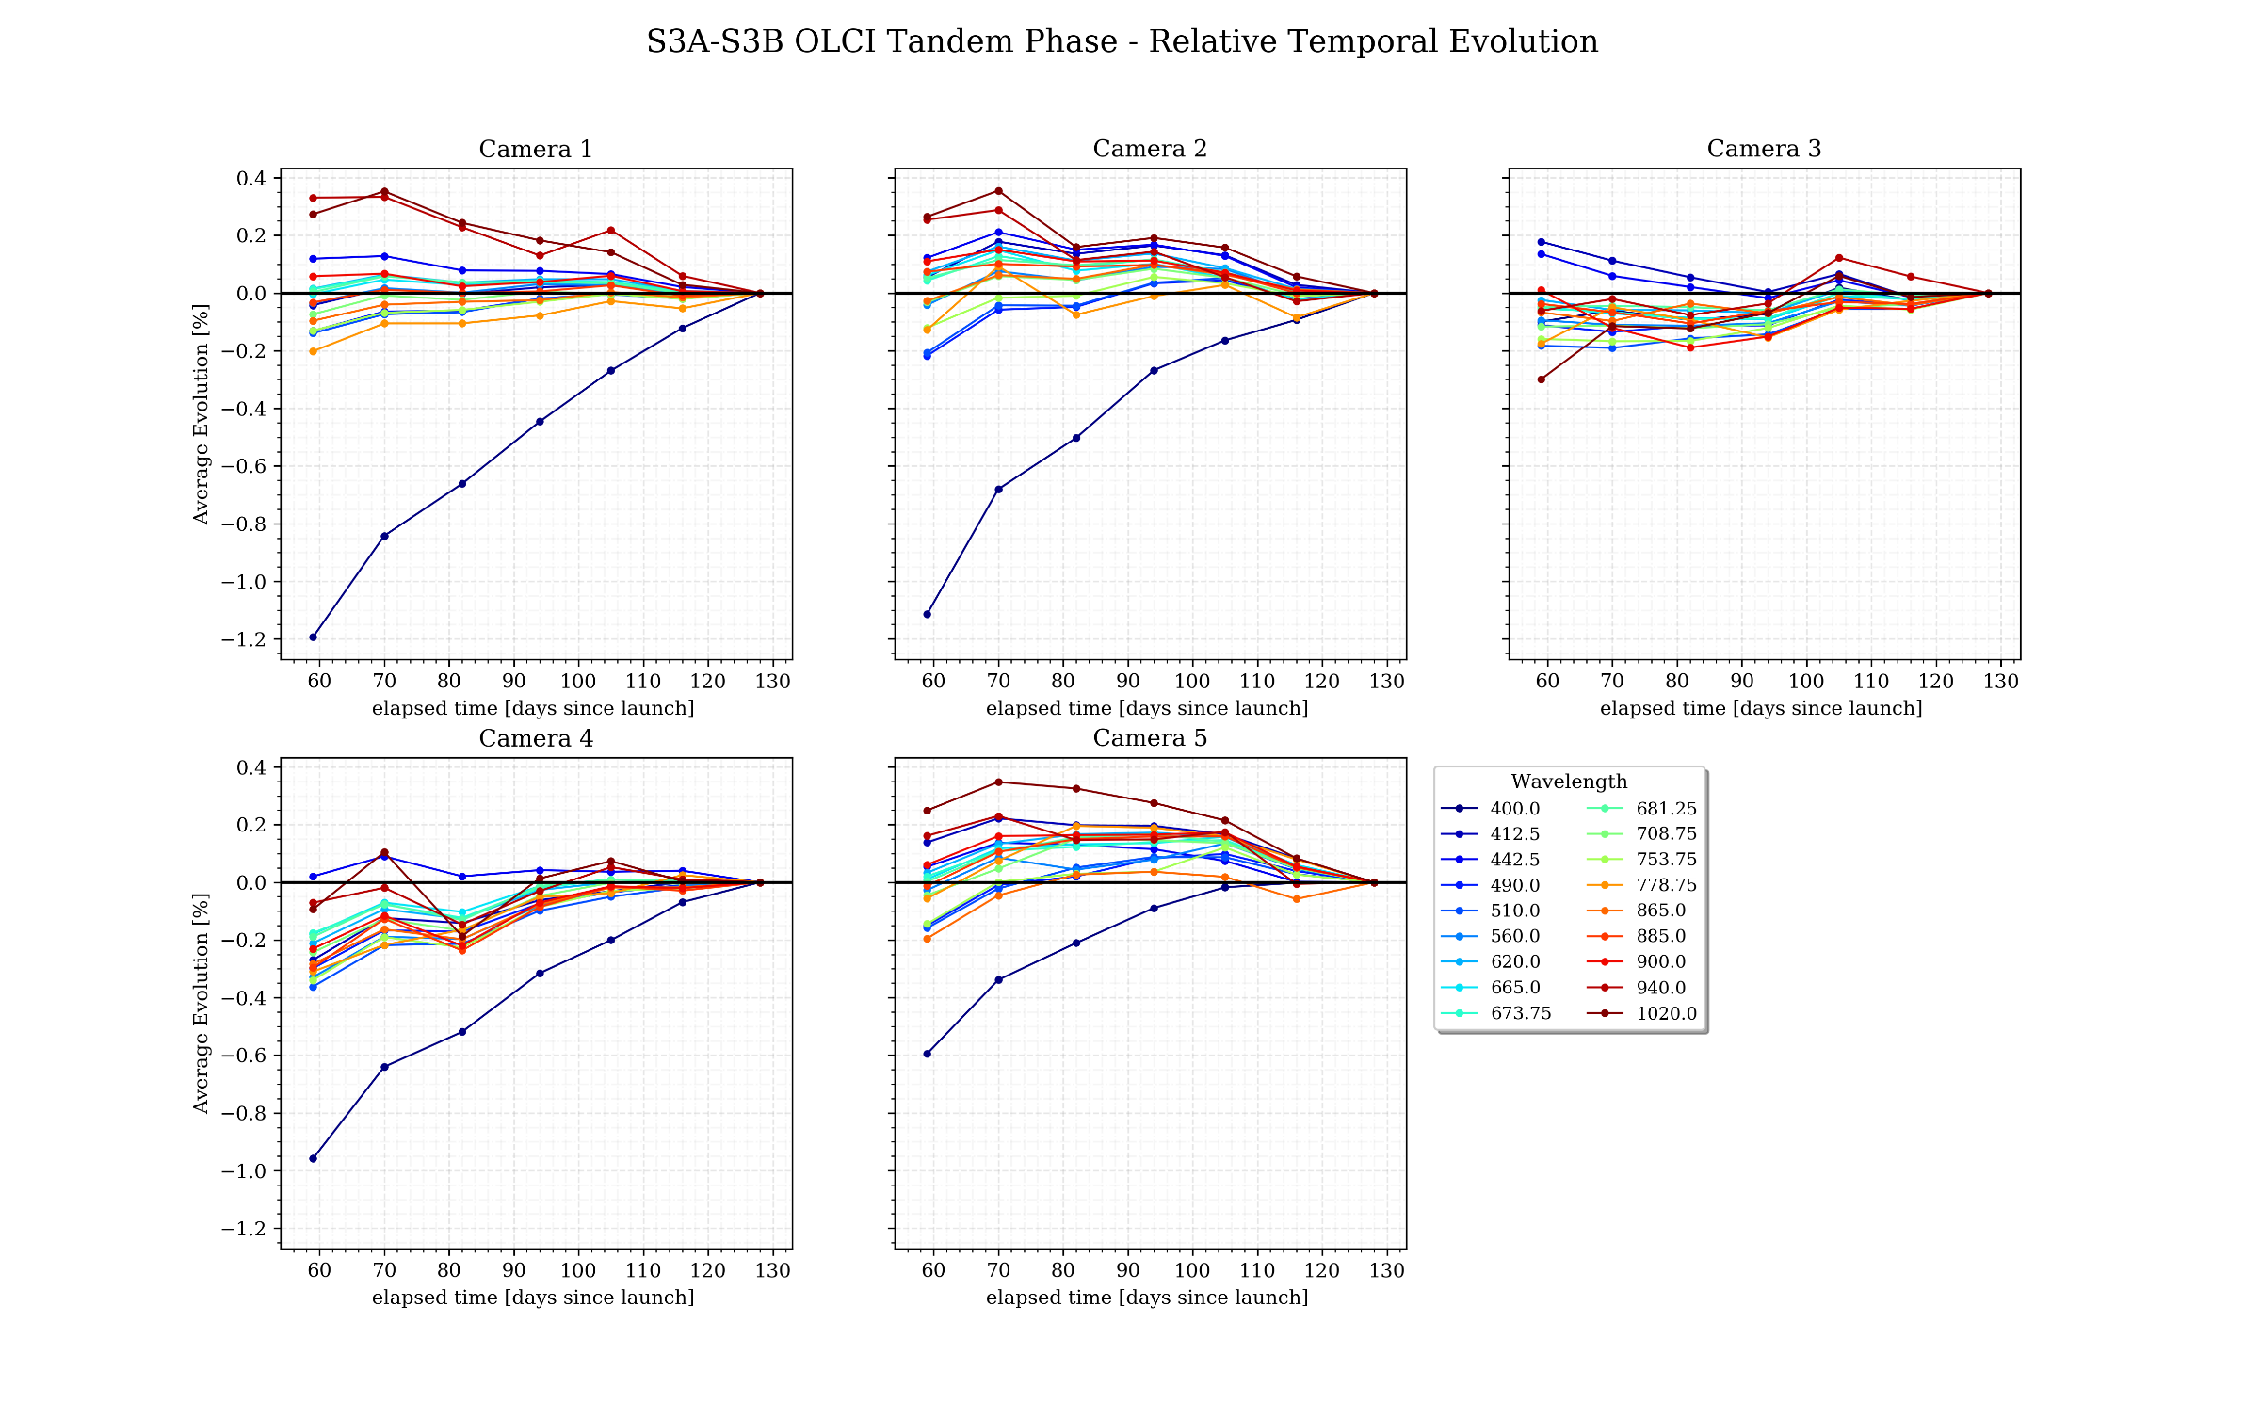
OLCI: Relative Time Evolution (no O₂ bands)
Analysis of 1 full day every ~2 weeks:
  2018-06-23
  2018-07-04
  2018-07-14
  2018-07-28
  2018-08-08
  2018-08-19
  2018-08-31
A. Burrini, EUMETSAT

Slide 13
GSICS support for GHG
Support to GHG instrument calibration in GSCICS falls under the
newly renamed Reflective Solar Spectrometers Subgroup (GSICS/UVSG)
The scope of the subgroup is addressing spectrometers operating in the UV –SWIR range, with the following focus areas:
Pre-launch calibration and characterisation is a major focus area, for all but particularly for GHG missions;
Solar calibration including interactions with the solar community which have already been initiated;
Lunar calibration where the focus will be on UV and spectrally resolved data, contributing to other lunar calibration activities;
Polarization (also for lunar calibration where possible);
Inter-calibration and development of common methods for use of pseudo-invariant targets & vicarious calibration sites (with a homogeneous surface over a sufficiently large area) will be further developed. Noting that the focus is on the atmospheric absorption.

Slide 14
Towards an operational GHG monitoring system - Context
Disclaimer:
“Towards an operational GHG monitoring system” is here within the scope of the satellite systems, specifically addressing the measurement capabilities and performances
CEOS WP CV-18: Greenhouse gas reference standards for interoperability – “Develop list of reference standards for CO₂ and CH₄ products that are suitable for use in intercomparison of multiple missions” with reporting deadline Q4/2019
Release of the CEOS AC-VC GHG Whitepaper in Q3/2018

Slide 15
Towards an operational GHG monitoring system (i)
Short-term:
  Address the WP action CV-18 with respect to CO₂, CH₄ (and CO, N₂O) Level-2 products
  Identify the current shortcomings/gaps/sustainability in GHG Cal/Val, and formulate recommendations on the medium- to long-term way forward → i.e. specific focus on GHG Fiducial Reference Measurement (FRM)
  Prepare a position/way forward paper to close the action CV-18 by mid-2020

Slide 16
Towards an operational GHG monitoring system (ii)
Medium to long term:
  Based on the expected outcome of the short-term, address a) improvements/gaps in the (inter-)calibration of sensors (in cooperation with GSICS), b) the level-2 validation infrastructures (GB algorithm inter-comparisons, and geographical/geophysical gaps for FRMs
  Identify long-term validation needs (2025-on) and potential process study needs (e.g. aircraft campaigns to characterise sources, challenging geophysical conditions)
  Work towards an operational reporting on the quality of space-borne GHG measurements and the underlying Cal/Val infrastructure

Slide 17
Towards an operational GHG monitoring system (iii)
Example from EUMETSAT 3MI/CO2M G/S concepts:
MPSTAR-3MI/CO2
Level-2
Algorithm 1
DB Schema L2
All platforms
Level-2
Algorithm 2
Define continuous Cal/Val and vicarious calibration needs.
Level-2
Algorithm 3
R. Lang, EUMETSAT

Slide 18
Towards an operational GHG monitoring system - Milestones
  Numerous preparation meetings/telecons on FRMs have taken place since Summer 2018, in particular wrt GHGs FRMs, with JAXA, NASA, ESA, EC, EEA → general consensus on the way forward addressing the “Greenhouse gas reference standards for interoperability” for the long-term
  1st European coordination meeting on GHG FRMs, with focus on the current status and long-term sustainability of the European component, planned for 15 April at EUMETSAT
  Dedicated WGCV/ACSG meeting dedicated to the GHG FRMs planned at JAXA next October → close the action CV-18 by mid-2020

Slide 19
  Thank you for your attention…
  Questions?

