Slide 1


Status of Joint CEOS/CGMS WGClimate
Jörg Schulz, EUMETSAT
Chair Joint CEOS/CGMS Working Group on Climate
John Dwyer, USGS
Vice Chair Joint CEOS/CGMS Working Group on Climate
Notes:
CEOS (the Committee on Earth Observation Satellites): September, 1984 is made up of 55 Agencies from all around the world committed to coordinating their satellite Earth observation programs and sharing data for a more sustainable and prosperous future. These satellite observations are critical for environmental monitoring, meteorology, disaster response, agriculture and many other applications (take a look at these case studies) that can improve life on Earth and save lives.
CEOS organizations currently operate 112 satellites. These satellites and their related systems operate simultaneously and serve both interdisciplinary and international activities; therefore, international discussion and cooperation are critical to their success.
CGMS: 19 September 1972, 16 members + 6 observers, coordinates the meteorological observing system. The main goals of the coordination activities of the Coordination Group for Meteorological Satellites are to support operational weather monitoring and forecasting as well as climate monitoring, in response to requirements formulated by WMO, its programmes and other programmes jointly supported by WMO and other international agencies.

Slide 2
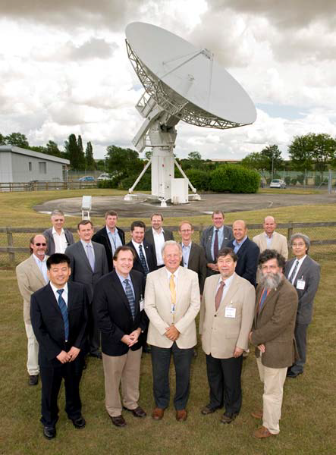
Short History of Joint WGClimate
2010
The joint development of the high-level architecture for climate monitoring from space led to the formation of the CEOS WGClimate in 2010 and then of the Joint CEOS/CGMS WGClimate in 2013.
Chair: Jörg Schulz (EUMETSAT) until 2020
Vice Chair: John Dwyer (USGS) until 2019

Slide 3
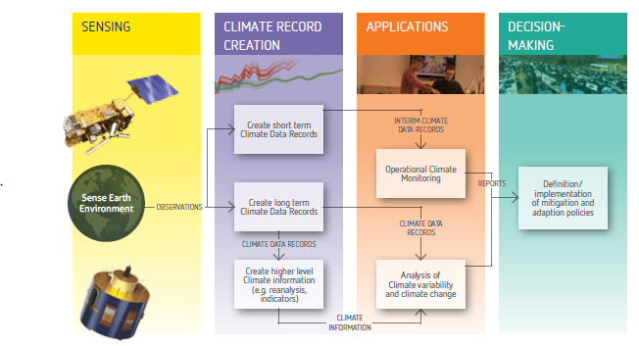


The Architecture for Climate Monitoring from Space
2013
http://ceos.org/document_management/Working_Groups/WGClimate/WGClimate_Strategy-Towards-An-%20Architecture-For-Climate-Monitoring-From-Space_2013.pdf

Slide 4
Major objectives of WGClimate
Provision of a structured, comprehensive and accessible view as to what Climate Data Records are currently available from satellite missions of CEOS and CGMS members or their combination;
Creation of the conditions for delivering further Climate Data Records, including multi-mission Climate Data Records, through best use of available data to fulfil GCOS requirements (e.g. by identifying and targetting cross-calibration or re-processing gaps/shortfalls );
Optimisation of the planning of future satellite missions and constellations to expand existing and planned Climate Data Records, both in terms of coverage and record length, and to address possible gaps with respect to GCOS requirements.

Slide 5
Addition to the Mandate 2018
Considering the specific importance of greenhouse gas monitoring as stated in the Conference of the Parties (COP) 21 Paris Agreement, it will:
Coordinate activities of CEOS and CGMS defining and implementing an integrated global carbon observing system including a targeted observing system for monitoring the column concentrations of CO₂, CH₄ and other greenhouse gases from space as well as insuring that these activities are integrated into a broader approach on greenhouse gas monitoring, i.e., WMO IG³IS, GCOS, and GEO-C;
Oversee the implementation of the CEOS Carbon strategy.

Slide 6





UNFCCC/GCOS – CEOS/CGMS Relations
COP-21 Paris Agreement: Adaptation (Article 7(c)):
Strengthening scientific knowledge on climate, including research, systematic observation of the climate system and early warning systems, in a manner that informs climate services and supports decision-making.
2015
Reports on Progress
@ SBSTA/COP
Needs and Requirements
Coordinated Response

Slide 7

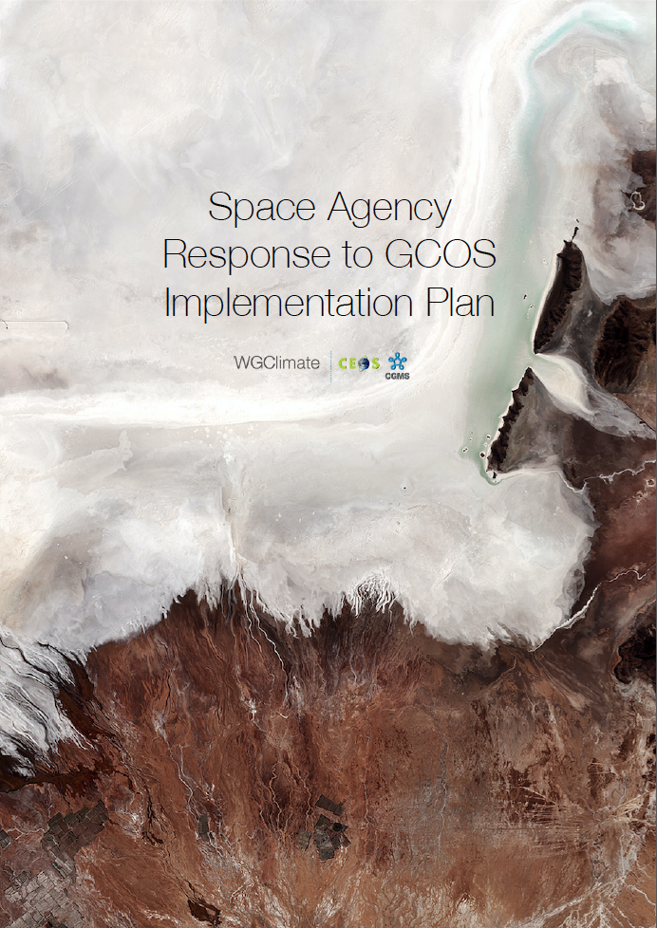
GCOS Implementation Plan &
The Comprehensive Answer
2016
Answer contains status and plans for all actions in GCOS IP relevant for space agencies.
Allows reporting of progress on GCOS needs to UNFCCC.
2017
Notes:
Addresses GCOS Actions with space relevance;
Structure of response is similar to the plan itself;
Contains status and plans for 11 (32) general, 19 (40) atmospheric, 17 (57) oceanic and 48 (72) terrestrial actions;
Allows reporting on progress to GCOS and UNFCCC.

Slide 8
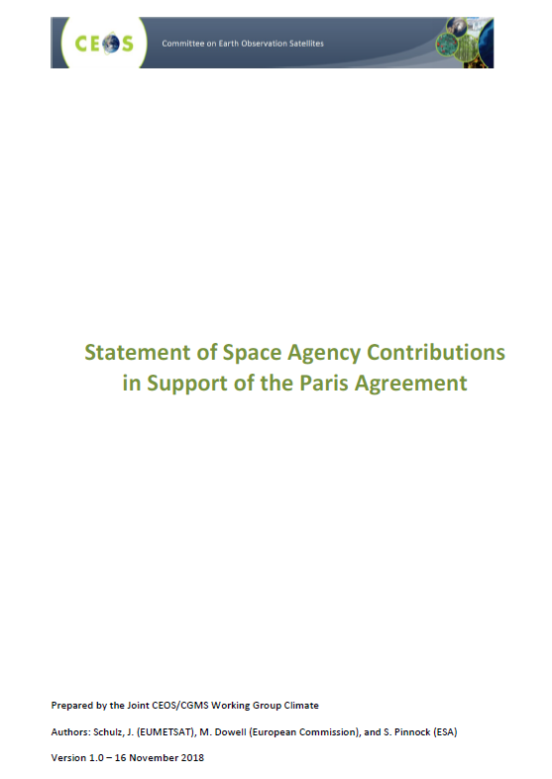
Space Agency contribution to the
Paris Agreement
Consulted GCOS and GEO that performed similar analysis in their areas;
Applied categorisation of Paris Agreement articles as depicted by GCOS (see next slide);
Document provides an assessment in support of individual articles of the Agreement;
Addressed in particular CEOS cross cutting Working Groups contributions;
Will become available on climatemonitoring.info soon.

Slide 9
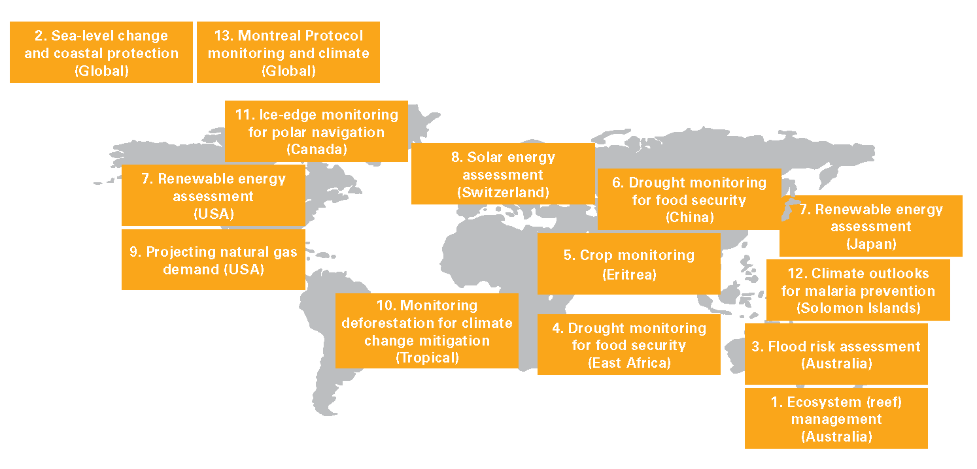
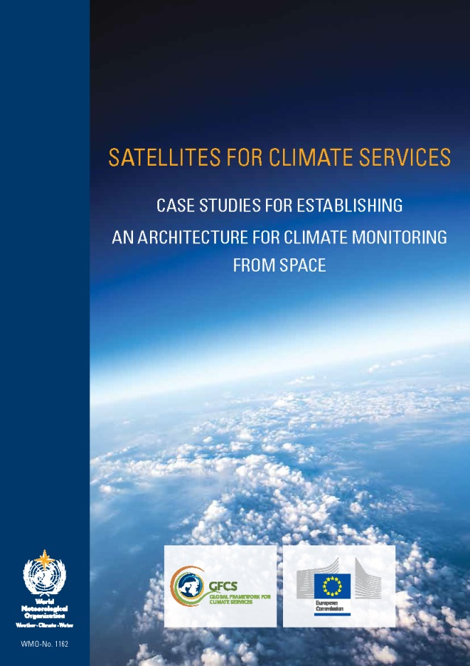



Enhancing use of climate data records
Courtesy of Bojinski et al.; 2015
2015
http://library.wmo.int/pmb_ged/wmo_1162_en.pdf

Slide 10
ECV Inventory - Resource for Coordinated Response
Action Plan & Creation of conditions to deliver CDRs
ECV Inventory
Gap Analysis & Recommendations
ECV Inventory fully describes current and planned implementation arrangements (ECV-by-ECV) within the Architecture;
Updated continuously with versions of Inventory, gap analysis, action plan created annually with approval from CEOS and CGMS;
Recommendations and Coordinated Actions inform space agency planning, improve availability and interoperability of climate data;
Feeds material for all future responses to the GCOS IP.
2018

Slide 11
Summary
Joint CEOS/CGMS WGClimate is the focal of point of space agencies to address GCOS requirements and is the single coordinated voice towards UNFCCC;
The ECV Inventory provides a resource for the whole community that wants to use and create climate data records – Use it to find data for applications, examples provided!
WGClimate has developed the tools for effective analysis of space agency data holdings and plans, to optimise utilisation of existing measurements and planning of new measurements for climate monitoring;
The implementation of the architecture for space-based climate monitoring requires an ongoing analysis of every pillar of the architecture and their interactions.

