Slide 1
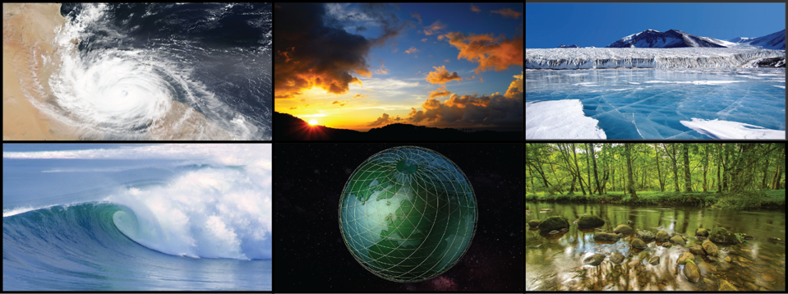
WORLD CLIMATE RESEARCH PROGRAMME
Michel Rixen
WDAC8
20-21 March 2019
Marrakesh, Morocco

Slide 2
WCRP’s mission….
... is to facilitate analysis and prediction of Earth system variability and change for use in an increasing range of practical applications of direct relevance, benefit and value to society.
The two overarching objectives of WCRP are:
to determine the predictability of climate
to determine the effect of human activities on climate

Slide 3
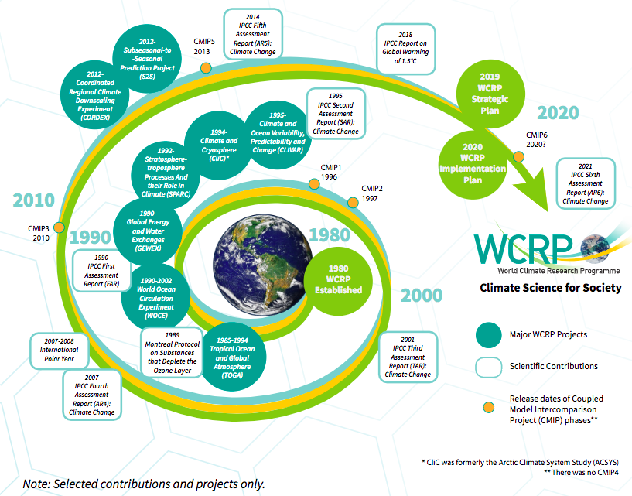
WCRP History and Milestones

Slide 4
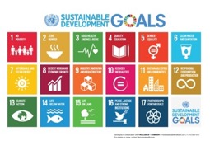
2015: A landmark Year
Over 190 countries signed up to reduce emissions, with the target to stay within a 2ºC world.
15-year agreement for the substantial reduction of disaster risk and losses in lives, livelihoods and health.
2030 agenda with 17 goals to end poverty and hunger, improve health and education, making cities more sustainable, combating climate change, and protecting oceans and forests.
Understanding and Quantifying Weather and Climate Risk are at the Core of these Actions

Slide 5
21st Century challenges in an interconnected world
Weather Hazards, Climate Variability and Change
Urbanisation
Population growth
Limited Natural Resources
Water
Food
Energy
Political
Economic
Health
Migration
Exposure to extreme weather and climate events threatens economic development and social welfare across the globe
© Crown copyright Met Office

Slide 6
New Tools : Seamless Prediction Across Timescales
Past climate
1-week
Decadal
1-month
Now
Days
Seasonal
Climate
Hours
Confidence boundary
Analysis of past weather observations to manage climate risks
E.g. Agriculture: informs crop choice, planting to yield optimisation and minimise crop failure risk.
Forecasting routine and hazardous weather conditions.
Public, emergency response, international Disaster Risk Reduction
Monthly to decadal predictions - probability of drought, cold, hurricanes….
Contingency planners, national and international humanitarian response, government and private infrastructure investment
Climate Change projections.
Informs mitigation policy and adaptation choices. Impacts on water resources, heat stress, crops, infrastructure.
Forecast lead-time
© Crown copyright Met Office
Notes:
The Vuvuzela of seamless prediction:
The Met Office is able to make predictions on all timescales from now until a century ahead.
Analysis of past weather data is also useful to understand weather risks today – for example what is the likelihood of a particular storm event occurring.
On longer timescales the confidence boundary gets wider – however if the climate information is applied in an appropriate manner it provides extremely useful information to inform adaptation decision making.

Slide 7
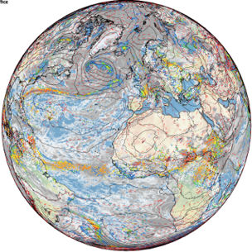
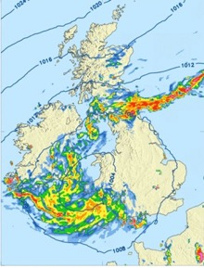
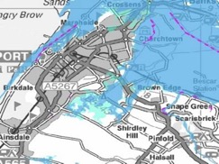
New Tools : Seamless Prediction Across Space scales
N x Global predictions at ~10km with lead times of days to years:
Synoptic drivers
<N x Regional predictions at <1km with lead times of hours to years:
Local meteorology
Probability of local hazards:
Impact Scenarios & Narratives
© Crown copyright Met Office

Slide 8
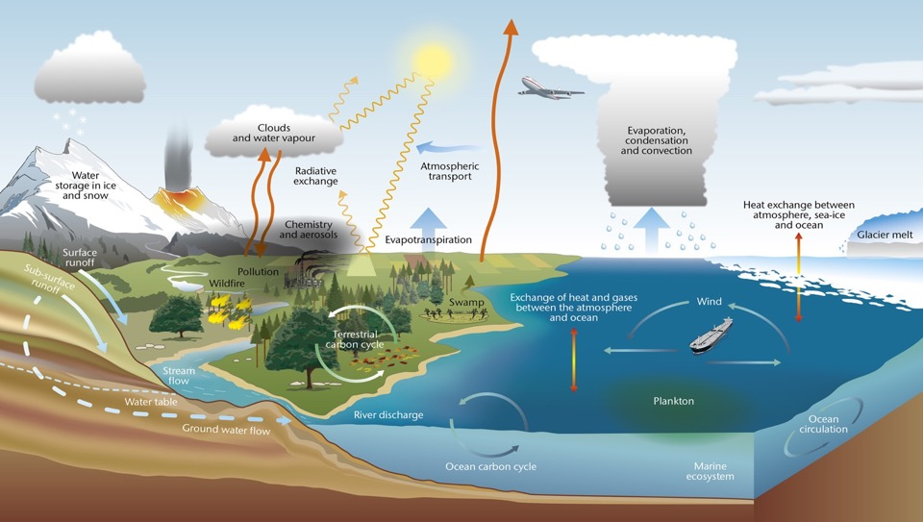
Taking a holistic view of the Earth System

Slide 9
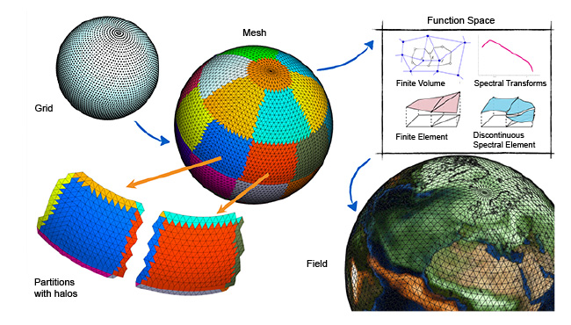
Next Generation Codes, Exascale Computing
Courtesy: ECMWF

Slide 10
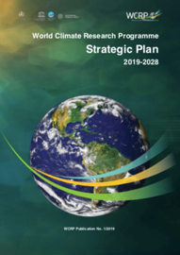
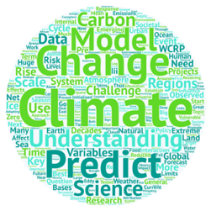
WCRP Strategic Plan
WCRP is developing a new Strategic Plan, covering a 10-year time horizon (2019-2029)
Takes into account the outcomes of the co-sponsors review (finalized in June 2018)
Importance of bedrock science, seamless approach (time, space, ESM, R-O) and links to services and policy emphasised
Accompanying Implementation Plan under development
Notes:
Esm = Earth System Models
R-O : Research to Operations

Slide 11
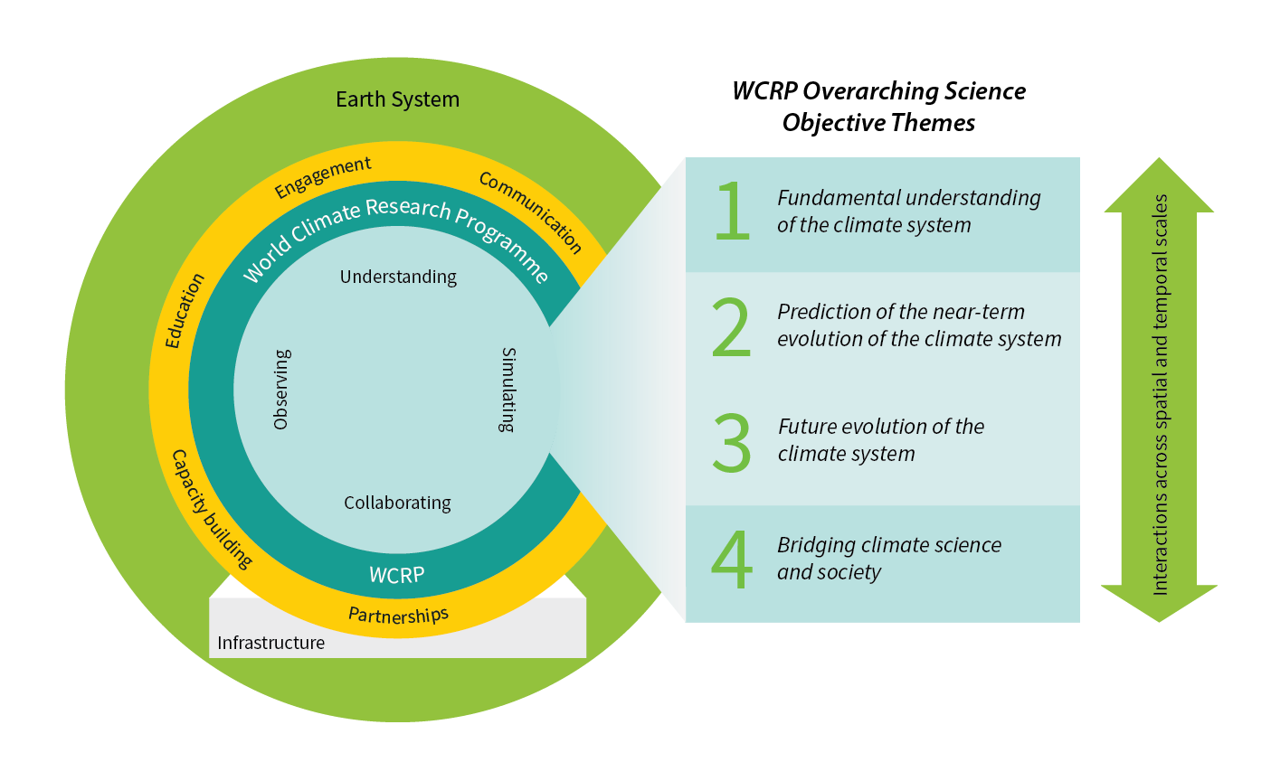
WCRP Strategic Plan

Slide 12
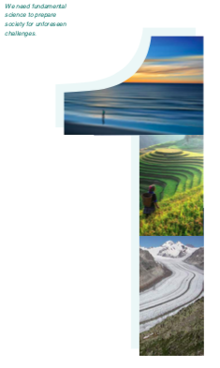
Objective 1
WCRP Strategic Plan
Advancement of sciences that enable an integrated and fundamental understanding of the climate, its variations and its changes, as part of a coupled physical, biogeochemical, and socio-economic system.
Emphases:
Climate dynamics: past and future global and regional changes in oceanic and atmospheric circulations
Reservoirs and flows: radiative, hydrologic, cryospheric and biogeochemical changes on energy, water, carbon, and other climate-relevant compounds

Slide 13
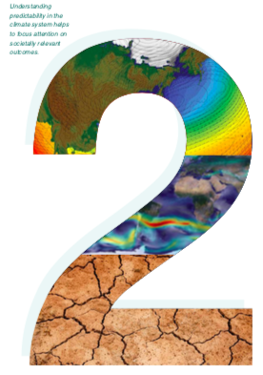
Objective 2
WCRP Strategic Plan
Frontiers of predictions and quantify the associated uncertainties for sub- seasonal to decadal time scales across all climate system components.
Emphases:
Simulation capabilities of component systems and their coupling. Deterministic, statistical and machine learning approaches. Data assimilation and ensemble generation
Predicting extreme events: regional climate hotspots and potential for crossing thresholds. Interactions between fact and slow extremes

Slide 14
Objective 3
WCRP Strategic Plan
Quantify the responses, feedbacks and uncertainties intrinsic to the changing climate system on longer timescales.
Emphasis:
Earth system models. Development and integration. Representation of complex interactions between aquifers, vegetation and soil carbon, between permafrost, glaciers, and ice-sheets. Dynamical and statistical downscaling

Slide 15
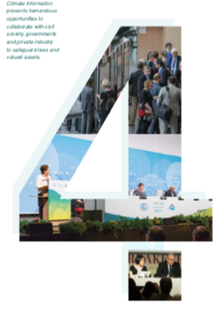
Objective 4
WCRP Strategic Plan
Innovation in the generation of decision-relevant information and knowledge about the evolving Earth system.
Emphasis:
Interactions with social systems: Social processes and emergent behaviour in the Earth System. Interactions and feedbacks between climatic and socioeconomic systems
Engaging with society: Actionable climate information, scientific assessments, educational approaches and public communication strategies.

Slide 16
Critical Infrastructures
WCRP New Strategy
I. A hierarchy of modeling tools
II. Observations for process understanding
III. Sustained reference data
IV. High-end computing and data management

Slide 17
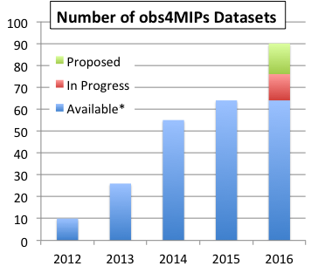
obs4MIPs
https://www.earthsystemcog.org/projects/obs4mips
A project for identifying, documenting and disseminating observations for climate model evaluation in WCRP model intercomparisons, notably CMIP.
Data (and tech notes) accessible with the distributed CMIP model output via ESGF, adhering to same conventions
Guided by the WCRP Data Advisory Council obs4MIPs Task Team
Target Quantities
Model Output
Gridded datasets
Complete (~125)
In Progress* (~15)
Proposals from Data Call (~100)
…. and growing!

Slide 18
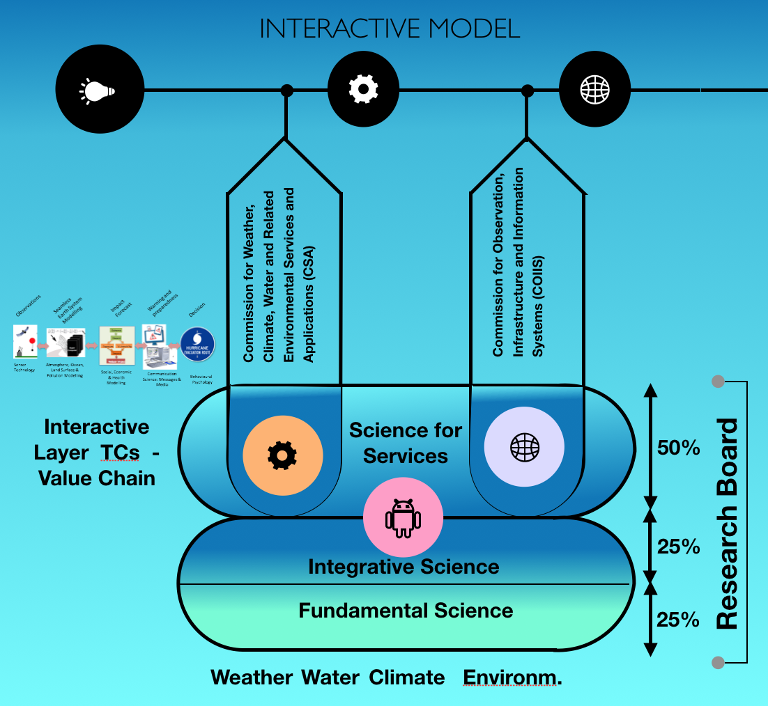
Integration, integration and more… integration
Infrastructure
Models
Time
Space
Disciplines
Communities
Value cycle
…

Slide 19
WMO/IOC
GLOBAL CLIMATE OBSERVATIONS, ANALYSES & MONITORING
(CCl, GCOS…)
WCRP CAPABILITY THEMES
WMO/ICSU
GLOBAL ATMOSPHERIC COMPOSITION
GHG Monitoring;
Air Quality Prediction;
Atmospheric Chemistry Processes & Modelling
(GAW, SPARC,IGAC)
EARTH SYSTEM PROCESSES ACROSS SCALES
Jointly with WWRP
CLIMATE VARIABILITY, PREDICTABILITY & PREDICTION
CLIMATE CHANGE AND EARTH SYSTEM FEEDBACKS
Jointly with AIMES
WCRP CROSS-CUTTING RESEARCH PROJECTS
(on occasions with WWRP, Future Earth…..)
WCRP WORKING GROUP ON CLIMATE MODEL DEVELOPMENT
jointly with WGNE
WCRP WORKING GROUP ON CLIMATE INFORMATION FOR REGIONS
linking with Future Earth
CLIMATE CHANGE ASSESSMENTS AND CLIMATE SERVICES (UNFCCCC, IPCC, GFCS, Copernicus, VIACS, ….....)

Slide 20
CLIVAR GEWEX SPARC CLIC
Data Advisory Council
Modeling Advisory Council, Core Projects
WGCM WGNE WGSIP
Climate Information for Regions
Multi-scale Processes in the Climate System
(WWRP, GAW, IGAC, SOLAS, PAGES, …)
Engagement with Society From Science to Service
(Future Earth
GFCS, IPCC, …)
Analysis of Observation and Data Assimilation
(GCOS
GOOS, GEO, ..)
Science of Model Development
(WWRP, AIMES)
Society
Fast-track Integrative Projects
(JSC)
Predictions
(weeks to decades)
(WWRP)
Grand Challenges
Projections
(decades to centuries)
(FE, AIMES)
Proposed structure for the discussion
of the WCRP implementation plan
DCPP WGSIP S2S
CMIP CORDEX

Slide 21
Ro
Timeline
WDAC8 Marrakesh
Feeding into:
Retreat 4-5 May, Geneva: first brainstorm on TP/IP
JSC40 6-10 May, Geneva: consolidation of inputs into TP/IP
WMO 18th Congress, June’19: reform
AGU Fall Meeting, 9-13 Dec 2018

Slide 22
Ro
WCRP – WG Climate
WDAC as interface
Focus
Climate/Earth System
Past, present and future
Reservoirs, flows -> budgets, exchanges
Data assimilation, reanalysis, initial conditions
Model development, verification
Data infrastructure, data mining/fusion
…

Slide 23
Ro
Some key topics for WDAC8
Integration, Earth System Reanalysis:
Disciplinary areas
Fluxes, modelling, observations
Need to accelerate research
Ref for model development & verification, process understanding, IC
Global Stocktake and much more
Data assimilation, OSSE/OSE
Data infrastructures, protocols, standards
Data mining/machine learning
Research-operations, links to C3S, space agencies, etc
WCRP Obs/Data coordination mechanism in new IP

Slide 25
Thank You
www.wcrp-climate.org

