Slide 1
CLIMATE@EUMETSAT
Jörg Schulz
+ Contributions of many
inside and outside of EUMETSAT

Slide 2
EUMETSAT Contribution to Climate Science and Services
Long term, multi-satellite programmes, with service continuity
Continuous improvement, expansion of portfolio of observations
Unique patrimonial archive: decades of observations
Data rescue (historic satellite observations)
Recalibration and production of climate records
    Physical parameters directly observed by satellites: level 1 (mostly done at EUM HQ)
    Geophysical parameters: ECVs (ocean, atmosphere, land) (mostly done by EUM SAF)
    Estimation of uncertainties
Data access
Cooperation with users: validation, research, applications
Training, support to climate-related capacity building initiatives

Slide 3

Metop-C Lift-off (7 Nov 2018)

Slide 4

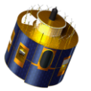
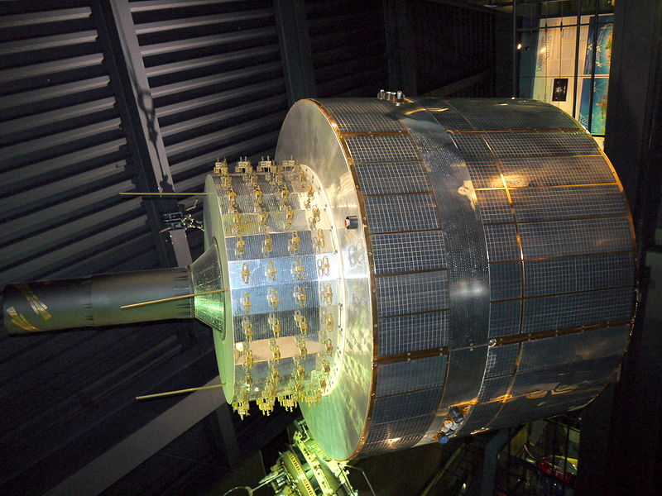
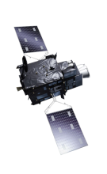
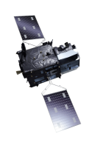
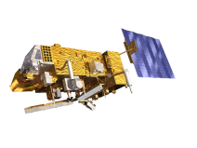

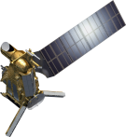
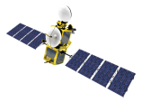
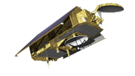
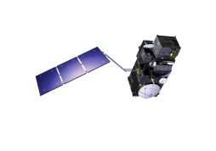
Long-term Commitment: Multi-Satellite Programmes
YEAR...
1977
…
2016
YEAR...
03
04
05
06
07
08
09
10
11
12
13
14
15
16
17
18
19
20
21
22
23
24
25
26
27
28
29
30
31
32
33
34
35
36
37
38
39
40
METEOSAT FIRST GENERATION
METEOSAT SECOND GENERATION
METEOSAT-8
METEOSAT-9
METEOSAT-10
METEOSAT-11
METEOSAT THIRD GENERATION
MTG-I-1 : IMAGERY
MTG-S-1: SOUNDING
Mandatory Programmes
MTG-I-2: IMAGERY
MTG-I-3: IMAGERY
EUMETSAT POLAR SYSTEM (EPS)
MTG-S-2: SOUNDING
METOP-A
MTG-I-4: IMAGERY
METOP-B
METOP-C
EUMETSAT POLAR SYSTEM SECOND GENERATION (EPS-SG)
METOP-SG A: SOUNDING AND IMAGERY
METOP-SG B: MICROWAVE IMAGERY
JASON (HIGH PRECISION OCEAN ALTIMETRY)
Optional
Programmes
JASON-2
JASON-3
SENTINEL-6 (JASON-CS)
COPERNICUS
SENTINEL-3 A/B/C/D
Third Party
Programmes
SENTINEL-4 ON MTG-S
YEAR...
03
04
05
06
07
08
09
10
11
12
13
14
15
16
17
18
19
20
21
22
23
SENTINEL-5 ON METOP-SG A
24
25
26
27
28
29
30
31
32
33
34
35
36
37
38
39
40
Notes:
By 2040 Meteosat imaging provides >60 years time series;
Improved imaging capability contributes to:
research on the global circulation (storm tracks including hurricanes, life cycle of storms, long term change in polar front position, etc.);
surface properties and aerosols;
better fire detection products and an increase in the quality of climate-relevant products such as fire radiative energy and power, which can be used to calculate carbon dioxide emissions from fires.
MTG IR sounder opens new opportunities:
for 3D AMV time series in conjunction with IASI/IASI-NG and AVHRR/MetImage;
for reanalyses with NWP models operating at regional scale and assimilating high resolution temperature, humidity and cloud information.
Lightning imager may contribute to quantification of naturally occurring NO_{x} and aircraft-induced NO_{x};
Improved spatiotemporal sampling addresses analysis of extreme events at local scale, e.g., thunderstorms.

Slide 5

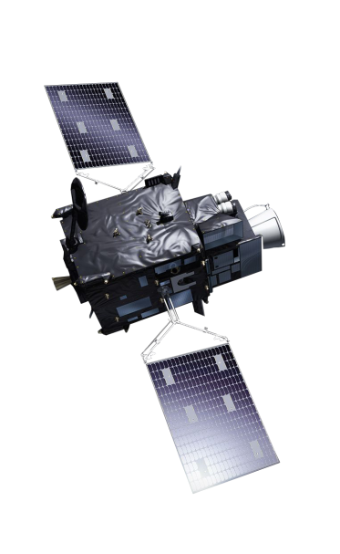
MTG-I Imaging Mission
Imagery mission implemented by two MTG-I satellites
Full disc imagery every 10 minutes in 16 bands (FCI)
Fast imagery of Europe every 2.5 minutes (FCI)
New Lightning Imager (LI)
Operational exploitation:
2022-2042

Slide 6
Meteosat: Spectral, Spatial and Temporal Sampling
Notes:
The yellow ones create the long data records.
The new ones allow new parameters to be retrieved.

Slide 7
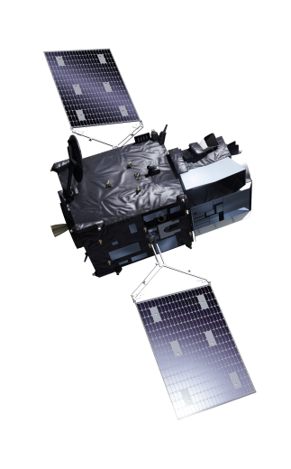
MTG-S Sounding Mission
Hyperspectral infrared
sounding mission (IRS)
3D weather cube: temperature, water vapour, O3, every 30 minutes over Europe
Air quality monitoring and atmospheric chemistry in synergy with Copernicus Sentinel-4 instrument (UVN)
Operational exploitation:
2023-2042

Slide 8
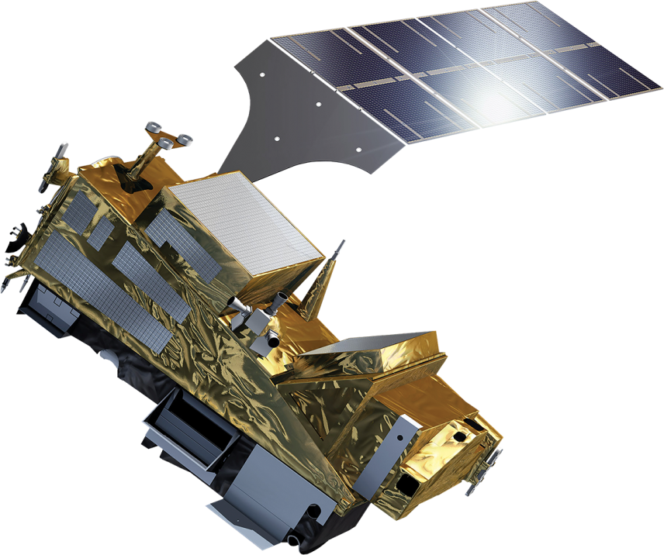
EPS-SG A Sounding and Imagery Mission
IASI-NG
Infrared Atmospheric Sounding
MWS
Microwave Sounding
METImage
Visible-Infrared Imaging
RO
Radio Occultation
3MI
Multi-viewing, -channel, -polarisation Imaging
Copernicus Sentinel-5
UN/VIS/NIR/SWIR Sounding
4
5
2
1
6
4
3
Notes:
IASI-NG: IASI heritage, 2x more channels, better S/N ratio
MWS: AMSU-A, MHS heritage, new channels (57GHz)
METImage: AVHRR heritage
3MI: POLDER, PARASOL heritage

Slide 9
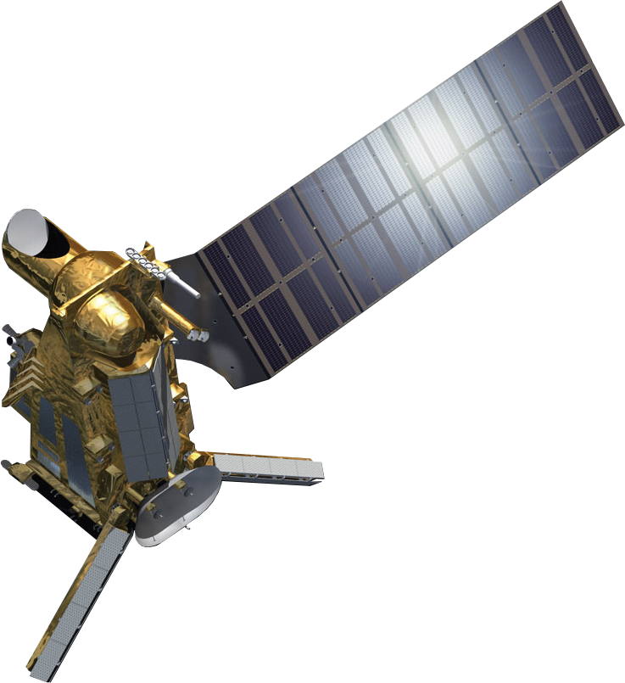
EPS-SG B Microwave Imagery Mission
SCA
Scatterometer
RO
Radio Occultation
MWI
Microwave Imaging for Precipitation
ICI
Ice Cloud Imager
ARGOS-4
Advanced Data Collection System
3
2
5
4
1
1
2
1
Notes:
MWI: SSMIS heritage
ICI: new

Slide 10
EPS Second Generation – Instruments’ Heritage
Metop-SG A Optical Imagery and Sounding | Instrument | Predecessor on Metop | Predecessor
Infrared Atmospheric Sounding (IASI) | IASI-NG | IASI | AIRS, HIRS
Microwave Sounding (MWS) | MWS | AMSU-A, MHS | MSU, AMSU-B, ATMS
Visible-infrared Imaging (VII) | METimage | AVHRR | AVHRR&VHRR
Radio Occultation (RO) | RO | GRAS | CHAMP, COSMIC, GRACE
UV/VIS/NIR/SWIR Sounding (UVNS) | Sentinel-5 | GOME-2 | GOME, Sentinel 5P
Multi-viewing, -channel, -polarisation Imaging (3MI) | 3MI | -/- | POLDER
Metop-SG B Microwave Laboratory | Instrument | Predecessor on Metop | Predecessor
Scatterometer (SCA) | SCA | ASCAT | ERS-1 Scat
Radio Occultation (RO) | RO | GRAS | CHAMP, COSMIC
Microwave Imaging for Precipitation (MWI) | MWI | -/- | SSMIS, SSM/I, SMMR
Ice Cloud Imager (ICI) | ICI | -/- | GMI for 183Ghz
Advanced Data Collection System (ADCS) | Argos-4 | Argos-3 | DCS (Argos-2)
Notes:
EPS-SG extends many EPS missions (Radio Occultation, scatterometer, hyperspectral IR sounding, etc. to ~35 years in a consistent manner.
EPS-SG extends heritage data records on VIS/IR imaging, IR and MW sounding to more than 60 years;
Derived geophysical parameters data records can be extended;
3MI: Horizontal Resolution: 4 km, 11 channels, extension to SWIR, Higher angular resolution (14 view angles) Mission objectives
Aerosols
Phase, altitude, properties
of clouds
Albedo, radiative budget (BRDF)
ICI: 11 channels (183 – 664 GHz) Mission Objectives
Cloud products, in particular ice clouds
Snowfall detection and quantification
Water-vapour profiles and imagery
MWI: 19 channels (18.7 - 183 GHz) Mission objectives
Precipitation and clouds
Imagery and H2O profiles
Sea ice, surface snow, wind

Slide 11

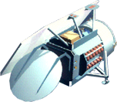
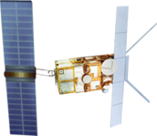
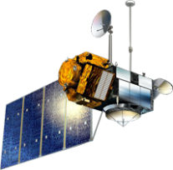
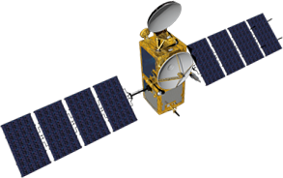
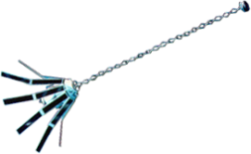
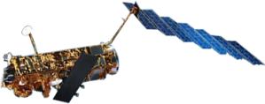

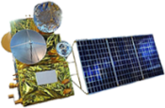
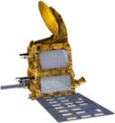

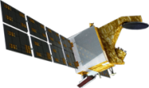

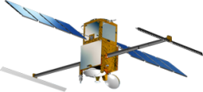
Altimetry missions – past, present, future
GFO
1998-2008
ERS-2
1995-2011
TOPEX-POSEIDON
1992-2006
ERS-1
1991-2000
GEOSAT
1985-1990
JASON-1
2001-2013
ENVISAT
2002-2012
JASON-2
2008
CRYOSAT
2010
HY-2A-G
2A 2011
2B 2018
2C 2018
2D 2019
2E 2021
2F 2020
2G 2022
SENTINEL-3A-D
3A 2016
3B 2018
3C Before 2020
3D 20??
SARAL
2013
CFOSAT
2018
JASON-CS/
SENTINEL-6
A 2020
B 2026
JASON-3
2016
SWOT
2020

Slide 12
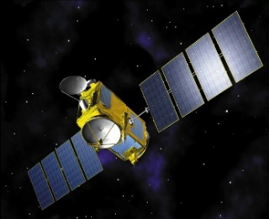
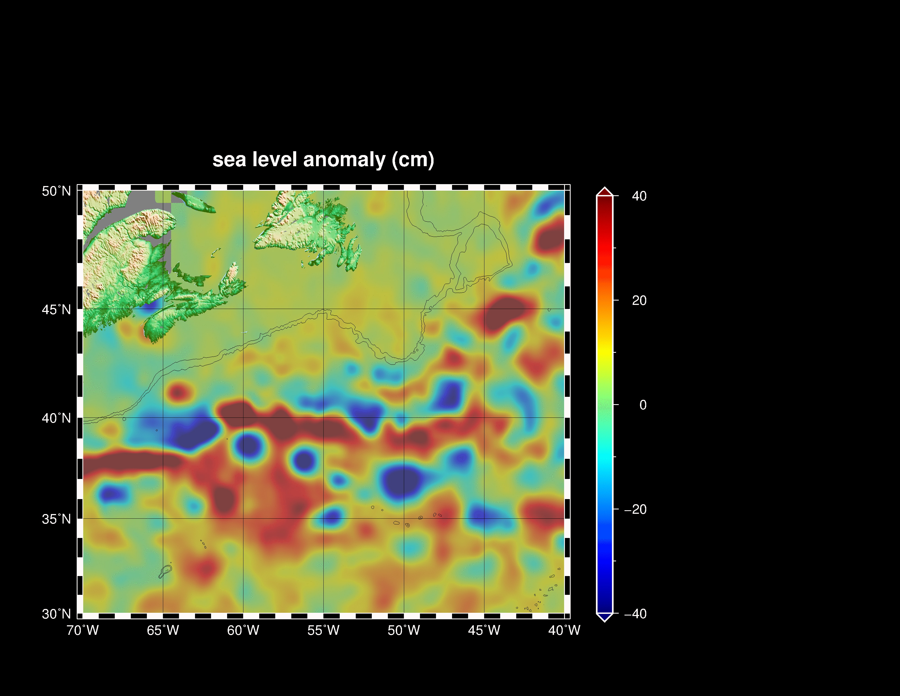
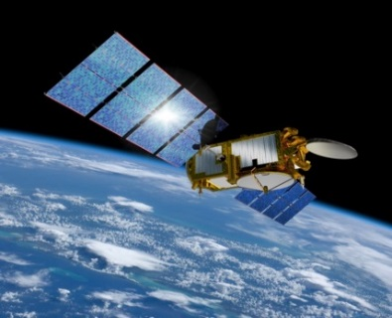
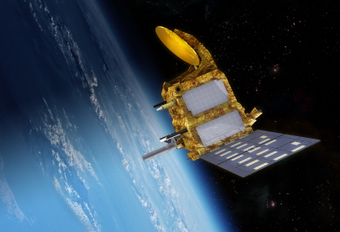
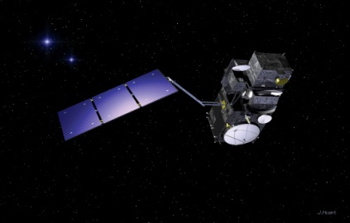
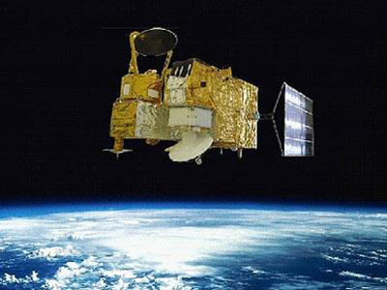
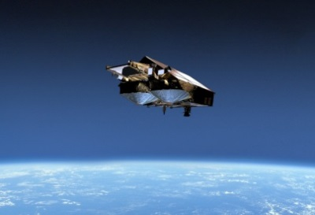
Sea Surface Topography: six missions are operational and interoperable by using the same QA tools
Jason-2
Jason-3
SARAL
Sentinel-3A / 3B
HY-2A
CryoSat-2
CryoSat-2
R. Scharroo, EUMETSAT

Slide 13

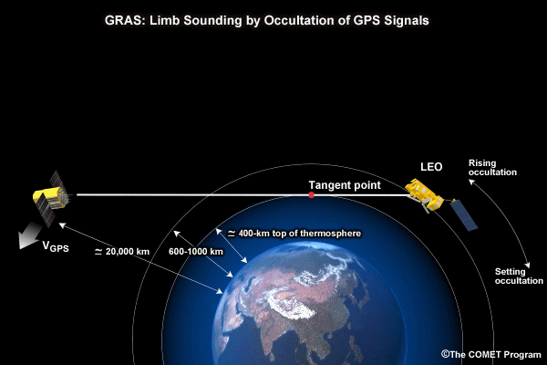
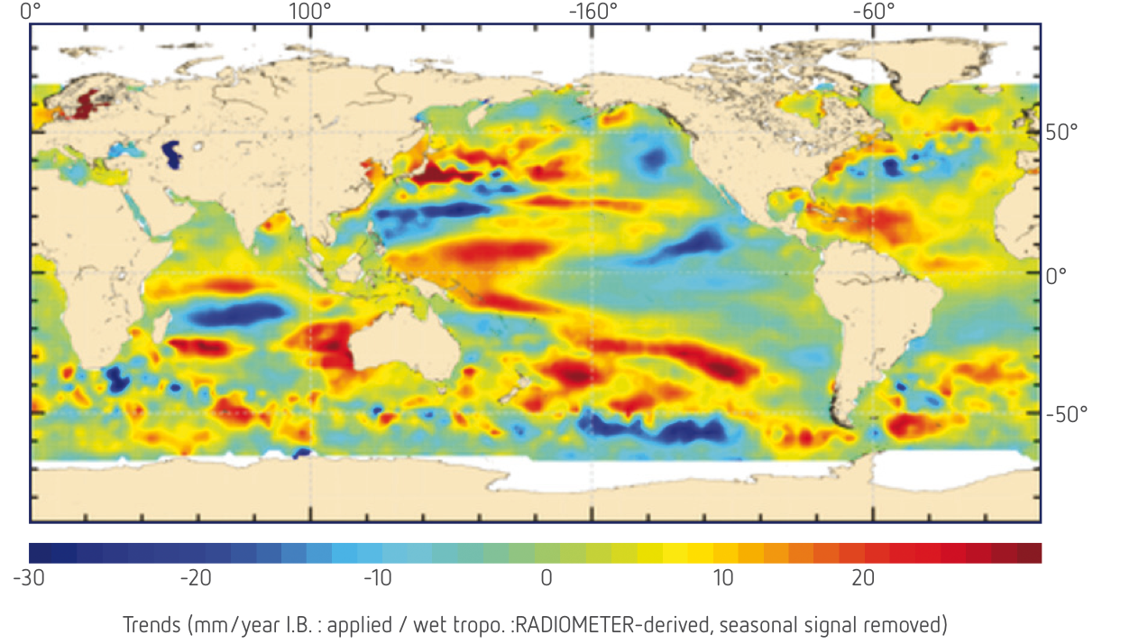
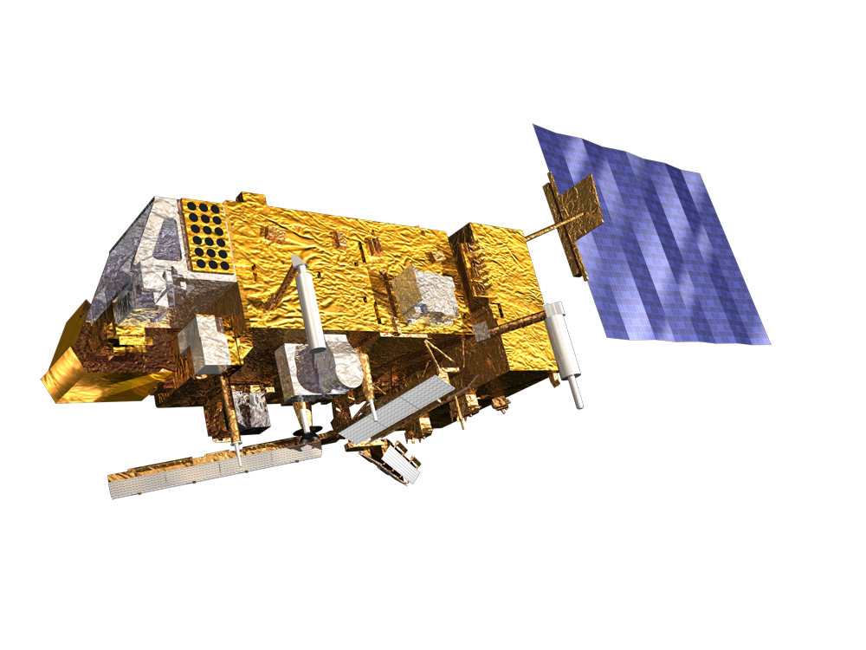
Some missions are optimised for climate monitoring …

Slide 14
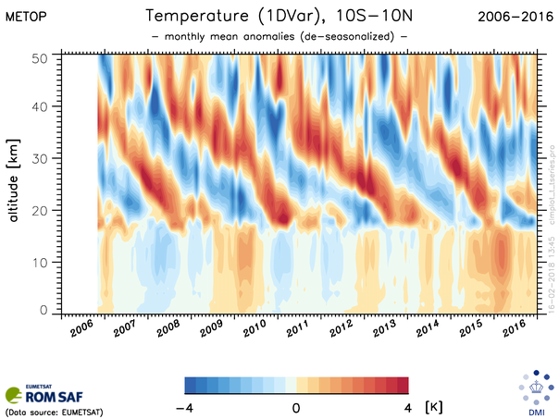
Radio Occultation Temperature Data Record
Includes: Bending Angle, refractivity, temperature, humidity and pressure profiles as well as the tropopause height
Generated from Radio-Occultation observations from Metop GRAS, CHAMP, GRACE and Cosmic mission
High degree of internal consistency (single processing version for all years and missions)
Covering the years 2002-2016
Released 19 February 2019
Notes:
14

Slide 15
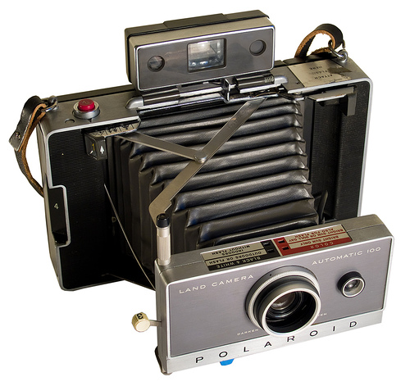
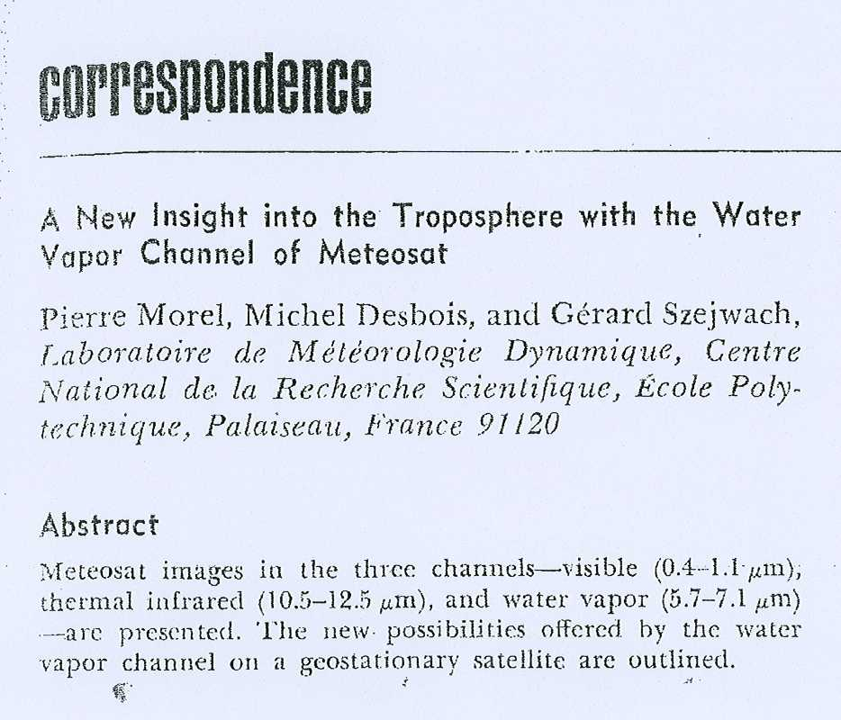
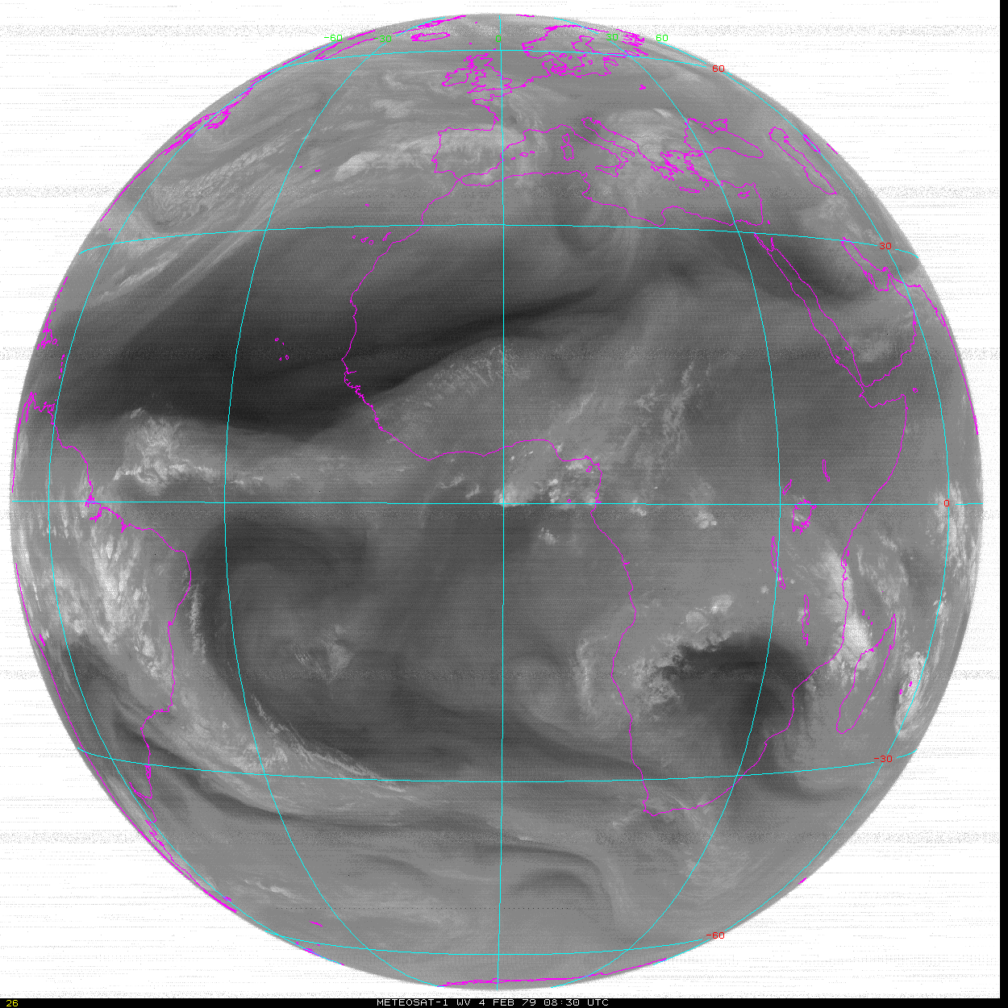
… others are not: Data Rescue and Preservation Challenge
– Meteosat-1 -
WV channel, Meteosat 1
4th February 1979, 15 images (Every hour from 08:30 UTC until 23:30 UTC (missing images at 18:30 UTC)
Bulletin of the AMS, 1978

Slide 16
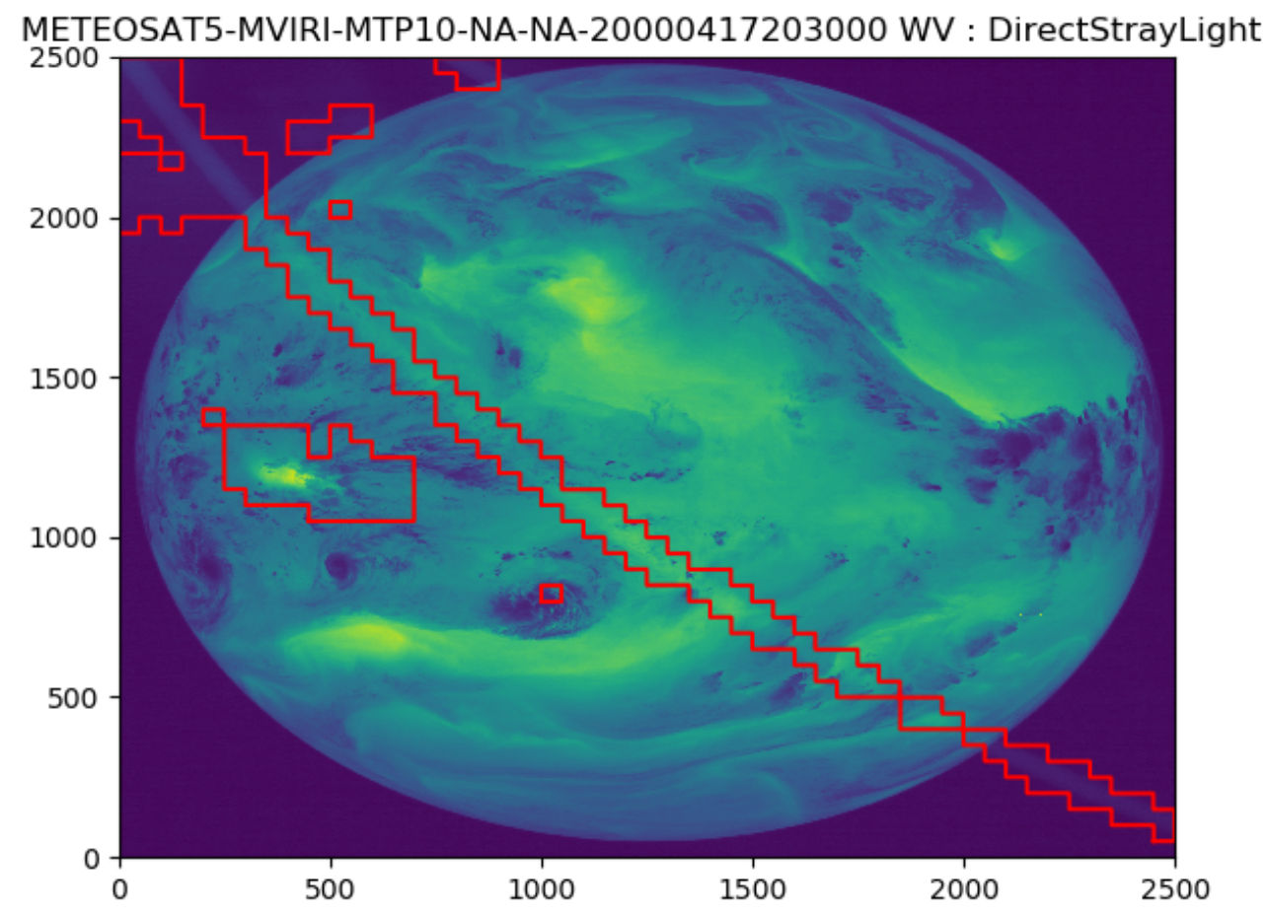
Data Rescue Meteosat First Generation
Enabling full image and product processing of Meteosat archive
Image anomaly detection on raw data distinguishes 30 anomaly types and runs over 65 data years of data in ~24 hours;
Preserved image processing software and migrate to modern computer system;
Recalibrated IR channels referenced to IASI;
Reconstructed VIS channel spectral response and recalibrated all MFG;
Included uncertainty estimates for radiance;
Implemented retrieval schemes for clouds, all sky radiance, atmospheric motion vectors, surface albedo, aerosol optical depth;
Work on data processing improvements;
Could be implemented for all geostationary.
Automated detection of anomalies present in historical Meteosat imagery
Red marked areas: anomalies due to direct stray light in Meteosat-5 image (17 April 2000, 20:30 UTC)

Slide 17
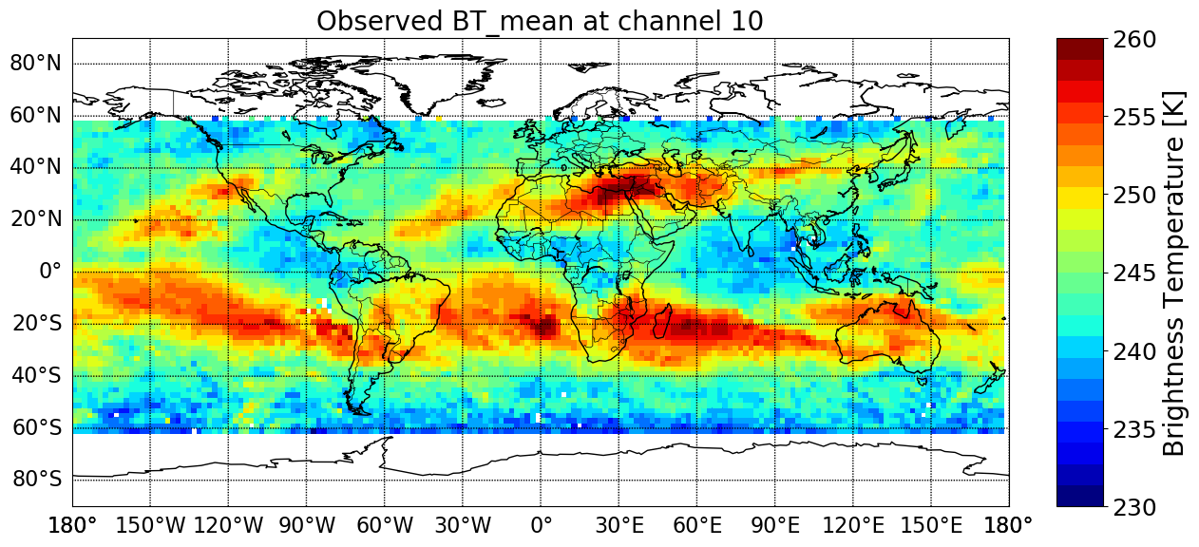
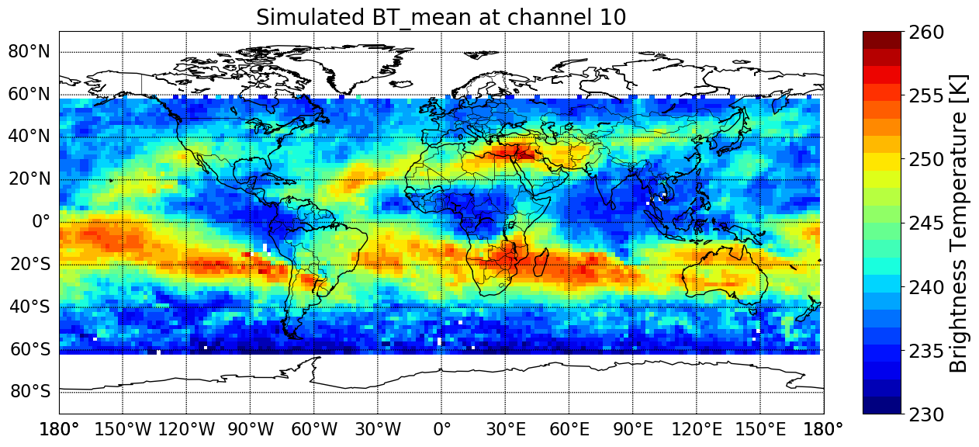
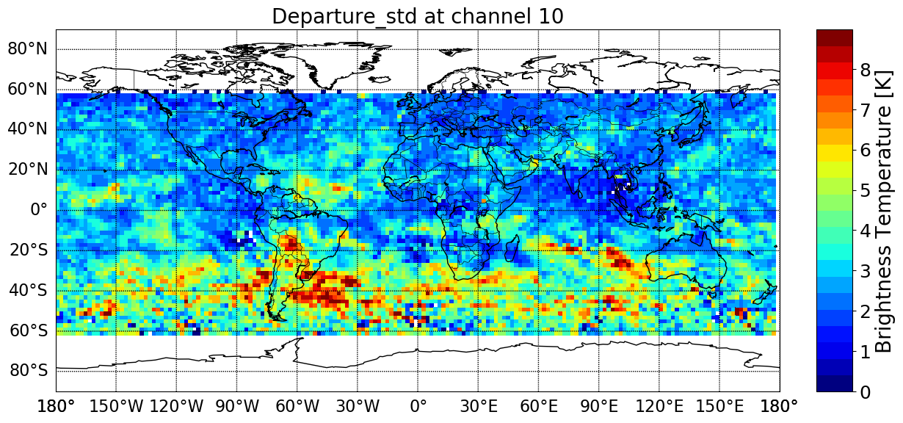
Analysis of NIMBUS-6 HIRS-1 Data
Nimbus-6 (Aug 1975)
ERA-5 (Aug 1975)
Standard Deviation
Nimbus-6 – ERA-5 departures
HIRS-1 Data from NIMBUS-6 /noon orbit (August 1975 and February 1976);
Reanalysis provides a tool to analyse historical data in absence of satellite and ground-based references;
High standard deviations in SH may point to additional information from HIRS-1 if assimilated.

Slide 18
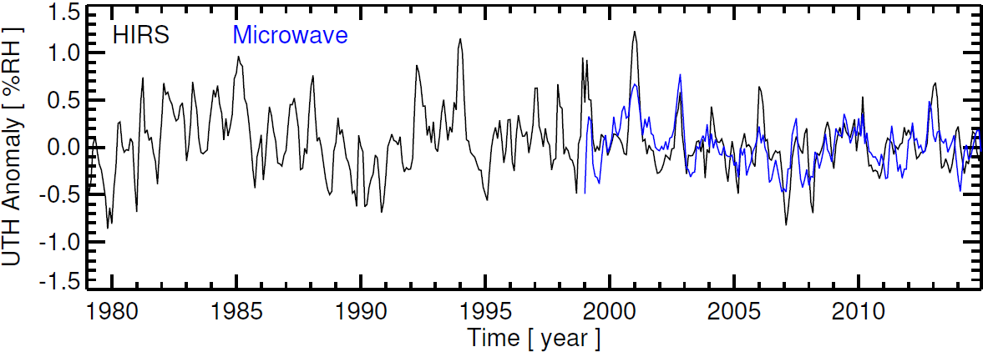
Upper tropospheric humidity with HIRS and MHS
Time series of upper tropospheric humidity anomalies using HIRS (black) and microwave sounder (blue) datasets. Data during overlapping time periods are averaged for both datasets. The anomalies are computed with respect to the 2001–2010 average, and the time series are smoothed to remove variability on time scales shorter than three months.
John et al., 2017
Notes:
The anomalies are computed relative to the 2001–2010 base period. A near-zero decadal trend in the upper tropospheric relative humidity time series indicates an increase in absolute (specific) humidity in step with the warming upper troposphere, and hence is consistent with a positive water vapour feedback (Chung et al. 2016). It is encouraging to see the consistency between the two independent datasets despite their differences in sampling: microwave data have an almost all-sky sampling whereas HIRS data sample mainly clear-sky scenes (John et al., 2011). Extreme anomalies for the HIRS time series arise from the sampling issues as demonstrated by John et al., 2011.

Slide 19

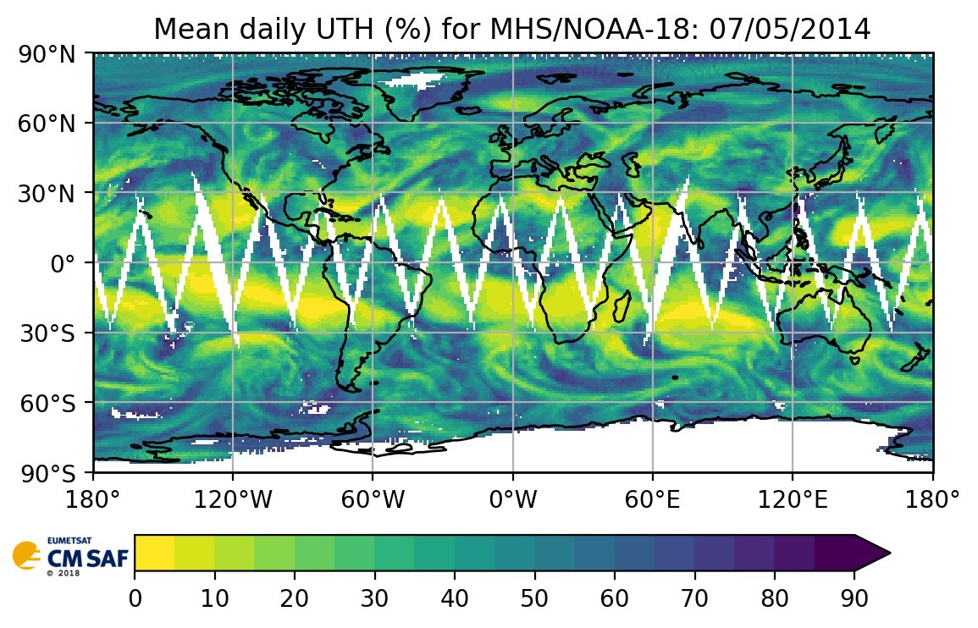
MHS Upper Tropospheric Humidity Data Record
Based on AMSU-B and MHS observations
Covering the 1999-2015 period
https://doi.org/10.5676/EUM_SAF_CM/UTH/V001
Released 15 January 2019

Slide 20
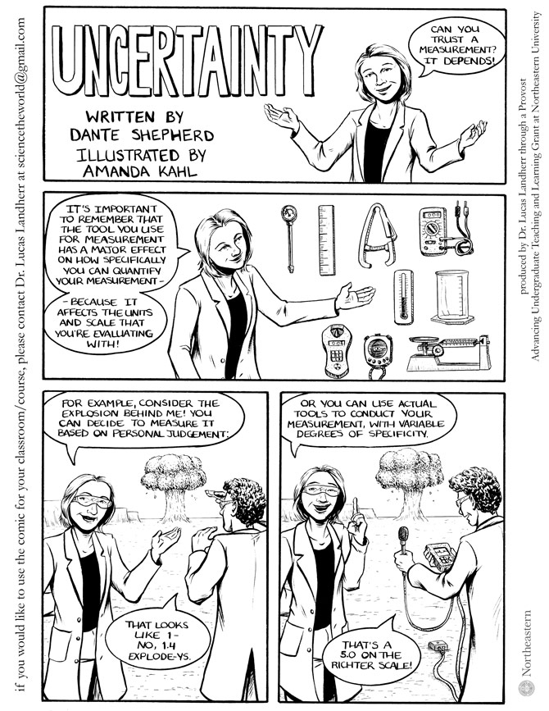




Uncertainties are important
Decision making requires appreciation of uncertainties
  Research is needed to narrow down uncertainties
  Science and reference data are needed to document and trace uncertainties
Traceability of uncertainties in observations
  Metrology
  Cross-calibration/validation against reference observations
  Evaluation of limitations of processing algorithms
Mature Climate Records
Include information on
uncertainties

Slide 21
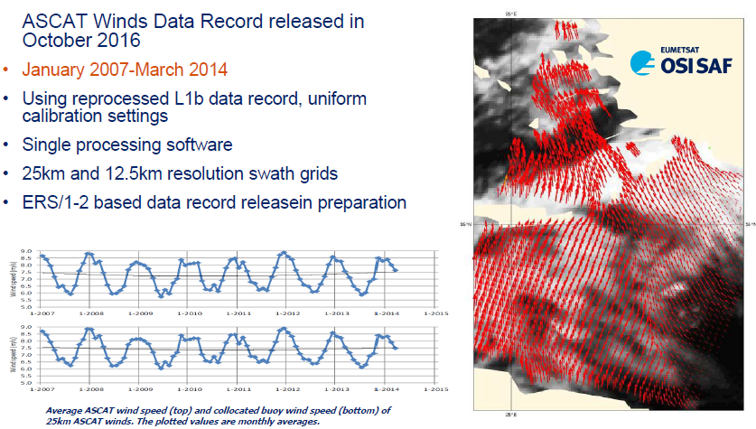
ASCAT Scatterometer Ocean Surface Winds

Slide 22
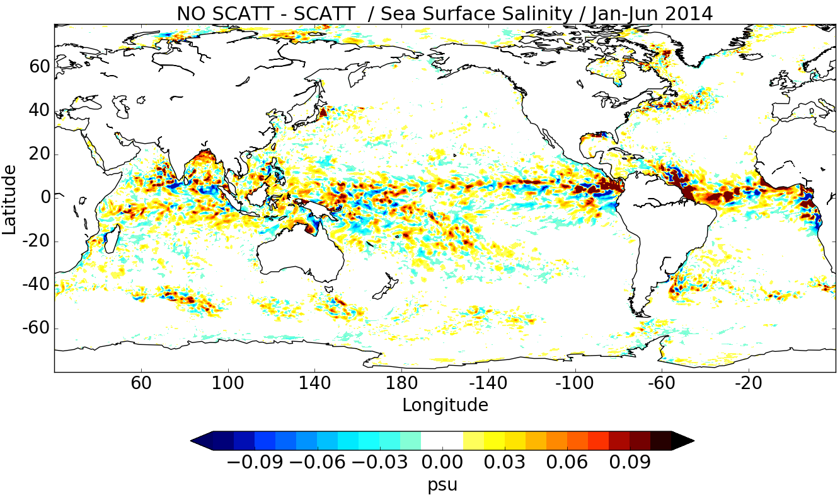
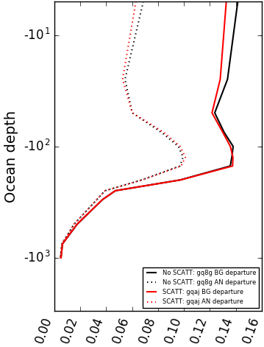
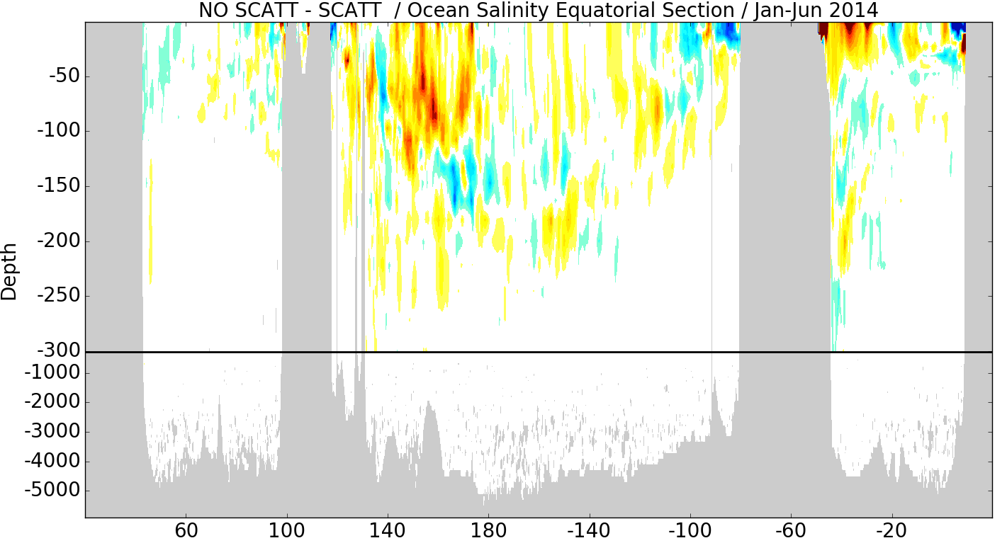
Coupled Assimilation - Atmospheric winds impact salinity
  Improved fit to in-situ observations
rmse
Mean
departure
SCATT
No SCATT
Courtesy of ECMWF

Slide 23

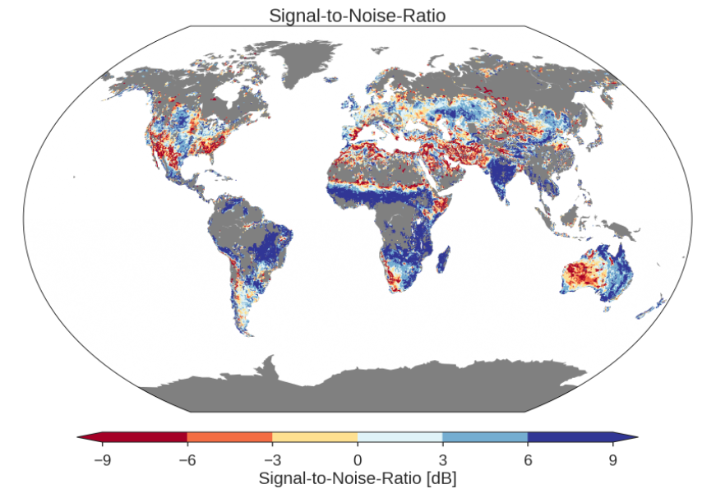
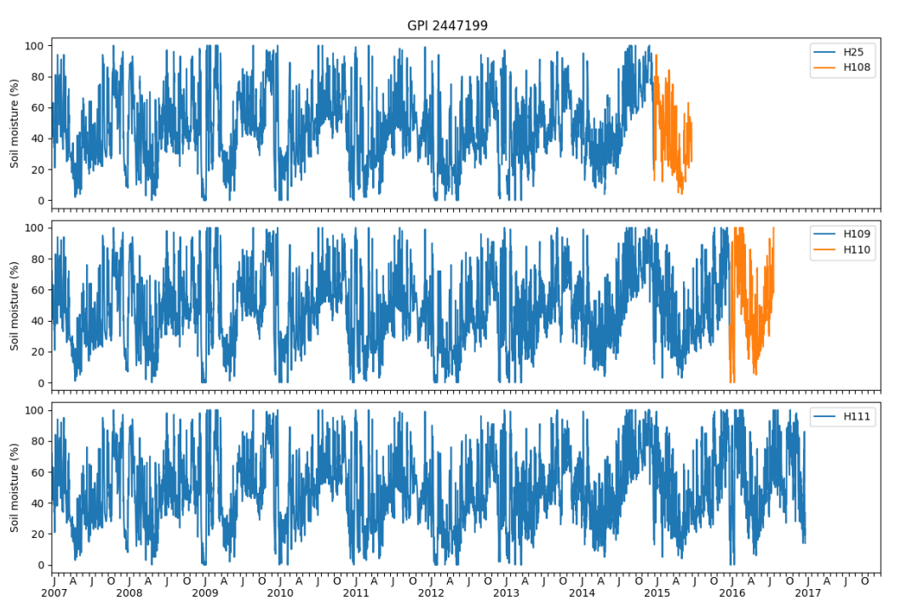
ASCAT Surface Soil Moisture Data Record
Improved and extended data record
based on Metop / ASCAT
Covering 10+ years: 2007- July 2017
Inclusion of a confidence flag, allowing own quality filtering
Improved model parameters applied
Complete Validation accessible at: http://rs.geo.tuwien.ac.at/projects/h-saf/
released 15 January 2018
More info:
http://h-saf.eumetsat.int

Slide 24





Water Shortage 2018 Capetown
Courtesy Mariette Vreugdenhil/TU Wien, EUMETSAT H SAF

Slide 25

Consistent surface solar radiation data record from SEVIRI
Based on Meteosat observations
Satellite-based climate data record of the solar surface irradiance, the surface direct irradiance (direct horizontal and direct normalized), the sunshine duration, spectral information, and the effective cloud albedo
Adding 2016 and 2017 period to extend the SARAH 2 data record now covering 34 years since 1983
http://dx.doi.org/10.5676/EUM_SAF_CM/SARAH/V002_01
Released 30 January 2019

Slide 26


Meteosat Land Surface Temperature and Surface Albedo Data Records
Based on Meteosat MSG SEVIRI observations
Land Surface Temperature: pixel based, full disk, temporal frequency of 15 min
Surface Albedo: pixel based 10-Day averages
Covering period of 2004-2015
Take benefit from L1 reprocessing by EUMETSAT Headquarter and cloud mask processing by CM SAF
Available through lsa-saf.eumetsat.int
Released 13 March 2019

Slide 27


Meteosat Sea Surface Temperature (SST) Data Record
Hourly sub-skin Sea surface temperature
Derived from observations from SEVIRI on board Meteosat Second Generation satellites
Covering the years 2004-2012
Validated against drifting buoy measurements
Take benefit from L1 reprocessing by EUMETSAT Headquarter and cloud mask processing by CM SAF
Released 25 April 2018
More info: http://osi-saf.eumetsat.int

Slide 28


GOME-2 NO₂ and H₂O Data Records
Covers period 2007-2017
Total column water vapour H₂O
Total and tropospheric NO₂
Metop-A and Metop-B GOME-2 observations
Monthly means, spatial lat-lon grid (0.5° x 0.5° for H2O and 0.25°x0.25°for NO2)
NetCDF format
Released 23 February 2018
More info: http://ac-saf.eumetsat.int

Slide 29
Summary
EUMETSAT has long-term, multi-satellite programmes, with service continuity;
Continuous improvement, expansion of portfolio of observations;
Provides operational access to foreign satellite data through agreements;
Works on science and sustainable operations for climate data records from historical to future observations.

