Slide 1
SIT Chair ‘New Space’ Report
Ivan Petiteville SIT Chair Team Coordinator
18th WGClimate meeting

Slide 2
International Context Rapidly Evolving
In last years, accelerating transformation of space international scene, at a pace unseen before:
80+ nations have now a national space programme e.g.:
US and China leading launches & deployment of new satellites.
India to become 4th nation for sending astronauts in LEO (2022).
UAE and South Korea: robotic exploration to Mars (2020) and Moon (2022).
Number of countries with a satellite in orbit: 50 in 2008 → 82 in 2018 → 91 now
Greater involvement of private sector, both Space and ICT sectors esp. in US
Global Space Economy grows in 2021 to €370 billion (+8.8% from 2018). EO only a small fraction 3 to 5%.
EO revenues for data & services forecast to double from ~ €2.8 billion (2021) to €5.5 billion over next decade.
Emerging New Space sector (upstream & downstream) ; strong support from national governments and private investors (e.g. in US) → Competition between nations and between Europe and other powerful economic zones.
Notes:
60 % of the European EO companies use Copernicus data
European Industry holds over 41% of the global EO downstream market
2021 global turnover for EO-derived data and services is €2.8b
Agenda 2025 writes 25%
Euroconsult: The space economy is expected to grow by 74% by 2030 to reach $642B (
Europe and Space
JOBS: 230 000
UPSTREAM REVENUES (35% OF GLOBAL MARKET): €9 Billion
DOWNSTREAM REVENUES (25% OF GLOBAL MARKET): €70 Billion
Another important limit to the EU's ambitions in the space sector is set by the budget allocated to the EU Space Programme.
despite the significant sum of 14.8 billion € allocated to this sector for the period 2021-2027 - more than the budget in the previous MFF - this budget is the smallest at international level and does not reflect properly the ambition of the EU and its leadership at global level. Traditionally the US is the takes the lead in the space sector, with an annual budget of 22.6 billion dollars (for 2020) allocated to NASA, while in 2019 the ESA managed to garner 14.4 billion euro for projects over 3 years.
n issue of major importance in a context where traditional space powers remain highly active, the competitiveness of the European space sector being increasingly challenged by new players, disruptive industrial organisations and business models frequently supported by national institutional entities (New Space economy).
New Space attracts attention from investor communities worldwide. Space ventures appeal to investors because new, lower-cost systems are envisioned to follow the path terrestrial technology has profitably travelled: falling system costs and massively increased user bases for new products, especially new data and telecom products.
Space Economy
The evolution of the space economy is forecasted to be driven by the following factors:
technological advances creating expectations of more cost-effective (and therefore profitable) space activities;
increased private sector investment by investors who are new to space;
a global economy that is increasingly data dependent with diverse consequences on space capabilities and markets; and
an increasingly widely-shared vision of space as transformative for humanity.
Space continues to attract attention from investor communities worldwide. Space ventures appeal to investors because new, lower-cost systems are envisioned to follow the path terrestrial technology has profitably travelled: falling system costs and massively increased user bases for new products, especially new data and telecom products. After a ten-fold increase in venture capital and seed investment in space start-ups from 2014 to 2015, such investment has remained relatively steady from 2015 to 2017, totalling between $2.5 and $3.0 billion annually, around 5% of governmental annual investment.
Satellite manufacturing and launch services are only a small part of the value adding chain, and that growth is essentially driven by the attractiveness of space asset enabled services.
The increase in international competition and reduced profit margins require European industry to reduce the cost of commercial space systems. Therefore, ESA needs to support industry with technology that helps reduce production costs and increase production rates, while fostering novel technology that encourages unique capabilities.
Central to Copernicus’ evolution is the expansion missions which include a focus on anthropogenic carbon dioxide emission monitoring, polar ice and water monitoring, land and natural resources monitoring, and food security and water applications. These missions will be complemented by the procurement of not only data but space services from New Space as well, as innovative technologies and practices advance. Hence, outlining a future cooperation model with private industry. This will enable improved spatial and temporal resolution of observations. Designing Copernicus as a hybrid constellation of various observation capabilities will support improved and new products for its services, such as those for water quality and cycles, the origin of atmospheric pollutants and air quality, natural and climate risk transverse analyses, emergency management, and additional services for better resiliency to crises. (https://www.copernicus.eu/en/news/news/observer-copernicus-horizon-2035 )

Slide 3
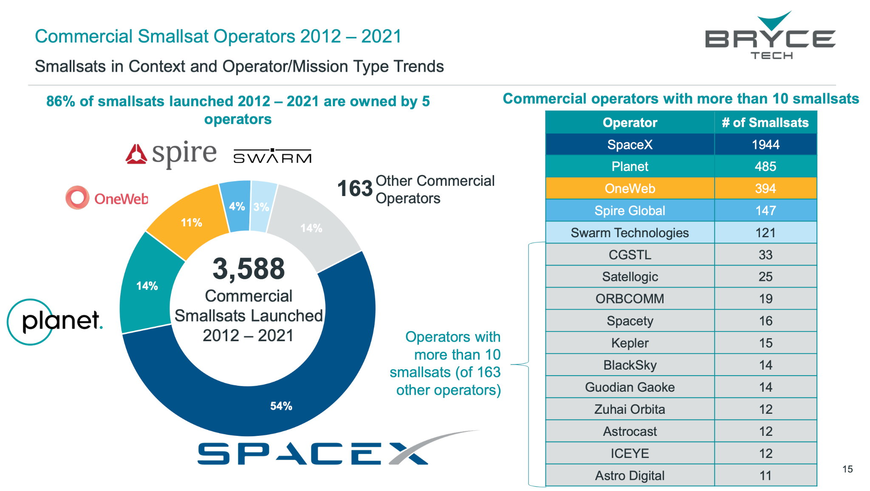
Upstream New Space Sector
EO missions
Slide 3

Slide 4
ESA and New Space (1/2)
Main expected ESA’s role (from the point of view of New Space EO companies):
New Space companies working with ESA (i.e. not developing satellites for ESA, but ESA’s role as anchor customer or as co-funding the development):
through the EU Copernicus Contributing Missions activity for operational purposes
through the ESA Earthnet Third Party Missions activity for scientific purposes
through the ESA InCubed Public Private Partnership co-funding development programme
EOP performs technical and business case assessment of new commercial initiatives
Commercial EO
New Space companies working for ESA (i.e. developing satellites for ESA, role is identical to that of established companies but with new development methods):
FutureEO SCOUT missions
PhiSats missions
PROBA-V Cubesat companion
Arctic Weather Satellite (AWS) prototype

Slide 5
ESA and New Space (2/2)
At COP26, +100 countries signed up to the Global Methane Pledge to limit emissions by 30% in 2030 compared with 2020 levels. Data-sharing partnership between ESA (Sentinel-5P) and GHGSat sat)
ICEYE commercial constellation of 14 small SAR satellites (18 by mid-2022)
Average access time: 3 hours anywhere on Earth
APPLICATIONS include:
Monitoring floods and mining activities, marine vessel detection and iceberg monitoring.
Copernicus Contributing Missions in complement to Copernicus Sentinel missions.
In May 2022, ICEYE and ESA agreed to conduct a pilot activity to support the Copernicus Emergency Management Services (CEMS) team with flood insights. The pilot will allow CEMS to evaluate ICEYE's flood insights and explore potential applications.
In October 2021, ICEYE became a Copernicus Contributing mission partner to the European Union’s Earth Observation programme.
Notes:
All current ICEYE imaging modes are offered through this programme. Users get access to the very high-resolution Spot imaging mode covering areas of 25 km², the high-resolution Strip and the recently launched Scan imaging mode covering areas of 10,000 km², respectively. It is possible to obtain archive data or request new image acquisitions.\
ICEYE builds and operates a commercial constellation of small synthetic aperture radar satellites. So far, 14 satellites have been launched and ICEYE and plans to expand its constellation up to 18 satellites by mid-2022, with the objective of reaching an average access time of three hours anywhere on the globe. The mission is used in many sectors, from monitoring floods and mining activities, to marine vessel detection and iceberg monitoring.
The ICEYE satellite constellation is a Copernicus Contributing Mission, complementing existing synthetic aperture radar missions in the Copernicus programme.
Read full story: ICEYE commercial satellite
at COP26, more than 100 countries have just signed up to the Global Methane Pledge, which aims to limit emissions by 30% compared with 2020 levels.
With both public and commercial satellite data playing key roles in assessing progress on climate action, ESA and GHGSat are supporting the United Nations Environment Programme’s new International Methane Emissions Observatory, also announced at COP26.

Slide 6
SIT-37 and New Space Outcomes
New Space: priority from 2022-203 CEOS SIT Chair (ESA)
SIT-37 (March 2022):
Changing composition of the EO space, governmental and commercial roles up and down the value chain
SIT Chair led an initial discussion on partnership of CEOS Agencies with New Space companies, including presentation of case studies from CNES, COM, and NOAA on their experience.
Some shared findings & suggestions:
Public-Private Partnerships: a familiar mechanism for collaboration with the private sector
CEOS ‘standardisation’ efforts are very beneficial for downstream industries
Move to smallsat constellations → Improve agility and resilience of the space architecture, and cost reduction
Commercial data provides for an enhancement of public operational missions → complementarity
Slide 6

Slide 7
SIT TW and New Space - Outcomes
SIT Technical Workshop (September 2022)
Case studies from Agencies (USGS, ESA, GISTDA, NASA, CSA), and further examples presented (ARD, WGCV).
Some shared findings & suggestions:
EO is only a small fraction of commercial space market; most purchases come from the governments in large transactions. Public-Private Partnerships (PPPs) are one of the most likely ways to underpin market sustainability
Copernicus is the big enabler of EO New Space in Europe
Direct dialogue between private and public sectors, and with users is needed to develop the way forward for partnerships
Proposal for a New Space Task team that would explore the principle of shared value between public and private commercial space services in delivering public benefit
CEOS Plenary (November 2022)
New Space Task Team created. ToRs endorsed by Plenary
Slide 7

Slide 8
‘New Space’ Task Team - Purpose
Significant interest across CEOS agencies wrt how best to engage with the “New Space” companies
Important potential for added value to the public upstream and downstream sectors for the benefit of users
Some countries represented in CEOS are facilitating innovative and rapidly-expanding industry
Sharing experience acquired can be beneficial to the other CEOS members.
Awareness and strong desire in CEOS to explore ideas for CEOS - commercial sector ideas
Ensure CEOS remains true to its mission statement - coordination of civil space-based EO
The topic of New Space introduced in CEOS by the 2022-2023 CEOS SIT Chair as strategic priority
New Space Task Team will explore collaboration opportunities that bring mutual benefit to all parties
Identification of concrete initiatives that will drive the agenda forwards
Slide 8

Slide 9
‘New Space’ Task Team - Objectives
Purpose: NSTT will explore collaboration opportunities in New Space that bring mutual benefit to all parties, including the identification of concrete initiatives that will drive the agenda forwards.
Sharing experience between CEOS Space Agencies
Organize dedicated sessions at each CEOS meeting attended by CEOS Principals (SIT Plenary, SIT Technical Workshop, and CEOS Plenary)
Define and implement actions within the CEOS framework that aim to enhance the outcomes of CEOS entities (WGs, VCs, AHTs) working with New Space companies
Commence with an assessment of the areas and issues that are common among CEOS agencies and that are predicted to impact public EO programmes in future
e.g. ground & space architectures; data interoperability; major datasets in support of CEOS priorities; cal/val.
Issue a White Paper with Findings & Recommendations
Develop a series of objectives and activities that will guide CEOS in fostering the combined use of public and private EO smallsat missions.
Slide 9

Slide 10
‘New Space’ Task Team - Organisation
Led by the CEOS SIT Chair
strategic guidance on the direction, progress, and status of implementation activities in relation to the established priorities, commitments, and partnerships of the CEOS organization
Contributions agreed from across CEOS including ….
CEOS Chair and Troika
SIT Vice-Chair
Systems Engineering Office (SEO)
CEOS Executive Officer (CEO)
Various CEOS Working Groups (WGs), Virtual Constellations (VCs) and Ad Hoc teams (AHTs)
CEOS WGs, VCs and AHTs will play a key role in the definition and implementation of activities
Seeking to provide more accurate and tailored information, and to propose innovative targeted services to users.
Slide 10

Slide 11
NSTT Progress Status
NSST : ~ 25 members
Outcomes of meetings (telcons) on 23 Jan. and 10 Feb.:
List of 15 actions at NSTT Topics - Working Document - Google Docs proposed by CEOS groups
See next slide.
List of New Space-related questions / points to discuss by NSTT in coming months.
Outcomes of discussions will be used to produce a White Paper with Findings & Recommendations.
White Paper will be submitted to CEOS Plenary (Nov. 2023) for endorsement
List of questions / points include:
What is meant by “New Space” ? | What is out of scope ?
Win-win partnership opportunities ? | What interactions have there been so far at CEOS Agency level - lessons learned
What does an integrated EO sector look like? | What CEOS can do for New Space?
What New Space can do for CEOS?

Slide 12
New Space-related Actions
CEOS & New Space White Paper | CEOS & New Space Sessions
Measures to optimise the availability and usability of public EO programme data | Cal/Val References
Intercomparison of New Space and CEOS datasets | Analysis Ready Data
EO standards and frameworks | CEOS Interoperability Framework
Observation gaps, commercial opportunities to fill CEOS priority requirements for climate, SDGs and disasters | CEOS provision of highly calibrated and characterised reference EO missions of long duration
Combined and harmonised data streams | EO QA measures - shared data quality metrics approach?
Data policies, data brokerage, multi-user licensing, block buying data and establishing end-user licensing agreements (EULAs) | Open Data Cube and other analytics/processing tools
Method and result sharing for performing evaluations of commercial data
List not closed → New actions can be proposed !!!

Slide 13
THANKS ….
QEUSTIONS ?

