Slide 1
Analysis Ready Data
Oversight Group
An Overview
Matt Steventon
CEOS-ARD Oversight Group / LSI-VC Secretariat
1 March 2023

Slide 2
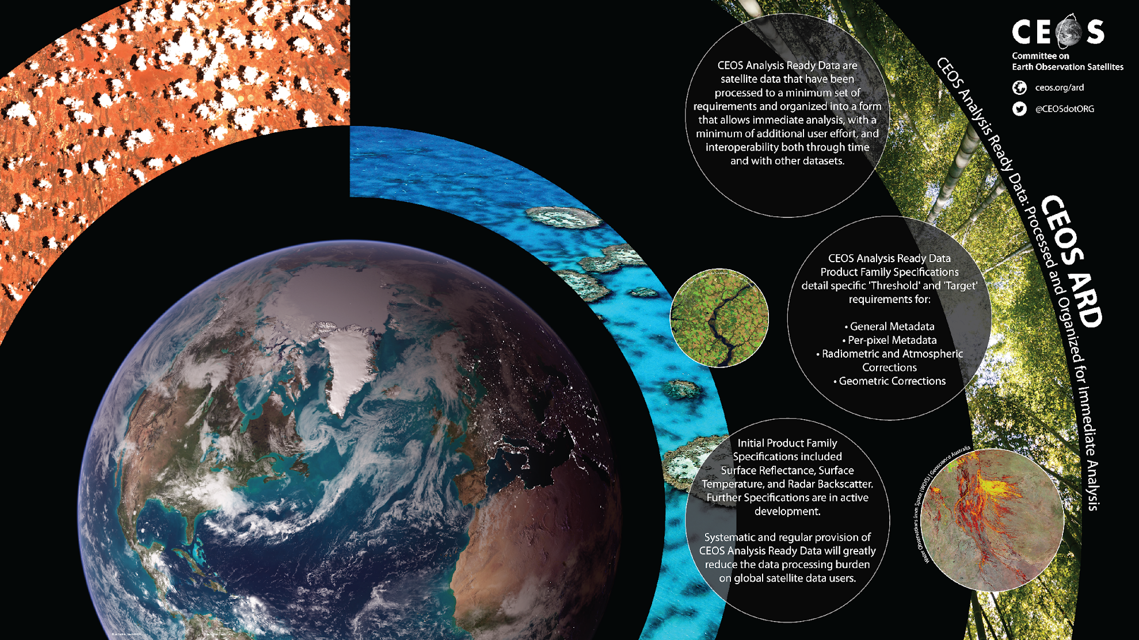
CEOS Analysis Ready Data (CEOS-ARD) are satellite data that have been processed to a minimum set of requirements and organized into a form that allows:
immediate analysis with a minimum of additional user effort
interoperability both through time and with other datasets
http://ceos.org/ard

Slide 3
Motivations
Provision of analysis-ready geophysical measurements
Reduce pre-processing burden for users
Facilitate analysis in the cloud
Reduce egress and processing
Provide a first step for interoperability
Open and transparent
Common starting point; consistency
Promote clear documentation of processing steps
Increase data uptake and foster new user communities
Capitalise on space agency expertise and experience
Best available science and high quality processes

Slide 4
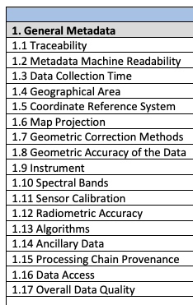
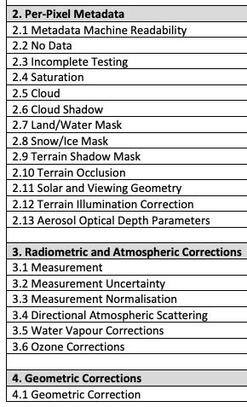
CEOS-ARD Product Family Specifications
Product Family Specifications (PFS)
Specifications for each geophysical measurement
Detail ‘Threshold’ and ‘Target’ requirements for a variety of parameters
Started with land (CARD4L):
Surface Reflectance
Surface Temperature
Normalised Radar Backscatter

Slide 5
Beyond Land (From ‘CARD4L’ to ‘CEOS-ARD’)
CEOS Analysis Ready Data broadened to be ‘beyond land’ in 2021.
Governance framework for CEOS Analysis Ready Data (CEOS-ARD) endorsed at CEOS Plenary 2021
Available here
Formalises the process LSI-VC used for CARD4L and generalises it
References the CEOS-ARD Oversight Group, which was also initiated at CEOS Plenary 2021 as a result

Slide 6
CEOS-ARD Oversight Group
Forum for all matters related to CEOS-ARD
Coordination across CEOS
Includes representatives from CEOS Virtual Constellations
Have the technical expertise to recommend, develop and maintain Product Family Specifications for other domains: Atmosphere, Ocean, Precipitation
Developing a shared Template for Product Family Specifications to promote commonality across all PFS domains

Slide 7
Discussion Point #1
WGClimate seeking to nominate someone to CEOS-ARD Oversight Group?
Expert knowledge of ECVs to guide prioritisation and development of relevant PFS
WGClimate focus is science-grade CDRs ?
CEOS-ARD main focus is to enable more average, non-expert users
Is there a parallel in the climate space?
Can we identify target climate products that could be the focus of a CEOS-ARD specification to enable a new, broad user base?
Connections with the Virtual Constellations
“ * A Thematic CDR (TCDR) is a consistently-processed time series of uncertainty-quantified values of a geophysical variable or related indicator, located in time and space, of sufficient length and quality to be useful for climate time-scale uses.”

Slide 8
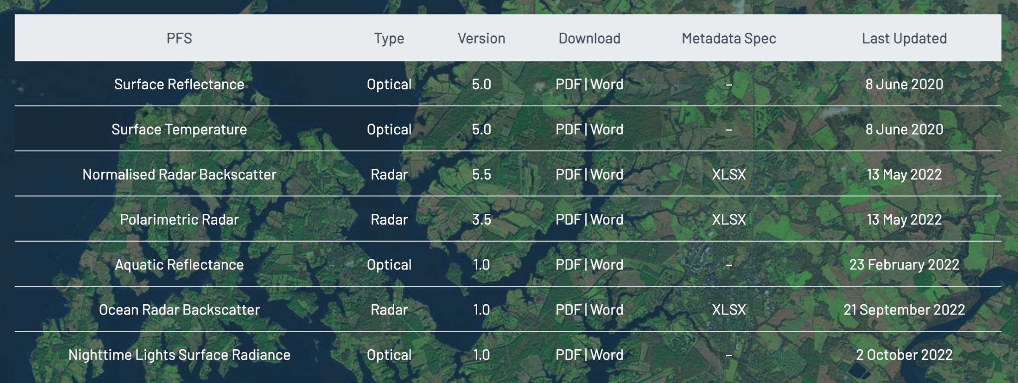
Current CEOS-ARD Specifications
Land
Inland and Coastal Waters
Oceans
Optical
Surface Reflectance
Surface Temperature
Nighttime Lights Surface Radiance
Radar
Normalised Radar Backscatter
Polarimetric Radar
Aquatic Reflectance
Ocean Radar Backscatter
http://ceos.org/ard/index.html#specs

Slide 9
Current + In-development CEOS-ARD Specifications
Land
Inland and Coastal Waters
Oceans
Optical
Surface Reflectance
Surface Temperature
Nighttime Lights Surface Radiance
LiDAR Terrain and Canopy Top Height
Radar
Normalised Radar Backscatter
Polarimetric Radar
Geocoded Single-Look Complex (GSLC)
Interferometric Radar (INSAR)
Aquatic Reflectance
Ocean Radar Backscatter
http://ceos.org/ard/index.html#specs

Slide 10
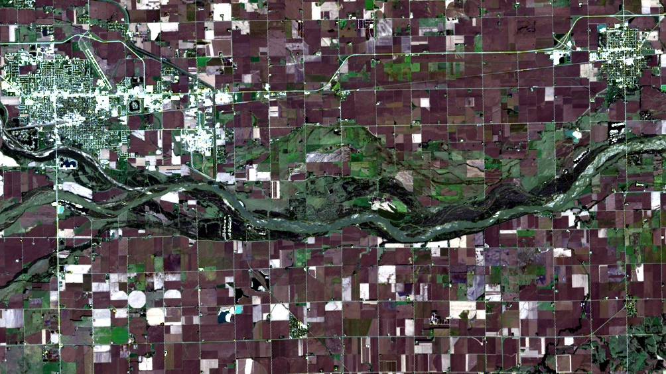
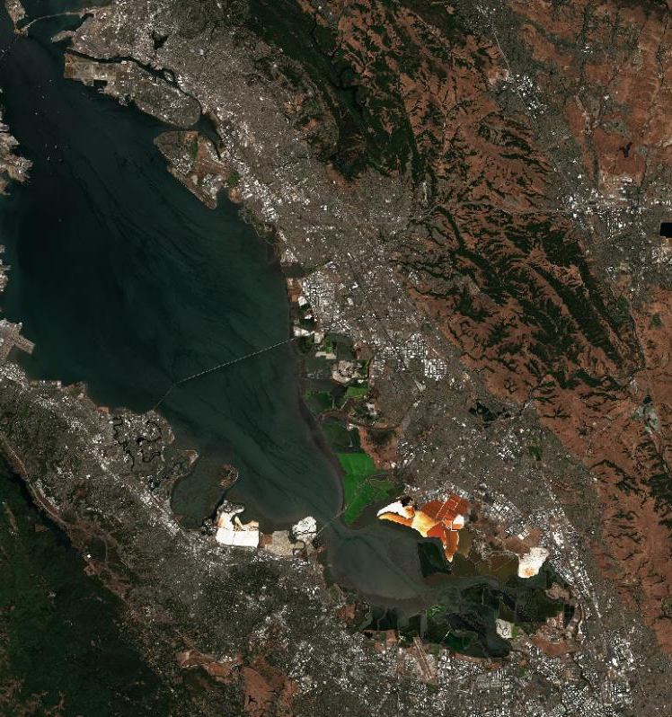
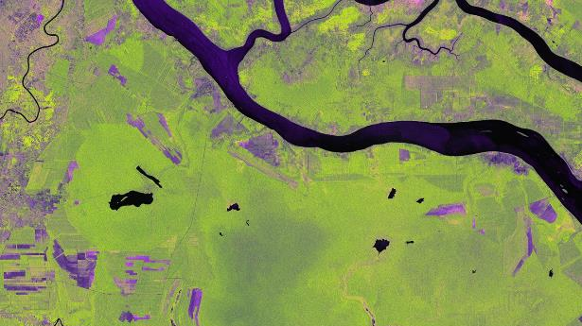
USGS Collection 2 Landsat 8 Level-2 Surface Reflectance
CEOS-ARD Examples
ALOS-2 PALSAR-2 Polarimetric Decomposition
©JAXA
Proc. by F. Charbonneau
Copernicus Sentinel-2 Level-2A Surface Reflectance
ALOS-2 PALSAR-2 Normalised Radar Backscatter
©JAXA
Proc. JAXA EORC

Slide 11
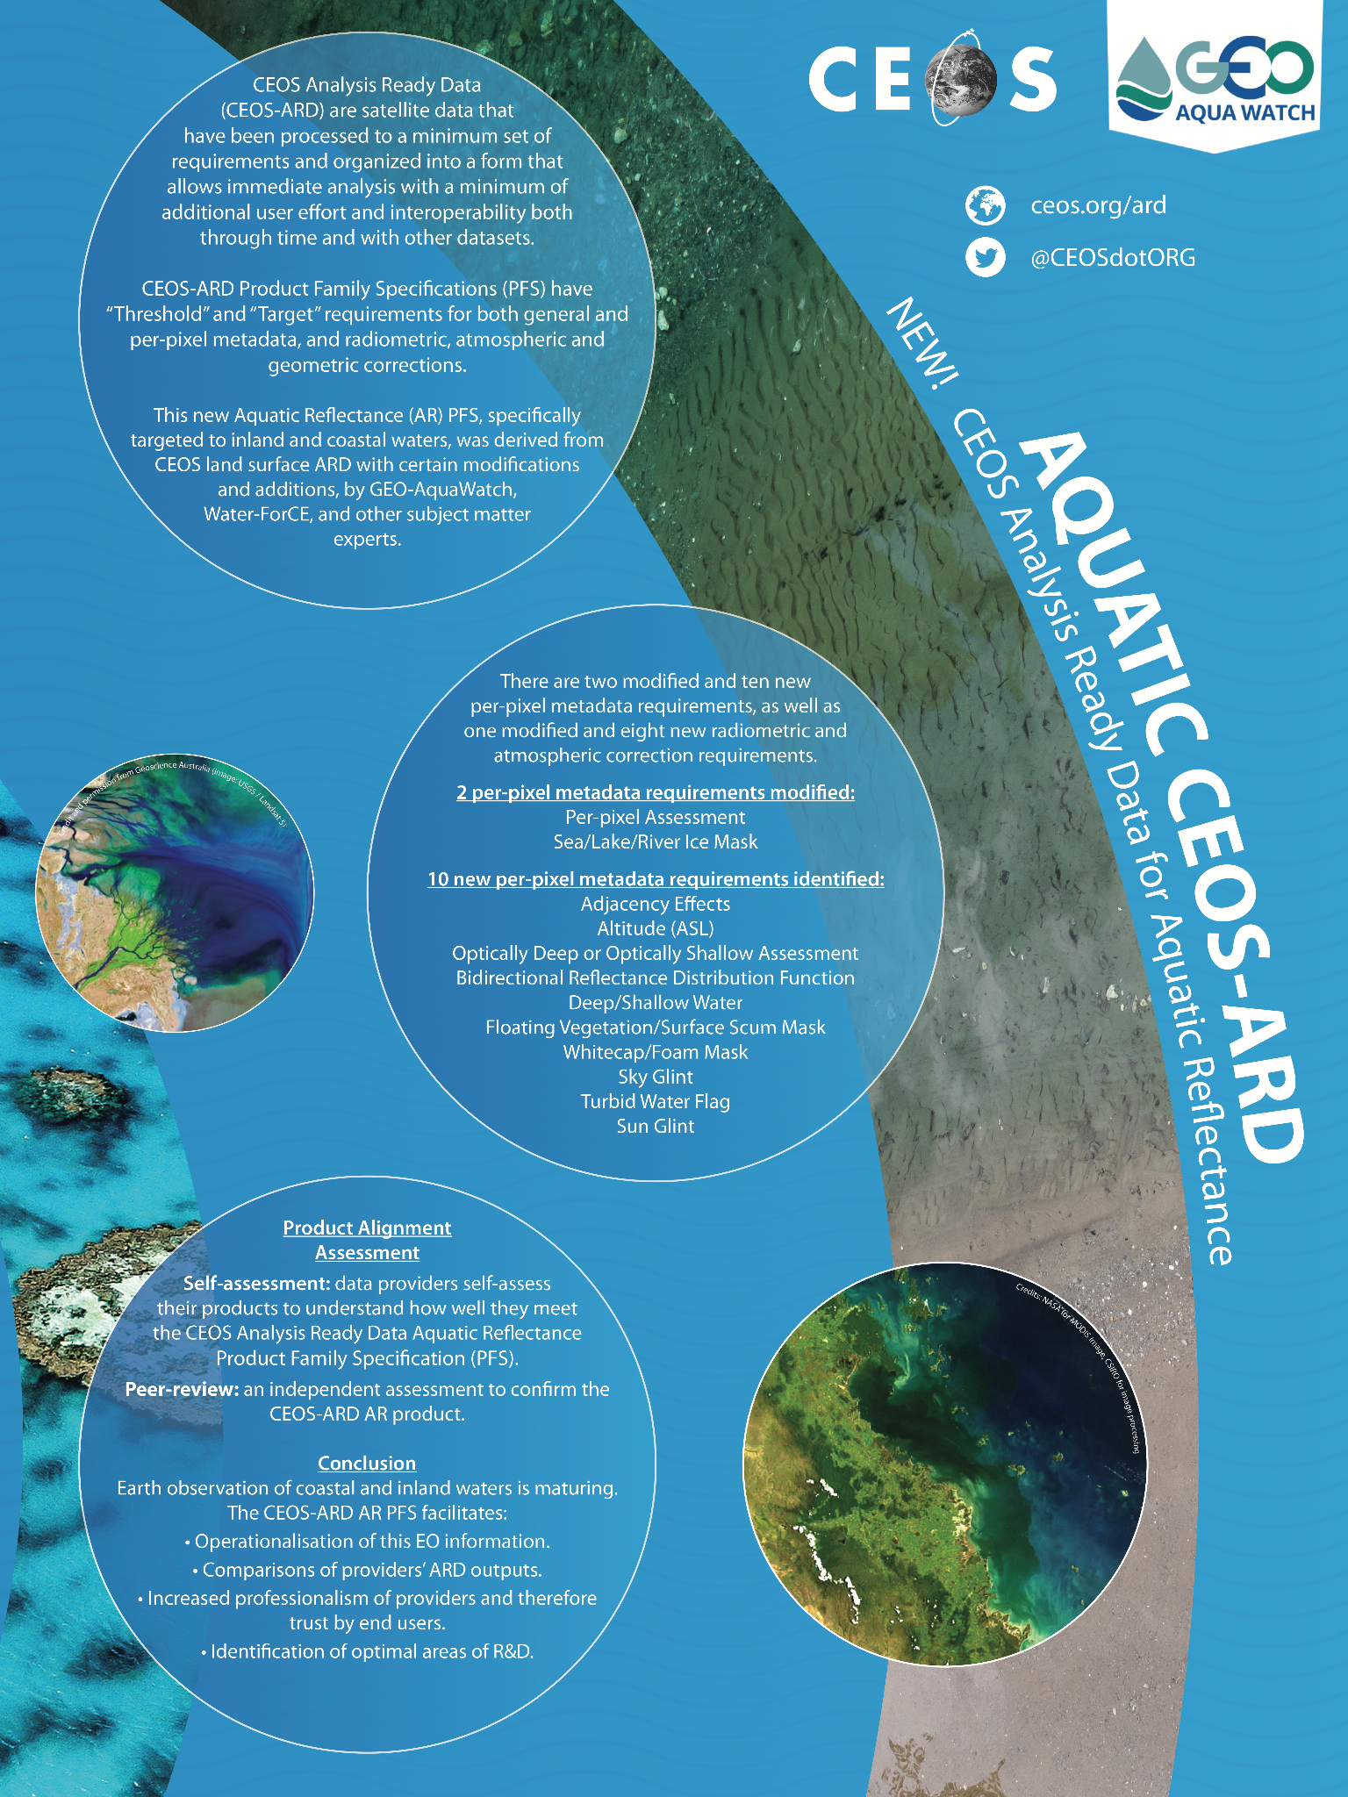
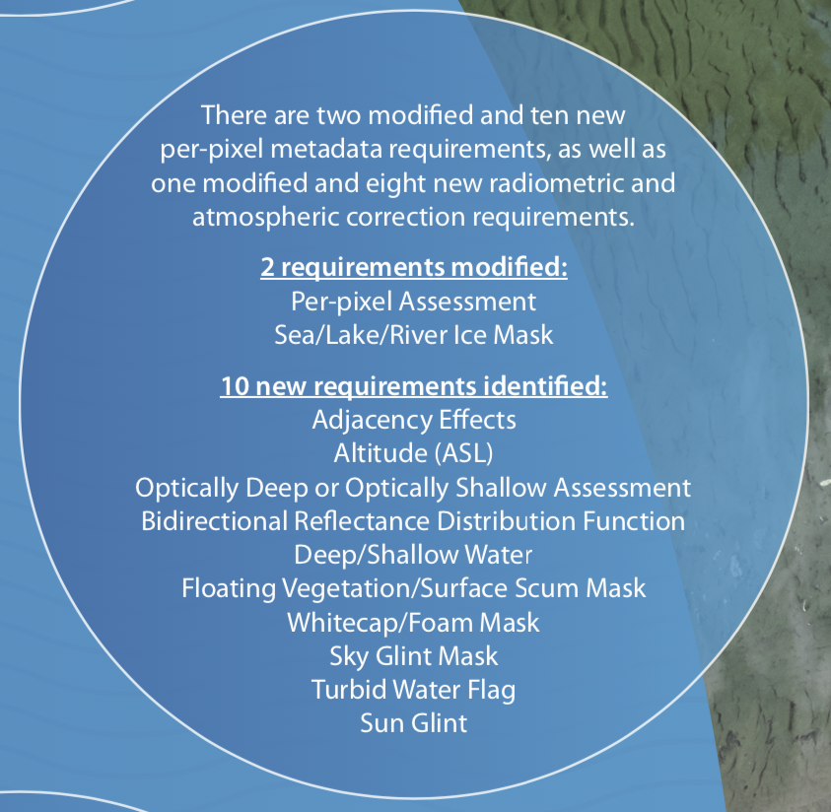
New for 2022: Aquatic Reflectance
Aquatic (non-Oceanic) Reflectance
Derived from Land Surface Reflectance specification with certain modifications.
Contributed by GEO-AquaWatch, Water-ForCE, and other subject matter experts.
Now working with OCR-VC and IOCCG to extend to also cover oceans.
PDF | DOC

Slide 12
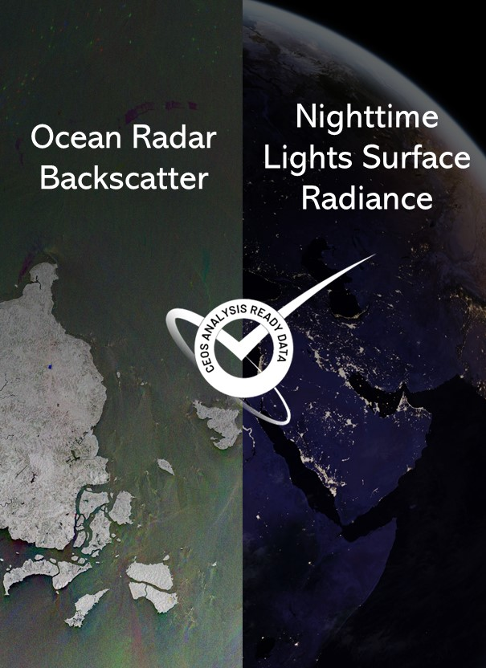
New in 2022
Coordinated by ESA, led by Clément Albinet. Derived from the Normalised Radar Backscatter (NRB) PFS.
Products are simplified to a degree, as a DEM is not applicable. Other changes are inclusion of a geoid incidence angle image and land mask.
Subject to geoid Correction and is provided in the sigma nought backscatter convention.
Speckle filtering not applied to preserve spatial resolution and user freedom.
Coordinated by Brian Killough (CEOS SEO, NASA) with technical support from Miguel Román (Leidos) and Zhuosen Wang (NASA GSFC).
Utilises features of the existing Surface Reflectance PFS with the primary differences in development accounting for lunar radiance and atmospheric scattering.
Applies to data in the visible and near-infrared wavelengths.
NASA Black Marble a prime example dataset – currently undergoing self-assessment.

Slide 13
What next?
Sea Surface Temperature?
Precipitation?
Ocean Colour?
Atmospheric Composition Datasets?
Active discussion by CEOS Virtual Constellations and CEOS-ARD Oversight Group. User demand is key.

Slide 14
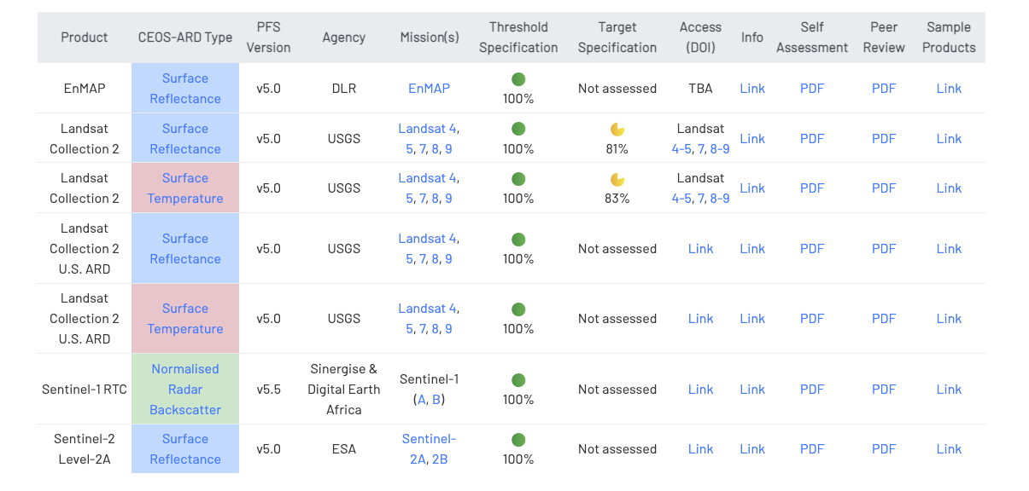
Current CEOS-ARD Products

Slide 15
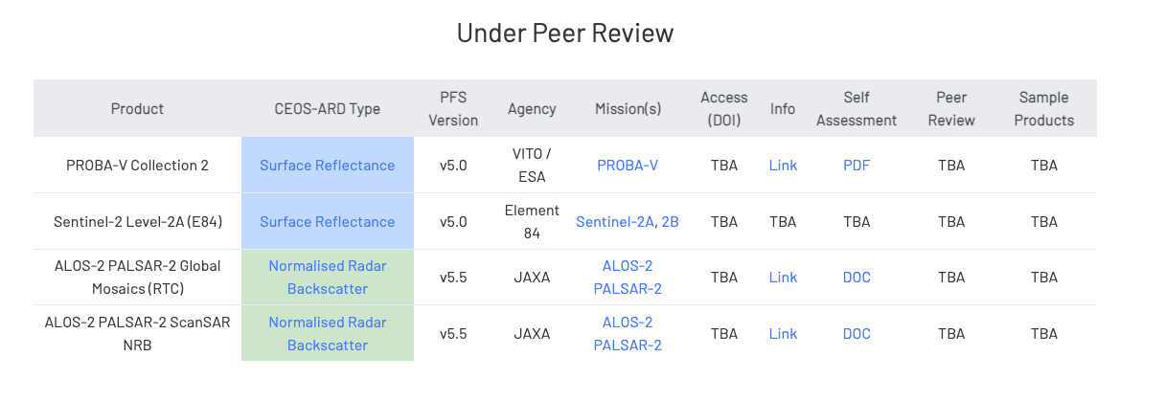
Under Peer Review
+ Many more upcoming, see: http://ceos.org/ard/index.html#datasets

Slide 16
Why are we talking ARD standards?
Significant activity and discussion in the broader EO community around ‘Analysis Ready Data’
Term ‘ARD’ is inherently subjective
CEOS, with its long heritage, experience, and expertise has a key role to play in defining ARD for the community (Incl. ‘New Space’)
Feedback from industry (VH-RODA, JACIE, LPS, ARD2x) that formal standards are needed for ‘ARD’
Government and commercial sectors will likely not reference documents and commit funds unless they have gone through an open standard process (formal peer review, etc.)
Standards built on the foundation of CEOS-ARD would be helpful
Increase reach of the concepts of CEOS-ARD

Slide 17
How to get involved?
Uptake beyond CEOS is critical
Any data provider can submit a self-assessment against the PFS
PFS updates – all feedback goes into the process
Involvement in the CEOS Virtual Constellations
Development of new Product Family Specifications
Technical inputs and discussions
Contact: matthew@symbioscomms.com
ARD standards discussion
Based on the foundation of CEOS-ARD
Opportunity to input to that process
Contact: matthew@symbioscomms.com

Slide 18
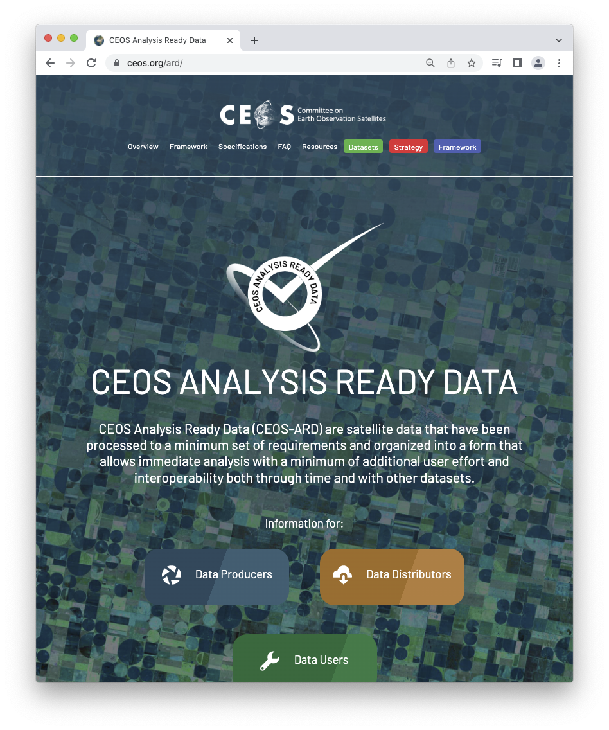
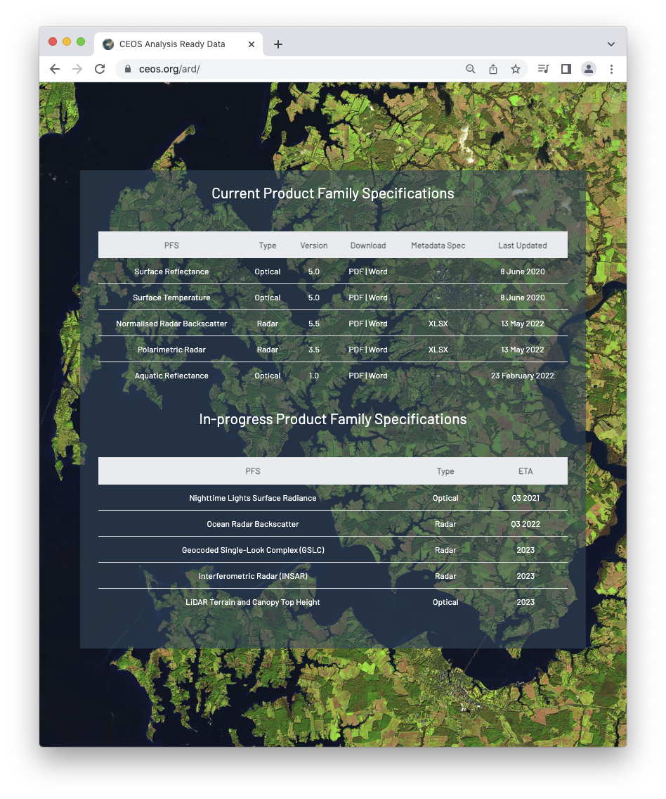
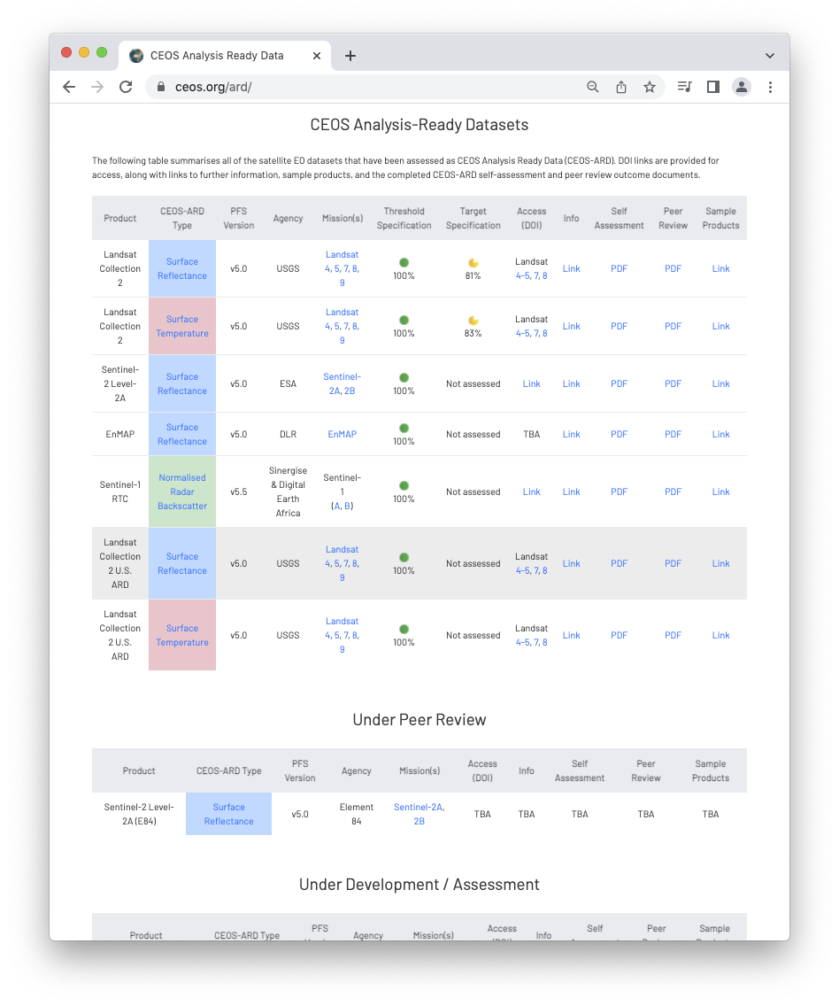
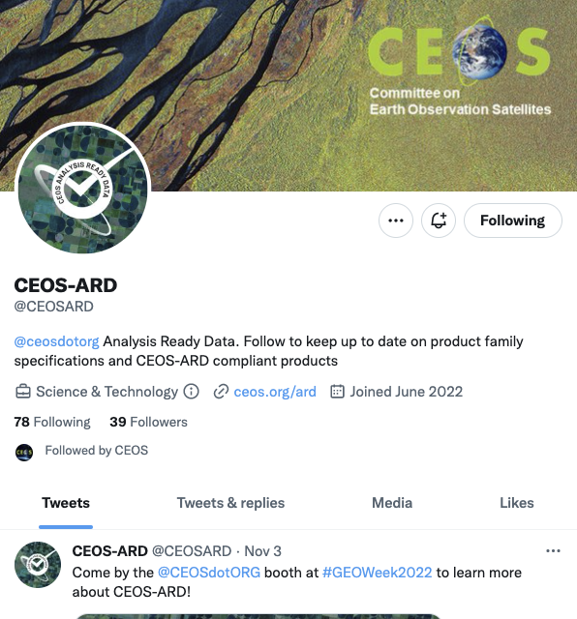
More information
ceos.org/ard
CEOS-ARD Newsletter Sign-up
Past issues: https://ceos.org/ceos-ard-newsletter/
https://twitter.com/CEOSARD
Contacts:
Ferran.Gascon@esa.int
matthew@symbioscomms.com

Slide 19
Discussion Point #2:
LSI-VC-8 Follow-up on LST CDRs

Slide 20
SIT TW Side Meeting Outcome
In the ‘before times’, LSI-VC-8 & WGClimate joint session in Anchorage, Sept 2019. Minutes.
“6. The joint session with WGClimate resulted in the LSI-VC agreeing to undertake two actions from the WGClimate Coordinated Action Plan (around LST Climate Data Records and continuity). This is a positive step forward on the LSI-VC requirements and gap analysis thread, and a new CEOS Work Plan Task will be suggested in response.”
Way forward on the following or similar updated priorities?

Slide 21
The goal here is to do a deeper analysis looking at the availability of LST datasets.
Datasets may also exist, but they may not necessarily be processed into a CDR.
Need to meet the 2004 CDR definition from NOAA. Derived geophysical records would also comply.
LSI-VC to begin by summarising the plans and projections of the way forward for USGS on Landsat TIRS, expanding to cover other missions and agencies in time.
Studying and understanding the future continuity of LST measurements is a valuable action for LSI-VC, as well as space agencies, outside of the WGClimate need.
The question of whether these measurements are supporting a CDR would also need to be addressed in a study, including whether there is a processing plan in place. This would necessarily involve both LSI-VC and WGClimate expertise on scientific assessment.

Slide 23
The suggestion at LSI-VC-8 was that activity and discussion on this LAI action be postponed until there is an outcome from an ongoing assessment within WGClimate?

Slide 24
Thank you!

Slide 25
CEOS-ARD Oversight Group Members
Ferran Gascon (Lead) SIT Chair Team
Matthew Steventon Secretariat
Andreia Siqueira LSI-VC
Steve Labahn LSI-VC
Peter Strobl LSI-VC
Maycira Costa OCR-VC
Mark Higgins OST-VC
Ed Armstrong SST-VC
Chris Kidd P-VC
Barry Lefer AC-VC
Medhavy Thankappan WGCV
Philippe Goryl WGCV
Makoto Natsuisaka WGISS
Jorge Del Rio Vera WGCapD
Mailing list: ard-oversight-group@lists.ceos.org

