Slide 1
3.2 Sensor development
David Crisp (SIT Chair Team)
Yasjka Meijer (ESA)
Agenda Item 3.2

Slide 2
GHG TT – Sensor Tracking – Measurement Requirements
(SENS-01) Work with stakeholders, GCOS, and the science community to identify the combinations of measurement requirements (e.g., precision, accuracy, resolution and coverage) for sensors needed to meet stakeholder requirements (e.g. science, WMO, IMEO, GCOS, national agencies). These focus on (1) Facility scale monitoring, (2) sub-regional to global-scale flux estimates, and (3) operational, thermal IR sounders that measure GHGs in the upper troposphere and above. | AC-VC | MONITOR | ANNUALLY | This is tracked at annual AC-VC and other CEOS meetings as well as IWGGMS
Update: Based on last two years of ACVC, WMO, GCOS, and IMEO meetings I changed emphasis from “Define” to “Work with stakeholders”
Examples: 1) IMEO needs coordinated facility scale measurements to support plume identification, 2) WMO needs the collection of measurements needed to obtain GHG fluxes at 1 degree resolution. 3) NASA Satellite Needs Working Group (SNWG) are working with national agencies to identify measurement needs
Issues: 1) How do we best propagate this information to the wider CEOS community and principals? 2) Not sure how to coordinate with new space, which is actively growing in this space.
Solution: GHG White Paper? Addendum to road map?

Slide 3
Sensor Tracking –Implementation and Operations of Space-based GHG Sensors
(SENS-02) Track implementation and operations of space-based GHG sensors and identify and propose solutions for observational gaps - see extract from Rec#14: The capabilities required to meet the needs of the UNFCCC and the Parties to the Convention are already at the limit of the state-of-the-art for existing, space-based measurement technology. The CEOS and CGMS agencies should therefore continue to pursue complimentary technologies for both sensors (e.g. wide swath passive CO₂ and CH₄ imagers, active lidar) and mission design (e.g. HEO). These development efforts should be coordinated to keep the Principals updated on additional needs and capabilities that would be useful to consider for future mission opportunities | AC-VC | MONITOR | ANNUALLY | Tracked throughout the year. Charts kept at https://database.eohandbook.com/ghg/
Update: CEOS portal provides mission timeline (examples follow)
Issues: 1) Do we include every mission that could potentially provide information about GHG fluxes / emissions?
2) How do we track non-public (new space) missions that do not engage with CEOS?

Slide 4
Sensor Tracking - Auxiliary Observations Enhancing Data Quality
SENS-03: Coordinate discussion on auxiliary observations enhancing data quality (e.g., aerosol properties for light path correction) - see extract from Rec#15: Ancillary measurements are needed both to improve the accuracy of the XCO2 and XCH4 retrievals (i.e. coincident observations of clouds and aerosols) and to facilitate their interpretation within the context of the anthropogenic and natural carbon cycle (i.e. SIF, NO2 and CO). Here, the proposed atmospheric CO2 and CH4 monitoring system could substantially benefit from the full scope of carbon cycle observations included in the CEOS Carbon Strategy. The CEOS partner agencies should therefore continue to support that strategy | AC-VC | Ongoing | ANNUALLY | Addressed through yearly AC-VC Meetings
Approach: These items largely addressed by annual AC-VC meetings
Examples. 1) Co measurements of aerosols to support XCO₂ and XCH₄ accuracy. 2) Using SIF to assess GPP variability while CO2 is used to estimate NBE 3) Using CO and NO₂ to attribute CO₂ variability to fossil emissions.
Issues: Same as previously except the notion of synergistic or attribution tracers need to be stated to principals.

Slide 5
Sensor Tracking –Identifying Measurement Gaps
(SENS-04) Identify measurement gaps that are limiting are capability to reduce uncertainty in the global carbon budget | AC-VC | Ongoing | ANNUALLY | This is tracked at annual AC-VC and other CEOS meetings as well as IWGGMS
Update and Approach: Information typically gathered at AC-VC or other meetings (e.g. WMO, IWGGMS)
Examples:
Previous ACVC meetings have identified the following
Ocean CO₂ fluxes are under-constrained → need improved ocean CO₂ validation plus likely XCO₂ measurements at 0.2 ppb accuracy or better.
There is a “spatial” measurement gap for CO₂ and CH₄ between 100 m to 100 km that could be important for constraining CO₂ and CH₄ fluxes from wetlands, livestock, and extreme event impact on ecosystems
Spatial resolution of terrestrial CO₂ fluxes, currently ~400 km², is limited by XCO₂ accuracy of ~0.8 ppm. We need a concerted algorithm and validation effort to push this boundary
Issues: How do we best push the information gathered from meetings to CEOS community and principals?
Solution: Again, white paper or other for CEOS principals?

Slide 6
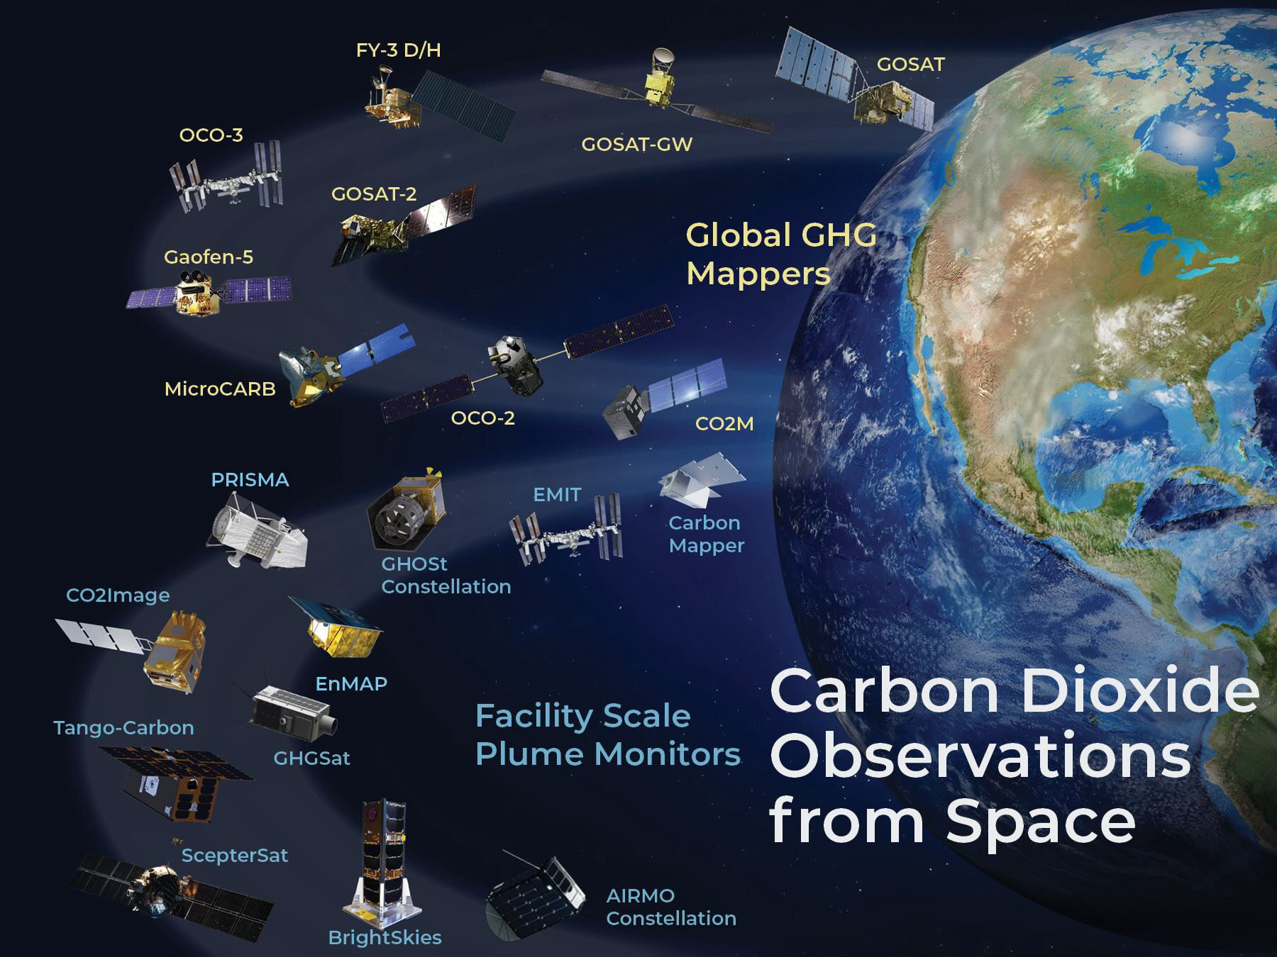
Sensor Tracking – CEOS GHG Portal
CEOS GHG Missions Portal; centralized overview of GHG Missions in one Portal at ceos.org/ghg
https://database.eohandbook.com/ghg/

Slide 7
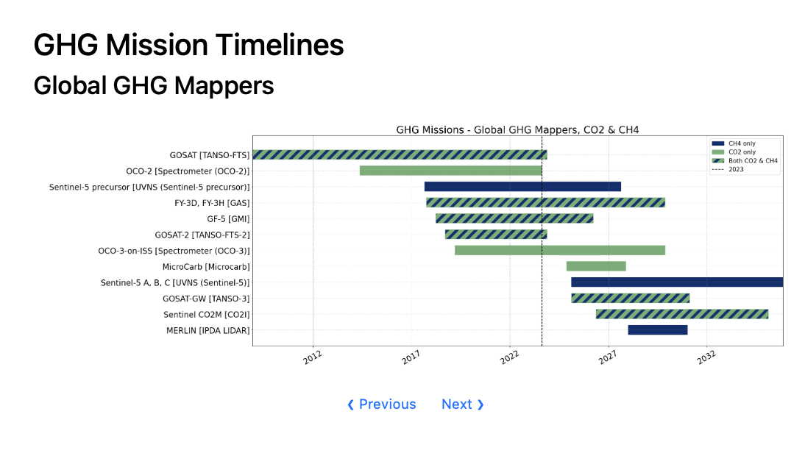
Regional to Global Emissions from Global GHG Mappers

Slide 8
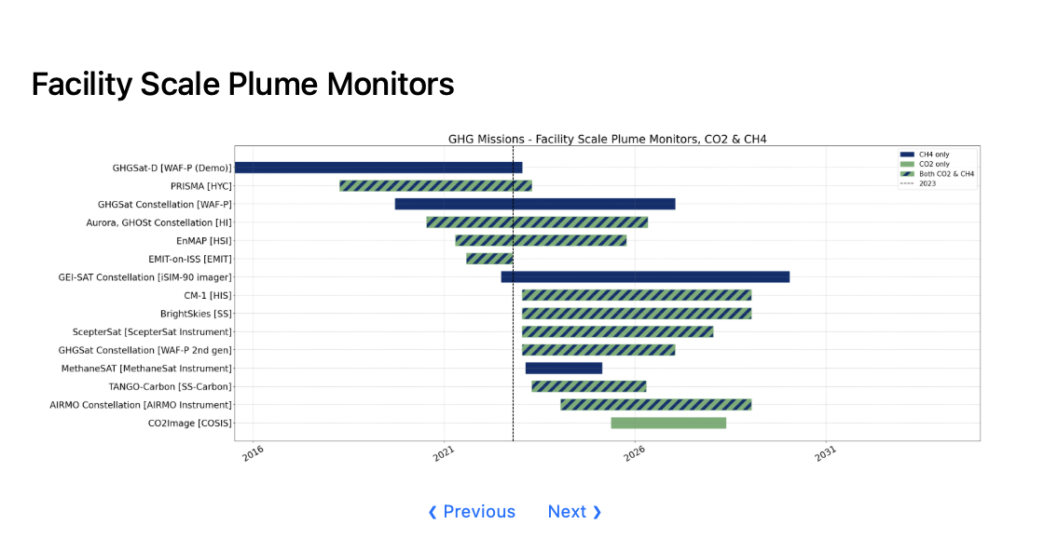
Facility Scale Emissions from “Plume Mappers”
10 of these 15 missions are from New Space!

Slide 9
Sensor Tracking – moved item
Work closely with GCOS to and other partner organizations and stakeholders to refine the requirements for space-based greenhouse gas measurements |  |  |  | Removing this item as it has been subsumed into SENS-01
Update: This Annex C Sensor item has been merged with SENS-01

Slide 10
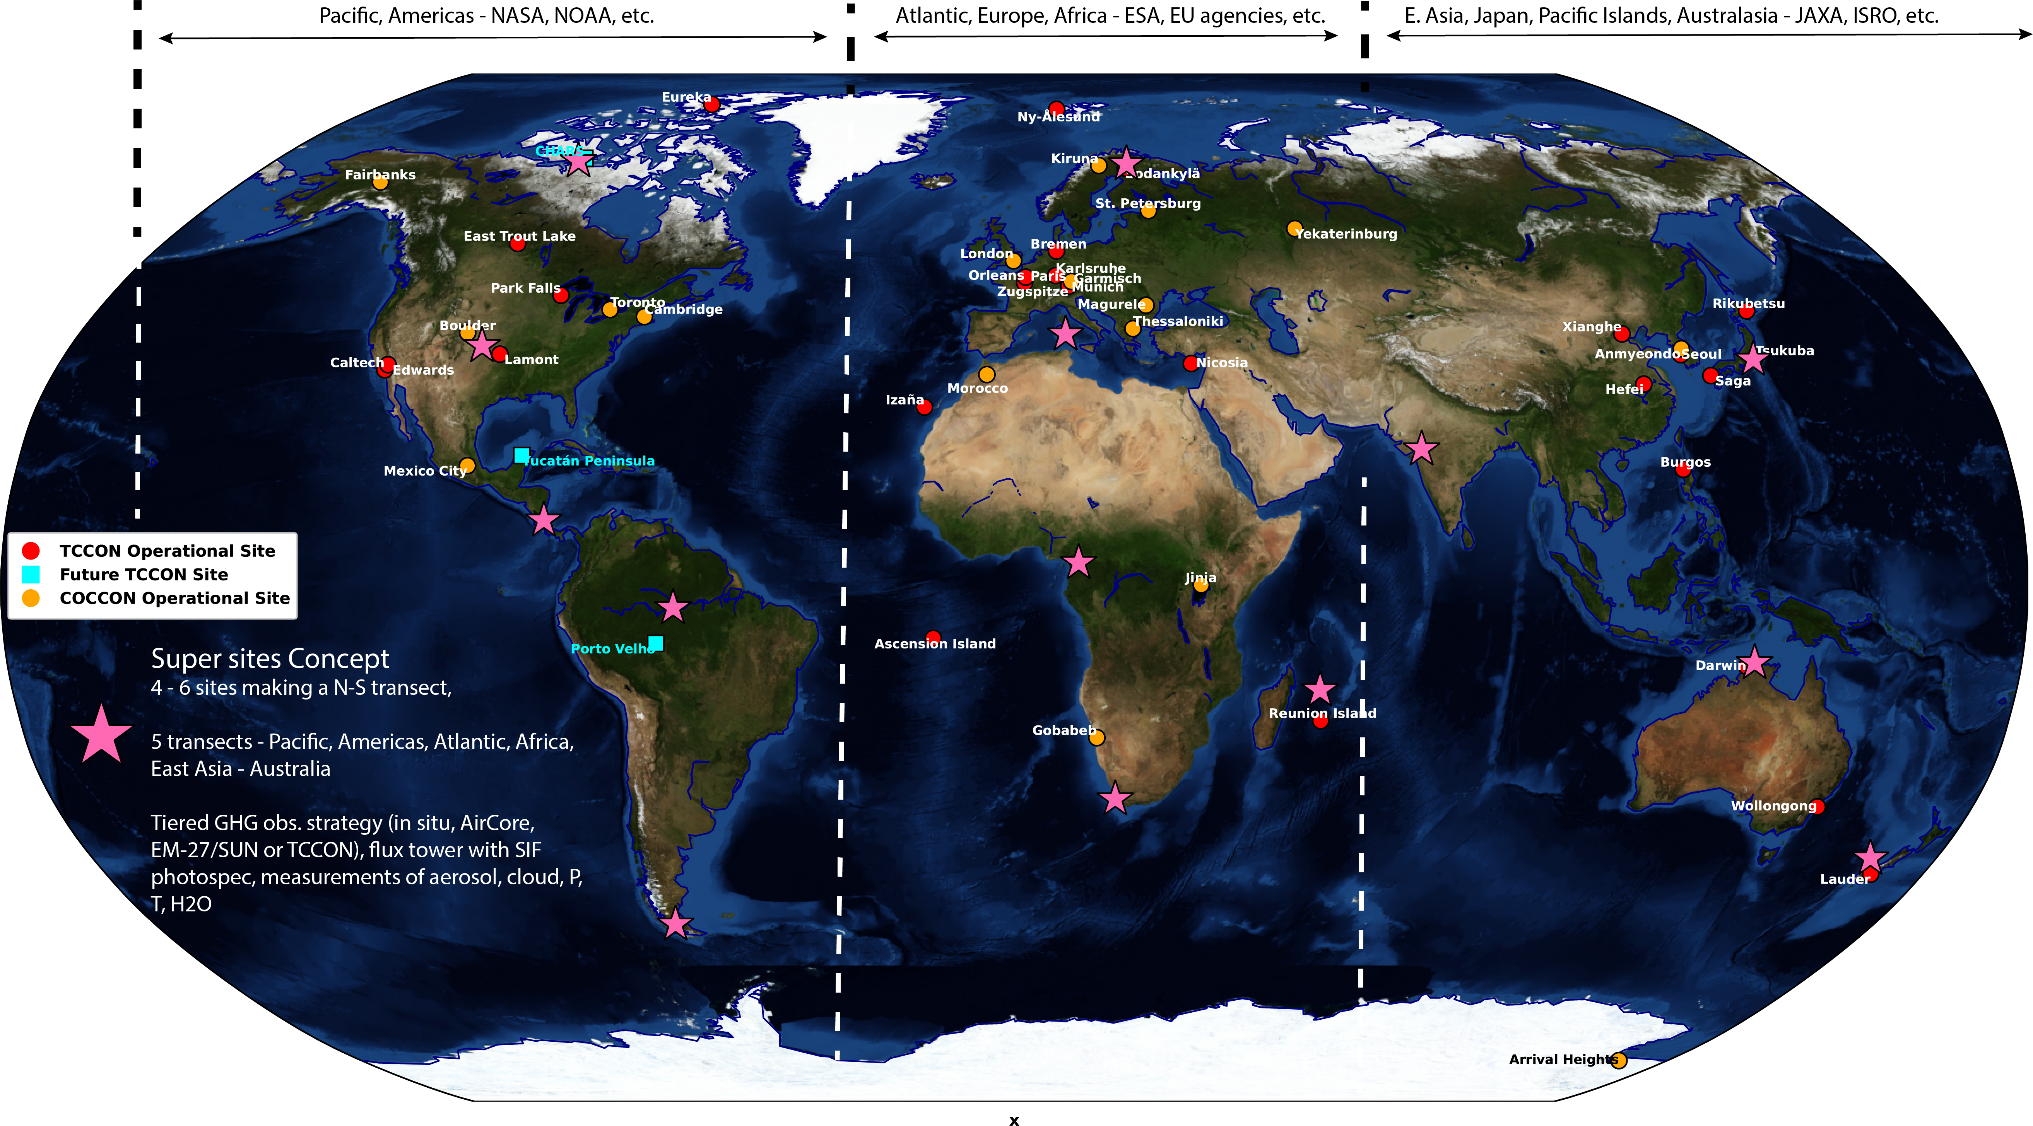
Improvements needed in current and future sensors: Improved cal/val sites for wide field observations
Maintaining and updating our validation network has been identified as a critical issue at AC-VC. In particular we would like to develop Super Sites with ancillary (aerosol, GHG profiles) observations needed to test L2 algorithms and support L4 validation
This requires a new addition to Annex C (L2VAL)
How does CEOS support current capability? Can CEOS support upgraded capability?

Slide 11
Improvements needed in current and future sensors:
Validation of fluxes for facility scale missions
Courtesy Annmarie Eldering
Problems identified at AC+VC + other related meetings: 1) Different algorithms give different results for emissions and 2) Probability of Detection (POD) needs to be better characterized for a range of viewing conditions → Current approaches use single-blind tests where the emissions location (but not magnitude) is known; ancillary evidence suggests this results in too optimistic a POD
Proposed solution → Community needs to update validation network approach and protocols for better testing of algorithms and validation of results from facility scale missions
How can CEOS support this effort?

Slide 12
Discussion and Next Steps
The GHG Roadmap and Annex C identify a series of areas that would benefit from coordination among CEOS agencies including;
  Sensor Characterization to Meet Stakeholder Requirements (G3W, IMEO, GCOS)
  Track and support national/multi-national agency needs (e.g. EPA, MOE, EEA, USDA), ‘
  Identify methods for increasing measurement precision and accuracy to quantify ocean fluxes,
  Improve XCO₂ and XCH₄ accuracy to improve carbon flux accuracy and resolution,
  Address the 100 m to 100 km measurement gap for space-based CO₂ and CH₄ estimates,
  Maintain validation network and add super sites for L2 and L4 validation,
  Support facility scale emissions validation
What is best way to push community input to CEOS agencies?
Alternatively, how can CEOS best support these different activities?
How do we track non-public (new space) missions that do not engage with CEOS
How should we track (in the annex) the need to maintain and update validation sites for both L2 and L4?

