Slide 1
WGClimate-22 & GHG-TT-4
Systematic Observations: Space-based data and the global stocktake
Heather Maseko-Msyale
Collective Progress, UNFCCC
Agenda Item 4.1

Slide 2
Systematic Observations in the UNFCCC Process
Climate actions:
-Mitigation
- Adaptation
- Enabled by MOI and support
Global stocktake
Temperature goal (limiting global warming to well below 2 °C, preferably 1.5 °C)
Enhanced climate action
Reporting (BTRs)
Periodic Review
Informed by scientific and systematic observations data
Notes:
Scientific data is vital for guiding the political process (determining temperature goal), tracking progress towards the same and re-calibrating our actions accordingly. It also supports global transparency in climate action.
Entry points for SO data are set at the beginning of the convention/PA, within climate actions, in the assessment of progress made, and corresponding measures

Slide 3
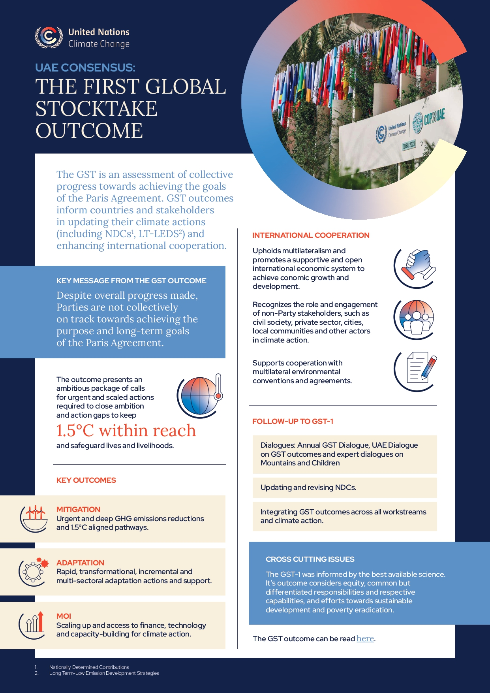
Lessons from the first GST
Prominent reflection of latest scientific findings (Synthesis report and Decision text).
Engagement of the SO and scientific community (TD and CoO phases)
Clear link with ongoing political processes (TD identified priority areas across all thematic areas)
Large data source base including synthesis reports (https://gst1.org/ )

Slide 4
Opportunities in the GST-1 follow up and GST-2
How space-based data can support GST-2:
Providing a comprehensive, up-to date data source to inform:
Tracking of GHG emissions (consideration of temporal and spatial monitoring)
Present observed climate impacts (including loss and damage, land-use change)
Determine the effectiveness of climate action- utilizing existing baselines

Slide 5
Opportunities cont’d
Positioned to support global transparency
Facilitate anticipatory action
Enablers
Understanding of data requirements
Effective coordination
Thematic alignment
2025
Discussions on modalities
2026
Information Collection (launched @ CMA 8)
2027
Technical work
2028
Political outcomes

Slide 6
Other considerations
Global data accessibility (Which includes existing and planned data sharing frameworks, open sources e.t.c)
Cooperation and engagement of countries (Ownership and transparency in the generation and use of data with Parties and other stakeholders, including with the global south)
Role of innovations- (The role of big-data and technologies that enhance accuracy).

Slide 7
Key considerations cont’d
4. Addressing gaps in underrepresented regions (Including complementarity with other forms of observations)
5. Socio-economic considerations (translation of scientific information and data to socio-economic contexts e.g. Nexus with sustainable development; and into policy actions)
Periodic review process- Consideration of synergies with the review which assesses effectiveness of the long-term global temperature goal

