Slide 1
Opportunities and challenges for the use of space-based observations to inform carbon fluxes

Slide 2
GHGI
The Greenhouse Gas Inventories (GHGI) provide a consistent methodology to calculate GHG emissions and removals, esp. for Annex I countries.
Consistent comparisons can be made between inventories.
GHGI
Energy
IPPU
Waste
AFOLU
Agriculture
LULUCF
Consistency is not the same as accuracy
Notes:
Industrial Processes and Product Use (IPPU);
Land-use, Land-use change and Forestry (LULUCF)

Slide 3
GHGI evaluation
2019 IPCC refinement: “An ideal condition for verification is the
use of fully independent data as a basis for comparison. Measurements of
atmospheric concentrations provide such datasets, and recent scientific ad­vances allow using such data as a basis for emission modeling.”

Slide 4
Go where the uncertainty is
EPA, UNFCCC, 2024
Category | 2022 Emission Estimate (MMT CO2 Eq.) | Lower Bound (MMT CO2 Eq.) | Upper Bound (MMT CO2 Eq.) | Lower Bound (%) | Upper Bound (%) | Mean (MMT CO2 Eq.) | Standard Deviation (MMT CO2 Eq.)
CO2 | 5053.0 | 4937.3 | 5257.7 | -2 | 4 | 5095.2 | 81.9
LULUCF Emissions | 67.5 | 64.3 | 73.2 | -5 | 8 | 68.6 | 2.3
LULUCF Net Total | -854.3 | -1090.3 | -680.5 | 28 | -20 | -888.8 | 105.3
Net Emissions (Sources and Sinks) | 4198.7
LULUCF relative uncertainty is roughly 5 times higher than FFCO2
The absolute uncertainty between FFCO2 and LULUCF is comparable.

Slide 5
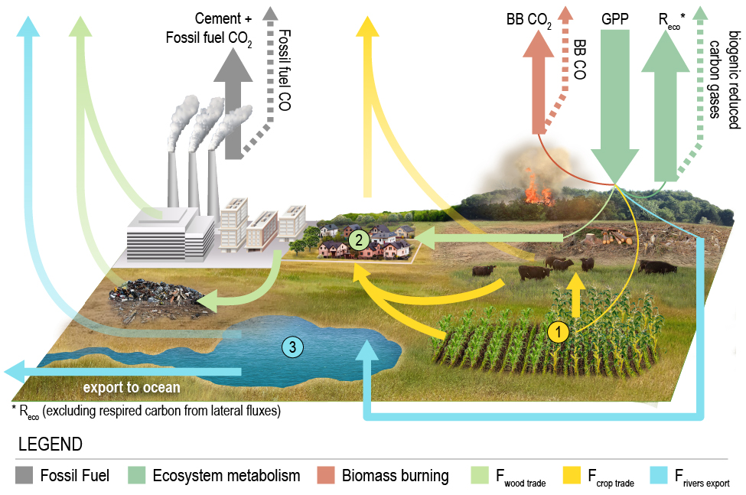

Attribution Net Carbon Exchange to GHGI sectors
Atmospheric CO₂ is a fundamental constraint
Net Carbon Exchange (NCE)
NGHGIs track changes in carbon stocks (ΔC_{loss}) due to Agriculture, Forestry and other Land Use (AFOLU).
We need to isolate this component for comparison:
$$ΔC_{\text{loss}}=NCE−FF−C_{\text{lateral}}$$
OCO-MIP
Bottom-up estimates
Byrne et al, ESSD, 2023
Uncertainties are propagated assuming independence

Slide 6
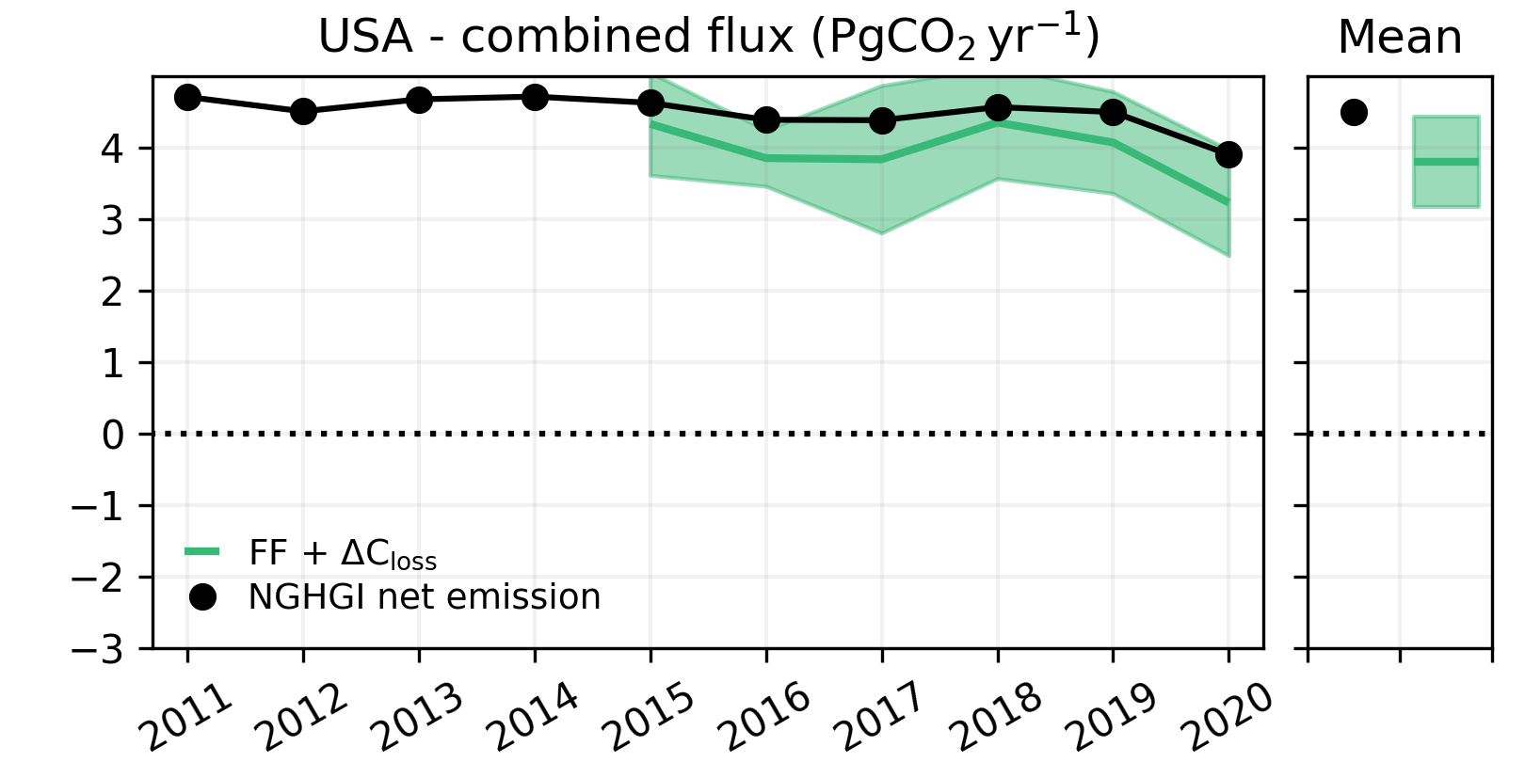
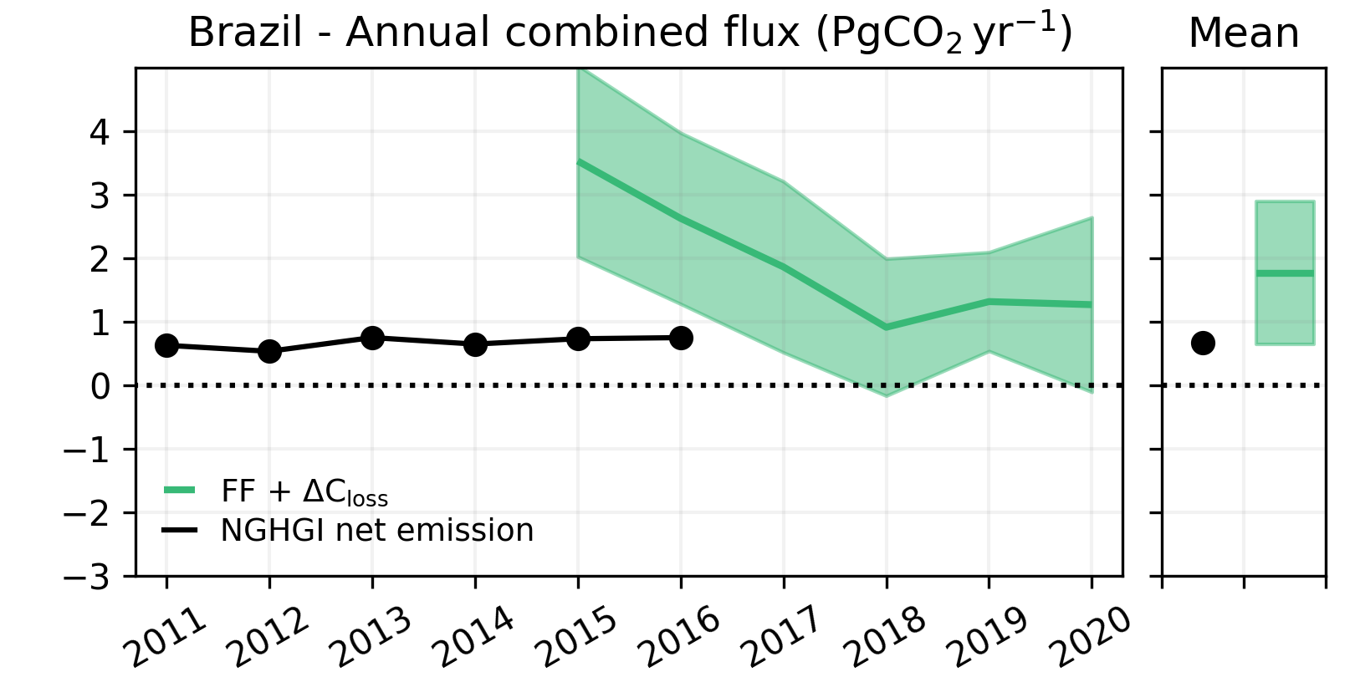
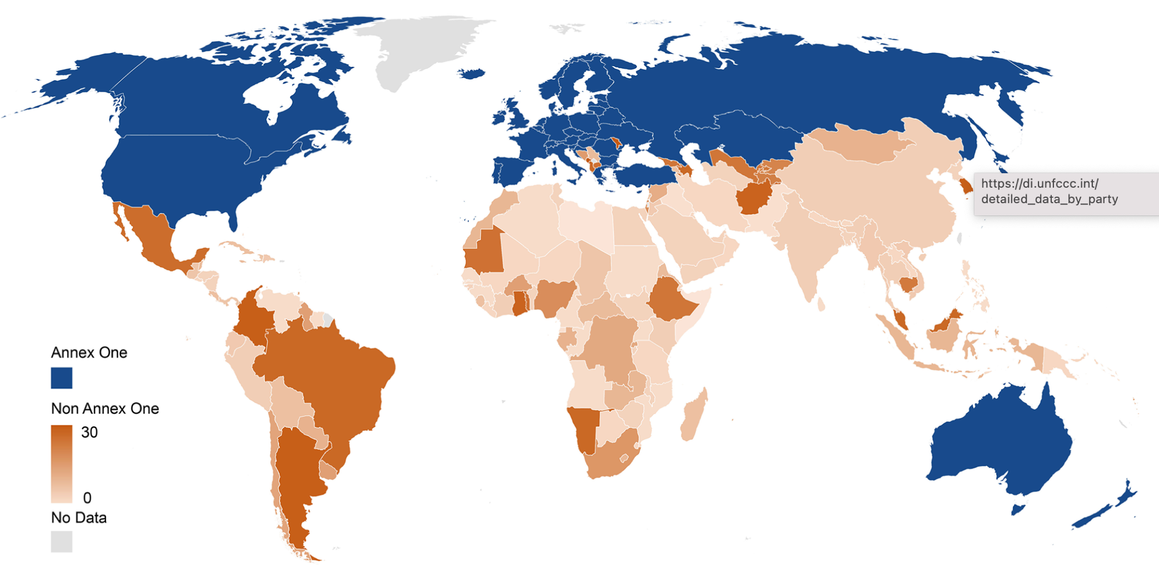
Contrasts with national GHG inventories (NGHGI)
Top-down estimate from OCO-2 MIP is in relatively good agreement with US.
For Brazil, by contrast, top-down fluxes show a 3 times larger than self-reported UNFCCC, in part due to the historic 2015-2016 El Niño.
Brazil has not reported its emissions since 2016–longer than a Global Stocktake time frame
52 countries have not reported their emissions in the last 10 years (Gore, Nature, 2022)
Deng et al, Earth Sci. Data, 2022
Number of reporting years by NGHGI reports

Slide 7
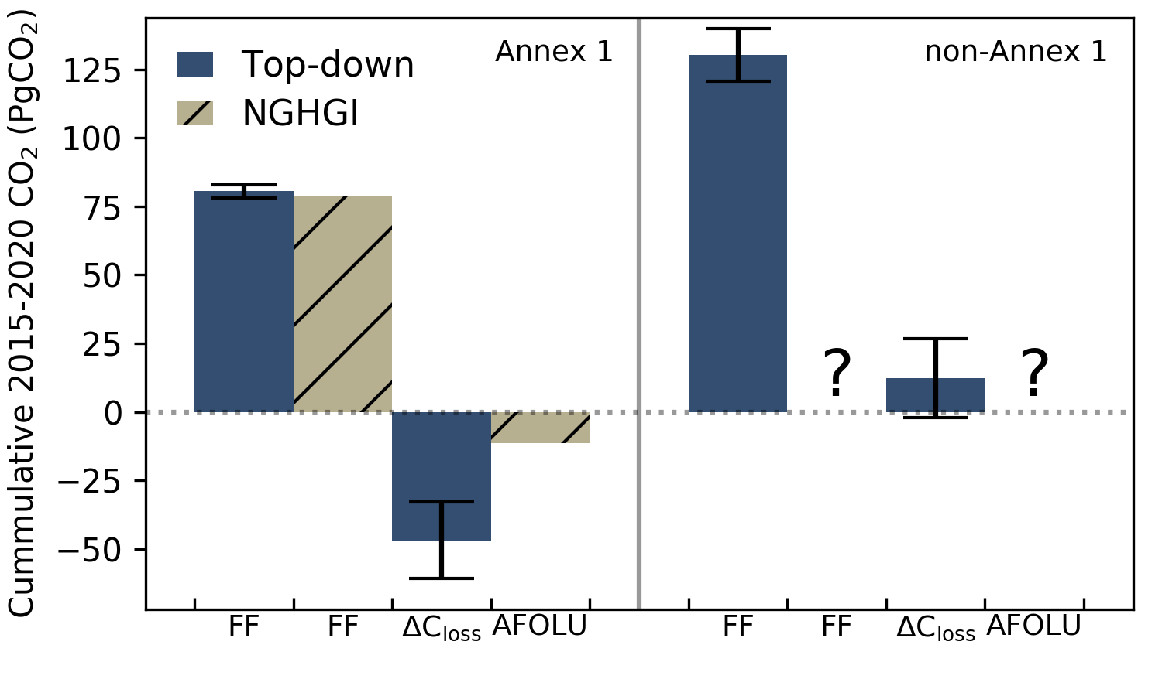
Comparison between Annex 1 and non-Annex 1
Annex 1 NGHGIs have ~34 PgCO₂ removals missing over 2015-2020 relative to top-down NCE.
  Partially expected due to exclusion of unmanaged lands (particularly for Canada & Russia).
  However, removals on managed lands appear to be estimated for USA and EU27+UK (Byrne et al.).
ΔC_{loss} is positive relative in non-Annex 1 countries
  Many non-Annex 1 countries have not reported NGHGIs, making comparisons difficult.
  Rapid updates would support near-term trajectories, e.g., 5-year scales
(LNLGIS)
(LNLGIS)

Slide 8
So, how do you update this?
EPA, UNFCCC,Energy Systems 2024
GHGI focus on sector. The emissions from these sectors are computed by
Emissions=
Activity Data×Emission Factor
These emission components can be derived from a number of different sources, which can have error.
Emissions occur at a place and time

Slide 9
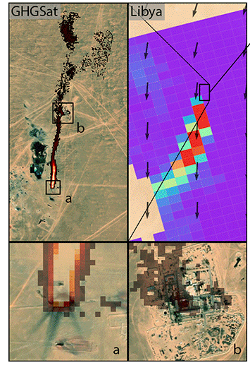
Can atmospheric observations evaluate emission inventories?
 | Plume mappers | Global concentration mappers | Inventories
Examples | GHGSat, Carbon Mapper | TROPOMI | EPA GHGI
Spatial coverage | Limited | Dense | Dense
Spatial resolution | High | Low | Very high (process-level)
Temporal coverage | Irregular revisits | Regular (e.g., daily) revisits | Annual estimates
Inventory evaluation potential | Need to reconcile temporal scales | Need to reconcile spatial scales | N/A
Adapted from Schuit et al. (2023)

Slide 10









How can observations from global concentration mappers be used to improve emission inventories?
Emission inventory($x_{A}, S_{A}$)
(facility-level sectoral emissions)
Modeled observations ($F(xA)+c$)
Forward model
Improved emissions estimate ($\hat{x}, \hat{S}$)
(gridded net emissions)
Observations ($y, S_{O}$)
Inverse model
Notes:
- describe variational and analytical approaches
gaussian errors

Slide 11
How can the resulting gridded fluxes be partitioned to individual sectors?
Improved emissions
inventory
(sectoral emissions)
Including estimates of:
Sectoral emission distribution within each grid cell
Sectoral uncertainty
Developed using:
Inventory data
Facility-level observations or emission estimates
Sector/facility information
Improved emissions estimate ($\hat{x}, \hat{S}$)
(gridded net emissions)

Slide 12

From many to one—and back again
Emission inventory($x_{A}, S_{A}$)
(facility-level sectoral emissions)
z₁
z₂
z_{n}
If we have some prior knowledge of that sector, we can infer the sectors given observations of that grid.
for

Slide 13
How can the resulting gridded fluxes be partitioned to individual sectors?
Improved emissions
inventory
(sectoral emissions)
Cusworth et al, 2021 developed a formalism to link net emissions to sectors and back:
Sector/facility information
Improved emissions estimate ($\hat{x}, \hat{S}$)
(gridded net emissions)
Worden et al, 2022 used this method to partition net emissions into sectors

Slide 14

How can the resulting gridded fluxes be partitioned to individual sectors?
Improved emissions
inventory
(sectoral emissions)
Sector/facility information
What if you have additional information on one sector?
Improved emissions estimate ($\hat{x}, \hat{S}$)
(gridded net emissions)

Slide 15
How can the observation-based sectoral fluxes be
used to improve inventories?
Facility-level reporting
(e.g., through government reporting programs, industry partnerships)
Existing accounting models
New accounting models
Annual sectoral emission inventory
Observation-based
annual sectoral emissions
(e.g., from point source imagers or global concentration mappers)
Update model parameters
(e.g., change default landfill recovery efficiencies)
Account for missing sources
(e.g., large emission events)
Additional observational information
(e.g., from individual point source observations, satellite imagery)
Notes:
Show that snapshot observations can be used to get sector-specific annualized atmosphere based emissions
Separate out non UNFCCC source characteristic information (“inferred data”)
Role of snapshot observations for missing sources
Show origin of different engineering models (model selection)
Graphic 1: how are inversions done
Graphic 2: how do we get from TROPOMI grid cell to sectors
Reconciling spatial and temporal scales of observations (TROPOMI vs. CarbonMapper) with inventory

Slide 16
Conclusions/next steps
A wide range of observations from facility to global scale offer new opportunities to improve understanding of the distribution and magnitude of emissions.
Frameworks have been developed to link from sector to net emissions.
  Additional work to link from sectors to activity and emission factor is needed.
  Independent information on sectors can be incorporated with more advanced Bayesian modeling
A critical step in linking these activities is better understanding of bottom-up uncertainty—accuracy and precisions

