Slide 1
WGClimate-22 & GHG-TT-5
Integrated Greenhouse Gas Monitoring System for Germany (ITMS)
Andrea Kaiser-Weiss, DWD
Agenda item 6.6

Slide 2





















National Project ITMS
SUPPORTED BY THE

Slide 3
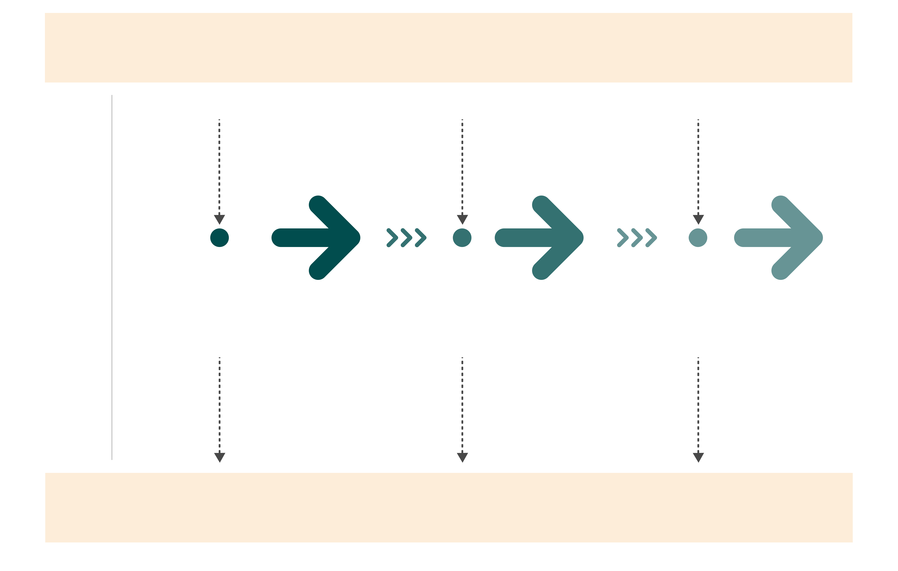
ITMS: obs-based emission verification
Societal need & research ideas
Input
Research
More research
More data
(esp. satellite)
R&D
Phase
1
2
3
Demonstrator
First Generation
Transfer to operations
Output
Structure
Code
Initial show cases
Products for core users
More & better products
Satisfied customers, cutting-edge research & successful climate change solutions

Slide 4
ITMS Showcasing
National top-down emission estimation
Plans and preliminary uses of satellite data

Slide 5
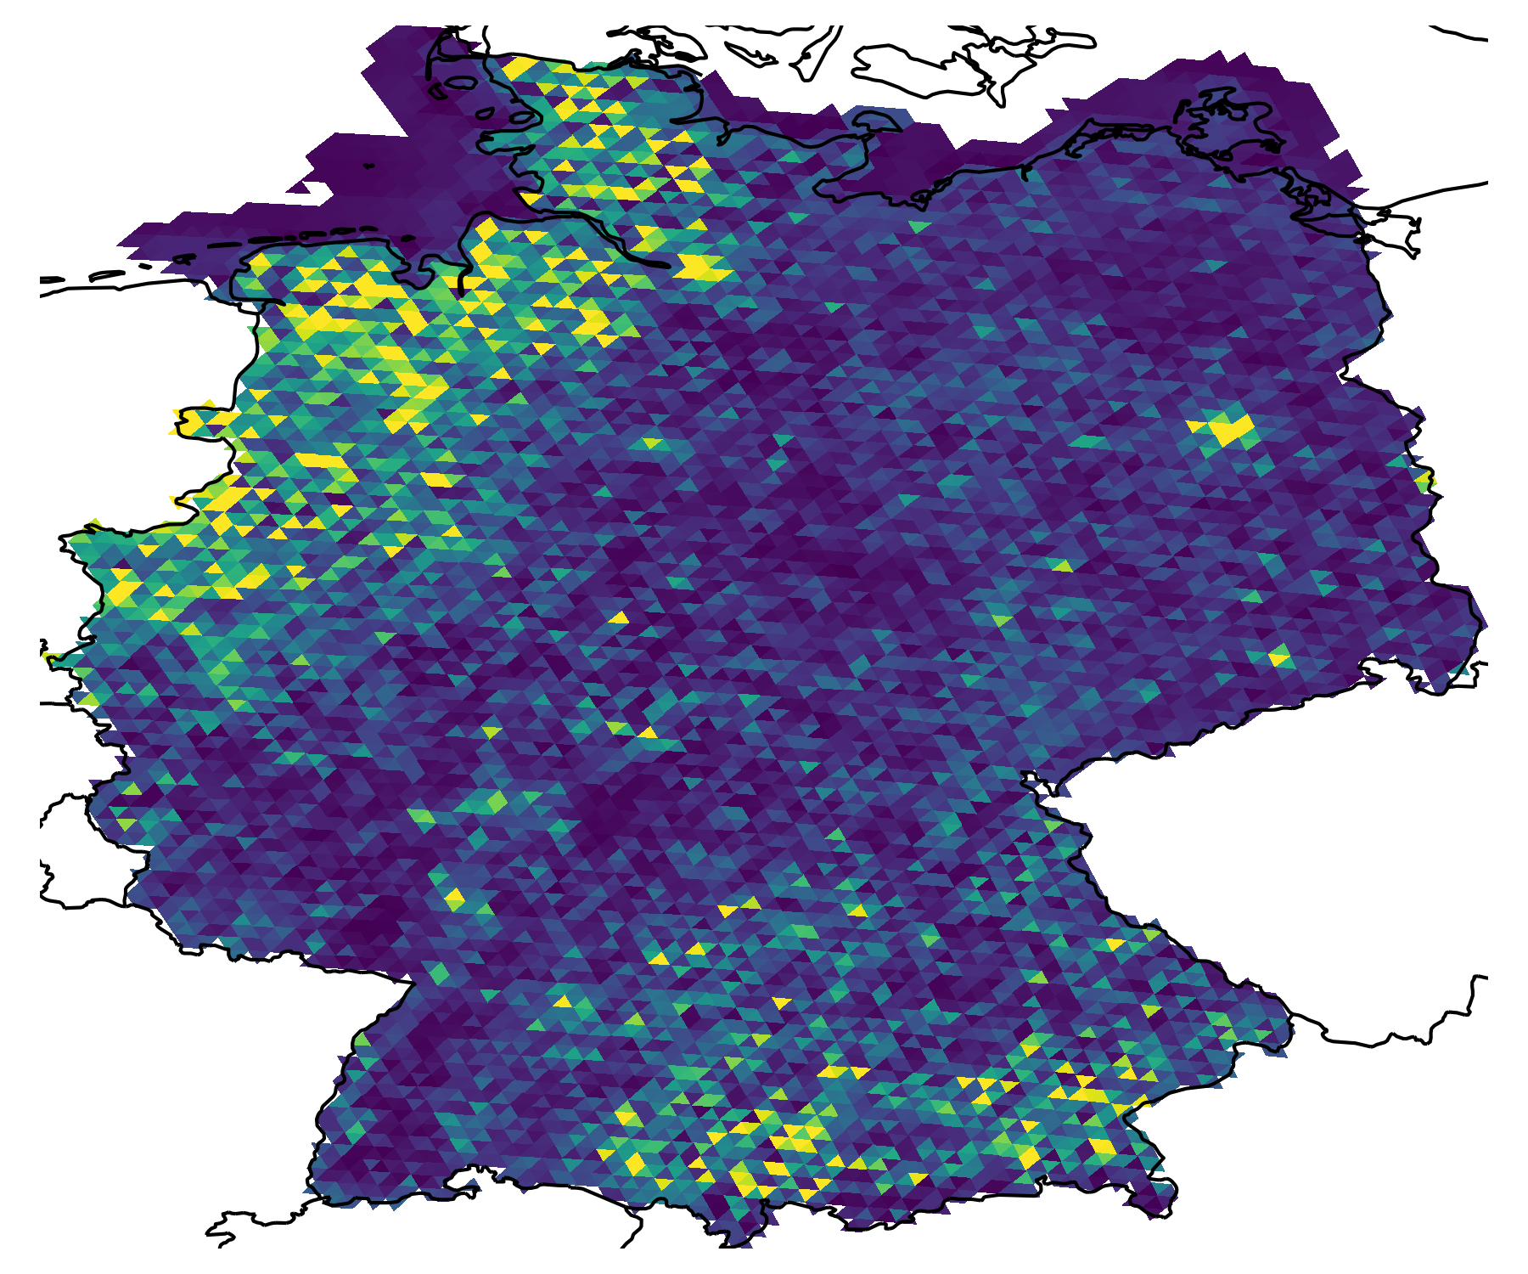
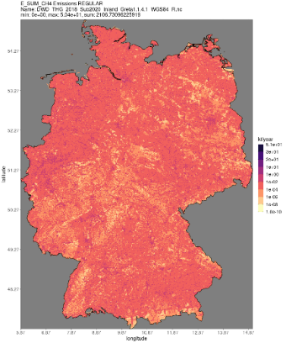

Starting from National Inventories
GRETA
Q&S
Figure credits: Valentin Bruch, DWD
Data credits:
Germany: Stephan Feigenspan, UBA
TNO CAMS-REG-ANT
(CAMS [publisher],
ECCAD [distributor]) for border region

Slide 6
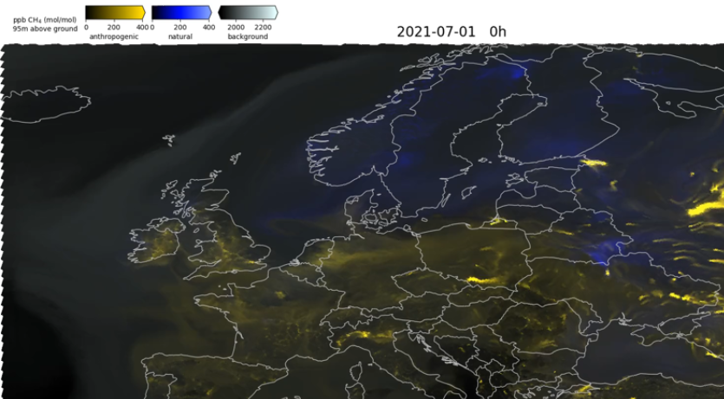
Methane tracers from prior
National emission estimates for Germany (UBA: GRETA) combined with appropriate sectors from CAMS outside Germany (CAMS-REG-ANT);
LULUCF sector from Thünen;
CAMS inversion optimized wetlands; inland waters (Rocher-Ross et al., 2023) and ocean (Weber et al., 2019) fluxes.

Slide 7
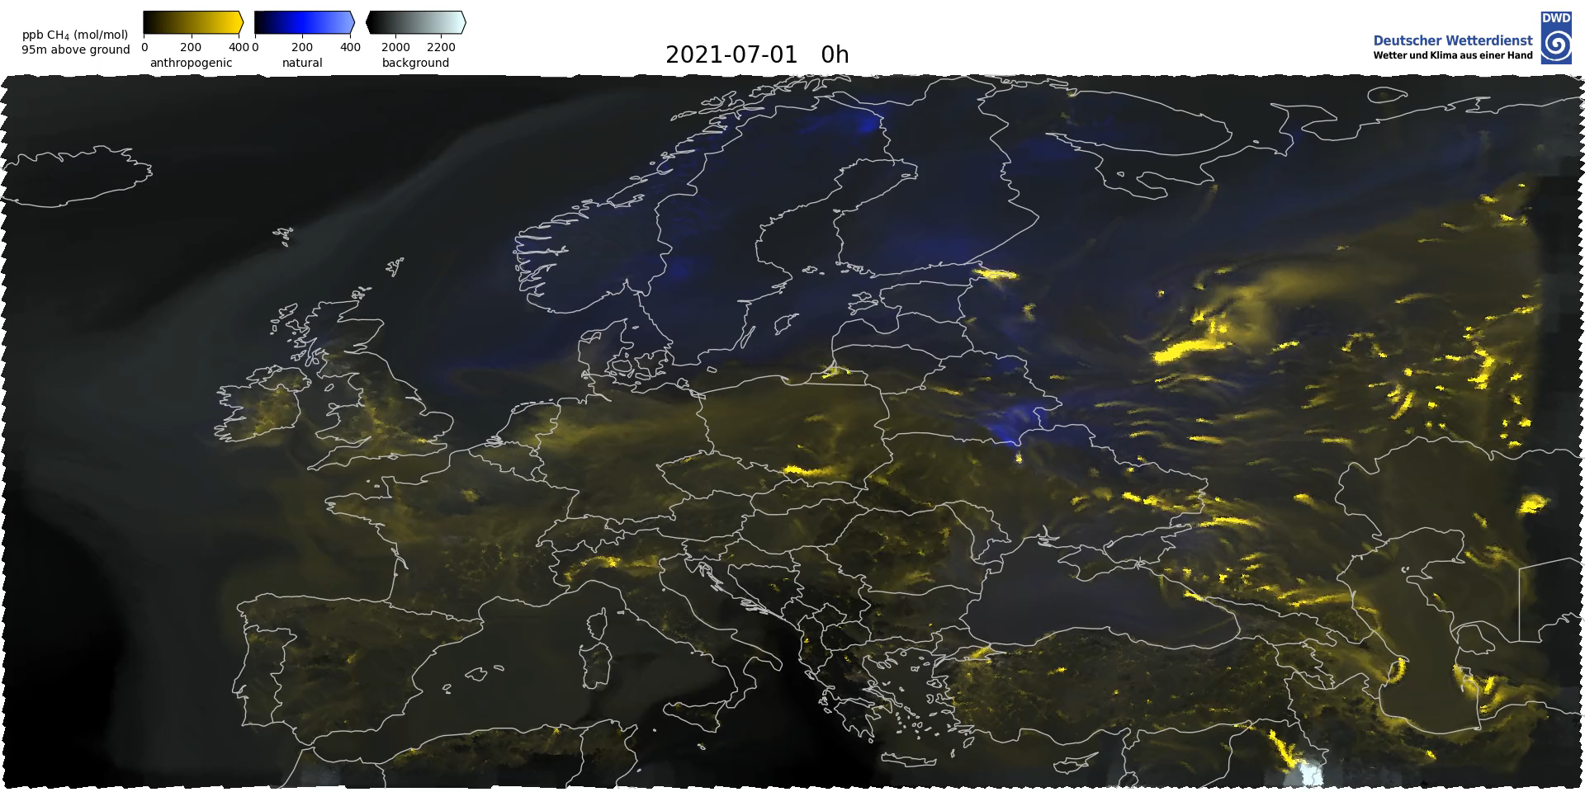
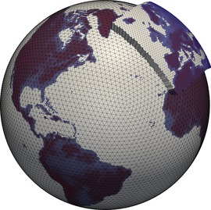

Forward CH4 modelling with NWP
CAMS for Limited Area Model boundary inversion- optimzied v22r2, resolution 1°×1°, 3 h
The Icosahedral Nonhydrostatic Model (ICON) is in operational use for NWP at DWD with effective mesh size of 6.5 km,
72 vertical levels, hourly output.
On-line passive tracer transport with the Aerosols and Reactive Trace gases (ART) module developed by KIT, with exact local mass conservation and mass-consistent transport, employing the Online Emission Module (OEM) as interface for various prior fluxes.
Video credits: V. Bruch, DWD

Slide 8
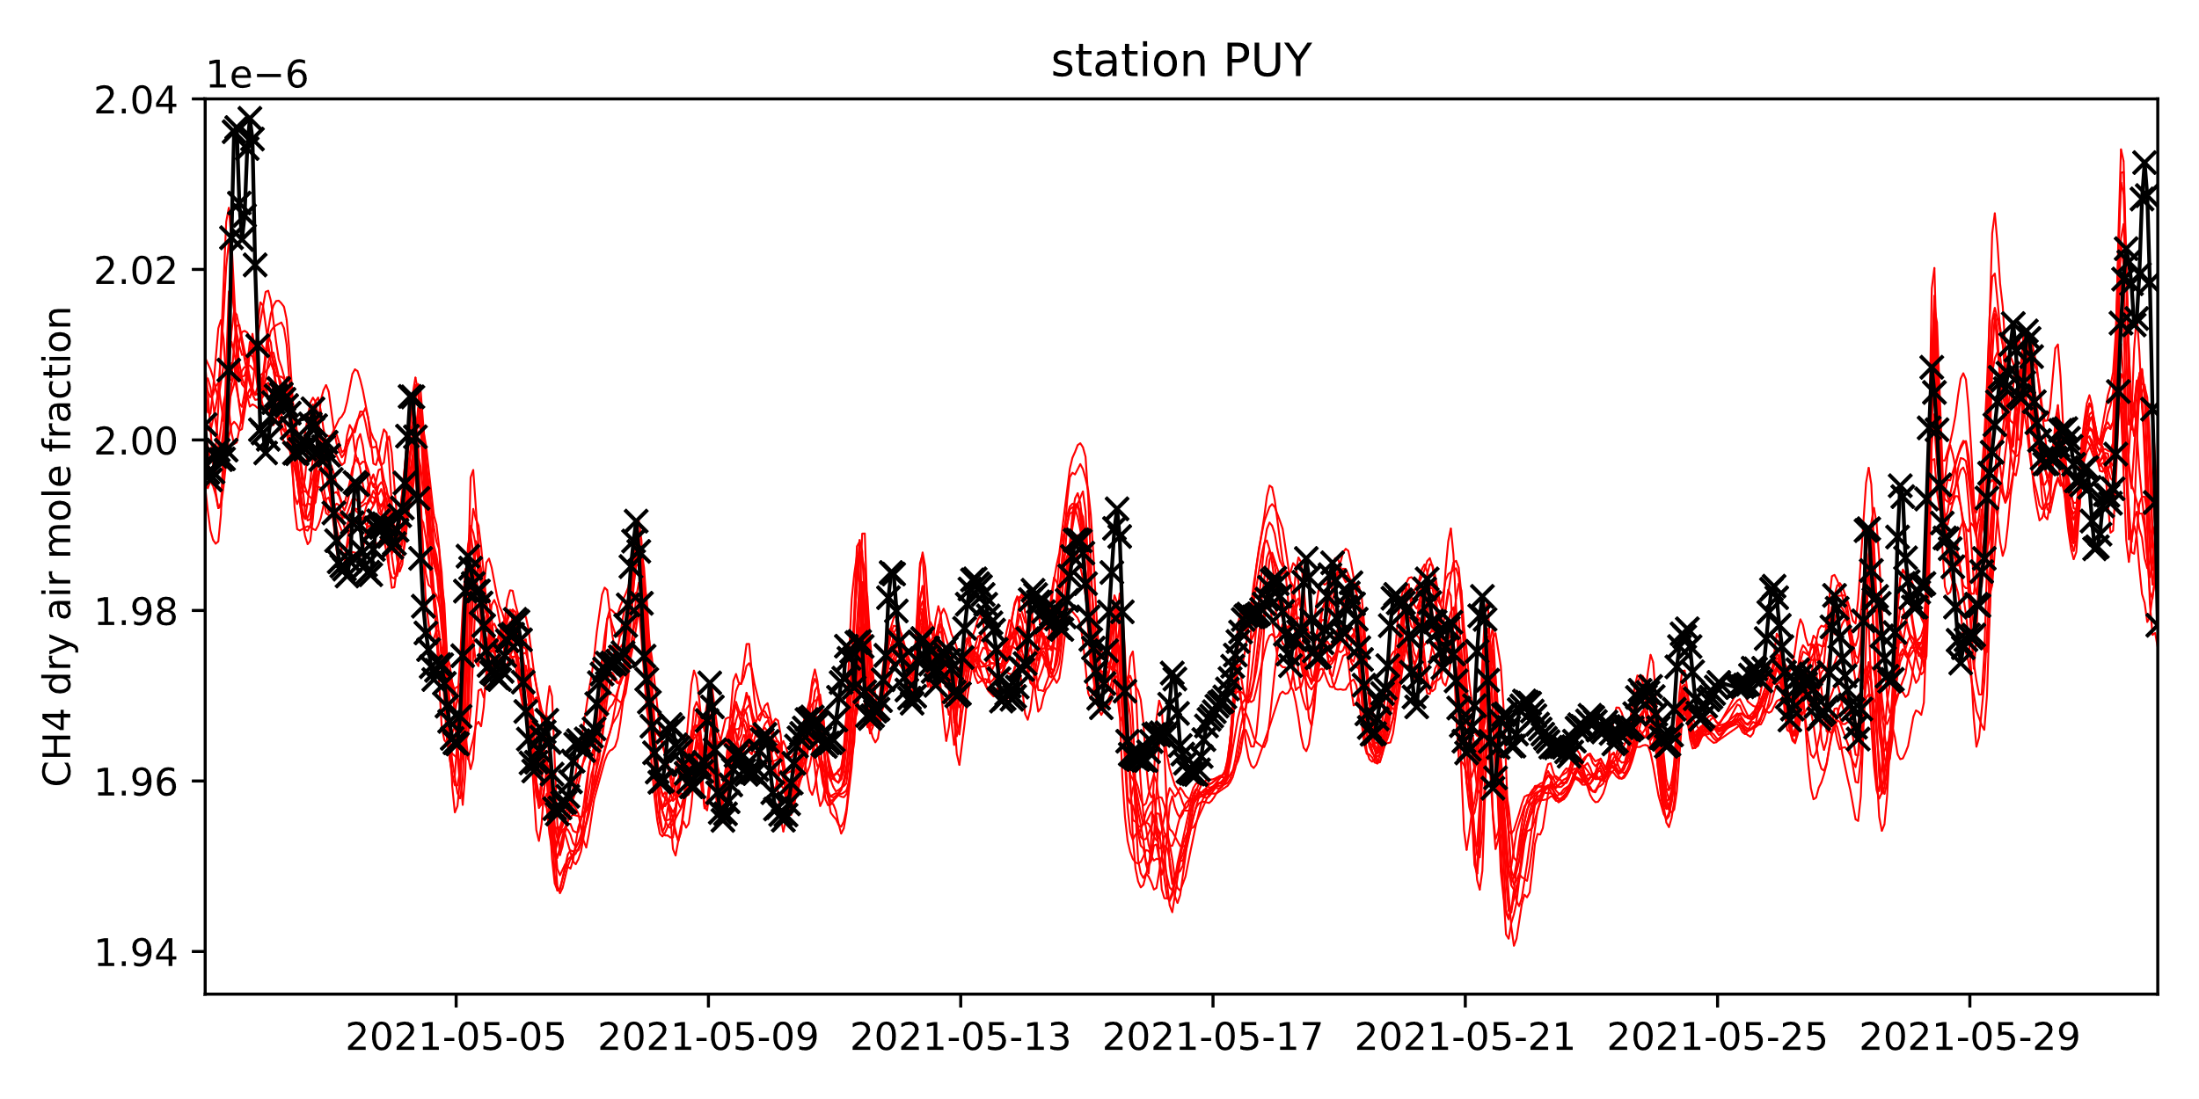
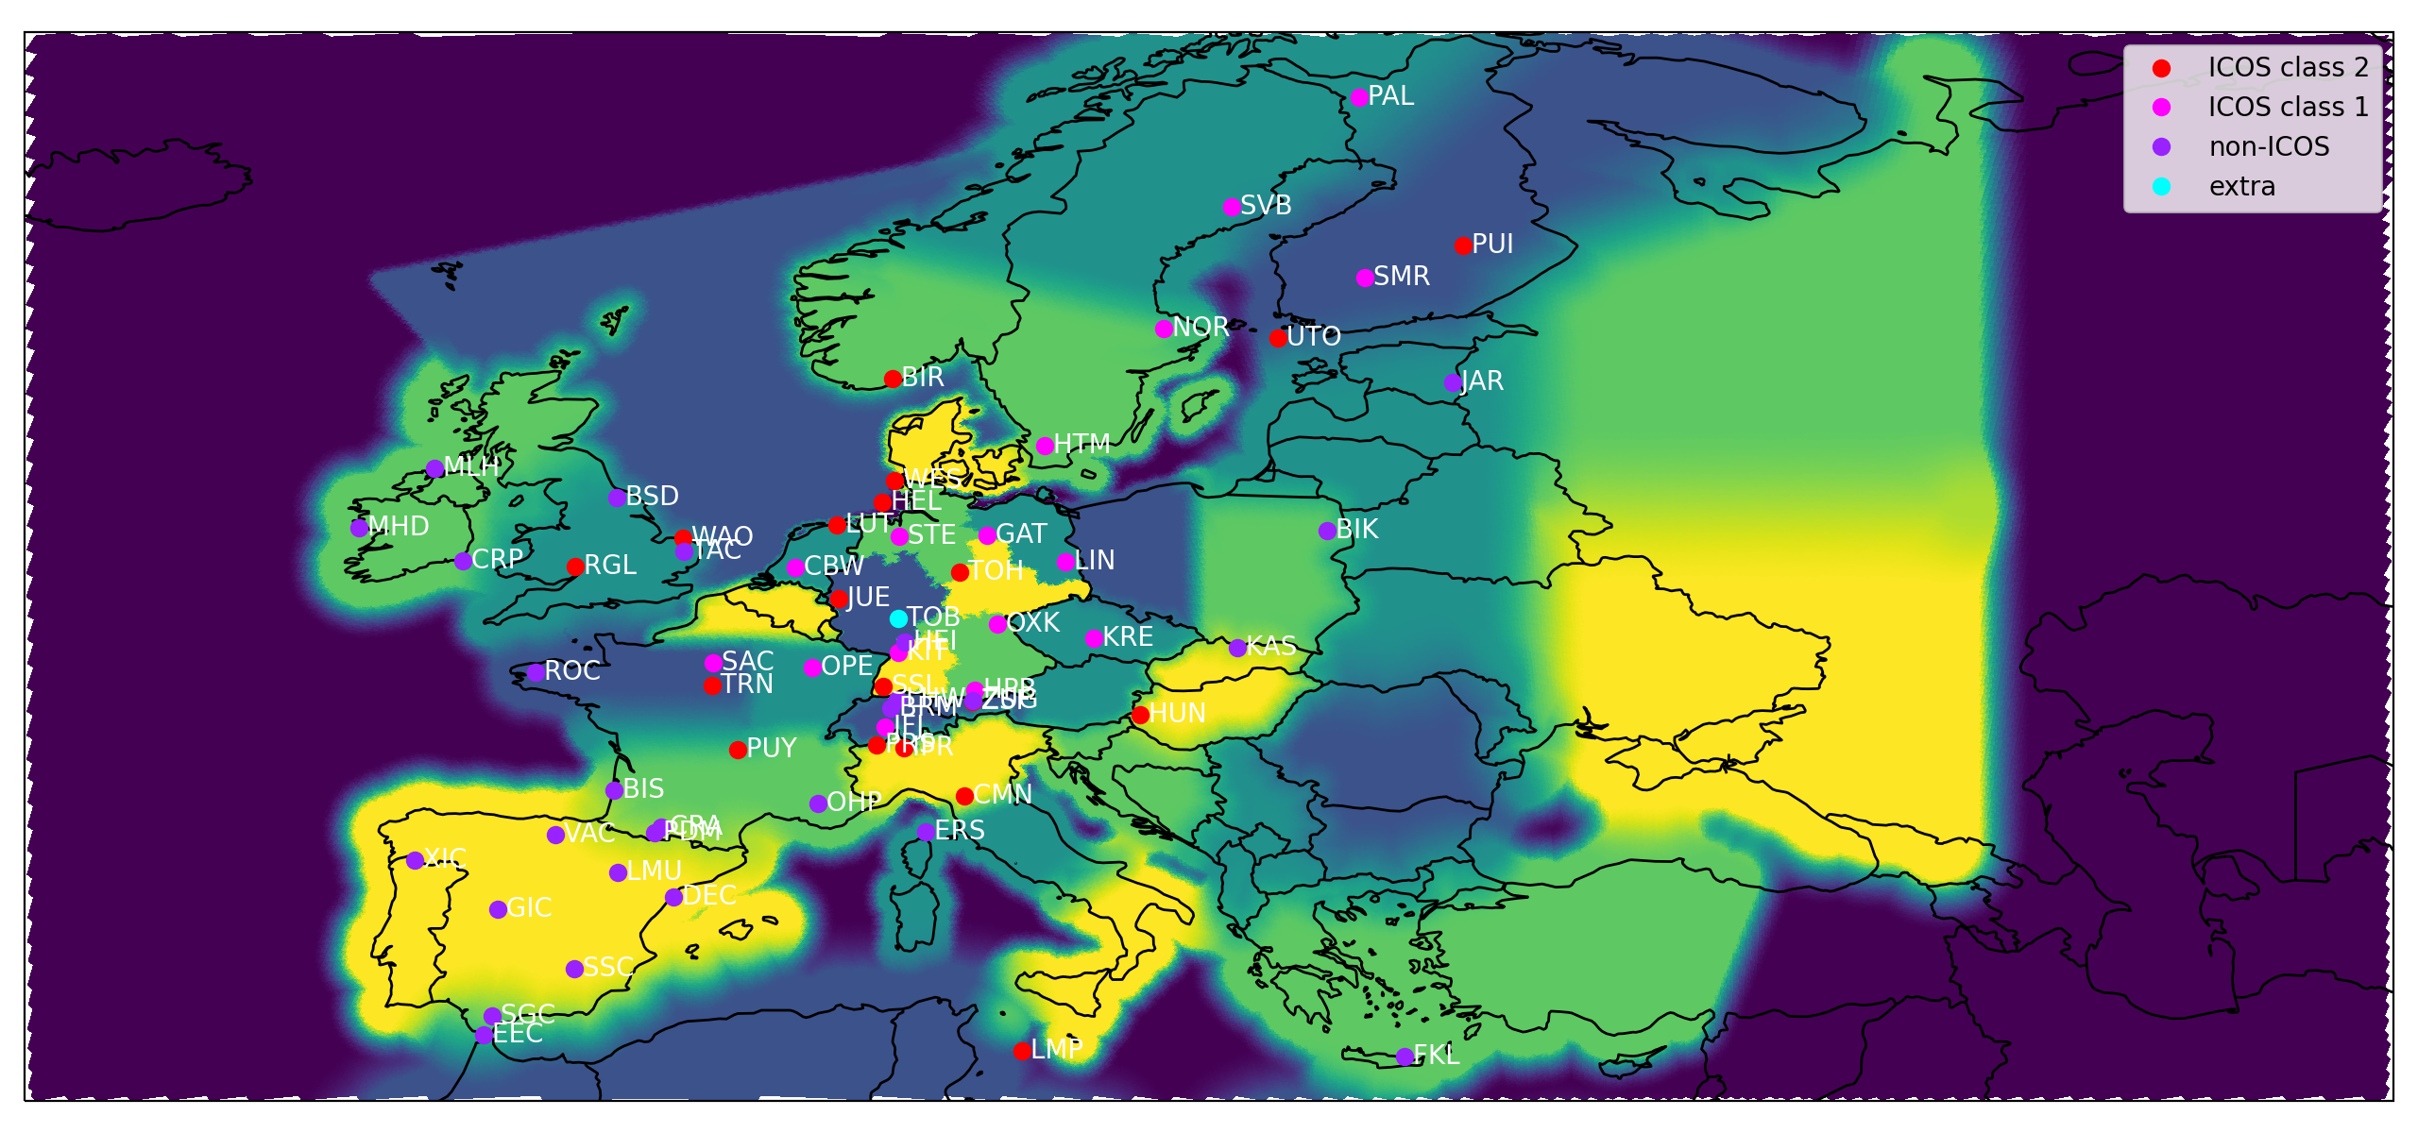




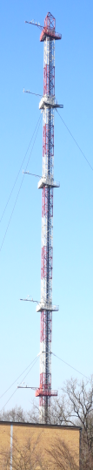
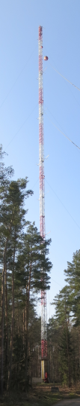
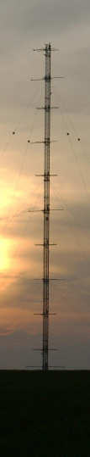

Modelled vs measured CH4
ICON-ART model ensemble
ICOS ATC CH4 observations
Puy de Dôme, Colomb et al. 2024
Image credits:
Mathias Lindauer

Slide 9
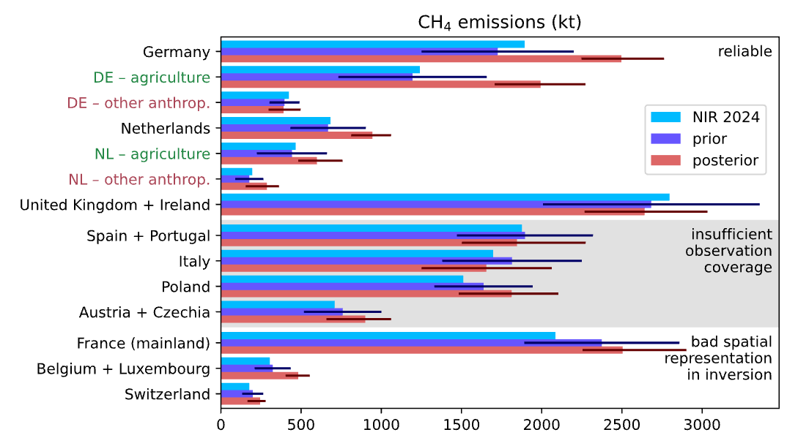
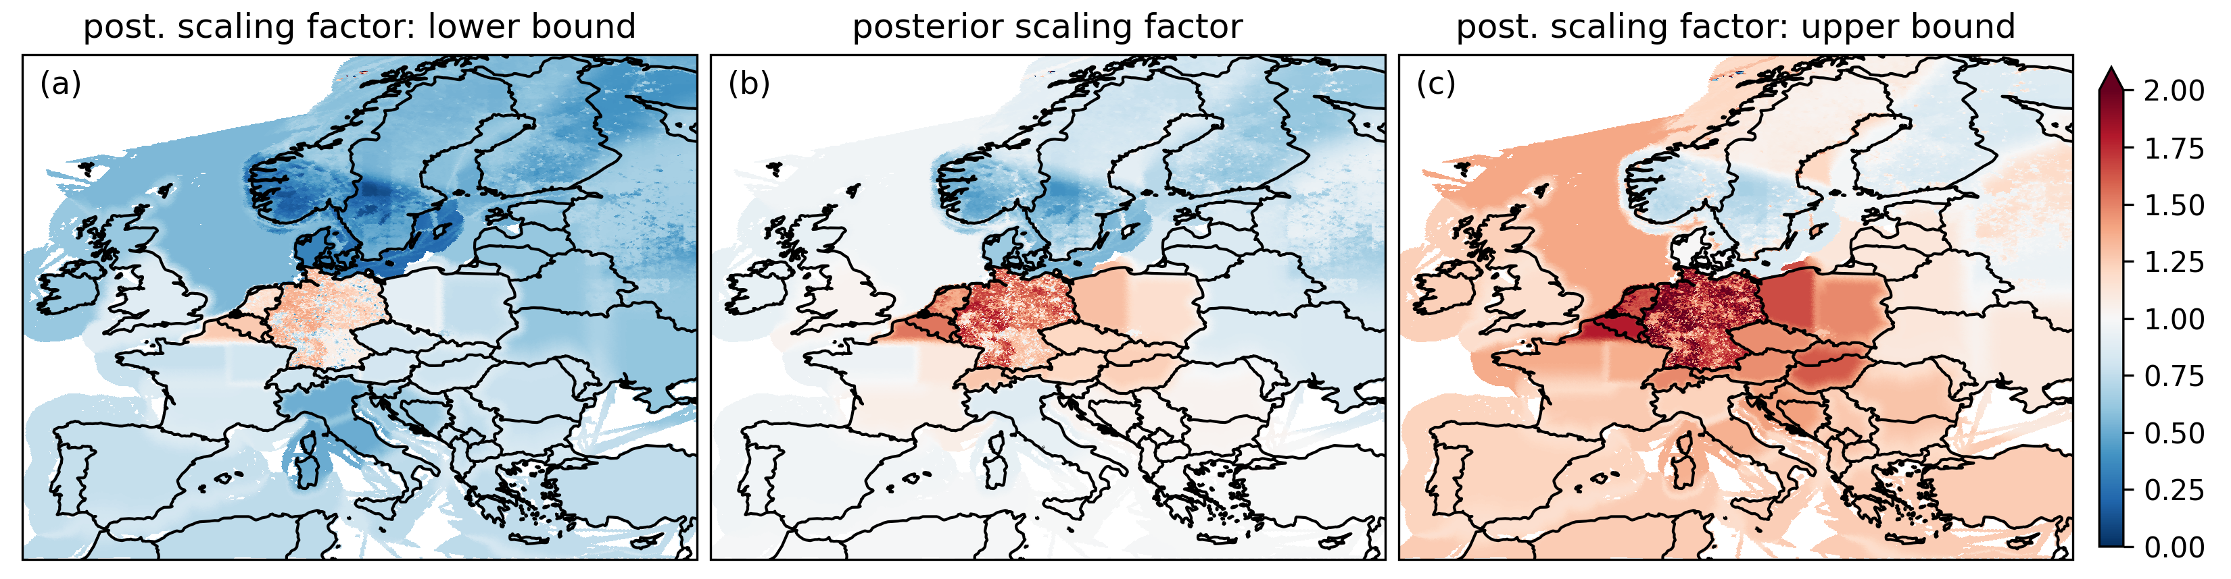
CH₄ Scaling Inversion
Only reasonable if forward model captures observed variability
Far-field correction necessary
Only reasonable if observation accuracy can be trusted
V. Bruch et al., in prep. 2025
time window: 1 month
scale 54 flux categories
2 inversion methods

Slide 10
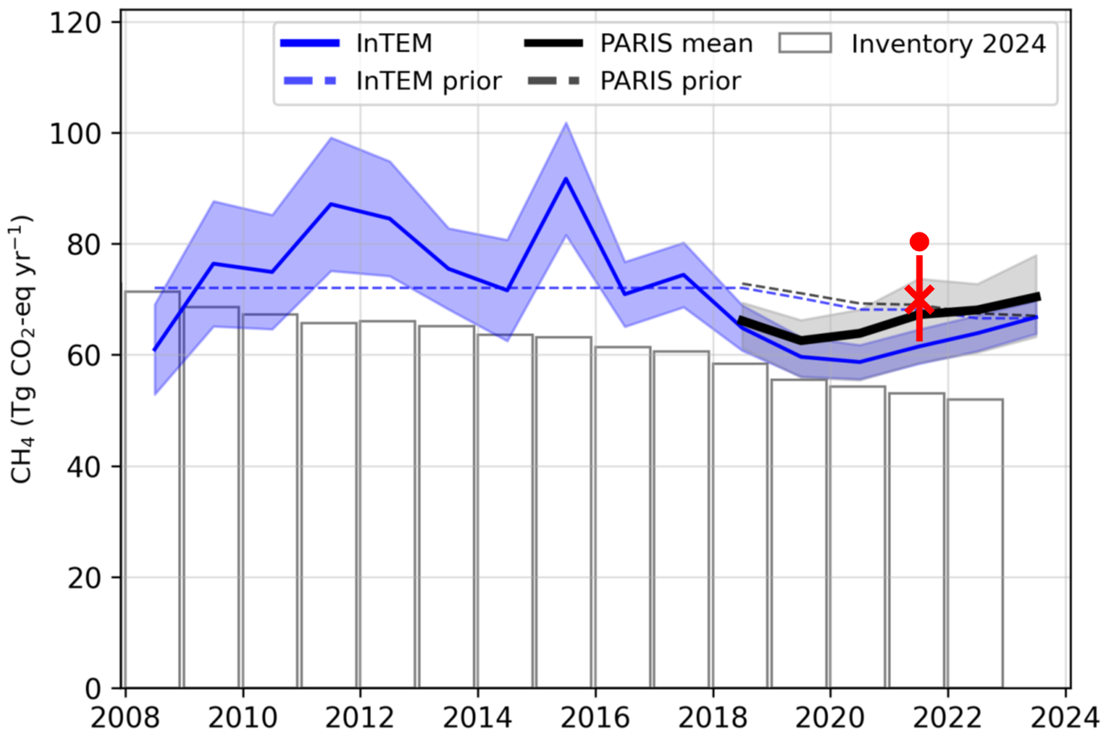




Comparison with other inversions
InTEM (UK Met Office), ELRIS (EMPA) and RHIME (University of Bristol)
CSR, version 2024-11
T. Koch et al., 2024
when using same prior fluxes as V. Bruch et al., in prep. 2025
ICON-ART, version 2024-09 V. Bruch et al., in prep. 2025

Slide 11
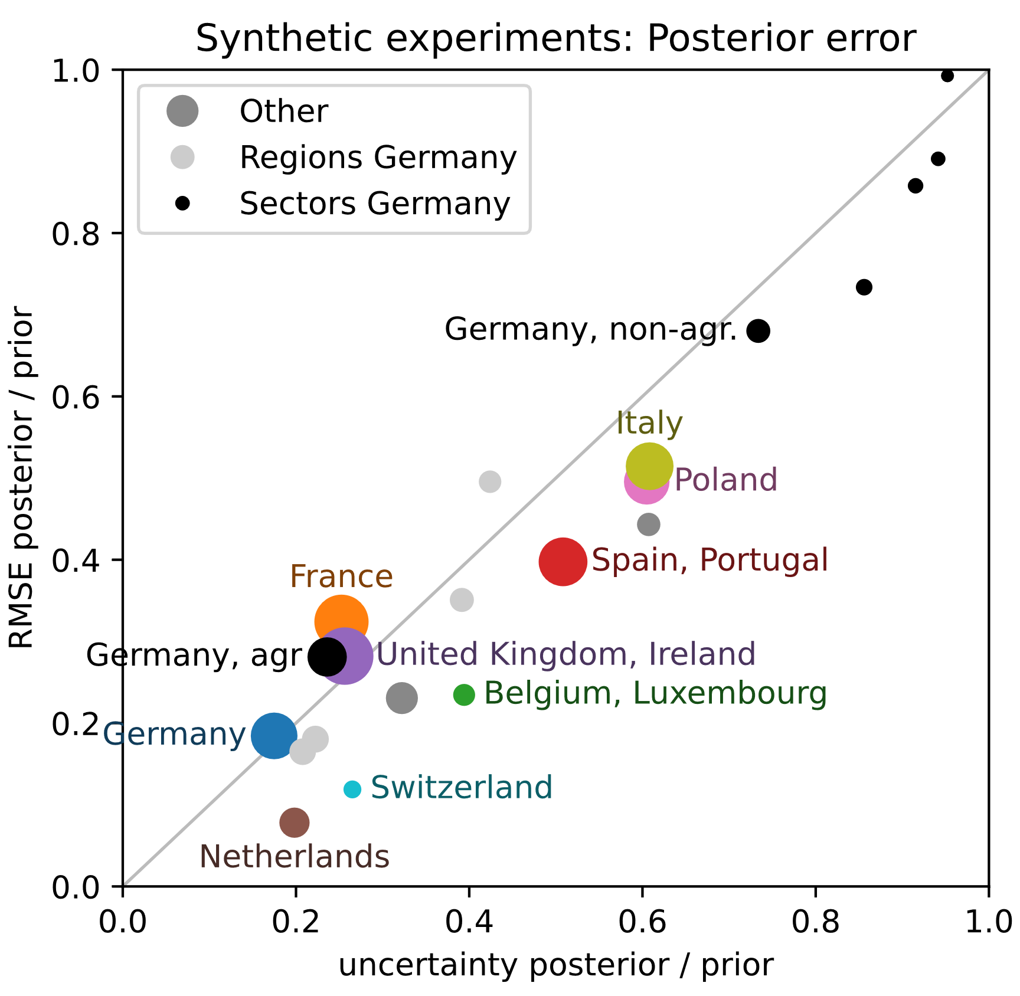
Inversions with known truth
  ICOS as an observing system is a very good start but we need more observations
V. Bruch et al., in prep. 2025
  biased obs would be a serious problem
posterior = truth
uncertainty = 0

Slide 12

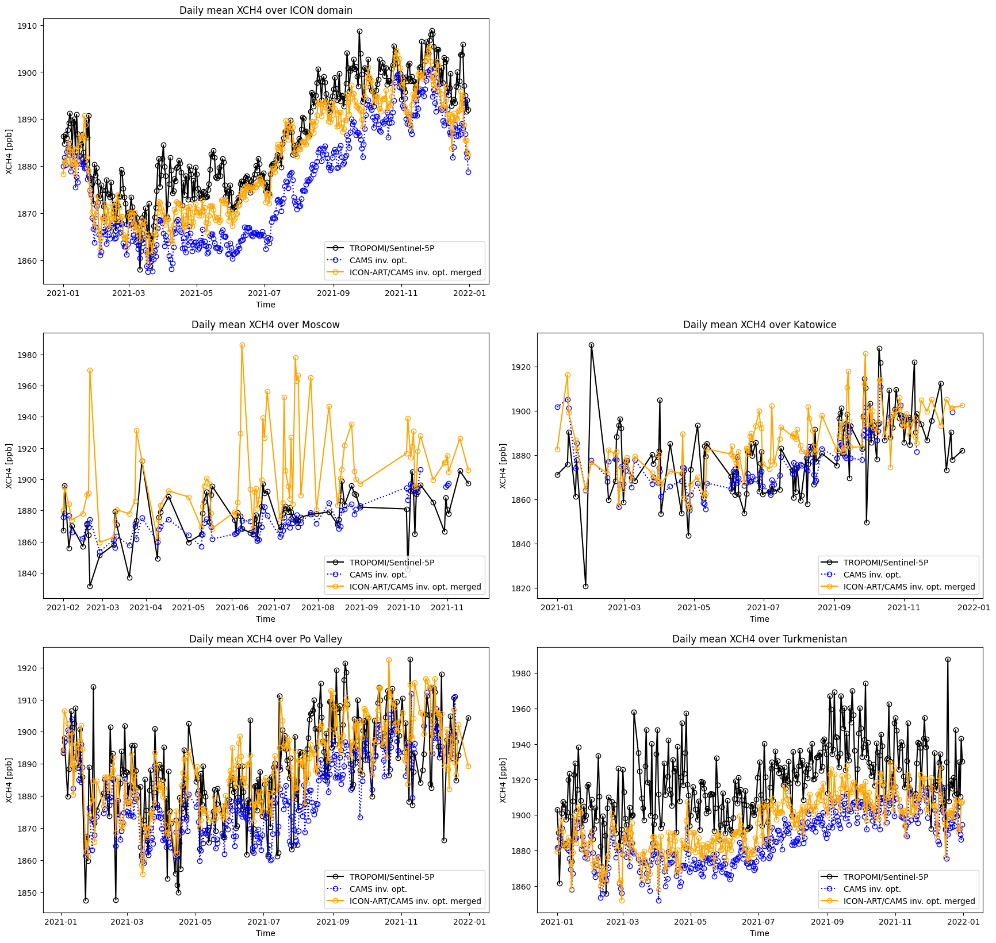
TROPOMI for model sanity checks
Credits:
Anne-Marlene Blechschmidt, DWD, 2025

Slide 13
Calling for more observations
For national GHG
top-down emission verification like aspired for Germany with ITMS …
  ICOS as an observing system is a very good start but we need more observations
  biased obs would be a serious problem
… we explore the use of satellite data

Slide 14
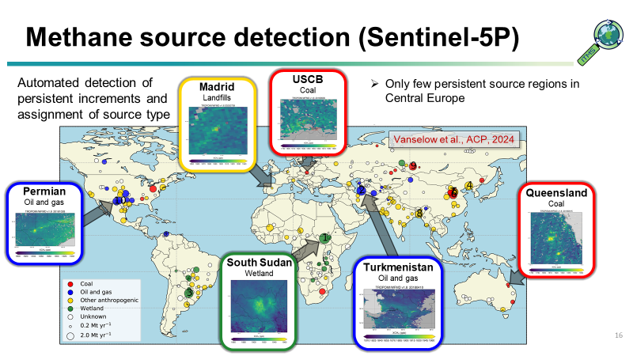
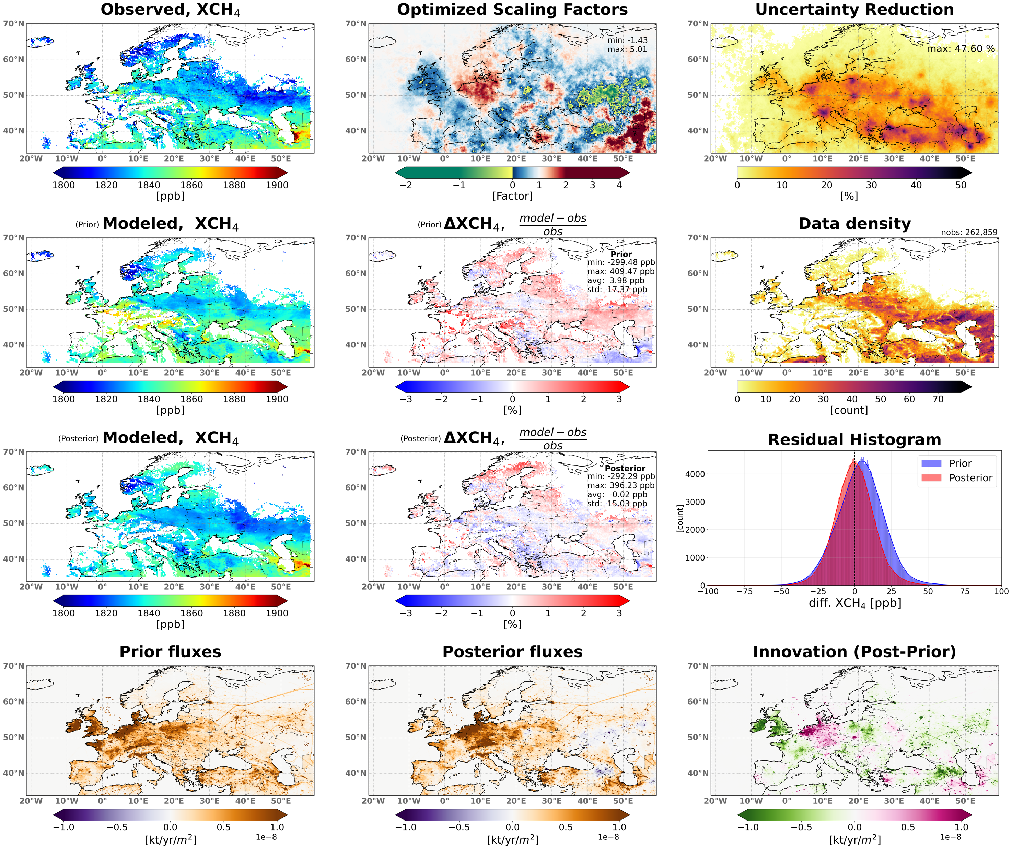
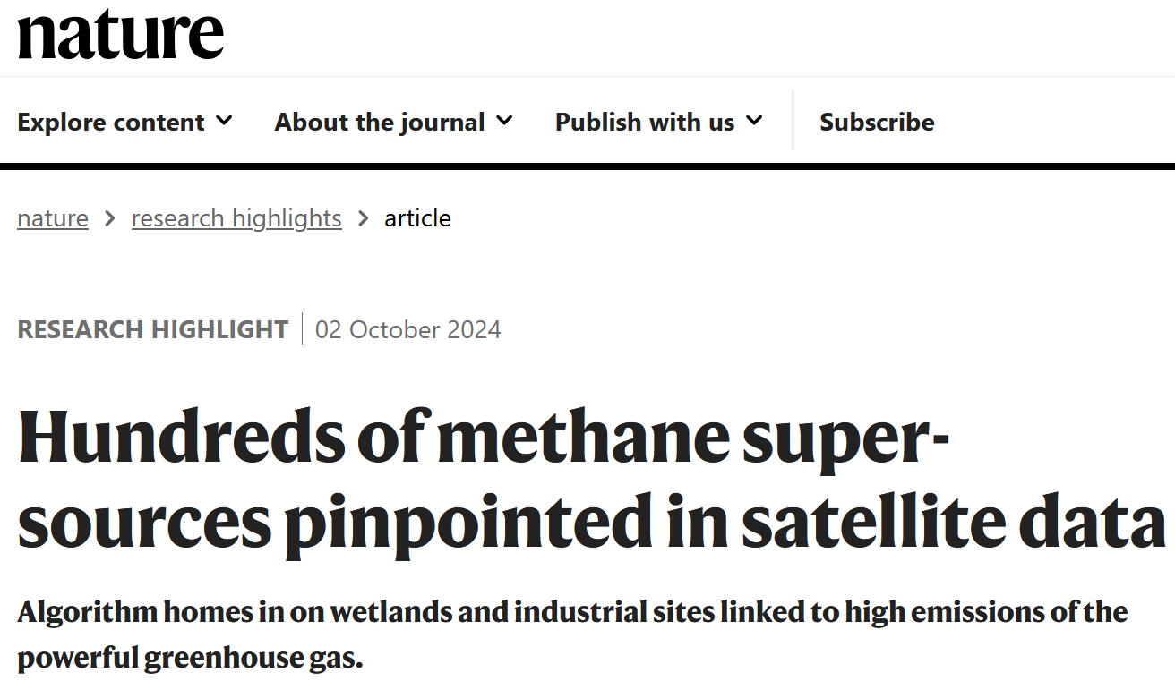
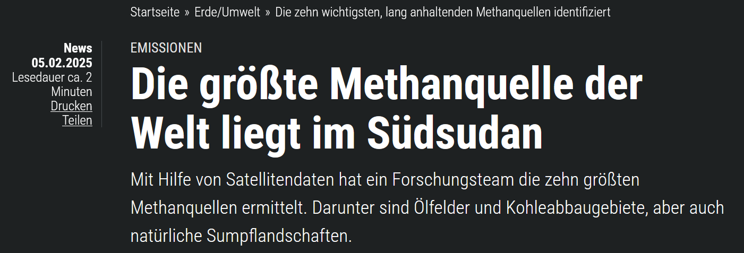

ITMS starts using satellite data
Preliminary assimilation of satellite XCH₄
Preliminary
ICON-ART – CTDAS, June 2018

Slide 15
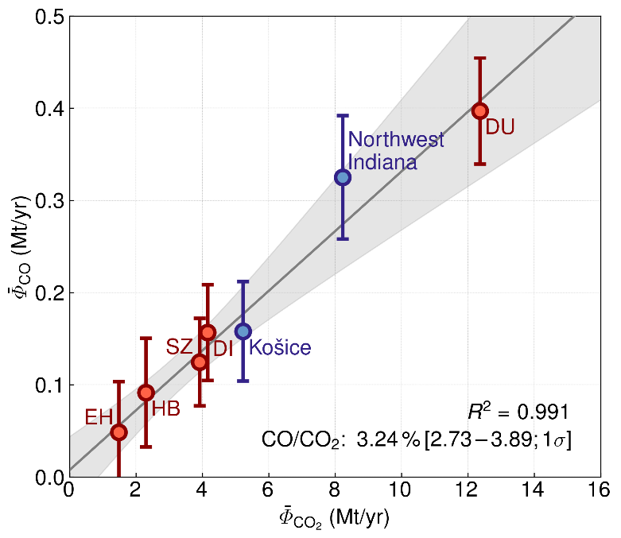
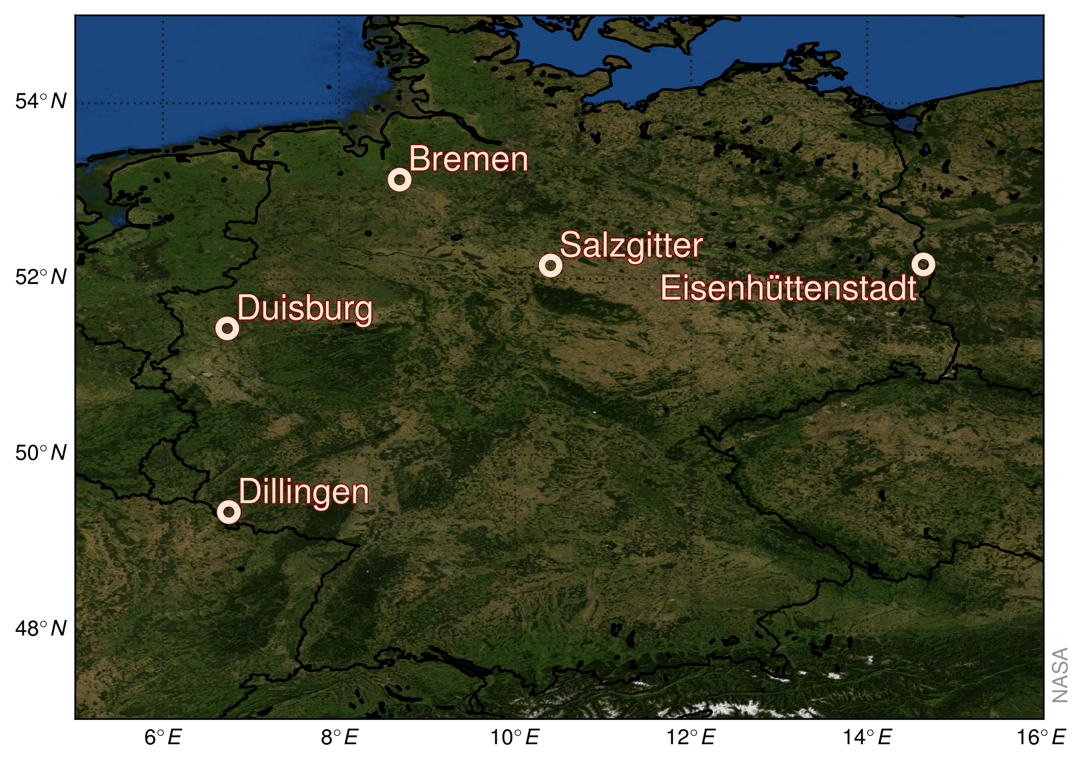
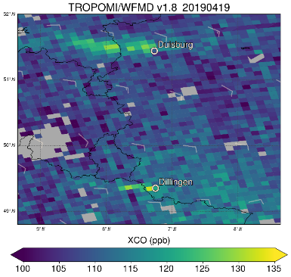
TROPOMI CO traces steelworks
Verification sites
15
Comparison with CO₂ emissions from the European Union Emissions Trading System yields a linear relationship with a sector-specific CO/CO₂ emission ratio for the analysed steelworks
Option of using CO as proxy for CO₂ emissions from comparable steel production sites as satellite-based CO₂ emission estimates at the scale of emitting installations are challenging
Schneising et al., ACP, 2024

Slide 16

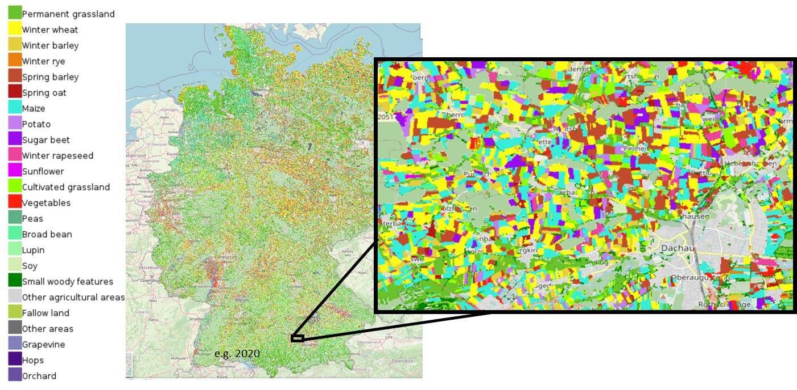
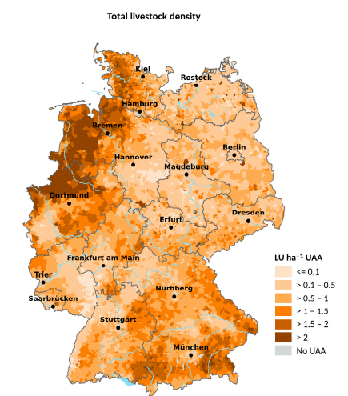
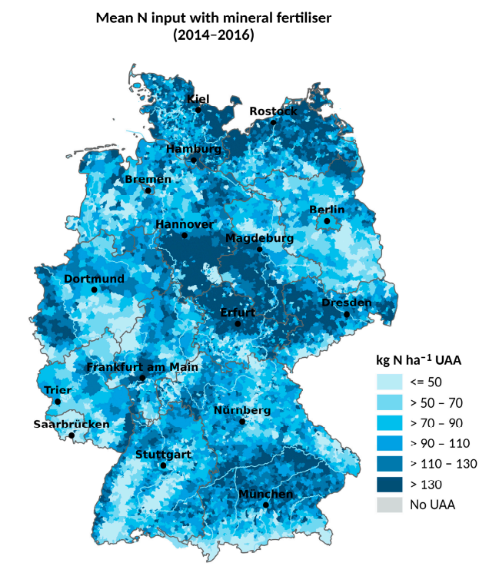
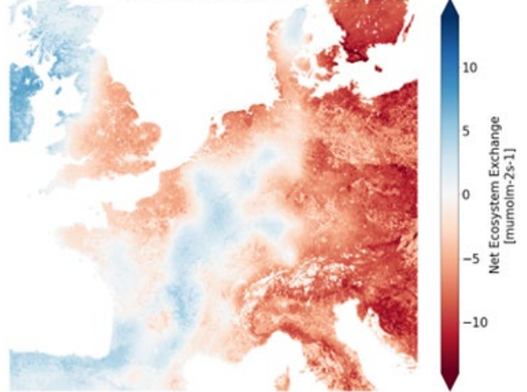
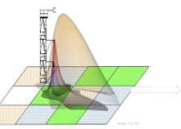
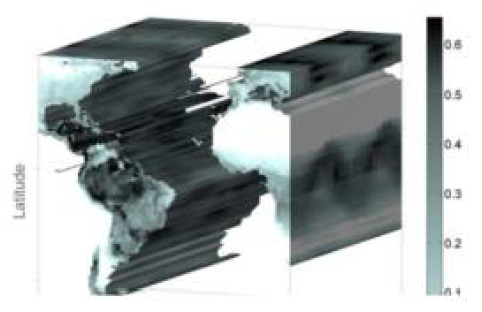

ITMS process modelling: with sat?
Process Based Modelling (Tier 3) of N₂O emissions agricultural soils
LandscapeDNDC
Improved national activity data
(cropping, management, soil)
Advanced process modelling of agricultural N₂O and biogenic CO₂ fluxes
Data driven AI based biogenic CO₂ fluxes
+
+
EddyCovariance data
Satellite Observations
Machine Learning
Nelson & Walther et al. 2024

Slide 17
Summary
German top-down emission estimates (“ITMS Demonstrator”) for CH₄ using ICOS successful, calling for more data.
ITMS is exploring the use of various satellite data (GHG, also NEE, land use), the uncertainty structure of the satellite observations needs to be understood and cared for by ITMS.
A variety of methods is under development within ITMS, operational use is in preparation for CH_{4,} CO₂, N₂O.

