Slide 1
Participation and Contribution to UNFCCC events
WGClimate
Agenda Item 8.1

Slide 2
WGClimate Submission on Possible Themes for 2024 EID
Sustained and systematic space observations have been providing long-term climate data records for many Essential Climate Variables defined by GCOS.
Space observations have been transformative in our ability to monitor and understand climate change and inform sound policy.
The Global Greenhouse Gas Watch (G3W) initiative of WMO provides a framework for the establishment of operational monitoring and information services about the atmospheric concentrations of the main greenhouse gases and their surface fluxes.

Slide 3
Establish a Dedicated “Tiger Team” for Coordination
This team, led by WGClimate leadership and supported by members of the CEOS Chair and CEOS SIT Chair teams , would focus on aligning objectives across space agencies, national delegations, and other relevant stakeholders.
Mandates of this team would include ensuring consistent preparation for EID, enhancing coordination at key events, and transforming EID into a compelling platform for showcasing the transformative potential of space-based data.
This team should develop a comprehensive multi-year engagement strategy aligned with the phases of the GST process. A central component of this strategy is the proactive preparation for party submissions.
The multi-year plan should clearly define key objectives for each COP and EID, ensuring that CEOS and CGMS efforts are strategic and aligned with broader climate goals.

Slide 4
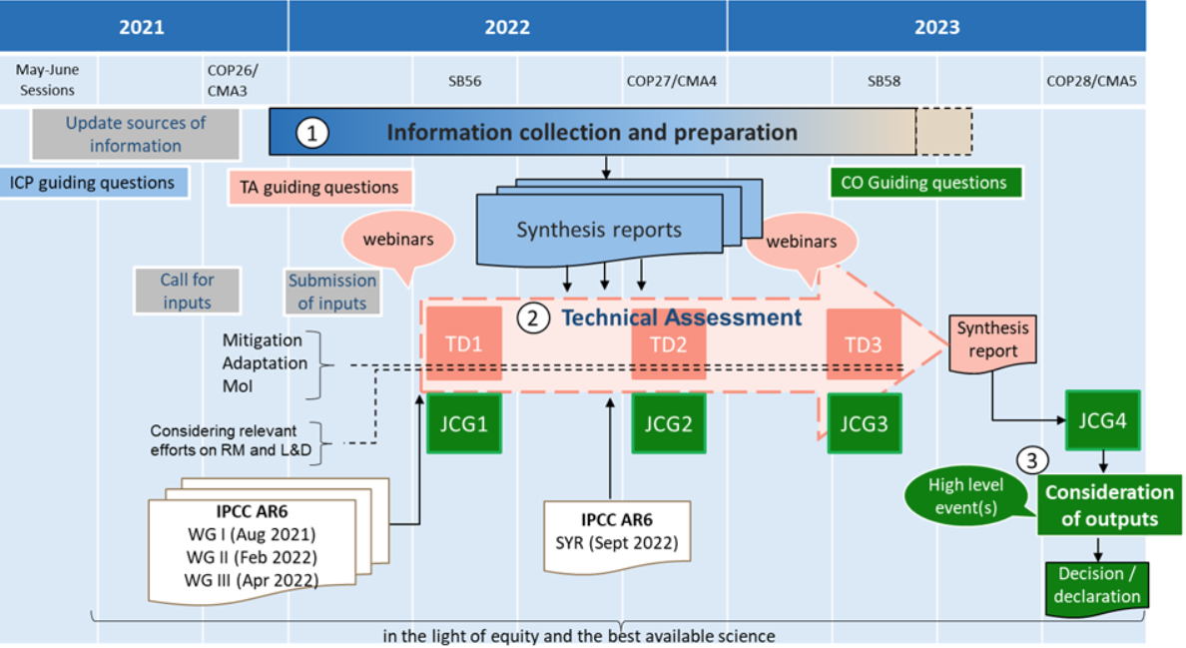
First GST timeline
Information Collection and Preparation (ICP) phase: Nov 2021 to June 2023
Technical Assessment (TA) phase: Summer 2022 to Summer 2023
Technical Dialogue (TD) phase: June 2022, Nov. 20222, and June 2023

Slide 5
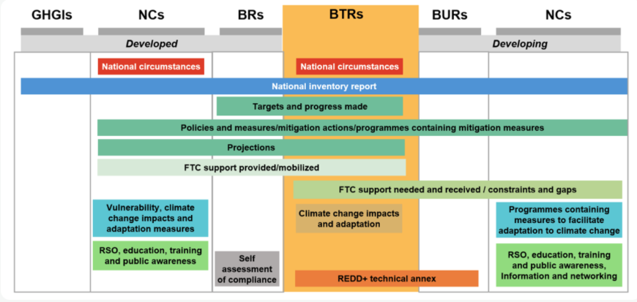
First Biennial Transparency Reports
Parties submitted their first BTR and National Inventory Report (NIR) in December 2024.
BTR include information on NIR, progress towards NDCs, policies and measures, climate change impacts and adaptation, levels of financial, technology development and transfer and capacity-building support, capacity-building needs and areas of improvement.
BTR will undergo a technical expert review. A facilitative, multilateral consideration of progress will also be conducted for each party.

Slide 6
Opportunities in the GST-1 follow up and GST-2
How space-based data can support GST-2:
Providing a comprehensive, up-to date data source to inform:
Tracking of GHG emissions (consideration of temporal and spatial monitoring)
Present observed climate impacts (including loss and damage, land-use change)
Determine the effectiveness of climate action- utilizing existing baselines
Courtesy to Maseko-Msyale

Slide 7
Opportunities cont’d
Positioned to support global transparency
Facilitate anticipatory action
Enablers
Understanding of data requirements
Effective coordination
Thematic alignment
2025
Discussions on modalities
2026
Information Collection (launched @ CMA 8)
2027
Technical work
2028
Political outcomes
Courtesy to Maseko-Msyale

Slide 8
Building Strategic Relationships with Key Stakeholders
Foster stronger connections with high-level COP delegations, whose decisions directly influence climate negotiations
Prioritize tailored communication that aligns with the specific policy priorities of these delegations
Identify and nurture “COP champions”, who can serve as influential advocates for integrating space-based data into global climate frameworks

Slide 9
Unified and Strategic Representation at UNFCCC Events
Leverage WMO as a Credible Central Channel
Collaborate closely with WMO, aligning CEOS-CGMS initiatives with WMO’s globally recognized authority. This partnership will enable the Earth observation community to present a cohesive and authoritative voice.
Participate in WMO-led activities to ensure that CEOS-CGMS priorities are seamlessly integrated into broader discussions about the role of Earth observations in climate policy.
Empower National Delegations for Advocacy at Earth Information Day (EID)
Proactively engage with CEOS-CGMS country delegations and prepare cohesive, impactful submissions, CEOS and CGMS can ensure their priorities are prominently represented.
This include identifying themes well in advance of the August EID submission deadline, crafting clear and actionable messaging, and developing proposals that emphasize the relevance of satellite-derived data to national and global climate goals.

Slide 10
Raise Awareness of Space-based Data
Implement tailored communication strategies designed specifically for policymakers and COP delegates (e.g., concise and impactful presentations, visually engaging materials, and executive summaries) to articulate the relevance of satellite-derived data to national mitigation and adaptation strategies.
Highlight case studies showcasing the successful integration of space-based data into national inventories and climate policy.
Build broader support among policymakers and position satellite-derived data as a critical tool in achieving national and global climate goals.

