Slide 1
GHG Task Team
WGClimate-25 Update

Slide 2
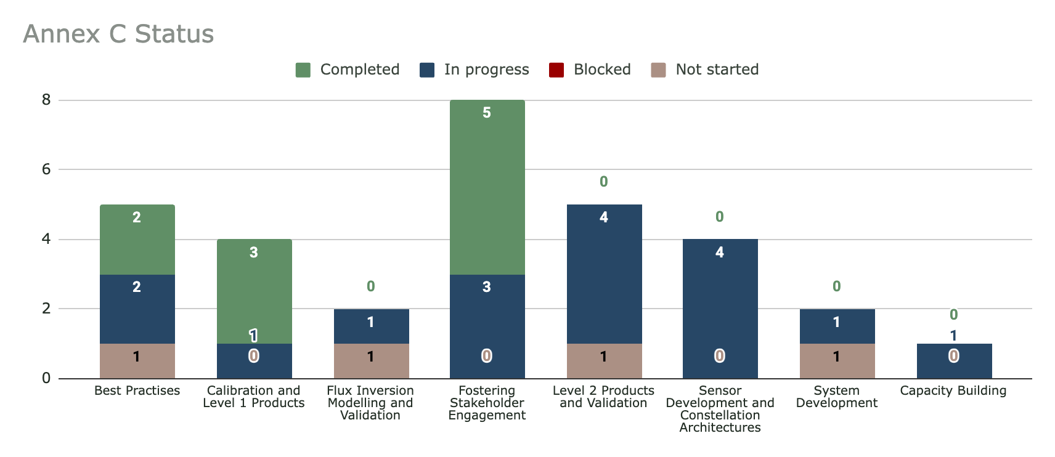
GHG Roadmap Annex C Status

Slide 3
Multispectral Imagers for Methane Detection
Draft paper prepared by Giorgio
Reviewed by IMEO
Out for review with GHG-TT
Aiming to present a near-final draft at February meeting
Potentially SIT-42 acknowledgement by CEOS

Slide 4
Workshop on GHG Inventories in Asia
Workshop on GHG Inventories in Asia (WGIA) is an annual meeting on inventory compilers - organised by NIES
Hiroshi Tanimoto engaging with NIES colleagues to add satellite component to 2027 workshop
2027 workshop will be held in Summer, in the Philippines (date TBC)

Slide 5
Best Practices
GHGSat & CarbonMapper assessed against V1.0, within the ESA EDAP
  Lessons learnt have been distilled, to be included in Best Practises 2.0
Workshop to develop v2.0 will be held 18-20 January 2027 at NPL
  Contact Paul Green for more information

Slide 6
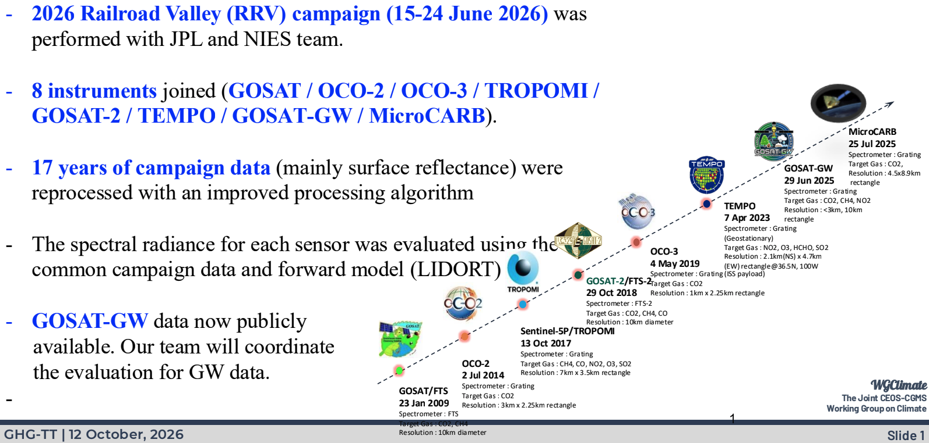
Railroad Valley Campaign 2026

Slide 7
Validation Networks
Developing the CO2M validation network requirements into general requirement for operational ground-based GHG validation networks
  Draft document expected to be ready for discussion at February meeting
Will also work on a gap analysis of validation networks
Chris O’Dell and Tommy Taylor continue to work on the aerosol intercomparison exercise. Aim to have initial feedback from participating teams by February
  More details in slides here

Slide 8
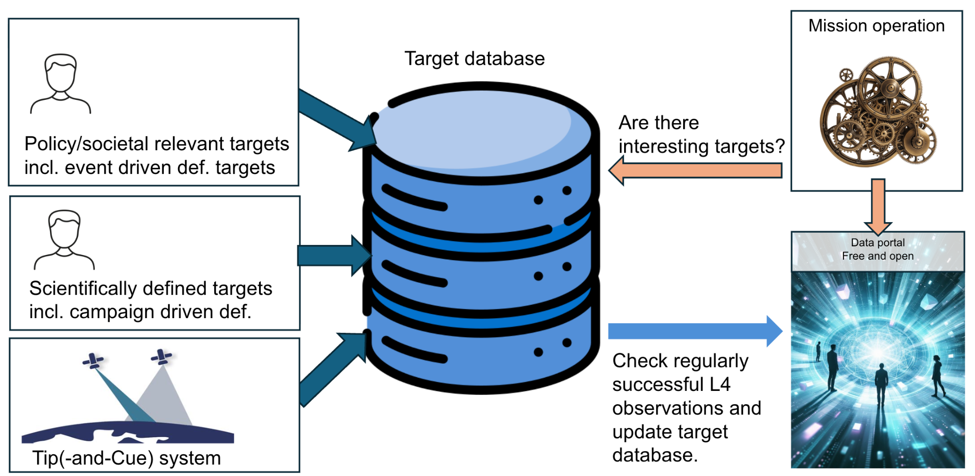
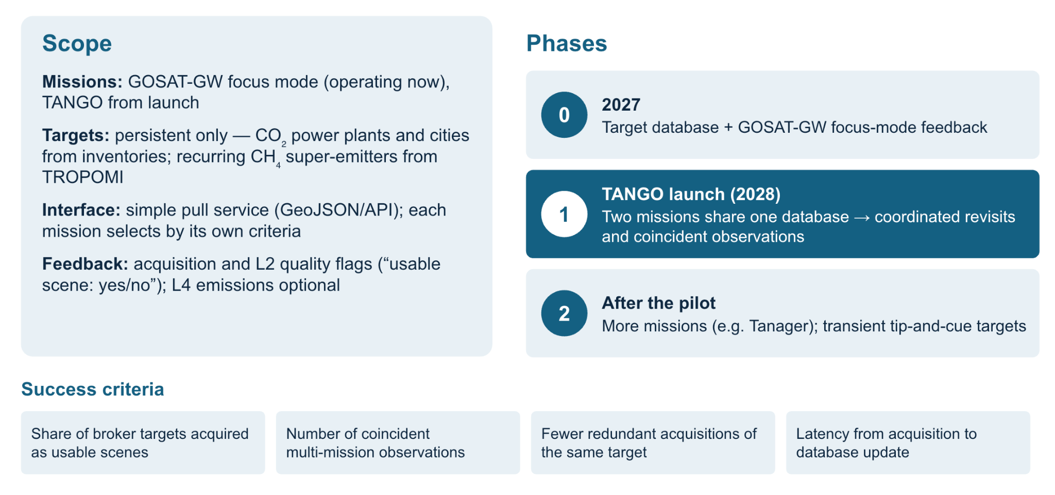
Tip and Cue
Jochen Landgraf & Yasjka have developed a proposal for a ‘GHG Target Broker’ network
Optimising target selection across missions.
The global mappers would provide information on potential targets for the facility scale.
Propose to start with GOSAT-GW focus mode, and then TANGO when it launches.
More details in slides here
Pilot Phase

Slide 9
GST Actions
GST Study Team Report set to be acknowledged today!
GHG-TT proposes to organise a call with stakeholders from across CEOS in late Nov / early Dec

Slide 10
Objectives for February 2027 Meeting
Review MSI for Methane paper
Plan for WGIA satellite component
Continue development of v2.0 best practices
Review operational validation network requirements
Develop the tip and cue methodology further

