Slide 1
Climate change as a cross-cutting theme in GEO
André Obregón Technical Expert for Climate CEOS-CGMS WGClimate
Paris, 7 March 2016

Slide 2
GEO-XII Plenary & Ministerial Summit
Mexico City 9-13 November 2015
Adoption of a ten year Strategic Plan (2016 - 2025)
Ministerial Declaration that focuses on harnessing critical environmental observations to enable leaders to make better-informed decisions for the benefit of humanity at a time of rapid global change
Notes:
1. Opening of GEO Geneva Ministerial Summit 17 January
L-R: B. Ryan, Director, GEO Secretariat; GEO Co-Chair R. Strohmeier, European Commission; J. Potočnik, European Commissioner for the Environment; GEO Co-Chair K. Sullivan, US; P. Gallagher, Acting Deputy Secretary of Commerce, US; B. Oberle, State Secretary, FOEN, Switzerland; D. Hanekom, Minister of Science and Technology, South Africa; GEO Co-Chair P. Mjwara, South Africa; J. Cao, Vice Minister of Science and Technology, China; L. Chen, China; A. Steiner, Executive Director, UNEP

Slide 3
Unique Time in GEO’s History
Transition to next decade 2016-2025
Recognition of GEO’s convening power – Members, POs, Development Banks, Foundations, emerging Private Sector
Evolution & Recognition of Policy Mandates
New Strategic Plan with new programmatic mechanisms – community activities, foundational tasks, initiatives and flagships

Slide 4
Implementation Mechanisms
Notes:
GEOSS is a global distributed system, including satellite observation systems, Global in situ networks and systems, And local and regional in situ networks.
GEOSS will deliver the benefits of EO to both data & information providers and consumers world wide.

Slide 5
Strategic Plan emphasizes climate change and its impacts as a cross-cutting area
AR5 WG II
Sectoral impacts
Freshwater resources
Terrestrial and freshwater ecosystems
Coastal systems and low-lying areas
Marine systems
Food security and food production systems
Urban and rural areas
Economic sectors and services
Human health and security
Livelihoods and poverty
Notes:
The absence of a stand-alone climate SBA in the GEO decade 2016-2025 is a testament to the overarching importance of climate and its relevance to all SBAs.

Slide 6
References to Climate in the SP
The Strategic Plan will enable GEO to contribute and support other international processes underway, including the Sustainable Development Goals established by the United Nations (UN) in September 2015, the UN Sendai Framework for Disaster Risk Reduction, the UN Framework Convention on Climate Change, and the UN Convention on Biological Diversity (p. 3)
Climate change cuts across all of these challenges with the potential to greatly exacerbate them. Moreover, in this inter-connected world, the impact of a single event can immediately cross borders and bring cascading consequences to locations further away (p. 5)
GEO will supply the requisite Earth observations in support of effective policy responses for climate change adaptation, mitigation and other impacts across the SBAs. (p. 8)
GEO will work with its partners, such as WMO, GCOS and FAO, to lead national, regional and global efforts to enhance global observation systems, thereby strengthening resilience and adaptive capacity to climate-related hazards and natural disasters in all countries. (p. 8)

Slide 7
Climate in the Work Programme 2016
Community Activities
CA-03: Access to climate data in GEOSS
CA-04: Strengthen collaboration between GEO and GFCS
CA-05: TIGGE evolution into a Global Interactive Forecasting System
GEO Initiatives/Flagships
GI-05: Global Carbon Observation and Analysis System
Foundational Tasks
GD-03: Global Observing and Information Systems (includes systems like WIGOS, GCOS; …. And reference datasets)
Need to ensure an effective mechanism for addressing climate in the new GEO Work Programme
→ establish appropriate interfaces between climate data providers and users across the new SBAs
Notes:
CA-03 will work towards improving access to climate datasets, as well as to bridge climate dataset providers and users within the different Societal Benefit Areas through the GEOSS Portal
CA-04 is proposed to build synergies between GEO and the Global Framework for Climate Services (GFCS). The primary focus is to identify targeted areas in existing GEO activities where collaboration with the GFCS could take place and to demonstrate in tangible ways in which GEO activities can be used to help implement the GFCS at the national and regional level.
New GEO Initiatives will contribute to adaptation and mitigation goals and deepen our understanding of climate change
On the level of Foundational Tasks, the Global Climate Observing System (GCOS), as the climate observing component of GEO, has a crucial role in defining and gathering requirements for Essential Climate Variables, reporting on the status of the observing system for climate and identifying gaps

Slide 8
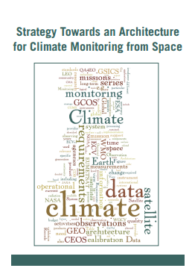
Architecture for Climate Monitoring from Space
Discussion points
Role of GEO in the implementation of the Architecture
Systematic integration of climate datasets of the ECV Inventory into the GEOSS Common Infrastructure

Slide 9
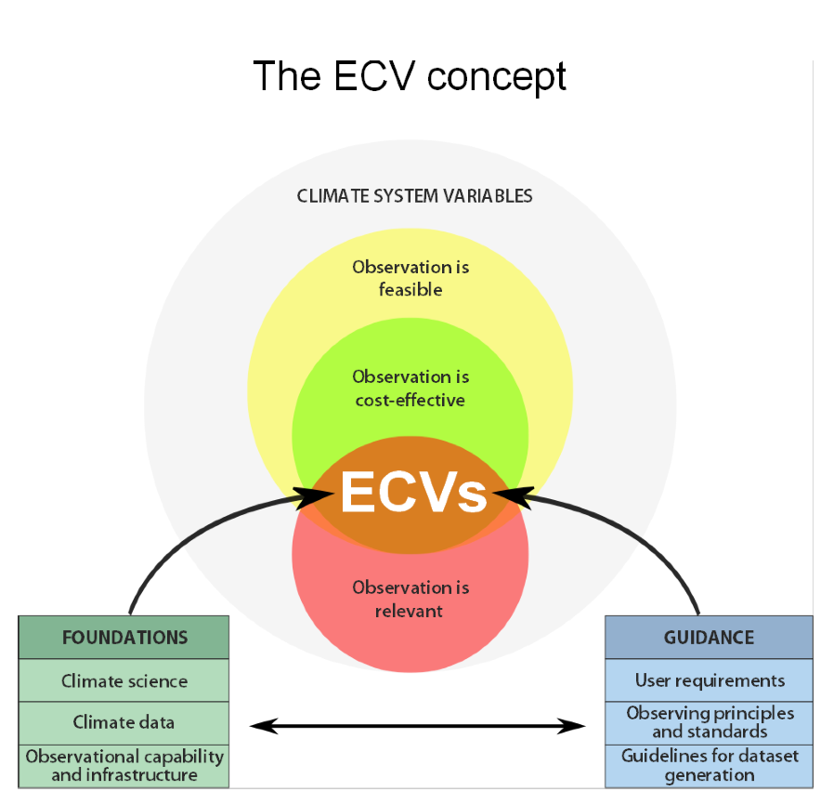
The Global Climate Observing System
“Climate-observing component of GEOSS”
GCOS Statement at GEO-XII Plenary
GCOS values GEO as a convening body and its role in identifying user needs in the revised SBA structure
GEO could benefit terrestrial observations by supporting coordination of data requirements between the various global observing systems and global observation initiatives
GEO can supplement the on-going activities of GCOS, such as facilitating access to climate datasets through GEOSS
Bojinski et al. 2014, BAMS

Slide 10
?

Slide 11
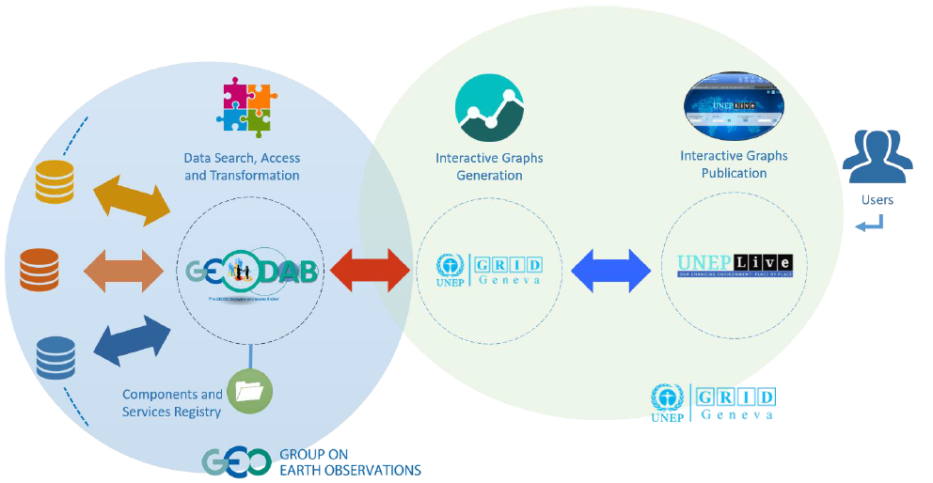
Use Case: UNEP and GEOSS Interoperability
Bridge the gap from data to information to support monitoring environmental status in near-real time
Visualization of various ECV datasets planned (in coordination with GCOS)

Slide 12
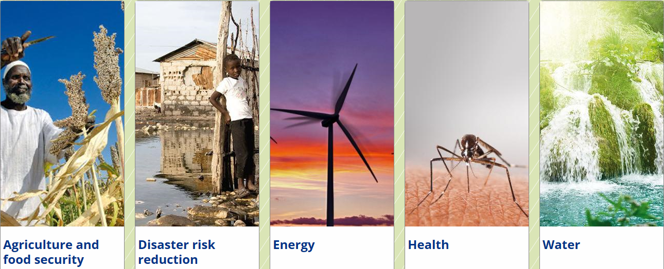
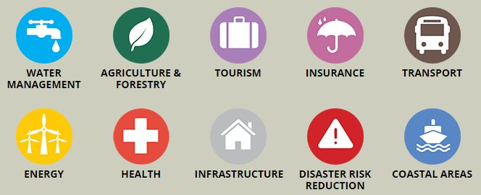
GEO and Climate Services
GEO-GFCS White Paper on interlinkages and synergies to be circulated to GEO Members
GEO participates in the Partner Advisory Committee
Copernicus is the European contribution to GEO
C3S: Climate Data Store → build appropriate interfaces with GEOSS

Slide 13
GEO and the Climate Convention
30. The SBSTA recognises the importance of:
GEO, including its implementation plan for GEOSS;
collaboration between GEO and GCOS; and of
capacity building on systematic observation, inter alia, to enable developing countries to apply climate observations for impact assessment and preparation for adaptation.
The new GEO Strategic Plan 2016-2025 establishes three Strategic Objectives – Advocate, Engage, Deliver – and emphasises climate change and its impacts as a cross-cutting area, and strengthens the societal benefit areas making them more focused on the needs of society to support processes under the UNFCCC, the UN Sendai Framework for Disaster Risk Reduction, the SDGs and other UN agencies

Slide 14
The “Carbon” Flagship: A timely initiative!
Article 7.7
Parties should strengthen their cooperation … including with regard to: …
(c) Strengthening scientific knowledge on climate, including research, systematic observation of the climate system and early warning systems, in a manner that informs climate services and supports decision-making.
Art 14.1
The parties “shall periodically take stock (“global stocktake”) of the implementation of this Agreement to assess the collective progress … It shall do so in a comprehensive and facilitative manner, considering mitigation, adaptation and the means of implementation and support, and in the light of equity and the best available science.
Notes:
Greenhouse Gas Monitoring
MRV is key element for the successful implementation of the Paris Agreement
Existing monitoring system is built upon national inventory reports
Need for development of an improved monitoring system

Slide 15
The “Carbon” Flagship
A timely initiative!
Long term and high precision observations and analysis of GHG cycles in the different domains (atmosphere, ocean, land), considering also anthropogenic emissions, are required (now more than ever) to better:
quantify the GHG sources and sinks
understand the feedbacks with the climate system and
address mitigation and adaptation actions.
Policy needs reliable GHG-related information

Slide 16
Motivation
Insufficient communication/coordination between:
atmosphere, land and ocean communities
in situ and satellite observations
modelers and observers
The GEO C-Flagship:
focus on the interfaces between the different domains/systems (transitional zones)
Atm
Space
Ocean
Land
in situ
obser-vations
models

Slide 17
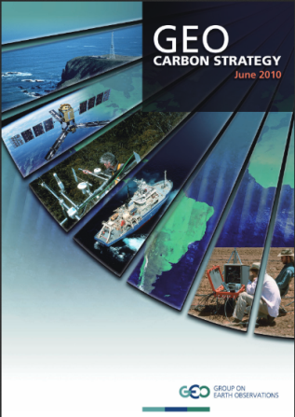
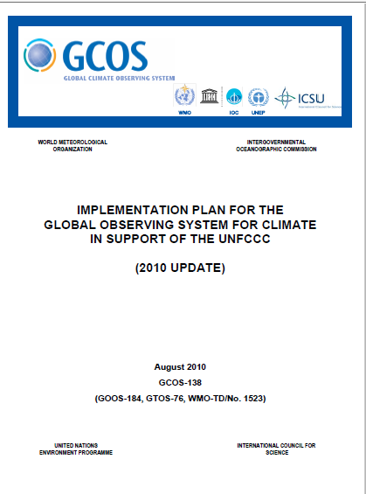
The difference – What the C-Flagship will not be/do
It will not be a self-standing entity in competition with others!
It will neither rewrite new strategies nor duplicate existing efforts.
What the C-Flagship will be/do
The C-Flagship will build on existing initiatives, networks and infrastructures, and integrate them with the missing pieces to obtain a comprehensive globally coordinated GHG observation and analysis system
Notes:
The GEO C-Flagship initiative will provide cross integration among the different pieces of the global system, acting as the coordination of the interfaces (between: atmosphere, ocean and terrestrial domains; space-based, air-borne and in-situ monitoring systems; other initiatives with global relevance inside and outside GEO) and promoting interoperability.
The C-Flagship will establish a common platform to plan joint strategies and implement joint activities

Slide 18
GEO Carbon Cycle and GHG Flagship
2016, the preparatory phase
Development of an Implementation Plan and fund raising
Implementation Plan will be ready for endorsement by the GEO-XIII Plenary
Flagship concept presented at GCOS Science Conference, Amsterdam

Slide 19
Discussion points
GEO´s role in the implementation of the Architecture for Climate Monitoring from Space
Interface between the ECV Inventory and the GEOSS Common Infrastructure
GEO Carbon Flagship in support of CEOS Stragegy for Carbon Observations from Space

Slide 20
Thank you!
aobregon@geosec.org www.earthobservations.org

Slide 21
Additional slides

Slide 22
Strategic Plan
Vison for GEO
- to envision a future wherein decisions and actions for the
benefit of humankind are informed by coordinated,
comprehensive and sustained Earth observations.
GEO’s Mission
- to connect the demand of decision-makers with the supply of
data and information
- to unlock the power of Earth observations
GEO’s Value
Convening Power
- to assemble and coordinate expertise from across different
disciplines and communities

Slide 23
Strategic Plan
GEO’ Strengths
a unique, multidisciplinary initiative that occupies an
upstream coordination position
a flexible and agile forum
a facilitator of policy-level
GEO’s Scope
end-to-end process:
identifying data needs
ensuring the availability of data
transforming the information into knowledge
GEO’s Strategic Objectives
to advocate
to engage
to deliver
ADVOCATE
ENGAGE
DELIVER

Slide 24
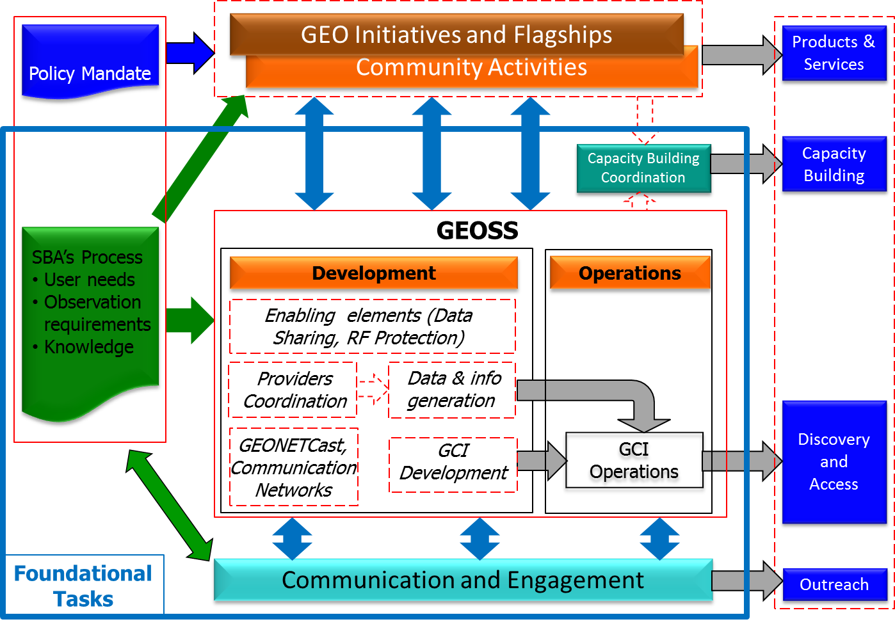
Workflows

Slide 25
Foundational Tasks – Current List
GD | GEOSS Development and GCI Operations
GD-01 | Advancing GEOSS Data Sharing principles
GD-02 | GCI Operations (including access to Knowledge)
GD-03 | Global Observing and Information Systems (new) (includes systems like WIGOS. GCOS; …. And reference datasets)
GD-04 | GEONETCast Development and Operations
GD-05 | GEOSS Satellite Earth Observation Resources (includes advocacy for continuity)
GD-06 | GEOSS in situ Earth Observation Resources (includes inclusion of citizens’ observatories) (includes advocacy for continuity)
GD-07 | GCI Development (includes development of Data Management guidelines)
GD-08 | SBAs processes: Systematic determination of user needs / observational gaps
GD-09 | Knowledge Base development
GD-10 | Radio-frequency protection
GD-11 | Utilization of Communication Networks
CD | Community Development
CD-01 | Capacity Building coordination
CD-02 | Reinforcing engagement at national and regional level
CD-03 | Assess the benefits from EOs and of their socio-economic value
SO | Secretariat Operations
SO-01 | Management and Support
SO-02 | Communication and Engagement
SO-03 | Monitoring and Evaluation
SO-04 | Resources Mobilization

Slide 26
GD-05: GEOSS Satellite Earth Observation Resources (includes advocacy for continuity)
Formalize user requirements and provide space data for specific activities
Contributors: CEOS (through Member Space Agencies and Associates)
Specify, develop, launch, operate and coordinate space missions for GEO requirements analysis
Enhance space data access via the GCI
Support GEO efforts to promote Earth observations
Coordinate increased interoperability among space data infrastructures and develop integrated global and regional space datasets

Slide 27
GEO Initiatives – Current List
GI-01 | GEOGLAM-Global Agricultural Monitoring and Early Warning
GI-02 | GEOBON-Global Biodiversity Observation (GEO BON)
GI-03 | GFOI Global Forest Observation Initiative
GI-04 | Global Observing System for Mercury and Persistent Pollutants
GI-05 | Global Carbon Observation and Analysis System
GI-06 | Reinforcing engagement at regional level: AfriGEOSS for Africa
GI-07 | Ocean and society - Blue Planet
GI-08 | GEO Geohazard Supersites and Natural Laboratories (GSNL)
GI-09 | Global Wildfire Information System
GI-10 | EO data and renewable energies
GI-11 | Information Services for Cold Regions
GI-12 | Integrated Information Systems for Health (Cholera, Heat waves)
GI-13 | Integration of Methods for Air Quality and Health Data, Remote Sensed and In-Situ with Disease Estimate Techniques (new US)
GI-14 | GECO: the GEO Global Ecosystem Initiative
GI-15 | GEO-GNOME Initiative: GEO Global Network for Observation and information in Mountain Environments
GI-16 | GEO-DARMA = Data Access for Risk Management (new-CEOS)
GI-17a | Global Urban Observation and Information
GI-17b | Global Human Settlement indicators for post-2015 international frameworks
GI-18 | GEO and SDGs. EOs role in providing support to countries in achieving SDGs and in defining and monitoring the associated indicators.
GI-19 | AmeriGEOSS (new)
GI-20 | GEO Global Water Security (GEOGLOWS) new-US

Slide 28
Key outcomes:
Growing demand and expectations
Need for more levels of classification and types of input data sources
New technologies and approaches
Land Cover Portal
Disparate user needs
→ Workshop on 23-24 May at Geospatial World Forum, Rotterdam: “Strategy for Harmonised Land Cover Classifications: Towards a sustainable operational system”
Notes:
Use of LC information in legally binding situations (e.g. reporting) requires high accuracy, accountability, transparency and reliability
multi-level classification legends, data fusion, integration of socio-economic data, more sources of remote sensing data
Data cube, separation of preprocessing and classification, single-class approach, fusing local and regional maps into global datasets
Increased access to land cover datasets and services
Disparate needs, no single map fits all purposes, need for more dialogue

Slide 29
Land degradation
15.3 By 2030, combat desertification, restore degraded land and soil, including land affected by desertification, drought and floods, and strive to achieve a land degradation-neutral world
GEO/GEOSS referenced in UNCCD COP-12 document (Oct 2015, Ankara)
Land Degradation Neutrality Project (‘LDN Project’) started in 2015
Expert meeting on land-based indicators for SDGs and Rio Conventions, 25-26 February 2016, Washington
Proposed indicators:
Land cover
Land productivity
Soil organic carbon

