Slide 1
Copernicus Climate Change Service
Jean-Noël Thépaut
Dick Dee

Slide 2
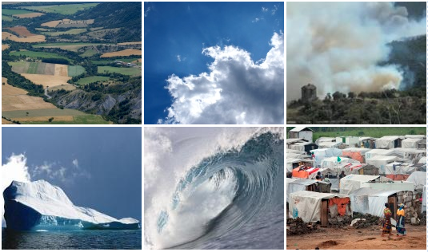

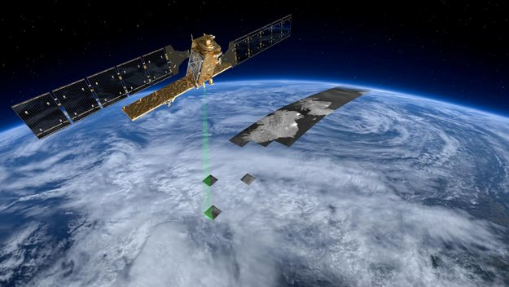
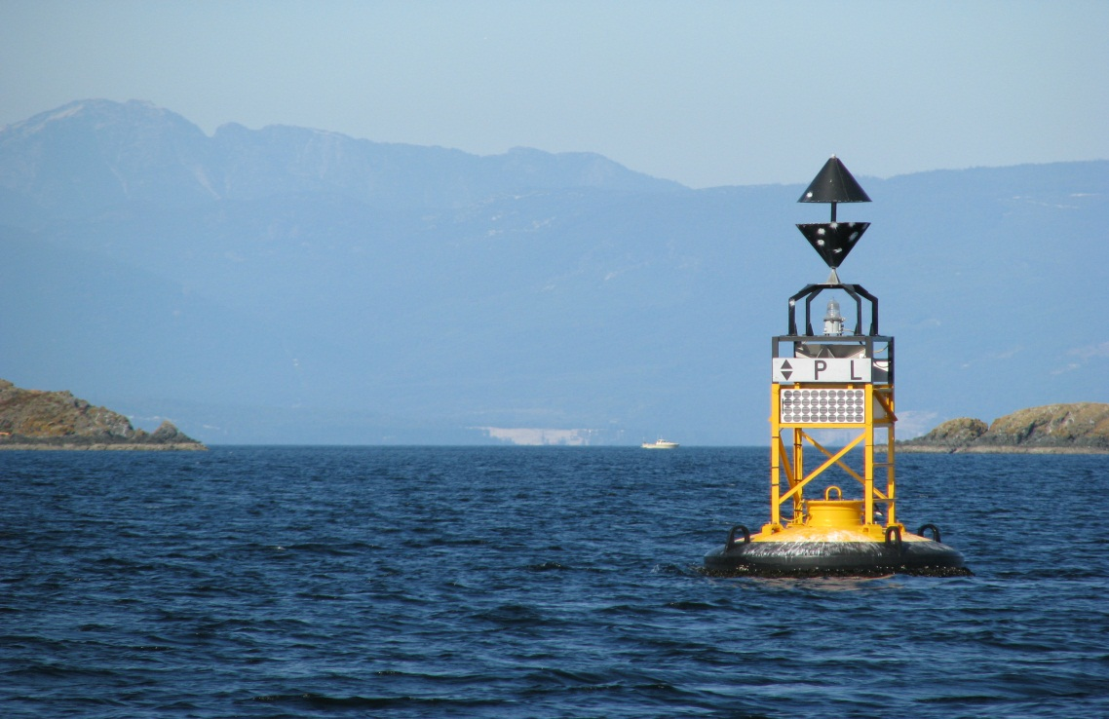


What is Copernicus?
Copernicus, previously known as GMES (Global Monitoring for Environment and Security), is the European Programme for the establishment of a European capacity for Earth Observation
Users
Service Components
copernicus.eu
Space Component
In-situ Component
Source: copernicus.eu, retrieved April 2014

Slide 3






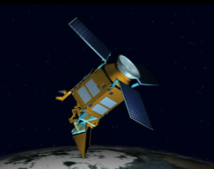
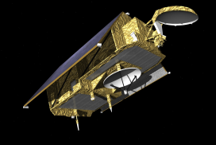

Space Component: Sentinel Missions
Sentinel-1 (A/B) – SAR imaging
All weather, day/night applications, interferometry
Sentinel-2 (A/B) – Multi-spectral imaging
Land applications: urban, forest, agriculture,…
Continuity of Landsat, SPOT
Sentinel-3 (A/B) – Ocean and global land monitoring
Wide-swath ocean color, vegetation, sea/land
surface temperature, altimetry
Sentinel-4 (A/B) – Geostationary atmospheric
Atmospheric composition monitoring, trans-
boundary pollution
Sentinel-5 precursor/ Sentinel-5 (A/B) – Low-orbit
atmospheric
Atmospheric composition monitoring
Jason-CS (A/B) – Low inclination Altimetry
Sea-level, wave height and marine wind speed
Source: ESA

Slide 4
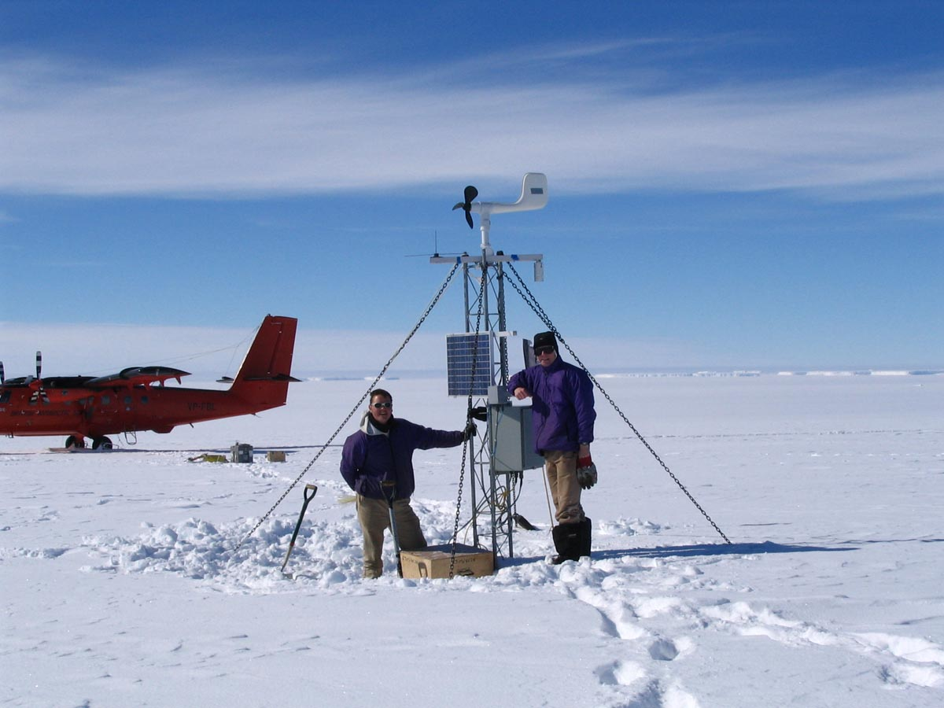

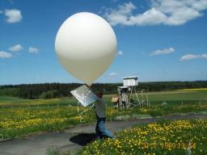
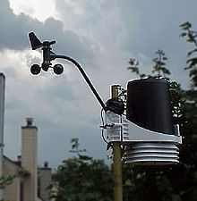
Contributing missions and In-situ Component
Copernicus services rely on data from in situ monitoring networks (maps, ground based weather stations, ocean buoys and air quality monitoring networks) to provide robust integrated information and to calibrate and validate the data from satellites.
Copernicus services rely on data from many other missions. The Copernicus Climate Change Service (C3S) benefits from historical datasets from space and in situ
Source: copernicus.eu, retrieved April 2014; Pictures: commons.wikimedia.org

Slide 5
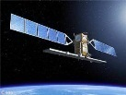
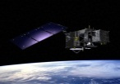
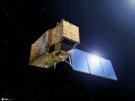

Copernicus Service Component
Services Component
Atmosphere
Emergency Management
Land
Marine
Climate Change
Security
Services Component
Source: ESA

Slide 6

C3S vision
C3S vision
To be an authoritative source of climate information for Europe
To build upon national investments and complement national climate service providers
To support the market for climate services in Europe

Slide 7
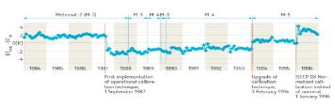
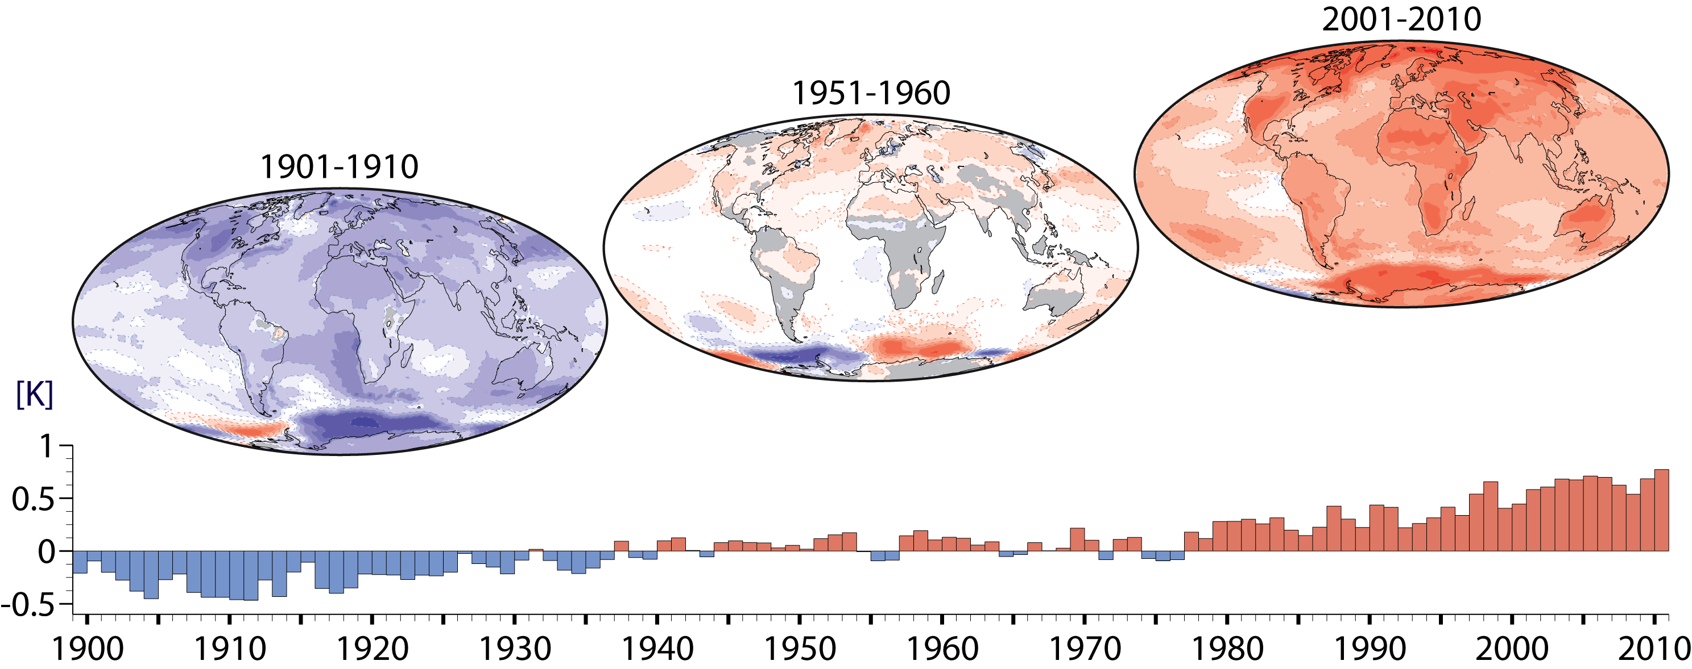
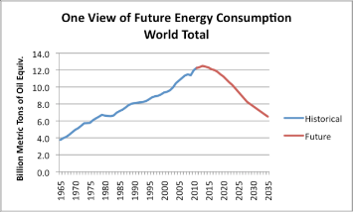
C3S vision
The basic questions:
How is the climate changing?
    Earth observations
    Reanalyses
How will climate change in future?
    Predictions
    Projections
How will it impact society?
    Climate indicators
    Sectoral information

Slide 8

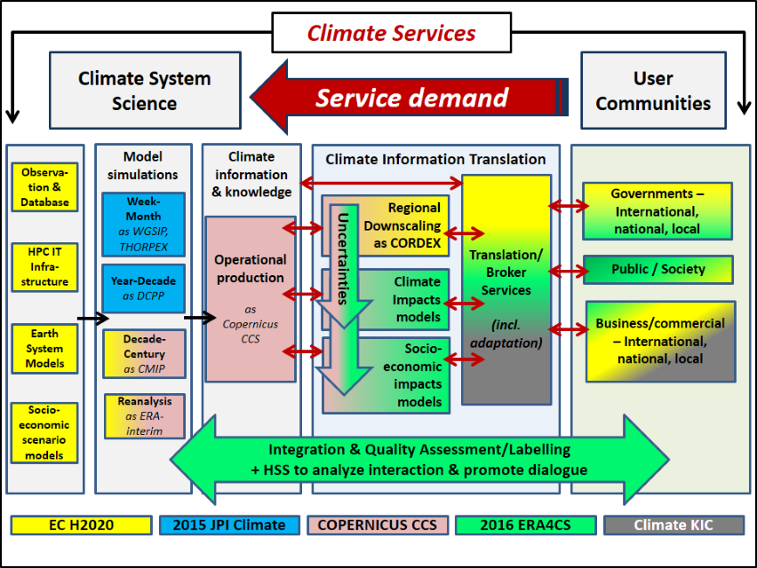
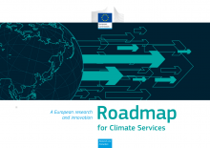
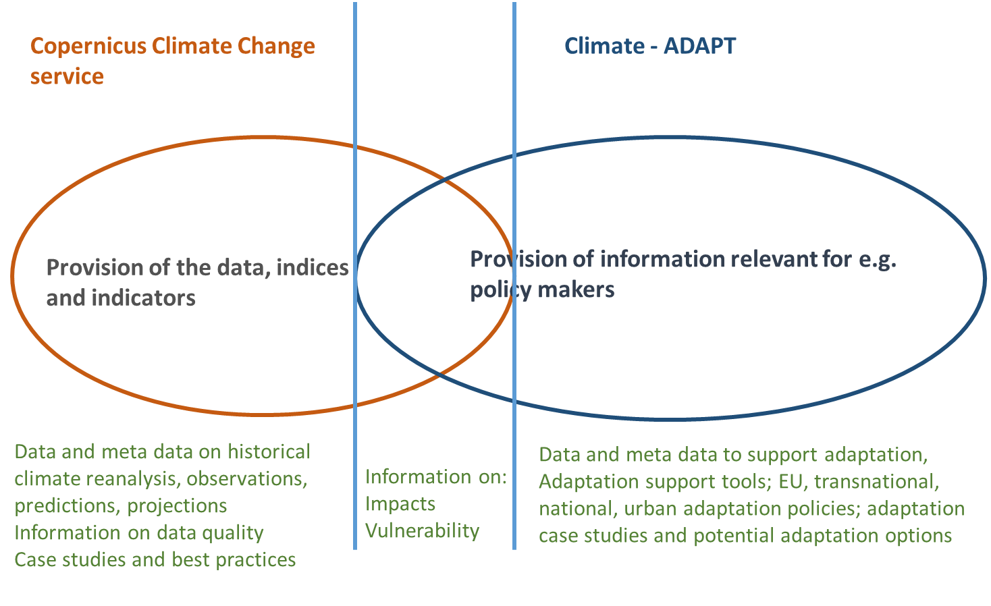
Copernicus Climate Change Service
Role of C3S in European Climate Services landscape
Background document
… work in progress …
Credit: P. Monfray, JPI Climate
André Jol, EEA

Slide 9
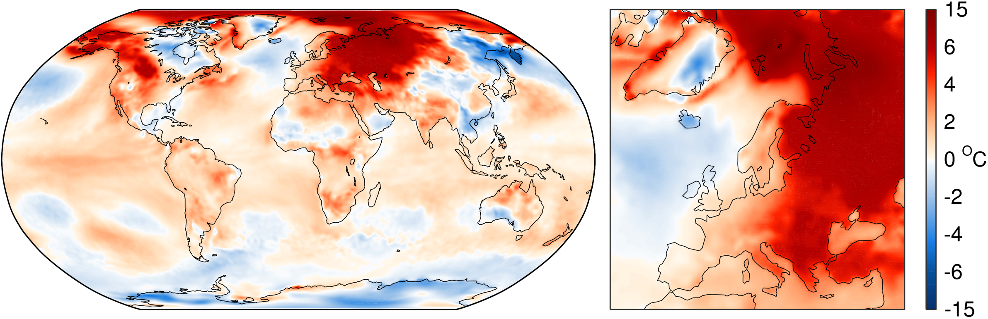
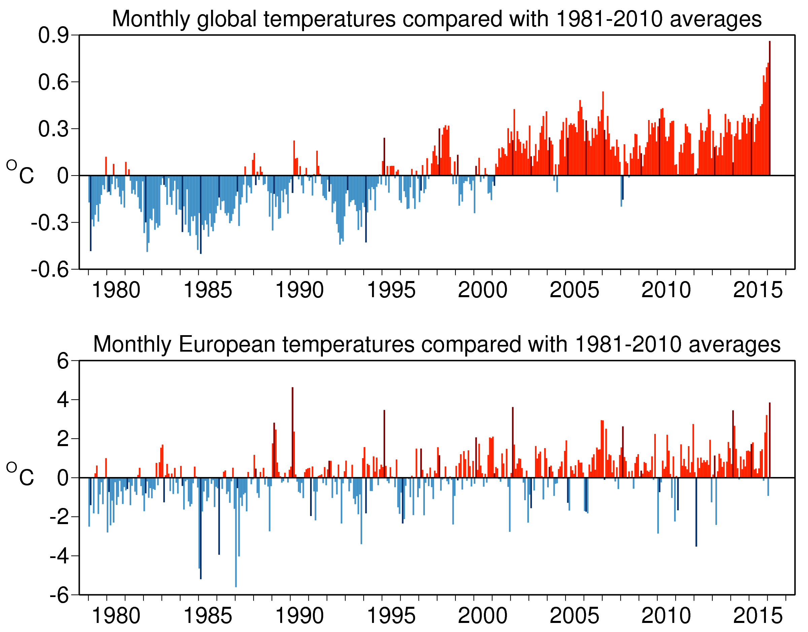
Climate monitoring
Copernicus Climate Change Service
Demonstrator of a European Climate Service of Reference
Combining
models and
observations
+ ~0.8ºC
The 16 warmest years on record: 1998 and 2001-2015
the latest 12-month mean exceeds 0.5K
To be issued on 8 March 2016

Slide 10

C3S components
Climate
Data Store
Sectoral
Information
System
Evaluation and
Quality Control
Outreach and Dissemination
  ECVs past, present and future
  Observed, reanalysed and simulated
  Derived climate indicators
  Tools to support adaptation and mitigation at global and European level
Monitors quality of C3S products and services
Ensures C3S delivers state-of-the-art climate information to end-users
Identifies gaps in service provision
Bridges Copernicus with the research agenda in Europe (e.g. H2020, national research projects)
Web content
Public outreach
Coordination with national outreach
Liaison with public authorities
Conferences, seminars
Training and education

Slide 11
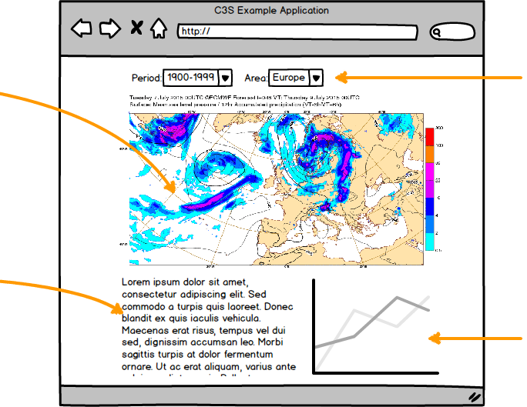
Climate Data Store
Technical challenges:
Diversity of users
Diversity of data sets
Very large data volumes
Data residing at different locations
Interoperability, efficiency
User-defined workflows
Variety of presentation methods
Need for interactivity
Access via API
User management
Performance monitoring
maps
controls
text
graphs

Slide 12
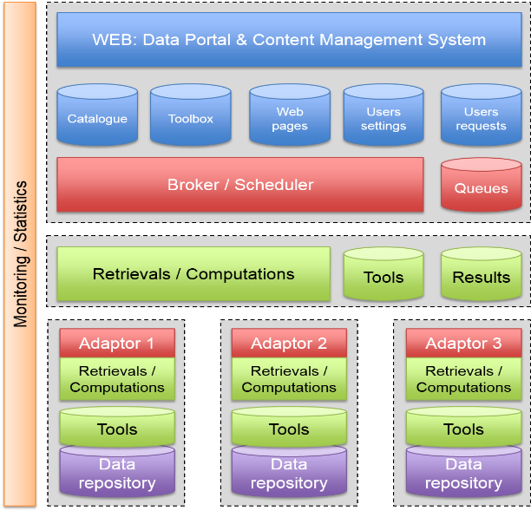
Climate Data Store
Development of CDS software infrastructure
2016 Q1: Start of contract
2016 Q3: Initial release of working prototype for limited testing
2017 Q1: First functional release exposed to a large user group, then quarterly releases with added functionality
2018 Q1: Final release
Development of CDS toolbox
2016 Q2: Start of contract

Slide 13
Climate Data Store
Scientific basis:
Essential Climate Variables as defined by GCOS
GCOS Status Report (GCOS-195)
IPCC, CMIP
Observations
Global estimates of ECVs from satellite and in-situ observations
Reprocessed CDRs, reference observations
Climate reanalysis
Global atmosphere, ocean, land
Regional reanalysis for Europe
Model output
Multi-model seasonal forecast products
Access to CMIP data and products
Support for data rescue, climate data collections
Coupled climate reanalysis for 100 years
Reference set of climate projections for Europe
Climate Indicators

Slide 14
Climate Data Store

Slide 15
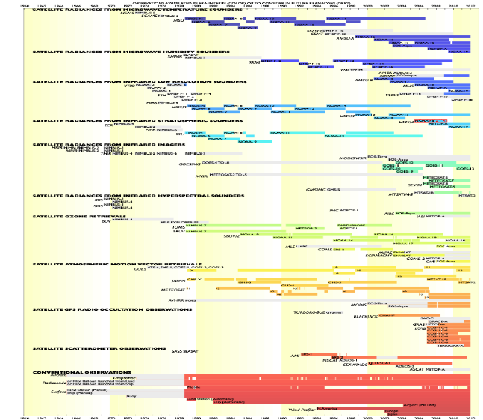
Climate Data Store
Global reanalysis:
ERA5 is now in production
32km global resolution
Uncertainty estimates
Improved use of observations
Newly reprocessed satellite data
Hourly data from 1979-NRT
Access to all input observations
Regional reanalysis:
European domain
Higher spatial resolution
Workshop planned for 2016 Q2
Competitive call by 2016 Q4

Slide 16
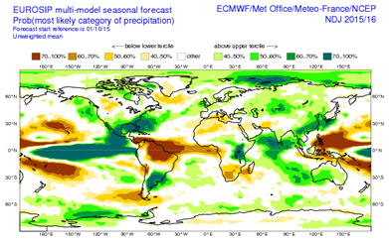
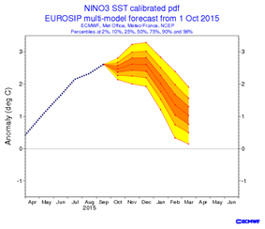
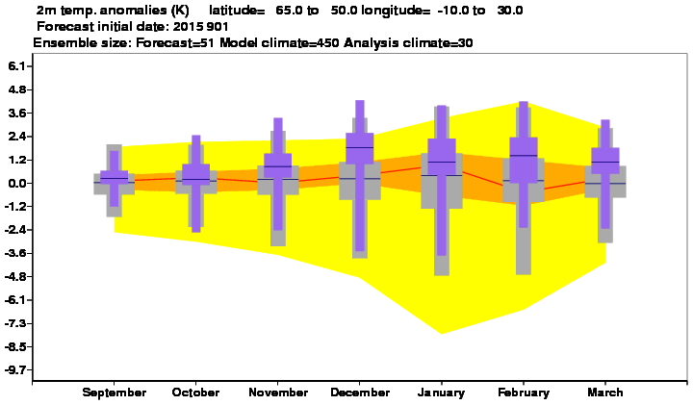
Copernicus Climate Change Service
C3S seasonal forecasts
Aim: to generate multi-model seasonal forecast products based on the best information available, to an operational schedule, and make them publicly available.
Components of the seasonal service:
Forecast data: a list of atmosphere (and ocean) variables, on 1x1 degree grid, at daily or sub-daily resolution, from 6-month forecasts
Graphical products (e.g. time series for indices, maps, climagrams)
Processed data (e.g. indices, probabilities, inputs for SIS)
First set of products will be available starting Q2 2016
Northern Europe; from September 2015

Slide 17










Sectoral Information System
Copernicus Climate Change Service
Proof of concept development of sectoral applications
Copernicus Climate Change Service

Slide 18

WATER: SWICCA
Water manager
Purveyor
Data Provider (C3S)
C3S
http://swicca.eu

Slide 19

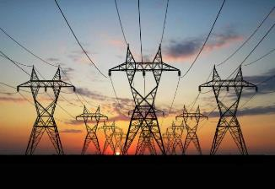
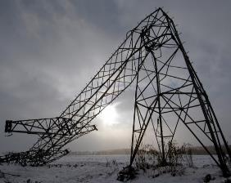
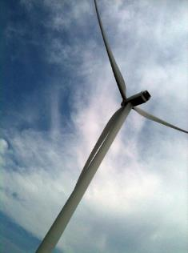
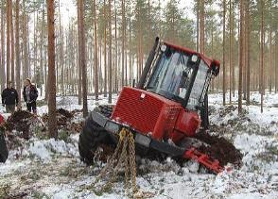
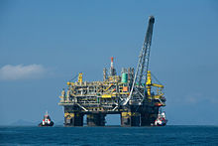
ENERGY: CLIM4ENERGY
Managing increasing sensitivity of supply-demand balance
to weather and climate variability
Evaluating risk changes
Evaluating renewable resources for investment
Evaluating changes in operating conditions
Accounting for sea-level rise

Slide 20
Timeline
Stage 0/1 - Proof of Concept/Pre-operational
Stage II - Operational ~20 ECVs, ~5-6 Sectors
Stage III - Operational ~30 ECVs, ~8-10 Sectors
PoC + Pre-operational Phase
2013
2014
2015
2016
2017
2018
2019
2020
2021
Stage 0
Stage I
Stage II
Stage III
Operational Phase

Slide 21
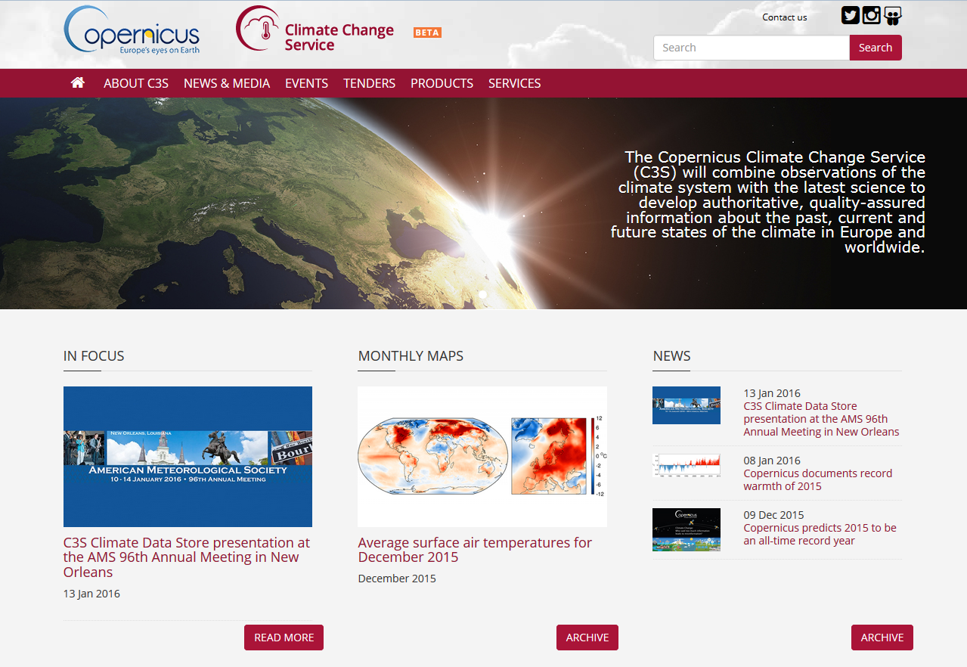
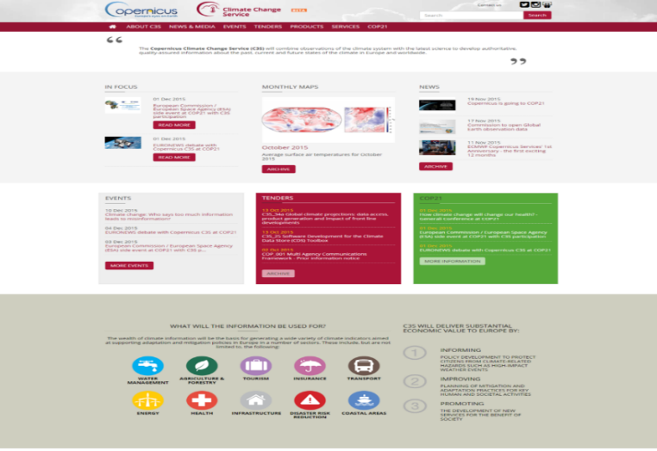
Copernicus Climate Change Service
climate.copernicus.eu
21

