Slide 1
NOAA CDR Program Overview
Sustained Production & User Engagement
W. Jesse Glance, Jr. Former Program Manager
Presented by John Bates
Center for Weather and Climate
NOAA’s National Centers for Environmental Information
National Centers for Environmental Information | Center for Weather and Climate

Slide 2
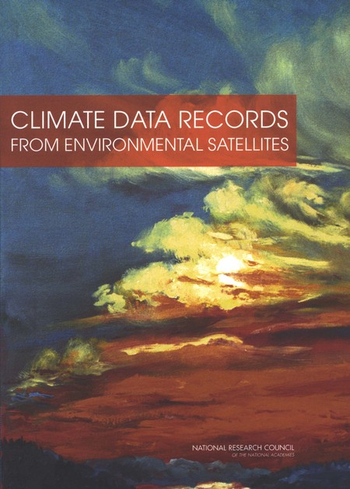
From Conception …
National Research Council (NRC) of National Academy of Sciences (NAS) (2004)
Office of Science and Technology (OSTP), NOAA/NESDIS guidance
Scientific Data Stewardship (SDS) Program (2007 & 2008)
The American Recovery and Reinvestment Act of 2009 (ARRA)
FY 2009 First NOAA CDR Grant Opportunity (FFO)
FY 2010 “CDR” Established as a NOAA/NESDIS Budget Line
FY 2011 Second NOAA CDR Grant Opportunity (FFO)
Requisite Competence
Notes:
NOAA’s CDR Program began in 2009 at the National Climatic Data Center (NCDC)
CDRs based on best science, and the most mature algorithms.
Focused on Essential Climate Variables (ECVs), with initial priority on critical CDRs identified by international experts.
Competitive awards to capture leading knowledge from across the research community (US agencies, universities, private companies).
Coordinated with NASA, USGS, and international partners.

Slide 3
… to Recognized Success!
U.S. Department of Commerce
2014 Gold Medal Award
CITATION:
For creation and operational
implementation of a new, extensible
community standard for the production and preservation of climate data records.
2014
Sustained production of multidecadal climate records - Lessons from the NOAA Climate Data Record Program, John J. Bates, Jeffrey L. Privette, Edward J. Kearns, Walter Glance, and Xuepeng Zhao
Bulletin of the American Meteorological Society 2015 ; e-View
doi: http://dx.doi.org/10.1175/BAMS-D-15-00015.1

Slide 4
CDR R2O Transition Status
PI R2O “work-in progress”, from Grant Competition
20+ more individual CDRs in the work “Pipeline”
Sustainment cost also limits operational CDR carrying capacity
30
Cumulative Operational CDRs
Aug 2015
Notes:
CDRs in development (blue line) are CDR PI development” bundles”, where Cumulative counts each individual CDR. As an example, one CDR bundle may have one CDR, while another unique CDR bundle may have several CDRs.
Early “bow wave” of CDRs bundles from competitive grants program
Sustainment costs will determine operational CDR carrying capacity
Still 20+ more individual CDRs possible and “in the pipeline”

Slide 5
CDR Program is Maturing
Program Evolution
Stage 1
2
Stage 3
NCDC’s
SDS
Program
Outputs
2009 ‘10 ‘11 ‘12 ‘13 ‘14 ’15 …
X
Annual Meetings

Slide 6
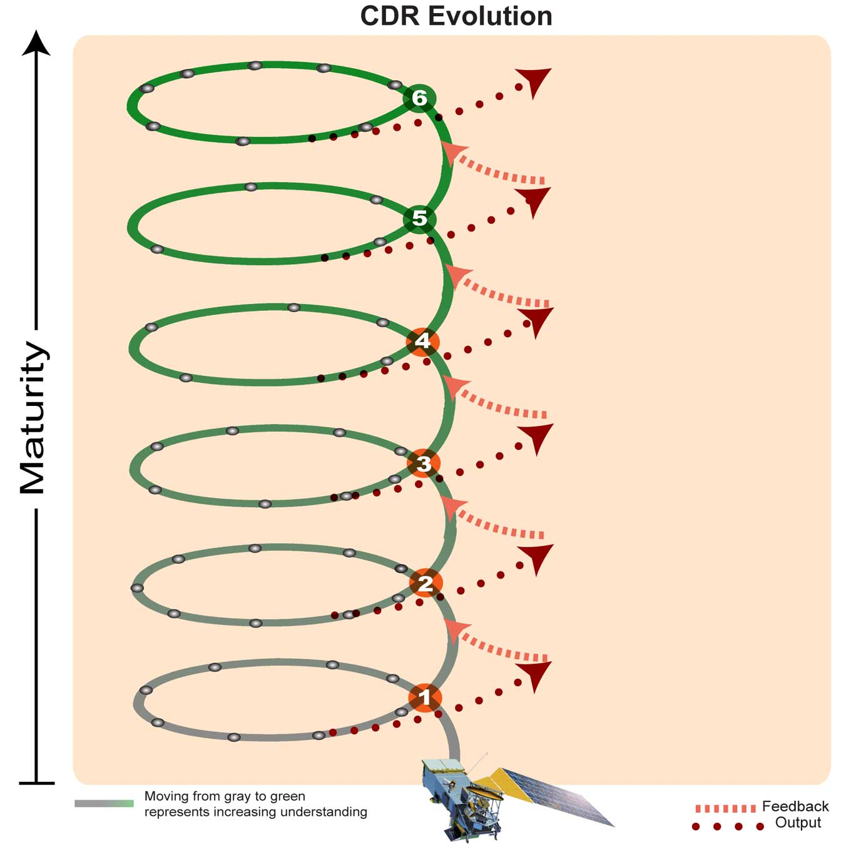
NOAA CDR Operational Spiral Development
6 – Benchmark CDR
5 – Full Operational CDR
Operations
4 – Sustained CDR
3 – Initial Operational CDR
2 – Research CDR
Research
1 - Conceptual CDR
Notes:
This diagram is based on one that has circulated through NCDC/NCEI for many years. In this version the maturity levels have been aligned to the CDR Maturity Matrix V 4.0 and Requirements for the FOC State [CDRP-REQ-0559], where the latter formally specifies the maturity levels for both IOC and FOC. The minimum standard of Maturity Level 3 at IOC is also specified in the ORR checklist [CDRP-FORM-0178].
The text labels for Levels 1, 2, 4, and 6 are not specified elsewhere, so this diagram is the only place their association is made.
The Spiral Model was developed and published by Barry Boehm in 1986, with subsequent improvements. The 1988 version is available at http://csse.usc.edu/csse/TECHRPTS/1988/usccse88-500/usccse88-500.pdf, while an improved version is available at http://www.sei.cmu.edu/reports/00sr008.pdf. References to these papers are at https://en.wikipedia.org/wiki/Spiral_model
As defined by Dr. Boehm the model has considerable detail in each iteration.

Slide 7
NOAA CDR Program (CDRP) – Stage 1
Annual Meetings #1-3
CDRP began in 2009 as an outgrowth of the National Climatic Data Center (NCDC) Science Data Stewardship (SDS) Program.
Focus: Essential Climate Variables (ECVs); “critical” CDRs identified by international experts were top priority.
R2O awards based on best science and most mature algorithms.
Grant competition captured leading knowledge from the research community. (U.S. agencies, universities, private companies)
CDRP coordinated with NASA, USGS, and international partners.
Notes:
2. Water and Energy Cycle-related CDRs were given priority.
R2O: “Research to Operations” transition.

Slide 8
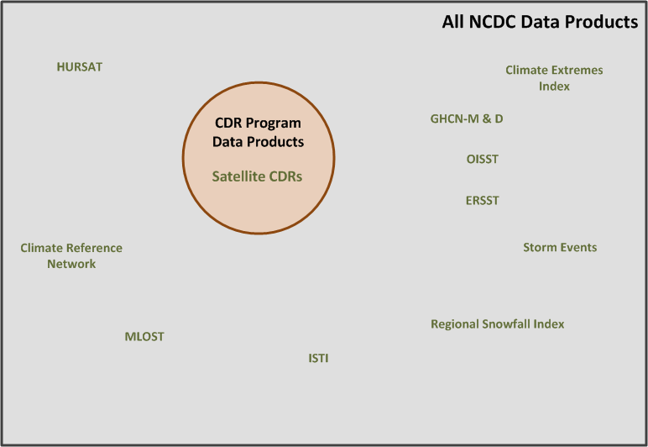
Stage 1 Product Scope: 2009 - 2011

Slide 9
NOAA CDR Program – Stage 2
Annual Meeting #4
CDRP in 2013 Expanded its Target Users to Include non-climate research Applications & Users.
Priority moved to “best use” regardless of Societal Benefit Area (SBA).
Began interactions with industry and public to identify needs and prioritize CDRs capable of meeting them.
Formalized R2O processes, cost-estimating, policies, and procedures for transition activities and information preservation.
Began CDR O&M using NOAA Contracts & IAAs with other agencies, universities, and private industry with provisions for deliverables, configuration mgmt., and quality assurance, and user/usage statistics.
Notes:
R2O: “Research to Operations” transition.

Slide 10
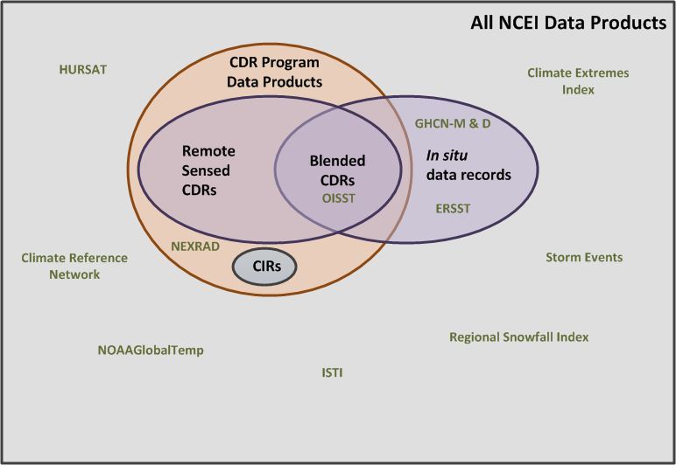
Stage 2 Product Scope: 2012 –2015

Slide 11
NOAA CDR Program – Beginning Stage 3
2015 Annual Meeting
CDRP in 2015 is focused on: Sustaining NOAA’s Operational CDRs and Users Requiring trusted environmental information products. (e.g. informed decision making, management, and climate applications including science)
Incorporating in-situ and blended products into the CDR portfolio to preserve those products for the future in addition to the satellite data products.
Developing Climate Information Products that target User needs and requirements.
Supporting decision-makers with lower-latency “Preliminary” or ICDRs that employ the most mature algorithms, but are not yet CDRs.
Accelerating high-demand, less scientifically maturity products, e.g. NEXRAD weather radar reprocessing for hi-res precipitation CDRs/CIRs requested by Users.

Slide 12
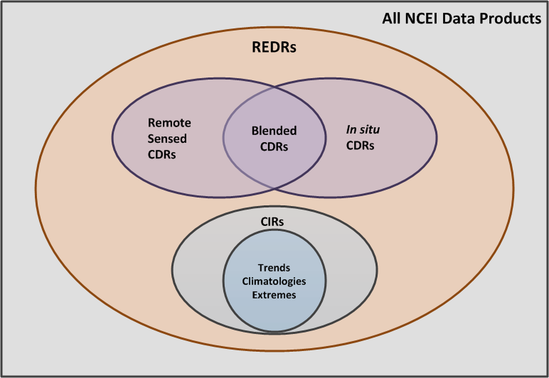
Stage 3 Product Scope: 2016 +
Reference Environmental Data Records (REDRs)
Non-REDRs
Non-REDRs
Non-REDRs

Slide 13
Near-Term Major Activities
O&M (Sustainment) for CDRs that Evidence Continued User Demand
End-User Application Projects that Verify CDRs alone, or in combination with other Products, Can Meet Specified User Needs (may precede R2O)
Complete the R2O Transitions Backlog
Transition Period of Record Extensions to CDRs Using New Sensor Data (from SNPP/JPSS, NASA-GPM, METOP, etc.)
With NOAA/NESDIS/OSGS and other Partner assistance, determine best path for attaining a CDR re-processing capability

Slide 14
CDR Program’s Vision - 2016 & Beyond
Meet End-User Needs for Environmental Information by:
Making vital contributions to an emerging market for a new class of environmental information products.
REDRs leveraging CDRP and Partner best practices, experiences and lessons learned.
Acknowledging some Users require lower-latency products and are willing to sacrifice accuracy to obtain decreased latency (i.e. ICDRs and products derived from or blended with them).
Addressing User needs across multiple Societal Benefit Areas (SBAs), including global climate change research.

Slide 15
REDRs: Able to Meet Any Higher-Latency Application / Requirement
REDRs
CDRs – Long Term Decision Support; Research Support (Epoch reprocessing of complete period of record, Complete, State-of-the-art)
Data Accuracy
(Quality for Climate Applications)
Interim CDRs -- Medium Term Decision Support
(Routine, Complete, Timely, Climate processing, Consistent in time/space/resolution over period-of-record)
EDRs
Operational Weather (Quick, Robust, Data as-available, Algorithm as-is, Sensor-unique)
Minutes
Days Weeks
Years
Decades
Data Latency

Slide 16
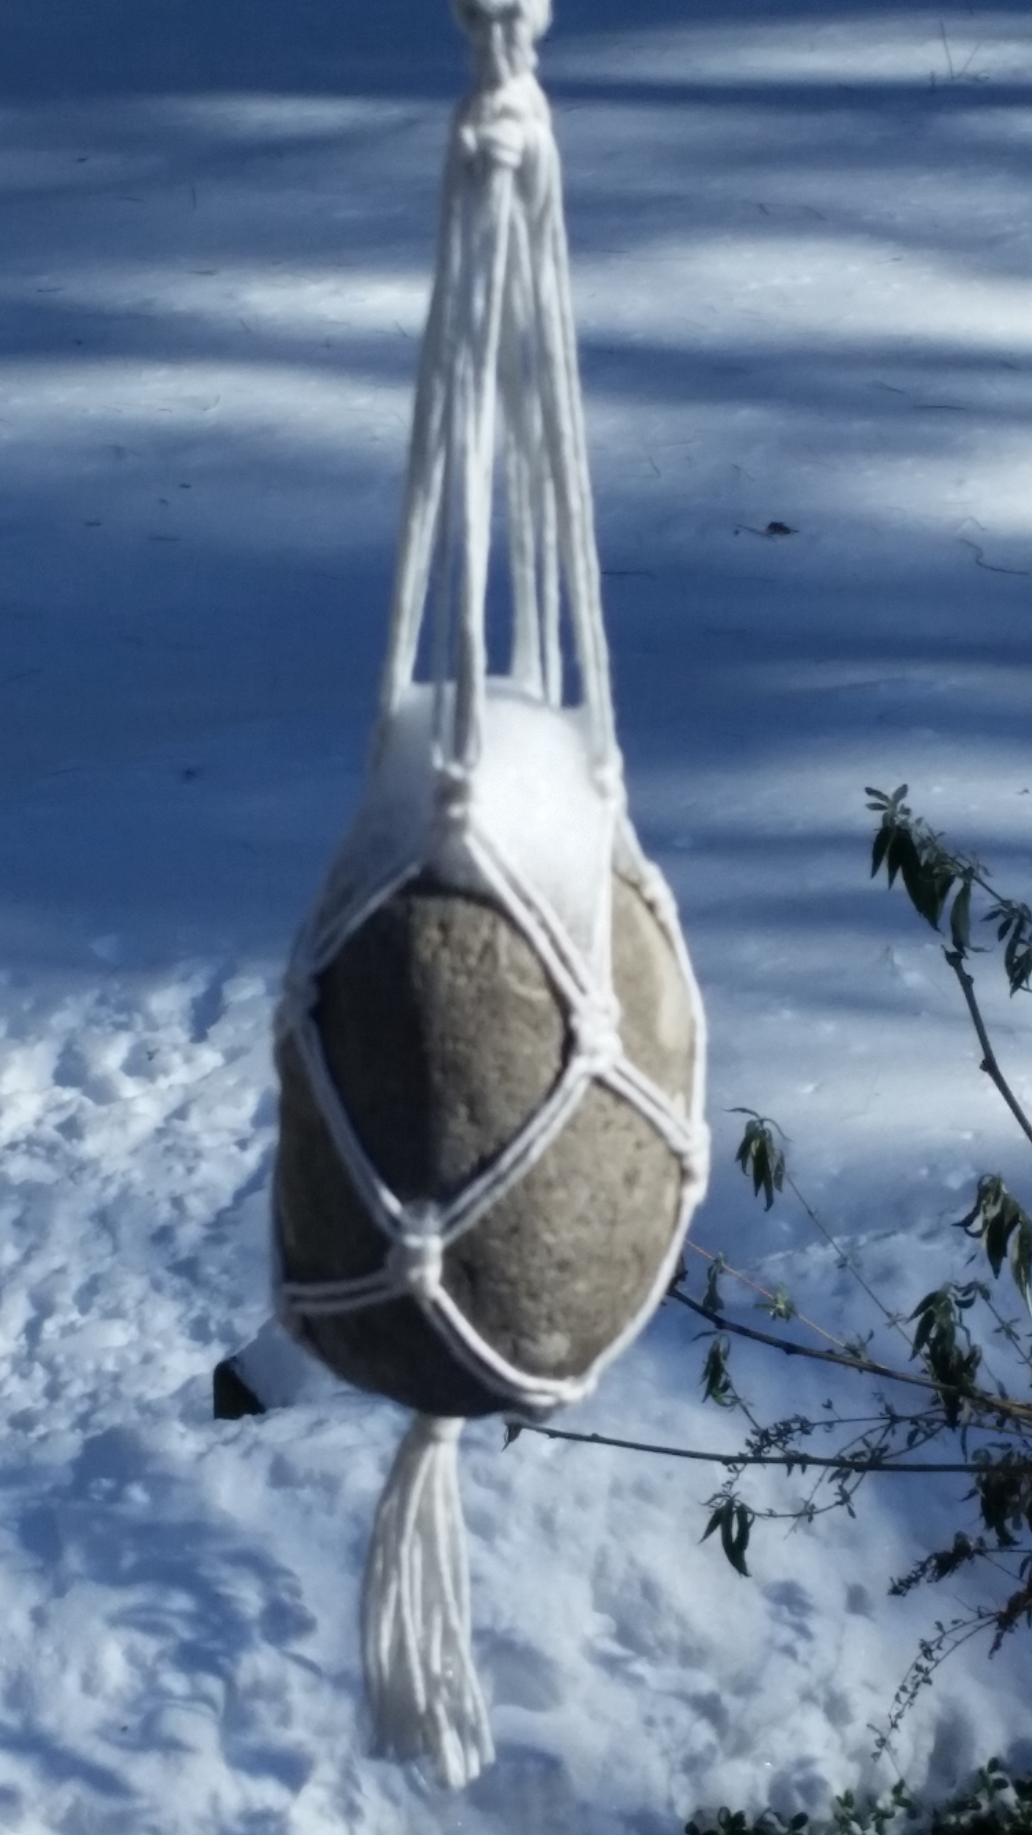
Questions?

Slide 17
Backup Slides

Slide 18
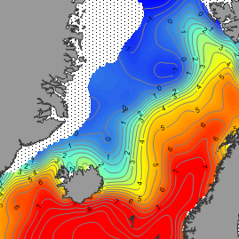
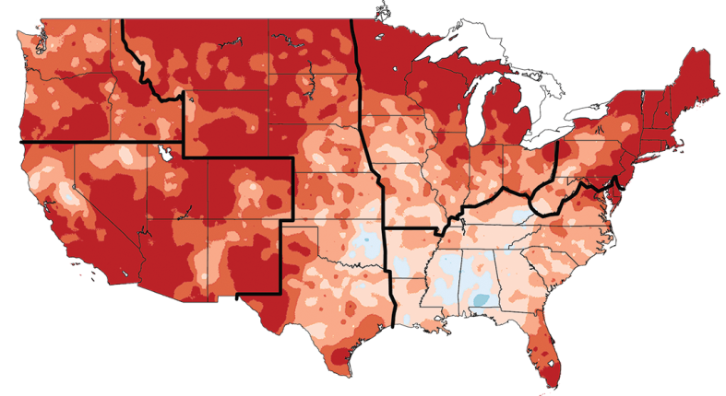
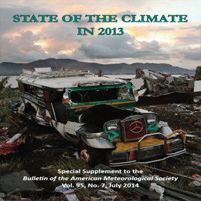
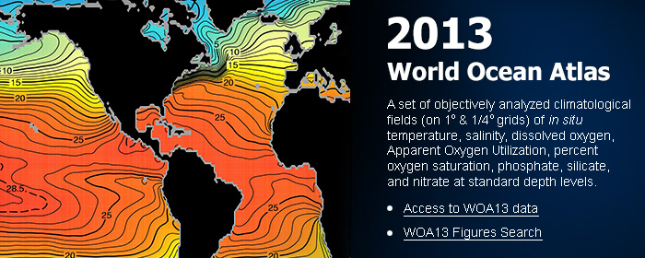
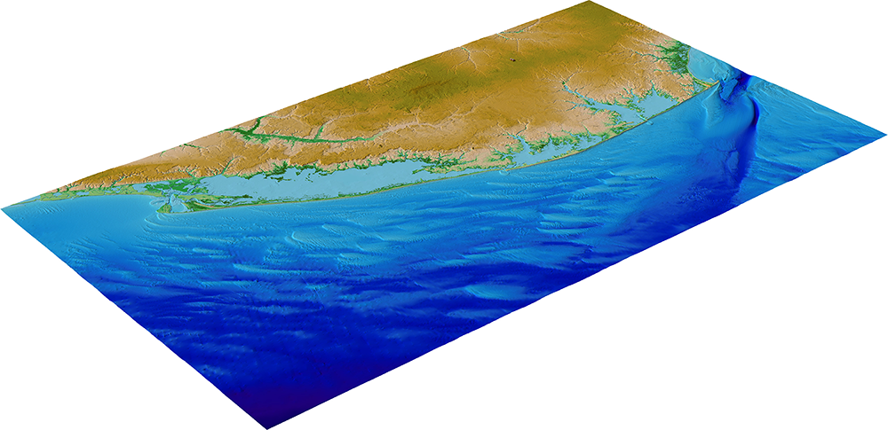
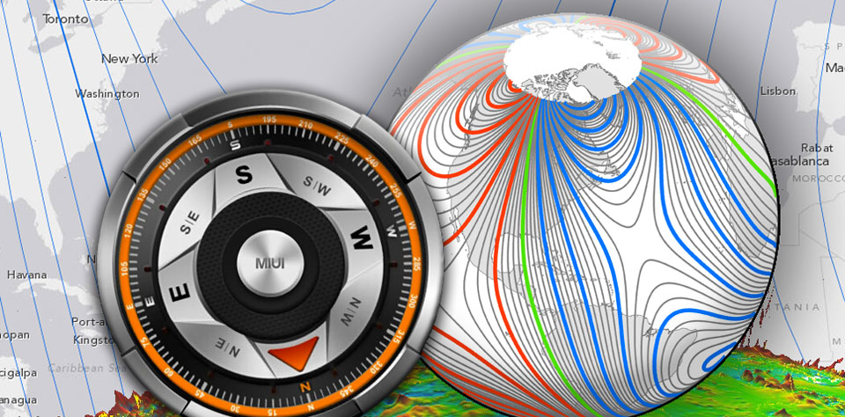
Examples of “Gold” standard NCEI Products (Data Set Maturity Matrix Model Level 6)
Climatological Atlas of the Nordic Seas and Northern North Atlantic
World Ocean Atlas 2013
National Climate Assessment
BAMS State of the Climate in 2013
Explaining Extreme Events of 2013 from a Climate Perspective
Extended Continental Shelf (ECS) Project
Post-Sandy Digital Elevation Model
World Magnetic Model for 2015-2020

Slide 19
How do we Develop & Maintain “Gold Standard” Reference Datasets?
Apply a maturity model similar to engineering readiness levels - a practical approach
Goes beyond measurements of quality to usability, transparency, and understanding
Assess products using a “Maturity Matrix” covering seven aspects of data maturity
Level | Data Use | Code Stability | Metadata & QA | Documentation | Validation | Public Release | Science & Applications
6 | Unified and coherent record; considered scientifically irrefutable following extensive scrutiny | Homogeneous and published error budget | Provenance tracking and reproducibility; meets international standards | Peer-reviewed product algorithm, validation, processing and metadata | Validated independent cross-checks, open inspection, and continuous interrogation | Publicly available from long-term archives | Used in various published applications and assessments
5 | Unified and coherent record | Stable and reproducible | See below | See below | See below | Source code portable and released; uncertainty estimate | See below
4 | Research and Operations | See above | Provenance tracking and reproducibility; meets international standards | Draft Operational Algorithm Description | See below | Source code released; Data available but of unknown accuracy | See below
3 | Research | Minimal changes expected | See below | Peer-reviewed algorithm and product descriptions | Uncertainty estimated over widely distribute times/location; differences understood | See below | Provisionally used in applications and assessments demonstrating positive value
2 | Research | Some changes expected | Research grade (extensive) | CTD | Uncertainty estimated for select locations/time | Data available but of unknown accuracy | Limited or ongoing
1 | Research | Significant changes likely | Incomplete | Draft concept of Theory Document (CTD) | Minimal | Limited data availability | Little or none
Primarily Operations
INCREASING REQUIREMENTS
Primarily Development
Adapted from AGU EOS 2012 Bates and Privette
Notes:
Adapted from Bates and Privette, AGU EOS, 2012.
The CDR Maturity Matrix is a measuring tool that CDRP uses to assess a CDR’s readiness for R2O (Research to Operations) transition [Levels 1-3] and level of operational state [Levels 4-6].
ATBD (Algorithm Theoretical Based Documents)

Slide 20
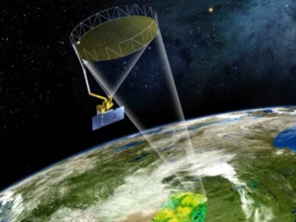
NCEI Supports the Full Information Lifecycle
Makes foundational investments in environmental information production and preservation
Supports others’ application development and policy/decision-making
Data Generating Systems
- Observing
- Models
Environmental Record Creation and Preservation
Data Access to Applications
Understanding Decision- maker Needs
Earth Environment
Observations
Records
Reports
Decisions
Shading represents levels of effort

Slide 21
User Needs Met are Society’s Benefit
One must first Understand the End-User’s Needs!

Slide 22
Agricultural Stakeholder Temporal Outlook
Days
Months
Years
<1 10 20 1 3 6 9 1 3 5 10 50 100<
Farmer
Consumer
Aid Agency
Commodities Trader
(Re-)Insurance Companies
Regulatory Agency
Crop Breeder
Elected Official
Biofuel or Processing Plant Construction
Reservoir Construction
Emissions Policymaker
Disaster Relief
Development Aid
Futures

Slide 23
Accuracy vs. Latency CDRs Have Higher Latency, but are Better for Long-Range Decisions than Low Latency Operational Weather Data Products
Increased Additional Uses
CDRs – Long Term Decision Support; Research Support (Epoch reprocessing of complete period of record, Complete, State-of-the-art)
Data Accuracy
(Quality for Climate Applications)
Interim CDRs -- Medium Term Decision Support
(Routine, Complete, Timely, Climate processing, Consistent in time/space/resolution over period-of-record)
EDRs
Operational Weather (Quick, Robust, Data as-available, Algorithm as-is, Sensor-unique)
Minutes
Days Weeks
Years
Decades
Data Latency

Slide 24
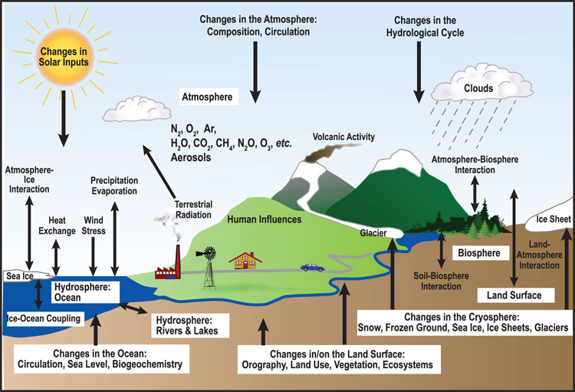
NOAA CDR Environmental Variable Coverage
(with Principle Investigator’s Names Highlighted near their Area of Contribution)
Ho
Menzel
Ferraro
Kato
Luo
Zou
Nelson
Heidinger
Rosenlof
Long
Xie
Minnis
Pilewski
Rossow
Kumerrow
Zhao
Flynn
Wentz
Clayson
Stone
Lee
Mittaz
Meier
Evans
Callahan
Sorooshian
Vermote
Key

Slide 25
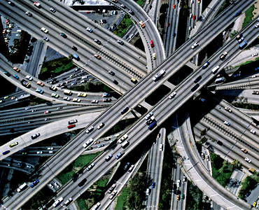
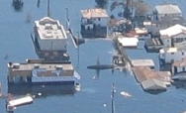
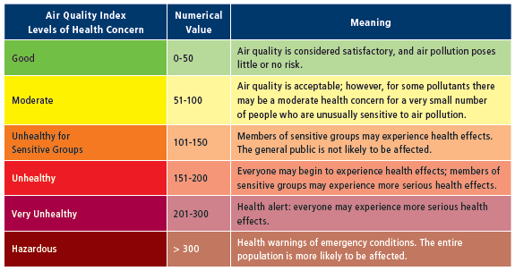
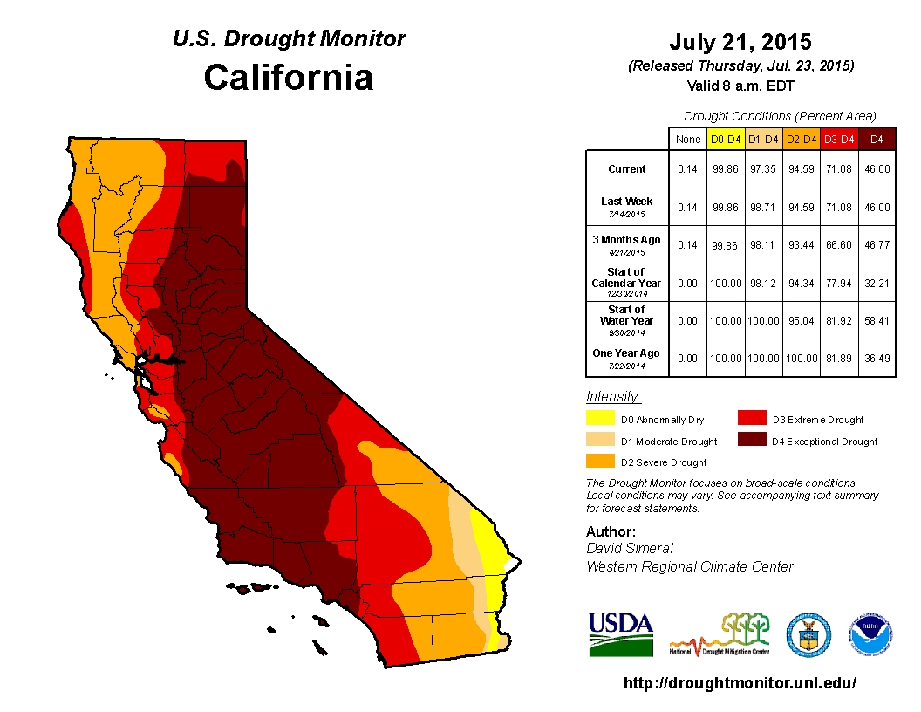
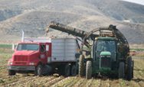
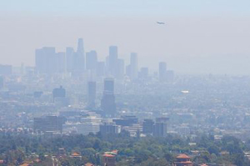
NOAA Operational CDRs Support User Needs (Details to be Presented in the Poster Session!)

Slide 26
NOAA CDRs are Being Used to Improve Monthly to Seasonal Forecasts
NOAA’s Outgoing Longwave Radiation (OLR) CDR is used to measure the Madden-Julian Oscillation (MJO) evolution
Reanalysis leads to estimates of the future MultiVariate Pacific-North American (MVP) index
MJO plus MVP provides a useful forecasting tool for future extratropical responses over US
Courtesy of Dr. Carl Schreck, CICS-NC
Notes:
Article on CDRs and energy accepted for publication in BAMS - A manuscript by C Schreck and others titled: “Natural Gas Prices and the Extreme Winters of 2011/12 and 2013/14: Causes, Indicators, and Interactions” was accepted for publication in the Bulletin of the AMS. The study demonstrated how energy traders and meteorologists use weather and climate data, including NOAA’s Climate Data Records, to supplement numerical models and anticipate changes in heating demand.
https://docs.google.com/a/noaa.gov/document/d/1BQwOojtmERNasmrUO1fVHQuygxVjQkmjl-i5qdoyLMM/edit
Composites of OLR (shading) and 200-hPa streamfunction anomalies. Both composites show the same phase of the MJO but different phases of the MultiVariate Pacific-North American (MVP) index. When the MVP is negative (bottom), a secondary maximum in convection appears near Hawaii. This convection is associated with an extratropical wave train (contours) that leads to warm temperatures over the eastern United States. Such a pattern is expected for this phase of the MJO. However, this pattern is strikingly absent when the MVP is positive (top). Even though the forcing from the MJO is similar in both patterns, the MVP identifies which set of dates produces the expected extratropical response and which does not.

Slide 27
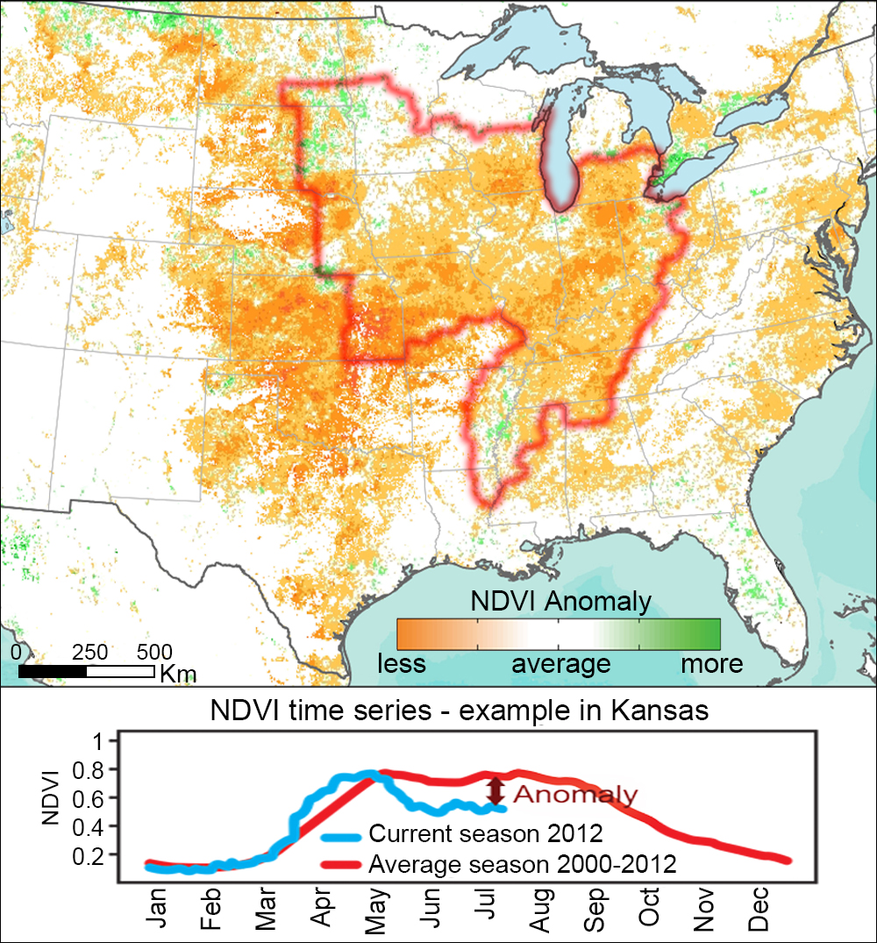
NOAA CDRs Supporting Farming / Agribusiness
2012 U.S. Drought as depicted using Vegetation Index CDR for July 17th
Enables understanding of anomalies and discovery of analogs.
Subset of 5-km resolution, “wall-to-wall” global NDVI CDR.
Historical record from 1981- to Present.
Env. Variables Also Available:
Surface Reflectance
Leaf Area Index (LAI)
FPAR (photosynthetically active radiation)
Primary U.S. Corn and Soybean
Production Region
Notes:
Article on CDRs and energy accepted for publication in BAMS - A manuscript by C Schreck and others titled: “Natural Gas Prices and the Extreme Winters of 2011/12 and 2013/14: Causes, Indicators, and Interactions” was accepted for publication in the Bulletin of the AMS. The study demonstrated how energy traders and meteorologists use weather and climate data, including NOAA’s Climate Data Records, to supplement numerical models and anticipate changes in heating demand.
https://docs.google.com/a/noaa.gov/document/d/1BQwOojtmERNasmrUO1fVHQuygxVjQkmjl-i5qdoyLMM/edit
Composites of OLR (shading) and 200-hPa streamfunction anomalies. Both composites show the same phase of the MJO but different phases of the MultiVariate Pacific-North American (MVP) index. When the MVP is negative (bottom), a secondary maximum in convection appears near Hawaii. This convection is associated with an extratropical wave train (contours) that leads to warm temperatures over the eastern United States. Such a pattern is expected for this phase of the MJO. However, this pattern is strikingly absent when the MVP is positive (top). Even though the forcing from the MJO is similar in both patterns, the MVP identifies which set of dates produces the expected extratropical response and which does not.

Slide 28
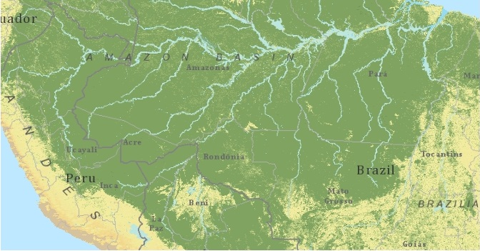
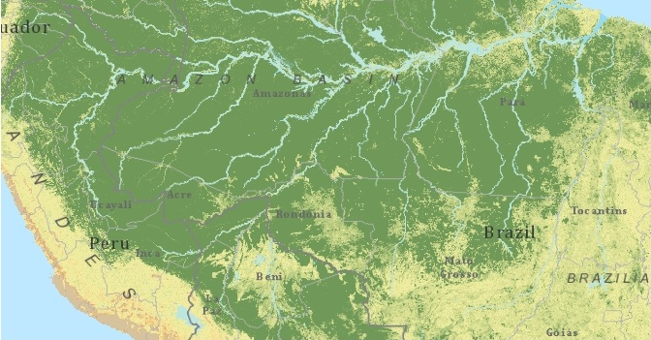
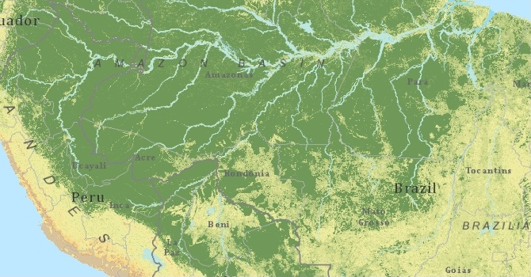
NOAA CDRs Supporting Resource Management Example: Forest Change Detection Using NOAA CDRs
Percent Tree Cover Change in the Amazon Basin
1990 (AVHRR NOAA CDRs)
2000 (MODIS Data)
2010 (MODIS Data)
AVHRR-based
NOAA CDR Variables:
- Normalized Difference Vegetation Index (NDVI)
- Leaf Area Index (LAI)
http://www.ncdc.noaa.gov/cdr/operationalcdrs.html
(Courtesy of Dr. Eric Vermote)
Notes:
Article on CDRs and energy accepted for publication in BAMS - A manuscript by C Schreck and others titled: “Natural Gas Prices and the Extreme Winters of 2011/12 and 2013/14: Causes, Indicators, and Interactions” was accepted for publication in the Bulletin of the AMS. The study demonstrated how energy traders and meteorologists use weather and climate data, including NOAA’s Climate Data Records, to supplement numerical models and anticipate changes in heating demand.
https://docs.google.com/a/noaa.gov/document/d/1BQwOojtmERNasmrUO1fVHQuygxVjQkmjl-i5qdoyLMM/edit
Composites of OLR (shading) and 200-hPa streamfunction anomalies. Both composites show the same phase of the MJO but different phases of the MultiVariate Pacific-North American (MVP) index. When the MVP is negative (bottom), a secondary maximum in convection appears near Hawaii. This convection is associated with an extratropical wave train (contours) that leads to warm temperatures over the eastern United States. Such a pattern is expected for this phase of the MJO. However, this pattern is strikingly absent when the MVP is positive (top). Even though the forcing from the MJO is similar in both patterns, the MVP identifies which set of dates produces the expected extratropical response and which does not.

Slide 29
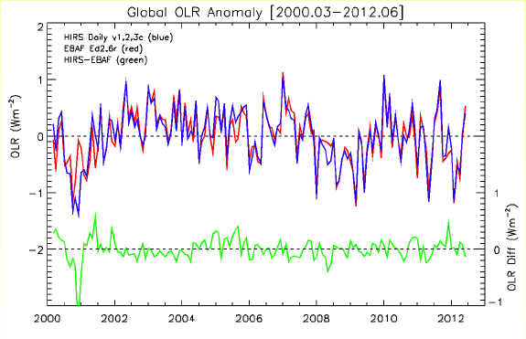
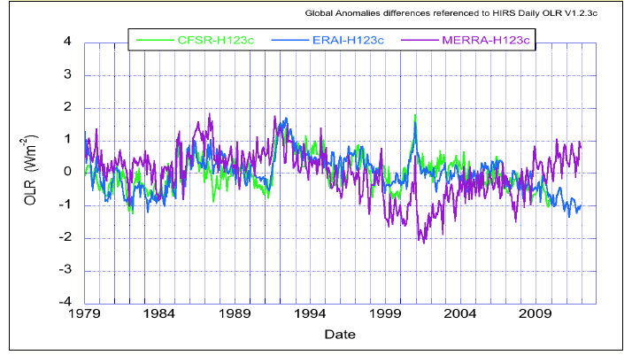
NOAA CDRs Support Climate Analysis and Climate Model Improvement
Diﬀerence of Global OLR Anomalies
(Long-term HIRS CDR vs. Short-term CERES CDR)
Diﬀerence of Global OLR Anomalies
^{(Reanalysis minus HIRS CDR )}

Slide 30
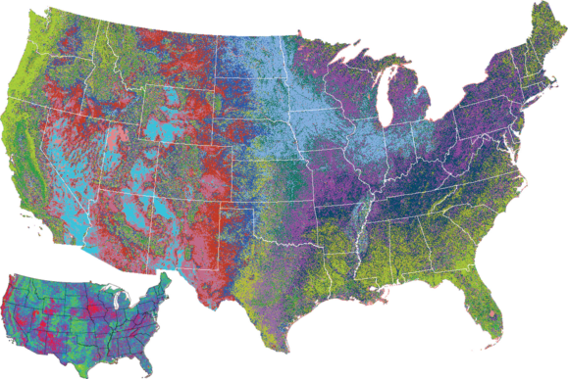
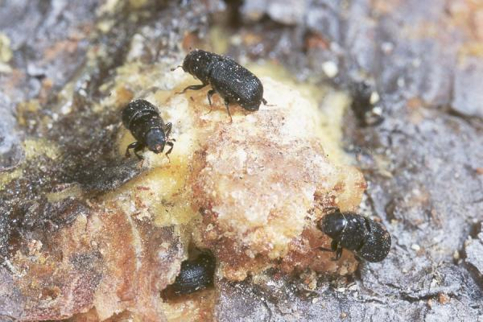
CDRs Supporting Resource Management
Example CDR Application: USDA Forest Change Detection
Background
USDA and NASA are collaborating to develop a capability to assess forest health using a satellite-derived Vegetation Index.
NOAA CDR Contribution
Verify the feasibility of using NOAA’s operational NDVI CDR. If successful, NASA’s research can be “operationalized” by USDA, since the NOAA CDR is an operationally sustained product.
Expanding ranges of forest scavengers,
linked to climate trends.
Expected Output and Impact
NOAA CDR Program sustains a 30-year times series Vegetation Index suitable for identifying forest health trends, enabling improved U.S. forest resource management.
Partners
USDA Southern Research Station, NASA, and NOAA.
Gypsy Moth Larvae Pine Beetles

