Slide 1
Concept for the physical view of the architecture for climate monitoring from Space
WMO Space Programme Office
CEOS/CGMS WGClimate
Geneva, Switzerland, 29 March 2018

Slide 2
Contents
Background
Logical and Physical View
Present Status
Proposed Concept
Virtual Constellations
Governance
Actions and Follow-Up

Slide 3
Background
WMO Resolution 19 (Cg-XVI) – called for the Development of an Architecture for Climate Monitoring from Space (2011)
“major initiative of the WMO Space Programme”
“invites CEOS, CGMS, GCOS, GEO and WCRP to collaborate with the WMO Space Programme on the development of the Architecture”.
Strategy Towards an Architecture for Climate Monitoring from Space (2013)
Terminology, logic, implementation roadmap
http://ceos.org/document_management/Working_Groups/WGClimate/WGClimate_Strategy-Towards-An-%20Architecture-For-Climate-Monitoring-From-Space_2013.pdf.
Notes:
Document contains description of logical view composed of four pillars and contains general views on the physical view.

Slide 4
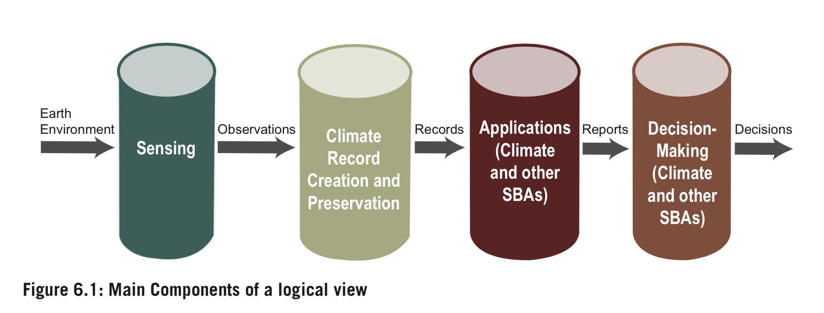
Logical View
4 Pillars

Slide 5
Physical View
Physical View of the Architecture for Climate Monitoring from Space to consist of:
Existing/planned missions, datasets, and key user organizations, agencies, coordination mechanisms (“who does/plans/needs what”);
A commitment by agencies, mechanisms, and activities to fulfil the functions identified in the logical Architecture;
Regular action by all stakeholders to the Architecture to address/fill gaps where these have been identified and validated.
Notes:
Document was a available in 2013. As a consequence out of this strategy a joint CEOS/CGMS WG on Climate was established. WGClimate was of the opinion to first generate an inventory on the present and future availability of ECVs.

Slide 6
Present Status
WGClimate-9 delivered a report on the ECV-Inventory Gap Analysis Report.
Contains not only the Gap Analysis but also Action report.
The action proposed are concerned with implementation of the physical view of Pillar I and Pillar II.
The physical view of Pillar I has not yet been developed.

Slide 7
Proposed Concept
The Physical View of the Architecture for Climate Climate Monitoring from Space should be a virtual constellation composed of virtual sub-constellations providing the observations to derive a single ECV or a group of ECVs.
The virtual sub-constellations belong to either CEOS members or CGMS members or a combination of both.
The Physical View is only for Pillars-I and II under the responsibility of the space agencies.
Physical view for Pillars III and IV still needs to be established by entities dealing with applications (e.g., WMO, GFCS).
Notes:
Make reference to WORKSHOP on ECV inventory use for climate monitoring, 27-29 November 2018.

Slide 8
CEOS Virtual Sub-Constellations
The existing seven CEOS Virtual Constellations to cover the ECVs related to:
Atmospheric Composition Virtual Constellation – (AC-VC)
Ocean Surface Topography Virtual Constellation – (OST-VC)
Precipitation Virtual Constellation – (P-VC)
Land Surface Imaging Virtual Constellation – (LSI-VC)
Ocean Colour Radiometry Virtual Constellation – (OCR-VC)
Ocean Surface Vector Wind Virtual Constellation – (OSVW-VC)
Sea Surface Temperature Virtual Constellation – (SST-VC)

Slide 9
CGMS “Virtual Sub-Constellations”
CGMS should establish the following virtual sub-constellations making use of existing CGMS Working Groups:
International TOVS Working Group – Temperature and Humidity Virtual Constellation – (VTP-VC)
International Radio-Occultation Working Group – Radio-Occultation Virtual Constellation – (RO-VC)
International Precipitation Working Group - Precipitation Virtual Constellation – (P-VC)
International Winds Working Group - Atmospheric Motion Vector Virtual Constellation – (AMV-VC)
International Clouds Working Group - Clouds Virtual Constellation – (C-VC)
Notes:
Not yet any virtual constellations.

Slide 10
Other Virtual Sub-Constellations
The remaining ECVs not yet covered should be addressed through additional virtual sub-constellations.
Example: Joint CEOS/CGMS Virtual Constellation for CO2/GHG.
Example: Joint CEOS/CGMS Precipitation Virtual Constellation (CEOS P-VC and CGMS P-VC).
Notes:
Mention proposal by EC

Slide 11
Governance
The virtual sub-constellations (CEOS, CGMS, joint) would report to CEOS/CGMS WGClimate, which takes stewardship over the Physical Architecture (Pillars I and II).
WGClimate would report to a high-level Virtual Climate Constellation Implementation Group composed of heads of space agencies or their deputies.

Slide 12
Actions and Follow-up
CGMS/CEOS WGClimate to provide comments on the proposed concept for the Physical View of the Architecture for Climate Monitoring from Space.
WMO Secretariat to prepare updated report to CGMS-46 and to 32nd CEOS Plenary.

