Slide 1
Working Group on Disasters
An overview
WGDisasters Leads:
Andrew Eddy (Athena Global)
Helene De Boissezon (CNES)
Laura Frulla (CONAE)
ceos.org/ourwork/workinggroups/disasters/

Slide 2
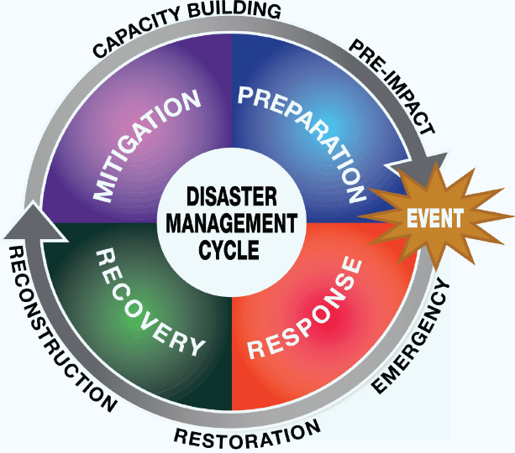

WGDisasters fundamentals
Earth observations to address risk: identification of natural hazards, exposure of people, assets and livelihoods, and related vulnerabilities
CEOS WG Disasters Work Plan is aligned with the Sendai Framework on Disaster Risk Reduction (DRR)
GEO’s EO4DRM
International Charter Space and Major Disasters and Copernicus EMS

Slide 3
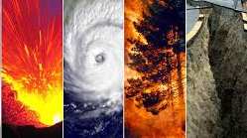
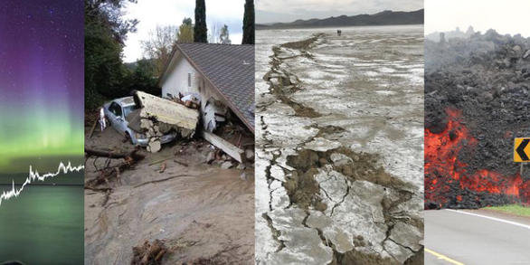

WGDisasters Objectives
Support Disaster Risk Management (DRM) authorities by means of satellite-based EO and science-based analyses
Support the UNDRR Sendai Framework, (mainly Priority1 “Understanding Risk”, Priority4 “Build Back Better”)
Support the work of international initiatives such as GEO
Raise the awareness of politicians, decision-makers, and major stakeholders of the benefits of using satellite EO in all phases of DRM
Foster increased use of EO in support of DRM and DRR, and express related EO needs

Slide 4
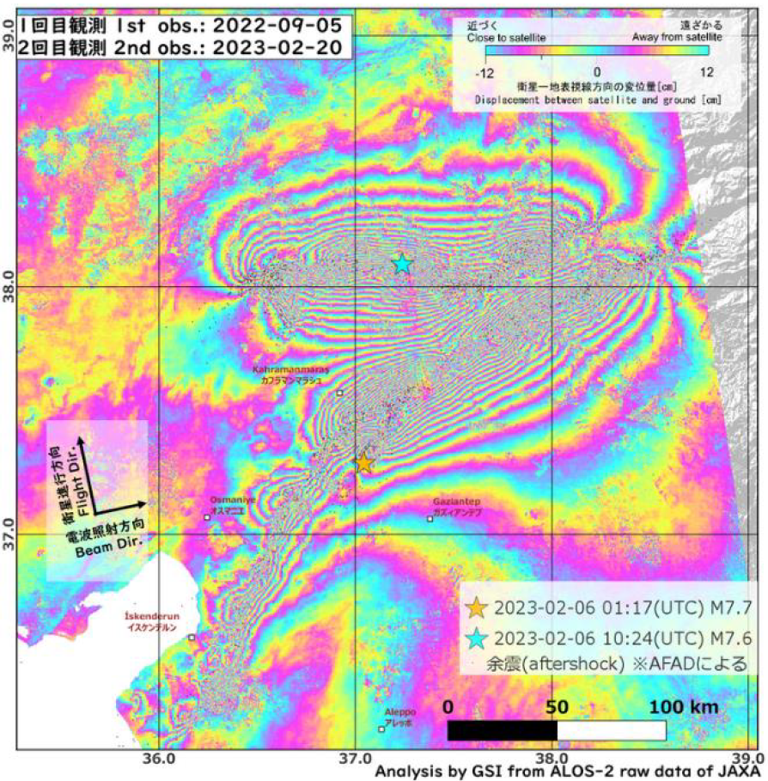
WGDisasters Activities
Pilots, Demonstrators, Labs
Wildfire Pilot
Flood (GEO/LEO/SAR) Pilot
Landslide Demonstrator
Volcano Demonstrator
Seismic Hazards Demonstrator
Recovery Observatory Demonstrator
Geohazards Supersites and Natural Laboratories (GSNL)
Co-seismic displacement over 2023 Turkey earthquake: ALOS 2 scansar image of February 20.

Slide 5
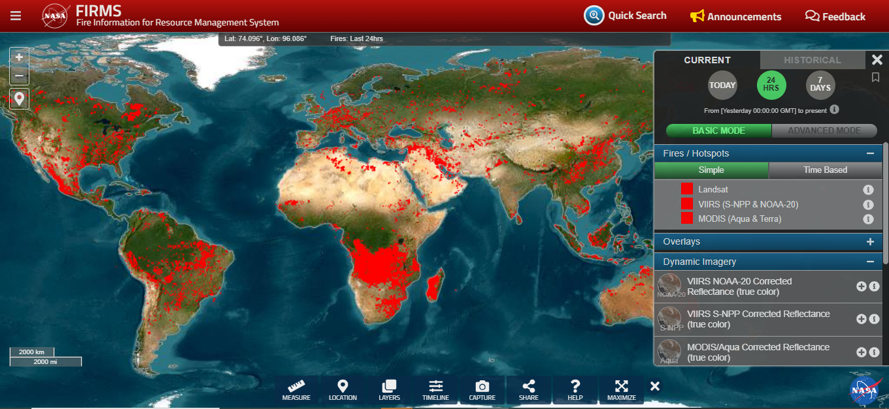
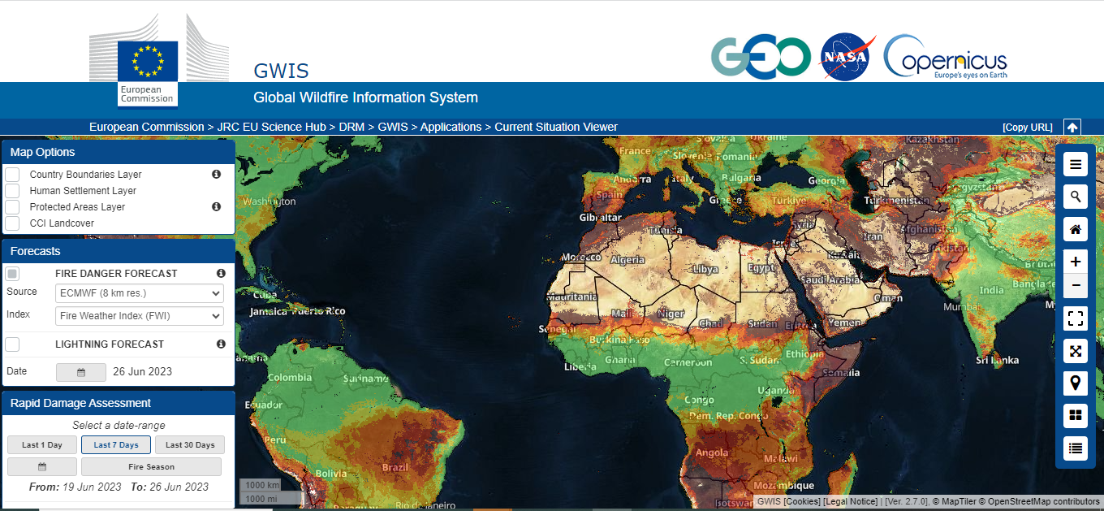
Wildfire Pilot – 1/2
Leads: J. Johnston and M. de Jong, NRCan; P. Moore, FAO; D. Dufour CSA
GOAL: To provide basis for defining global priorities for active-fire monitoring and characterization.
OBJECTIVES / OUTCOMES:
  Provides inventory of EO systems suitable for active-fire monitoring.
  Explores existing gaps in wildfire EO capabilities (existing and proposed).
  Articulates global stakeholders and user requirements for active-fire remote sensing monitoring and way-forward.

Slide 6
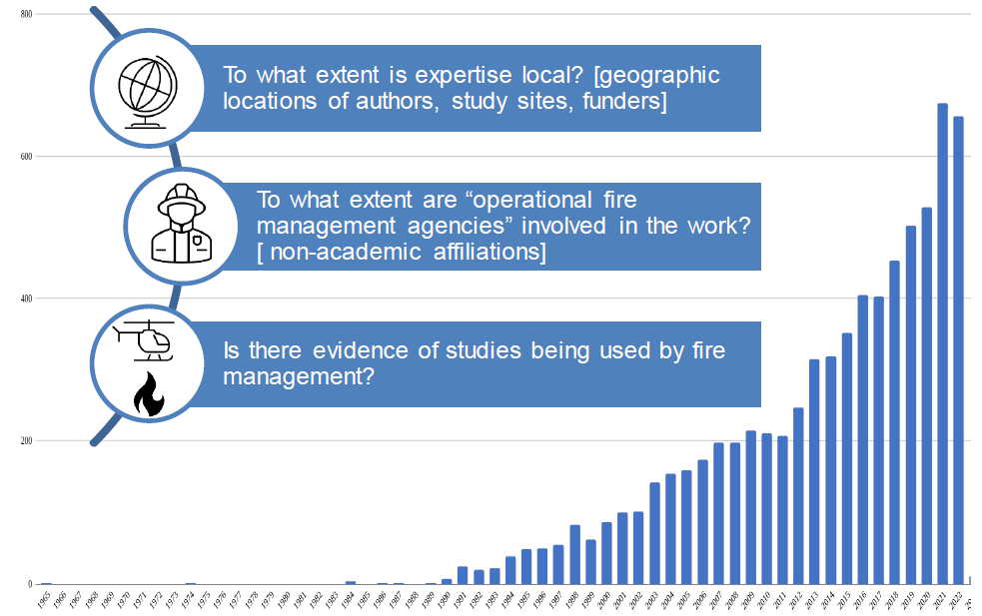
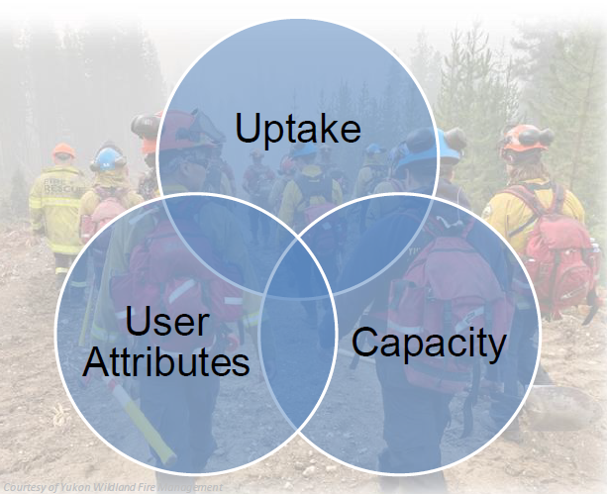
Wildfire Pilot – 2/2
Leads: J. Johnston and M. de Jong, NRCan; P. Moore, FAO; D. Dufour CSA
Capacity: potential to use, create, develop and integrate EO active fire products.
Uptake: understanding, comprehension and consequent use of EO active fire products.
Number of Publications per year
User attributes: user contributions to interact and use EO-active fire products.

Slide 7
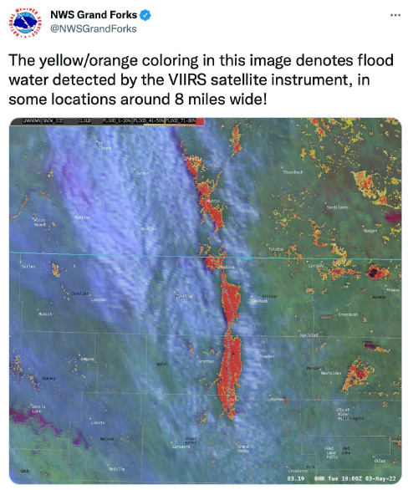
Flood Pilot – 1/2
Leads: M.U. Quirno, CONAE; M. Goldberg, NOAA; G. Schumann, RSS Hydro
GOAL: Explores and demonstrates best practices for combining diverse optical and radar data sources to improve current abilities to map flood extent and depth and improve understanding of how hazard science can be better integrated with vulnerability and exposure information.
OBJECTIVES / OUTCOMES:
  Focuses on flood risk management.
  Report on best practices about the integration of LEO-GEO and SAR data.
  Coordinate global stakeholders and users for flood response and management.

Slide 8
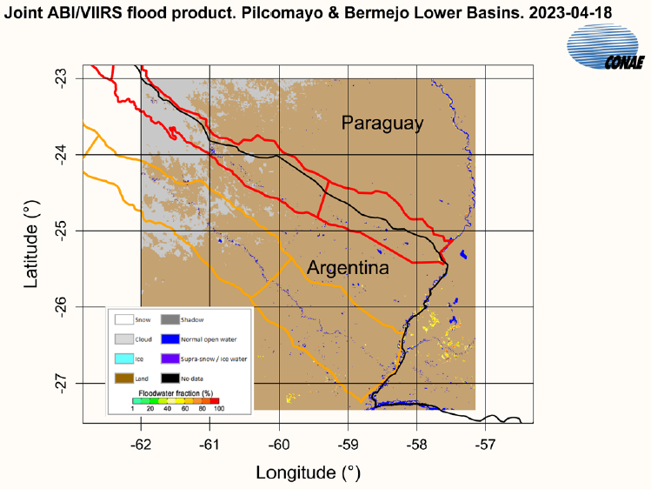
Flood Pilot – 2/2
Leads: M.U. Quirno, CONAE; M. Goldberg, NOAA; G. Schumann, RSS Hydro
Lessons Learnt and outcomes:
  ML techniques for products data fusion.
  Downscaling flood mapping to a finer detail with the use of DEMs.
  Merging GEO-LEO and SAR sources, to flood monitoring, mapping and warning systems.
  Probabilistic inundation maps, combining the results of hydrologic modelling with SAR-based statistics.
  Develop SAR-based flood mapping methodology for flood extent, flood frequency, evolution, etc.

Slide 9
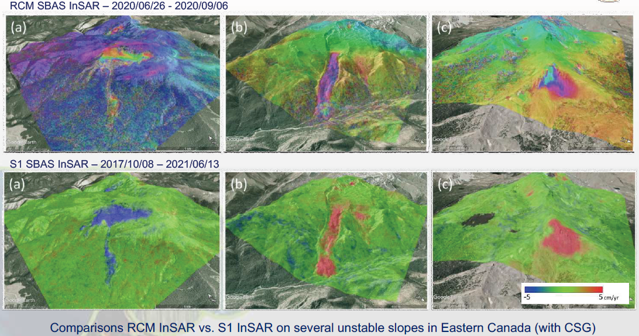
Landslide Demonstrator – 1/3
Leads: Pukar Amatya, NASA; Jean-Philippe Malet, UNISTRA/EOST
GOAL: demonstrate the effective exploitation of satellite EO across the full cycle of landslide disaster risk management (preparedness, response, and recovery at global, regional, and local scales), including the possibility of multi-hazard focus on cascading impacts and risk.

Slide 10
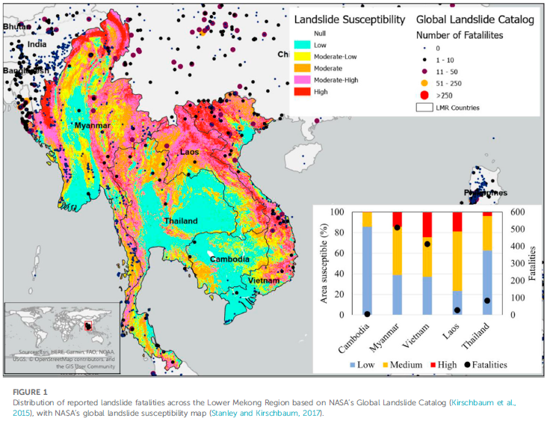
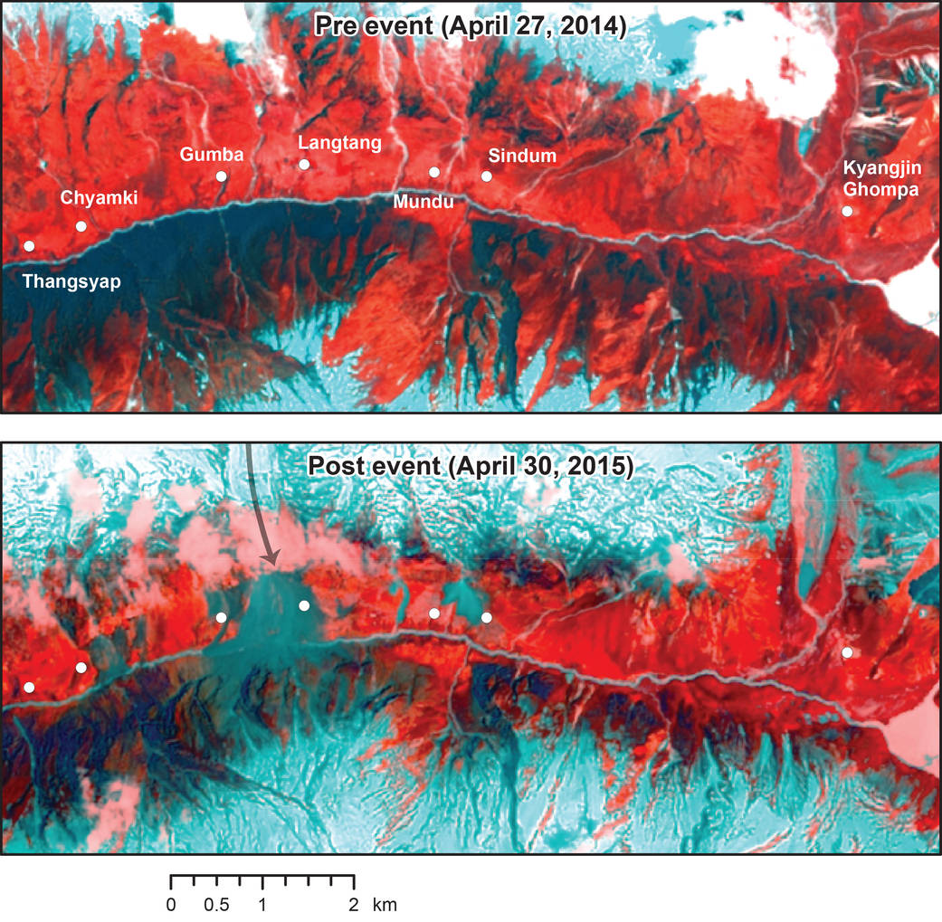
Leads: Pukar Amatya, NASA; Jean-Philippe Malet, UNISTRA/EOST
Landslide Demonstrator – 2/3
Distribution of reported landslide fatalities across the Lower Mekong Region based on NASA’s Global Landslide Catalog (Kirschbaum et al., 2015), with NASA’s global landslide susceptibility map (Stanley and Kirschbaum, 2017).
Landsat 8 Reveals Extent of Quake Disaster in Nepal

Slide 11
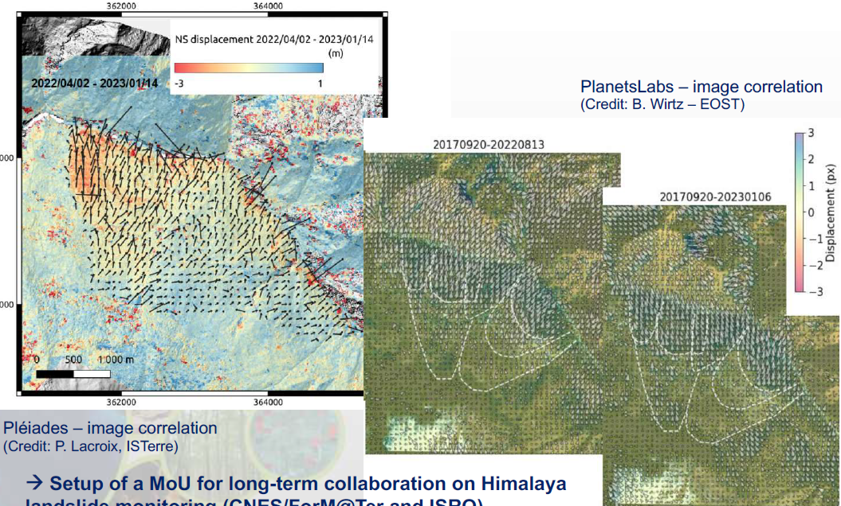
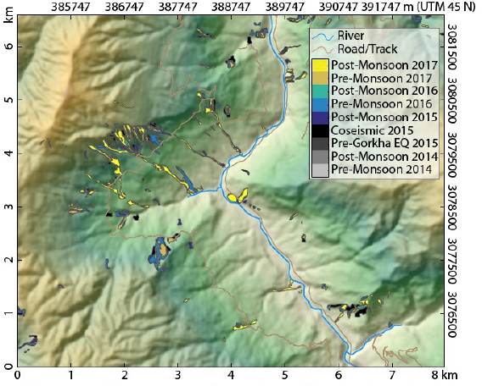
Landslide Demonstrator – 3/3
Leads: Pukar Amatya, NASA; Jean-Philippe Malet, UNISTRA/EOST
Test of ALADIM algorithm to automatically map landslides in Nepal for pre- and post-monsoon landslide inventories, using S2 images.
Uttarahkand, Joshimath landslide crisis monitoring, India, 2023

Slide 12
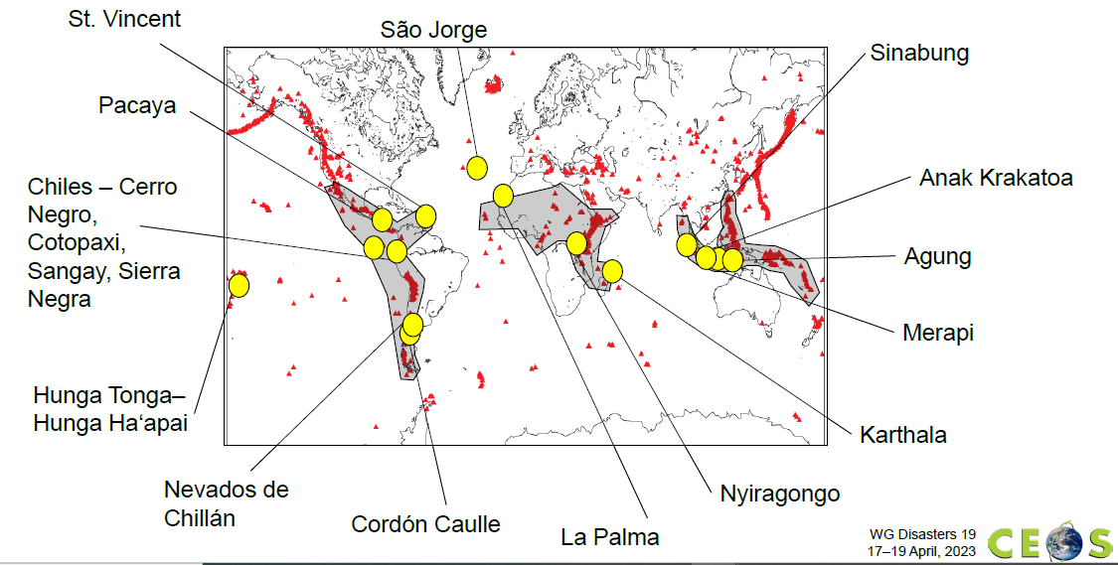
Volcano Demonstrator – 1/4
Leads: Mike Poland, USGS; Susi Ebmeier, University of Leeds.
GOALS:
Aims to evaluate the utility of EO data for anticipating, detecting, and tracking volcanic eruptions.
Supports EO applications that promote volcanic disaster risk reduction worldwide.
Focus on high-risk volcanoes in areas where monitoring is not currently well developed (LAC, Africa, SE Asia).

Slide 13
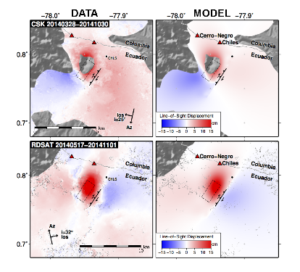
Volcano Demonstrator – 2/4
Leads: Mike Poland, USGS; Susi Ebmeier, University of Leeds.
Cerro Negro
Chiles
Ground deformation related to magma and seismic activity over Cerro Negro Volcanic area.
TerraSAR-X
18th Oct- 27th Nov 2014

Slide 14
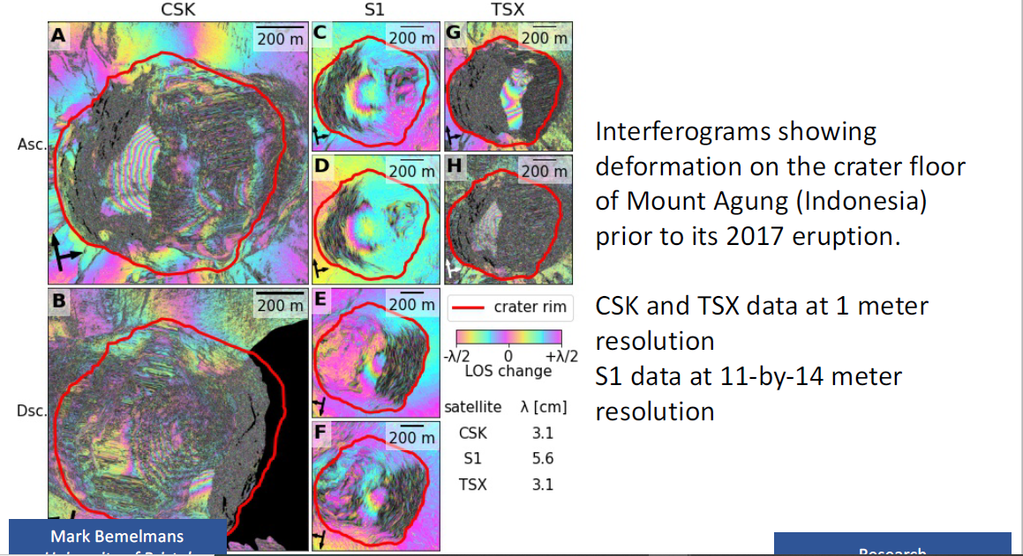
Volcano Demonstrator – 3/4
Leads: Mike Poland, USGS; Susi Ebmeier, University of Leeds.
Mark Bemelmans, University of Bristol.
Example of Multi-frequency volcanic SAR-products

Slide 15
Volcano Demonstrator – 4/4
Leads: Mike Poland, USGS; Susi Ebmeier, University of Leeds.
Contribution to multi-sensor Study of Sierra Negra, Galapagos
Tara Shreve,
Francisco Delgado
Carnegie Institute,
University of Santiago
Example of Multi-frequency volcanic SAR-products

Slide 16
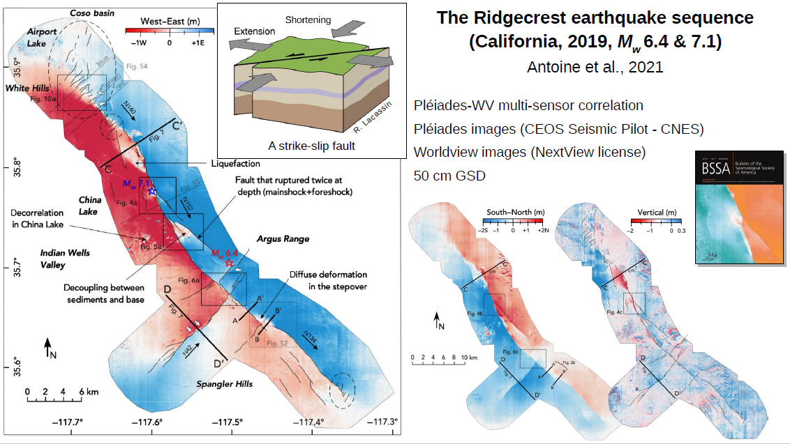
Seismic Demonstrator – 1/3
Leads: Philippe Bally, ESA; Stefano Salvi, INGV
GOALS:
Develops and demonstrates advanced science products for rapid earthquake response and better understanding of risk and exposure.
Supports the uptake of these products and methodologies through co-design an development with WG stakeholders and users.

Slide 17
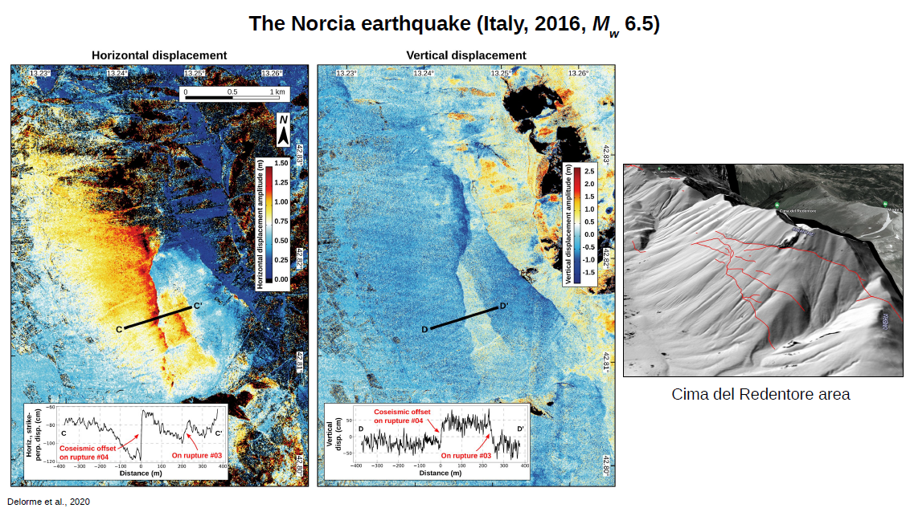
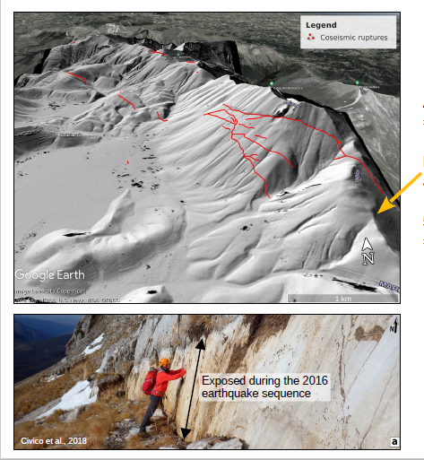
Seismic Demonstrator – 2/3
Leads: Philippe Bally, ESA; Stefano Salvi, INGV
High-resolution DEM generated using Pleiades images
DInSAR maps from ALOS data

Slide 18
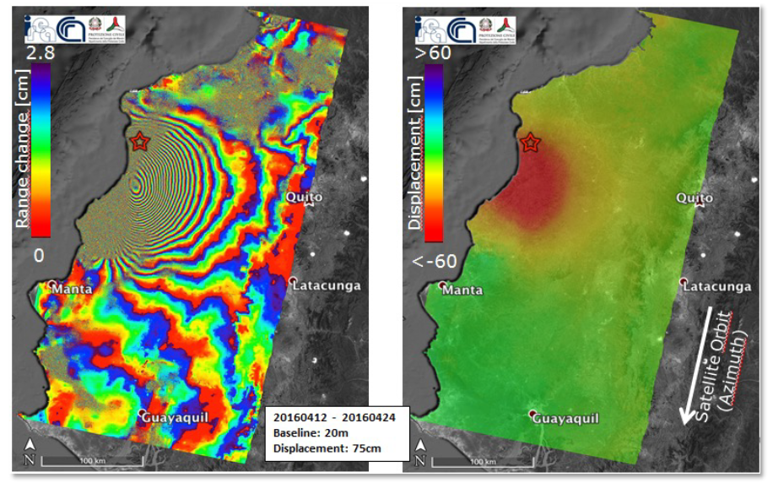
Seismic Demonstrator – 3/3
Leads: Philippe Bally, ESA; Stefano Salvi, INGV
Interferogram generated by CNR-IREA, exploiting two Copernicus Sentinel-1© 2016 images acquired from descending orbits (Track 40) before (12 April) and after (24 April) the Mw 7.8 event in Ecuador, whose epicentre is indicated by a red star. Left: Differential Interferogram; Right: Line of Sight (interpolated) Displacement map. The reference point for the measurement is located in correspondence to the Guayaquil town.

Slide 19
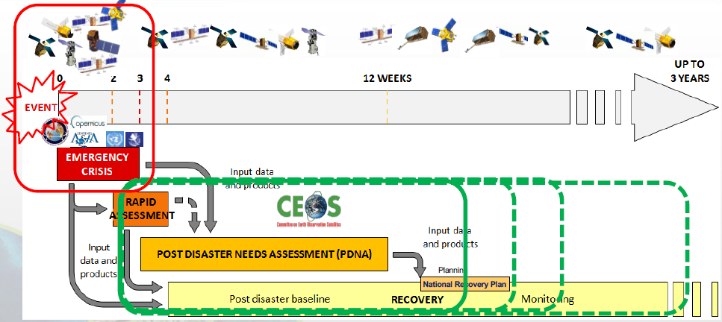
Recovery Observatory Demonstrator – 1/3
Leads: Hélène de Boissezon, CNES; Rashmin Gunasekera; World Bank
GOALs:
Showcase contribution of satellite data and products to recovery efforts following major disaster events.
Direct input to Post Disaster Needs Assessments and long-term contribution to Recovery Framework.
Cited in Space Agenda 2030 (UN GA).

Slide 20
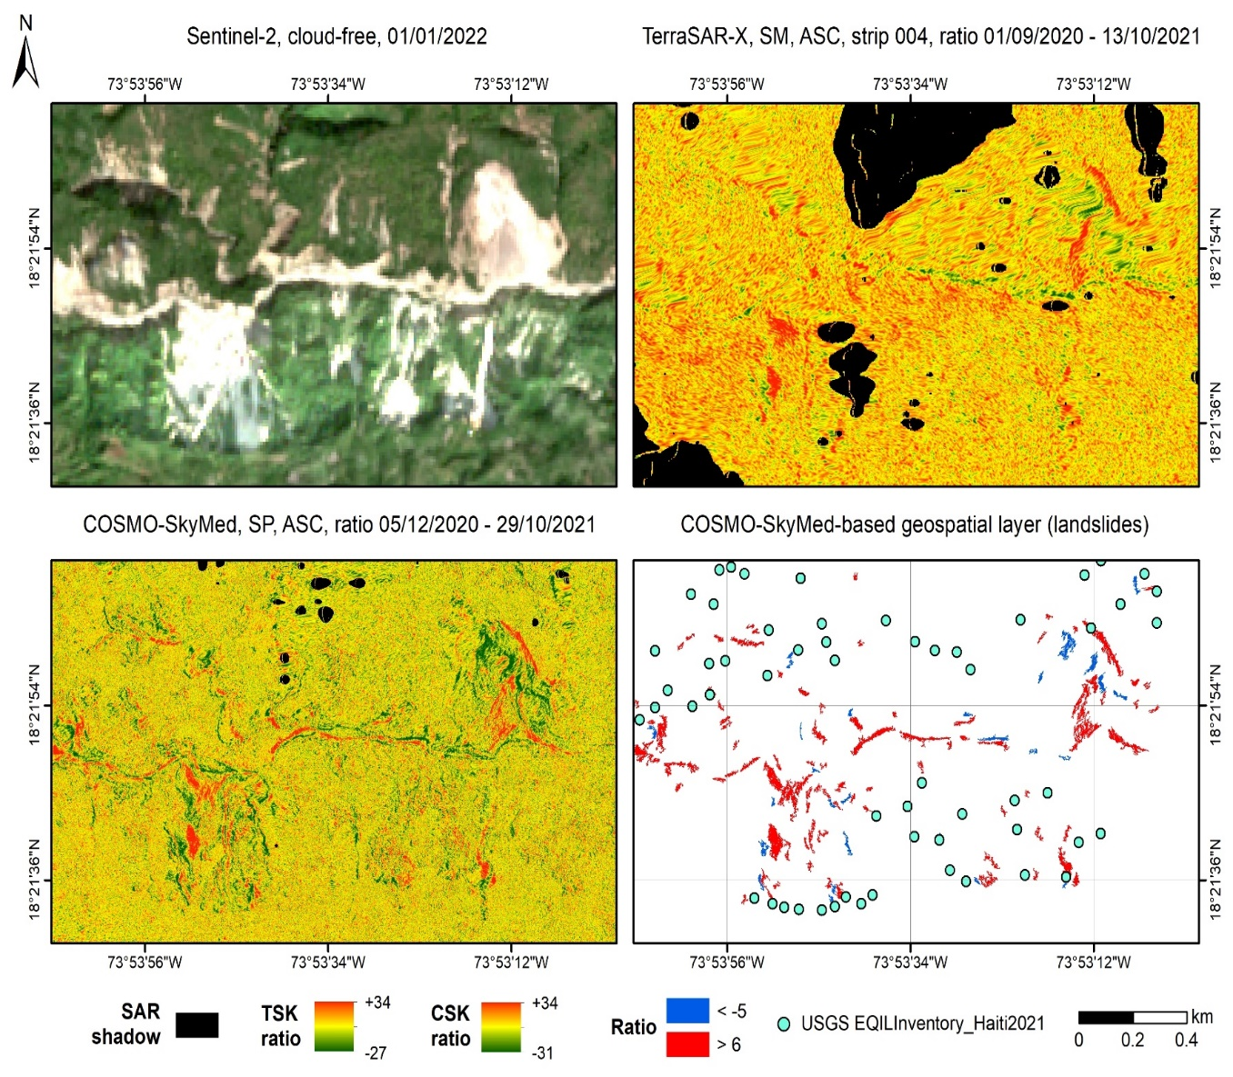
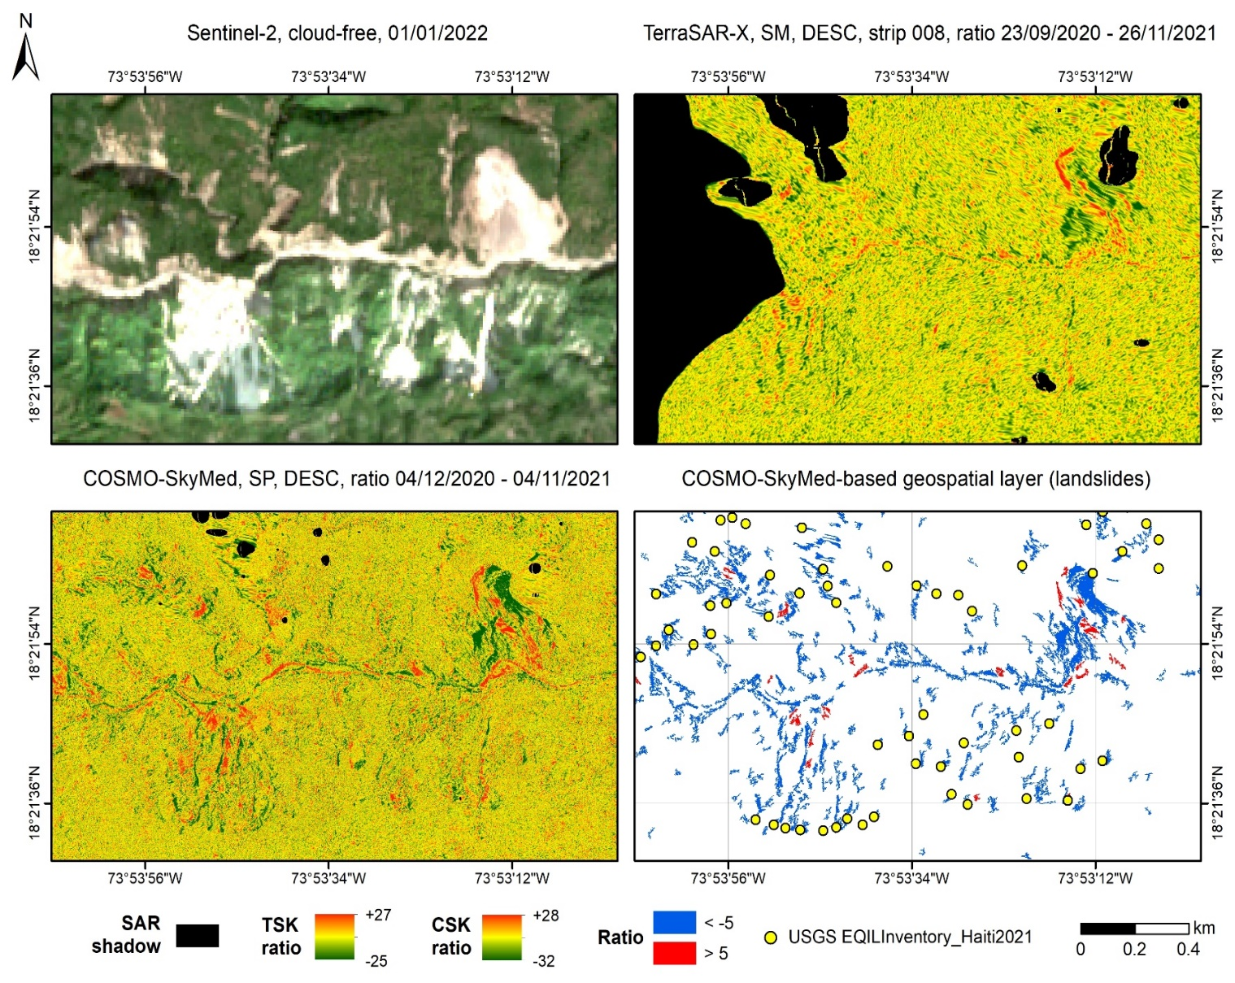


Recovery Observatory Demonstrator – 2/3
Leads: Hélène de Boissezon, CNES; Rashmin Gunasekera; World Bank
Multi-frequency SAR products relevant to the RO activation for 2021 Haiti earthquake.

Slide 21
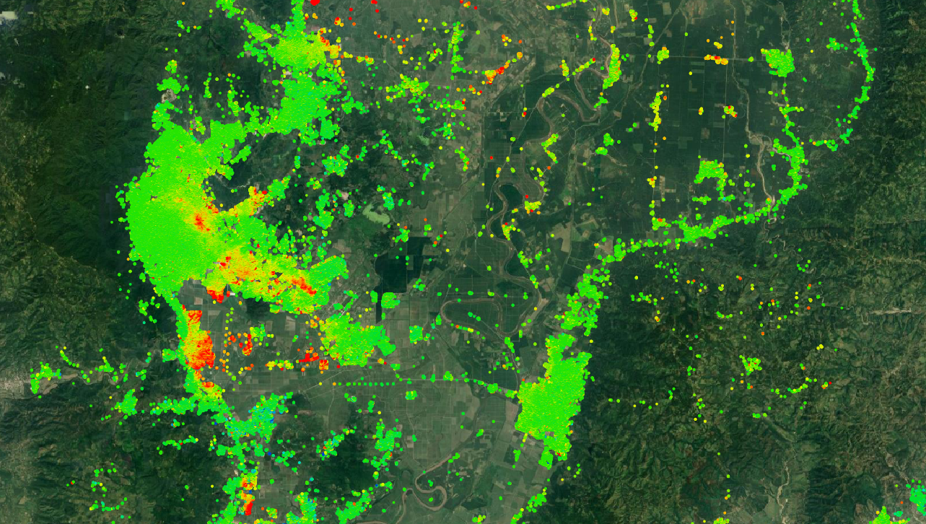
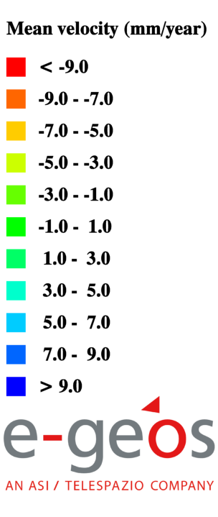
Recovery Observatory Demonstrator – 3/3
Leads: Hélène de Boissezon, CNES; Rashmin Gunasekera; World Bank
CSK-based multi-temporal DInSAR deformation maps in Honduras, for ETA-IOTA activation

Slide 22

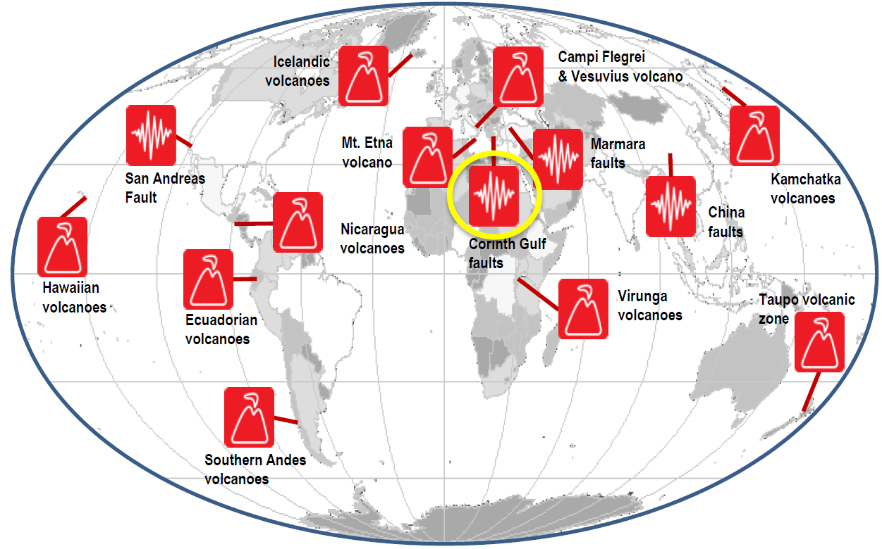


Geohazards Supersites and Natural Laboratories – 1/4
Lead: Stefano Salvi, INGV.
GOALS:
Aims to improve geophysical scientific and geohazard assessment, promoting rapid and effective uptake of new science results for enhanced societal benefits in DRR
Best effort international partnership.
https://geo-gsnl.org/

Slide 23
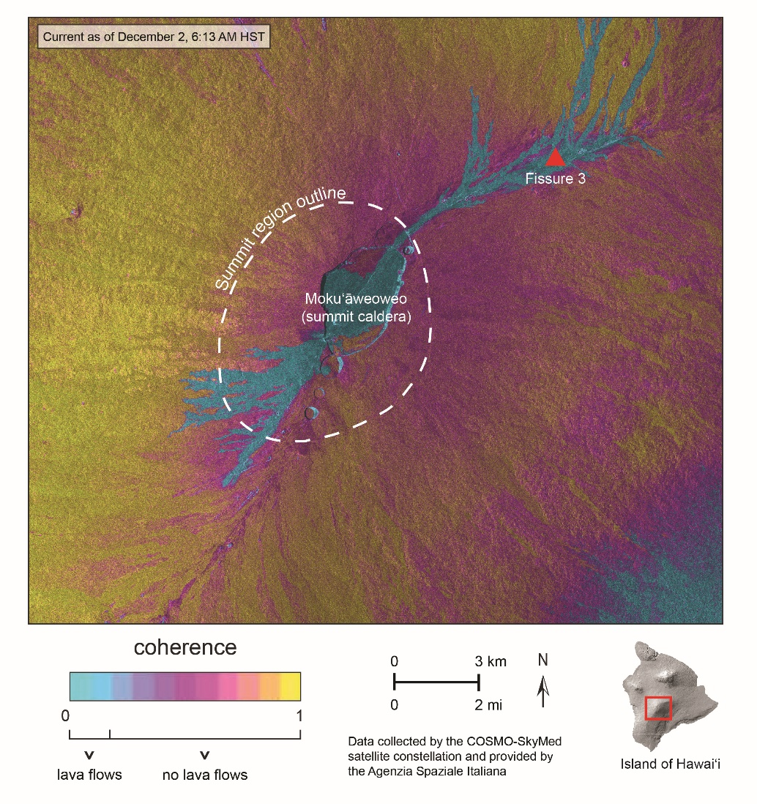
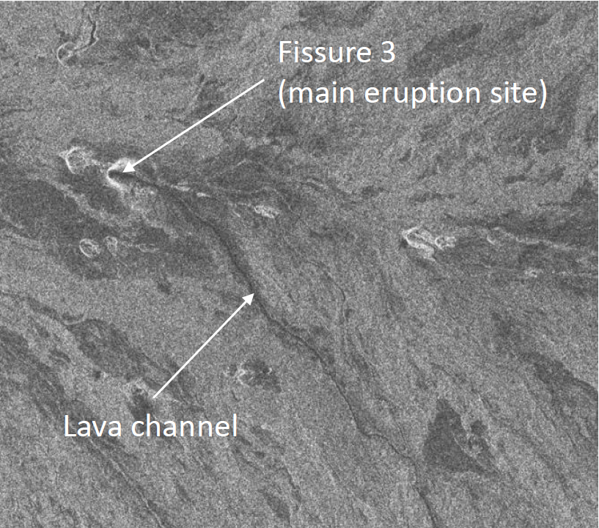
Geohazards Supersites and Natural Laboratories – 2/4
Lead: Stefano Salvi, INGV.
CSK, S1 and RSAT products over Mauna Loa volcano, to monitor fractures and lava flows during the late 2022 eruption.
S1 deformation pattern (mainly deflation) during the late 2022 eruption.
C-band Radarsat-2 Radar amplitude image
https://geo-gsnl.org/

Slide 24
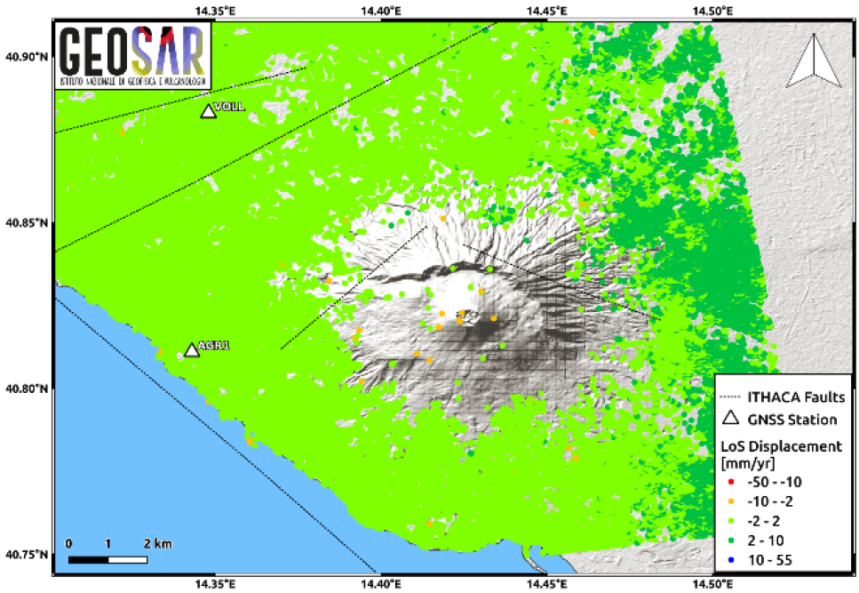
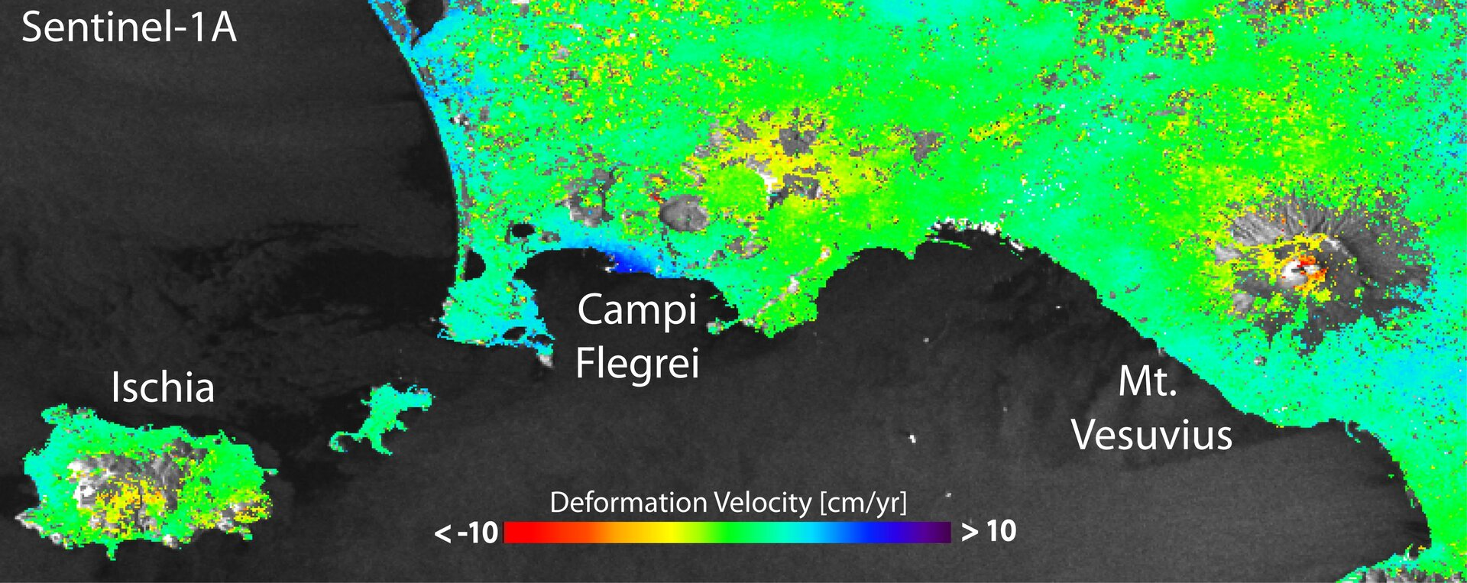
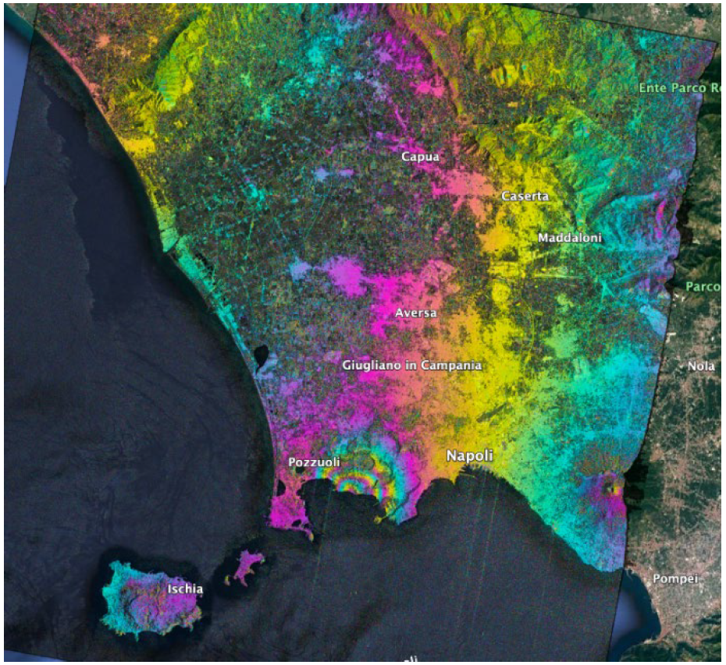
Geohazards Supersites and Natural Laboratories – 3/4
Lead: Stefano Salvi, INGV.
Deformation map over Campi Flegrei and Mt. Vesuvius with Sentinel-1A data relevant to 2014–15.
Mean LoS velocity map over Mt. Vesuvius (CSK ascending, 2011-2022)
SAOCOM stripmap interferogram over Campi Flegrei
(2020.03.13 -2023.02.02)
https://geo-gsnl.org/

Slide 25
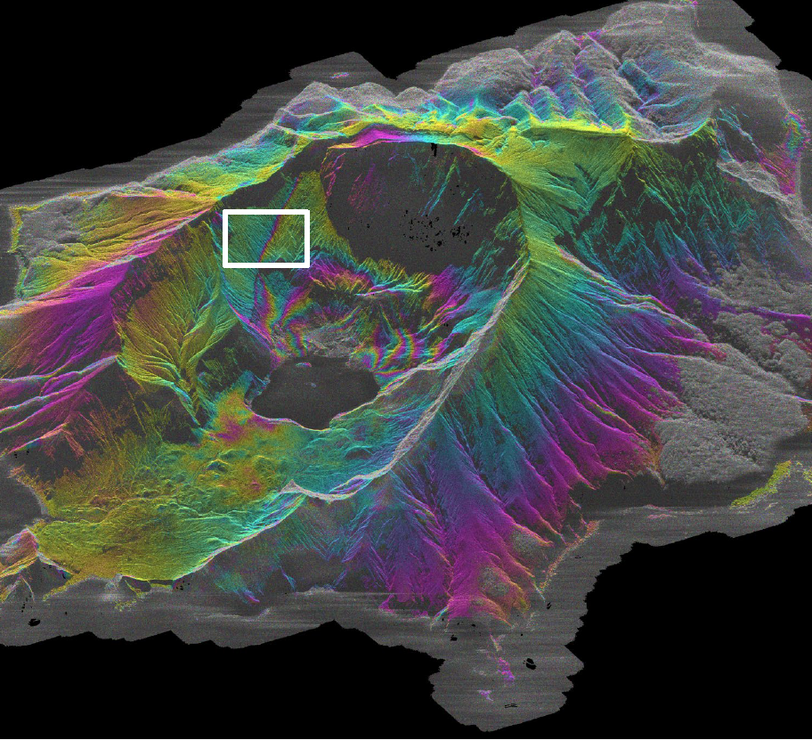
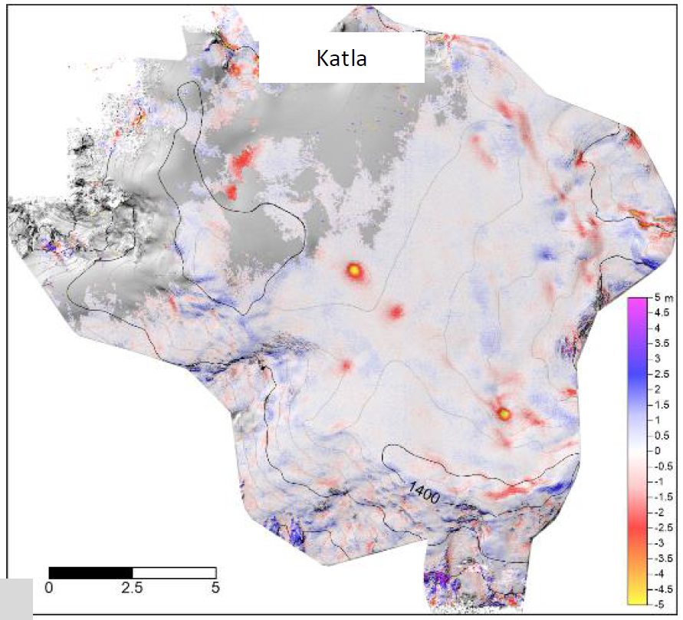
Geohazards Supersites and Natural Laboratories – 4/4
Lead: Stefano Salvi, INGV.
TSX spotlight deformation products, related to hydrothermal activity over White Island (Taupo Supersite).
Pleiades stereo images acquired over Katla volcanic area (Iceland Supersite): 2 July – 15 august 2022.
Co-seismic displacement over 2023 Turkey earthquake: ALOS 2 scansar image of February20.
https://geo-gsnl.org/

Slide 26
CEOS WGD Priorities & Successes
Priorities:
  Provide and Demonstrate potential use cases to build sustainability paths for post-demos operations (strengthen ties to international stakeholders, local actors and GEO WGs).
  Focusing on capacity building in all CEOS WGD activities.
  Explore linkages to climate related activities (assessment, mitigation, resilience).
  Exploit new technology opportunities (e.g. new missions, new activities, new data exploitation techniques, New Space contributions).
Lessons learnt:
  Demonstration of technical feasibility for thematic area and/or disaster cycle phase
  Provide pre-operational EO-based products and uptake from practitioners and final users, improving and supporting Disaster Risk Management with EO data.
  Creation of partnerships and bridging gaps between different types of partners.
  Provision of best practices to use/combine satellite data to improve understanding and management of risk

Slide 27
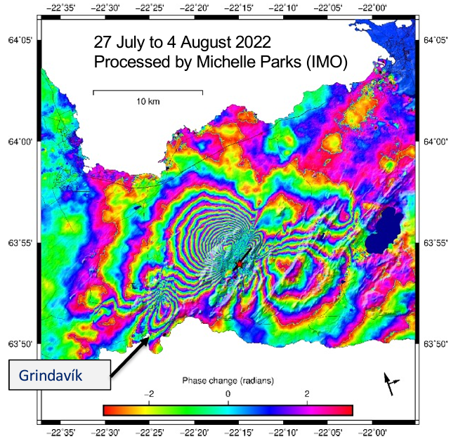
ASI Contribution to CEOS Activities
Leads: S. Zoffoli, A. Montuori, D. Tapete, M. Virelli.
Since 1986 the Italian Space Agency (ASI) is supporting CEOS initiatives.
Since 2012 ASI participates in GEO GSNL, CEOS DRM projects and Recovery Observatory (RO) activities, providing COSMO-SkyMed data and joining scientific research.
About 20.000 COSMO-SkyMed images have been delivered for all CEOS activities and 6000 are going to be provided in the next year.
Since 20 July 2021, ASI has been started the provision of SAOCOM data within the ASI ZoE
Iceland Supersite: COSMO-SkyMed interferogram showing deformation related to the dike intrusion on the Reykjanes Peninsula started on the 21st December 2021.

Slide 28
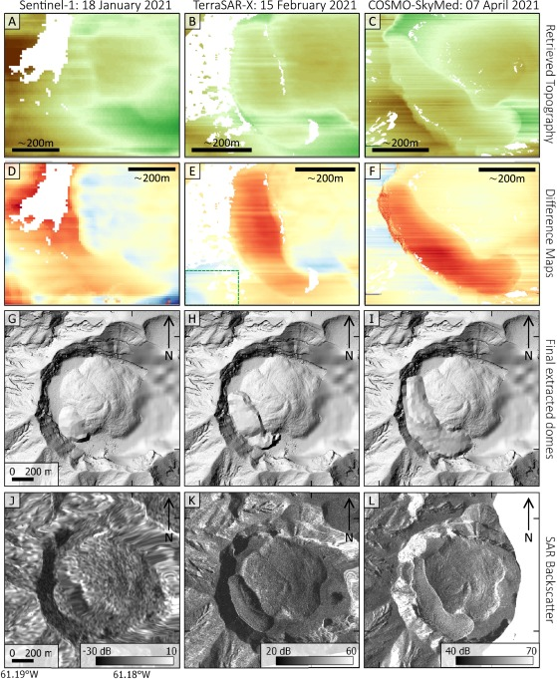
ASI Contribution to CEOS Activities
Leads: S. Zoffoli, A. Montuori, D. Tapete, M. Virelli.
Since 1986 the Italian Space Agency (ASI) is supporting CEOS initiatives.
Since 2012 ASI participates in GEO GSNL, CEOS DRM projects and Recovery Observatory (RO) activities, providing COSMO-SkyMed data and joining scientific research.
About 20.000 COSMO-SkyMed images have been delivered for all CEOS activities and 6000 are going to be provided in the next year.
Since 20 July 2021, ASI has been started the provision of SAOCOM data within the ASI ZoE
SAR-based products over St. Vincent volcano. (A-B-C) Range line retrieval of topography. (D-F) difference between the extracted height from SAR and the pre-eruption DEM. (G-I) final dome shapes. (J-L) original SAR backscatter images.

Slide 29
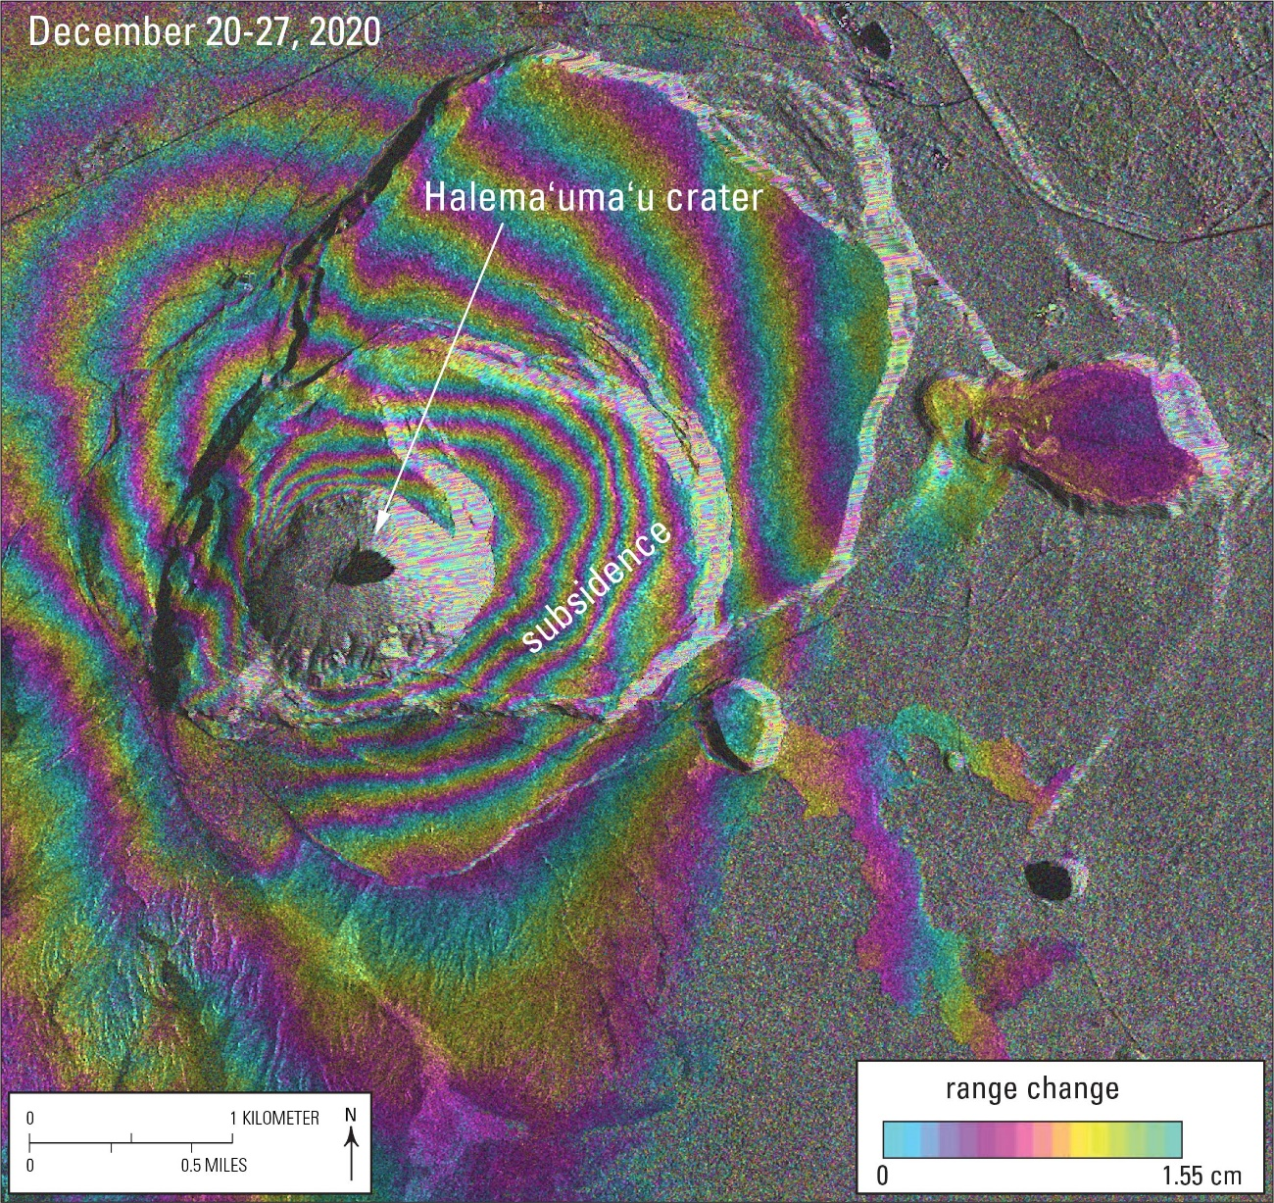
ASI Contribution to CEOS Activities
Leads: S. Zoffoli, A. Montuori, D. Tapete, M. Virelli.
Since 1986 the Italian Space Agency (ASI) is supporting CEOS initiatives.
Since 2012 ASI participates in GEO GSNL, CEOS DRM projects and Recovery Observatory (RO) activities, providing COSMO-SkyMed data and joining scientific research.
About 20.000 COSMO-SkyMed images have been delivered for all CEOS activities and 6000 are going to be provided in the next year.
Since 20 July 2021, ASI has been started the provision of SAOCOM data within the ASI ZoE
CSK interferograms over Kilauea volcano indicating subsidence caused by depressurization of the volcano’s shallow magma chamber, which is feeding the 2020–2021 summit eruption.

Slide 30
Working Group on Disasters
An overview
WGDisasters Leads:
Andrew Eddy (Athena Global)
Helene De Boissezon (CNES)
Laura Frulla (CONAE)
ceos.org/ourwork/workinggroups/disasters/

