Slide 1

Committee on Earth Observation Satellites
Satellite EO for
Better-Informed
Decision Making.
Ivan Petiteville (European Space Agency)
CEOS
“Geospatial Information/EO for DRR”
5th Global Platform for DRR, 26 May 2017

Slide 2
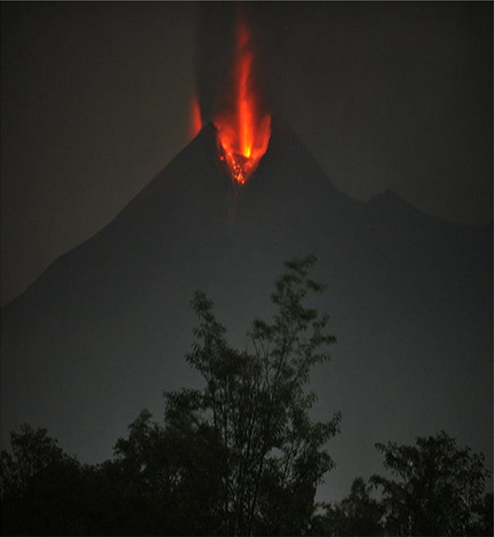
WHY?
Volcano Monitoring
Hundreds of millions live within 20 km of an active volcano today.
In 2010, the Eyjafjallajökull eruption brought losses of $200m/day, and 100,000 cancelled flights.
Merapi, Indonesia, erupting in 2010. From Pallister and others, 2013

Slide 3
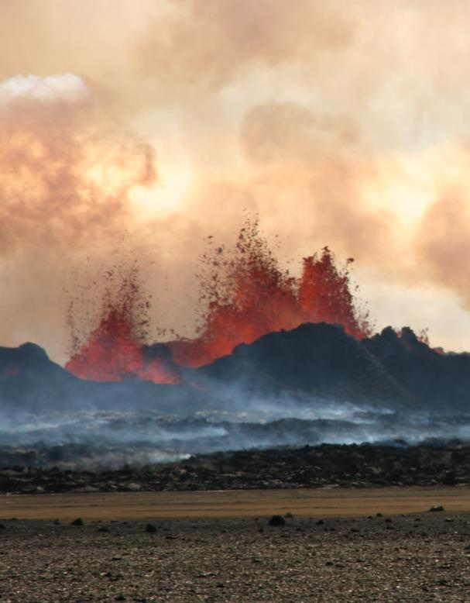
WHAT IS MISSING?
Volcano Monitoring
Only ~10% of the ~1500 active volcanoes in the world are being monitored in some way
Satellite observations are not coordinated for volcano monitoring
Need systematic observations / processing before, during, and after volcanic events
Bardarbunga, Iceland, erupting in 2014.
Photo credit: M Parks

Slide 4
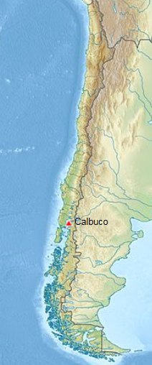
Calbuco, Chile
After 43 years of quiescence, Calbuco began erupting on 22 April 2015, with very little warning.
Large amount of ash, significant impact on air traffic on Chile and Argentina. Ash tracked and was communicated to VAAC Buenos Aires
Several 1000s people were evacuated from villages closest to Calbuco .
Other interferograms constrain the deformation to have started no more than 1.5 days before the eruption, and to have lasted no more than 1 day.
Partner agencies: SERNAGEOMIN (Chile); Buenos Aires Volcano Ash Advisory Center (Argentina); University of Bristol (UK); Cornell University (USA); NOAA (USA)
Notes:
Preliminary model of the deflation indicates that the source is located about 5 km SW of the volcano’s summit at a depth of 9.3 km beneath the surface, with a volume changes of ~0.045 km³. This source geometry and strength is consistent with recordings from a tiltmeter located 4 km W of the volcano.
SAR data used to characterize co-eruption surface deformation, and to constrain the location of the magma body that fed the eruption.

Slide 5
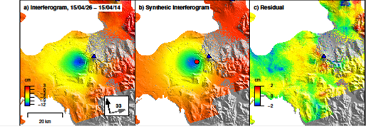
Calbuco, Chile
Observed (left), modeled (center), and residual (right) deformation at Calbuco from a Sentinel-1a interferogram spanning April 14–26, 2015. Deformation can be approximated by a source at ~9 km depth beneath the volcano’s west flank.
Observatorio Volcanológico de Los Andes del Sur (OVDAS) used this source model to validate their tilt meter records

Slide 6
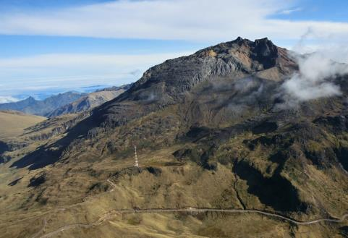
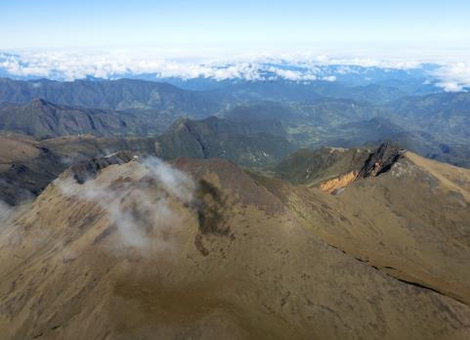
Chiles –
Cerro Negro de Mayasquer
Chiles- Cerro Negro are volcanoes on the Ecuador-Colombian border, with no historical activity
Since September 2014, thousands of small earthquakes every day – but no changes at the surface.
As there have been no historical eruptions, ground based monitoring is limited:
-> satellite data are critical
Chiles
Cerro-Negro
photos: Instituto Geofisico, Ecuador

Slide 7
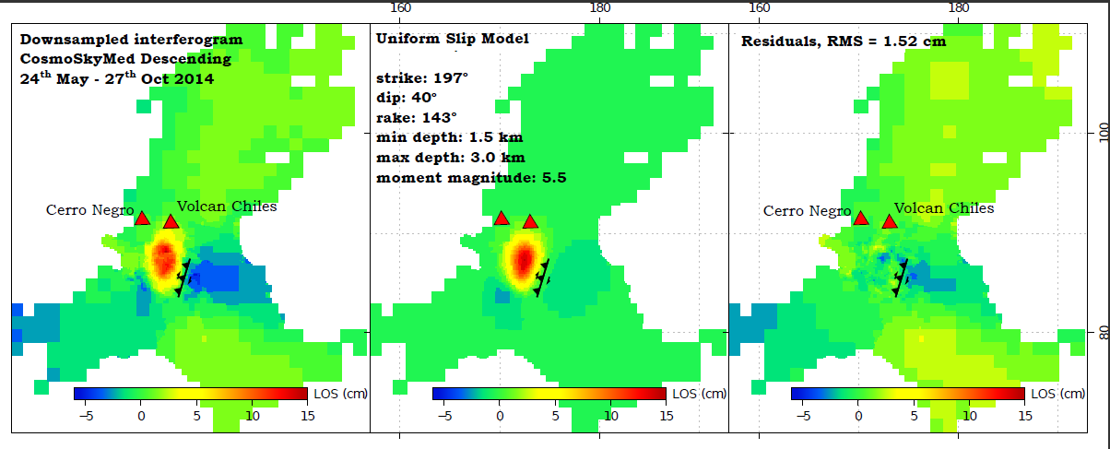
Chiles –
Cerro Negro de Mayasquer
Deformation Best-fit fault plane solution Residuals
The deformation detected using InSAR has so far been primarily associated with a larger (M5.6w) earthquake on the 22nd October 2014. This earthquake result in maximum displacements of 15 cm towards the satellite in a region SW of Chiles volcano.
The majority of deformation can be explained by oblique slip on a fault at depths ~1.5-3 km. Civil Defense in Colombia ordered the evacuation of 12,000 people.
Notes:
The majority of deformation can be explained by oblique slip on a fault at depths ~1.5-3 km dipping WNW. The orientation of this fault aligns well with faults mapped from regional topographic structures.

Slide 8
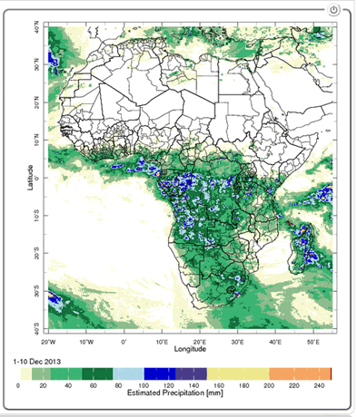
Flood & Climate Information for Management of Mosquito-Borne Diseases
Malaria and meningococcal meningitis epidemics: recurring problems in Africa
Risk for malaria transmission increases:
Average temperature between 18°C and 32°C
Average precipitation is greater than 80mm
Average relative humidity is greater than 60%
Estimated Precipitation
From SERVIR, NASA’s
Earth Science
PI: Pietro Ceccato,
Columbia UniversityTeam
Combined use of satellite observations and
performing models can provide accurate
predictions to local populations
Notes:
78% of events are infection diseases; 17 % are due to climate events (floods, droughts)

Slide 9
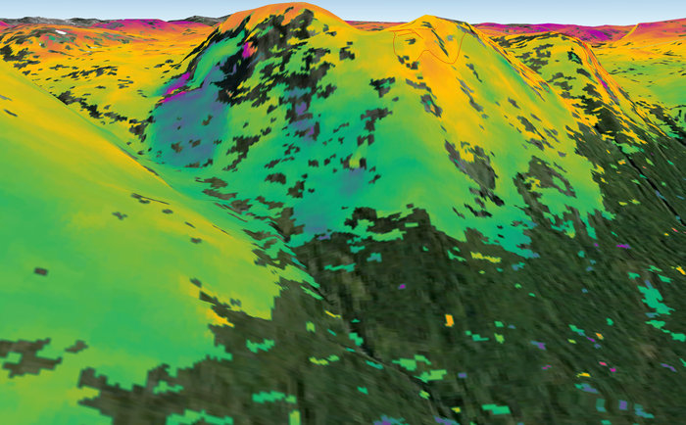
Landslide Risk Monitoring
‘Interferometric’ image showing surface deformation of a landslide in the municipality of Kåfjord in Troms county, Norway.
  Sentinel-1A radar scans from 23 Sep. and 30 Aug. 2014
In 24 days, the ground moved about 1 cm.

Slide 10
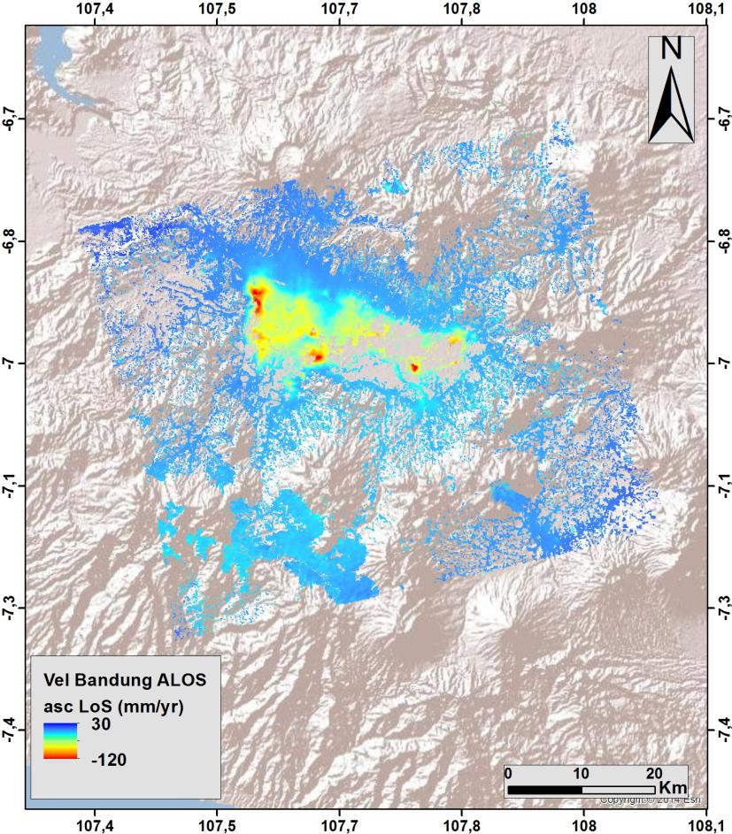
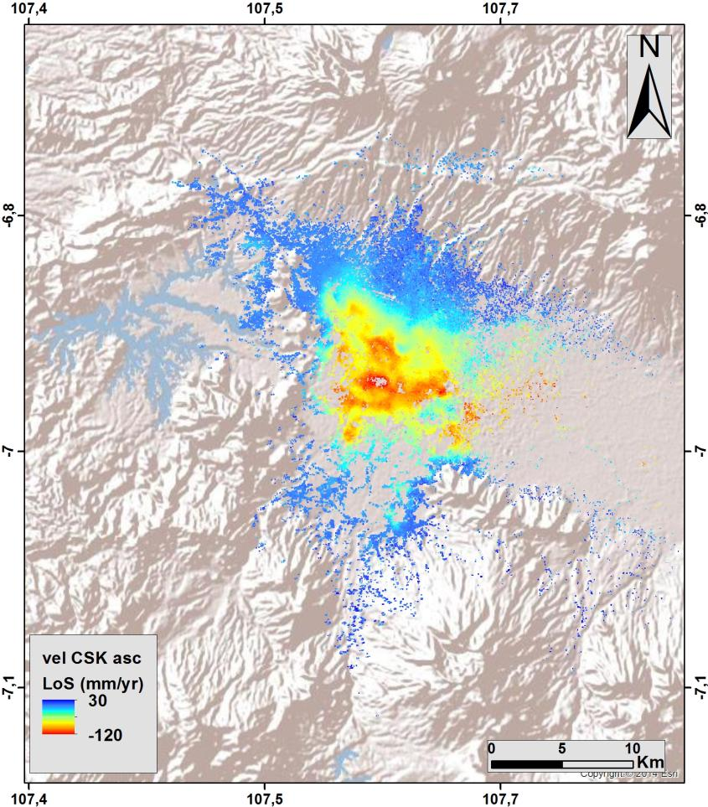
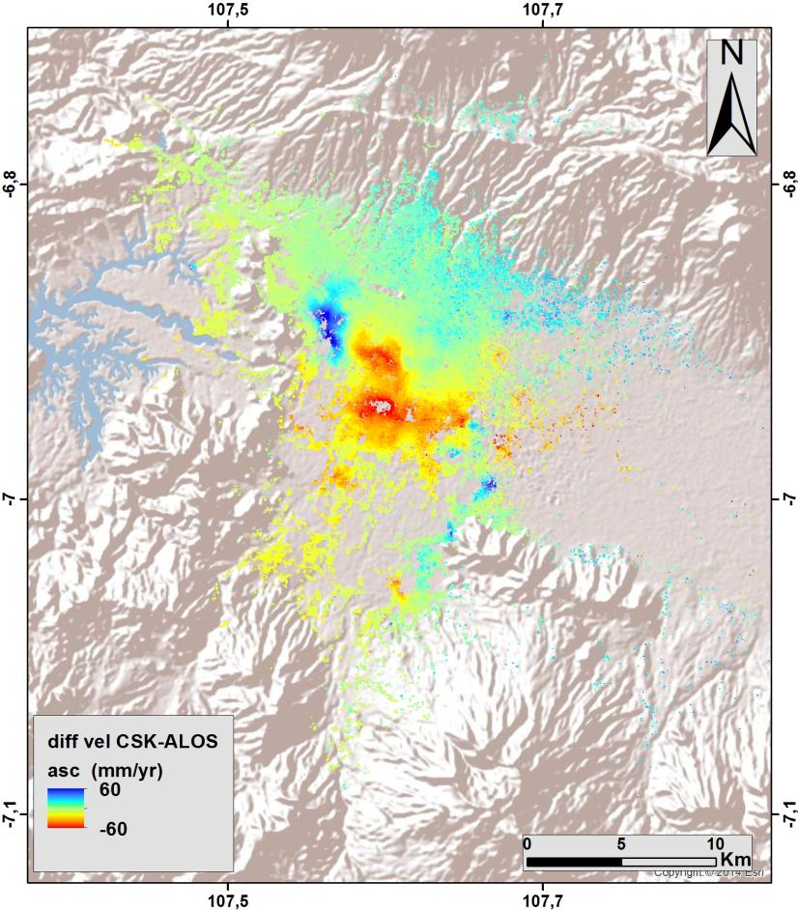
Flood Modelling in
South-East Asia
ALOS ascending (2007-2011)
CSK ascending (2013-2015)
Difference (CSK-ALOS)
(red = increased rate of subsidence)
Notes:
Using ALOS and CSK data, INGV calculated the changing rate of subsidence (2007-2015) in an urban flood plain in Bandung, Indonesia, with a view to improving risk assessment for long-term flood projections (RASOR Project).

Slide 11
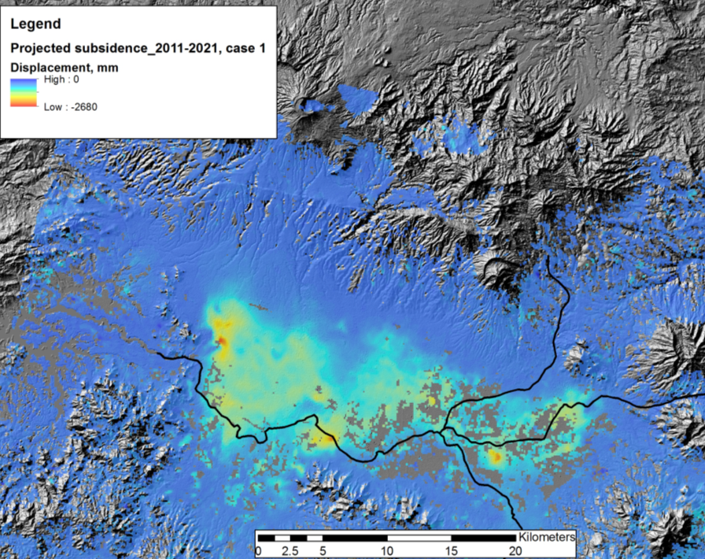
Floods Modelling
- Subsidence Projection
Other Activities:
Consultations on new pilot
products with UN, World Bank, and ICRC
Asian Disaster Preparedness
Center (ADPC, Bangkok
Thailand) to setup instance of
flood modeling and monitoring
processing and distribution
software installed under
cooperation with SERVIR and
USAID Oct-Nov 2015
Projected total subsidence by 2021 of up to 2.2 m along main drainage areas.
© INGV
11
Notes:
RASOR project showing subsidence impact on flood hazard in the Bandung area in West Java, Indonesia.

Slide 12
Value Added of Satellite EO
Main benefits of EO satellite data to DRR:
Complement in-situ, socio-economic and model data,
Sometimes, only data source available due to lack of ground observation.
Not affected by disasters and weather (radar).
Regularly monitoring of changes in a consistent manner
Large amount of space images are available for free
Can contribute to all phases of disaster risk management.
Can be used for exposure, vulnerability & risk assessment.

Slide 13
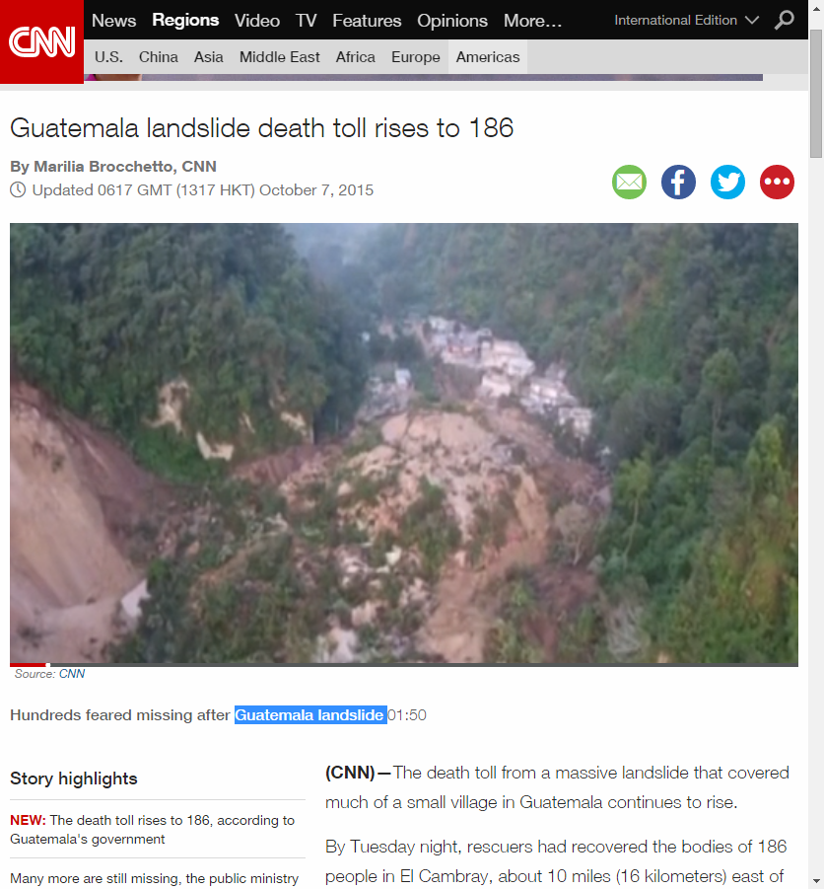
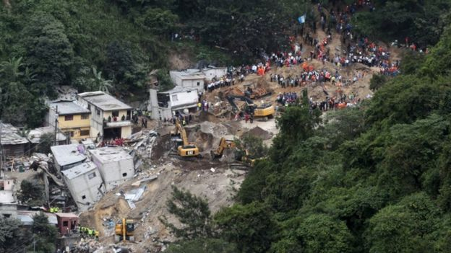
Why Landslides ?
Thank
you …

