Slide 1


Flood-FINDER
Forecast-based INtegrated Flood Detection for Emergency Response
Early activations for Flood monitoring using a Global Flood Forecast Model
CIMA Research Foundation
UNITAR – UNOSAT

Slide 2
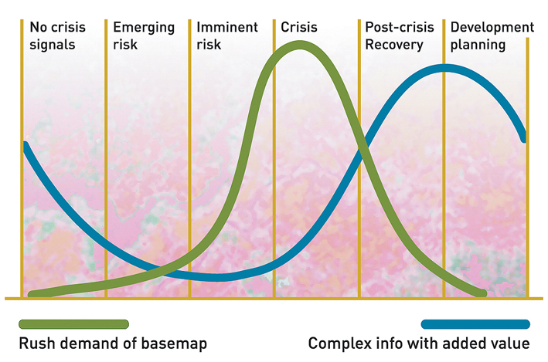
The needs
Flood Early Warnings System
Modelled Streamflow
and
Rapid Estimation
of
Flood Extent
Goals:
Improve disaster response planning with timely identification of potential affected areas, in particular for critical areas of the world that lack of data
supporting humanitarian actors during flood emergency with data and analysis
overcome delays due to the triggering process of satellite imagery
guide satellite image acquisition and fill in any gaps in the satellite image analysis
Notes:
Satellite services for emergency management are activated usually following the occurrence of an event of magnitude and effects above a given threshold.
The experience of the authors says that waiting the occurrence of events prevents to provide maps produced even in rush mode when they are actually needed, in the very first hours of the emergency
The presentation describes the experience of two case studies in which it is tested the possibility to activate satellite services during the forecast phase.

Slide 3

The problem: Early activation
Thanks to
Programming
Acquisition
Programming mode
Routine
Routine
First observation of the event
AFTER one day or more if based on event occurrence
Crisis
Crisis
Crisis
Crisis
Passages over Italy
*
*
*
09:30
13:30
21:30
06:21
8:30
18:21
06:21
00:00
Today
Tomorrow
Day after t.
00:00
00:00
Time in UTC;
The authorization procedure can anticipate deadlines of 1 h or more;
Notes:
In this example the timing for the activation at national scale of the CMOSMO-SkyMed (CSK) observing system is shown. This case quantifies the lower limit in the timing of activation without using forecasts

Slide 4
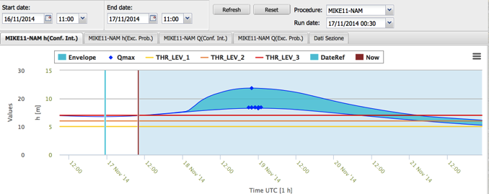
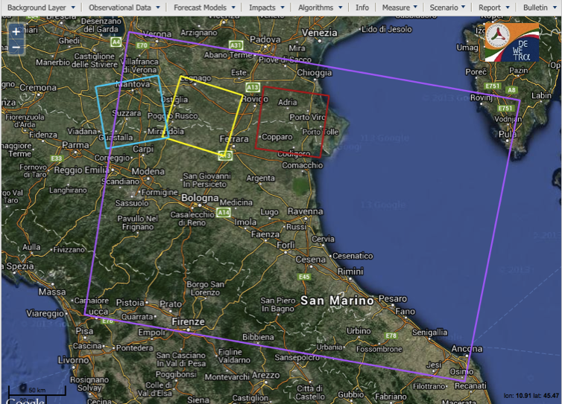
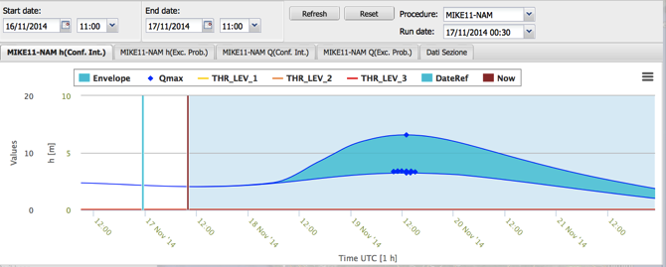
Solution: Trigger based upon flood wave propagation forecast
The Po river flood has been monitored from November 17 morning to November 20 evening, CSK acquisitions were planned based on predictions of the FEWS hydraulic model (Po Basin Authority). S1 pre-event image of October 24 and November 17 were used for permanent water bodies. FEWS predictions allowed to request real time access to the November 17th S1 image via the Italian collaborative ground segment.
November 19 01:00 UTC
CSK November 19 4:55 UTC
CSK November 19 17:53 UTC
CSK November 20 16:59 UTC
November 19 14:00 UTC
Forecast of Nov. 17, 00 UTC
S1A October 24 and November 17
05:18 UTC (pre-event)
Notes:
The next two slides show, using again the case of the activations of CSK on a national scale. Using the organization of the Italian Civil protection systems, that have operational flood forecast models implemented for the main Italian rivers, it was possible to significantly reduce the lag time between the beginning of the crisis and observations , making available the basemaps in the moment of greatest demand.

Slide 5
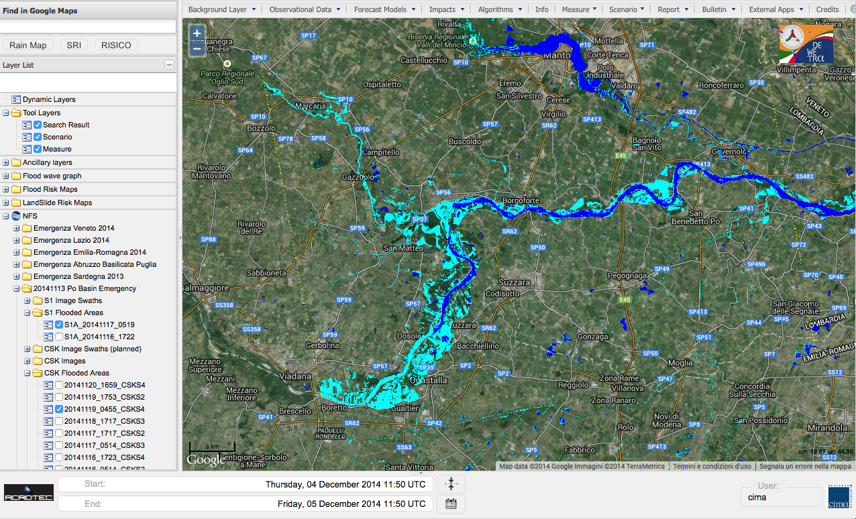
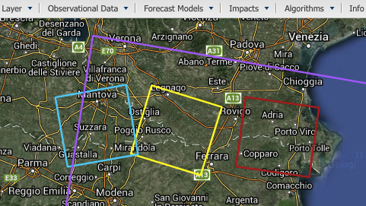
The acquisitions based upon forecast were successful: the lag time from flood occurrence to observation was reduced from 24 to 4 hours. The maps were delivered in less than 12 hours after the event .
Here the example of flooded areas extracted from the acquisition of November 19, 4:55 UTC is shown. Permanent water bodies (dark blue) are defined using the S1 interferometric pair (not available for CSK in this case)
CSK November 19 4:55 UTC
Notes:
These maps were delivered to the end user on November 19, early afternoon.
This case demonstrates the feasibility of a system of early activation based on flood forecast including hydrological and hydraulic modelling.

Slide 6
The proposal
USGS and UNOSAT developed a global hydrologically conditioned SRTM data for flood modelling (SRTM-FM)
CIMA and UNEP developed, in the framework of the GAR2015, a complete flood model including a distributed hydrological model and floodplain hydraulic model for hazard assessment at global scale
The system, designed for the hazard assessment, is adaptable for use in real-time
Simplified but reliable global flood forecasts models can provide forecasts of inundations for early activations
Compared to other global modelling suites, it includes the connection with an inundation model (USGS’s GFT), which can allow the prediction of the potential extension of the flood and its temporal evolution

Slide 7
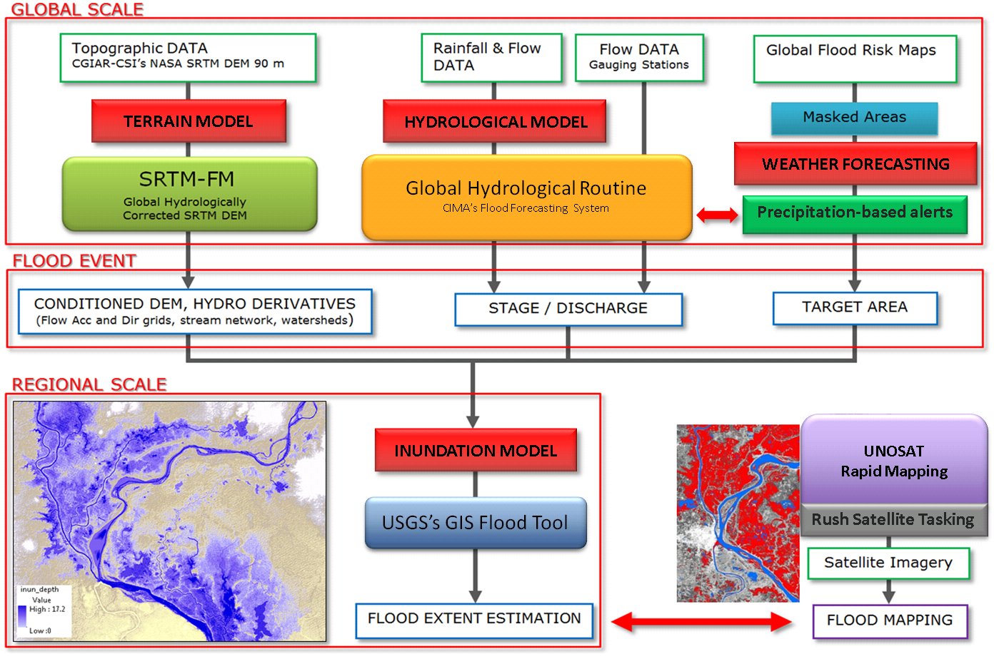
Forecast-based Integrated Flood Detection for Emergency Response
Satellite service activation module (SAM)
Notes:
This slide shows the structure of the system that has been tested for future operational implementation. Beyond the complexity, what has to be highlighted are the different modules, which includes, as input data and physical modelling, pre-existing elements or available free of charge. The effort will be to connect the different elements into an operational chain.
In order to test the feasibility of this project two testcases, described on the following slides, were analyzed

Slide 8
Testcases
Two pilot experiments have been carried out:
2011 Chao Phraya river (Thailand) flood - hindcast experiment
2015 Shire river (Malawi-Mozambique) flood - forecast experiment and early activation
Notes:
The two pilot experiments presented differ for the fact that the second was an experiment with real satellite services activation based upon mid-term flood forecast .

Slide 9
Chao Phraya River Basin
Thailand Floods 2015
Flood - hindcast experiment

Slide 10
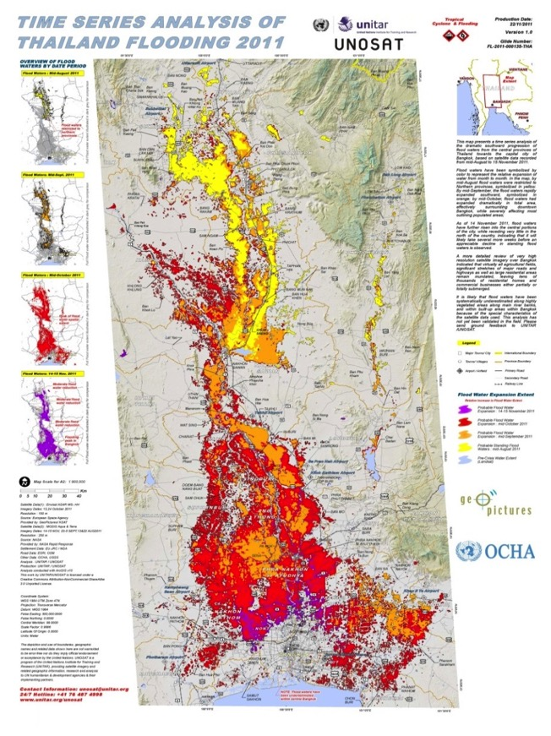
Hindcast: Chao Phraya pilot case
Thailand Flood event of 2011: first flooding started in Northern Thailand in the first half of August.
Test case goal:
simulating the ex-ante condition of having to forecast the beginning of this flooding, for the purpose to anticipate the programming of the satellite acquisitions in the preparedness phase

Slide 11
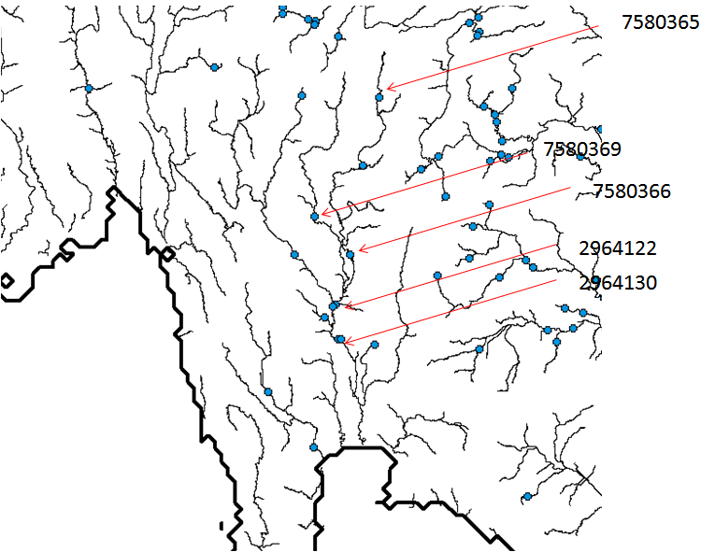
Hindcast: Chao Phraya pilot case
River sections of the Chao Phraya river
where the GAR2015 hydrological routine has been implemented

Slide 12
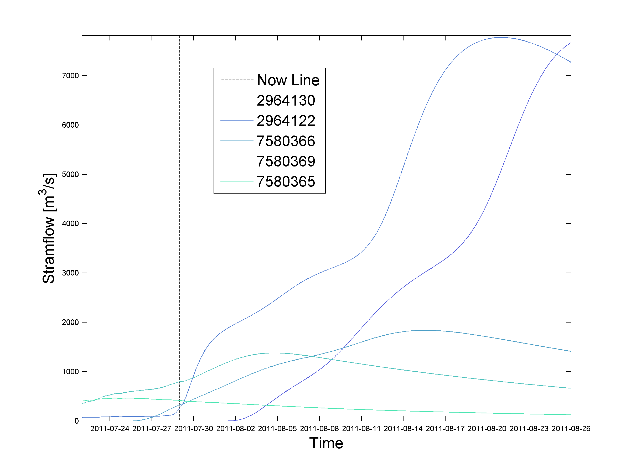
Forecasted river discharges
Notes:
This slides are shown the forecasts of the hydrological module for the month of August 2011, carried out with the data available to July 28th, 2011.
The forecasts showed a general increase of flow throughout the month with the highest values towards the end.
The values of expected flow rate were used to derive, through the hydraulic module, a prediction of the space-time dynamic of the flood. The results are shown in the following slides

Slide 13
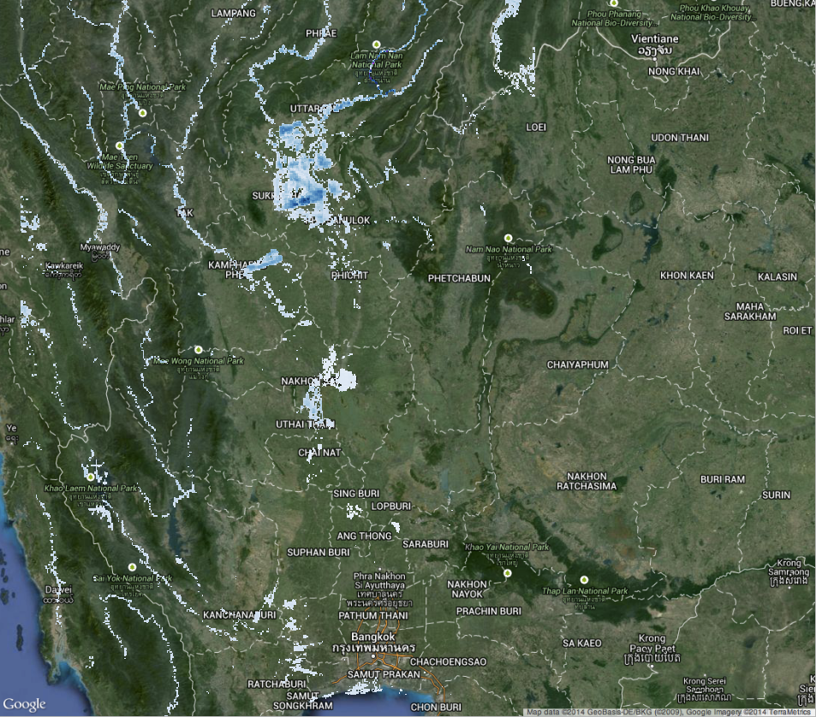
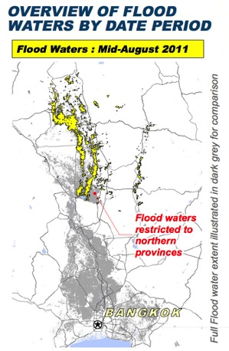
Predicted Flood conditions on August 2nd, 2011

Slide 14

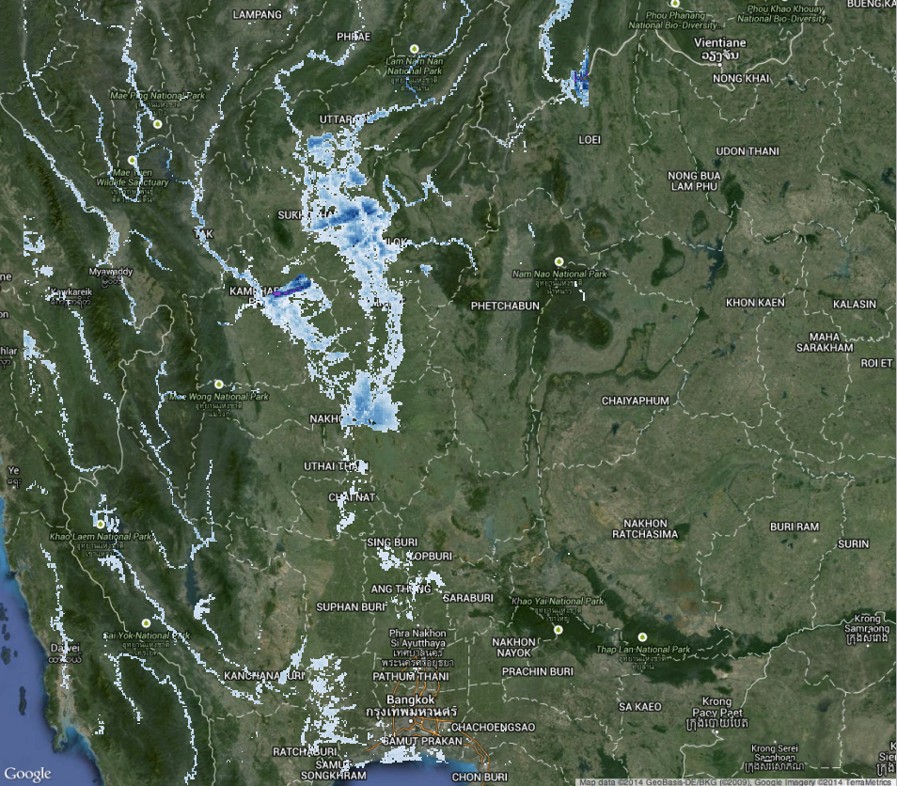
Predicted Flood conditions on August 14th, 2011
Notes:
The comparison between the flood maps derived from satellite observations of mid August and the scenario with the expected flood predicted with information updated on July 28 shows good agreement

Slide 15
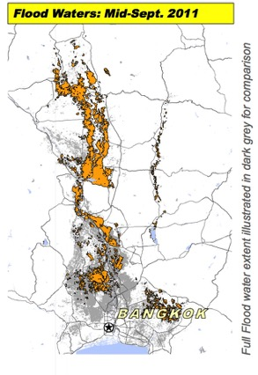
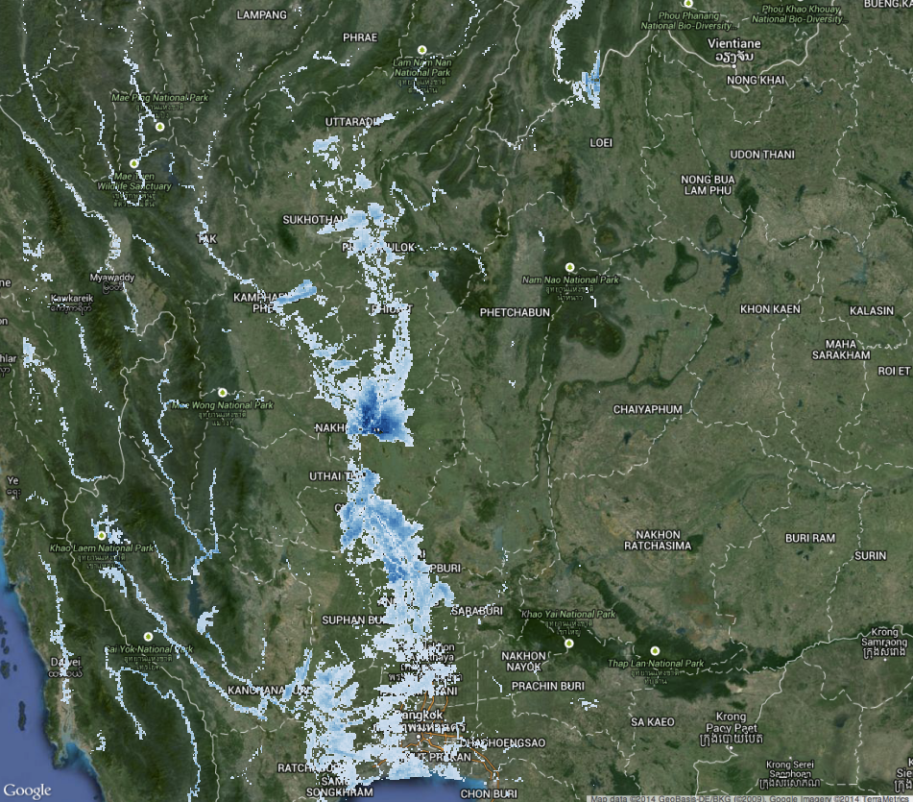
Predicted Flood conditions on August 31st, 2011
Notes:
Same as previous, end of August 2011

Slide 16
Outcomes from Testcase 1
Good agreement between flood forecasted scenario and observations.
The testcase demonstrated the use in operational configuration of the Global Flood Model designed for GAR 2015.
Some Additional activities are needed to transform it into a 24/7 service using supercomputing facilities.

Slide 17
Zambezi River Basin (Shire river)
Malawi-Mozambique Floods 2015
Flood - forecast experiment
and early activation
Notes:
In the second case, the pilot system was used to make forecast in real time, used to identify AOI for erarly activation of satellite services

Slide 18
Validation
Flood forecast were validated against satellite observations
Both the hydrologic module and the inundation module were validated

Slide 19
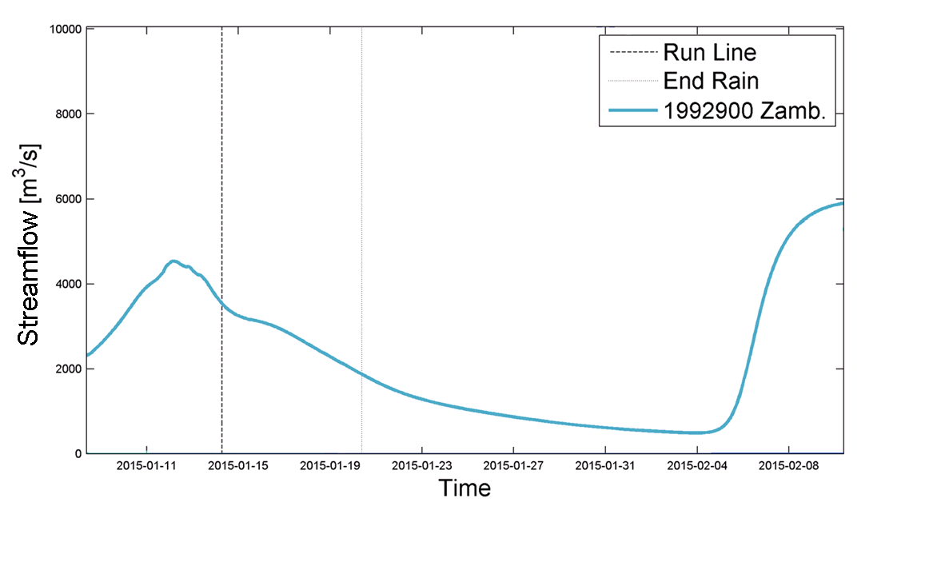
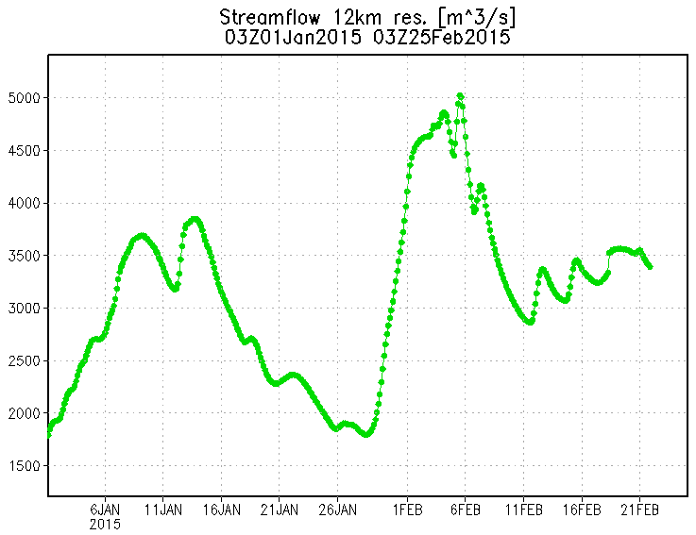
CIMA Forecast - 14 Jan
Mid term forecast
Event 1
Event 2
GFMS Forecast - 18 Feb
Forecasted Streamflow over the Chire River from CIMA Foundation and GFMS of University of Maryland
CIMA - Mid term forecast
GFMS - 5 days forecast
Event 2
Event 1
5 days
forecast
Notes:
The forecasts made in mid-January 2015 using both TRMM observations and GFS forecast (upper right panel) showed a possible new increase of discharge in the following 2-3 weeks.
It was expected then the permanence or even the increase of flood conditions, fueled by new contributions by the Shire.
This prediction was used to pre-program the RADARSAT-2 acquisitions for late January, early February , in order to monitor the possible effects of this increase in flow.
The prediction by Flood-FINDER is validated by a cross check with the GFMS outputs of the following weeks based on TRMM observations (lower right panel)

Slide 20
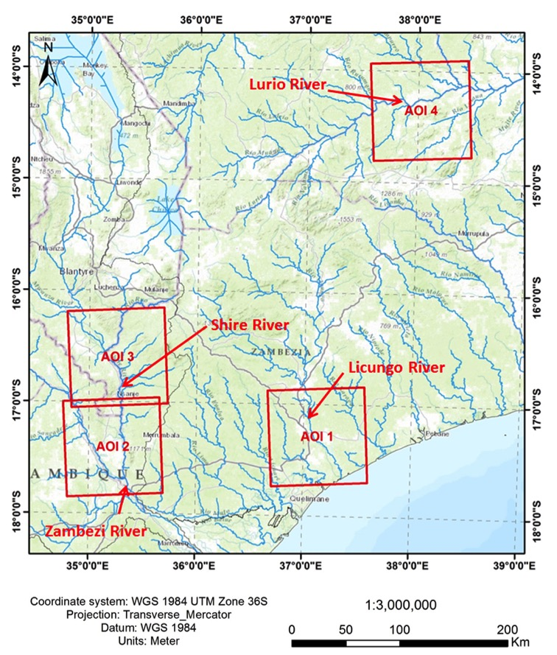
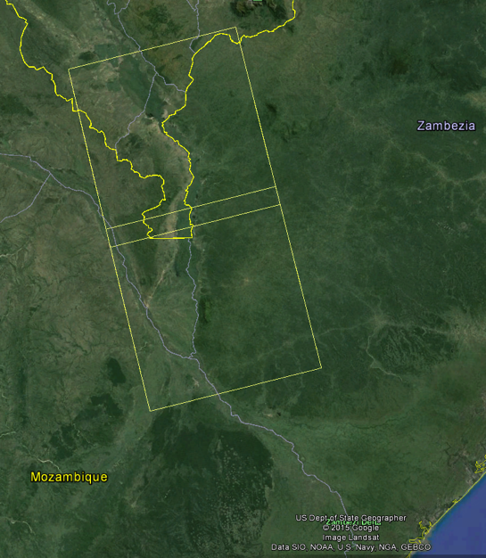
Modelling support & Rush Identification of AOIs
KSAT
Radarsat-2 tasking
30th of January
Frame start UTC Time: 2015-01-30T16:14
Notes:
The medium-term forecasts gradually confirmed by short-term forecasts by GFMS allowed the definition of AOIs and programming Radarsat-2 acquisitions starting from January 30, 2015

Slide 21
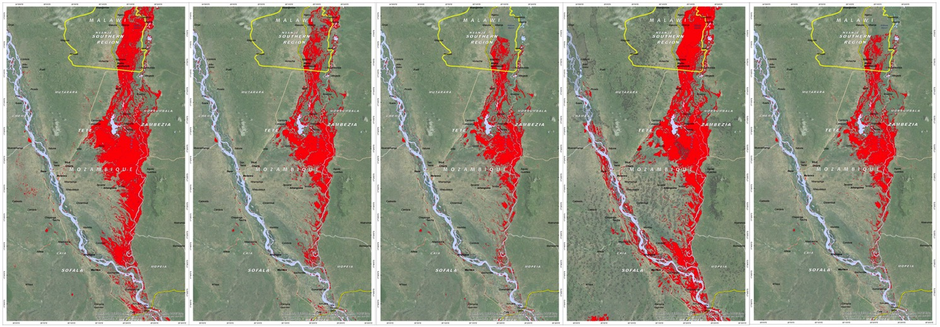
UNOSAT’s flood records from 21 of January to 13 of February
Jan. 21
Jan. 30
Feb. 04
Feb. 07
Feb. 13
Radarsat-2
Radarsat-2
Radarsat-2
Landsat-7
Radarsat-2
First floods have been recorded around 11-16Jan (MODIS Terra and Aqua). As recorded by Radarsat-2 waters receded until the beginning of February. Forecasted trends appeard to be very consistent to the observed evolution of this first event observed by satellite sensors. Despite larger extensions due to different impact of vegetation on L7 observations, on day 7 Feb a slight increase of the extent has been recorded which is probable caused by fresh waters of 5-6 Feb.
Notes:
The sequence of images shows that during the first week of February there was an actual increase (though limited) of flooded areas, confirming the validity of the mid-term forecasts

Slide 22

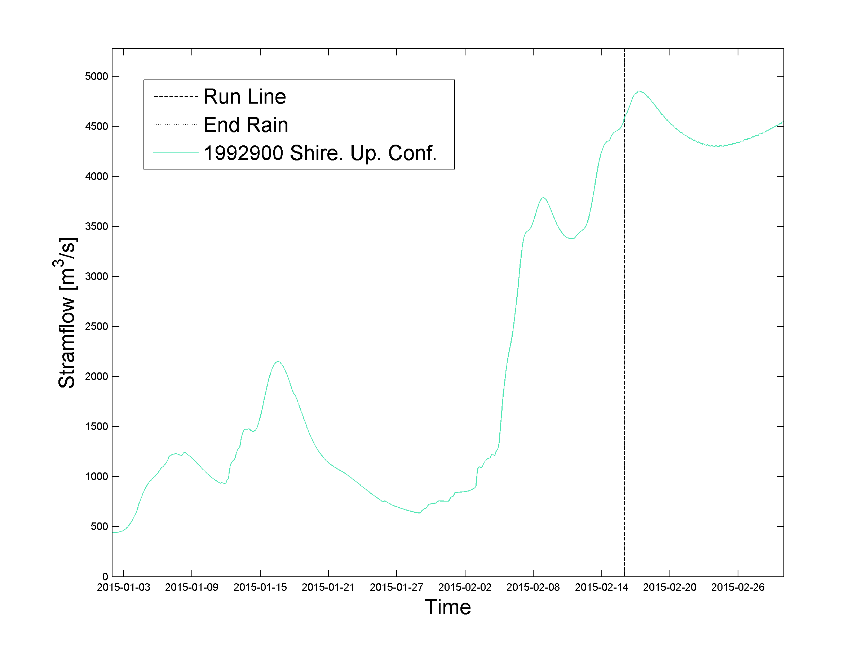
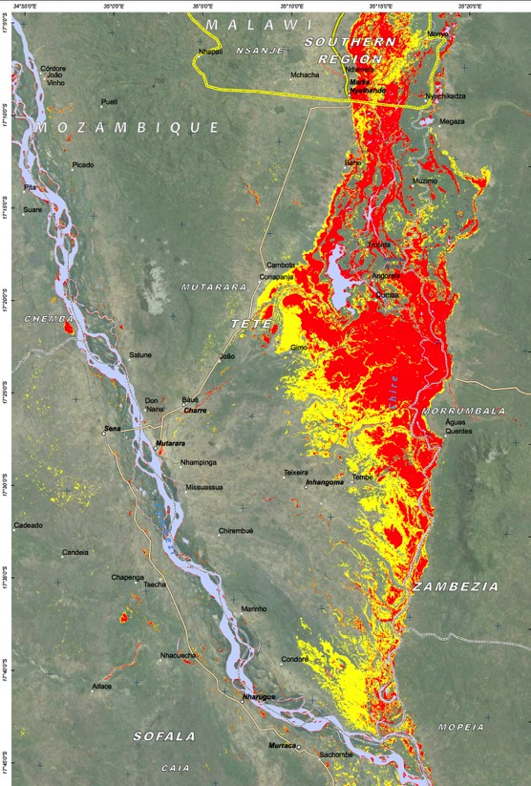
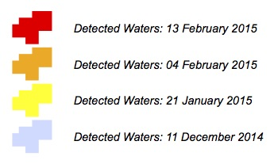
Streamflow estimation based on TRMM data and flood records (simulated)
From the beginning of the ascending phase of the hydrograph, around the end of January, the extent of the flood remained almost stable.
Notes:
This is a further validation of the predictions.
In the recession phase of the hydrograph (January 21 to 30) there was a substantial withdrawal of water, that stopped from 4 to 13 February. This testifies a supply of flood water (probably produced by the increase in flow in the river bed) compensating volumes drained in the same period.

Slide 23
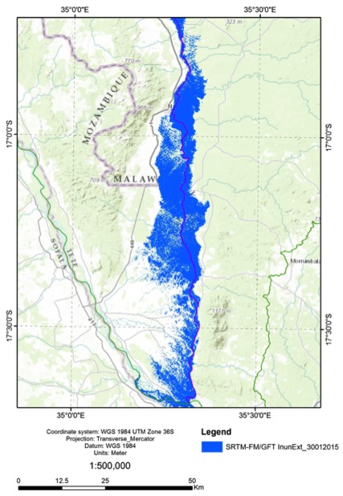
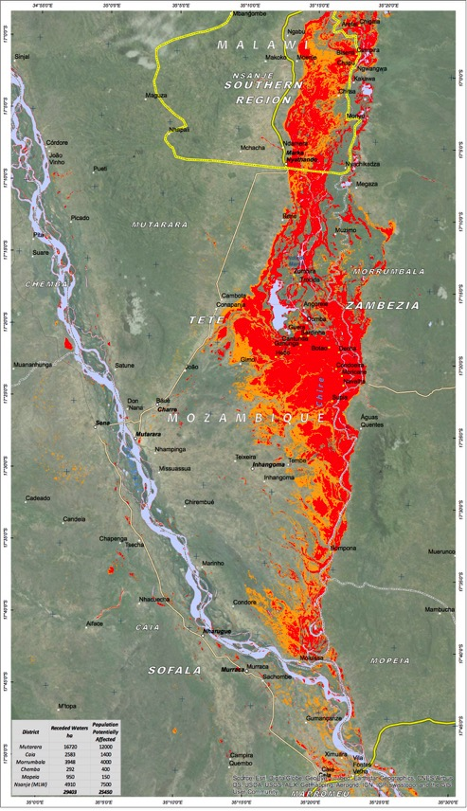
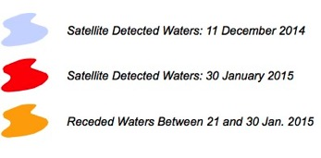
Comparison flood water extension and simulations (1)
Notes:
This slide and the next one provide a validation of the extension of the flooded area produced by the inundation model according to mid-term forecasts

Slide 24
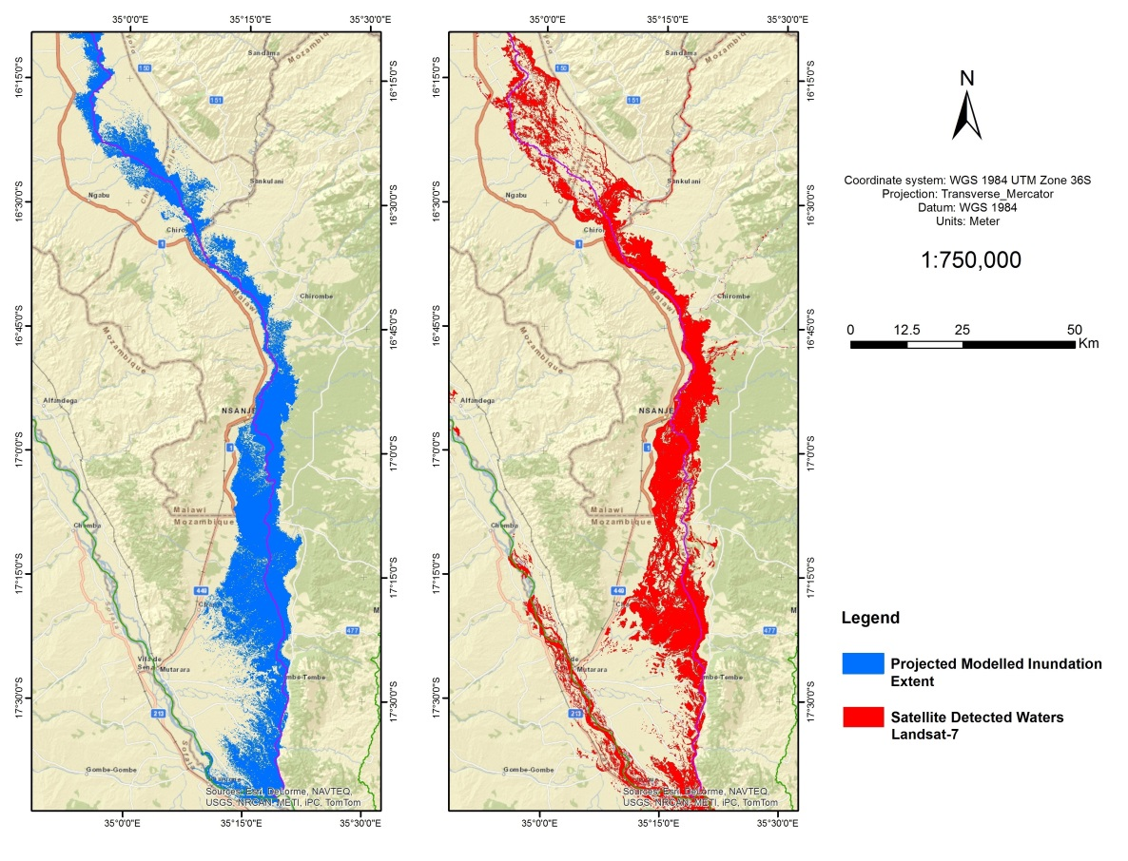
Comparison flood water extension and simulations (2)

Slide 25
Outcomes from Testcase 2
Results clearly show how the Flood-FINDER is able to predict fairly realistic streamflow values in both magnitude and timing.
Model results have been used to guide and support the definition of Areas of Interest (AOIs) for the rapid acquisition of satellite imagery and have been provided to OCHA, UNDAC and UN Humanitarian Country Teams. UNOSAT’s analysis supported UN Humanitarian Country Teams and UNDAC team deployed in the field with information on affected population over areas not directly covered during field assessments.
TRMM rainfall observations and model simulations does not explain the larger extension of the first flood since discharge values simulated by different models for the previous days are underestimated. The explanation is probably to be sought in the uncertainty on TRMM based precipitation estimates and in the poor knowledge of the behaviour of Lake Malawi in terms of discharge lamination.

Slide 26
Conclusions from testcases
Both testcases demonstrated the potential use of the proposed modelling chain for emergency response and rush mapping.
There is a clear agreement between forecast trend of streamflow derived from the Hydrological Forecasting System (HFS) and observed flood evolutions. On the other hand, daily streamflow estimation seem to be more uncertain due to global modelling limitations.
Anyway to have a mid-term trend is already a significant added value: for the programming of satellite acquisitions is often enough to know whether, when and where the extension of the flood may increase or decrease
The Inundation Model (IM) provided flood extents consistent with later observations.

