Slide 1

CEOS Disaster Risk Management Flood Pilot Status and Plans
Presented at the CEOS Disasters Working Group Meeting #4 in Frascati, Italy
Co-Lead Stu Frye (stuart.frye@nasa.gov)
Co-Lead Bob Kuligowski (bob.kuligowski@noaa.gov)
NASA DisWG Rep David Green (david.s.green@nasa.gov)
8-10 September 2015

Slide 2
Outline
Flood Pilot overview
Status of data acquisition and exploitation
Pilot status report:
  Objective A: Global component status
  Objective B: Regional component status
    Caribbean/Central America
    Southern Africa
    Southeast Asia
    Ad hoc Texas component
  Objective C: Capacity Building
Issues and Risk Management

Slide 3
CEOS DRM Flood Pilot Overview
Goal: demonstrate effective application of EO to the full cycle of flood management at all scales by:
  Objective A: Integrating information from existing NRT global flood monitoring / modeling systems into a Global Flood Dashboard;
  Objective B: Delivering EO-based flood mitigation, warning, and response products and services through regional end-to-end pilots in:
    Caribbean/Central America (focus on Haiti)
    Southern Africa (inc. Namibia, South Africa, Zambia, Zimbabwe, Mozambique, and Malawi);
    Southeast Asia (focus on lower Mekong Basin and Java)
  Objective C: Encouraging at least base-level in-country capacity to access EO and integrate it into their operational systems and flood management practices
3

Slide 4
Data Acquisition Status
Detailed EO Requirements for each Pilot approved at 2013 Plenary; acquisition allocations approved at 2014 Plenary
Individual requests from each Pilot coordinated by co-leads and detailed on consolidated request form
Mission / Instrument | Repeat or Revisit | Swath | Resolution | Agency | Image Counts
 |  |  |  |  | Annual Quota | Last 6 months | Total
Optical - Coarse Resolution (>100 m)
Terra / MODIS | 1 day | 2230 km | 250, 500, 1000 m | NASA
Aqua / MODIS | 1 day | 2230 km | 250, 500, 1000 m | NASA
NPP / VIIRS | 1 day | 3000 km | 375, 750 m | NASA
Optical - Moderate Resolution (10 to 100 m)
Sentinel-2A / MSI | 10 days | 290 km | 10, 20 m | ESA | ? | N/A | N/A
EO-1 / ALI | 204 days | 185 km | 10, 30 m | NASA | 300 | 42 | 112
Landsat-8 / OLI | 16 days | 183 km | 15, 30 m | USGS | 730 | ? | ?
Optical - High Resolution (<10 m)
SPOT (archive only) | 26 days | 60 km | 1.5 and 6 m | CNES |  | 0 | 0
Pleiades | 26 days | 20 km | 50 cm and 2 m | CNES | 50 | 0 | 0
C-Band SAR
Sentinel-1A / SAR | 12 days | 80, 250, 400 km | 9, 20, 50 m | ESA |  | 15 | 15
Radarsat-2 / SAR-C | 1-6 days | 8-500 km | 0.8 to 100 m | CSA | 500 (3 yr) | 110 | 200
ALOS-2 / PALSAR-2 | 14 days | 25 to 490 km | 10 to 100 m | JAXA | 100? | 0 | 0
X-Band SAR
Cosmo Sky-Med / SAR-2000 | 5 days | 10-200 km | 1 to 100 m | ASI | 300 | 67* | 67*
* 50 of the 66 CSK images were archive images that counted toward the 2014 quota
4

Slide 5
How Data Are Being Exploited
Geographic Area | Product | Value Added Partner
Haiti | Flood extent maps, flood risk maps, landslide maps, flash flood guidance / threat maps, integrated risk assessment platform | SERTIT, CIMA, INGV, Altamira, CIMH, RASOR FP7, NOAA/HRC
Other Caribbean islands, Central America | Flood damage maps, change detection products, co-registered map overlays | CATHALAC, CIMH, NASA/GSFC
Namibia | Flood extent maps, flood warning products, co-registered map overlays | Namibia Hydrology Dept, Namibian Water Authority, NASA
Zambezi basin | Flood extent maps, flood forecast models, flood hazard maps, flood depth forecasts | Lippmann Institute (PAPARAZZI, HAZARD, WATCHFUL), DELTARES, NASA/JPL
Mekong | Flood extent maps, flood risk maps, flash flood guidance / threat maps | Mekong River Commission, NASA, NOAA/HRC, USGS, University of South Carolina, Texas A&M
Java (Bandung, Jakarta, Cilacap) | Flood risk maps, subsidence maps tied to flood risk, tsunami risk maps (Cilacap only), flood extent maps | SERTIT, Deltares, CIMA, Altamira, INGV, RASOR FP7
Products used by: national end users, civil protection agencies, World Bank, Red Cross, World Food Program, River Commissions (Kavango, Zambezi, Mekong)
5

Slide 6
Outline
Flood Pilot overview
Status of data acquisition and exploitation
Pilot status report:
  Objective A: Global component status
  Objective B: Regional component status
    Caribbean/Central America
    Southern Africa
    Southeast Asia
    Ad hoc Texas component
  Objective C: Capacity Building
Issues and Risk Management

Slide 7
Objective A: Global Component Status
2014 Milestone: initial pilot Global Flood Dashboard website with linkages to major global projects and systems and archive flood products
2015 Milestone: functional linkages between the Global Flood Dashboard and the three regional flood component areas; indication of regions of interest based on reports of flooding; showcase at WCDRR
Status: 50% complete—initial site design completed and linkages defined but still looking for a host. Four possible options being explored:
  Host at GSFC using a copy of the Southern Africa Flood Dashboard as a platform, retrieving data anywhere requested by the user;
  Host on DEWETRA platform at CIMA with links to individual products, organized by event
  Implement Open Geo-Social API publishers for each global data server
  (Last resort) Site on the Matsu cloud with static links to all individual pages serving global products

Slide 8
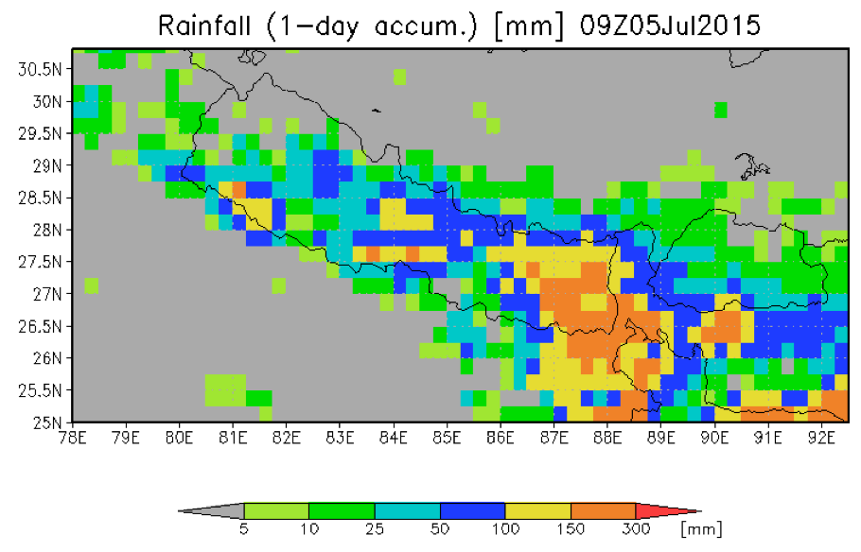
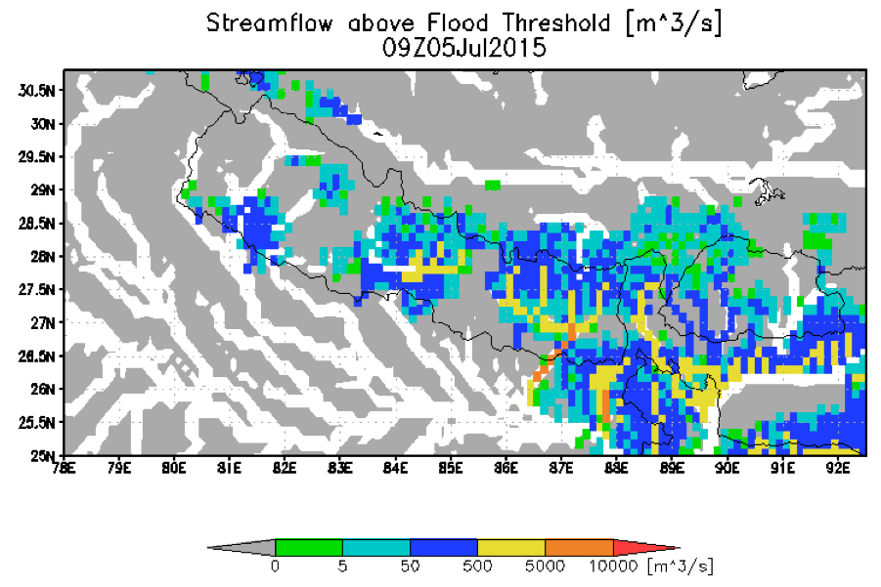
Global Component Highlight: GFMS
GFMS cited by UN World Food Program:
  "The Global Flood Monitoring System (GFMS) provides one key step further by indicating how an excess rainfall event will impact river flow, and also whether there is a potential for flooding downstream away from the heavy rain event," said Emily Niebuhr of the UN’s World Food Program (WFP) in Rome. "We check the GFMS nearly every single day to monitor current flood concerns, and also to assist in discovering new flood events that may not have been reported yet or are developing”.
Nepal Department of Hydrology and Meteorology and ICIMOD used GFMS data after the Nepal earthquake

Slide 9
Outline
Flood Pilot overview
Status of data acquisition and exploitation
Pilot status report:
  Objective A: Global component status
  Objective B: Regional component status
    Caribbean/Central America
    Southern Africa
    Southeast Asia
    Ad hoc Texas component
  Objective C: Capacity Building
Issues and Risk Management

Slide 10
Objective B: Caribbean/Central American Component Status (1/4)
2014 Milestones:
  Flood dashboard based on Namibia pilot adapted to Caribbean and Central American users
    Status: Prototype Flood Dashboard completed: http://matsu-flashflood.opensciencedatacloud.org/
  Flood monitoring (i.e., targeted EO data acquisitions)
    Status: Targeted EO acquisitions in 2014 for Guatemala, Panama, Trinidad, Haiti, and Belize
  Contributions of data to KAL Haiti data base
    Status: Completed

Slide 11
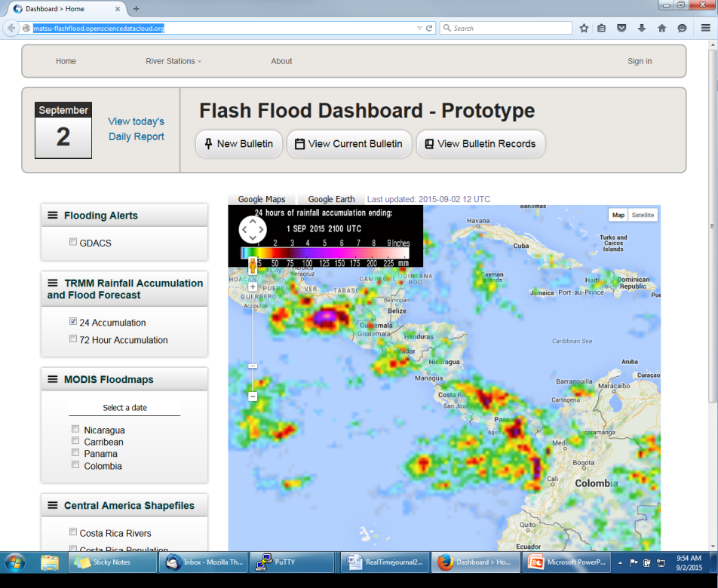
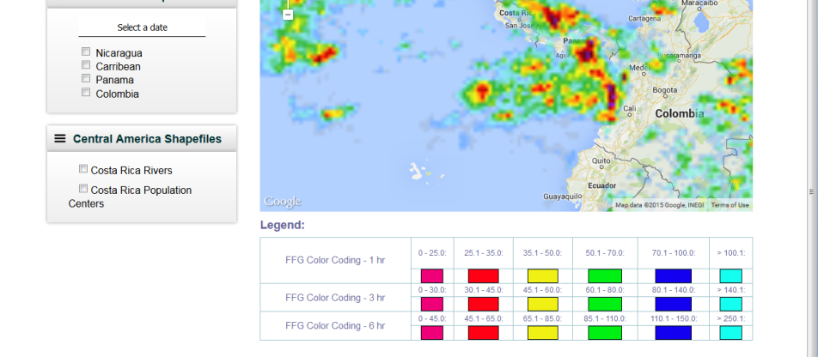
Objective B: Caribbean/Central American Component Status (2/4)
http://matsu-flashflood.opensciencedatacloud.org/

Slide 12
Objective B: Caribbean/Central American Component Status (3/4)
2015 Milestones:
  Flood monitoring during 2015 season
    Status: EO-1 / MODIS / Landsat flood maps for CATHLAC for June floods in Panama; COSMO-Sky-Med, Radarsat-2, and EO-1 data for coverage of Dominica after TS Erika in August
  RASOR risk management platform operational for flood risk and landslide risk analysis in Haiti
    Status: COSMO-SkyMed data (from KAL-Haiti database) to RASOR team for subsidence work and revised flood risk maps
  10-year flood archive based on Deltares Flood Monitoring Programme
    Status: DELTARES has ceased efforts (lack of funding???)
Overall Status: 50% complete.

Slide 13
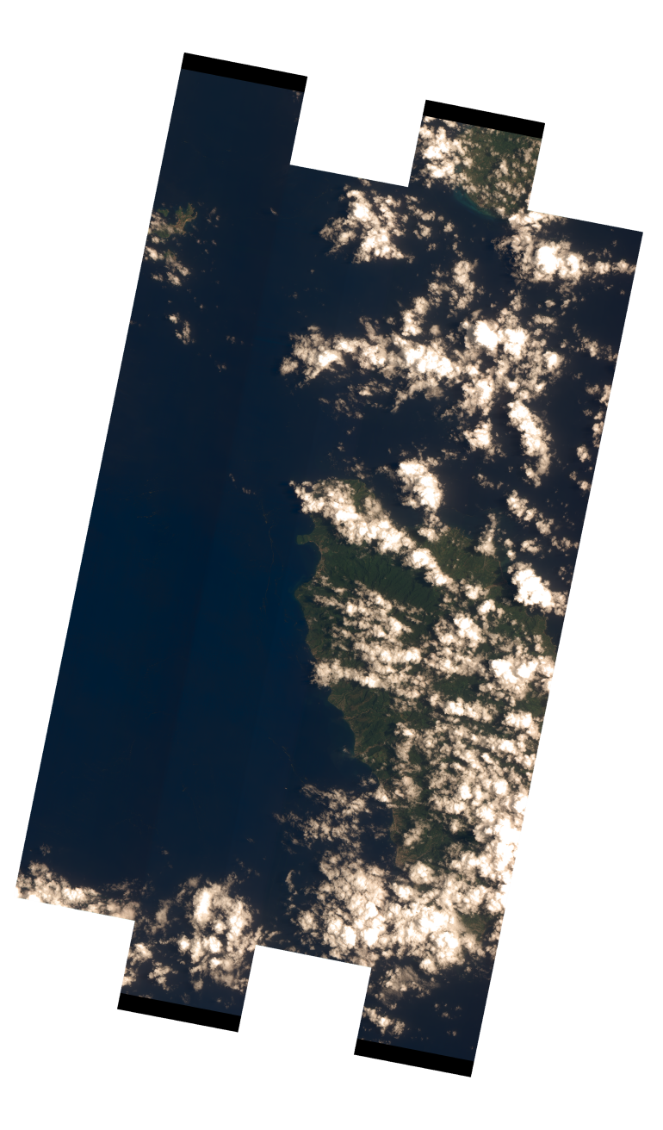
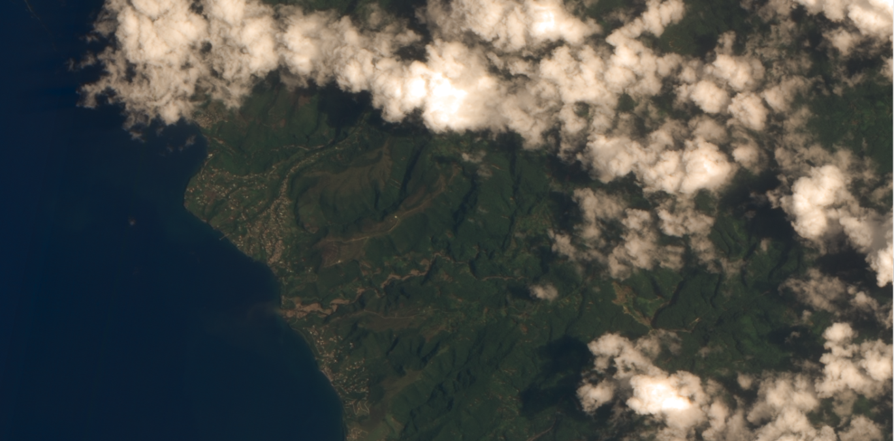
Objective B: Caribbean/Central American Component Status (4/4)
EO-1 image of Dominica from 1245 UTC 2 September 2015 (NOTE: was first available non-cloudy image)

Slide 14
Objective B: Caribbean/Central American Component Status (5/4)
Other Planned Activites
  Collection of background Radarsat-2 pre-event imagery at known look angles and modes for the entire region (CSA-Giguere)
    Status: 4 rounds of background collections completed and in archive
  Damage assessment studies to analyze satellite-derived inputs as compared to ground-based manual techniques (CIMH-Farrell)
    Status: Case study performed in Saint Vincent and the Grenadines…combination of radar and optical technique being evaluated for general application by CIMH
  Open GeoSocial API for publishing flood modeling and monitoring products to be installed September 2015 as part of the disasters component of the Climatic Information Platform for Central America and the Dominican Republic under the Regional Climate Change Program (RCCP) funded by USAID. The software suite will be hosted by DAI in Costa Rica under grant from SICA/CEPREDENAC

Slide 15
Outline
Flood Pilot overview
Status of data acquisition and exploitation
Pilot status report:
  Objective A: Global component status
  Objective B: Regional component status
    Caribbean/Central America
    Southern Africa
    Southeast Asia
    Ad hoc Texas component
  Objective C: Capacity Building
Issues and Risk Management

Slide 16
Objective B: S. Africa Component Status (1/3)
2014 Milestones:
  Flood monitoring during early 2014
    Status: Acquisitions from NASA and CSA under previous agreement within GEO task
  Updates to flood dashboard
    Status: Upgraded Flood Dashboard completed: http://matsu-flashflood.opensciencedatacloud.org/
2015 Milestones:
  Flood monitoring during early 2015
    Status: Radarsat-2 images provided for Namibia during flooding on 24 Feb; three Archive Radarsat-2 images of Malawi (early January—ordered in March) provided to LIST for Flood Hazard Mapping that were Disaster Charter acquisitions
  10-year flood archive over region based on Deltares Flood Monitoring Programme
    Status: DELTARES has ceased efforts (lack of funding???)
Status: 75% complete.

Slide 17
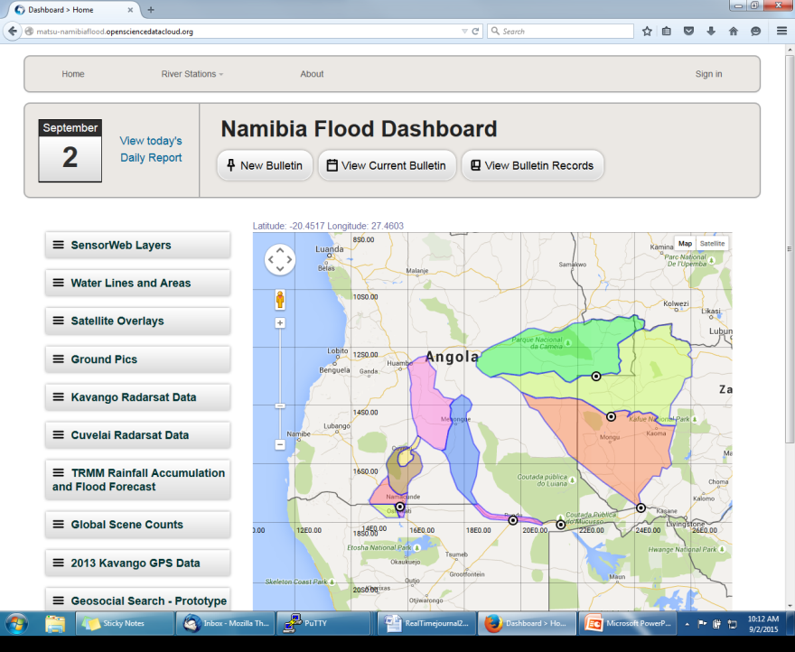
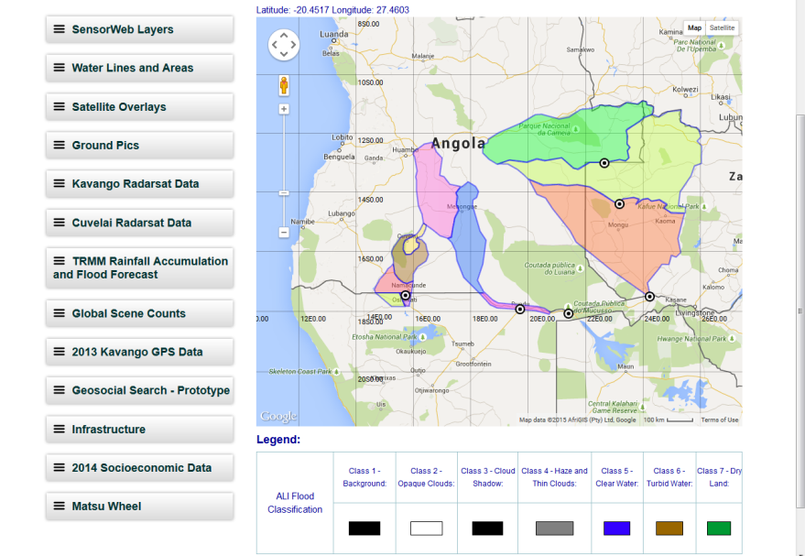
Objective B: S Africa Component Status (2/3)
http://matsu-namibiaflood.opensciencedatacloud.org/

Slide 18
Objective B: S Africa Component Status (3/3)
Other Planned Activites
  Improvements to flood model by computing river width and deriving more realistic and complete stream networks derived from Landsat-8 (UCLA-Schumann)
    Status: In-progress
  Implementation of regional CREST flood model in Namibia, Kenya, and South Africa (U of Oklahoma-Hong/Flaming)
    Status: Completed…training conducted on-site in Windhoek Namibia March 28-April 2 2015

Slide 19
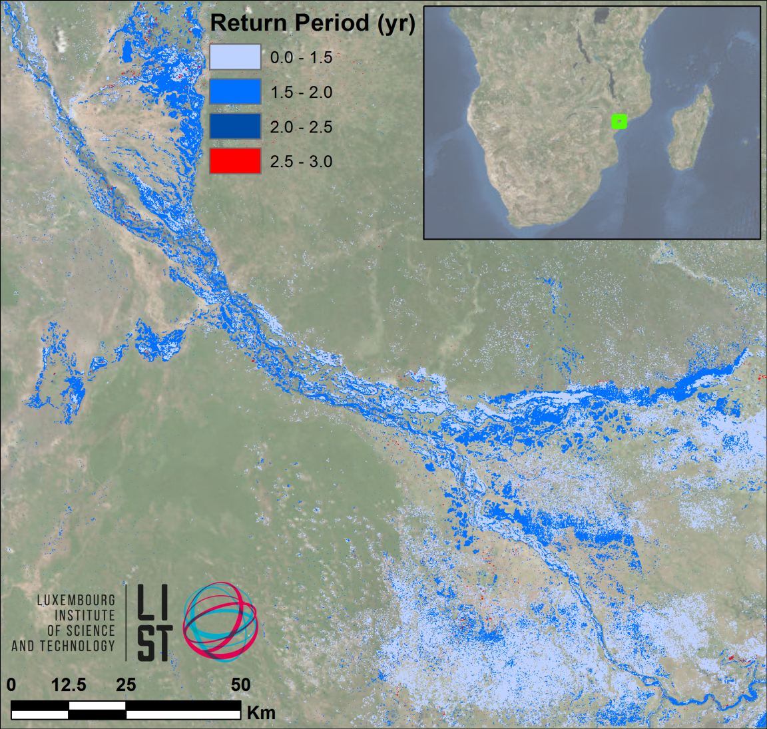
Southern Africa Component Highlight
LIST flood hazard maps determine flood severity by comparing flood extent in a SAR image with computed extent / return period from simulated historic floods
The UN World Food Programme has shown interest

Slide 20
Outline
Flood Pilot overview
Status of data acquisition and exploitation
Pilot status report:
  Objective A: Global component status
  Objective B: Regional component status
    Caribbean/Central America
    Southern Africa
    Southeast Asia
    Ad hoc Texas component
  Objective C: Capacity Building
Issues and Risk Management

Slide 21
Objective B: SE Asia Component Status (1/7)
2014 Milestones:
  User consultations on new pilot products
    Status: Meeting with ICIMOD held September 2014 to arrange flood mapping software installation for early 2015, meeting with ADPC delayed at request of host agency
  Test TRMM/GPM-based Global Flood Modeling System (GMFS) 1km resolution flood modeling product over the Lower Mekong Basin (contingent on river gauge data being obtained)
    Status: On hold—unable to obtain gauge data so far
  Flood Dashboard development based on Namibia pilot example adapted to SE Asia users;
    Status: Completed http://matsu-seasia.opensciencedatacloud.org/

Slide 22
Objective B: SE Asia Component Status (2/7)
2015 Milestones:
  Operational test bed for RASOR risk management system for test sites in Java
    Status: INGV / RASOR subsidence maps for 2007-11 and 2013-15 completed plus projected subsidence maps for flood risk update
  Integration of flood dashboard
    Status: Completed http://matsu-seasia.opensciencedatacloud.org/ however funding ceased for automation of dashboard updates, so not all data being served is current
  Initial services for Mekong River Commission
    Status: ADPC to host Open GeoSocial API Flood Monitoring software suite during October-November 2015
  10-year flood archive over region based on Deltares Flood Monitoring Programme
    Status: DELTARES has ceased efforts (lack of funding???)
  1st new TRMM/GPM and other flood monitoring products
    Status: iMERG products now available at GPM website and to be served under Open GeoSocial API access starting November 2015
Status: 75% complete.

Slide 23
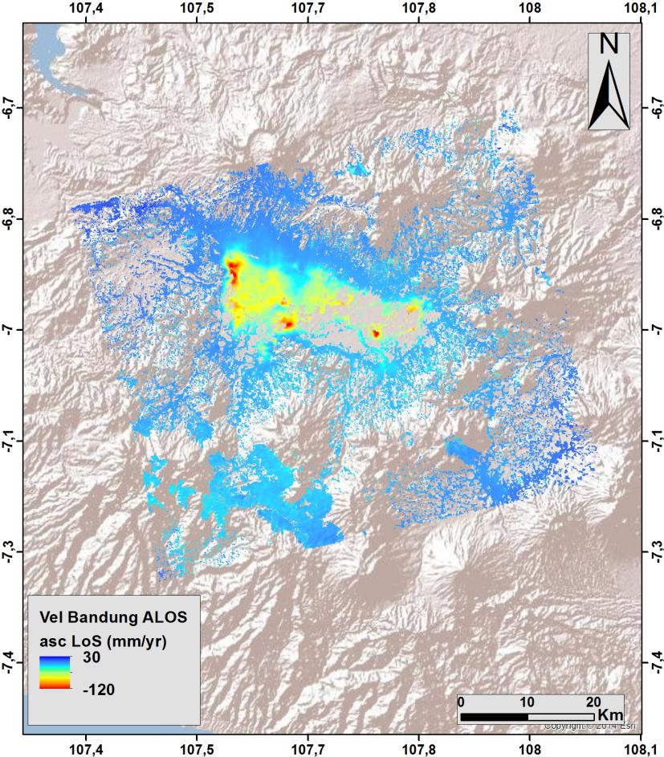
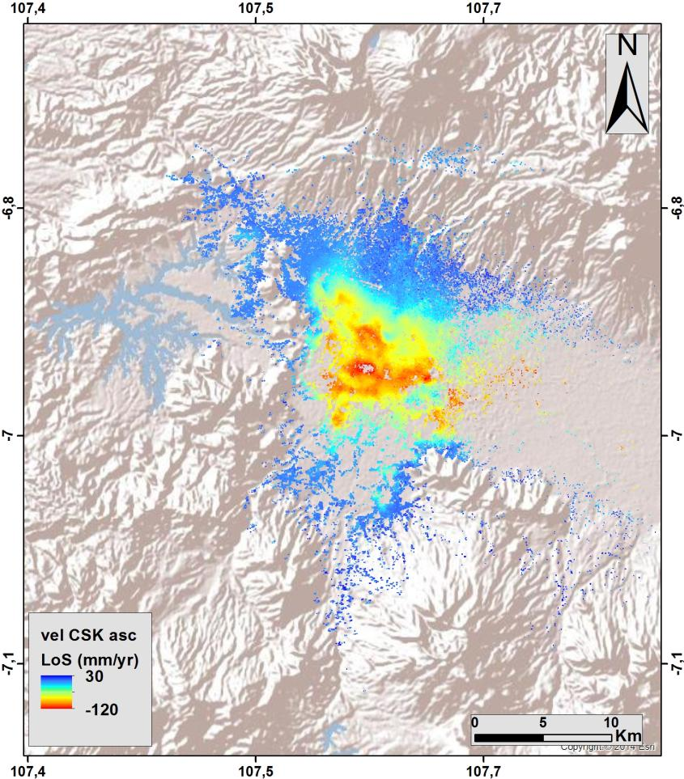
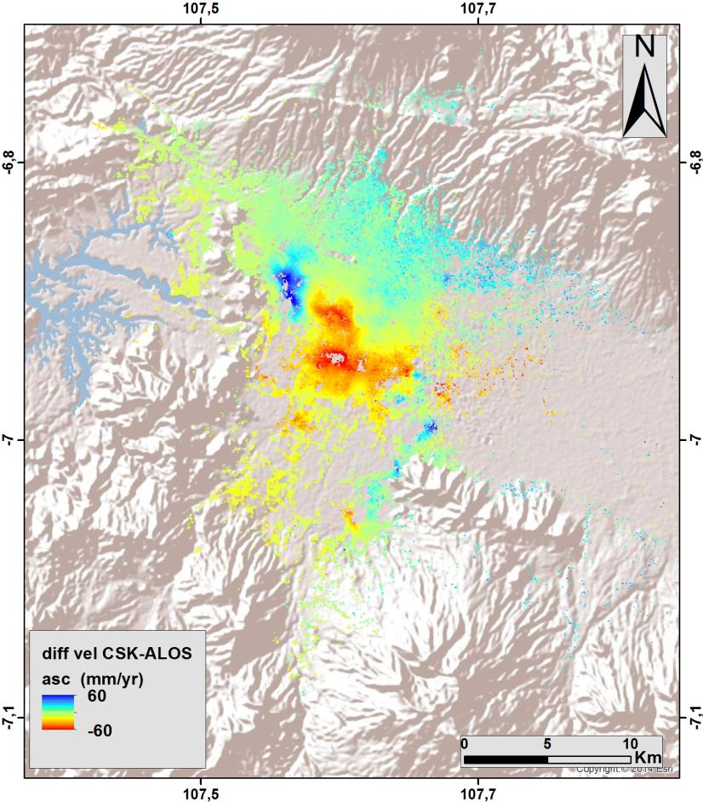
Objective B: SE Asia Component Status (3/7)
Subsidence Mapping by INGV (RASOR)
ALOS ascending (2007-2011)
CSK ascending (2013-2015)
Difference (CSK-ALOS)
(red = increased rate of subsidence)

Slide 24
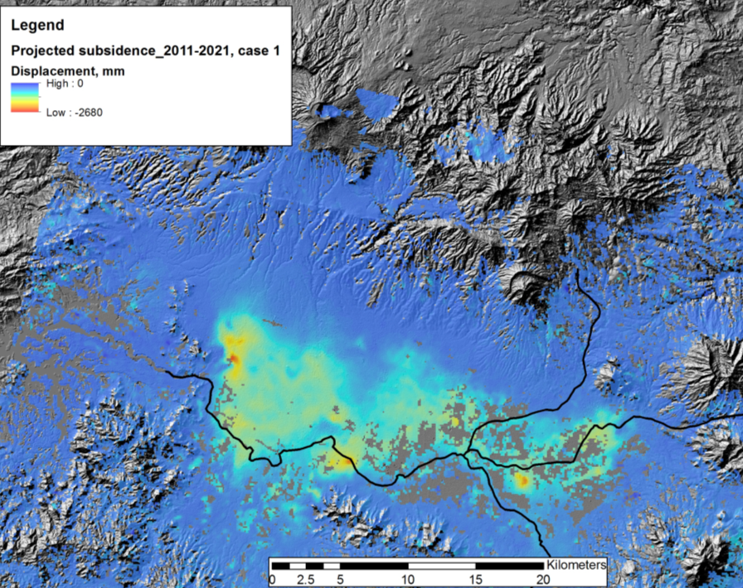
Objective B: SE Asia Component Status (4/7)
Subsidence Projection by INGV (RASOR)
Projected total subsidence by 2021 of up to 2.2 m along main drainage areas.

Slide 25
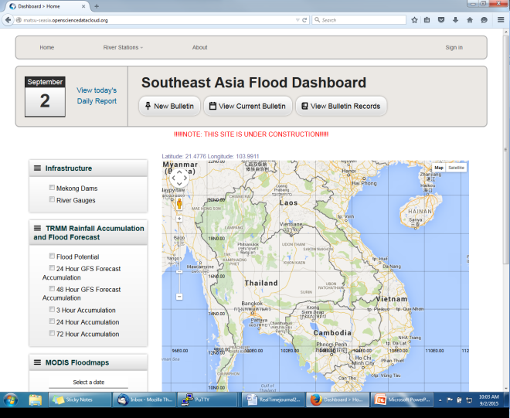
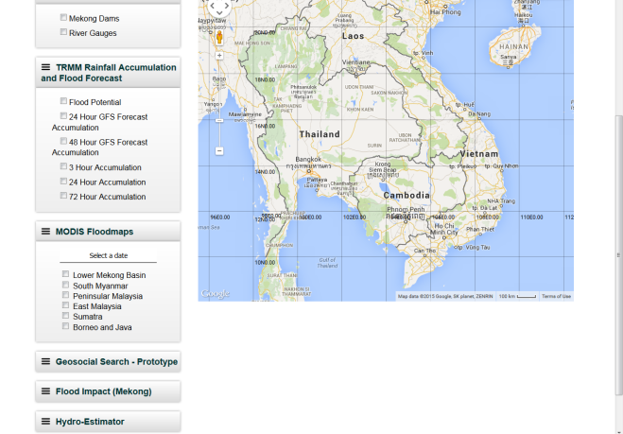
Objective B: SE Asia Component Flood Dashboard Status (5/7)
http://matsu-seasia.opensciencedatacloud.org/

Slide 26
Objective B: SE Asia Component Status (6/7)
Other Planned Activites
  Indonesia and Java risk assessments and subsidence calculations (Deltares-Villars)
    Status: DELTARES has ceased efforts (lack of funding???)

Slide 27
Objective B: SE Asia Component Status (7/7)
Other Activities:
  Consultations on new pilot products with UN, World Bank, and ICRC
  Asian Disaster Preparedness Center (ADPC) in Bankgok Thailand to setup instance of flood modeling and monitoring processing and distribution software installed under cooperation with SERVIR and USAID Oct-Nov 2015

Slide 28

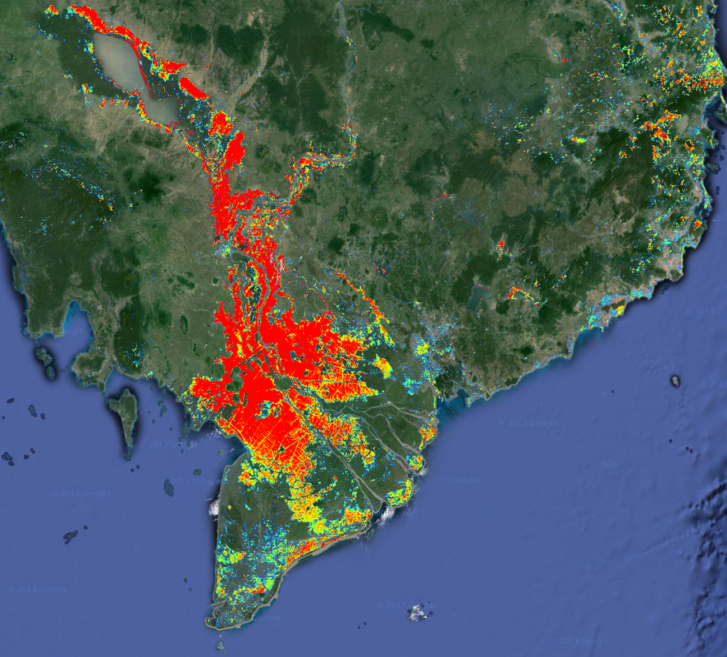
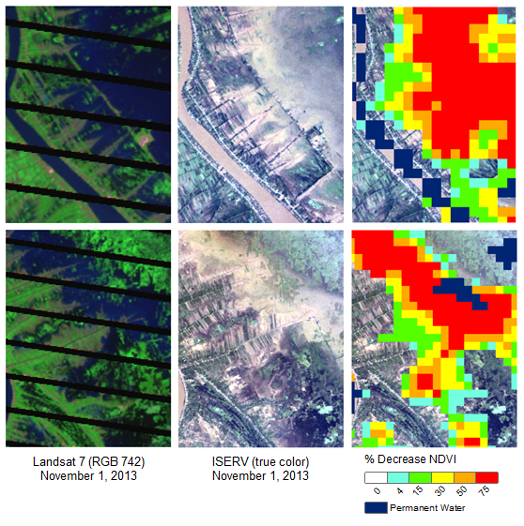
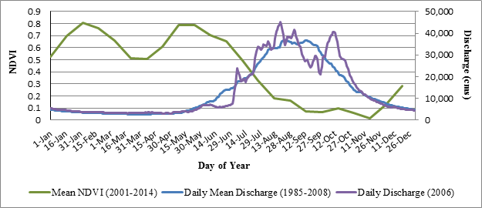
Monitoring the Mekong
John Bolten (NASA GSFC)
Flood Impact
Operational Near Real-Time Flood Inundation maps based on relative anomalies in NDVI from MODIS 250-m data
Stakeholders: Mekong River Commission
Notes:
Change in spectral index

Slide 29
Outline
Flood Pilot overview
Status of data acquisition and exploitation
Pilot status report:
  Objective A: Global component status
  Objective B: Regional component status
    Caribbean/Central America
    Southern Africa
    Southeast Asia
    Ad hoc Texas component
  Objective C: Capacity Building
Issues and Risk Management

Slide 30
Texas “Component” (1/3)
Data provided: EO-1, ASTER, COSMO-SkyMed, Sentinel-1, and LANDSAT, plus high-resolution GFMS forecasts
Users: FEMA, US Forest Service, EPA, Texas Water Development Board and Texas Commission on Water Quality, plus briefings by UT-Austin personnel to Texas Emergency Operations Center and Governor’s Emergency Management Council
Feedback from Theresa Howard and Gordon Wells (UT-Austin):
  “The imagery offered a detailed view of inundation impacting agriculture in rural areas, which is information that can be difficult to obtain from other sources. The imagery also helps to fill in the coverage gaps between stream gages that are monitored for current and forecast conditions.”
  Helpful even for gauged streams because “The greatest impacts do not necessarily coincide with the locations of the highest measured flood crests, but occur at sites that contain vulnerable features.”

Slide 31
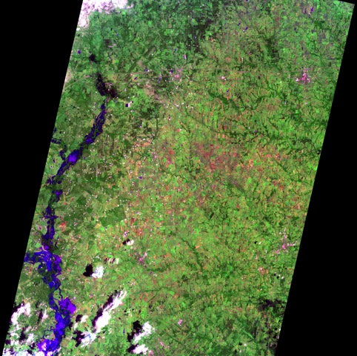
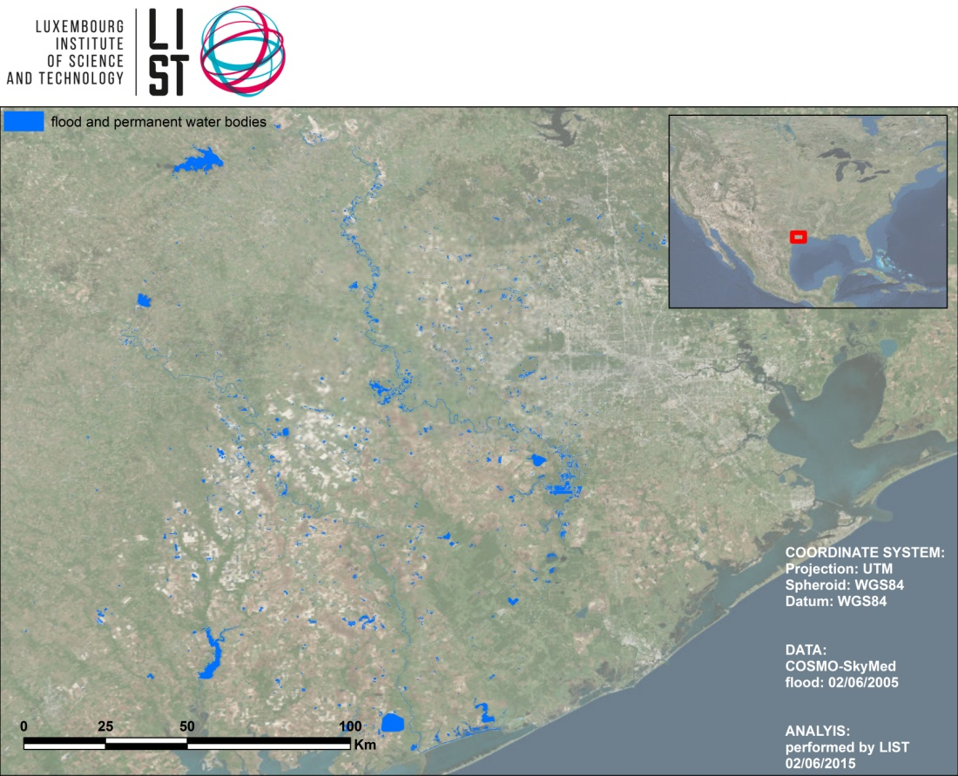
Texas Component (2/3)
COSMO-SkyMed, 2 June 2015 as processed and analyzed by LIST
EO-1, 1045 CDT 27 May 2015
Note: Imaged processed by Texas partners

Slide 32
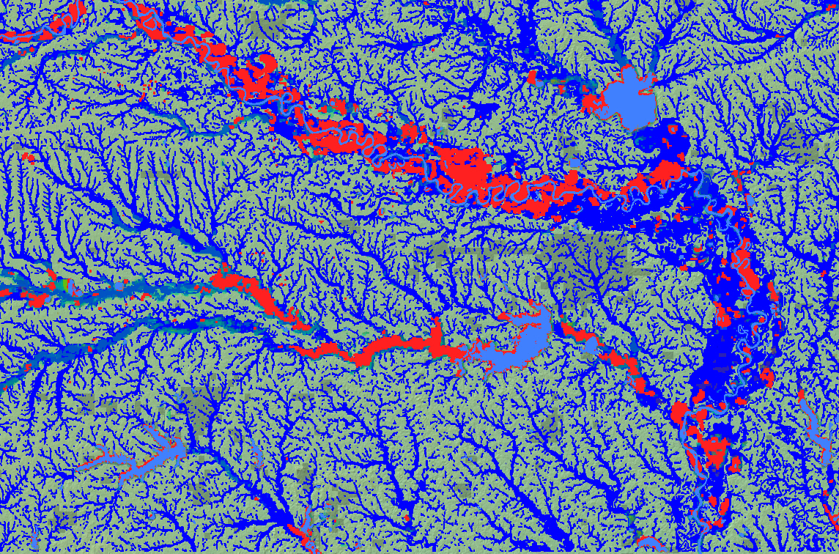
Texas Component (3/3)
Overlay of 2015 flood extent from MODIS (red) with the 100-year flood extent (blue). Image courtesy Bob Brakenridge and SSBN.

Slide 33
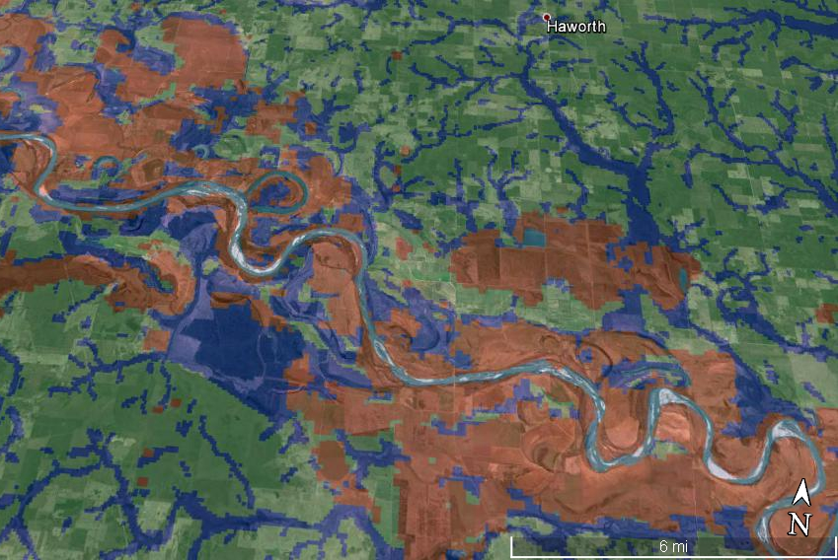
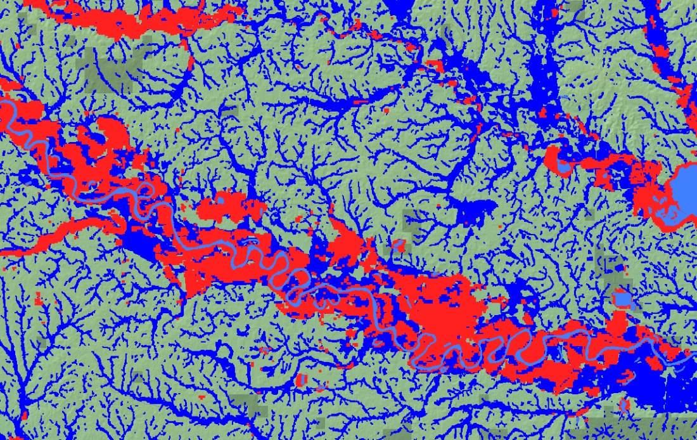
Texas Component (3/4)
Comparison of satellite and model shows that some flooded areas were forested and hence not mapped by satellite; models thus offer complementary information

Slide 34
Outline
Flood Pilot overview
Status of data acquisition and exploitation
Pilot status report:
  Objective A: Global component status
  Objective B: Regional component status
    Caribbean/Central America
    Southern Africa
    Southeast Asia
    Ad hoc Texas component
  Objective C: Capacity Building
Issues and Risk Management

Slide 35
Objective C: Capacity Building Status (1/2)
Caribbean/Central American Component:
  Trained forecasters and end users on how to run the Ensemble Framework for Flash Flood Forecasting (EF5) model
  Coordinated inclusion of Open GeoSocial API Flood Monitoring software suite as disasters component within the Climatic Information Platform for Central America and the Dominican Republic as part of the USAID Regional Climate Change Program (RCCP); training workshop by NASA GSFC personnel (supported by SERVIR and USAID) in Costa Rica scheduled for September 2015
Southern Africa Component:
  Open GeoSocial API training for RCMRD held 8-12 March 2015
  SANSA hosted on-site training and capacity development for flood modeling using the newly-released SRTM-2 DEM held 23-27 March
  Trained forecasters and end users on how to run the Ensemble Framework for Flash Flood Forecasting (EF5) model in Windhoek, Namibia 28 March-3 April (2014 milestone)

Slide 36
Objective C: Capacity Building Status (2/2)
Southeast Asia Component:
  Installation and training for Open GeoSocial API with ICIMOD in Kathmandu; in-country image processing capability used during earthquake aftermath to monitor stability of mountain lakes created by landslide dams
  ADPC installation of API under development, training workshop to be held in Bangkok October-November 2015

Slide 37
Outline
Flood Pilot overview
Status of data acquisition and exploitation
Pilot status report:
  Objective A: Global component status
  Objective B: Regional component status
    Caribbean/Central America
    Southern Africa
    Southeast Asia
    Ad hoc Texas component
  Objective C: Capacity Building
Issues and Risk Management

Slide 38
Issues and Risk Management Approach
Data acquisition: all negotiated acquisition agreements are being honored by the data providers
  Issue: these agreements will only last for the duration of the Pilots
  Recommendation: need mechanism to continue acquisitions after end of Pilot - to either obtain funding source(s) or negotiate long-term agreements with providers to sustain capacity
  Expected result: long-term sustainment of capabilities demonstrated in the Pilots; timely resolution of this issue will minimize risk of disruptions
38

Slide 39
Issues and Risk Management Approach
Data access:
  Issue: access to some data is limited because of licensing issues
    A non-CEOS agency (which had declined to join the Pilot) is acquiring data (mainly Radarsat-2) that the Pilots would like to use, but their licensing agreements are (unintentionally) making these data inaccessible to the Pilots and preventing the Pilots from demonstrating their (added) value.
  Recommendation: Engagement by CEOS to encourage such non-CEOS agencies to get involved in the Pilots. The Pilots would share their data with the other party and both parties would pool their funds to purchase imagery under renegotiated licensing agreements that would make the data available to both. An alternative solution would be to have the CEOS agencies insist that all data be delivered to their archives and thus be available to the Pilots.
  Anticipated benefit: The Pilot benefits by being able to demonstrate development and delivery of improved map layers to Pilot end users and thus demonstrate greater capability and benefit from EO data in flood management; such non-CEOS agencies benefit by having (free) access to the Pilot data quotas in addition to what they are purchasing and thus expanding their own capabilities, and also benefits from sharing expertise with the Flood Pilot to enhance their own capabilities.
39

Slide 40
Issues and Risk Management Approach
Data sharing:
  Issue: Lack of mechanism for coordination among the three Pilots in image acquisition may result in redundant requests (which will waste valuable quota space) or in one Pilot using their own quota space for a request that actually could be shared between Pilots
    Example: INGV will need additional (descending) CSK data over Java to refine and update their subsidence mapping. The Flood Pilot has 83 images left for 2015 but will need to coordinate with the Seismic Hazards Pilot to ensure this need can be met.
  Proposed solution: create an on-line, map-based inventory (metadata and links) of all images acquired by all three Pilots to enable each Pilot to identify needed images already acquired by other Pilots and provide a clearing house at the same URL for pending requests so all pilot members can see upcoming request status.
  Anticipated Benefit: eliminate risk of redundant data requests by multiple Pilots; reduce risk of individual Pilots reaching their limits.
40

Slide 41
Issues and Risk Management Approach
Pilot Management:
  Issue: Flood Pilot management coordinated support is becoming more critical to Pilot success for completion of activities and demonstration of on-going flood product delivery assurance after end of the Pilot. As the end of the pilot draws near, added coordination between donor agencies, CEOS agencies, and pilot members will be required to establish sustainment of pilot results: Stu Frye and dashboard efforts are supported by various competed grants from NASA, NOAA, and USGS, with funding for management support provided by ESA. Stu had to stop work earlier this year because of a funding gap, and Andrew’s support has been very helpful but significant extra effort is still required by the co-chairs (one relying on external funding, the other out-of-hide) and communication among the Pilot members has been less than optimal. One result is that many of the projects that comprise the Pilot did not have their efforts represented here.
  Proposed solution: Increased, dedicated support for Pilot management.
  Anticipated Benefit: More effective and consistent management of the Pilot, better communication / improved visibility of Pilot accomplishments; increased likelihood of successful completion.
41

Slide 42
Questions / Discussion

