Slide 1
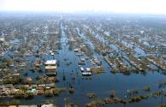
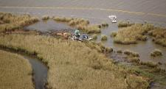
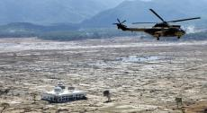
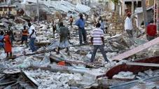
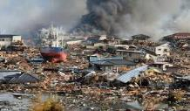
Status of development - Challenges
CEOS Recovery Observatory
Catherine Proy, CNES
Steven Hosford, CNES
Andrew Eddy, AG
WG Disasters #4
Frascati, Italy
9 September, 2015
Hurricane Katrina
2005
Deepwater Horizon
2009
Indonesian Tsunami
2004
Haiti Earthquake
2010
Tohoku Tsunami
2011

Slide 2
Oversight Team (ROOT) Membership
Space agencies:
CNES – chair (Steven Hosford and Catherine Proy)
ASI (Simona Zoffoli)
DLR (Jens Danzeglocke)
ESA (Ivan Petiteville)
JAXA (Chu Ishida and Nobuyoshi Fujimoto)
NASA (Stuart Frye and David Green)
DRM Stakeholders:
UNDP (Chiara Mellucci)
UNOSAT (Olivier Vandamme and Einar Bjorgo)
World Bank/GFDRR (Keiko Saito and Tahir Akbar)
Other partners:
CURBE (University of Cambridge, Emily So)
COPE (University of Copenhagen, Nathan Clarke)
Secretariat support provided by Athena Global (Andrew Eddy)
Membership is open to all CEOS agencies with an interest in the RO.
Associate Members are from donors and DRM stakeholders, and value-adding partners.

Slide 3
Recovery Observatory Status - Overview
Overview, status, objectives, role of agencies
Lessons Learned – Cyclone Pam
Review of needs – products and services
User and stakeholder involvement
IT Architecture demo
Value-adding strategies
Licensing issues
Sustainability and Next steps
Promotion and outreach for the RO
Triggering – criteria, process, candidates

Slide 4
Objectives
Demonstrate in a high-profile context the value of using satellite Earth Observations to support Recovery from a major disaster:
near-term (e.g. PDNA process, rapid assessments); and
long-term (e.g. major recovery planning and implementation, estimated to be about 3 years).
Establish institutional relationships between CEOS and stakeholders from the international recovery community.
Work with the recovery community to define a sustainable vision for increased use of satellite Earth observations in support of recovery.
Foster innovation around high-technology applications to support recovery.

Slide 5
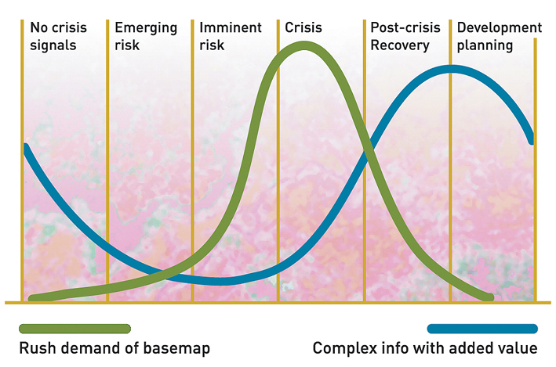
Geo-Information in Response & Recovery
Recovery Observatory added value
Highest current use during crisis – need to develop methodologies and products for recovery planning and monitoring
Demand for geo-information
Slide adapted from UNOSAT Luca dell’Oro
Notes:
The availability and sharing of timely and relevant information is critical for assisting humanitarian operations.
As shown here in the graph in the immediate aftermath of an event there is a peak in the demand of data and information including maps.

Slide 6
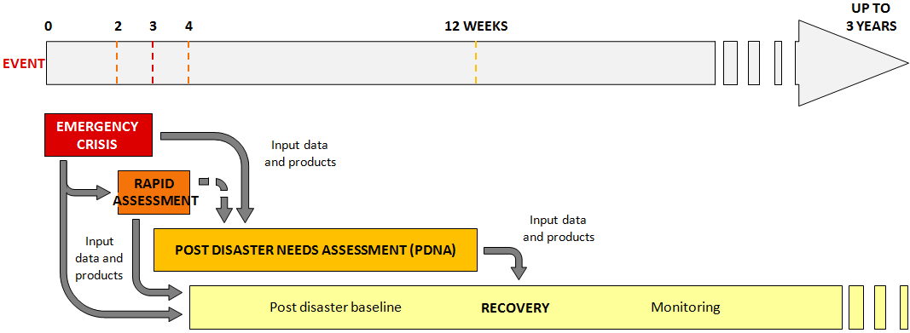
Rapid Assessment vs Recovery Planning and Monitoring
Notes:
PDNA will be used to confirm product definition and better evaluate needs of data for the future recovery activation

Slide 7
Status Overview
  Recovery Observatory ready for triggering since early 2015
  collaboration attempted on Cyclone Pam (Vanuatu – see Lessons Learned Report), highlighting possible contradictions between Rapid Assessment and Recovery support;
  possible further collaboration (PDNA before RO?) late 2015 to establish operational linkages;
  triggering of the RO after a major event;
  evaluation at RO + 6 months;
  lessons learned and sustainability strategy after evaluation of 1st RO
Notes:
PDNA will be used to confirm product definition and better evaluate needs of data for the future recovery activation

Slide 8
RO Lifecycle
  Upload of Charter data and
  baseline products
  Link to national end user
  Development of RO activity grid
  Protocols for RO operations
  Value-adding coordination
  Initial reporting
  Research and training & capacity
  development
  Liaison and development of
  links with end users
  Promotion and Outreach
  Evaluation (+ 6 months) and lessons
  learned
  Reporting
  IT maintenance
  Legacy planning
  Infrastructure
  Institutional relationships
  Product development
  PDNA support
  Scenario building
  Charter activation monitoring
  Summary Event Report
  Preliminary Data Acquisition Plan
  Decision by ROOT to trigger
Prepare
Trigger
Establish
Operations
Notes:
Before activation (now)
Development/characterization of product list with UNDP, WB (and others) in coordination with UNOSAT (and others)
Update of existing scenarios including estimates of volume of data to be tasked and processed
Preparation of data processing (ortho-rectification and atmospheric corrections) with involved CEOS agencies
Preparation of value-adding strategy (who? how? in kind contributions? funds?)
License for RO data use (CNES for SPOT and Pleiades, others?)
Pre-triggering RO activities (strategy for PDNAs and for 1st RO; others? which agencies would host and operate)
Link between the RO and the CEOS WEB pages
Development of IT and data ingestion process
Triggering preparation:
Rapid report on situation to support triggering
Interface with stakeholders for product needs, coordination with other initiatives…
Preliminary definition of acquisition plan (V0)
Analyze of possible implementation of IT (deployment, hosting, project management and operations)
After activation (3 to 6 months)
Implementation of the RO when triggered
First operations: upload of Charter data and result, PDNA or for RO, baseline first products for recovery planning and monitoring
Coordination activities:
Interface with stakeholders for precise definition of needs and identification of national entities to involve
Interface with the national institutions for product needs, coordination with other initiatives…
Definition of the acquisition plan (v1) and initial liaison with agencies
Establishment of formal institutional relationship with national entities (definition of role and responsibilities, identification of funding sources if available)
Elaboration of the RO activity grid (applications……)
Reporting to CEOS on development of RO and recommendations on issues to address
Building of research and training activities
On-going operations (1 to 3 years)
Coordination activities:
Liaison and development of institutional relationships, new relationship building
Promotion and outreach (including long term promotion of RO within country)
Development of lessons learned and replication of RO model (in other countries)
Value-adding coordination and new product development; new value added partners
Regular Report of technical results to national institutions
Support to national users (technical and policy), including new service development
Coordination and animation of new research activities around RO concept
Management of the activity (applications) grid in coordination with the project manager
Formal report to CEOS on RO (annual)
Project Management activities
Management of the acquisition plan and tasking with CEOS agencies
Management of RO content (data, product, news, documents)
Management of data processing
Technical reporting
Development of long-term plan for RO after initial set-up (1-3 years)
Maintenance of the RO IT (corrections, evolutions)
VA generation
Preparation of closure
Evaluation
Legacy strategies

Slide 9
Role of CEOS Agencies
  Data contribution (archived data and on-going acquisitions for RO lifetime)
  Other necessary tasks
    Oversight of RO establishment (International coordination)
    RO management
    Definition of operational products with users and stakeholders
    In some cases, support to operational value-adding (e.g. through support of value added provider for some applications)
    IT infrastructure (hosting and evolution)
    Project animation (workshops, ateliers, capacity development and training)
    Promotion and outreach, showcasing RO success stories
Notes:
PDNA will be used to confirm product definition and better evaluate needs of data for the future recovery activation

Slide 10
Recovery Observatory Status - Overview
Overview, status, objectives, role of agencies
Lessons Learned – Cyclone Pam
Review of needs – products and services
User and stakeholder involvement
IT Architecture demo
Value-adding strategies
Licensing issues
Sustainability and Next steps
Promotion and outreach for the RO
Triggering – criteria, process, candidates

Slide 11
Cyclone Pam (Vanuatu) Lessons Learned Report
Devastating cyclone struck several islands in the Vanuatu Archipelago the night of 13 March, 2015
The International Charter was activated the day before the event (12 March)
On 17 March, CEOS was approached by GFDRR to collaborate on a rapid assessment of Cyclone Pam damage, as part of the institutional collaboration planned in the ‘ramp-up’ period of the Recovery Observatory
On 14 April GFDRR decided not to proceed with a collaborative rapid assessment activity with CEOS in Vanuatu.
In May and June, CEOS and GFDRR prepared a Lessons Learned Report with a view to improving future collaboration on rapid assessments and the Recovery Observatory. That report was endorsed at the 10th ROOT meeting on 24 June. This report is presented today and will be released in a final version after this meeting.

Slide 12
Issues
Type of support to be provided: target products should be focused on near and long-term recovery, as opposed to response products which are generated according to very short timelines and respond to different imperatives.
Early articulation of need and jointly agreed definition, including areas of interest: establishing the correct Areas of Interest is critical, early in the process. This is necessary to acquire the correct data sets to support rapid assessments and PDNAs, and also to establish a post-event baseline for the future RO.
Timeliness requirement & area covered/interaction with International Charter: CEOS RO collaboration is not set up for 24/7 responsiveness.
Value-added support: understanding at the outset what budget is available and committing to that budget is critical.
Science vs. Operations: the Recovery Observatory aims to demonstrate operational EO-based methodologies for rapid assessments, PDNAs, and recovery monitoring.
Notes:
Differences between rapid assessment and recovery can deal also with zones covered, as well as timeliness; sometimes also sectors vary. Charter and rapid assessment also not identical (cf Vanuatu)

Slide 13
Recommendations (1/2)
An agreement between DRM stakeholders and the CEOS agencies on the nature and scope of PDNA/rapid assessment work is required, and should be brokered in the context of the ROOT.
The ROOT needs to engage other agencies active in satellite response and recovery work more directly, especially the International Charter and the Copernicus EMS. Work in the context of the RO should be closely coordinated with these agencies to avoid overlap, avoid confusion, increase synergies, and leverage mutual resources.
The ROOT should request that the CEOS WG Disasters ask member agencies if there is interest in demonstrating innovative EO-based approaches in support of Recovery objectives.

Slide 14
Recommendations (2/2)
For future collaboration on PDNAs and rapid assessments, priority should be given to products and needs that are likely to be relevant for the Observatory. A clear statement of needs, including listing of products to be generated and specific areas of interest (polygons) should be established by the DRM stakeholder and agreed to by CEOS before collaboration begins.
A clear value-adding strategy is required at the outset of the collaboration. The work plan must be developed based on the available resources, and the exact source of these resources must be identified before the plan is finalized.
An analysis of the work requested versus work performed should be conducted to further improve on mechanisms for collaboration.

Slide 15
Conclusions for RO
Rapid Assessments: the RO is not set up to deal with rapid assessments because of the very short timelines and the nature of the products, which are closer to response products from the Charter or Copernicus EMS rush services. The RO should focus on refining the product definition, and selecting the event for the Observatory. Support to a PDNA may however be better suited to the RO, especially if the PDNA event becomes the RO event.
Financing the value-added contribution: the ROOT should continue to pursue specific commitments for value-adding, working with partners already involved in the value adding process (e.g. Copernicus Risk and Recovery, UNOSAT); a minimum level of effort should be defined and organised to be able to move forward, which does not exclude further contribution from donor agencies further into the RO.

Slide 16
Recovery Observatory Status - Overview
Overview, status, objectives, role of agencies
Lessons Learned – Cyclone Pam
Review of needs – products and services
User and stakeholder involvement
IT Architecture demo
Value-adding strategies
Licensing issues
Sustainability and Next steps
Promotion and outreach for the RO
Triggering – criteria, process, candidates

Slide 17


Utility of Satellite Imagery for Recovery (from GFDRR)
1) Post disaster damage and needs assessments
  Rapid assessments
  PDNAs
  Validation of disaster data (e.g in housing, agriculture)
2) Recovery & reconstruction planning & implementation
Recovery Planning
  Prioritization and sequencing both spatially and by sector
Recovery Implementation
  Land use planning
  Hazard mapping
Reconstruction Monitoring
  Overall progress
  Progress within sectors
3) Recovery institutionalization
  Ex-ante Baseline Development
Notes:
1) Post disaster damages and needs assessments
Rapid assessments
PDNAs
Validation of disaster data (e.g in housing, agriculture)
Rapid Assessments
Key source to identify
Extent of Damages (Geographical spread)
Intensity of Damages (completely destroyed, partially damaged, or negligibly damaged)
PDNAs
Pre-disaster baseline development
Validation of Secondary data provided by the Government
Disaster damage estimates where secondary data is not available
2) Recovery & reconstruction planning & implementation
Recovery Planning
Prioritization and sequencing both spatially and sectorally
Recovery Implementation
Land use planning
Hazard mapping
Reconstruction Monitoring
Overall progress
Progress within sectors
3) Recovery institutionalization
Ex-ante Baseline Development
Cost effective source for developing baseline of key sectors
Ex-ante baseline development can significantly improve the speed of post disaster assessments

Slide 18
CNES-commissioned SERTIT study
Overview of state-of-the-art of use of satellite imagery for support to Disaster Risk Management: response, rapid assessment, Post Disaster Needs Assessment, and Recovery
Study provides summary analysis of use of information needs and use of satellite data today, possible areas where further use is possible today and most promising applications/products for an RO in three study scenarios: earthquake, major flood and hurricane/typhoon
Study began summer 2015 and is still in draft form – further analysis required, particularly for radar EO products; input sought from CEOS agencies to complement existing findings

Slide 19
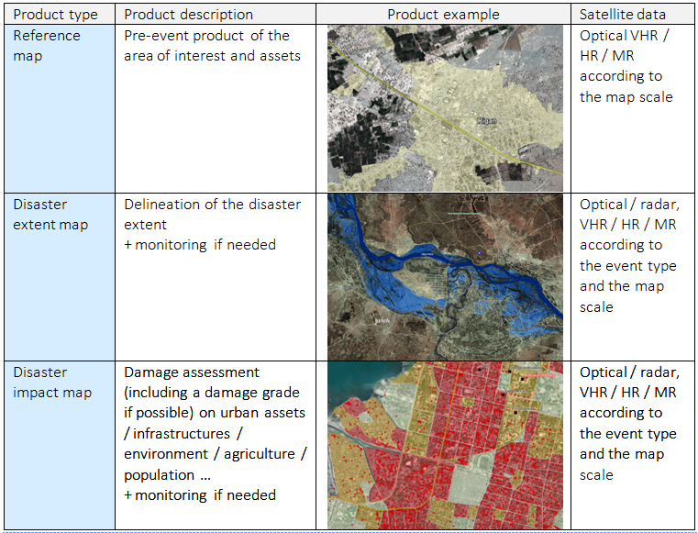


Response/Crisis Phase
Fully operational use
3 main services providing EO based information and products in a crisis mode at the international scale (Charter, Copernicus EMS, Sentinel Asia)
3 main product types derived from VHR, HR, MR optical and radar data

Slide 20
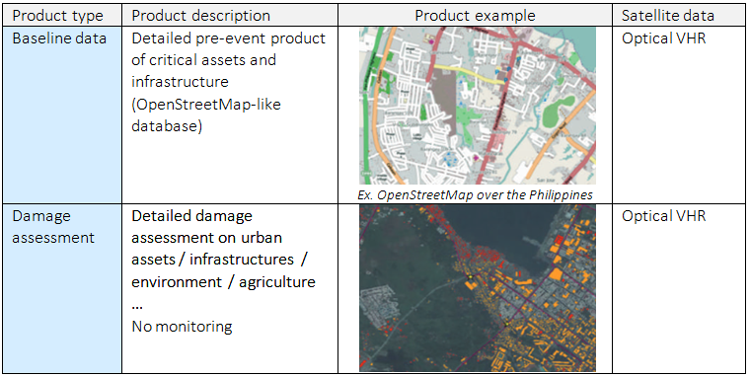
Rapid Assessment
Post event phase with emerging requirements; limit with Emergency / Crisis phase and PDNA not clear. Clear differences with crisis phase: larger AOIs, larger fields of Interest (Agriculture, environment…). Reference data available through OSM
Little current use of EO data in Rapid Assessments but potential to support this activity
⇨ Rapid Assessment developed in the aftermath of typhoon Haiyan in the Philippines in 2013, highlighting 2 EO based types of products:

Slide 21
Post Disaster Needs Assessment
Main thematic sector | Thematic sector | Information of interest | EO usefulness
Social | Housing and shelter | Affected houses and shelters, by level of damage and by type of buildings | High
 | Health | Affected buildings*, by level of damage | Medium
 | Nutrition | Affected sites, crops, water | Low
 | Education | Affected buildings*, by level of damage | Medium
 | Culture | Affected sites*, by level of damage | Medium
Productive | Agriculture | Affected crop lands, affected infrastructures, by level of damage | Medium
 | Irrigation | Affected infrastructure*, by level of damage | Low
 | Livestock | Affected buildings, animals/herds…* | Low
 | Manufacturing | Affected buildings*, by level of damage | Medium
 | Trade | Affected buildings (commercial), port and transport infrastructure*, by level of damage | Medium
 | Tourism | Affected buildings*, by level of damage | Medium
Notes:
EO level of usefulness
High: EO data can systematically provide information
Medium : need of a preliminary inventory of assets by exogenous databases / difficulties to derive information on damages using EO data
Low : no efficient support of EO

Slide 22
Post Disaster Needs Assessment
Main thematic sector | Thematic sector | Information of interest | EO usefulness
Infrastructure | Transport | Affected roads, bridges, railroads, airports, ports…, by level of damage and type of network | High
 | Communications | Affected infrastructure | Low
 | Mining and energy | Affected infrastructure | Low
 | Water and sanitation | Affected buildings and infrastructure*, by level of damage | Low
Cross-cutting | Governance | Affected buildings*, by level of damage | Medium
 | Disaster risk reduction | Affected risk management infrastructure (dikes…) | Medium
 | Environment | Affected natural environment (forests, river beds, protected sites*…), affected infrastructures* | High
 | Employment | Affected buildings | Low
 | Social protection | Affected buildings | Low
 | Gender equality and social inclusion | Distribution of damage | Low
 | Poverty and human development | Distribution of damage | Low
 | Macroeconomic impact assessment | Distribution of damage | Low
Notes:
EO level of usefulness
High: EO data can systematically provide information
Medium : need of a preliminary inventory of assets by exogenous databases / difficulties to derive information on damages using EO data
Low : no efficient support of EO

Slide 23
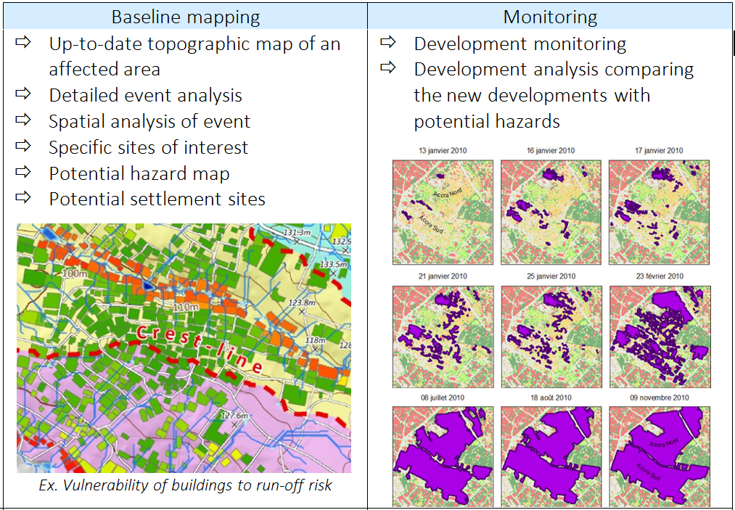
Recovery Monitoring examples
Examples of products already delivered within recovery work (SERTIT work for the American Red Cross over Port au Prince et Kal-Haiti)

Slide 24
Recovery – Inventory of potential Recovery indicators and products
Baseline mapping | Monitoring
Buildings, shelters | Buildings footprint mapping Building attributes (roof type, height indication, collapsed or partially collapsed) Indicate density of damaged buildings Urban blocks with indication of damage | Building removal and construction Change in urban land use, morphology and density Indicate type of dwelling reconstruction
Camps | Location of spontaneous and organized gathering areas Location of temporary dwellings Land use, open spaces | Camp removal and installation Tent removal and installation New land use / open spaces
Transport | Accurate transport network mapping with detailed metadata (type, damage level) Accessibility analysis Proximity analysis Traffic activity analysis | Rebuilt transport facilities New transport facilities Removal of transport facilities Accessibility analysis Proximity analysis Traffic activity analysis
Infrastructures | Mapping of utilities and services infrastructures (administration, education, healthcare, power - water - sanitation facilities…) with detailed metadata (type, level of damage) | Recovered infrastructures Infrastructure removal and construction
Environment | Landcover, open spaces Affected landcover (e.g. burn scar with fire damage severity…) | Change in landcover, open spaces Indicate loss of vegetation Vegetation re-growth
Topography | Risk analysis (vulnerability to flood, to water run-off risk, to soil erosion…) | Risk analysis
Notes:
RED – mainly eo-based
Blue – requires significant external input

Slide 25
Recovery phase: Required acquisition planning per monitored theme
 | Baseline mapping (Starting 4 weeks after major disaster) | 1st year | 2nd + 3rd year | Total no. of Coverages
Event extent | Consolidation | - | -
Event impact | Consolidation | - | -
Risks analysis | Once | - | -
Buildings | Once | Quarterly | Bi-annual | 8
Infrastructure | Once | Quarterly | Bi-annual | 8
Camps | Once | Every 2 months | Quarterly | 14
Environment | Once | Bi-annual | Bi-annual | 6
Agriculture | Once | Quarterly | Bi-annual | 8
⇨ hypotheses, results open to discussion

Slide 26
Legend of imagery classes for case studies
Preliminary assessment of the use of EO within each phase and domain
can be enriched depending on input from CEOS agencies and other partners
only (pre-)operational EO applications covered (not research level EO applications)
OPTICAL |  |  |  | SAR
Resolution | Acronym | Class |  | Resolution | Acronym | Class
<= 1m | O-VHR | Very High |  | <= 1,75 m | S-VHR | Very High
<= 10m | O-HR | High |  | < 6,5 m | S-HR | High
<=30 m | O-MR | Medium |  | <10 m | S-MR | Medium
<=60 m | O-LR | Low |  | <= 35 m | S-LR | Low
>60m | O-VLR | Very Low |  | > 35 m | S-VLR | Very Low

Slide 27
RECOVERY OBSERVATORY PRODUCT SPECIFICATIONS AND IMAGE ACQUISITION REQUIREMENTS
NEPAL BASED SCENARIO (1) - EARTHQUAKE AFFECTING REMOTE COMMUNITIES
Overall size of areas of interest : 3 * 2 500 km² - urban areas 3000 km2 – camps 300 km2
 | Potential products | Operational mode
 |  | Number of monitoring | Number of EO data needed
Recovery baseline mapping | 1. Detailed urban damage assessment (on buildings & Infrastructure) | 1 | Urban inventory, camps, shelters, infrastructure O-VHR: 3000 km²
 | 2. Humanitarian situation (camps, shelters, infrastructure, natural resources - wood & water) | 1 | Natural resources and agriculture O-HR or O-MR: 7 500 km²
 | 3. Agricultural damage | 1
 | 4. Risk analysis (hydrological & topographical risks especially close to urban areas) | 1 | Hydrological risk in urban areas: O-VHR stereo-pairs: ??? km²
Recovery monitoring (3 years) | 1. Reconstruction monitoring (buildings, infrastructure) | Urban centres and camps: 8 O-VHR coverages | O-VHR: 8*3000 km²
 | 2. Camps monitoring (camps, shelters, infrastructure, environmental resources - wood & water) | Camp monitoring: 6 extra O-VHR coverages | (Targeted extra) O-VHR: 6*300 km²
 | 3. Agriculture rebound | 8 for product 3 O-MR at <=10m | O-MR: 8* 7 500

Slide 28
RECOVERY OBSERVATORY PRODUCT SPECIFICATIONS AND IMAGE ACQUISITION REQUIREMENTS
PAKISTAN FLOODING BASED SCENARIO (2) - VERY LARGE PLAIN FLOOD
Area of interest : 100*1000km (100 000 km²)
GLOBAL SCALE | Potential products | Operational mode
 |  | Number of monitoring | Number of needed EO data
Recovery baseline mapping | 1. Urban, agricultural & environmental impact (remaining flood waters, flood traces, deposits, possibly affected urban, infrastructure) | 1 | Ponding mapping, large scale residues, and epidemiology, O-MR or S-MR: 100 000km²
 | 2. Epidemiological related analysis | 1
Recovery monitoring (3 years) | 1. Agricultural & environmental monitoring (including flood draw-off, flood risk protection works, general infrastructure) 2. Epidemiological risk monitoring | 5 | O-MR plus S-MR: 5 * 100 000

Slide 29
RECOVERY OBSERVATORY PRODUCT SPECIFICATIONS AND IMAGE ACQUISITION REQUIREMENTS
PAKISTAN FLOODING BASED SCENARIO (2) - VERY LARGE PLAIN FLOOD
5 SELECTED URBAN AREAS 225 km2 | Potential products | Operational mode
 |  | Number of monitoring | Number of needed EO data
Recovery baseline mapping | 1.Detailed urban impact (remnant flood waters, flooded / damaged buildings & infrastructure, mud deposits) | 1 | O-VHR: 5*225 km² = 1 125km² O-HR: 5 images (but much less useful)
 | 2. Humanitarian situation (camps, shelters, infrastructures, environmental resources) | 1
 | 3.Agricultural impact (affected parcels, damaged infrastructure) | 1 | O-HR: 10 images
Recovery monitoring (3 years) | 1.Reconstruction monitoring (buildings, infrastructure) | 5 | O-VHR: 5*5*225km² - 5625km²
 | 2.Camps monitoring (camps, shelters, infrastructures, environmental resources)
 | 3.Agricultural rebound |  | O-HR would suffice but area already covered by O-VHR

Slide 30
RECOVERY OBSERVATORY PRODUCT SPECIFICATIONS AND IMAGE ACQUISITION REQUIREMENTS
HAIYAN STORM BASED SCENARIO (3) - WIND STORM OVER A LARGE AREA
Area of interest : 1*7 400km² + 1*13 000km² and 5 urban areas of 225km²
 | Potential products | Operational mode
 |  | Number of monitoring | Number of needed EO data
Recovery baseline mapping | 1.Urban impact (damaged / disappeared buildings & infrastructure) over 5 urban zones | 1 | O-VHR 5*225km²: 1 125 km²
 | 2.Impact on agriculture (field changes, new deposits, soil erosion) | 1 | O-HR or O-MR: 1*20 400km²
 | 3.Environmental impact (river bed changes, forestry, windfall damage …) | 1
Recovery monitoring (3 years) | 1. Reconstruction monitoring (buildings, infrastructure) over 5 urban zones | 8 | O-VHR: 8*5*225km²: 9 000 km²
 | 2. Agro-forestry monitoring (clearing & rebound?) | 8 | O-HR or O-MR 8*20 400km²: 163200 km²
 | 3.Environmental monitoring | 8

Slide 31
Conclusions for RO
Current use of satellite data for recovery very limited
Clear, operational products can be supported using current technology
Need for validation and prioritization of products with DRM community, and ultimately with end users once RO is triggered
Strong potential for useful application on on-going basis but need for further demonstration within user community

Slide 32
Recovery Observatory Status - Overview
Overview, status, objectives, role of agencies
Lessons Learned – Cyclone Pam
Review of Needs – products and services
Triggering – criteria, process, candidates
User and stakeholder involvement
IT Architecture demo
Value-adding Strategies
Licensing issues
Sustainability and Next steps
Promotion and Outreach for the RO

Slide 33
Links to National End User
The core user community for the Recovery Observatory is at the national and local level – an analysis of actual needs starts at the national and local levels, even if based on a generic product list developed from past experience
In the first weeks following a disaster, the liaison with the National End User will be established by the international DRM stakeholder or stakeholders – they will support the generation of imaging requirements according to a product list established in coordination with the national end user
After the initial response phase is completed, the Observatory will work directly with the national and local end users, ensuring requirements meet expectations and that products respond to needs; the international DRM stakeholders support and facilitate this process
Once the Observatory is established, the Oversight team will work with DRM stakeholders and national and local authorities to develop a legacy strategy, ensuring data and products can be used for long-term recovery and reconstruction efforts, and support resilient reconstruction.

Slide 34
Prospective RO Partners
National end users (government of affected area with mandate for recovery and reconstruction and other government ministries)
International humanitarian GOs and NGOs with interest in reconstruction (e.g. IFRC, OCHA)
International stakeholders with interest in post-disaster needs and recovery/reconstruction financing (e.g. GFDRR, UNDP, EU/ Copernicus EMS Risk and recovery, UNEP)
Satellite data providers (CEOS agencies, commercial providers)
Value-added product generators (academia, research institutes, companies, specialised organisations (e.g. UNOSAT)

Slide 35
Role of DRM stakeholders
  Monitor international disasters to consider RO triggering
  Participate in RO selection
  Define needs and products (possibly through further collaboration on PDNAs)
  Foster and develop linkages with national and local end users
  Support value-adding activities and facilitate new financing
  Challenges
  Stakeholder commitment requires rapid RO selection to maintain momentum
Notes:
PDNA could be used to confirm product definition and better evaluate needs of data for the future recovery activation, ideally when PDNA is over future RO area. Beginning with PDNA allows a go/no go decision after PDNA regarding RO establishment

Slide 36
Role of national end users
  National end users ‘own’ the RO:
    Content and product definition,
    Use and assessment,
    If possible, content management and animation,
    Resources to augment RO content (possible VA support through contracted help or national agencies),
    In-situ data contribution,
    Long-term hosting.
  Challenges
  National end users are critical success of RO but relationship building cannot begin until RO is established
Notes:
PDNA could be used to confirm product definition and better evaluate needs of data for the future recovery activation, ideally when PDNA is over future RO area. Beginning with PDNA allows a go/no go decision after PDNA regarding RO establishment

Slide 37
Role of value-added providers
  Generate VA products based on needs defined with/by end user (and generic product definition currently underway)
  Work with end users and RO management to refine and validate operational products
  Challenges
  Advance financing commitment difficult – may require innovative partnering or incremental approach
Notes:
PDNA could be used to confirm product definition and better evaluate needs of data for the future recovery activation, ideally when PDNA is over future RO area. Beginning with PDNA allows a go/no go decision after PDNA regarding RO establishment

Slide 38
Recovery Observatory Status - Overview
Overview, status, objectives, role of agencies
Lessons Learned – Cyclone Pam
Review of needs – products and services
User and stakeholder involvement
IT Architecture demo
Value-adding strategies
Licensing issues
Sustainability and Next steps
Promotion and outreach for the RO
Triggering – criteria, process, candidates

Slide 39
Recovery Observatory IT Development
As of summer 2015, the RO IT infrastructure is essentially complete. Current portal:
  supports geographic and temporal search functions
  display raw and georeferenced images (SPOT and Pléiades available)
  offers simple registration process
  allows networks of users to define community of practice and share resources available for browsing and download, and eventually upload as well once RO is established
  Guest login available for demonstration/beta trial
Work continuing
  to increase number of data formats supported : CSK, ALOS-2, TSX, RSAT-2, Sentinel-1 & 2, Landsat-8 to be completed by November, and possibly US VHR
  vector and raster product archiving (as opposed to data archiving)

Slide 40
Recovery Observatory IT DEMO
How to test:
  http://dotcloud.akka.eu/drupal_dev/
  Login: dotcloud.ro@gmail.com
  Password: drupal2015dev
Link to the demo:
http://www.cityfactory.fr/dotCloud_demo.mp4

Slide 41
Recovery Observatory Status - Overview
Overview, status, objectives, role of agencies
Lessons Learned – Cyclone Pam
Review of needs – products and services
User and stakeholder involvement
IT Architecture demo
Value-adding strategies
Licensing issues
Sustainability and Next steps
Promotion and outreach for the RO
Triggering – criteria, process, candidates

Slide 42
Value-adding Strategies: multiple approaches
In-kind through partnership
  RO partners with expertise and with secured resources volunteer to join and provide value-added products on a best efforts basis (for PDNAs and RO)
  Direct partnerships with recovery organisations/programmes (e.g. Copernicus EMS Risk and Recovery; first bilateral meeting CNES/EC; follow-up planned)
Financed by CEOS agency partners
  CEOS agency places contract with value-adding company (for PDNAs and RO)
Financed through dedicated 3rd party funding
  DRM stakeholders facilitate access to development and/or humanitarian assistance funding for dedicated work on RO (for RO, after triggering)

Slide 43
Recovery Observatory Status - Overview
Overview, status, objectives, role of agencies
Lessons Learned – Cyclone Pam
Review of needs – products and services
User and stakeholder involvement
IT Architecture demo
Value-adding strategies
Licensing issues
Sustainability and Next steps
Promotion and outreach for the RO
Triggering – criteria, process, candidates

Slide 44
Licensing
Users of RO Data and Products:
National end users (government of affected area with mandate for recovery and reconstruction and other government ministries)
International humanitarian GOs and NGOs with interest in reconstruction (e.g. IFRC, OCHA)
International stakeholders with interest in post-disaster needs and recovery/reconstruction financing (e.g. GFDRR, UNDP, EU, UNEP)
Value-added product generators (academia, research institutes, companies, specialised organisations (e.g. UNOSAT)
Scientists
Need to check if licences are adapted to this type of distribution.
For CNES data, there is an existing licence enabling all partners of a defined project to access data.
Objective: broaden this to a defined area for a defined period for non-commercial applications of recovery managers.

Slide 45
Standard License Agreement
COPE undertaking a review of licenses used by CEOS partners in context of RO, with a view to establishing best practice for license use, and ultimately proposing simplified licenses for disaster recovery applications
First Analysis: Identify common (and conflicting) terms and conditions
  Permitted Uses
  Ownership and Attribution
  Categorization of Data
  Registration and Reporting
Licenses: TerraSAR-X/ TanDEM-X, Pleiades, COSMOS-SkyMed, ALOS-2, NextView

Slide 46
Common Ground
Registration (online and written)
Permitted Uses
  Project specific
  Non-commercial
Categorization: Products and Metadata
  Standard Product (original, primary, unprocessed)
  Protected Product (characteristics of standard product still identifiable and/or could be via reverse engineering)
  Derived Product (significant irreversible modifications)
    Value-added
  Metadata (ancillary data, support data, information)
Ownership (IPR)
  Standard and Protected Products
Attribution
  All Products
Reporting
Other conditions (e.g. liability, warranty, validity, publication/print specifications, sublicensing)

Slide 47
Main issues: Registration, reuse, and re-distribution
If the RO was triggered today:
Users must register with each data provider separately
  Different registration requirements and domestic procedures for approving users/requests.
Permitted uses
  Rights for use, reuse, and sharing of products and information varies between licenses.

Slide 48
 | Registration/ User Types | IPR | Reuse | Re-distribution | Reporting
TerraSAR-X/ TanDEM-X | Online Individuals (in relation to GSNM) | Standard Protected | Open | Authorization required (unclear) | Progress reports Publications Maintain record of delivered products
Pleiades | Online and written Institutions | Standard Protected | Max 10 copies of product for installation, archiving and back-up purposes. | Permitted among Authorized Users. Registration required for, and limited rights given to, contractors and consultants. Print/display restrictions. | Publications
COSMOS-SkyMed | Online and written (unclear) Institutions and Individuals | Standard Protected | Affiliated Users must make a request to ASI. Contractors and consultants may not keep or reuse products. | Registration required for Affiliated Users, contractors, and consultants. Authorization required for distribution of metadata. Web publication restrictions. | Publications
ALOS-2/ PALSAR-2 | Online (unclear) Institutions | Standard Protected Derived | 100 scenes per year. Duplication of products prohibited (excluding backups). | Third party distribution requires written consent from JAXA. (unclear) | None
NextView | Online Institutions | Open | Open | Open | None

Slide 49
Next steps
Harmonize existing licenses
  Terminology
  Registration and use conditions
  Waive non-essential elements
Sublicense
  Through CNES
  DB ownership
  Customized license (CC) or contract (clickwrap)
  Ownership and attribution
Other considerations…
  Domestic policies (users, data types, etc.)

Slide 50
Recovery Observatory Status - Overview
Overview, status, objectives, role of agencies
Lessons Learned – Cyclone Pam
Review of needs – products and services
User and stakeholder involvement
IT Architecture demo
Value-adding strategies
Licensing issues
Sustainability and Next steps
Promotion and outreach for the RO
Triggering – criteria, process, candidates

Slide 51
RO Lifecycle
Preparation
Infrastructure
Institutional relationships
Triggering
Charter activation monitoring
Establishment
Product development
Scenario building
Summary Event Report
Decision by ROOT to trigger
Upload of Charter data and baseline products
Operations
Preliminary Data Acquisition Plan
Link to national end user
Development of RO activity grid
Research and training & capacity development
Liaison and development of links with end users
Promotion and Outreach
Reporting
Evaluation (+ 6 months) and lessons learned
Value-adding coordination
Initial reporting
IT maintenance
Legacy planning
PDNA support
Protocols for RO operations
Notes:
Before activation (now)
Development/characterization of product list with UNDP, WB (and others) in coordination with UNOSAT (and others)
Update of existing scenarios including estimates of volume of data to be tasked and processed
Preparation of data processing (ortho-rectification and atmospheric corrections) with involved CEOS agencies
Preparation of value-adding strategy (who? how? in kind contributions? funds?)
License for RO data use (CNES for SPOT and Pleiades, others?)
Pre-triggering RO activities (strategy for PDNAs and for 1st RO; others? which agencies would host and operate)
Link between the RO and the CEOS WEB pages
Development of IT and data ingestion process
Triggering preparation:
Rapid report on situation to support triggering
Interface with stakeholders for product needs, coordination with other initiatives…
Preliminary definition of acquisition plan (V0)
Analyze of possible implementation of IT (deployment, hosting, project management and operations)
After activation (3 to 6 months)
Implementation of the RO when triggered
First operations: upload of Charter data and result, PDNA or for RO, baseline first products for recovery planning and monitoring
Coordination activities:
Interface with stakeholders for precise definition of needs and identification of national entities to involve
Interface with the national institutions for product needs, coordination with other initiatives…
Definition of the acquisition plan (v1) and initial liaison with agencies
Establishment of formal institutional relationship with national entities (definition of role and responsibilities, identification of funding sources if available)
Elaboration of the RO activity grid (applications……)
Reporting to CEOS on development of RO and recommendations on issues to address
Building of research and training activities
On-going operations (1 to 3 years)
Coordination activities:
Liaison and development of institutional relationships, new relationship building
Promotion and outreach (including long term promotion of RO within country)
Development of lessons learned and replication of RO model (in other countries)
Value-adding coordination and new product development; new value added partners
Regular Report of technical results to national institutions
Support to national users (technical and policy), including new service development
Coordination and animation of new research activities around RO concept
Management of the activity (applications) grid in coordination with the project manager
Formal report to CEOS on RO (annual)
Project Management activities
Management of the acquisition plan and tasking with CEOS agencies
Management of RO content (data, product, news, documents)
Management of data processing
Technical reporting
Development of long-term plan for RO after initial set-up (1-3 years)
Maintenance of the RO IT (corrections, evolutions)
VA generation
Preparation of closure
Evaluation
Legacy strategies

Slide 52
Sustainability
Sustainability Issues for Operations:
Three main categories:
Establishment and maintenance of strong ties with end users (buy-in from RO ‘owners’)
Technical and financial management of RO products (value-adding), services (IT) and activities (outreach, animation)
Legacy strategies and evolution of the model in other contexts

Slide 53
Project Assessment
COPE will provide RO assessment during 1st six months after triggering, and end assessment:
Survey Design
Based on project objectives, user expectations, PDNA
  Partners
  End-users
Validate
Implement after 6 months
Used for later assessments

Slide 54
Recovery Observatory Status - Overview
Overview, status, objectives, role of agencies
Lessons Learned – Cyclone Pam
Review of needs – products and services
User and stakeholder involvement
IT Architecture demo
Value-adding strategies
Licensing issues
Sustainability and Next steps
Promotion and outreach for the RO
Triggering – criteria, process, candidates

Slide 55
Promotion and Outreach
Promotion and Outreach:
Recovery Observatory demo now described/available on CEOS WG Disasters website
RO was presented at two international symposia/conferences:
  General overview presented at ISRSE in Berlin in May by Steven Hosford (CNES)
  Computer infrastructure presented at the EARSel Symposium in June in Stockholm by Arnaud Sellé (CNES)
Future/upcoming events to showcase the RO include:
  Understanding Risk, Istanbul May 2016
  ESA Living Planet, Prague May 2016
  Others? What are YOUR plans?

Slide 56
Recovery Observatory Status - Overview
Overview, status, objectives, role of agencies
Lessons Learned – Cyclone Pam
Review of needs – products and services
User and stakeholder involvement
IT Architecture demo
Value-adding strategies
Licensing issues
Sustainability and Next steps
Promotion and outreach for the RO
Triggering – criteria, process, candidates

Slide 57
RO Triggering Process Paper Status
Process Paper draft has been finalised and will be presented at next SIT Technical Workshop for information (Darmstadt, 17-18 September)
Revisions will be made if required after comments received from CEOS principals after SIT
Final Process Paper will be approved at Plenary (Kyoto, 4-6 November); if triggering requested before then, triggering itself will also be presented for approval at Plenary.
No current requests to trigger RO, although informal discussions have taken place on Nepal earthquake reconstruction efforts

Slide 58
CONCLUSIONS
Significant progress made in past few months on:
End user product definition
Infrastructure
Licensing issue
Preparation phase is now complete – triggering now required to mature the project further
Project would benefit from deeper involvement of other agencies (specifically on products generated from their data)
Better understanding of sequencing (rapid assessment, PDNA, Recovery period) – issue of contribution of RO vs. Charter/EMS/SA

Slide 59
CONCLUSIONS
Significant effort continues in exchanges with WB/UNDP
Develop close relationship with EMS Risk and Recovery
RO is an ambitious project and much work remains to be done by the ROOT

Slide 60
Thank you!
steven.hosford@cnes.fr
catherine.proy@cnes.fr

