Slide 1
Evaluation Report WGCapD & WGDisasters Distance Education Course: Webinar Series on Remote Sensing Technology for Disaster Management Held April 6th – May 31st, 2015
Committee on Earth Observation Satellites
Coordination
Hilcea Ferreira, INPE
SP Aggarwal, ISRO
CEOS Working Group on Disasters Meeting # 4
September 8-10, 2105 in Frascati, Italy, hosted by ESA

Slide 2
Uniqueness
Several reasons made this course unique:
Offered free of charge
Increased knowledge about data availability through the International Charter during a disaster and how it can be activated.
Increased knowledge about using satellite Earth observation data from different sources for DM.
Increased knowledge about how to determine which specific GIS capabilities and data types are required to support emergency management work before, during, and after a disaster strikes.
Improved student ability to advise decision makers about how to use space technology for DM.
Fostered the construction of a community of learners in the field.

Slide 3
Webinar Themes
Introduction to Webinars Series
Overview of CEOS/WGCapD
Where CEOS can help: Datasets and Useful Tools: CEOS Visualization
International Collaboration for DRM
Introduction to Disasters: Causes, effects, monitoring, mitigation, and management. Methods of hazard, vulnerability, and risk assessment and the role of geospatial data.
Space-based Earth observation systems and their applications for hydro-meteorological disasters (floods)
Space-based Earth observation systems and their applications for geological disasters (earthquakes, landslides, and volcanoes)
Space-based Earth observation systems for environmental disasters (Forest Fires)
Real Time Monitoring of Global Precipitation from Space: New Technologies Applied to Heavy Rainfall Risk Reduction
Concepts and applications of internet GIS and Sensor Web (network of sensors) for disaster management. Example of an open source tool (TerraMA² - computational platform for developing Monitoring, Analysis and Alert systems)
Rapid mapping and emergency services

Slide 4
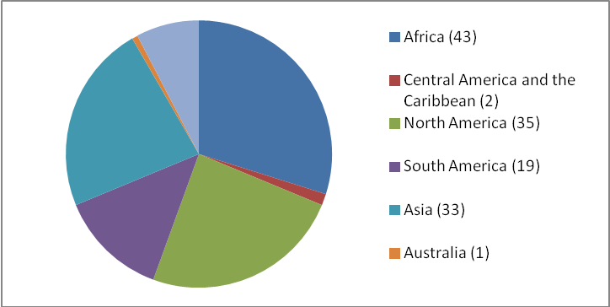
Registrants
Geographic distribution of all registrants (144)

Slide 5
Attendance
Geographic distribution of all selected registrants (99)
Webinars overall attendance

Slide 6
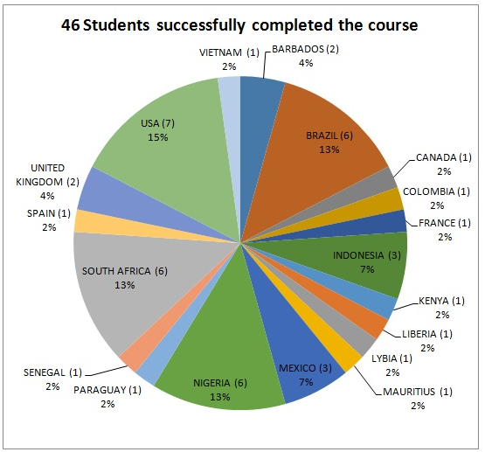
Successful participants
Successful students by country

Slide 7
Successful participants
Most successful students, 44%, came from Government organizations
Successful students by affiliation

Slide 8
Feedback: Awareness about course

Slide 9
Feedback: Overall Rating /
Expectations
Expectations

Slide 10
Feedback: webinar wise expectations

Slide 11
Feedback: Objectives /
Subject interest
Objectives
Subject Interest

Slide 12
Feedback: Platform/
Learning Material/ Quizzes

Slide 13
Feedback: Strength and Weakness
Strength | Weakness
All, the whole course was so informative. | None, all of them were very helpful
The review of the types of data publicly available. Some ideas on how to get it and how to use it. I have appreciated this opportunity. | The quizzes were an ok form of self-assessment. However, I didn’t like having to wait to get the correct answers.
The experience of the instructors and the exchange of contacts with the other participants. | Just to say there were not African examples of studies applicable to Africa.
I find most helpful the parts of the course that give us information about access of data.
The recordings.
The case studies.
The explanations of the experts when giving the presentation.
The explanation of the different platforms using remote sensing and satellite imagery.
The last module on International Space Charter was of great interest to me.
Module 3 and Module 6 were the most useful modules
Module 5 (forest fire)

Slide 14
Feedback: General Observations
Suggestions
Provide additional reference resources and/or e-books.
Encourage more interaction among the participants.
→ MORE HANDS-ON!
Provision of some assignments to work on using the software discussed in the Moodle.
More practical examples and tutorials on software used to get required results that matter.
It would be nice to see further demonstrations and techniques in software used for analyzing the data.
Would love to see disaster response scenario event practical videos.
Practical classes on programming TerraMA².
If hands-on training on remote sensing and GIS software are included, would greatly improve the course.
Include real processing of data instead of results. Demonstrate how to derive maps and products.

Slide 15
Future: topics to be added or covered
Other Application Areas
Using Remote Sensing in Agriculture.
Application of GIS in Epidemiology, Disease Outbreaks; Public Health Issue
Oil spills, disaster project management, disaster chain of command. Newly available Satellites and accessing historical data archives.
Real Time Monitoring of Forest Fire
Remote Sensing in Municipals Waste Management.
Crowdsourcing and disaster management.
Hands-on
Early warning.
Nowcasting of meteorological disasters.
Flood monitoring and simulations
Software and techniques used for analyzing the data.
Another session about the use of bandwidth and channel in the satellite image.
Application of RS GIS in flood management.
Image processing/analysis.
Modeling of remote sensing data for disaster management.
Image processing.

Slide 16
Lessons Learned
The webinar tool connects instructors and learners when they are located in different geographic areas.
Students will always have teachers contact information for further professional needs.
Methodology used (Webinars + Learning Management Platform – Moodle)
Access to materials
Questions and Answers
Low level of interaction among students
The feedback and suggestions from students reflect their need for more hands-on activities and software/real scenarios demonstrations.

Slide 17
Thank you
NAME | INSTITUTION | ROLE
Hilcéa Ferreira | INPE | Coordinator/Instructor
S.P.Aggarwal | IIRS/ISRO | Coordinator/Instructor
Marie-Josee Bourassa | CEOS CEO | Contributor
Kim Holloway | CEOS SEO | Contributor/Instructor
Guy Aube | CSA | Contributor
Antonios Mouratidis | ESA | Instructor
Ivan Petiteville | ESA - WGDisasters | Contributor
Jesus A. G. Bernal | INAOE/CRECTEALC | Contributor
Claudia Lucaccioni | INPE | Moodle Tutor
Daniel Vila | INPE | Instructor
Alberto Setzer | INPE | Instructor
Fabiano Morelli | INPE | Instructor
Laercio Namikaya | INPE | Instructor
Su-Yin Tan | University of Waterloo and ISU | Instructor
Ana Prados | NASA | Instructor
Amita Mehta | NASA | Instructor
Nancy D. Searby | NASA | Contributor
Phila Sibandze | SANSA | Contributor
Lorant Czaran | UNOOSA | Contributor
Brenda Jones | USGS - WGDisasters | Instructor
Eric Wood | USGS | Contributor

Slide 18
Housekeeping: what is next?
Webinar series repeat?
Webinar series: hands-on in DRM?
Webinar series on other topic?
Natural Resources Management (NRM)
Free and open-source software for NRM
3 months e-learning programme on NRM/DRM ?
More suggestions?

