Slide 1
Remote Sensing Monitoring of Vector-borne Disease –Schistosomiasis and Malaria
Prof. Chuan-rong Li
Key Laboratory of Quantitative Remote Sensing Information Technology , Academy of Opto-Electronics, CAS

Slide 2
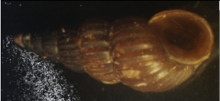
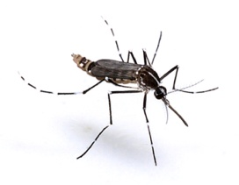
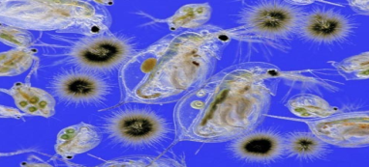
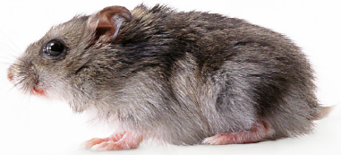
Background
Epidemic and infectious diseases
Schistosome
血吸虫
Malaria/dengue
疟疾/登革热
Cholera
霍乱
Hantavirus
汉坦病毒
Oncomelania
钉螺
Mosquito
蚊虫
Zooplankton
浮游动物
Rat
老鼠
Vector
Oncomelania
钉螺
Zooplankton
浮游动物
Mosquito
蚊虫
Rat
老鼠
Environmental Factors
Water
Temperature
Humidity
Vegetation
……
Many epidemic and infectious diseases are closely related to natural environment due to the presence, breeding and evolution of their pathogens or reservoir hosts, especially vector-borne diseases (e.g. schistosomiasis, malaria and dengue, etc.) which rely heavily on their vectors.
Notes:
Many epidemic and infectious diseases are closely related to natural environment due to the presence, breeding and evolution of their pathogens or reservoir hosts, especially vector-borne diseases (e.g. schistosomiasis, malaria and dengue, etc.) which rely heavily on their vectors.

Slide 3
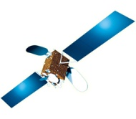

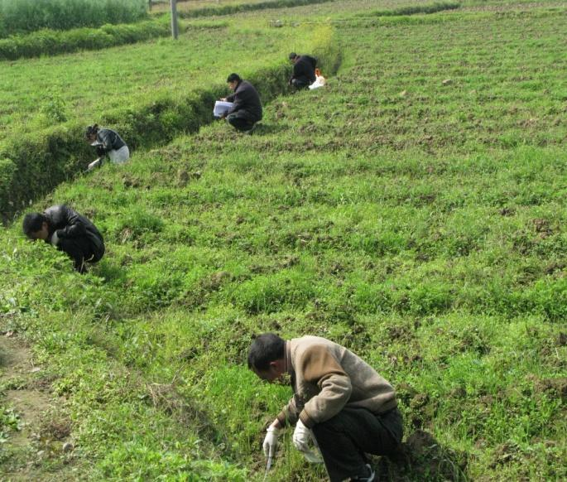
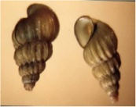
Background
Monitoring characteristics of vectors’ spatial/temporal distribution is of vital importance to the prevention and control of vector-borne disease.
Remote sensing technology provides promising ways for snail monitoring and control.
The traditional in-situ survey methods based on field detection are difficult to meet the demand of monitoring in large scale.

Slide 4
Project Background
Remote sensing experts may not exactly know what environmental factors are required to identify the incubators of vector-borne diseases.
Consequently, any single of these disciplines is insufficient, it is essential to bring together scientists from computing science and remote sensing along with domain experts to foster a substantial collaboration.
RS
Effective RS data processing and parameters retrieval techniques are also challenges for hygiene experts who are lack of experience of remote sensing applications.
Taking into account of different type of massive data are involved, computing scientists with substantial intelligent data analysis expertise is crucial to successfully incorporate advance intelligent data analysis, such as data mining, pattern analysis.
Hygiene
DM

Slide 5




Team Composition
A joint research with experts from different areas
1
2
Hygiene Information
Academy of Opto-Electronics, Chinese Academy of Sciences
Remote Sensing
National Institute of Parasitic Diseases, Chinese Center for Diseases Control and Prevention
Data Mining
3
University of Ulster,
United Kingdoms

Slide 6
Outline
Develop a quantitative remote sensing monitoring model of snail(vector of schistosomiasis) by using the TS (Takagi-Sugeno) fuzzy information theory.
The Improvement of TS Fuzzy RS Monitoring Model of Snail and New Application at Xinmin Beach of Gaoyou Lake.
Remote Sensing Monitoring of mosquitoes (vector of malaria) and develops the T-S fuzzy remote sensing monitoring and prediction model of malaria.

Slide 7
1、Remote sensing monitoring of snail
(vector of schistosomiasis) by using the TS fuzzy model

Slide 8
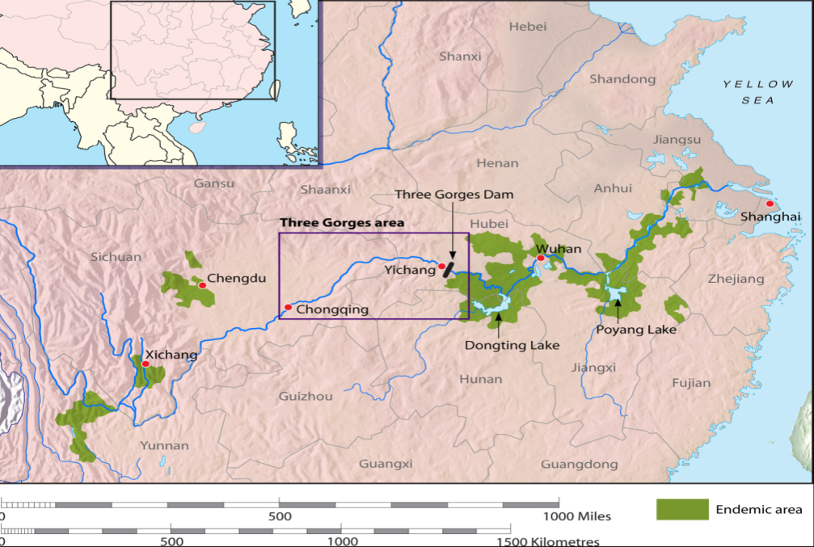
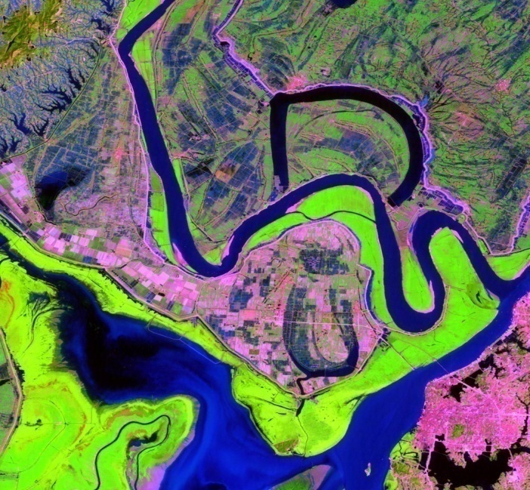
Study area
Jun Shan, Dongting Lake
Dongting Lake is located within 28°30′–30°20′ N and 111°40′–113°40′ E, in the northeast of Hunan Province and covered by water of about 2,681 km². Archaeological studies have shown that schistosomiasis japonica has been endemic in the Dongting Lake region for thousands of years. Nearly 20% buffaloes were infected, and about 200,000 human cases were reported in 2003.
TM band 7/4/3 color composite image of Jun Shan (2003)
Map of schistosomiasis epidemic regions and the Dongting Lake
Notes:
Figure 1 is the spatial distribution map of schistosomiasis, the schistosomiasis endemic area is shown in green, the red circle displays the area of Dongting Lake.
Figure 2 is the remote sensing image of Dongting Lake
The study area of our research is Junshan near Dongting Lake, with its TM remote sensing image shown in the left.
左图是我国的血吸虫病的空间分布图，其中绿色的区域是我国血吸虫病流行区，红色圈是洞庭湖地区。
本研究的研究区域是洞庭湖的君山区，其2003年的TM遥感影像图见 Fig.3

Slide 9
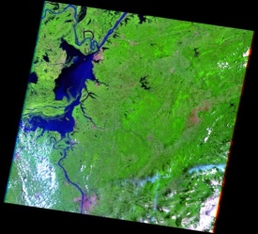
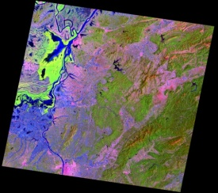
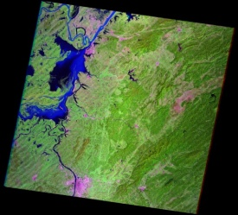
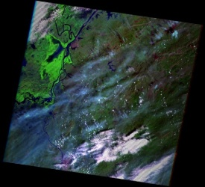
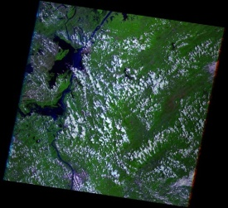
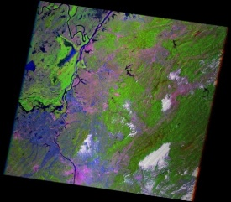
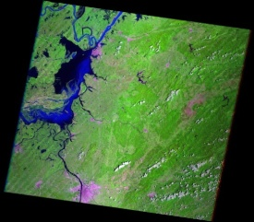
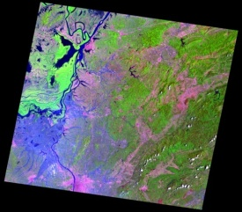
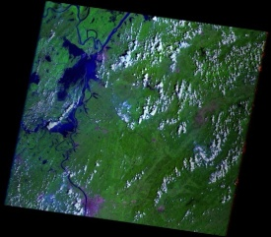
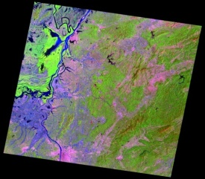
  EO Data acquisition
Table 1 Landsat data
ID | Acquisition time | Satellite | Sensor
1 | 2002.07.09 | Lansat5 | ETM+
2 | 2003.04.15 | Lansat5 | TM
3 | 2004.09.16 | Lansat7 | ETM+
4 | 2005.04.12 | Lansat7 | ETM+
5 | 2006.08.21 | Lansat7 | ETM+
6 | 2007.04.18 | Lansat7 | ETM+
7 | 2007.08.08 | Lansat7 | ETM+
8 | 2008.04.28 | Lansat5 | TM
9 | 2008.08.10 | Lansat7 | ETM+
10 | 2009.04.15 | Lansat5 | TM
2002.07.09
2003.04.15
2004.09.16
2005.04.12
2006.08.21
2007.04.18
2007.08.08
2008.04.28
2008.08.10
2009.04.15
Notes:
Acquisition time：
From late march to late April each year (synchronized with the field data)
Remote sensing data with maximum submerging range during July, August, September of the previous year (as reference for “summer water”)

Slide 10
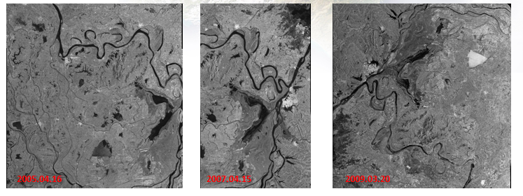
  EO Data acquisition
Table 2 ENVISAT ASAR data
ID | Acquisition time | Imaging mode | polarization mode
1 | 2005.04.16 | Alternating Polarization | HV/HH
2 | 2007.04.15 | Image | HH
3 | 2009.03.20 | Image | VV
Notes:
Above ENVISAT ASAR are suppoted by ESA, download via EOLI-SA using our dragon 3 account

Slide 11
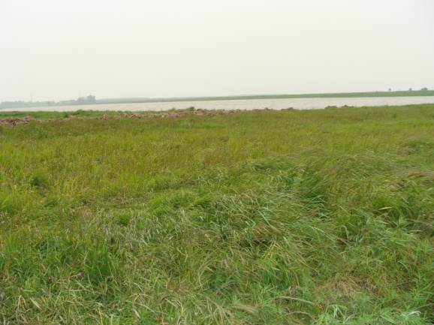
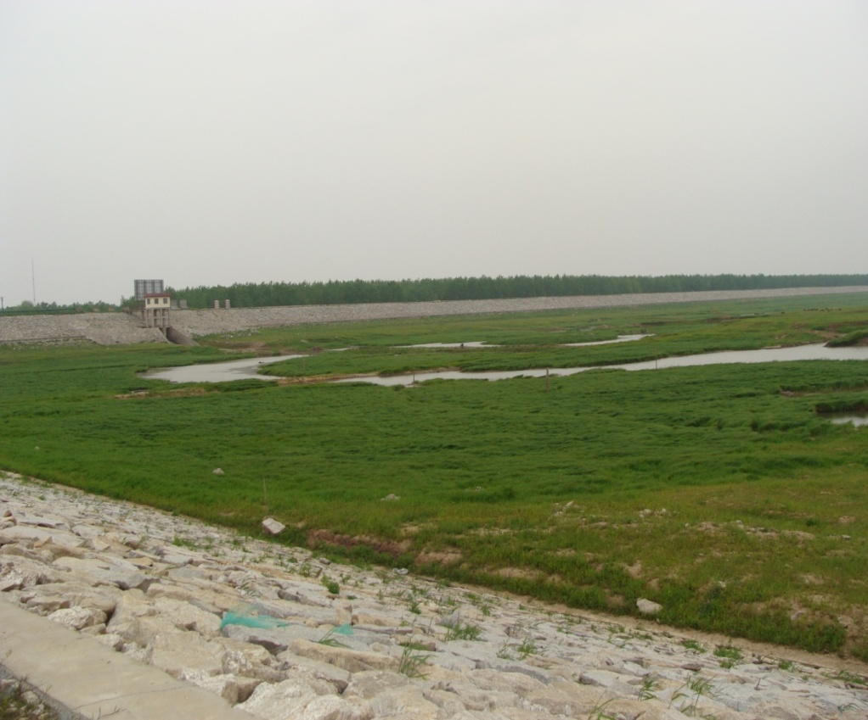
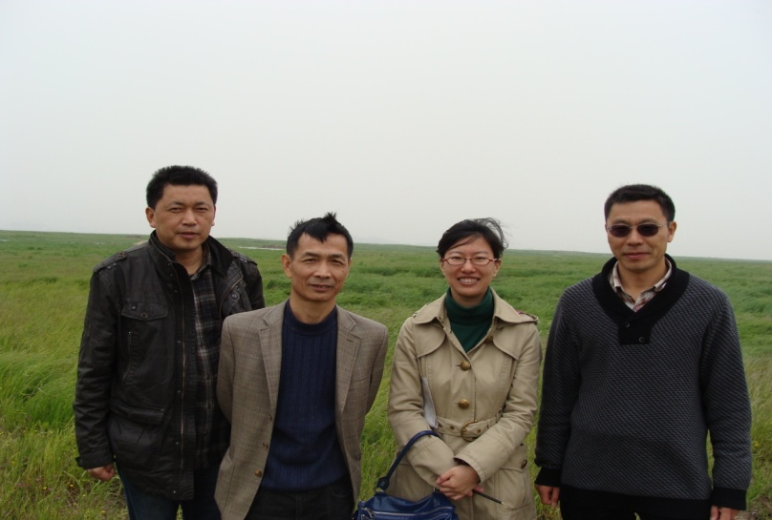
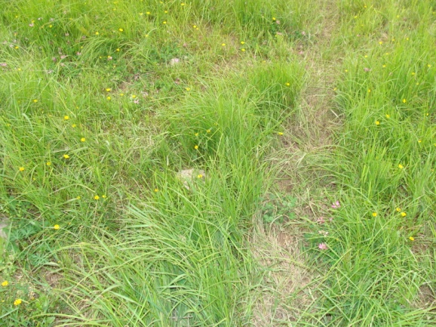
  In-situ data measurements
Project team member went to Junshan, Dongting Lake to participate in the field campaign for snail survey , on April 2013.
(b) Vegetation of snail breeding
Photo of snail breeding environment,
Lakeshore near Dongting Lake dam
(c)Vegetation of no snail breeding
Notes:
The field campaign is carried out in April 2013, the landscapes of experimental sites are shown bellow:
The first one is ecological environment of snails
The next one shows that there are snails growing under dense vegetation
The last one is a area where there is no snails and its landscape is sparse vegetation
2013年4月份，项目组成员赴洞庭湖君山区开展野外实验和调研，下面是调研的现场的照片。
（a） 是洞庭湖大坝旁的湖滩钉螺孳生环境照片
（b） 是有螺区，植被高而茂密
（c） 是无螺区域，植被稀疏，相对低矮

Slide 12
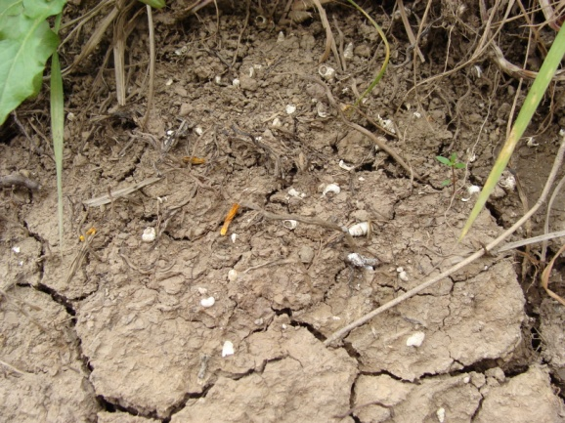
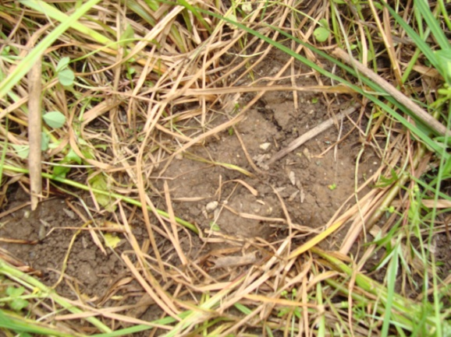
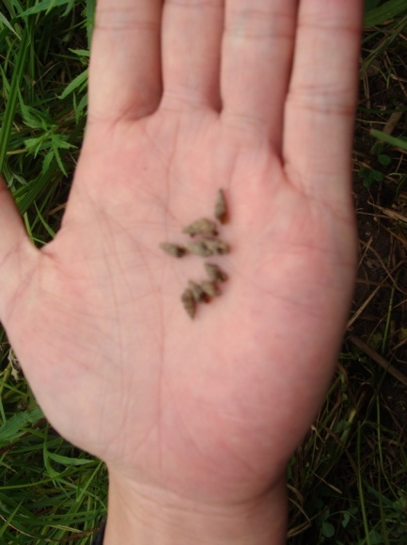
  In-situ data measurements
(a) Environment unsuitable for snail breeding
(b) Environment suitable for snail breeding
(c) Snail on-site
Notes:
（a） photo of environment near Dongting Lake is unsuitable for snail breeding soil is very dry and hard. The white snail are die. It used to be snail breeding area, but because the change of environment, not it is unsuitable for snail survival.
(b) photo of environment near Dongting Lake is very suitable for snail breeding. The soil is very moist
and soft.
(c) Photo of snail on site
We can find that through change the environment of Dongting Lake, we can eliminate snail.
Then remote sensing can be used to characterize and monitor environmental factors related to snail breeding and reproduction, and become a powerful means to monitor the snail. And the application of remote sensing in schistosomiasis prevention and control will play an increasingly important role.
是目前洞庭湖周边的非钉螺滋生地环境照片，可以发现这个地方的土壤很干燥很硬，图中白色的钉螺是往年死螺，说明这个地方曾经是钉螺孳生范围，由于环境变化，已经不适宜钉螺孳生。
（b） 是钉螺分布的地面现场，灰色的就是钉螺，可以看出适宜钉螺的地表土壤湿润而松软。
（e） 是现场钉螺照片
说明通过环境改造可以改变洞庭湖地区的环境特征，进而消灭钉螺，控制血吸虫病的感染和传播，遥感技术可以监测大尺度、长时间序列的环境变化，进而监测钉螺的分布变化趋势，为血吸虫病防控及相关政策的制定提供最快速、详实的数据。

Slide 13
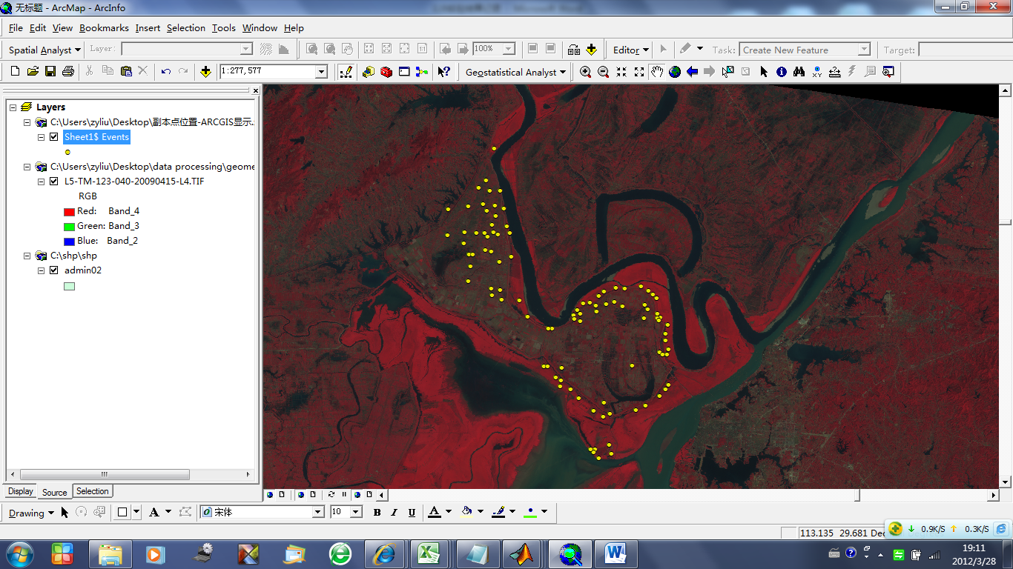
  In-situ data measurements
Snail field data of spring 2003-2013 were collected around the JunShan, near Dongting Lake.
Survey parameters:
  Survey location
  No. of survey frame
  No. of living snails within a frame (area of a frame is 0.1m²)
Fig.4 Location of snail survey of JunShan, near Dongting Lake
Notes:
Collect in-situ data, including field measurement data (2013) and historical data (03-12). The survey parameters are : survey location, No. of survey frame, No. of living snails, etc.
Fig 4 is the location of snail survey of JunShan District, near Dongting Lake.
Above survey data can provide Sufficient data source for the building of snail remote sensing model, model validation, dynamic monitoring and analysis.
获得了2012-2012年洞庭湖附近君山区的历史查螺数据，以及2013年的现场查螺数据，获取的数据主要是：钉螺分布位置，框数，以及活螺个数等地面实测数据，Fig.4 是钉螺野外调查现场的空间分布图。
这些地面数据将为钉螺遥感监测模型的建立，以及模型验证，动态监测和分析提供充分的数据源支持。

Slide 14
Current research results
Research on RS monitoring of potential snail breeding area
Considering the problems of previous linear regression remote sensing model of snail , new researches carried out as follows:
Quantitative suitability relationship between snail breeding and remote sensing environmental parameters
Analysis of coefficients of environmental factors
Model development for snail monitoring
Fuzzy Theory is introduced to develop a novel monitoring model to solve the problems caused by linear regression.
Notes:
We go on to carry out the research on schistosoma, include:
(1) Quantitative suitability relationship between snail breeding and remote sensing environmental parameters
(2)Analysis of coefficients of environmental factors,
(3)Model development for snail monitoring
Presently, we are developing a new model based on Fuzzy Theory to solute the problems caused by linear regression and improve the monitoring accuracy.

Slide 15
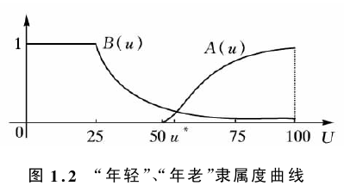
Current research results
Fuzzy theory
Fuzzy theory is a form of probabilistic logic, and it deals with complicated matter that is approximate rather than fixed and exact by building membership functions.
Takagi-Sugeno (T-S) fuzzy model is described by fuzzy IF-THEN rules， which can express relations of a nonlinear problem by a linear model.
The T-S fuzzy model provide a better method o explore the relationship between snail density and remote sensing environmental factors, and build a snail prediction model by only using remote sensing data.
True
Partial truth
False
Membership functions
Notes:
Fuzzy theory is a form of probabilistic logic, and it deals with complicated matter that is approximate rather than fixed and exact. Fuzzy logic has been extended to handle the concept of partial truth, where the truth value may range between completely true and completely false by building membership functions.
Takagi-Sugeno (T-S) fuzzy model is described by fuzzy IF-THEN rules which represent relations of a nonlinear problem. It is suitable for reducing the number of rule and can express the dynamics of each fuzzy implication (rule) by a linear model.
The T-S fuzzy model provide a better method o explore the relationship between snail density and remote sensing environmental factors, and build a snail prediction model by only using remote sensing data.

Slide 16
Current research results
Methodology
Notes:
According to the biological characteristics of snails and requirement and feasibility of remotely sensed data, we collect the optical, Microwave RS data of 2003,2005,2007, then remote sensing environmental factor are inversed, including surface temperature, soil moisture, vegetation index, topography, etc.
And based on the data of above RS environmental factors and Field data, T-S fuzzy was employed to analyze the relationship between snail density and environmental factors. A model for predicting snail distribution and density was developed. The new model was used to predict the distribution of snails in 2008,2009, and validated by field date. 根据钉螺生物学特性的研究成果，开展遥感数据需求分析，并基于可见光、微波等多源遥感数据，获取了研究区2003,2005,2007年相关环境特征的遥感参数，基于这些环境特征参数与地面实际查螺数据，应用模糊理论建立钉螺遥感监测模型，最后分别利用2008年和2009年遥感数据反演的环境特征参数预测研究区2008年和2009年的钉螺分布。

Slide 17
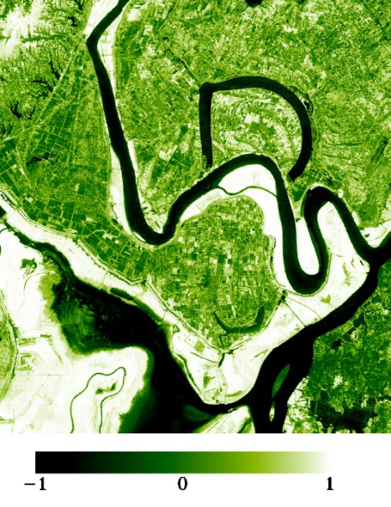
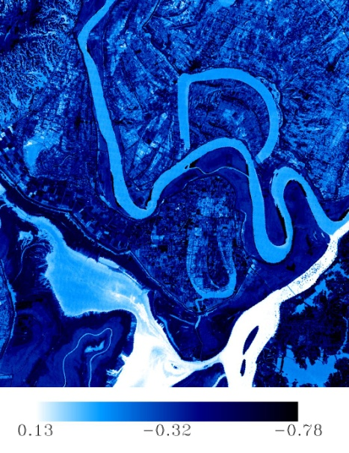
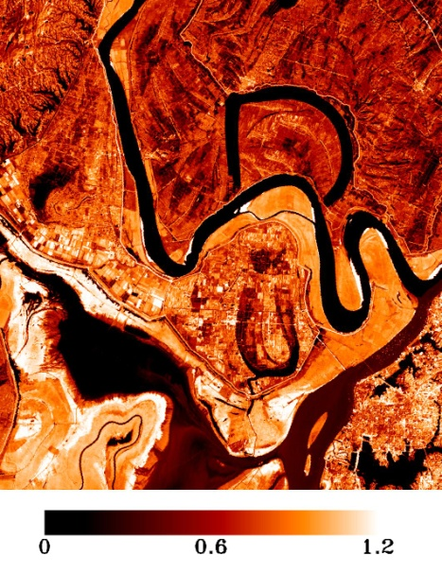
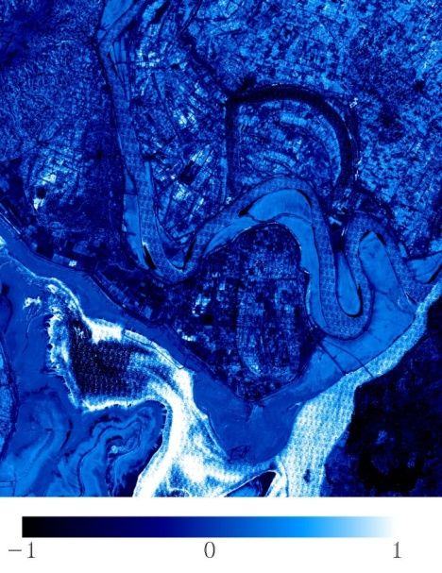
Current research results
  Environmental factors retrieval
NDVI(Normalized Difference Vegetation Index)
Tasseled cap transformation _Wetness
Tasseled cap transformation _Brightness
NDMI(Normalized difference moisture index
Environmental factors retrieved from Landsat TM/ETM+ images(2009.04.15)
Notes:
From Landsat TM/ETM+ dta, we retrieval RS Envionmental factors, include NDVI(Normalized Difference Vegetation Index), Tasseled cap transformation Wetness and brightness, NDMI(Normalized difference moisture index), etc.

Slide 18
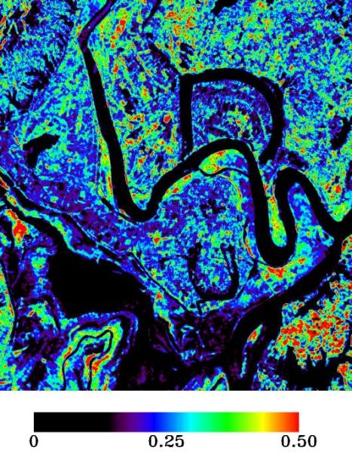
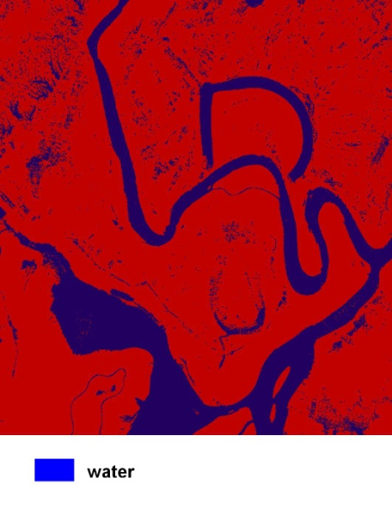
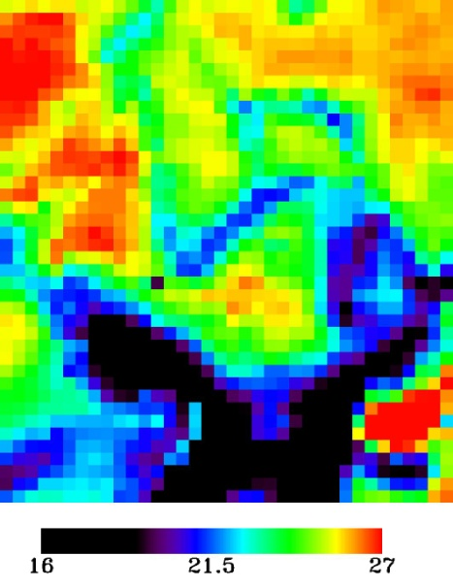
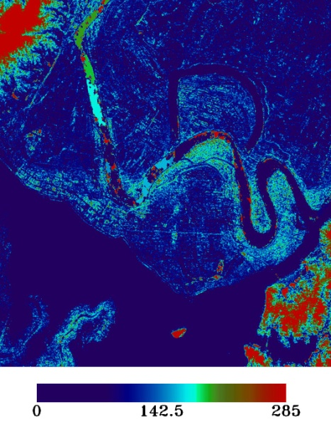
Current research results
  Environmental factors retrieval
Soil moisture
Water distribution
LST (Land Surface Temperature)
DEM
From ENVISAT-ASAR images
(2009.03.2)
MODIS-LST product
(Average of April ,2009)
ASTER DEM product
Notes:
From ENVISAT-ASAR data, we retrieval RS environmental factors of soil moisture and water distribution. And we use the MODIS land surface temperature product, and ASTER DEM prodect.

Slide 19

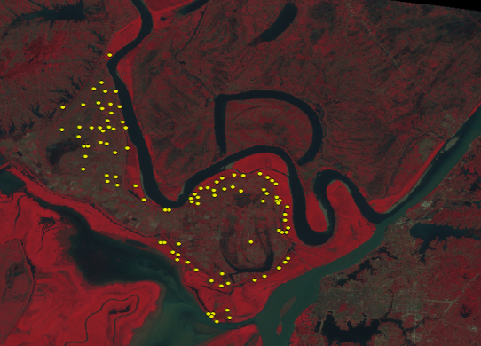
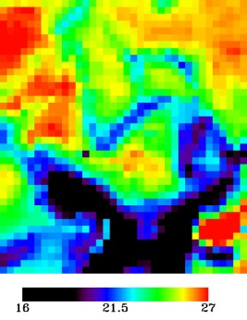
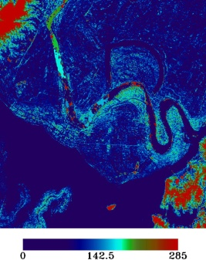




Current research results
Quantitative suitability relationship between snail breeding and RS environmental parameters:
Fuzzy theory
Survey data of living snail density
Retrieval environmental factors images
Soil moisture
LST
TC_Brightnes
Distance from water
NDVI
Membership functions of environmental factors
Notes:
On the basis analysis of snail habitats and its dependence on environment, the fuzzy membership functions of remote sensing environmental parameters (include vegetation index, surface temperature, tasseled cap transform moisture / brightness, soil moisture, distance from water, elevation) are established through Fuzzy theory, which describe the quantitative suitability relationship between snail breeding and remote sensing environmental parameters.

Slide 20
Current research results
RS model based on T-S Fuzzy :
Fuzzy rules:
(1) If( d is μD1 )and( t is μT1 )and( m is μMI )and( b is μB1 )and( v is μNDVI1 ) then (u is u1)
If( d is μD2 )and( t is μT2 )and( m is μMI )and( b is μB2 )and( v is μNDVI2 ) then (u is u2)
where u1=-0.006407d - 0.1846t +1.925m + 0.1168b - 0.995v+15.689
u2=0.0644d + 0.1957t + 0.08948m + 0.407b - 0.4411v - 4.476
RS model :
Notes:
A quantitative remote sensing monitoring model of snail is established based on T-S fuzzy, solving the linear expression of nonlinear relationship between snails and environmental factors
Fuzzy rules: the rules of environmental factors in different membership function, which describe the quantitative suitability relationship between snail breeding and remote sensing environmental parameters. In this study, there are two membership function in every environmental factors, hence it needs to calculate the density of snail in different rules.
RS model: Final snail density are synthetically the results from all rules. Min{…} calculate the minimum value of the membership function of all environmental factors， which multiply with the snail density from different rules to get the finally snail density.
基于T-S fuzzy，解决了钉螺与环境因子之间的复杂的非线性问题的线性表达，建立了一个定量化的钉螺遥感监测模型。
Fuzzy rules:是对各环境因子在不同隶属度函数内的是否适宜钉螺孳生的综合评价准则，本研究每个环境因子都有两个隶属度函数，因此，分别计算在不同隶属度函数中的钉螺密度值。
RS model：最终的钉螺密度值将综合考虑在不同隶属度函数中计算得到的钉螺密度值，其中，Min{…}是计算在所有环境因子适宜钉螺孳生的隶属度函数的最小值（就是木桶原理中选择最短的木板），该值与Fuzzy rules计算的钉螺密度进行相乘，最后计算得到模型的最终结果。

Slide 21
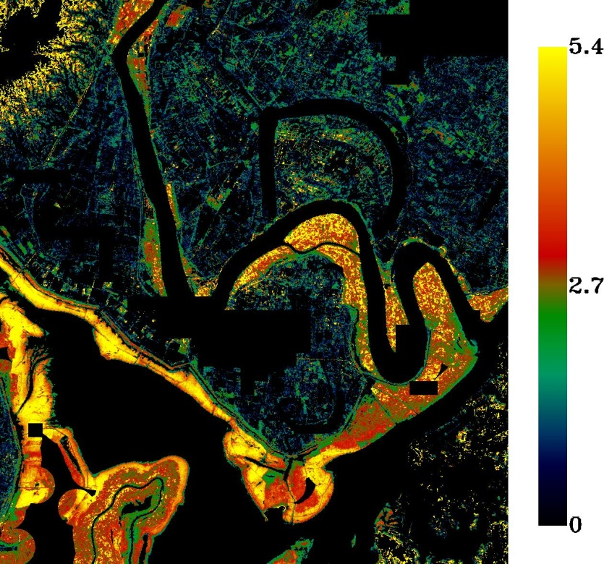
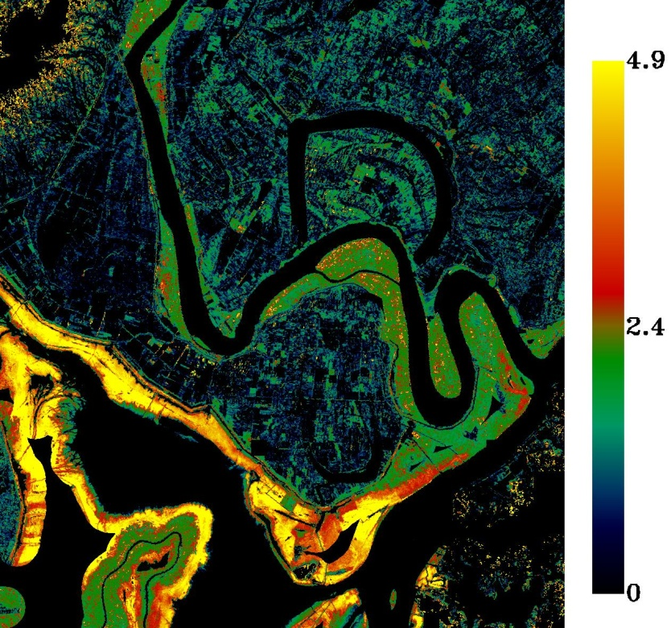
Current research results
Predict the snail density by using RS model based on T-S Fuzzy :
( a) 2008 (b) 2009
Estimation snail distribution and density of 2008, 2009 by only using environmental factors retrieved from RS data
Notes:
The pictures show the prediction results of snail remote sensing monitoring model based on T-S fuzzy model.
The input data of the model are environmental parameters retrieved from RS data of 2008 and 2009, and the prediction results are distribution and density of snails in 2008 and 2009
展示了应用基于T-S模糊模型的钉螺遥感监测模型的预测结果，模型的输入数据只有2008年和2009年的遥感反演的环境参数，分别预测得到2008年和2009年的钉螺分布和钉螺密度结果图。

Slide 22
Current research results
Predict the snail density by using RS model based on T-S Fuzzy :
Year | Accuracy of snail distribution
2008 | 95.12%
2009 | 93.33%
( a) 2008 (b) 2009
Comparison of field measured data (x-axis) and estimated data(y-axis)
Notes:
Validation experiment is carried out based on field data of 2008 and 2009 respectively.
, the results showed that: RMSE are 0.57422 and 0.52724 respectively., and the prediction accuracy of snail distribution is 95.12% and 93.33%, respectively.
利用实测数据对预测的钉螺密度进行验证，RMSE分别是0.57422和0.52724，预测钉螺分布的精度分别是95.12%和93.33%。

Slide 23
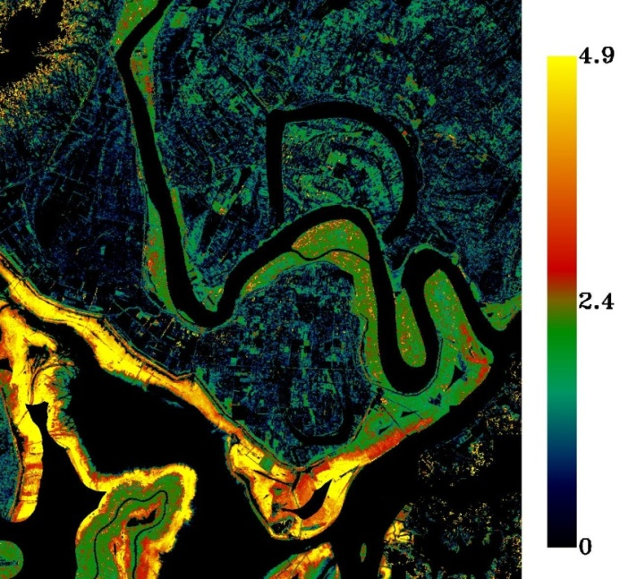
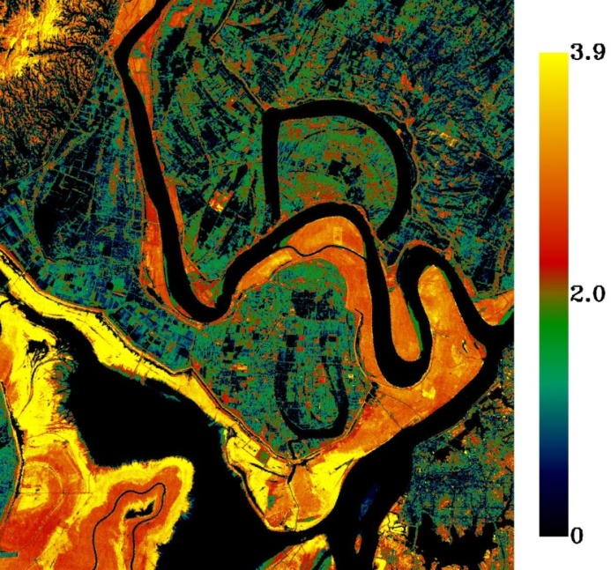
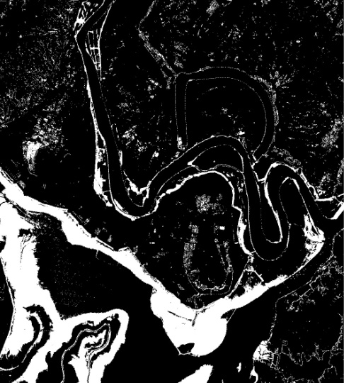
Current research results
Compare the Predict results between fuzzy model and linear regression model
(a) Fuzzy model (b) linear regression (c) water in summer and
land in winter
Estimation snail distribution and density of 2009
Notes:
The figure shows the comparison of distribution prediction results of snails in 2009 calculated fuzzy information method and linear regression method, indicating that the former is obviously better than the latter, in especial:
(1) The red circle is Jushan island, and in figure (a), the black area is a small hillside with no snail propagation, which is not correctly forecasted by linear regression method
(2)The blue circle is Yueyang city, where has been basically no propagation of snails and is not the study area for analysis of “winter land summer water”, however, green circle, a place for propagating snails, is marshland, which have been accurately predicted by the method based on fuzzy information theory, while the results calculated by linear regression method is incorrect
基于模糊信息论结果与线性回归的2009年钉螺分布预测结果对比图，基于模糊信息论的钉螺预测结果明显好于线性回归模型的结果，最典型的是：
（1）红色圈：是君山岛，(a)图没有预测到钉螺分布的黑色区域是小山坡，没有钉螺孳生，而线性回归不能预测出来
（2）蓝色圈：是岳阳市， 岳阳市已经基本没有钉螺孳生，不是研究区“冬陆夏水”区域，但是绿色圈的区域是洲滩，是钉螺滋生地，基于模糊信息论的方法能准确预测，而基于线性回归的方法则不能正确预测。
Winter land summer water: Two typical traits of snail habitats in Dongting Lake, including "water in summer and land in winter" and "no grass, no snails", the "water in summer and land in winter" region and the vegetation coverage region were calculated by RS image processing respectively. The two regions mentioned above were then overlapped to confirm the snail distribution regions .

Slide 24
Current research results
Summary :
Based on the fuzzy information theory, a quantitative model has been developed by using the field epidemiological data and the associated environmental data including water, soil temperature and moisture, DEM, NDVI etc. , which are extracted from satellite data.
Taking input these factors derived from 2009 satellite data, the model has been employed to predict the distribution and density of snails.
A comparative analysis has been performed to validate the predicted results against the field survey data. The results demonstrate the promising of the developed model in predicting location and distribution of snails.
These studies lay down a significant pathway for carrying out the next phase of work in research and development on dynamically monitoring spatial-temporal distribution of vector-based diseases and early warning.

Slide 25
2、The Improvement of TS Fuzzy RS Monitoring Model of Snail (vector of schistosomiasis) and New Application at Xinmin Beach of Gaoyou Lake

Slide 26
Background
Research contents:
IMPROVE the TS Fuzzy RS snail monitoring model by adjusting environmental index and normalizing multi-source RS data, in order to be applied to different places, different time series, and different RS data.
ADJUST the improved model according to the field survey data type. The field survey data are collected in the form of village block instead of GPS point, which is a common way for field data collections in China.
Take Xinmin beach, Gaoyou Lake as new research area, carry out 20 years (1990 - 2010) of dynamic monitoring, to further VALIDATE the effectiveness of the T-S Fuzzy RS snail monitoring model.

Slide 27

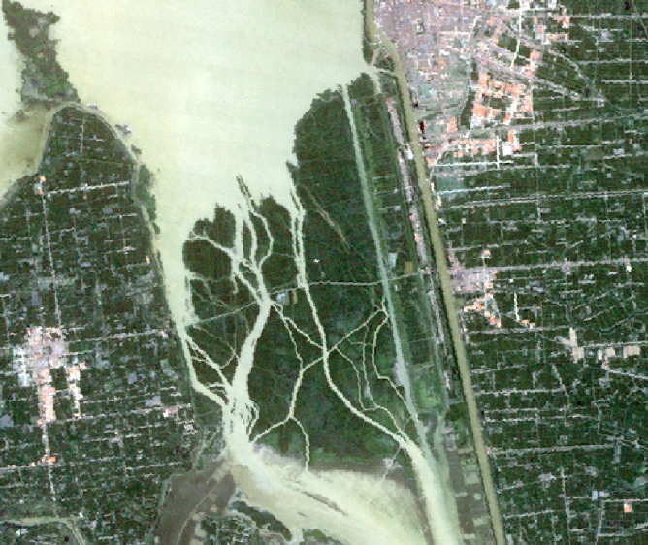
Study area
Xinmin Beach is located in 32.72 N and 119.41 E, in the southern of Gaoyou Lake, Jiangsu Province. Xinmin Beach is composed of 486 lakeshores and its area is about 53.62 km². Historical statistics revealed that Xinmin Beach was one of the most serious schistosomiasis endemic area and 1335 deaths were reported in 1950. The schistosomiasis transmission has been effectively controlled during 1976-1987, however, the number of snail raised again in 1988,2001 and 2007.
Xinmin Beach,
Gaoyou City
Xinmin Beach
Junshan,
Dongting Lake
Fig.1 Map of schistosomiasis epidemic regions, location of
Junshan, Dongting Lake and Xinmin Beach ，Gaoyou Lake
Fig.2 Image of Xinmin Beach

Slide 28
Study area
Compare the environment characteristics of Xinmin beach, Gaoyou Lake with Junshan, Dongting Lake
 | P: Junshan, Dongting Lake | C: Xinmin Beach, Gaoyou Lake
Types of distribution | Lake type | Lake type
Environment renovation | Inside and outside embankment, inside embankment is reclaimed | Inside and outside levee, inside levee is reclaimed
Influence of water distribution | Winter Land, Summer Water | Floodplains
Time of medication | Spring and Autumn | Spring and Autumn
LST | suitable breeding | suitable breeding
Elevation | 20-35m | 1-7m
Similar
Difference
The environment of Xinmin Beach is basically consistent with Junshan, except for the elevation.
Need to build a new suitability index membership function of elevation to improve the T-S Fuzzy RS monitoring model built by the data of Junshan, Dongting Lake.

Slide 29
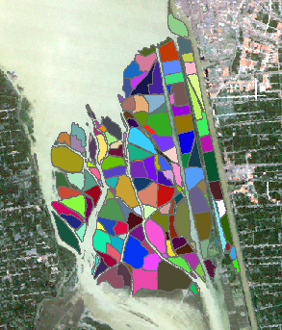
Study area
Compare the field survey data of Xinmin beach, Gaoyou Lake with Junshan, Dongting Lake
Snail field data of Xinmin 1990-2010
Survey parameters:
  Survey block
  Survey block area
  Snail area within block
  No. of survey frame
  No. of living snails within a frame (area of a frame is 0.11m²)
洞庭湖的
(a) Junshan, Donging Lake (b) Xinmin beach, Gaoyou lake
Fig.3 Distribution of snail
The field data of Junshan, Dongting Lake are collected by GPS. In fact, China CDC have huge field data in the unit of village block. In this study the predicted results are validated by snail habitat block number and the mean density within a block.

Slide 30
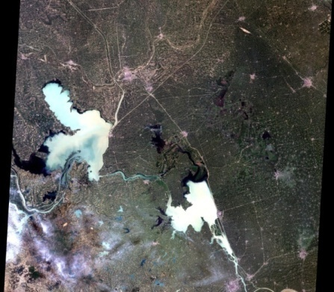
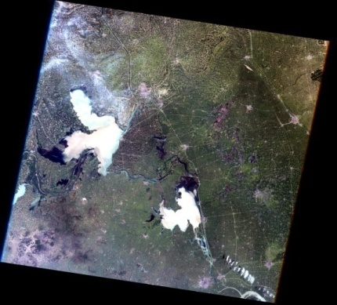
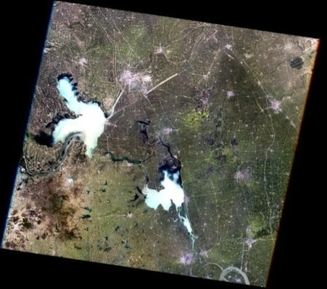



EO Data acquisitions and processing
Landsat 5 can provide long-term RS data for environment factor retrieval, but lack of data around April 2007.
CBERS 02B and MODIS data are used instead, according to the similar bandwidth as shown in Table 2.
Table1. RS data
ID | Acquisition time | Satellite | Sensor
1 | 1990.05.08 | Lansat5 | TM
2 | 1995.04.20 | Lansat5 | TM
3 | 2000.04.17 | Lansat5 | TM
4 | 2007.04.23 | CBERS 02B, TERRA | CCD（band1~4） MODIS（band6,7）
5 | 2010.04.29 | Lansat5 | TM
Table2. Bandwidth of CBERS-2’s CCD, MODIS band 6,7 and LANDSAT-TM5
The problems of inconsistent environment factor retrieved from multi-source remote sensing data need to be solved
Landsat Band # | Band1 | Band2 | Band3 | Band4 | Band5 | Band7 | Resolution
Landsat TM5 | 0.45-0.52 | 0.52-0.6 | 0.63-0.69 | 0.76-0.9 | 1.55-1.75 | 2.08-2.35 | 30m
CBERS CCD | 0.45-0.52 | 0.52-0.59 | 0.63-0.69 | 0.77-0.9 |  |  | 20m
MODIS |  |  |  |  | 1.628-1.65 | 2.105-2.135 | 500m
1990.05.08 TM
1995.04.20 TM
2000.04.17 TM
2010.04.29 TM
2007.04.23 MODIS
2007.04.23 CBERS

Slide 31
EO Data acquisitions and processing
Solution: Normalization of temporal-spatial-spectral-angle features of different remotely sensed data
Temporal normalization: Select the data of similar imaging time
Spatial normalization: Aggregation / Scale transfer model
Spectral normalization: A spectral band adjust factor (SBAF) is established:
Angle normalization: a observation geometry adjusted factor (OGAF) is established:

Slide 32
Experiment results
Flowchart of the methods
Biologic characteristics of snail
Requirement and feasibility of remotely sensed data
Normalization
Multi-sources RS data
Field observation data
T-S Fuzzy
Extracted environmental factors of 1990-2010
Soil bright
Validation by survey block
Wetness
Vegetation indexs
Elevation
……
Predicted snail distribution and density of 1990,1995,2000,2007, 2010
Remote sensing model of
snail with new fuzzy
function of elevation
Red box denotes the model improvement

Slide 33




Experiment results
  Environmental factors retrieval
Landsat TM images(1990.05.08)
NDVI(Normalized Difference Vegetation Index)
Tasseled cap transformation _Wetness
Tasseled cap transformation _Brightness
MNDWI(Modified Normalized difference water index

Slide 34





Experiment results
  Environmental factors retrieval
CBERS
(2007.04.23)
MODIS
(2007.04.23)
MNDWI
(2007.04.23)
ASTER
NDVI
Tasseled cap transformation _Brightness
Water distribution
DEM

Slide 35


Experiment results
Suitability index for snail breeding vs. RS environmental parameters
Gaoyou Lake data
T-S Fuzzy
Suitability index for snail breeding
Survey data
DEM data
Elevation
(Snail thrive when elevation between 4-6m)
Dongting
Lake data
TC_Wetness
TC_Brightnes
Distance from water
NDVI
Fig.4 other suitability index for snail breeding vs. RS environmental parameters

Slide 36






Experiment results
1990-2010 dynamic monitoring results of snail spatial distribution
(a)1990
(b)1995
(c)2000
(d)2007
Low: 0
High :0.1354
(e)2010
Fig.5 Estimation of snail distribution and density only using environmental factors retrieved from RS data

Slide 37






Experiment results
Compare the predicted results with survey data (block by block)
Right predict
Wrong predict
No survey data
(a)1990 (b) 1995 (c)2000 (d)2007 e(2010)
Fig. 6 Predicted results of the snail distribution blocks
Table.3 Accuracy of predicted snail distribution blocks
Year | No. of survey snail block | No. of predict snail block | Accuracy
1990 | 73 | 64 | 87.67%
1995 | 33 | 30 | 91%
2000 | 15 | 15 | 100%
2007 | 40 | 37 | 92.5%
2010 | 59 | 52 | 88.14%
Average |  |  | 92%

Slide 38
Experiment results
Compare the predicted results with survey data (by time series)
Year
(a)Trend of snail habitat areas change
(b)Trend of snail density change
Fig.7 Estimation of snail distribution and density from 1990 to 2010
The change trend of predicted result is in consist with the survey data.

Slide 39
Experiment results
Compare the predicted results with survey data (by scatter diagram)
(a) Junshan,Dongting Lake (b) Xinmin Beach, Gaoyou Lake
RMSE=0.024634
NRMSD= 0.5636
Fig.8 Comparison of field measured data (x-axis) and estimated data(y-axis)
The results compared with Dongting Lake had little difference, so the improved model is suitable for Xinmin Beach, near Gaoyou Lake.

Slide 40
Experiment results
Summary:
The T-S Fuzzy RS model of nail are improved by establishing a new suitable index membership function of elevation and normalizing different RS data for environmental factors retrievals, achieving a long time series dynamic monitoring of snail distribution in Xinmin beach from 1990 to 2010.
A comparative analysis has been performed to validate the predicted results against the field survey data. The results demonstrate the accuracy of the developed model in predicting location and density of snails.
The successful application of improved model in Xinmin beach, Gaoyou Lake from 1990 to 2010 indicates that the T-S Fuzzy RS monitoring model and RS technology can play an important role in predicting and early warning of vector-borne diseases.

Slide 41
  3、Remote Sensing Monitoring of mosquitoes (vector of malaria) and develops the T-S fuzzy remote sensing monitoring and prediction model of malaria.

Slide 42

Background
Research results of vector-borne disease of Schistosomiasis demonstrated that the T-S Fuzzy model and RS technology can play an important role in predicting vector-borne diseases.
Research contents
  Based on the achievement on RS monitoring of Schistosomiasis, this research uses RS technology to retrieve environmental factors related to mosquitoes (vector of malaria) breeding and reproduction, and develops the T-S fuzzy remote sensing monitoring and prediction model of malaria.

Slide 43


Background
Malaria: status in the world
This left map shows an approximation of the parts of the world where malaria transmission occurs. (CDC website, 2010)
China
Malaria transmission
Occurs throughout
Malaria transmission
Occurs in some parts
Malaria transmission
is not known to occur
Malaria is one of the most common mosquito-borne diseases and a great public health problem worldwide.
3.3 billion people(half the world’s population ) in 97 countries and territories are live in area with risk of malaria, and 1.2 billion are in high risk .
Most regions of China were under the risk of Malaria in the past.

Slide 44

Background
Malaria: status in China
2010: Malaria is endemic to only two provinces: Yunnan Province and Hainan Province
2015: the goal is no indigenous cases outside of Yunnan province
2020: national elimination
Challenge:
  In China-Myanmar border area, for example, Tengchong county in Yunnan province, malaria is hard to control, because imported malaria cases are very serious. Reintroduction of the disease is a constant risk.
China-Myanmar Border Area
(from HPA(health poverty action))
0.1 million permanent immigrants
1.5 million floating population
2,000 km National border
Hundreds of “Pathways”

Slide 45

Background
Requirement of the malaria control
The mosquito carries the disease from one person to another (acting as a "vector").
  Develop methods for long-term dynamic monitoring the number and distribution of mosquitoes (vector of malaria), which will provide early warning to avoid the imported malaria case leading to malaria outbreak.
  Develop ways of real-time acquiring high risk information and locations of Myanmar in China’s neighboring countries, and help reduce the imported malaria cases.

Slide 46
Background
Biologic characteristics
Malaria is found mainly relating to climatic and environmental factors, such as temperature, humidity, vegetation, etc. where
Mosquitoes can survive and multiply
Malaria parasites can complete their growth cycle in the mosquitoes ("extrinsic incubation period").
Environmental factors | Characteristics
Temperature | Below 16℃ or above 30℃, it will grow slowly and die
EAT(Effective accumulated temperature) | At least 220℃ •day to grow up to adult mosquito, survival percentage increased with ETA
Humidity of air | Suitable range is 60%~85%, too low or too high can not survival
Vegetation | Cover the sunshine, adjust humidity
Temperature range is between 14.5℃ to 30℃, different species of malaria will vary.
Whether the RS technology and T-S fuzzy Fuzzy can describe the biologic characteristics between mosquito, malaria parasites and environmental factors like above ? And find the quantitative suitability relationship between the malaria and environmental factors ?

Slide 47

Study area – Tengchong
YUN NAN
Coordinates | 25.017°N, 98.483°E
Province | Yunnan, China
Area | 5,845 km² (2,257 sq mi)
Average Elevation | 1,667 m (5,469 ft)
Population | 620,000
Borders with Myanmar | in the northwest for 151 km.
Study area
Fig.1 Location of Tengchong County (pink) in Baoshan City, Yunnan province
Malaria situation:
Historical statistics revealed that Tengchong was one of the most serious malaria endemic area, and malaria had been effectively controlled during 1976-1987.
  Now it is the highest incidence of malaria in China. From 2010, there are scarcely any indigenous malaria case. Cross-border migration from Myanmar is the major source for the malaria in Tengchong, which could cause malaria to erupt again in China.

Slide 48



  Study area – Malaria surveys
Monthly malaria case data between 2002 to 2014 were collected from 18 village in Tengchong:
  Indigenous case
  Imported case
  Population of village
village
Infective stage
Diagnostic stage
Fig.2 Location of 18 villages
It is about one month delay from infecting by mosquitoes to discover malaria. So the malaria cases data can be used to validate predicted results of previous monthly RS data.

Slide 49
RS data acquisitions
RS Data acquisitions
ID | Environmental factors | Sensor | Satellite | Spatial resolution | Temporal resolution | Temporal coverage
1 | Surface soil moisture | AMSR-E | Aqua | 25km | Daily | 2003-2011
2 | Surface temperature and NDVI | MODIS | Terra | 1KM | Monthly And Daily | 2002-2014
3 | NDVI, pool and gutter | TM/ EMT+ | Lansat5/7 | 30m | Yearly (Jan,Feb,Mar,Dec ) | 2002-2013
4 | DEM | ASTER | Terra | 30m | N/A | N/A
During the rainy season, it is hard to get high spatial and temporal resolution Vis-NIR RS data, which would limit the precision of the research.

Slide 50
  Methods
Flowchart of the methods
Biologic characteristics of mosquitoes
Requirement and feasibility of remotely sensed data
Normalization
Multi-sources RS data
Monthly Malaria cases data
T-S Fuzzy
Previous monthly environmental factors
(2003-2011 except 2005)
Soil moisture
LST
Vegetation indexs
Elevation
……
Validation
Predicted monthly malaria high risk area of 2005
Remote sensing model of
malaria
Monthly RS date of 2005

Slide 51



  Methods
  RS retrieval of environmental factors
MODIS images (2005.01)
NDVI(Normalized Difference Vegetation Index)
LST(Land surface temperature )
EAT(Effective accumulated temperature)
Notes:
Effective Accumulated Temperature(ETA) is the sum of daily temperature for the period of daily mean temperature(Td) above the threshold temperature of animal or vegetation growth. ETA=Sum of Td when Td> threshold temperature
Unit:deg.C days ℃.d

Slide 52


  Methods
  RS retrieval of environmental factors
AMSR-E
ASTER
Surface soil moisture
DEM
3773
1950
127
0.22
0.11
0

Slide 53



  Methods
  Model training
Previous Monthly RS DATA
Test
data
T-S Fuzzy
T-S fuzzy model
Fuzzification
Membership functions
No
Monthly Malaria Case Data
Parameter identification
Training
data
RMSE
Structure identification
Fuzzy rules
Yes
Model
output
Finish
Defuzzification

Slide 54


Current research results
  Quantitative suitability relationship between malaria and RS environmental parameters:
EAT
Suitability index for
malaria
LST
Growth and breeding rate of mosquito and Malaria parasites are influenced by temperature:
Red line: below 16℃, the mosquito die, and suitability index increases with temperature between 16℃ to 23℃.
Green line: above 14℃, the malaria parasites can complete their growth cycle, and the peak is between 17℃ to 20℃.
When it reaches the threshold of Effective Accumulated Temperature(EAT)-about 200℃ •day to grow up to adult mosquito, percentage of survival increases with ETA, and the peak is at 800 ℃•day.

Slide 55

Current research results
  Quantitative suitability relationship between malaria and RS environmental parameters:
Suitability index for malaria
Soil moisture
Soil moisture can affect the humidity of air, too low or too high are not conductive to mosquito survival.

Slide 56
Current research results
  12 months’ dynamic monitoring results of Tengchong
腾冲 2005年12个月的疟疾分布动态监测及分析
Feb March April May Jun Jul
High risk
Low risk
No risk
Aug Sep Oct Nov Dec /Jan(2006)

Slide 57


Current research results
  Validation and analysis
Indigenous case
Malaria risk
Percent of risk
area
September
Month
Month
The changing trend of predicted malaria risk is in consist with the indigenous data.
August

Slide 58


Current research results
Compare the predicted results with survey data (by village location)
No Indigenous
malaria case
Indigenous
Malaria case
Mar April May Jun Jul
Accuracy of predicted malaria incident location is 74% .
Aug Sep Oct Nov Feb Dec and Jan
The location prediction accuracy is rather good when only using 1km and 25km spatial resolution RS data. Higher spatial resolution should improve the results.

Slide 59
Current research results
Summary:
The T-S fuzzy remote sensing monitoring and prediction model of malaria was established by using the malaria case data and the associated environmental data.
Comparative analysis has been performed to validate the predicted results against the survey data. The average accuracy of predicted malaria incident location is 74%.
The 12 months’ dynamic monitoring results of Tengchong showed good application prospect of the T-S Fuzzy RS monitoring model in predicting and early warning of mosquito-borne diseases.
The quantitative suitability relationship between malaria and RS environmental parameters is in consist with the biologic characteristics of malaria.

Slide 60
Future works
Model Improvement
  Collect mosquito data to further validate the accuracy of final model prediction results.
  Use high spatial and temporal resolution RS data, which would be promising for malaria prediction, such as Sentinel, etc.
Model Application
  Long-term dynamic monitoring of the risk of malaria and distribution of mosquito in China-Myanmar border area, which will provide technology support for China and Myanmar’s control and prevention of malaria, and help China implement the malaria elimination strategy .

Slide 61

Thank you !

