Slide 1
Committee on Earth Observation Satellites
Landslide Disaster Working Group
Pilot: Status Report
March 8th, 2016

Slide 2
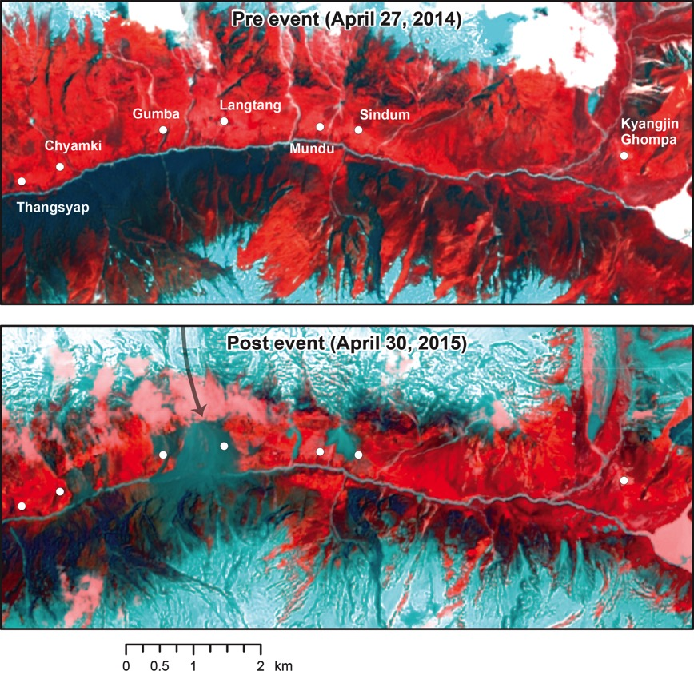
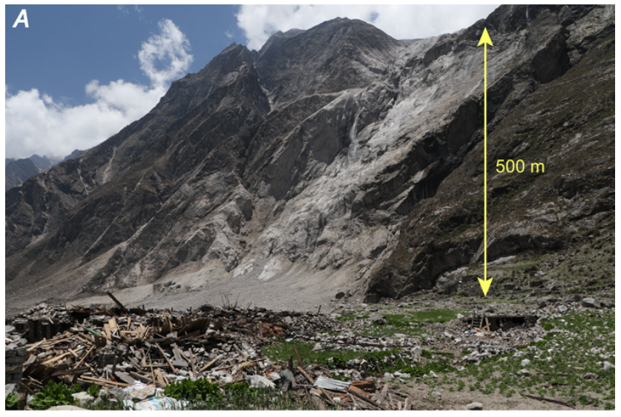
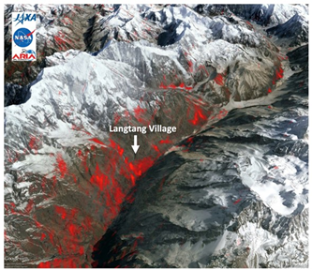
Motivation
Langtang Valley, Nepal
View from the ground (Photo credit USGS)
Landsat-8 Pre and Post event views of the valley
Damage Proxy Map (DPM) from ALOS-2 Data

Slide 3
Impact
Landslides with fatalities from a global landslide catalog of rainfall-triggered events 2007-2013 (Kirschbaum et al. 2015)

Slide 4
Landslides Pilot: Goal
To demonstrate the effective exploitation of Earth observations (EO) data and technologies to detect, map and monitor landslides and landslide prone hillsides, in different physiographic and climatic regions.
To apply satellite EO across the cycle of landslide disaster risk management, including preparedness, situational awareness, response and recovery with a distinct multi-hazard focus on cascading impacts and risks.
Notes:
Key message regarding the new pilot :
- it's about multi-hazard and multi-sensor approach to disaster resilience and risk reduction
- the multi-hazard tactic is to advance data fusion, integration and analysis, leveraging existing pilots as they end their 3 years. Starting with the new pilot we will look at earthquake, volcano and flood inducing cascading effects such as landslide and debris flow.

Slide 5
Proposed Objectives
Objective A:
Establish effective practices for merging different Earth Observation data (e.g. optical and radar) to better monitor and map landslide activity over time and space.
Objective B:
Demonstrate how landslide products, models or services can support disaster risk management for multi-hazard and cascading landslide events.
Objective C:
Exploit the experience, data, and lessons learned from ongoing pilots (i.e., seismic hazards, floods, volcanoes).
Objective D:
Engage and partner with data brokers and end users to understand user and service requirements, user expectations, and to get feedback through the activities described in objectives A-C.

Slide 6
Key Pilot Outputs & Deliverables
Objective A: Report on recommended practices for the combined exploitation of SAR and Optical imagery and technologies for landslide detection, mapping and monitoring”.
Objective A-C: Report on effective methodologies and strategies for considering multi-hazard and cascading aspect of landslides through multi-temporal landslide mapping from multiple triggers (leveraging information/interactions with the volcano, flood and earthquake pilots)
Objectives B-C: Landslide event inventory and activity (monitoring) maps produced using optical and SAR imagery and technologies, and their combination, for selected case studies / geographical areas.
Objective D: Report on end user engagement strategies and characterize enablers, challenges, barriers to effective transfer of information, knowledge and technologies.

Slide 7
Status
Past Activities
Developed an initial plan with objectives and overarching goals
Held 2 meetings (December 2015 and February 2016) each with approximately 35 participants
Participant Survey was prepared and sent to pilot contributors in early January to solicit details from team members for refining Pilot objectives
Upcoming activities
Finalize Landslide Pilot objectives and define regional focus areas
Hold a meeting on April 20th at the EGU Meeting in Vienna, Austria
Identify 1-2 additional co-leads for the Landslide Pilot
Establish the Landslide Pilot web presence on CEOS.ORG with a summary of goals, objectives and participants

Slide 8
CEOS Landslide Pilot Survey
What is your area(s) of expertise or operational authority or responsibility (e.g. research focus or disaster response and recovery)?
In what geographic region(s) do you primarily work or have responsibility (e.g. Global, national, regional)?
Please rate your interest the proposed Pilot Objectives from Very important to not relevant
Please provide feedback on current objectives in terms of your proposed contribution and suggest ways to modify the objectives to better accommodate your expertise or the group’s collective expertise.
What Earth Observation data are you most interested in acquiring as part of this pilot?
What specific aspects of this activity do you expect to participate in for the duration of the pilot?
The CEOS Landslide Pilot is in the scoping state. Who should be added to this discussion?
Please recommend others who you currently work with or who may be interested in this activity and include organization, point-of-contact name, affiliation, and email contact information.
28 Responses

Slide 9
Current Landslide Pilot Members (50)
Country | Number of participants | Organizations
USA | 18 | NASA, USGS, FEMA, GFDRR (World Bank), Southern Methodist University, U. of Oregon, U. of Washington, U. of Colorado
China | 10 | Academy of Opto-Electronics, CAS, China Earthquake Administration, Institute of Water Resources and Hydropower Research, Institute of Crustal Dynamics, CEA
Italy | 7 | CNR IRPI, ESA, EURAC, INGV, Università degli Studi di Firenze
France | 6 | CEA AIM, CNRS, UJF Grenoble, UNESCO, University of Strasbourg
Germany | 2 | GFZ German Research Centre for Geosciences
UK | 4 | University of Leeds, NERC COMET, University of Durham
Norway | 2 | Norut, Geological Survey of Norway
Kenya | 1 | RCMRD
EU | 1 | European Commission
Nepal | 1 | ICIMOD
India | 1 | ISRO
Barbados | 2 | CIMH
Sri Lanka | 1 | IWMI
Canada | 1 | NRCan
Taiwan | 1 | National Central University of Taiwan

Slide 10
Summary of Expertise
Roles | Research | Disaster Response | Imagery Type
Researcher | Landslide hazard mapping | National Landslide Hazard Program | InSAR for landslide mapping and monitoring
Disaster Response Coordinator | gradual landslide motion in mountain | Disaster Preparedness, Post disaster impact assessments | optical and radar satellite remote sensing for improved landslide process understanding
Manager for disaster preparedness and impact assessment | Initiation processes and early warning | Support to the Government for emergency management as centre of competence for civil protection | Satellite radar interferometry (InSAR) for landslides.
Regional Science Coordination Office | image analysis for automatic event landslide detection | Operational monitoring of landslides | satellite radar for measuring ground deformation
Scientific Advisor for National Civil Protection | optical and radar satellite remote sensing for improved landslide process understanding | Earthquake disaster emergency response and relief | Optical remote sensing with a particular focus on landslide mapping and monitoring
 | forecasting, monitoring and assessment of hydrometeorological related hazards |  | airborne lidar analysis, landslide mechanics
 | debris flow inundation hazard modeling

Slide 11
Regional Foci of participants
Global
Regional
Caribbean
South Asia
Asia
Mediterranean
Tibetan Plateau
Central America
National
US
Western US, Appalachian States, California, Colorado
France
Norway
Nepal
Italy
China
Kyrgyzstan
Iran
Local/sub-national efforts (catchment scale)
Taiwan, Korea, Japan
Southwest China

Slide 12
Interest in Objectives
 | Objective A | Objective B | Objective C | Objective D
1 - Very Important | 85% | 60% | 15% | 21%
2- Moderately | 10% | 35% | 60% | 52%
3 - Neutral | 5% | 5% | 25% | 21%
4 - Not Important | 0% | 0% | 0% | 5%
Objective A:
Establish effective practices for merging different Earth Observation data (e.g. optical and radar) to better manage landslide detection, mapping, and monitoring.
Developing / testing / benchmarking / sharing tools for high-frequency monitoring and rapid mapping of landslides with satellite EO data
Leverage revisit time of multiple sensors (e.g. the Sentinel constellation (S1, S2) to use EO satellite images as a real source of information for the monitoring of landslide displacement/deformation at high frequency.
Processing stacks of Optical and SAR images to create horizontal displacement maps over time
Improve the efficiency in processing remote sensing data for emergency response
Establishment of benchmark datasets to test available semi-automatic techniques

Slide 13
Comments on Objectives
Objective B:
Create integrated products & services for practices or activities, such as landslide inventories, to support disaster risk management for multi-hazard and cascading landslide events.
Further develop operational services leveraging existing projects on landslide inventory mapping, landslide monitoring and early warning, landslide modeling and interpretation
Demonstrate the rapid emergency response landslide mapping during major disasters in coordination with end users
Create closer links between remote sensing analysis and the needs for hazard and risk analysis
Use the longest available time series of remote sensing data to create systematic spatiotemporal assessment of landslide activity

Slide 14
Interest in Data Access
 | SAR | Optical | DEMS | Soil Moisture & rainfall | land use/soils | landslide inventories | LiDAR
Number interested | 15 | 17 | 5 | 3 | 3 | 3 | 2
Percent | 58% | 65% | 19% | 12% | 12% | 12% | 8%
Source | Sentinel-1 and 2,RADARSAT-2, COSMO-SkyMed, ALOS-1 and 2, TerraSAR-X, RISAT | Landsat, IRS, Worldview, Pleiades, SPOT5, SPOT-6/7, QuickBird, GF2, RapidEye, Sentinel-1, Sentinel-2, Venus | TanDEM-X | rainfall (weather data) |  | landslide catalogs | LiDAR
Resolution |  | 1m-10m | <10m
Notes | Polarimetric SAR (amplitude), better if HR/VHR; need the ability to target over specific sites of interest (supersites, Nepal), time series important | Multispectral (VHR better, GSD < 1 m); hyperspectral; time series needed |  |  | soil erosion, regolith depth, exposed bedrock for unconsolidated deposits | landslide maps (specifically after earthquakes) suceptibility maps | Time series would be best

Slide 15
Interest in Thematic Topics
Monitoring: Develop/advance/communicate monitoring capabilities leveraging and integrating Optical and SAR data (Obj A)
Mapping: Develop methodologies for multi-temporal image processing over select region to improve/expand landslide mapping/inventories (Obj A)
Hazard assessment/modeling: Demonstrating how EO data (DEMs, hydrological information, and imagery/SAR) can advance landslide modeling/hazard assessment at a regional scale (Obj B)
Rapid Assessment: Demonstration of how EO data can be rapidly processed for informed decision making (Obj A & D)
User/Pilot Engagement: Need to leverage existing connections and those from other pilots to turn products into actionable information (Obj C & D)

Slide 16
Suggested regional study areas
Nepal
Pacific Northwest, U.S. (Oregon, Washington)
China (southwestern area)
4. Caribbean (focus area TBD)

Slide 17
Future: Landslide Modelling
Advanced landslide modelling tools capable of assimilating remote sensing data and products for model initialization and validation.
optical
SAR
API
MODEL
forecast
envir.
data
map
Slide courtesy of Fausto Guzzetti

Slide 18
Take-Away
Clear need in the community: Landslide hazards are pervasive and research activities related to application of EO data are often not well-coordinated between regions
Landslide Pilot is still forming: we are still seeking new participants
Open to suggestions and guidance: particularly from other pilots

Slide 19
Questions/Comments
Dalia Kirschbaum (NASA/US): dalia.b.Kirschbaum@nasa.gov
Jonathan Godt: (USGS/US): jgodt@usgs.gov

