Slide 1
WG Disasters # 6, RO and Data Licensing
Committee on Earth Observation Satellites
Patrice Benarroche, ROOT Co-Chair
Joe Leitmann, ROOT Co-Chair
Tahir Akbar, GFDRR
Steven Hosford, Sub-Group on Data Licensing for Disasters Chair
Andrew Eddy, ROOT Secretary
Vancouver, Washington, 6-9 September, 2016

Slide 2
RO Session Overview
Status of RO and RO Demonstrator
- RO status
- Malawi Demonstrator (Flood Recovery Monitoring)
- Nepal (Housing Reconstruction)
- Syria (Agricultural Sustainability)
EO Data for Disasters Licensing Sub-Group
Notes:
RO ready to trigger
Malawi demonstrator being set up – support from DoDMA and Surveys
Nepal demonstrator AoI identified – end user World Bank
Syria work still under discussion

Slide 3
Oversight Team (ROOT) Membership
Space agencies from CEOS Disaster working group:
CNES (Patrice Benarroche- Co-chair)
ASI (Simona Zoffoli)
DLR (Jens Danzeglocke)
ESA (Ivan Petiteville and Philippe Bally)
JAXA (Chu Ishida and Nobuyoshi Fujimoto)
NASA (David Green and Stuart Frye)
USGS (Brenda Jones)
DRM Stakeholders:
World Bank/GFDRR (Joe Leitmann (Co-Chair), Keiko Saito and Tahir Akbar)
UNDP (Chiara Mellucci)
UNOSAT (Olivier Vandamme and Einar Bjorgo)
European Commission (Francoise Villette and Peter Spruyt)
Other partners:
CURBE (University of Cambridge, Emily So)
COPE (University of Copenhagen, Nathan Clarke)
Secretariat support provided by Athena Global (Andrew Eddy)
Membership is open to all CEOS agencies with an interest in the RO.
Associate Membership is open to donors and DRM stakeholders, and value-adding partners.

Slide 4
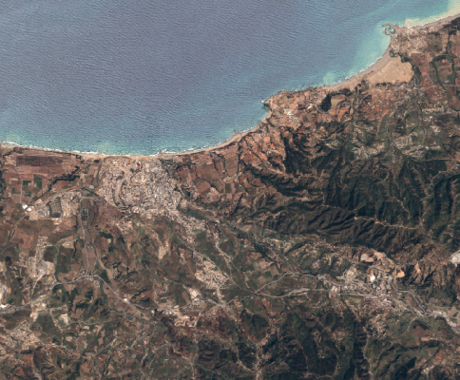
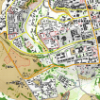
What will the RO consist of?
Collection of images and maps at several scales
For 3 to 5 years after a major disaster
(duration to match recovery framework)
Overview area
Mid-scale products from Sentinel data at 10m resolution
Change in landcover, open spaces
Vegetation loss or re-growth
Agriculture
Update frequency:
every 10 days to 6 months
Overview
AOI
Urban
zoom 1
Urban zooms
Large scale products from very high resolution data
Buildings
Infrastructure
Camps
Update frequency:
every 2 to 4 months
Urban
zoom 2

Slide 5
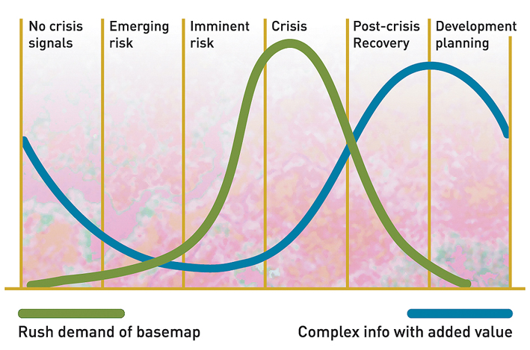
Geo-Information in Response & Recovery
Recovery Observatory added value
Highest current use during crisis – need to develop methodologies and products for recovery planning and monitoring
Demand for geo-information
Slide adapted from UNOSAT Luca dell’Oro
Notes:
The availability and sharing of timely and relevant information is critical for assisting humanitarian operations.
As shown here in the graph in the immediate aftermath of an event there is a peak in the demand of data and information including maps.

Slide 6
RO Status Overview
Recovery Observatory ready for triggering since 1 January, 2015
Collaboration attempted on Cyclone Pam (Vanuatu, March/April 2015 – see Lessons Learned Report), highlighting contradictions between Rapid Assessment and Recovery support;
CNES-commissioned study on RO product definition and image requirements presented to DRM stakeholders;
Finalization of RO data infrastructure fall 2015;
Demonstrator decided spring 2016 (Malawi; Nepal; Syria?);
Demonstrator under final definition; acquisitions begun;
Triggering of the RO after a major event or as follow-on to demonstration work in Malawi (in 2016 or early 2017);
Evaluation at RO + 6 months;
Lessons learned and sustainability strategy after evaluation of 1st RO
Notes:
Preliminary demonstration will be used to confirm product definition and better evaluate needs of data for the future recovery activation

Slide 7
RO Demonstrator
Assessment of a Recovery Observatory « Demonstrator » initiated in the scope of 2015 Malawi flood recovery.
Extensive discussions with end-users (WB and Malawi Govt) led to an extension of the Demonstrator in order to cover more potential areas where the RO may bring useful information. Following WB proposals, it has been agreed during ROOT telecon on the 28th of June to provide additional showcases for building reconstructions (Nepal) and agriculture recovery over large areas (Syria).

Slide 8
Demonstrator in Malawi (1/8)
After several propositions, AoIs have converged for Malawi. Final sign-off of Government of Malawi expected September 2016. Agreement in principle is given
Activities identified are extracted from Malawi National Disaster Recovery Framework document (NDRF) in order to address final user needs as closely as possible

Slide 9
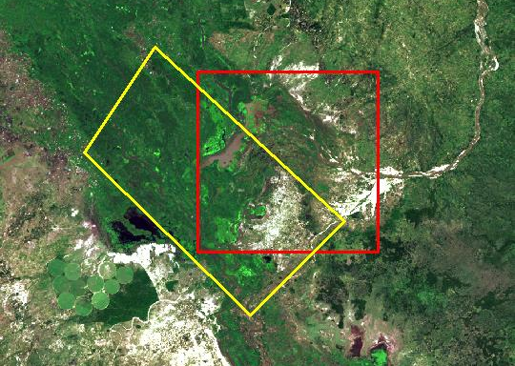
Demonstrator in Malawi (2/8)
Three AoIs retained :
Makhanga river bed assessment (DEM)
monitoring for agricultural damage in « Elephant Marsh »
Thabwa road reconstruction
SERTIT proposal

Slide 10
Demonstrator in Malawi (3/8)
ROOT asked for assessment of possible contributions June 2016;
Contributions from ROOT members are under discussions:
Pleiades acquisitions have started for CNES part,
Agriculture assessment (CNES subcontractor) started with Landsat images granted by B. Jones, and possibly Sentinel (to be discussed with F. Vilette),
TerraSarX potential use under assessment by J. Danzeglocke,
Thabwa and Makhanga contributions under assessment by D. Green,
Others ??

Slide 11
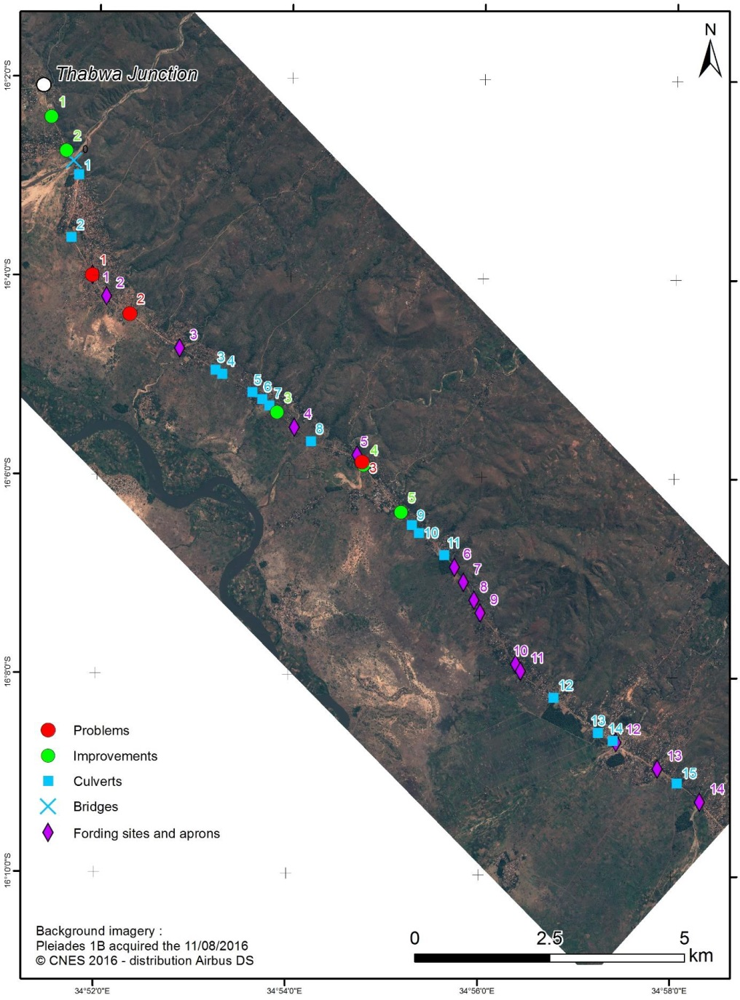
Demonstrator in Malawi (4/8) Thabwa Road
1 Peiades 1B image acquired 11/08/2016. Extensive interpretation along the road with the following objectives:
Demonstrate that VHR optical images can give precise assessment of road reconstructions
Prepare works follow-up with Malawi when road works are identified by Malawi/WB officals

Slide 12
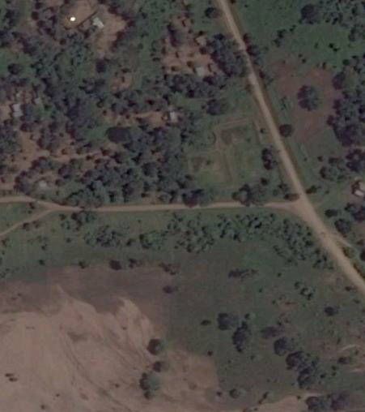
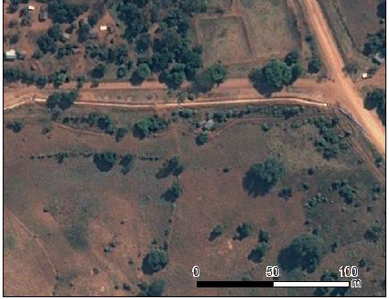
Demonstrator in Malawi (5/8) Thabwa Road
Situation 20/01/2015
2
Image clearly shows crossroad enlargement and roadside drainage project
Image 11/08/2016

Slide 13
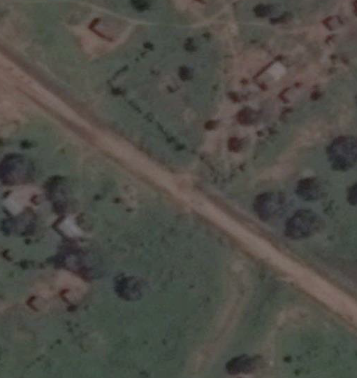
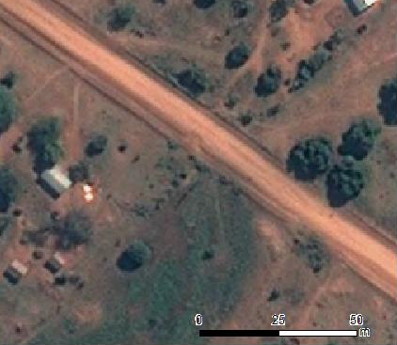
Demonstrator in Malawi (6/8) Thabwa Road
Situation 20/01/2015
2
Image clearly shows damage in road structure
Image 11/08/2016

Slide 14
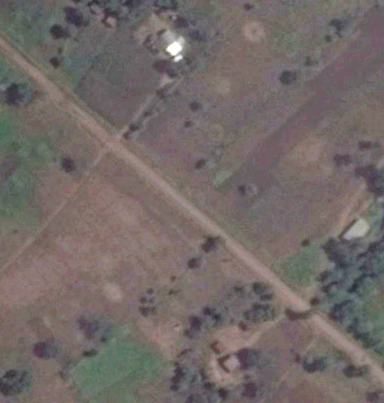
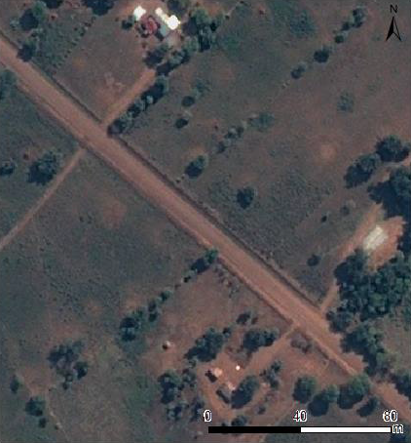
Demonstrator in Malawi (7/8) Thabwa Road
Situation 20/01/2015
3
Image clearly shows road enlargement
Image 11/08/2016

Slide 15
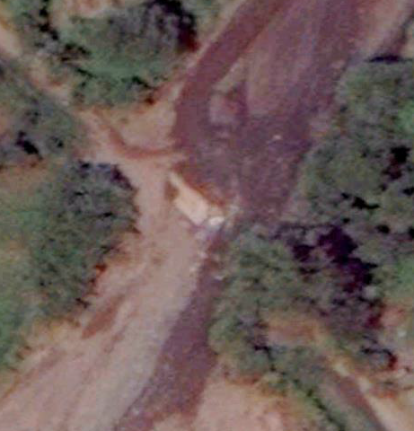
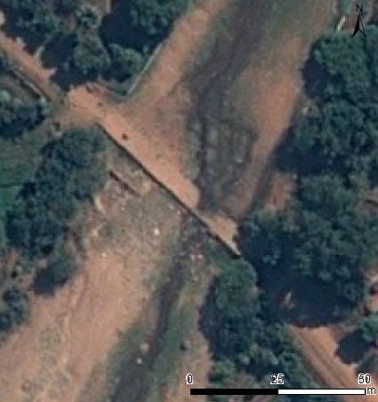
Demonstrator in Malawi (8/8) Thabwa Road
Situation 20/01/2015
14
Image clearly shows deck reconstruction and possibly subsequent damage
Image 11/08/2016

Slide 16
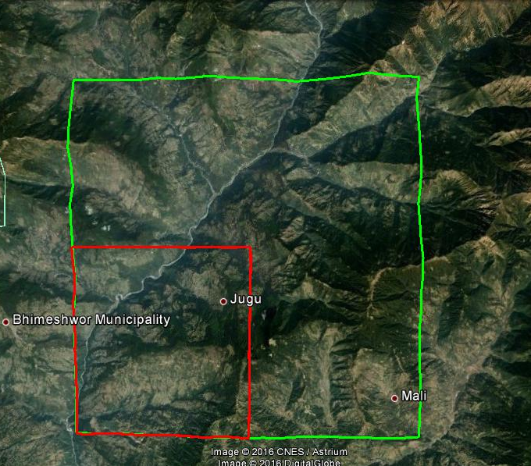
Demonstrator in Nepal (1/2)
1 AoI retained for building reconstruction assessment.
Focused AoI
from WB

Slide 17
Demonstrator in Nepal (2/2)
Contributions from ROOT members are under discussions:
Pleiades acquisition is on-going for CNES part,
TerraSarX potential use under assessment by J. Danzeglocke,
NASA contributions under assessment by D. Green,
Others ??

Slide 18
Demonstrator in Syria
AoI(s) to be defined by WB for an overall agricultural assessment in Syria, and its evolution from 2010 to present day. This option is a global one, with relatively low resolution need to cover global statuses (more like Landsat and/or Sentinel capabilities).
Potential Indicators
Change in vegetation coverage (ha)
Change in vegetation coverage of major crops (ha)
Change in yield for major crops (tons/ha)

Slide 19
Demonstrator coverage (1/2)
Comparison between Recovery indicators identified in previous ROOT working sessions and present Demonstrator showcases
 |  | Malawi | Nepal | Syria
Buildings, shelters | Building removal and construction |  | X
 | Change in urban land use, morphology and density
Camps | Camp removal and installation
 | Tent removal and installation
 | New land use / open spaces
Transport | Accessibility analysis
 | Proximity analysis
 | Removal of transport facilities
 | New transport facilities
 | Rebuilt transport facilities | X
Infrastructures | Infrastructure removal and construction |  | X
Environment | Change in landcover, open spaces | X |  | X
 | Indicate loss of vegetation | X |  | X
 | Vegetation re-growth | X |  | X
Topography | Change in topography, future risk assessment | X

Slide 20
Demonstrator coverage (2/2)
Other more general RO objectives are fulfilled in the scope of this Demonstrator
Establish institutional relationships between CEOS and stakeholders from the international recovery community | Dialogue with both WB (now co-chair of ROOT) and Malawi Govt is strongly established
Work with the recovery community to define a sustainable vision for increased use of satellite Earth observations in support of recovery | Dialogue is starting with specialists to define outputs in « clear format »
Foster innovation around high-technology applications to support recovery | Automated analysis of images is under assessment for agriculture monitoring (Malawi and Syria)

Slide 21
Next steps
Tentative schedule
summer 2016: sign-off of AOI and timeline by Government of Malawi
September: first products completed;
October: review of initial results with Malawi users
March: review of final Demonstrator results and assessment of next steps

Slide 22
EO data licensing for disasters
ROOT supported University of Copenhagen study on data licensing for disasters
Licensing conditions for several systems analysed with view to identifying common points and differences:
Sub-group on EO Data Licensing for Disasters created at WGD#5 – first mtg in May 2016, and second mtg in July 2016
Draft harmonized license created for discussion on main terms and conditions to be considered for harmonized approach

Slide 23
COPE Report
Obtain an overview from data providers of the restrictions on data and information based on international and national policies and legislation.
Estimate the long-term impact that access and use conditions will have on end users once the RO has finished.
Examine the license conditions of EO contributions to the RO from commercial providers.

Slide 24
Next Steps
Draft license to be reviewed by legal departments of space agencies.
Discussions to be held with commercial partners of agencies on facilitating terms and conditions of data access for full cycle disaster management
Further analysis required for specific terms and conditions of RO data usage in near term (before harmonised licensing)

Slide 25
Conclusions
Significant progress has been made on the Recovery Observatory in the past six months, engaging new users and broadening scope of recovery applications
Further progress expected pending results of Demonstrator activities over coming six months
A solid understanding of the scope of the RO activities has been reached with the DRM community, and has sharpened the focus of RO activity
Awareness is being built within the Recovery community and this will contribute to address certain outstanding issues, but resources for value-adding remain a challenge
Further involvement and commitment from additional CEOS agencies not currently engaged would be useful and welcome

Slide 26
Thank you!
patrice.benarroche@cnes.fr
takbar@worldbank.org
steven.hosford@cnes.fr
andrew.eddy@athenaglobal.com

Slide 27
RO Lifecycle
Preparation
Institutional relationships
Triggering
Charter and EMS activation monitoring
Establishment
Product definition and development
Scenario building
Summary Event Report
Decision by ROOT to trigger
Upload of Charter and EMS crisis data and products
Operations
Preliminary Data Acquisition Plan
Link to national end user
Development of RO activity grid
Research and training & capacity development
Liaison and development of links with end users
Promotion and Outreach
Reporting
Evaluation (+ 6 months) and lessons learned
Initial reporting
IT maintenance
Legacy planning
Recovery demonstrator
Protocols for RO operations
Infrastructure
Value-adding coordination
baseline products
RO database feeding
Notes:
Before activation (now)
Development/characterization of product list with UNDP, WB (and others) in coordination with UNOSAT (and others)
Update of existing scenarios including estimates of volume of data to be tasked and processed
Preparation of data processing (ortho-rectification and atmospheric corrections) with involved CEOS agencies
Preparation of value-adding strategy (who? how? in kind contributions? funds?)
License for RO data use (CNES for SPOT and Pleiades, others?)
Pre-triggering RO activities (strategy for PDNAs and for 1st RO; others? which agencies would host and operate)
Link between the RO and the CEOS WEB pages
Development of IT and data ingestion process
Triggering preparation:
Rapid report on situation to support triggering
Interface with stakeholders for product needs, coordination with other initiatives…
Preliminary definition of acquisition plan (V0)
Analyze of possible implementation of IT (deployment, hosting, project management and operations)
After activation (3 to 6 months)
Implementation of the RO when triggered
First operations: upload of Charter data and result, PDNA or for RO, baseline first products for recovery planning and monitoring
Coordination activities:
Interface with stakeholders for precise definition of needs and identification of national entities to involve
Interface with the national institutions for product needs, coordination with other initiatives…
Definition of the acquisition plan (v1) and initial liaison with agencies
Establishment of formal institutional relationship with national entities (definition of role and responsibilities, identification of funding sources if available)
Elaboration of the RO activity grid (applications……)
Reporting to CEOS on development of RO and recommendations on issues to address
Building of research and training activities
On-going operations (1 to 3 years)
Coordination activities:
Liaison and development of institutional relationships, new relationship building
Promotion and outreach (including long term promotion of RO within country)
Development of lessons learned and replication of RO model (in other countries)
Value-adding coordination and new product development; new value added partners
Regular Report of technical results to national institutions
Support to national users (technical and policy), including new service development
Coordination and animation of new research activities around RO concept
Management of the activity (applications) grid in coordination with the project manager
Formal report to CEOS on RO (annual)
Project Management activities
Management of the acquisition plan and tasking with CEOS agencies
Management of RO content (data, product, news, documents)
Management of data processing
Technical reporting
Development of long-term plan for RO after initial set-up (1-3 years)
Maintenance of the RO IT (corrections, evolutions)
VA generation
Preparation of closure
Evaluation
Legacy strategies

