Slide 1

CEOS Disaster Risk Management Flood Pilot Status and Plans
Presented at the CEOS Disasters Working Group Meeting #7 in Rome, Italy
Co-Lead Stu Frye (stuart.frye@nasa.gov)
Co-Lead Bob Kuligowski (bob.kuligowski@noaa.gov)
NASA DisWG Rep David Green (david.s.green@nasa.gov)
14-16 March 2017

Slide 2
Outline
Flood Pilot overview
Status of data acquisition and exploitation
  JAXA ALOS-2 / PALSAR-2 data use
Pilot status report:
  Objective A: Global component status
  Objective B: Regional component status
    Caribbean/Central America
    Southern Africa
    Southeast Asia
  Objective C: Capacity Building
Issues and Risk Management

Slide 3
CEOS DRM Flood Pilot Overview
Goal: demonstrate effective application of EO to the full cycle of flood management at all scales by:
  Objective A: Integrating information from existing NRT global flood monitoring / modeling systems into a Global Flood Dashboard;
  Objective B: Delivering EO-based flood mitigation, warning, and response products and services through regional end-to-end pilots in:
    Caribbean/Central America (focus on Haiti)
    Southern Africa (inc. Namibia, South Africa, Zambia, Zimbabwe, Mozambique, and Malawi);
    Southeast Asia (focus on lower Mekong Basin and Java)
  Objective C: Encouraging at least base-level in-country capacity to access EO and integrate it into their operational systems and flood management practices
3

Slide 4
Data Acquisition Status
Detailed EO Requirements for each Pilot approved at 2013 Plenary; acquisition allocations approved at 2014 Plenary
Individual requests from each Pilot coordinated by co-leads and detailed on consolidated request form
Data distribution co-ordinated by co-leads (the lack of standardized data distribution makes it very labor-intensive)
Mission / Instrument | Repeat or Revisit | Swath Width | Spatial Resolution | Agency | Image Counts
 |  |  |  |  | Annual Quota | Since 9/2016 WGDisasters Meeting | Cumulative Total
Optical - Coarse Resolution (>100 m)
Terra / MODIS | 1 day | 2230 km | 250, 500, 1000 m | NASA
Aqua / MODIS | 1 day | 2230 km | 250, 500, 1000 m | NASA
NPP / VIIRS | 1 day | 3000 km | 375, 750 m | NASA
Optical - Moderate Resolution (10 to 100 m)
Sentinel-2A / MSI | 10 days | 290 km | 10, 20, 60 m | ESA |  | 0 | 0
EO-1 / ALI | 204 days | 185 km | 10, 30 m | NASA | 300 | 48 | 129
Landsat-8 / OLI | 16 days | 185 km | 15, 30 m | USGS |  | 39 | 117
Optical - High Resolution (<10 m)
SPOT (archive only) | 26 days | 60 km | 1.5 and 6 m | CNES |  | 0 | 0
Pleiades | 26 days | 20 km | 50 cm and 2 m | CNES | 50 | 0 | 10-12*
L-Band SAR
ALOS-2 / PALSAR-2 | 14 days | 25 to 350 km | 10 to 100 m | JAXA | 100 | 32 | 47
C-Band SAR
Sentinel-1A / SAR | 12 days | 80, 250, 400 km | 9, 20, 50 m | ESA |  | 12 | 64
Sentinel-1B / SAR | 12 days | 80, 250, 400 km | 9, 20, 50 m | ESA |  | 0 | 0
Radarsat-2 / SAR-C | 1-6 days | 50 to 500 km | 8 to 100 m | CSA | 500 (3 yr) | 21 | 144
X-Band SAR
Cosmo Sky-Med / SAR-2000 | 5 days | 10 to 200 km | 1 to 100 m | ASI | 300 | 37 | 144
*includes a set of 4 stripes over Jakarta corresponding to 7-9 individual images
4

Slide 5
ALOS-2 PALSAR-2 Data Use (1/4)
47 ALOS PALSAR-2 images (all from Charter activations) have been obtained for Flood Pilot use:
  6 images over Vietnam, 31 July / 4 August 2015;
  2 images over Myanmar, 11-16 August 2015;
  6 images over India (Chennai), 9 December 2015;
  6 images over Louisiana, 18 January 2016;
  4 images over Haiti, 5 September 2016.
  30 images over Panama and Costa Rica, 21 Nov-13 Dec 2016.
Users:
  NASA: Fritz Policelli (GSFC); Jordan Bell (MSFC); Sang-Ho Yun (JPL)
  Universities: Bob Brakenridge (U. Colorado), Huan Wu (University of Maryland), Guy Schumann (UCLA), Zac Flamig (U. of Oklahoma)
  Regional Centers: David Farrell (CIMH), Amaranth Giriraj (IWMI)
5

Slide 6
ALOS-2 PALSAR-2 Data Use (2/4)
Caveats:
  Images from the first four Charter cases were obtained via an agreement with the Charter that was reached in early 2016, so these data were not suitable for real-time use.
  Prior to this agreement, licensing issues prevented the Flood Pilot from obtaining PALSAR-2 data from Charter activations.
  For several other (non-Charter) events of interest PALSAR-2 was not tasked at the right time.
  The Dartmouth Flood Observatory attempted to use the Haiti images but they did not show any flooding.
  There are other examples of PALSAR-2 use by Pilot members who had separate arrangements with JAXA (see next slide)
6

Slide 7
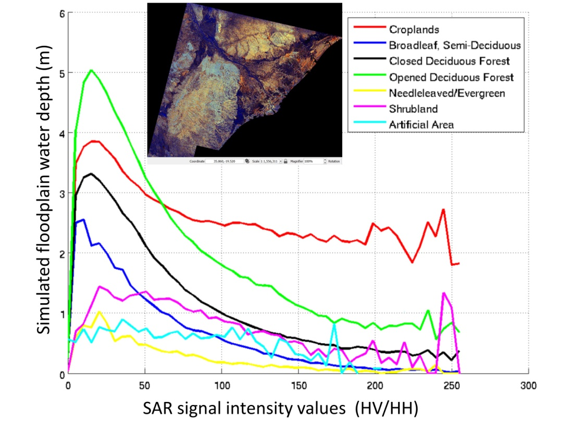
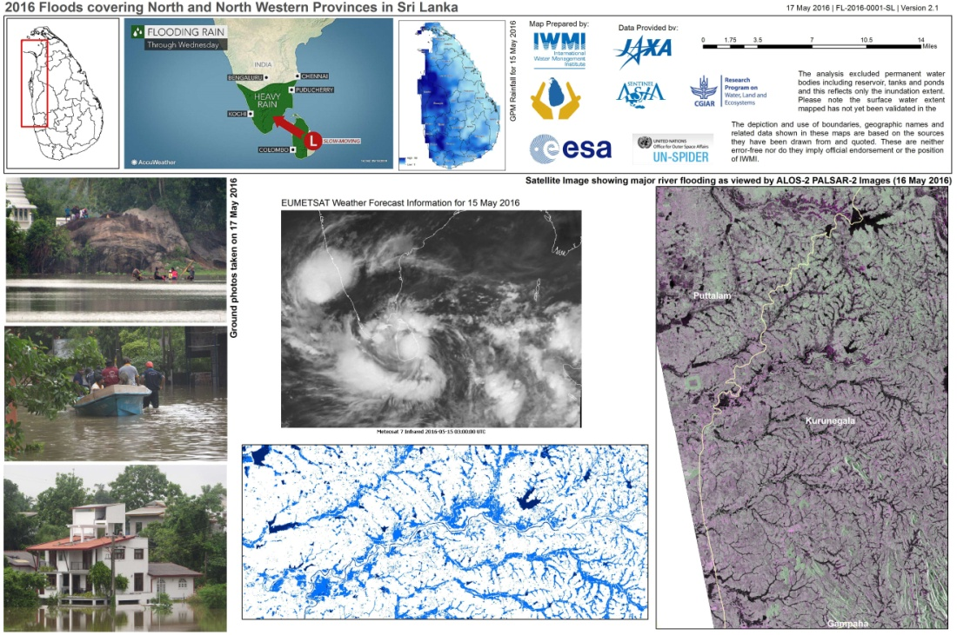
ALOS-2 PALSAR-2 Data Use (3/4)
Examples of PALSAR data from other sources used by Pilot members:
Comparison of SAR signal compared to land cover and (modeled) inundation depth over Malawi, 14 January 2015 (figure courtesy G. Schumann, UCLA)
International Water Management Institute Flood Maps in NW Sri Lanka, 17 May 2016
7

Slide 8
ALOS-2 PALSAR-2 Data Use (4/4)
(courtesy B. Brakenridge, U. of Colorado)
Lesson learned: a better approach would have been to request access for retrospective cases in addition to the real-time cases, because
  Normal (non-flood) scenes at the same scale are essential to provide a robust means of accurately discriminating flooded from non-flooded regions;
  Scenes from previous floods are also critical for
    Validation of past events;
    Comparison of current events to past events (e.g., return period)
The ESA Sentinel system is a great example of this: one can download the latest scene and also easily identify and download exact repeat scenes from previous months and years to compare.
Even for providers who charge for images, such collections may be of interest to those with the resources to purchase larger collections (e.g., the Development Banks)

Slide 9
How Data Are Being Exploited
Geographic Area | Product | Value Added Partner
Global | Flood extent maps and flood forecasts | Dartmouth Flood Observatory, University of Maryland
Haiti | Flood extent maps, flood risk maps, landslide maps, flash flood guidance / threat maps, integrated risk assessment platform | SERTIT, CIMA, INGV, Altamira, CIMH, RASOR FP7, NOAA/HRC
Other Caribbean islands, Central America | Flood damage maps, change detection products, co-registered map overlays | CATHALAC, CIMH, NASA/GSFC, RCCP (Costa Rica)
Namibia | Flood extent maps, flood warning products, co-registered map overlays | Namibia Hydrology Dept, Namibian Water Authority, NASA
Zambezi basin | Flood extent maps, flood forecast models, flood hazard maps, flood depth forecasts | Lippmann Institute (HAZARD, WATCHFUL), Deltares, RSS
Mekong | Flood extent maps, flood risk maps, flash flood guidance / threat maps | Mekong River Commission, ADPC, NASA, NOAA, HRC, USGS, Univ. of South Carolina, Texas A&M , IMWI
Java (Bandung, Jakarta, Cilacap) | Flood risk maps, subsidence maps tied to flood risk, tsunami risk maps (Cilacap only), flood extent maps | SERTIT, Deltares, CIMA, Altamira, INGV, RASOR FP7,
Products used by: national end users, civil protection agencies, World Bank, Red Cross, World Food Program, River Commissions (Kavango, Zambezi, Mekong)
9

Slide 10
Outline
Flood Pilot overview
Status of data acquisition and exploitation
    JAXA ALOS-2 / PALSAR-2 data use
Pilot status report:
  Objective A: Global component status
  Objective B: Regional component status
    Caribbean/Central America
    Southern Africa
    Southeast Asia
  Objective C: Capacity Building
Issues and Risk Management

Slide 11
Objective A: Global Component Status
2014 Milestone: initial pilot Global Flood Dashboard website with linkages to major global projects and systems and archive flood products
2015 Milestone: functional linkages between the Global Flood Dashboard and the three regional flood component areas; indication of regions of interest based on reports of flooding; showcase at WCDRR
  2015 Status: Functional requirements completed and presented at WCDRR and shared requirements with potential host agencies
  2016-17 Status: 75% complete—Discussed hosting with B. Koetz of ESA...still under evaluation. Discussed possible hosting on CIMA servers with Roberto Rudari; supportive of demo but funding needed for ongoing operations. Submitted proposal to NASA grant call that would include hosting of the Global Flood Dashboard.

Slide 12
Objective A: Global Component Status
2016-17 Milestone: draft a plan for longer-term sustainability; provide functional linkages to additional user-selected polygons of interest beyond the three regional Pilot areas.
  Status:
    Submitted responses to long-term sustainability questions on 16 September 2016; in the process of revising based on feedback from Andrew
    In concert with GeoDARMA, reach out to UN, World Bank, International Red Cross, and other potential partners to implement the global and regional Flood Pilot modeling and monitoring capabilities that are interconnected via an API on a more permanent basis

Slide 13
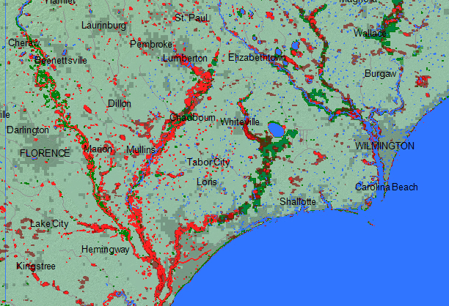
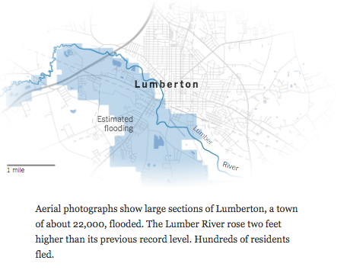
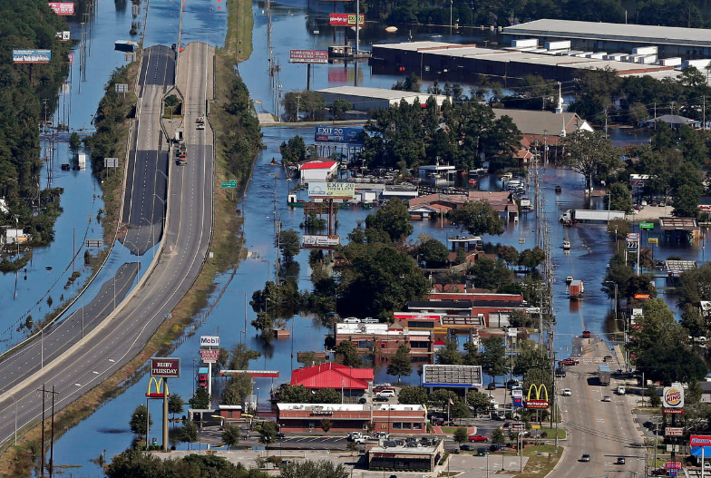
Global Component Highlight
Mapping of the Hurricane Matthew flooding in North Carolina using Landsat 8 data and MODIS (Dartmouth Flood Observatory)

Slide 14
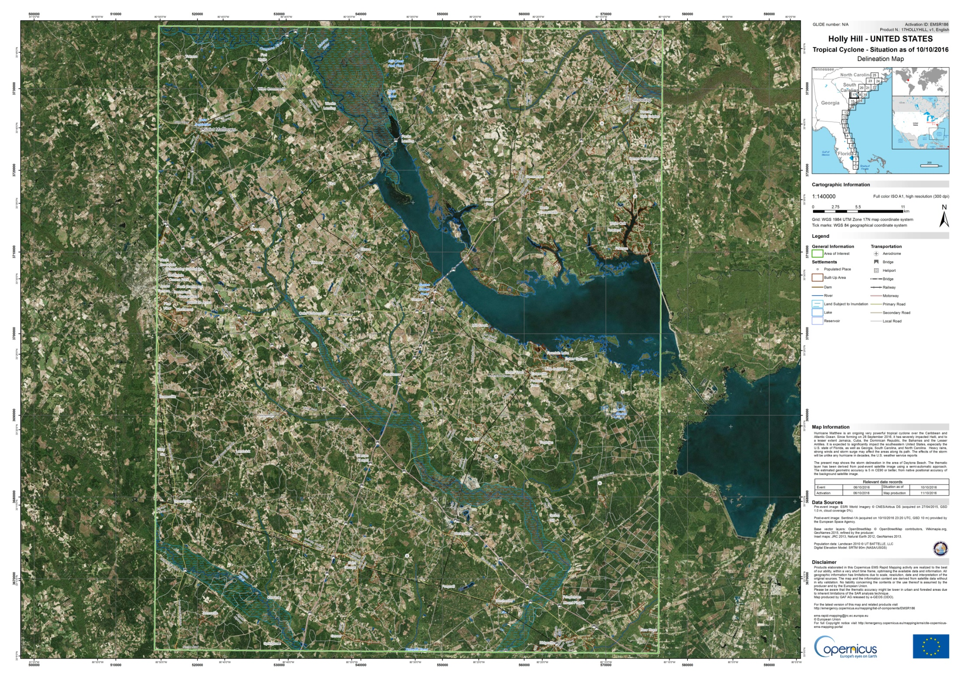
Global Component Highlight
Map of Hurricane Matthew flooding in Holly Hill, NC by Copernicus Emergency Management Service on 06 October 2017.

Slide 15
Outline
Flood Pilot overview
Status of data acquisition and exploitation
      JAXA ALOS-2 / PALSAR-2 data use
Pilot status report:
  Objective A: Global component status
  Objective B: Regional component status
    Caribbean/Central America
    Southern Africa
    Southeast Asia
  Objective C: Capacity Building
Issues and Risk Management

Slide 16
Objective B: Caribbean/Central American Component Status (1/8)
2014 Milestones:
  Flood dashboard based on Namibia pilot adapted to Caribbean and Central American users
    Status: Prototype Flood Dashboard completed: http://matsu-flashflood.opensciencedatacloud.org/
  Flood monitoring (i.e., targeted EO data acquisitions)
    Status: Targeted EO acquisitions in 2014 for Guatemala, Panama, Trinidad, Haiti, and Belize
  Contributions of data to KAL Haiti data base
    Status: Completed

Slide 17
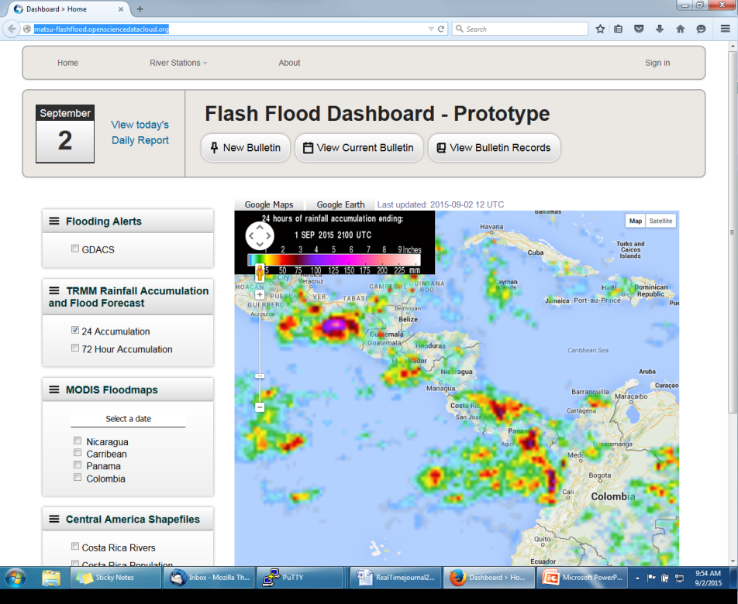
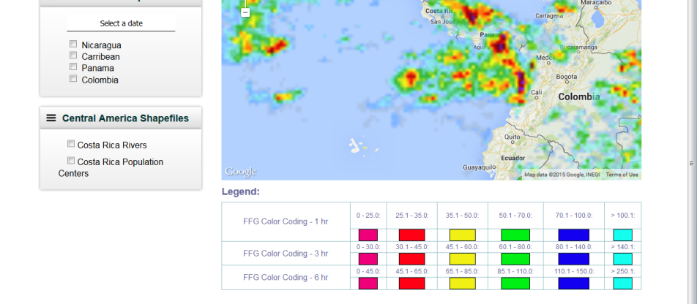
Objective B: Caribbean/Central American Component Status (2/8)
http://matsu-flashflood.opensciencedatacloud.org/
(To be replaced with the Open GeoSocial API in 2017—see slide 18)

Slide 18
Objective B: Caribbean/Central American Component Status (3/8)
2015 Milestones:
  Flood monitoring during 2015 season
    Status:
      Panama (June); EO-1 / MODIS / Landsat flood maps for CATHLAC
      Dominica (August—TS Erika): COSMO-Sky-Med, Radarsat-2, and EO-1 data
      Bahamas (October—H Joaquin); EO-1 images, GPM rainfall, GFMS flood predictions, flood maps from multiple sensors
  RASOR risk management platform operational for flood risk and landslide risk analysis in Haiti
    Status: Subsidence mapping completed and reported at March 2016 meeting; proposal submitted to extend and deepen this work through the Global Facility for Disaster Reduction and Recovery (GFDRR) in collaboration with the Haitian government.
  10-year flood archive based on Deltares Flood Monitoring Programme
    Status: Deltares did not receive funding to continue collaboration with this Pilot region.

Slide 19
Objective B: Caribbean/Central American Component Status (4/8)
2016-17 Milestones:
  Flood monitoring during 2016 season
    Status: Provided optical imagery (EO-1 and MODIS) and GFMS for Mexico (TS Danielle—June), Belize (H Earl—August), and Hispaniola (H Matthew—October)—also RADARSAT-2, Sentinel-1A and ALOS-2 for Hispaniola. Requested Panama and Costa Rica (both November) Charter data in late November but response received in March.
  Draft a plan for longer-term sustainability
    Status: Intent is to transition much of this work into AmeriGEOSS, but details need to be worked out with GEO-DARMA; also waiting on results of NASA Flood Pilot call
Overall Status: 75% complete.
Notes:
BK: Just polled Flood Pilot team about interest in CNES Pleiades (DR / Haiti only), ISRO ResourceSat, KARI KOMPSAT-2 (DR / Haiti only), ROSCOSMOS Resurs-P.

Slide 20
Objective B: Caribbean/Central American Component Status (5/8)
Other Planned Activities / Accomplishments
  Collection of background Radarsat-2 pre-event imagery at known look angles and modes for the entire region (CSA-Giguere)
    Status: Completed; 8 complete sets of background images collected over all of Central America and the Caribbean
  Damage assessment studies to analyze satellite-derived inputs as compared to ground-based manual techniques (CIMH-Farrell)
    Status: Analysis in Saint Vincent and the Grenadines (using Radarsat and EO-1), and in Dominica (using Radarsat and COSMO-SkyMed) has been hampered by lack of pre-event imagery with same characteristics as post-event imagery; this work will be revisited if suitable matching pairs can be obtained. Currently looking at the effects of Hurricane Earl in Belize using pre- and post-event Radarsat-2 data (next slide); after additional refinement these routines will then be tested on other datasets as they become available. Upcoming training on SAR image processing for CIMH personnel may is expected to enhance future efforts.

Slide 21
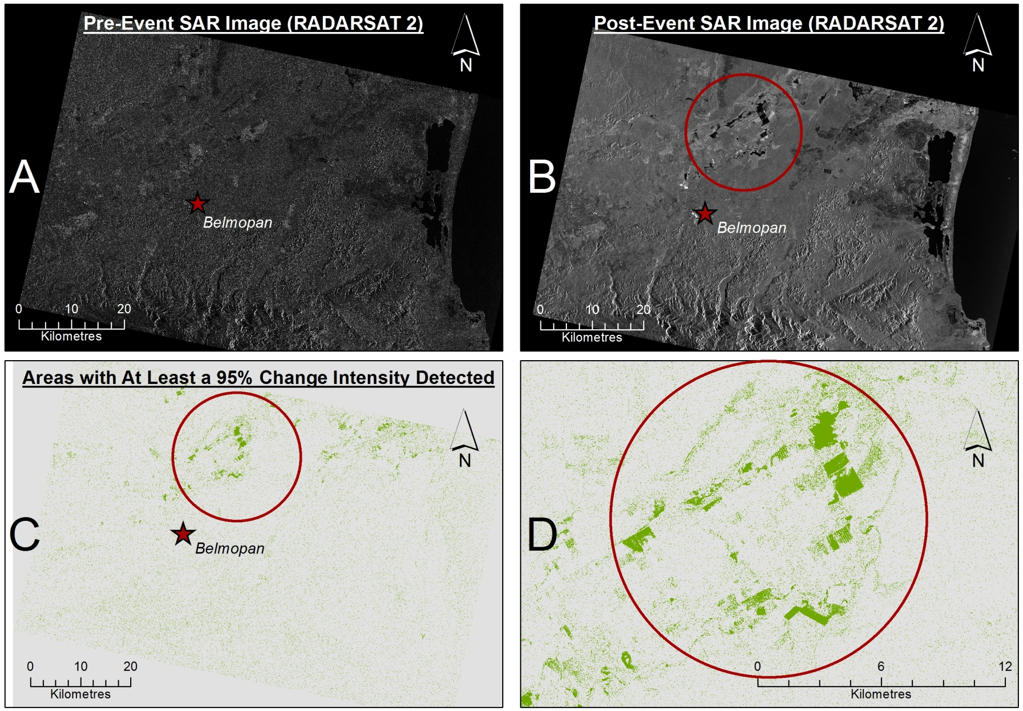
Objective B: Caribbean/Central American Component Status (6/8)
Notes:
CIMH has experimented with a processing routine which compared two RADARSAT 2 images (pre-event and post-event) for an identical area in which Belmopan is relatively central. The result of the process produced an image which highlighted a series of regions for which it is suggested that a level of 95% change intensity occurred. Please see the attached image for which the following labelled sections are explained below:
A - The Pre-event image
B - The Post-event Image
C - The result of the change detection routine (where features in green represent detected changes)
D- A close up of some of the larger change features from the result.
Although the geographic locations of the change features appear to coincide with reports of flooding, we would still need to verify the authenticity of the result by running classification techniques to establish the nature of the change areas detected (i.e. are they water?). We would also need to compare the locations and spatial extents of the change features with any observed features detected from cloudless optical images of the same region to be absolutely sure. At present, we are working on such validation techniques, but due to a shortage in capacity with respect to processing of SAR data, there has been a delay in this aspect of the research. However, I am happy to report that we will be undergoing SAR training in the coming months to fill these gaps and put our research back on track.

Slide 22
Objective B: Caribbean/Central American Component Status (7/8)
Other Planned Activites / Accomplishments (cont.)
  Open GeoSocial API for publishing / visualizing flood modeling and monitoring products installed at DAI in Costa Rica
    Part of the disasters component of the Climatic Information Platform for Central America and the Dominican Republic under the Regional Climate Change Program (RCCP) funded by USAID; software installation supported by a grant from SICA/CEPREDENAC.
    Training workshop conducted in early May 2016 in Costa Rica
    System operational since May 2016: http://centroclima.org/powered-by-nasa/ (example on next slide)—replaces the current Caribbean / Central America Flood Dashboard

Slide 23
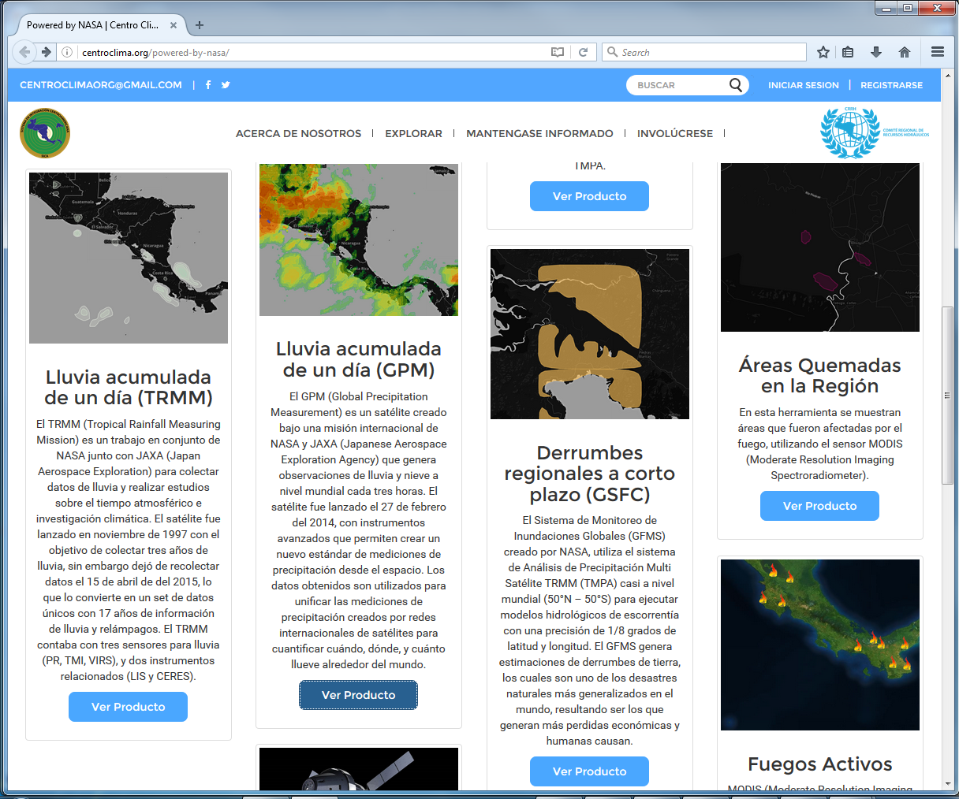
Objective B: Caribbean/Central American Component Status (8/8)

Slide 24
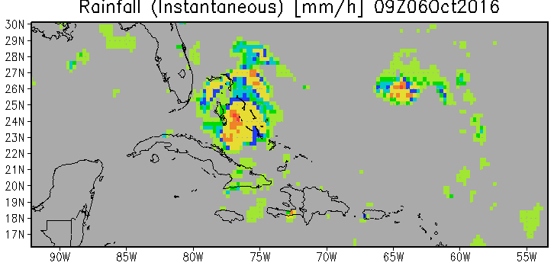
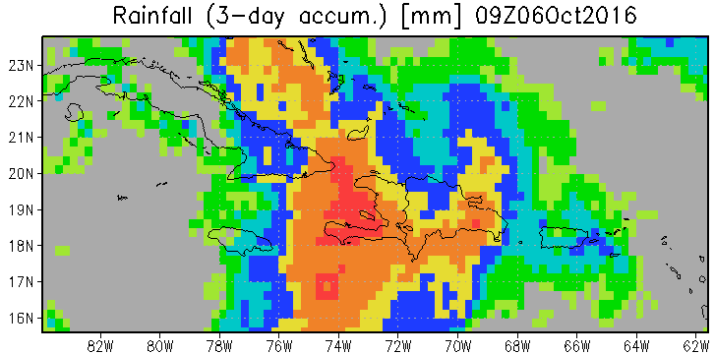
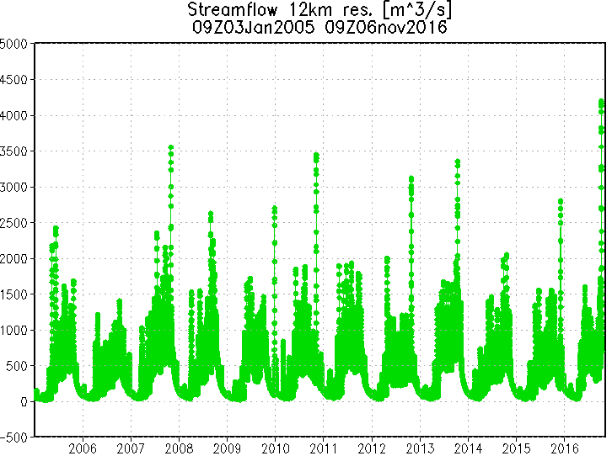
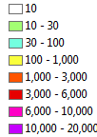
Caribbean / Central America Highlight
Inundation Depth (mm)
1km res
Largest peak discharge since 2005
@ La Artibonite River mouth
Maximum inundation depth over ~5 day period
Credit: Huan Wu/Bob Adler, UMD
Aggregated Inundation map from Oct 2 to Oct 6 09Z UTC

Slide 25
Outline
Flood Pilot overview
Status of data acquisition and exploitation
      JAXA ALOS-2 / PALSAR-2 data use
Pilot status report:
  Objective A: Global component status
  Objective B: Regional component status
    Caribbean/Central America
    Southern Africa
    Southeast Asia
  Objective C: Capacity Building
Issues and Risk Management

Slide 26
Objective B: S. Africa Component Status (1/6)
2014 Milestones:
  Flood monitoring during early 2014
    Status: Acquisitions from NASA and CSA under previous agreement within GEO task
  Updates to flood dashboard
    Status: Upgraded Flood Dashboard completed: http://matsu-namibiaflood.opensciencedatacloud.org/
2015 Milestones:
  Flood monitoring during early 2015
    Status: Radarsat-2 images provided for Namibia during flooding on 24 Feb; three Archive Radarsat-2 images of Malawi (early January—ordered in March) provided to LIST for Flood Hazard Mapping that were Disaster Charter acquisitions
  10-year flood archive over region based on Deltares Flood Monitoring Programme
    Status: Deltares did not receive funding to continue collaboration with this Pilot region.

Slide 27
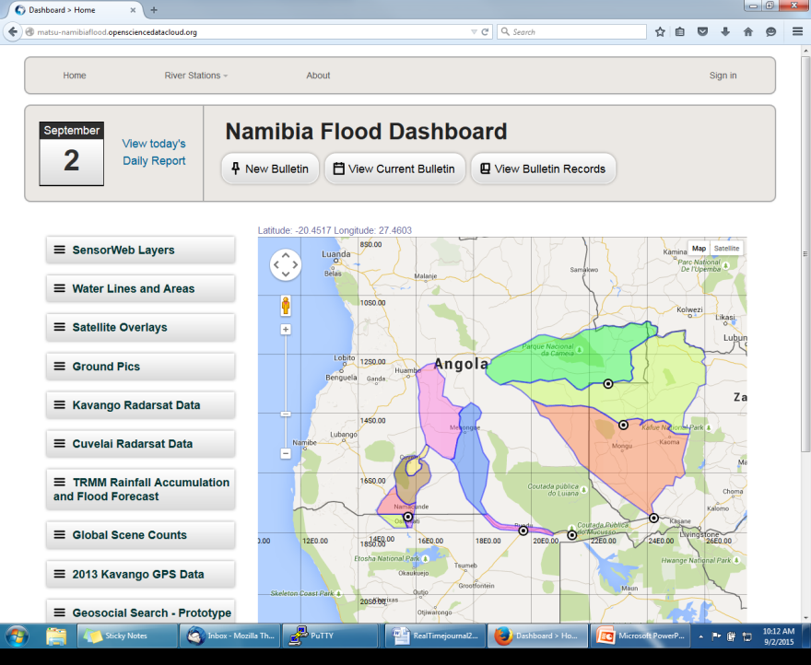
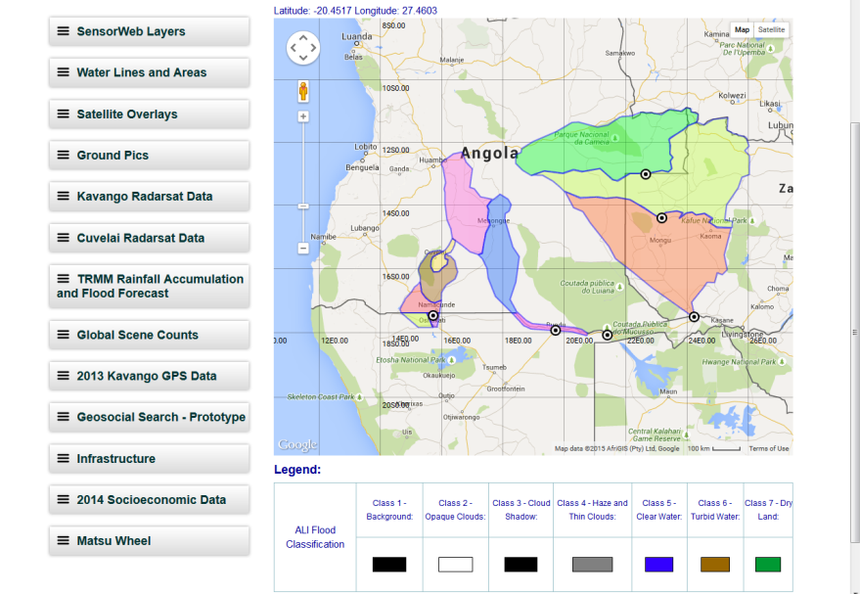
Objective B: S Africa Component Status (2/6)
http://matsu-namibiaflood.opensciencedatacloud.org/

Slide 28
Objective B: S. Africa Component Status (3/6)
2016-17 Milestones:
  Flood monitoring during 2016 season
    Status: Charter data just requested for ongoing Madagascar floods
  Draft a plan for longer-term sustainability
    Status: Intent is to transition much of this work into AfriGEOSS but details need to be worked out.
Status: 75% complete.

Slide 29
Objective B: S Africa Component Status (4/6)
Other Planned Activities
  Improvements to flood model by computing river width and deriving more realistic and complete stream networks derived from Landsat-8 (UCLA-Schumann; results in next slide)
    Status: Validating the improved flood model outputs with MODIS and ALOS-2 flood maps (see next slide)
  Using a flood modeling study of the Lower Zambezi to define areas for high-resolution LiDAR acquisitions over the floodplains to construct higher-resolution DEMs for flood modeling / forecasting (UCLA-Schumann)
    Status: DEM has been completed; terms of access still being worked out with the World Bank
  Implementation of regional CREST flood model in Namibia, Kenya, and South Africa (U of Oklahoma-Hong/Flaming)
    Status: SERVIR grant secured to transition from CREST to EF5 flood model; work began November 2016 with RCMRD. These products are being provided through the Open GeoSocial API under RCRMD control (web interface is being implemented).

Slide 30
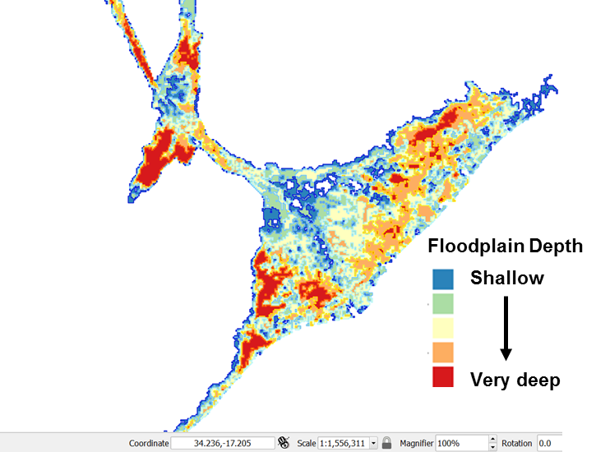
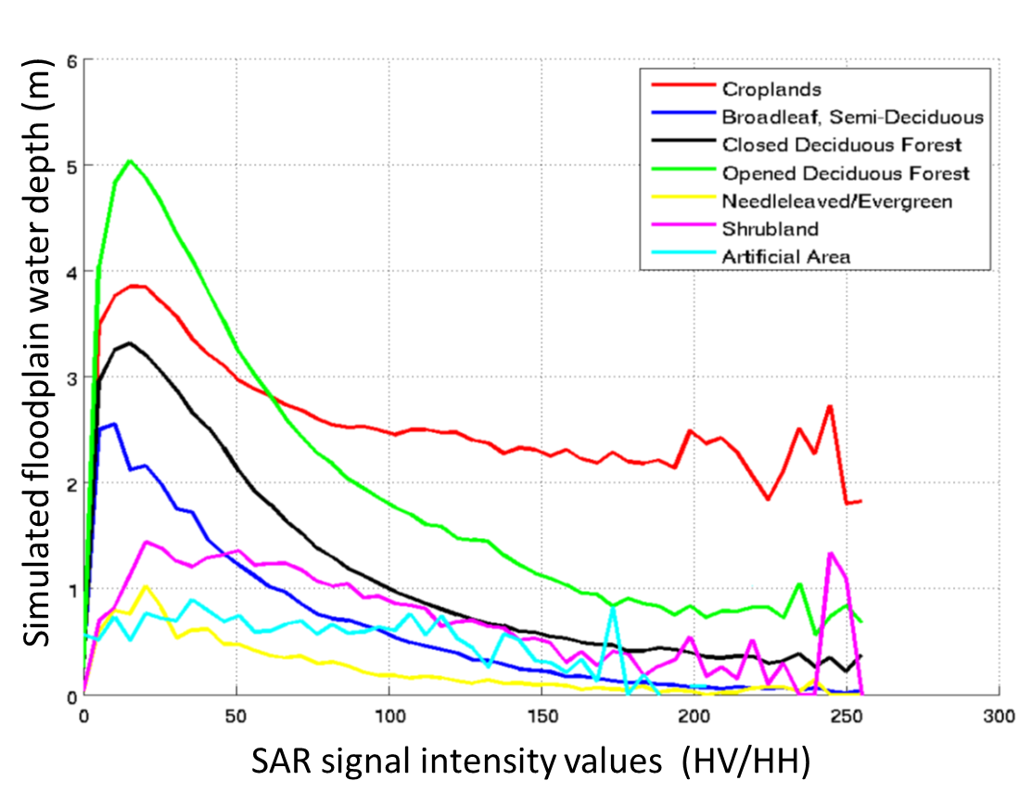
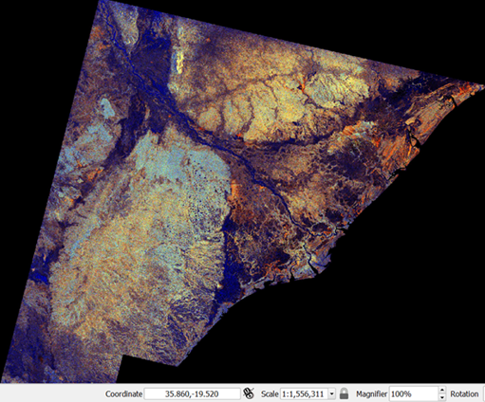
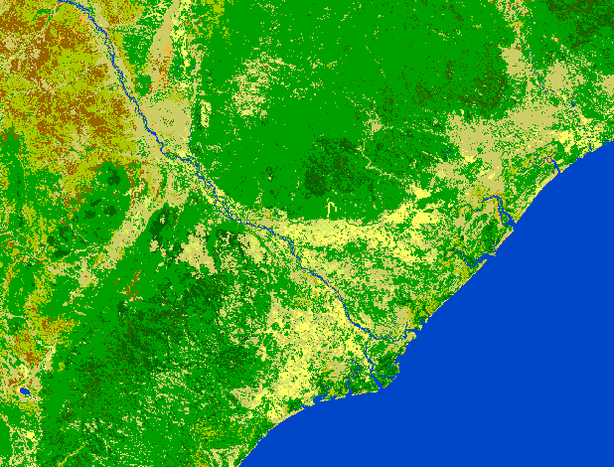
Objective B: S Africa Component Status (5/6)
2-D flood model simulation based on Water Balance Model (WBM) long-term simulated hydrologic flows
ALOS-PALSAR L-band flood image of the 2015 event. RGB composite of multiple polarizations (HV, HH, HV/HH)
Detailed land cover classification (2009) based on ESA’s GLOBCOVER: http://due.esrin.esa.int/page_globcover.php
Coupled WBM-LISFLOOD-FP flood model is capable of simulating floodplain depth magnitudes. Cross-validating those with ALOS L-band polarizations for different flooded vegetation can improve satellite-based flood mapping.
Contributors: G. Schumann, V. Dang, A. Kettner & B. Brakenridge

Slide 31
Objective B: S Africa Component Status (6/6)
Other Planned Activities
  Framework for evaluating flood model forecasts in the Zambezi basin using satellite-derived flood extent maps (LIST-Matgen)
    Status: In progress; results can also be used to evaluate and modify model calibration parameters and thus improve accuracy
  Invited talk at International Society of Remote Sensing of the Environment (ISRSE) in Tshwane, South Africa during 8-12 May (need sponsor to support travel for Namibia or Kenya collaborators to present on behalf of the Flood Pilot).
Notes:
BK: Any updates here or should I reach out to Patrick?

Slide 32
Outline
Flood Pilot overview
Status of data acquisition and exploitation
      JAXA ALOS-2 / PALSAR-2 data use
Pilot status report:
  Objective A: Global component status
  Objective B: Regional component status
    Caribbean/Central America
    Southern Africa
    Southeast Asia
  Objective C: Capacity Building
Issues and Risk Management

Slide 33
Objective B: SE Asia Component Status (1/10)
2014 Milestones:
  User consultations on new pilot products
    Status: Open GeoSocial API flood forecasting and event mapping software installed at ICIMOD in 2015.
    Under SERVIR funding, a flood inundation system was installed at ADPC in January (http://projectmekongnasa.appspot.com/; see next three slides for examples)
  Test TRMM/GPM-based Global Flood Modeling System (GFMS) 1km resolution flood modeling product over the Lower Mekong Basin (contingent on river gauge data being obtained)
    Status: On hold—unable to obtain gauge data for this application. SERVIR project will not be a way forward due to usage restrictions.
  Flood Dashboard development based on Namibia pilot example adapted to SE Asia users
    Status: Completed http://matsu-seasia.opensciencedatacloud.org/
Notes:
BK

Slide 34
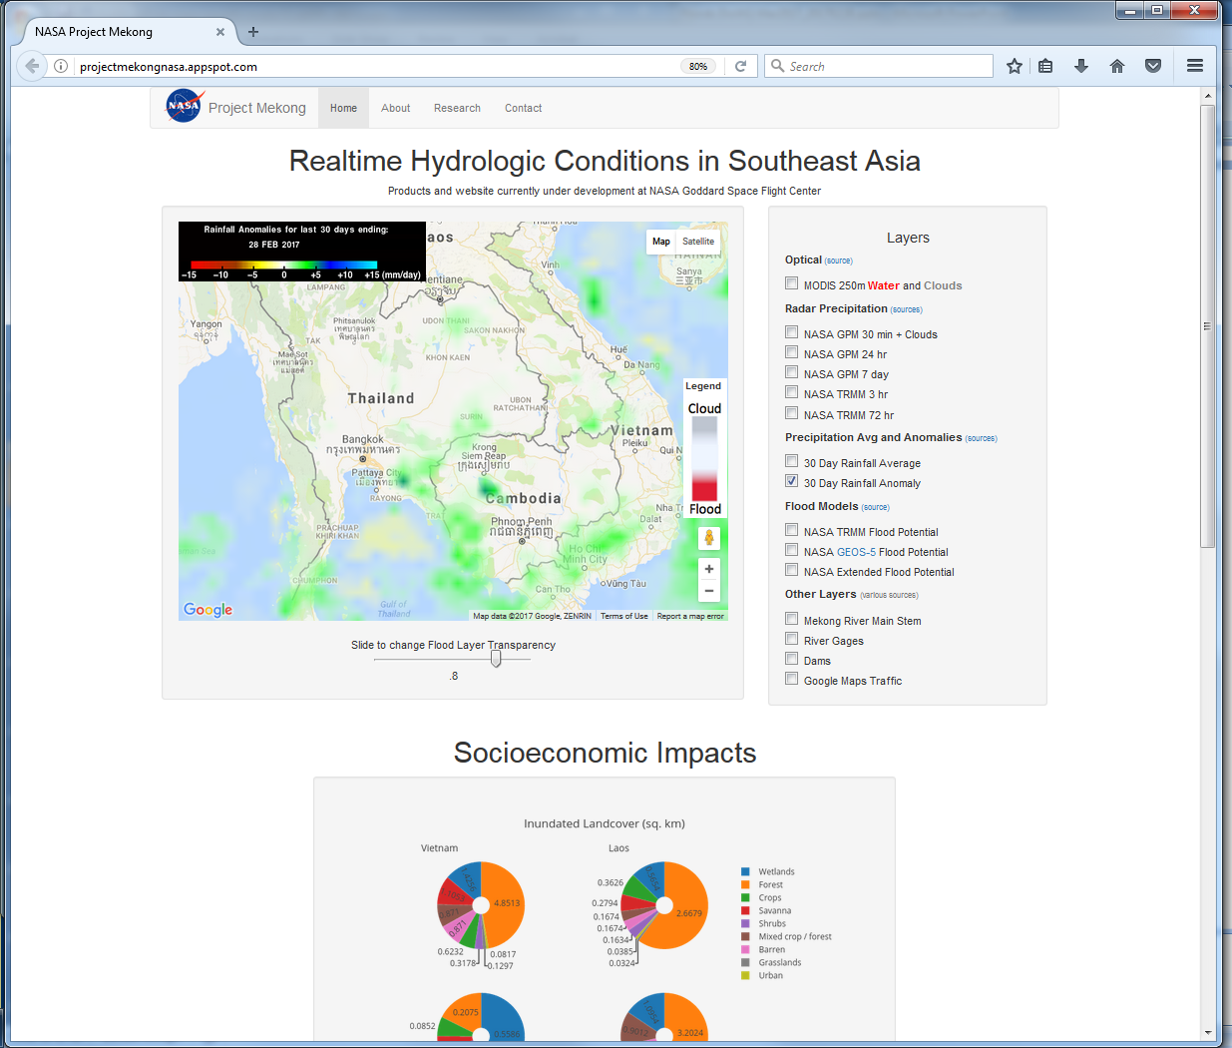
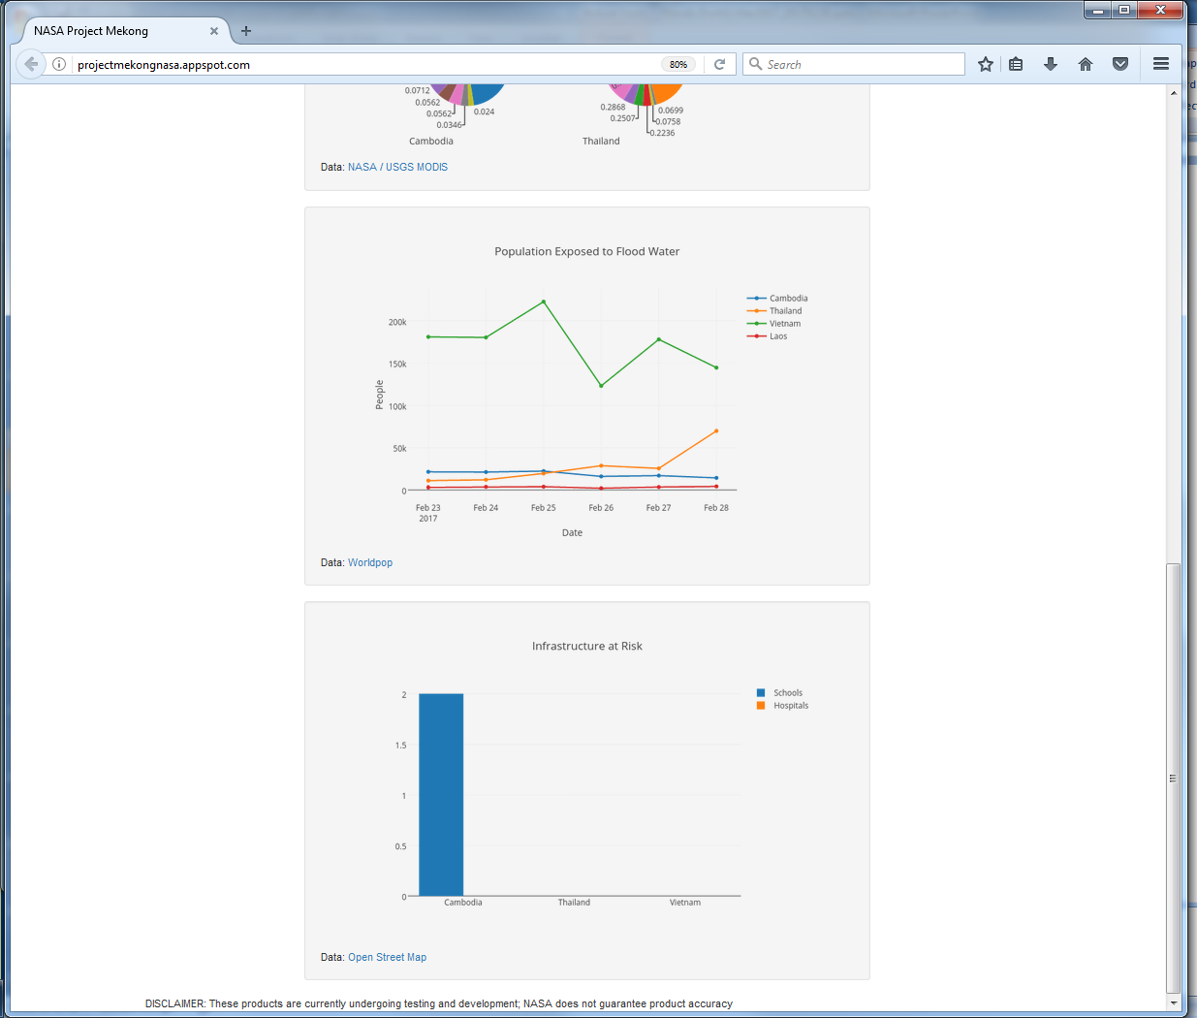
Objective B: SE Asia Component Status (2/10)
http://projectmekongnasa.appspot.com/

Slide 35

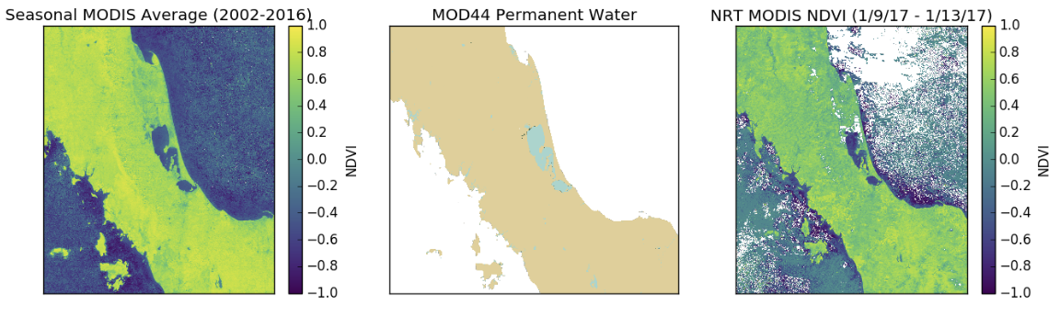
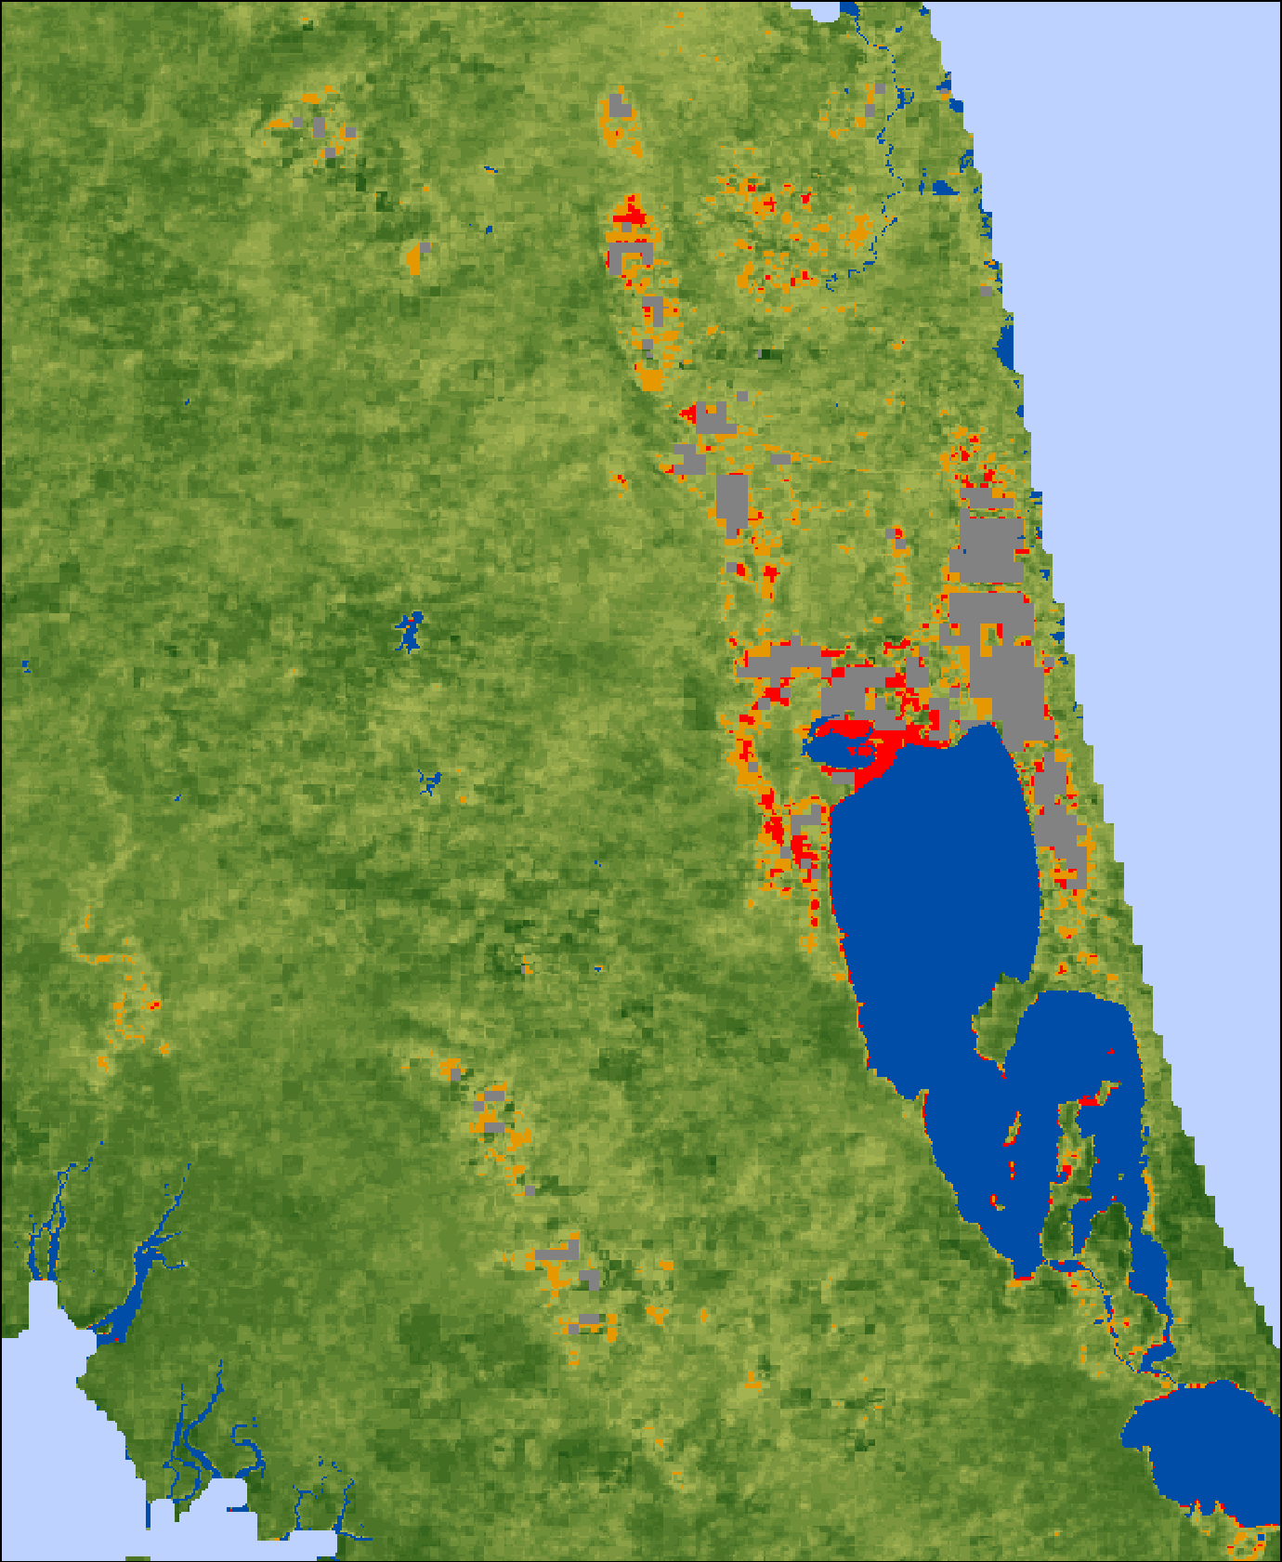
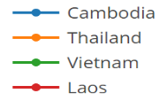
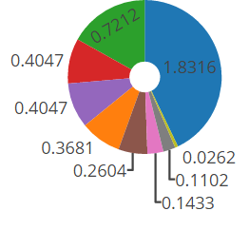
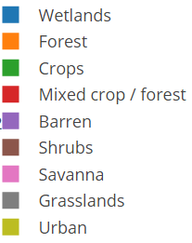
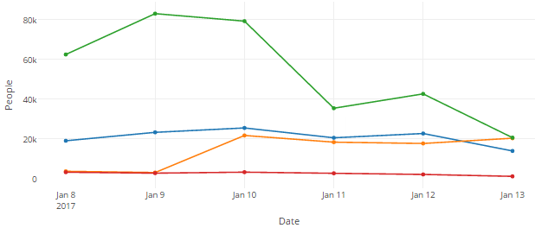
Objective B: SE Asia Component Status (3/10)
Southern Thailand Flooding as of 1/13/17
Figure 2
Figure 1
A
B
C
Spectral Training and Image Classification
Incorporate Socioeconomic Data
Impacted Landcover (sq km.) in Thailand (as of 1/13)
Population Exposed to Flooding
(as of 1/13)
B
A
Figure 3
MODIS satellite observations and derived information products (e.g. flooded areas and socioeconomic impacts) are being used by regional NGO’s like the Asian Disaster Preparedness center to identify floods and associated impacts to people and infrastructure in near real-time.
Credit: A. Ahamed, J. Bolten, NASA GSFC
Interactive Web Map: http://projectmekongnasa.appspot.com
Notes:
Technical Description of Figures:
Figure 1: (A) Map of MODIS Aqua / Terra NDVI in Southern Thailand averaged over the length of the MODIS record for the 8-day surface reflectance product (MOD09Q1) acquired annually on January 9. (B) Permanent Water Bodies (MOD44) dataset used to train surface water classifiers which are applied to detect flooding from Near Real-Time MODIS imagery. (C) 4-day Aqua/Terra Near Real-Time NDVI composite image showing flooded conditions in Southern Thailand.
Figure 2: Shows the flood classifier calculated in Figures 1A – 1B applied to Figure 1C in order to classify high confidence flooded areas (red), medium confience flooded areas (orange), and non-flooded areas (others). Flood extent resolution is 250m resolution; and the method has been validated with multiple high resolution radar sensors across multiple years and conditions, achieving 87% accuracy.
Figure 3: (A) Landcover (sq. km) impacted by high confidence flooding in Thailand for the time period 1/9/17 – 1/13/17. Flooded areas are those shown in Figure 2. Landcover data is derived from MOD12Q1 Landcover products and the Global Landcover Facility GLCF Classification scheme. (B) Population per country at risk of flooding for the time period 1/9/17 – 1/13/17. Population data derived from Worldpop (http://worldpop.org).

Slide 36
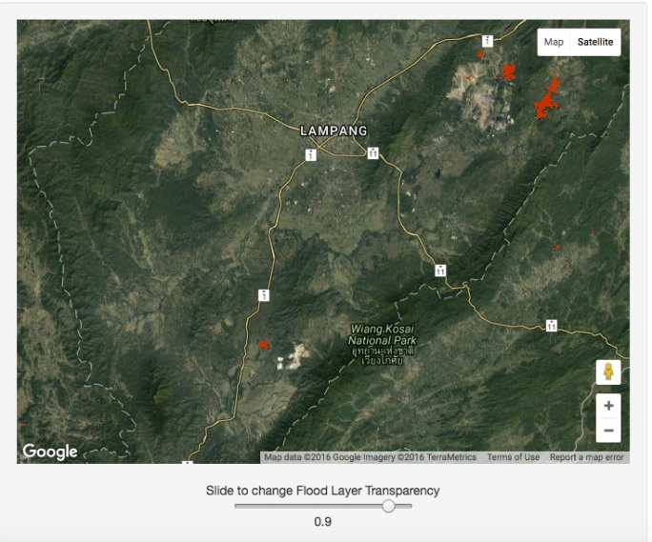
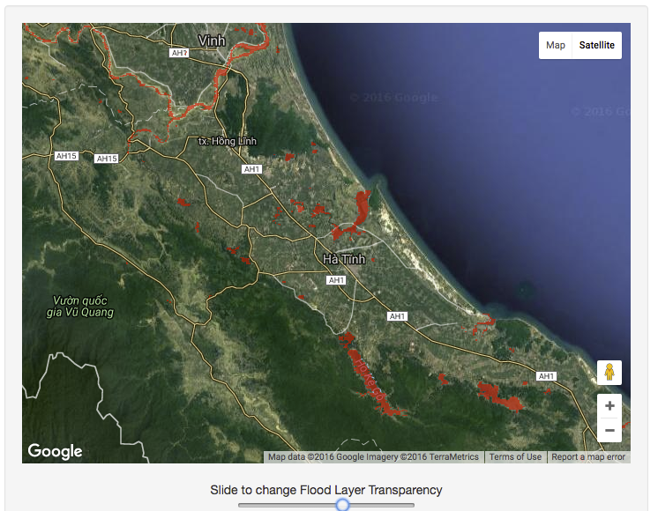
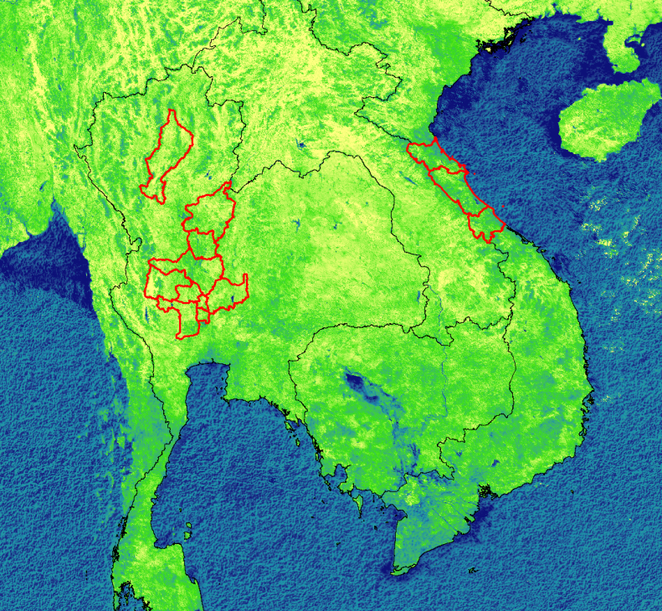
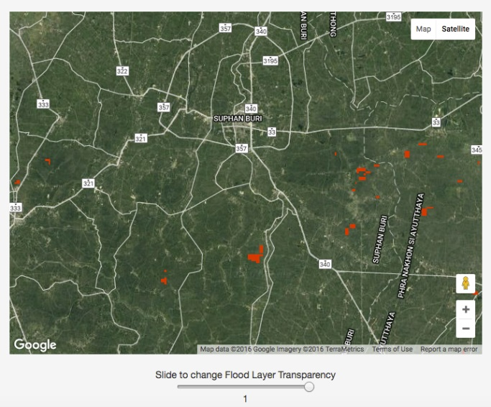
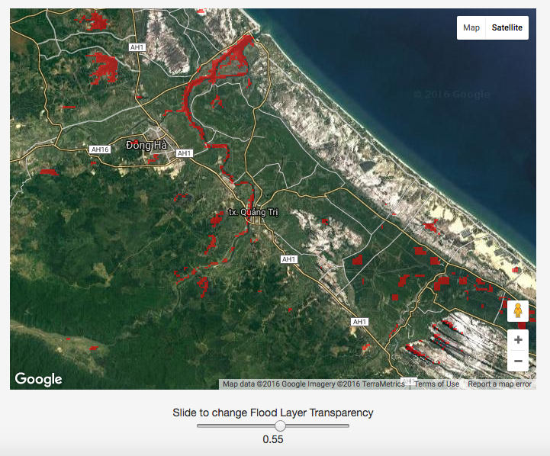
Objective B: SE Asia Component Status (4/10)
Figure 1: MODIS-NDVI Composite (10/27/2016 – 11/06/2016)
Laos
Figure 2
Figure 3
Thailand
Cambodia
Vietnam
Provinces Experiencing Flooding (Red Cross)
Figure 4
Real Time Surface Water (MODIS; 250m)
Figure 5
Near Real Time MODIS observations improve impact assessments for flood events reported by international agencies in the flood-prone Lower Mekong region of Southeast Asia.
Credit: A. Ahamed, J. Bolten, NASA GSFC
Notes:
Figure 1 (center): False Color NDVI composite computed from MODIS surface reflectance observations made in Southeast Asia between 10/02/2016 – 11/06/2016. Red polygons indicate provinces in Thailand (left) and Vietnam (right) experiencing flooding, reported by the International Federation of Red Cross and Red Crescent Societies (http://www.ifrc.org/). Flooding in Vietnam was reported on 10/30/16 – 11/01/16; flooding in Thailand was reported on 10/05/2016.
Figures 2 - 5 (outer): High resolution 250m surface water extent derived from near real-time LANCE – MODIS imagery for the days on which flooding was reported. Surface water is classified using the historic NDVI signatures (MOD09Q1) of permanent water bodies (MOD 44W). Each image is a screenshot of the operational flood monitoring system taken on the day of the reported flood. The images show (clockwise from top-left) Lampang, Thailand on 10/5; Ha Tinh, Vietnam on 11/1; Quan Tri, Vietnam on 11/1; and Chainat, Thailand on 10/5.
Scientific significance, societal relevance, and relationships to future missions:
Flood disaster events in Southeast Asia result in significant loss of life and economic damage. International agencies and governments typically report flood disasters at the province or district level, often after the onset of an event. These reports traditionally rely on correspondence with local municipalities, census data, information from news and media agencies, and back of the envelope calculations. Remote sensing information systems designed to monitor floods in near real-time can significantly improve the spatial resolution and accuracy of information procured by international agencies like the Red Cross, and serve as decision support tools to formulate effective response to sudden onset events. An operational near real-time monitoring system (available at http://projectmekongnasa.appspot.com) and supporting software tools automatically assess flood impacts to population and infrastructure to provide a rapid first set of impact numbers generated hours after the onset of an event. MODIS-derived surface water extent products (e.g. Figures 2-6) exhibit good agreement (80-90%) when compared to high resolution (22m – 150m) radar data (TerraSAR-X, Envisat ASAR, Disaster Monitoring Constellation), during both flood and non-flood conditions. These methods can help guide radar satellite tasking in persistently cloudy or highly damaged areas, and may be extended to other sensors (e.g. VIIRS, Landsat), as well as future missions.

Slide 37
Objective B: SE Asia Component Status (5/10)
2015 Milestones:
  Operational test bed for RASOR risk management system for test sites in Java
    Status: Phase 2 proposal by RASOR team to fund extensions of 2007-11 / 2013-15 risk mapping work (see next slide) to additional high-risk areas in Indonesia is currently under review by the EC. RASOR also used Pleiades data to generate more accurate maps of urban landscape for damage potential assessment. Recently obtained World Bank funding to highlight how EO can be used in conjunction with flood models to improve loss estimates and DRR planning in Myanmar and SE Asia.
  Integration of flood dashboard
    Status: Current Dashboard may go away before the end of the Pilot due to end of NSF grant support
  Initial services for Mekong River Commission
    Status: See above

Slide 38
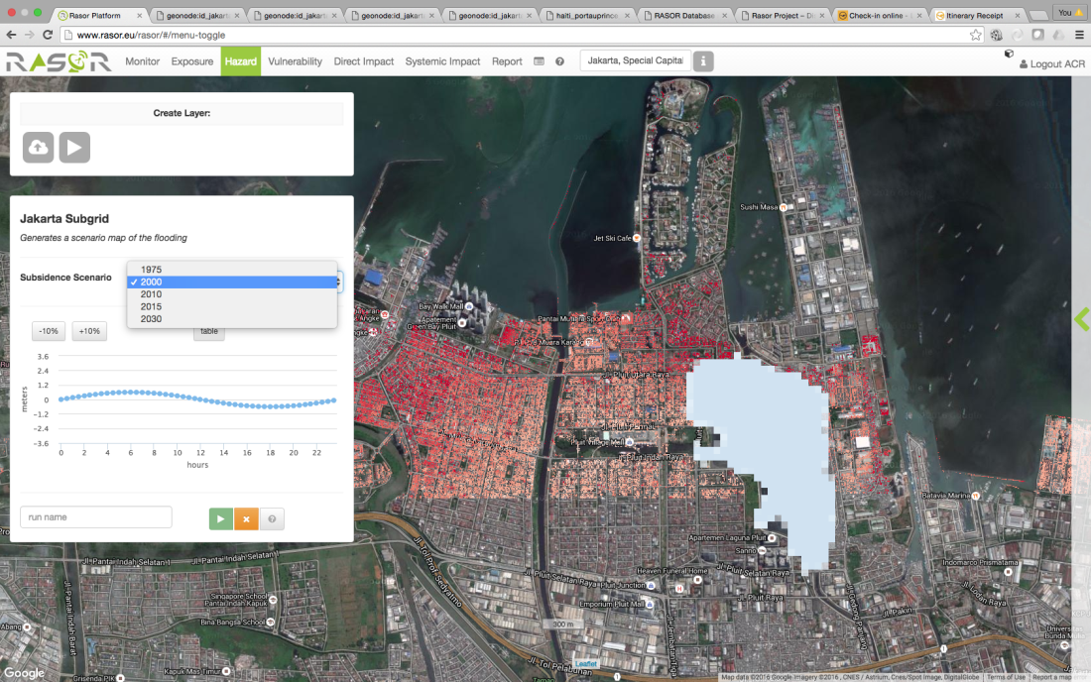
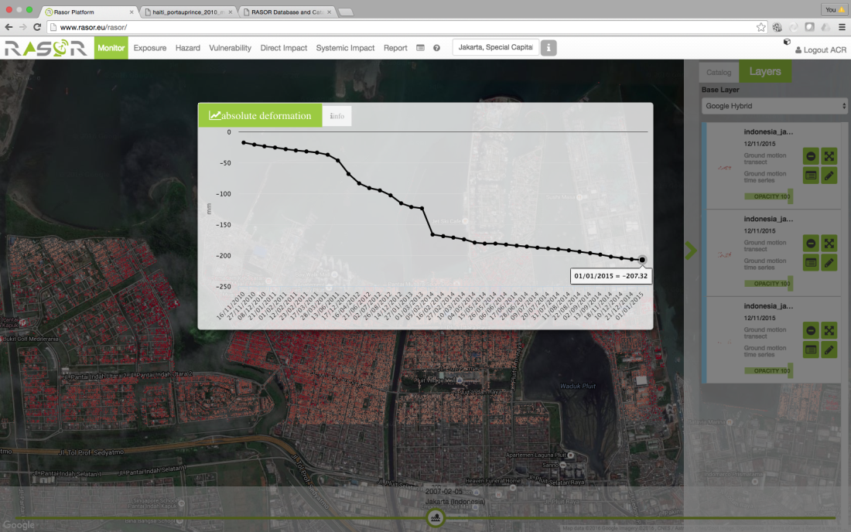
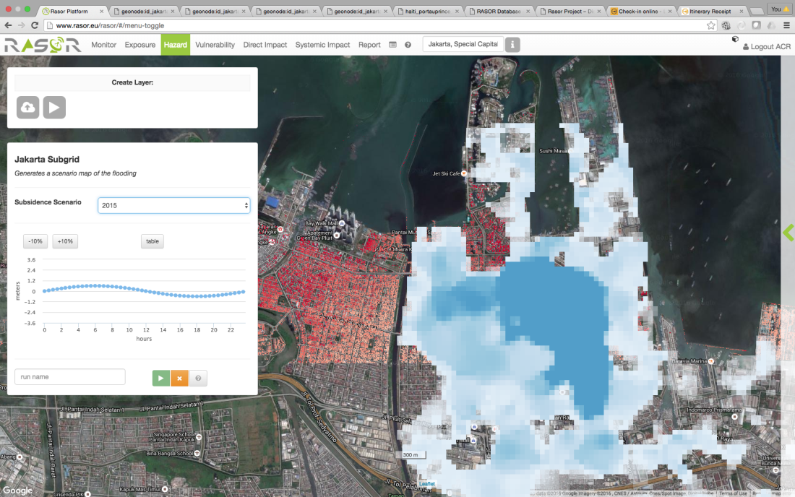
Objective B: SE Asia Component Status (6/10)
Coverage area of the same (hypothetical) flood in 2000 (top right) and 2015 (bottom right) showing the impacts of subsidence.
Point subsidence in Bandung, 2010-2015 from ALOS (2007-11) and CSK (2013-15).

Slide 39
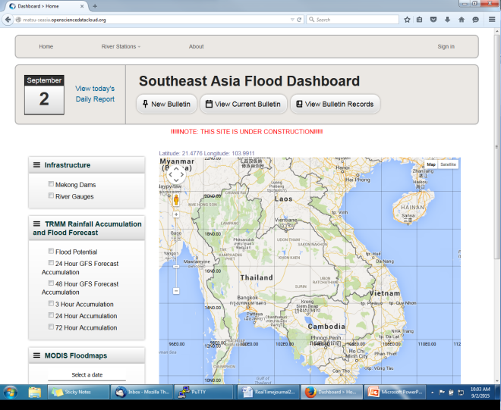
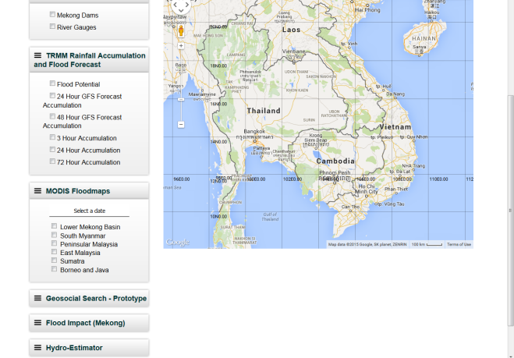
Objective B: SE Asia Component Status (7/10)
http://matsu-seasia.opensciencedatacloud.org/
Notes:
BK: Do we have any screenshots of the Open GeoSocial API for the Mekong that we could use?

Slide 40
Objective B: SE Asia Component Status (8/10)
2015 Milestones (cont.):
  10-year flood archive over region based on Deltares Flood Monitoring Programme
    Status: Deltares did not receive funding to continue collaboration with this Pilot region.
  1st new TRMM/GPM and other flood monitoring products
    Status: iMERG rainfall and GFMS flood products being served under Open GeoSocial API at https://pmm.nasa.gov/precip-apps
2016-17 Milestones:
  Flood monitoring during 2016 season
    Status: Provided optical imagery for flooding in Sri Lanka (May) and Myanmar (June / November); Indonesia (September).
  Draft a plan for longer-term sustainability
    Status: Intent is to build this capacity into ADPC via the SERVIR Applied Science Grant but details need to be worked out
Status: 80% complete.

Slide 41
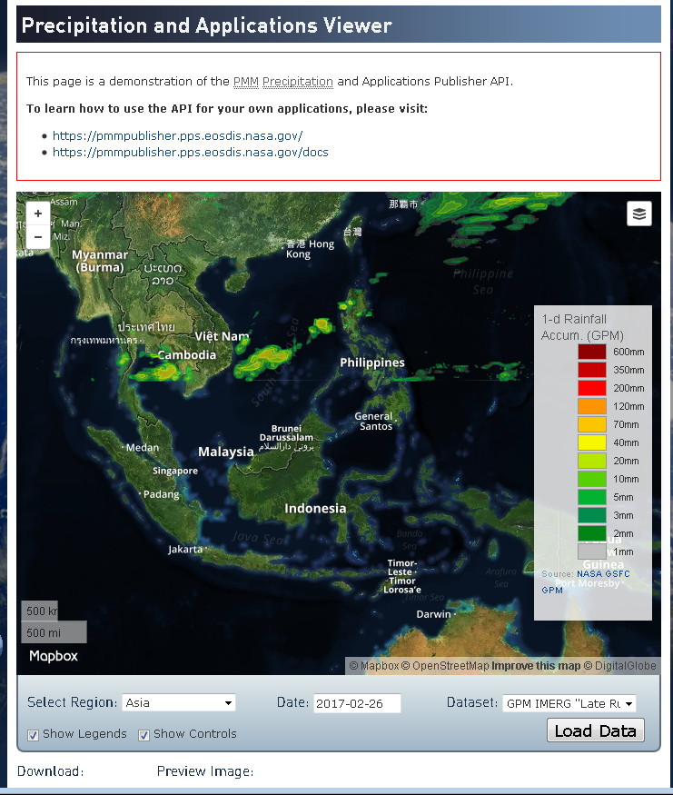
Objective B: SE Asia Component Status (9/10)
https://pmm.nasa.gov/precip-apps

Slide 42
Objective B: SE Asia Component Status (9/10)
Other Planned Activites
  Indonesia and Java risk assessments and subsidence calculations (Deltares-Villars)
    Status: Deltares did not receive funding to continue collaboration with this Pilot region.
Other Activities:
  Interaction with the World Bank in December 2015 as part of the RO meeting revealed types of flood products that would be useful to their needs assessments and ongoing recovery support.
  Provided demonstration of the Open GeoSocial API interface on the ojo-streamer client to World Bank GFRR personnel in April 2016 and to the Sri Lanka head disaster manager in July 2016.
  Provided Open GeoSocial API interface demo and code to the Pacific Disaster Center in December 2016.

Slide 43
Outline
Flood Pilot overview
Status of data acquisition and exploitation
      JAXA ALOS-2 / PALSAR-2 data use
Pilot status report:
  Objective A: Global component status
  Objective B: Regional component status
    Caribbean/Central America
    Southern Africa
    Southeast Asia
  Objective C: Capacity Building
Issues and Risk Management

Slide 44
Objective C: Capacity Building Status (1/2)
Caribbean/Central American Component:
  Implemented previously mentioned Open GeoSocial API Flood Monitoring software suite
    Training workshop by NASA GSFC personnel (supported by SERVIR and USAID) in Costa Rica held in May 2016
    Now creating products in real time and delivering to regional partners
  Working through AmeriGEOSS to extend this capability to other portions of the Americas (Chile, Colombia, and Mexico)
    2-day disaster training course on disasters (including floods) for AmeriGEOSS participants conducted in Bogata in June 2016
    Demonstrated the CentroClima Open GeoSocial API to MARN (Ministerio de Medio Ambiente y Recursos Naturales) in El Salvador in December 2016
Southern Africa Component:
  Worked with Namibia Department of Hydrology to monitor the status of small farming ponds using Radarsat-2 and EO-1 data (January 2017).

Slide 45
Objective C: Capacity Building Status (2/2)
Southeast Asia Component:
  SERVIR funding (J. Bolten) for new ADPC flood products, including ADPC-produced NDVI differences in the Mekong as a new product
  Provided demonstration of the Open GeoSocial API interface on the ojo-streamer client to ADPC in April 2016 and to the Sri Lanka head disaster manager in July 2016.
  Provided Open GeoSocial API interface demo and code to the Pacific Disaster Center in December 2016.
Notes:
BK: Any updates on capacity building in SE Asia?

Slide 46
Outline
Flood Pilot overview
Status of data acquisition and exploitation
      JAXA ALOS-2 / PALSAR-2 data use
Pilot status report:
  Objective A: Global component status
  Objective B: Regional component status
    Caribbean/Central America
    Southern Africa
    Southeast Asia
    Special Event: Mississippi River (US)
  Objective C: Capacity Building
Issues and Risk Management

Slide 47
Issues and Risk Management Approach
Feasibility and acceptance of Flood Pilot sustainability plan after December 2017 needs additional development and involvement of stakeholders and sponsors
47

Slide 48
Data Use: Recent (since September) Publications / Conference Presentations
Publications
Bolten, J., 2017: Remote sensing information systems for real-time and historic flood monitoring in Southeast Asia. International Journal of Applied Earth Observation and Geoinformation, in review.
Clark, III, R., Z. L. Flamig, H. Vergara, Y. Hong, J. J. Gourley, D. J. Mandl, S. Frye, M. Handy, and M. Patterson, 2016: Hydrological modeling and capacity building in the Republic of Namibia. Bulletin of the American Meteorological Society, in press. (Early online release 13 December 2016)
Schumman, G., 2017: Remote sensing of floods. Oxford Research Encyclopedia of Natural Hazard Science, in press.
Wu, H. and Adler, R., 2017: Evaluation of Quantitative Precipitation Estimations (QPE) and Hydrological Modeling at the Iowa Flood Studies Focal Basins. Journal of Hydrometeorology, in review.
Conference presentations (oral unless otherwise noted): None this period
48

Slide 49
Questions / Discussion

